Slide 1
Lab 5: Introduction to R for Bioinformatics
PLB 812

Slide 2
R
Why R
R built as an open source language for statistical analysis (alternative to SAS, etc)
https://www.r-project.org
Extremely good for:
Data handling – has some of most powerful data formats
Statistical analysis – easy to implement mathematical & statistical equations
Plotting – makes IMO the most beautiful plots, epecially with ggplot2
Not good for:
Anything that requires processing extremely large amounts of data & text
Parallelization
Initial Genomics Analyses
Use Unix, Python, or Perl (or if you know C or Fortran...) for this and to get the data into a more compact & meaningful table

Slide 3
Working with R
R
Type in command line to enter R
R code can be run as a script from the command line
Rscript myscript.R
R CMD BATCH myscript.R
Rstudio
https://www.rstudio.com
Powerful interactive Command Line + some GUI features

Slide 4
Basic R commands
R commands always end in parentheses ()
Arguments are given in the parentheses
quit()
quit R
ls()
list contents
getwd()
get the working directory
setwd(“plb812”)
set the working directory to plb812
library(PackageName)
Load an R package
eg. library(DESeq2)
save.image(“my_workspace.RData)
Save your R workspace
Has ending .RData
load(“my_workspace.RData”)
load an old workspace
rm(a)
remove the variable a

Slide 5
The workspace
When working in R, values and other things that you create exist within the R environment...
When you exist R, if you do not save your workspace, all of that will be lost
You can reload saved workspace and all the stuff you did in it

Slide 6
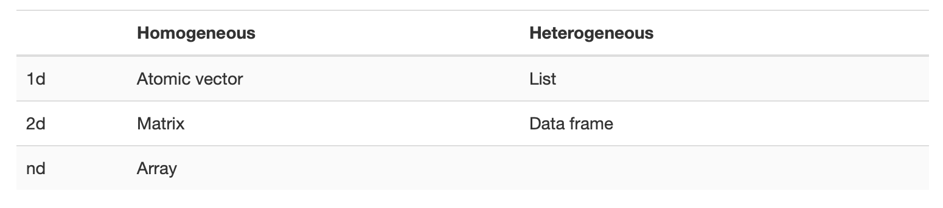
Data Structures
Every programming language has defined data structures
Many of these are common across languages
R
http://adv-r.had.co.nz/Data-structures.html

Slide 7
Setting a variable
Two ways
a <- 1
“<-” assignment operator
a = 1
Good practice to use assignment operator over “=”
equal sign is used to assigning arguments within functions
using the assignment operator “<-” instead helps differentiate these and can avoid confusion in more complex commands/loops

Slide 8
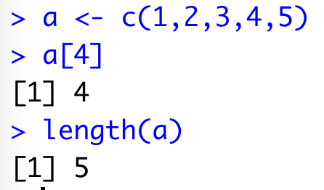
Vectors
1-dimensional
Data is homogeneous
e.g. all numeric or all character
lists can have heterogenous data
Use the c() command to assign
a <- c(1,2,3,4)
multiple elements are separated by comma
Easy to access specific values
a[4]
brackets & number can be used get that specific value from the vector
Properties like the length are easy to get
length(a)

Slide 9
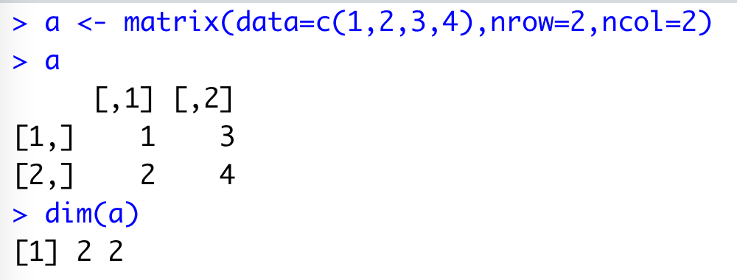
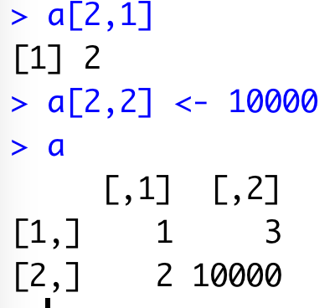
Matrices
Has rows & columns (2-dimensional)
Arrays can be even more complex
Values have to be homogeneous
e.g. all numeric or all character
data frames can have heterogenous data
matrix()
a <- matrix(data=c(1,2,3,4),nrow=2,ncol=2)
arguments are given within the () for the command
arguments are assigned values using = sign
arguments are comma separated
a[2,1]
Get value for row #2 for column #1
a[2,2] <- 10000
Assign row #2, column #2 the value 10000
dim(a)
Get the dimensions (nrows & ncols) of matrix

Slide 10
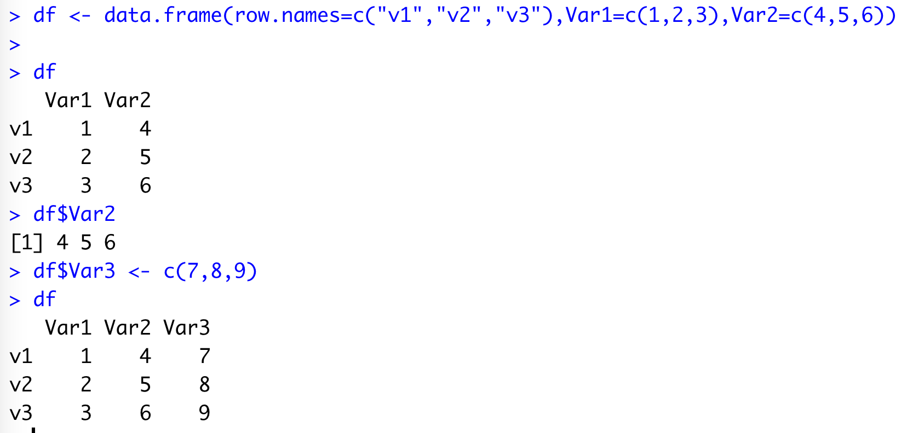
Data Frames
2-dimensional
Heterogenous data
Extremely powerful
pandas package in python tries to recapitulate R data frames
https://pandas.pydata.org
data.frame()
df <- data.frame()
create empty dataframe
df <- data.frame(row.names=c(“v1”,”v2”,”v3”),Var1=c(1,2,3),Var2=c(4,5,6))
You can list column names as arguments and assign those columns values
row.names will specifically assign a column that contains row names
df$Var2
Can easily access a specific column using data frame name, followed by $ sign, and column name
df[row,column]
Can access specific row & column using [] like for matrices
Can use to also assign values
df$Var3 <- c(7,8,9)
Can easily add new columns using $ sign and column name or assign an existing column a set of values

Slide 11
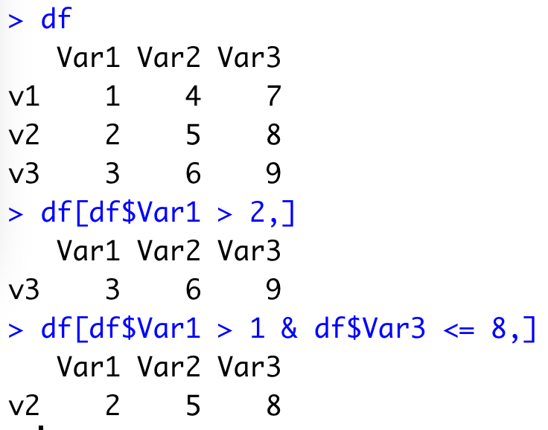
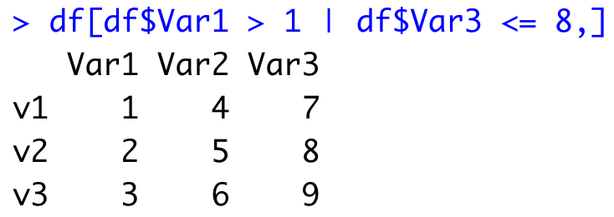
Data Frames
Can use [] to filter rows/columns on various values
Can use logical operaters “&” (and), “|” (or)

Slide 12
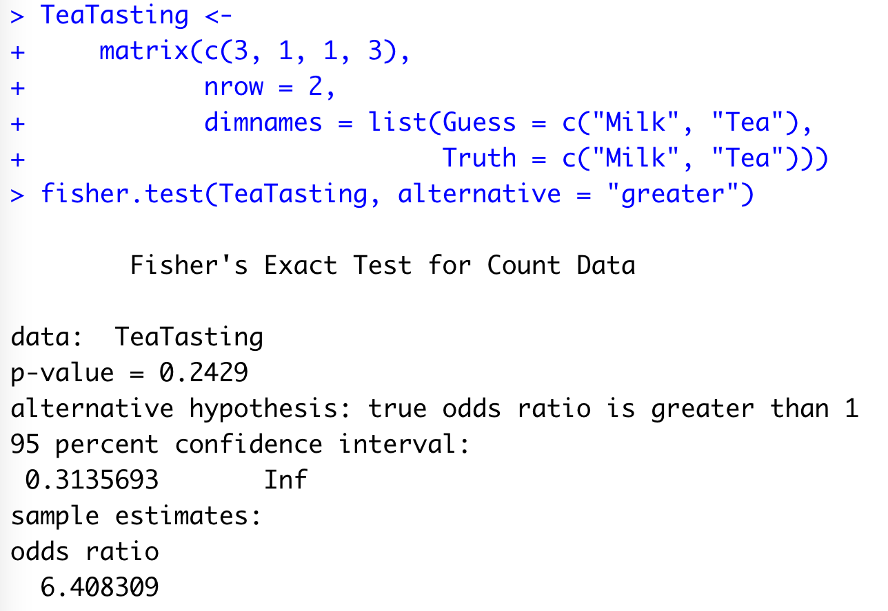
Statistical Analysis
Extensive array of functions & statistical tests have been implemented in R (some by default, others with specific packages)
Example from: https://www.rdocumentation.org/packages/stats/versions/3.6.2/topics/fisher.test

Slide 13
Reading & Writing Files
df <- read.table(“mydata.tsv”,header=TRUE,sep=“\t”)
reads a tab-delimited file in as a data frame.
The first row is assumed to be the header line. Values in that line are set to column names
sep=“\t”
sets the delimiter for that file
df <- read.table(“mydata.tsv”,header=FALSE,sep=“\t”)
same as above, but header=FALSE, so data is read in without a header line. Default names are given to the column
df <- read.csv(“mydata.csv”,header=TRUE)
Specific command for csv files
Equivalent to read.table(“mydata.csv”,header=TRUE,sep=“,”)
write.table(df,“mydata.csv”,sep=”,”,quote=FALSE)
Write a dataframe to a file, using commas as the delimiter
By default, R outputs the values for each column surrounded by quotation marks, quote=FALSE can turn that off

Slide 14
Plotting in R
See 5_Supplement_Plotting.pptx

Slide 15
Advanced data handling
Apply (and all its variations)
Set of functions that allows you to “apply” your own functions across different data types (e.g. matrices, dataframes, etc)
https://statisticsglobe.com/apply-functions-in-r/
Tidyverse
Collection of packages and best practices for handling and plotting data
https://www.tidyverse.org

Slide 16
Comprehensive R Archive Network: CRAN
https://cran.r-project.org
CRAN is a repository for packages developed by the R community
Packages contain functions & scripts to perform specific/novel tasks & analyses
install.packages("BiocManager")
install.packages() can be used to access CRAN and install packages in your local R environment.
Package name is placed in quotation marks inside the parentheses.
Capitalization matters!

Slide 17
Bioconductor
https://www.bioconductor.org
Package repository specific to bioinformatics
Has own package for managing & installing packages “BiocManager”
BiocManager::install(“DESeq2")
Install package DESeq2 from Bioconductor

Slide 18
Getting Help
?data.frame()
information regarding a command can be accessed by placing ? in front of the command
Vignettes
Many packages have helpful instructions & walk-throughs called “vignettes”
vignette(DESeq2)
Command to open the vignette
The internet

Slide 19
Upcoming
I encourage you to work on your proposals and share draft sections with me.
10/5 Today
Lab Assignment #3 Due
Lab Assignment #4 Assigned
10/10 Lecture #6 Chromatin & Epigenomics
Papers on D2L
10/11 Lab #6 Differential Gene Expression
Lab Assignment #4 Due
Lab Assignment #5 Assigned

