Slide 1
Data Formats & Databases
PLB 812

Slide 2
Data Formats

Slide 3
TSV & CSV
Text files consisting of rows & columns
TSV: tab separated values
columns separated by tabs
CSV: comma separate values
columns separated by commas
Advantages
Flexible
Lightweight
Not subject to introduced errors that can happen in excel
Excel has been known to automatically change gene names (Zeeberg et al. 2004)
Easy to manipulate & extract data using UNIX or any programming language

Slide 4
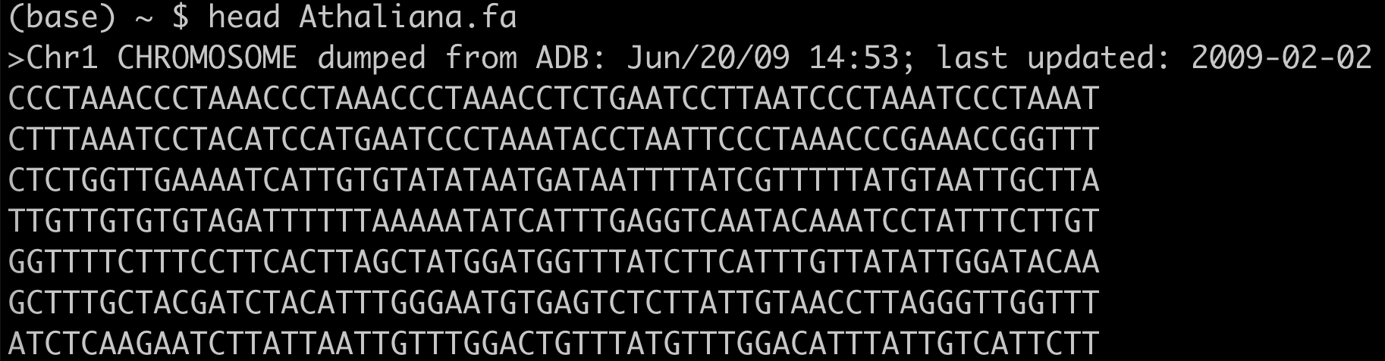
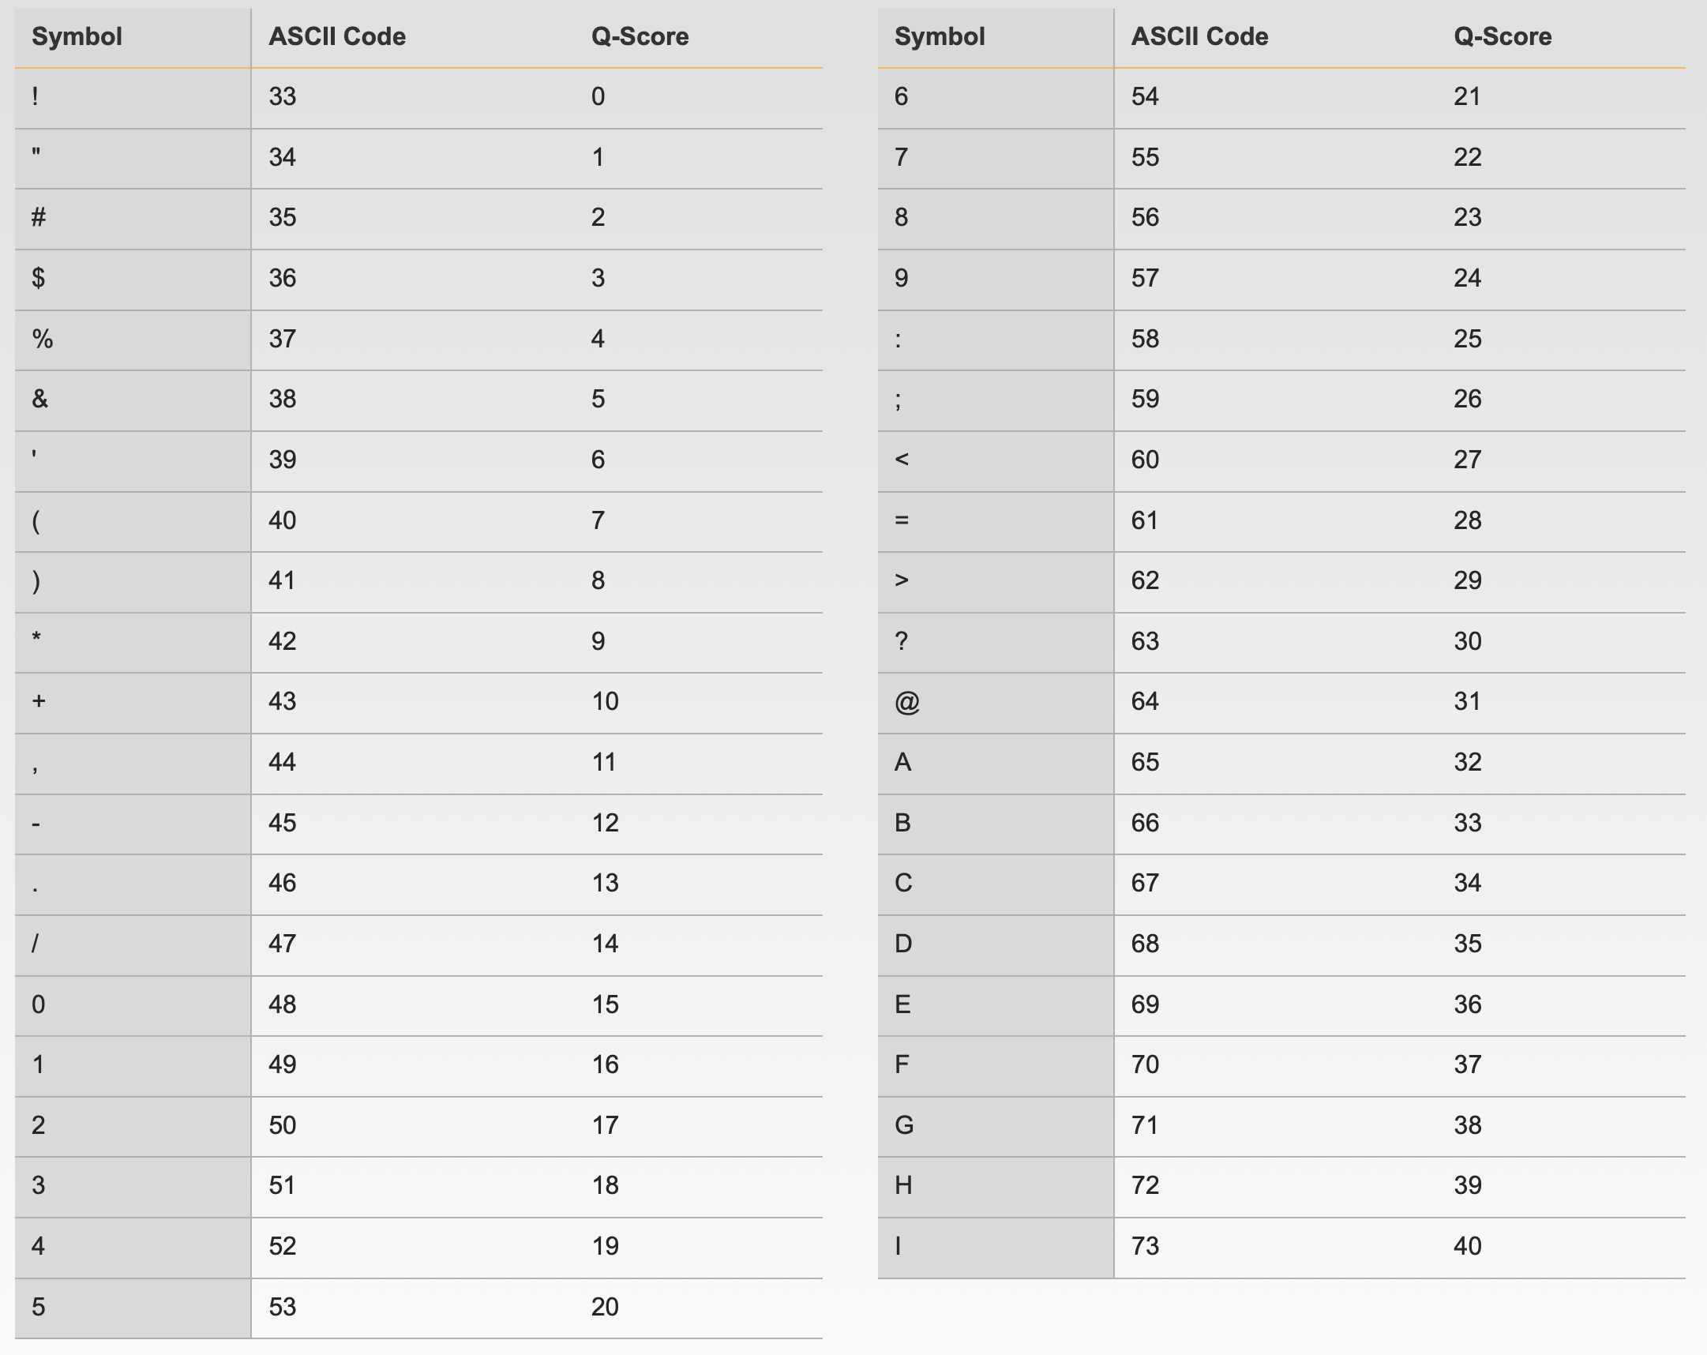
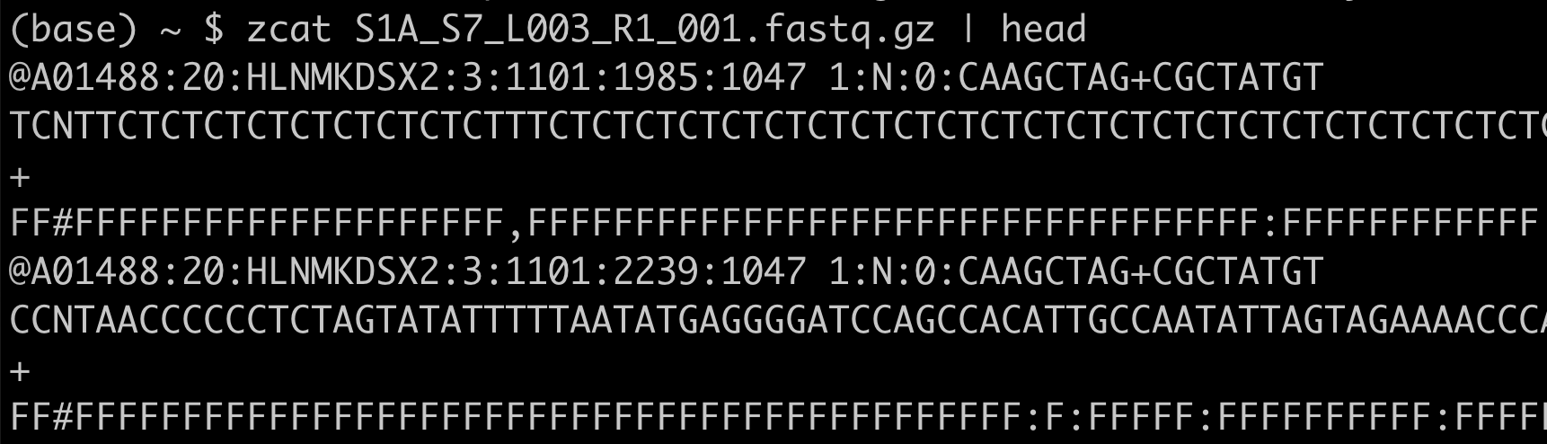
FASTA/FASTQ - Sequences
Fasta
end in .fa/.fasta or .fna (nucleotide) or .faa (amino acid)
>seq_name (text after first space ignored)
sequence can be any number lines & length
Phred 33 Quality Score table
(Phred 64 sometimes used)
Fastq (Each sequence is 4 lines)
Seq name, starts with “@”
Sequence
Seq name or just “+” filler
Base quality score
https://support.illumina.com/help/BaseSpace_OLH_009008/Content/Source/Informatics/BS/QualityScoreEncoding_swBS.htm

Slide 5
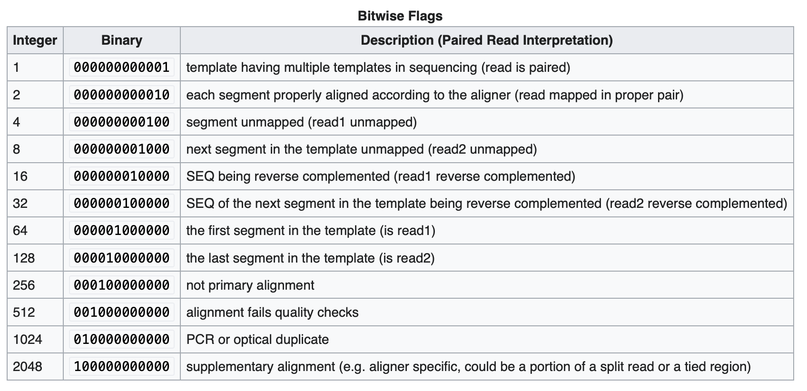
SAM/BAM – Sequence Alignment Maps
Most commonly used output format for alignment of high-throughput sequencing
SAM – text, BAM – binary (uses less storage space)
Essentially a formalized TSV file (tab-separated columns)
Description of fields in SAM/BAM
https://en.wikipedia.org/wiki/SAM_(file_format)
FLAG field provides important information about alignment
Useful for filtering
https://en.wikipedia.org/wiki/SAM_(file_format)#Bitwise_flags

Slide 6
GFF/GTF – Features/Annotations
Used for storing coordinate and other information information about genes or other types of genomic features (e.g. transposons, etc)
Corresponds to a fasta sequence
Can include hierarchy of features: exon -> mRNA -> gene
GFF: General Feature Format
Flexible, used for many feature types
GTF: Gene Transfer Format
Stricter format, used almost exclusively for transcripts
Descriptions:
GFF: https://www.ncbi.nlm.nih.gov/datasets/docs/v1/reference-docs/file-formats/about-ncbi-gff3/
GFF (short version) & GTF: http://www.genome.ucsc.edu/FAQ/FAQformat.html#format3

Slide 7
BED –Sequence Coordinates
Browser Extensible Data
Originally designed for use with browsers
Now widely used for many applications
Flexible and lightweight format for storing genomic coordinate information
Description:
http://www.genome.ucsc.edu/FAQ/FAQformat.html#format1
Example
chr1 1 10000 gene1 . +
chr2 2500 3200 gene2 . -

Slide 8
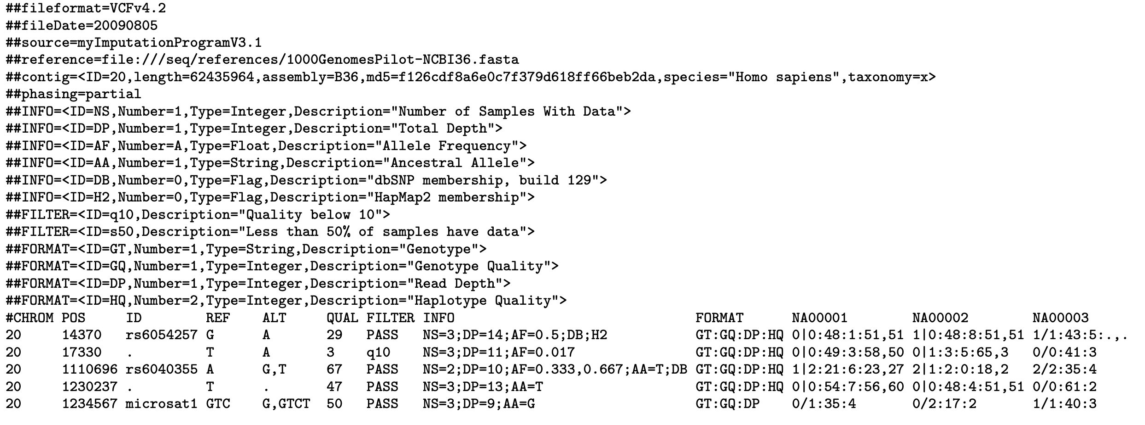
VCF/BCF – Sequence Variants
Sequence variation
Typically SNPs & small INDELs
Can also handle some larger insertions/deletions
VCF – text, BCF - binary
Detailed Description:
https://samtools.github.io/hts-specs/VCFv4.2.pdf
https://samtools.github.io/hts-specs/VCFv4.2.pdf

Slide 9
Additional Formats
Lots of other formats are used for more specialized types of data
Good list of more common formats: https://github.com/kmhernan/awesome-bioinformatics-formats
Good description of some common formats: http://www.genome.ucsc.edu/FAQ/FAQformat.html

Slide 10
Text Processing in UNIX
Good list and brief description of commands & tools:
https://tldp.org/LDP/abs/html/textproc.html

Slide 11
grep
Global Regular Expression Search
Powerful text search tool
Good explanation & examples
https://www.howtogeek.com/496056/how-to-use-the-grep-command-on-linux/
grep PATTERN search_file
Search for a specific pattern in a file
fgrep –f file1 file2
For each line in file1, search for that pattern in file2

Slide 12
sed
stream editor
Can perform a number of text editing tasks
search and replace
delete lines
In-depth guide
https://www.grymoire.com/Unix/Sed.html
sed s/PATTERN1/PATTERN2/ file1 > file2
s – substitute
find matches to PATTERN1 in file1 and substitute with PATTERN2
separated by forward slashes
substituted text is redirected to file2
only substitutes first occurrence in each line
sed s/PATTERN1/PATTERN2/g file1 > file2
g - global
will replace all occurrences
sed – i s/PATTERN1/PATTERN2/g file1
-i (in place)
will modify file1 directly

Slide 13
awk
Swiss army knife for text processing
first letter of last name of each of 3 creators
Tutorial & Introduction:
https://www.tutorialspoint.com/awk/index.htm
too many possible uses to cover in this lecture
awk '{if ($2 > 0 && $3 < 10000) print}’ file1
if column #2 is greater than 0 and column 3 is less than 10000, print that line
same as awk ‘$2 > 0 && $3 < 10000’ file1
awk ‘{a+=$2}END{print a}’ file1
set a variable “a” to the sum of column #2 and then print “a”
awk '{if(!/>/){print toupper($0)}else{print $1}}' FASTA1 > FASTA2
convert lower case text (softmask) to uppercase in a FASTA file

Slide 14
More commands
cut –f1,3,5 file1
will extract columns 1, 3, and 5
sort file1
will sort each line in file1
sort –n –k 3,3 file1
sort file1 only on column 3 in numerical order
tr ‘\t’ ‘\n’ < file1 > file2
convert tabs to new lines
can find&replace, more limited than sed, but handles tabs better
I only use for modifying column separators
uniq –c file1
uniq will remove duplicate lines from a sorted list
-c outputs a count of all matching lines
gzip file1
compress file
gunzip file1.gz
uncompress file
zcat file1.gz
will print gzip files to screen in text
There are others not discussed

Slide 15
Processing Bioinformatic Formats
Large number of command line tools have been developed to specifically process common bioinformatics formats
bedtools: bed, gff/gtf, sam, vcf, fasta (see slides)
samtools: sam/fasta (see slides)
vcftools: vcf https://vcftools.github.io/index.html
bcftools: vcf/bcf https://samtools.github.io/bcftools/bcftools.html
Many others are available
Specific packages & libraries have also been developed for use in common coding languages
bioperl (perl): https://bioperl.org
biopython (python): https://biopython.org
bioconductor (R): https://www.bioconductor.org

Slide 16
Bedtools
Incredibly power set of tools for handing genomic intervals & positions (i.e. bed, gff, vcf, etc)
Can be used to intersect, extract, and more
Manual & Details:
https://bedtools.readthedocs.io/en/latest/index.html
Install bedtools into your plb812 conda environment
bedtools –h
show help menu for bedtools
will list & describe different tools available
bedtools intersect –h
show help menu for bedtools intersect
bedtools intersect can be used to show overlap in genomic intervals/positions
One of most powerful & commonly used tools

Slide 17
Samtools
Used for processing SAM/BAM files (and a few other file types)
Manual & Details:
https://www.htslib.org
Install samtools into your plb812 conda environment
samtools –h
Like bedtools, has a number of different tools available
samtools faidx –h
faidx is used to index a fasta file
samtools view –h
view used to convert between sam/bam and extract data

Slide 18
Piping in UNIX
Output of one command can be fed directly into next
Use “|” to separate commands
echo Hello World | sed s/Hello/Bye/ | sed s/$/\!/
modify “Hello World” to “Bye World!”
cut –f3 example.gff | sort | uniq –c
count number of types of features in a gff file using a pipe

Slide 19
Databases

Slide 20
NCBI
National Center for Biotechnology Information
Central repository for a wide range of genomics and non-genomics data
One stop shop for a lot of things
https://www.ncbi.nlm.nih.gov

Slide 21
EMBL-EBI
European Bioinformatics Institute
Similar in some ways to NCBI, less extensive database
https://www.ebi.ac.uk

Slide 22
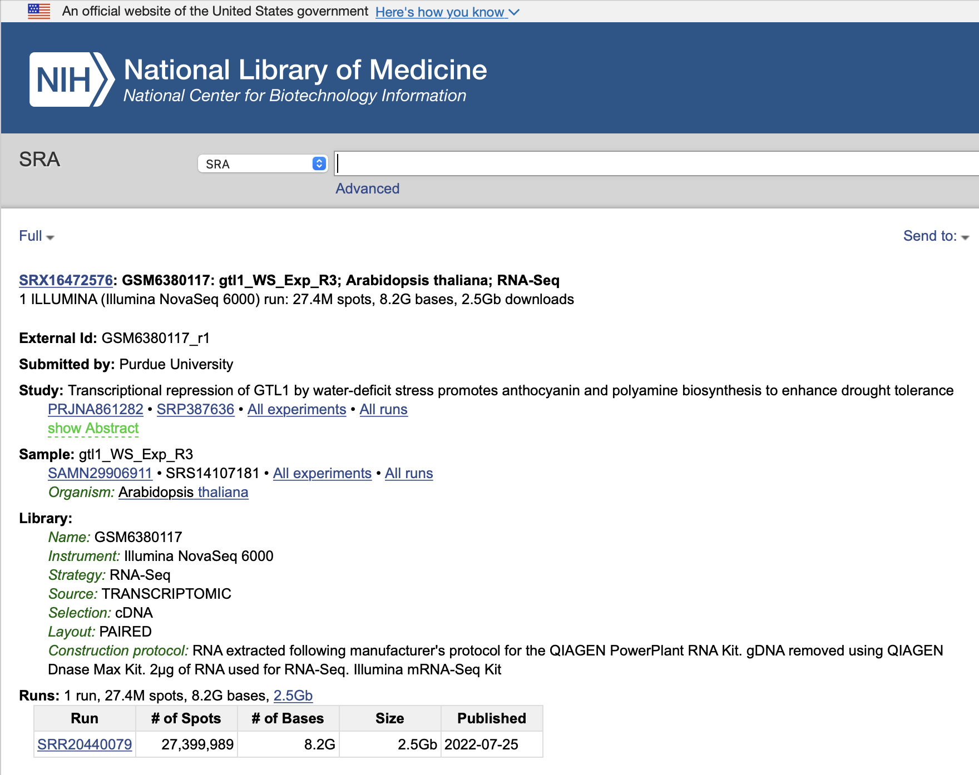
SRA & ENA
Sequence Read Archive (SRA) & European Nucleotide Archive (ENA)
SRA part of NCBI: https://www.ncbi.nlm.nih.gov/sra
ENA part of EMBL-EBI: https://www.ebi.ac.uk/ena/browser/home
Repositories for sequencing experiments

Slide 23
SRA Toolkit
Command line tools for downloading and converting SRA sequencing data
https://github.com/ncbi/sra-tools
Basic instructions: https://github.com/ncbi/sra-tools/wiki/08.-prefetch-and-fasterq-dump
prefetch --max-size 100000000 SRR2922661
Download the SRA file SRR2922661: https://www.ncbi.nlm.nih.gov/sra/SRX1436250[accn]
prefetch is better for initial download than fastq-dump, can handle much larger files and doesn’t try to convert on the fly
fasterq-dump --gzip --split-3 SRR2922661.sra
convert from sra to a gzip compressed fastq file, if reads are paired-end, will split into two files
Used for conversion from sra file format to fastq

Slide 24
Phytozome
DOE database for plant genomics data
https://phytozome-next.jgi.doe.gov
One of best resources for plant genomes and annotations
Data all organized and in standardized formats
Offers a number of comparative genomics tools
Need an account

Slide 25
PlantGDB & Ensembl Plants
Multiple species
Fewer than Phytozome however
Data is typically less standardized than in Phytozome
Plant GDB
http://plantgdb.org
Ensembl Plants
https://plants.ensembl.org/index.html

Slide 26
CoGe
Comparative Genomics
https://genomevolution.org/CoGe/
Powerful suite of tools for doing comparative genomics
Many genomes are also deposited at CoGe
Not curated like NCBI or Phytozome
Many genomes are user-deposited and so lack critical metadata
Lots of duplicate versions
Recommend using Phytozome, NCBI, or a curated database (e.g. TAIR) as primary source for genome sequences & annotations

Slide 27
Species/Lineage Specific Databases
Limited to specific species or set of related species
Some are better than others
The Arabidopsis Information Resource https://www.arabidopsis.org
Extensive and powerful descriptions of Arabidopsis genes
MaizeGDB https://maizegdb.org
Sol Genomics Network https://www.solgenomics.net/solanaceae-project/index.pl
Solanacea species
Soybase https://www.soybase.org
Many more than can list

