Slide 1
Lab 4: Variables, Loops, & Workflows
PLB 812

Slide 2
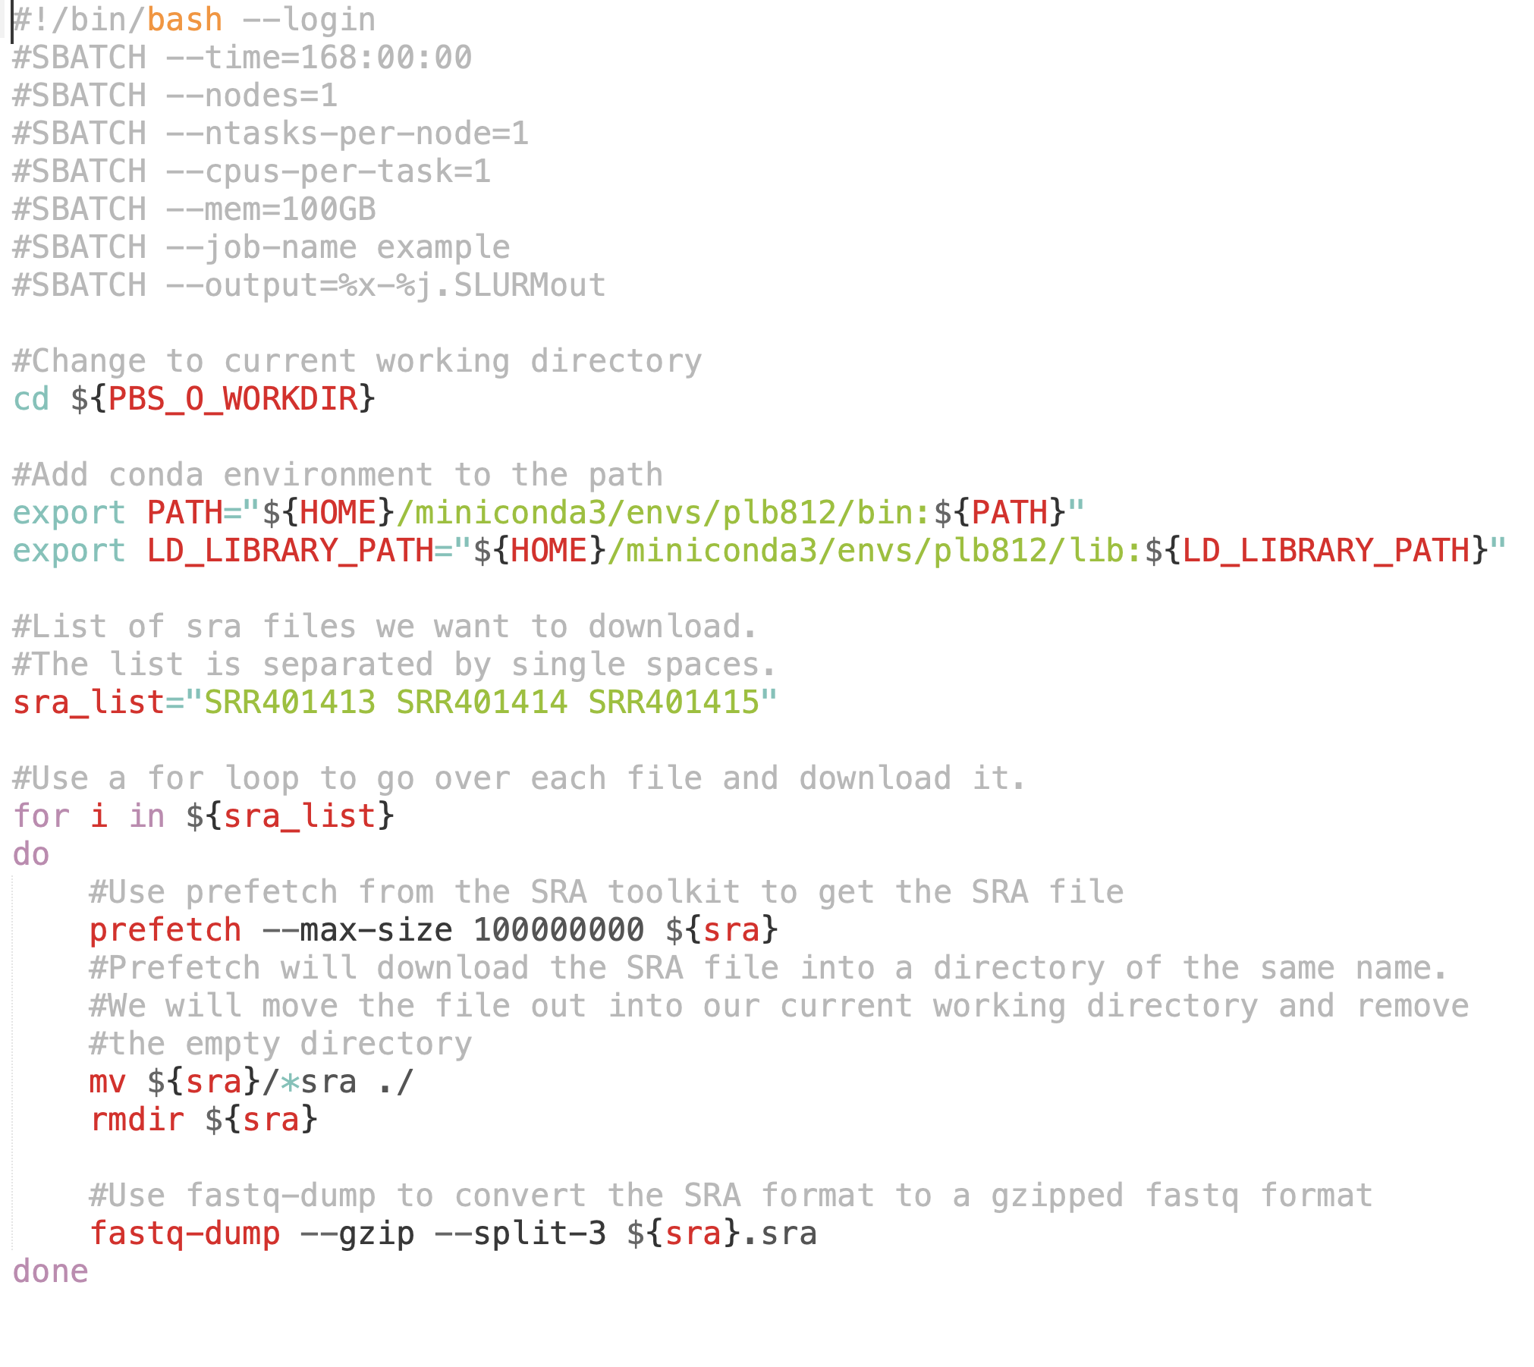
Creating Workflows in Shell Scripts
Example_Job_Script.sh
Processed line by line, top to bottom
Knowing this, we can structure our scripts to perform multiple tasks

Slide 3
Variables in Unix
See:
https://afni.nimh.nih.gov/pub/dist/edu/data/CD.expanded/AFNI_data6/unix_tutorial/basic/basic_05.vars.html
Can set any named variable to a value using the “=“ sign
a=“Hello World”
sets variable “a” to value “Hello World”
To access the variable, we use the $ sign followed by the variable name
echo ${a}
print to screen the variable $a

Slide 4
Variables in Unix
Braces ${} around the variable have a number of uses
They can be used to separate the variable from surrounding text
If you have a variable “$name” and put it in combination with other text without braces, it will not be properly recognized
$name_data.txt : unix will look for the variable “$name_data” not “$name”
${name}_data.txt : unix now knows that $name is the variable
If you want to use a variable with sed you will often have to use braces
a=“Bye”
echo “Hello World” | sed s/Hello/${a}/
Can be used to modify the variable
name=“Arabidopsis_thaliana”
echo ${name}
prints “Arabidopsis_thaliana”
echo ${name/_*/}
will print out the variable with the underscore and everything else removed
prints “Arabidopsis”
Braces are not always necessary, but I like to always include braces because it keeps the variable from accidentally being misread

Slide 5
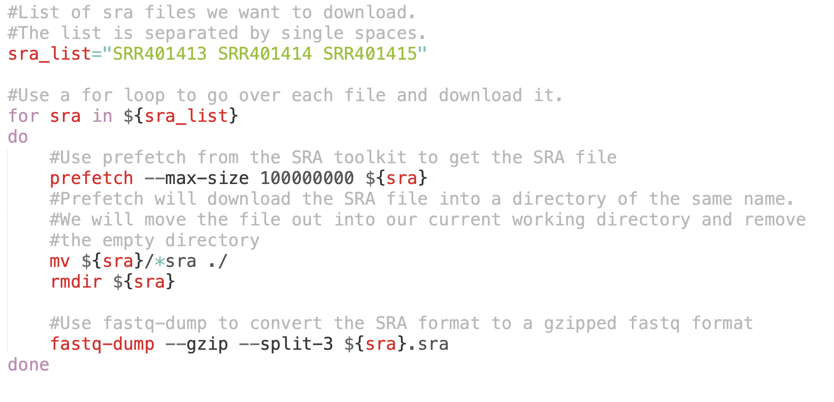
Using Variables To Control Input/Output
Use variable ${sra} both as part of the input & output throughout
-allows us to run multiple commands in sequential order
-requires knowing something about the format of input/output
prefetch outputs a directory with the name of the SRR accession. Inside is a file with same name, ending in “.sra” By setting the variable to the accession, we can use same variable throughout, but specify the file by adding the “.sra” suffix at the end.

Slide 6
Loops
Given some list, we can loop over the list and perform a series of tasks
Primary ways of doing a loop
for
while
until

Slide 7
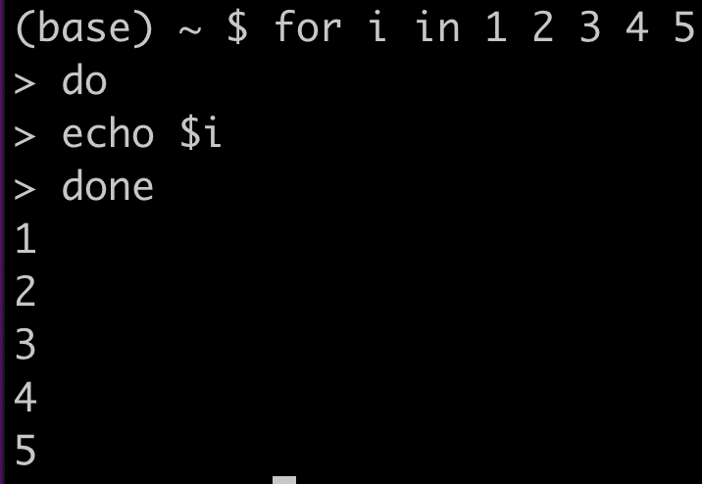
for
i is a variable that will be set to each item in the list one after the other. You can name this variable anything you want
in is a command indicating that what follows is the list of objects to iterate over
for is the command that initiates the loop
Given some list, we can loop over the list and perform a series of tasks
After in we give the list
this is normally a space separated list
NOTE: for must be followed by “do” and end in “done”

Slide 8
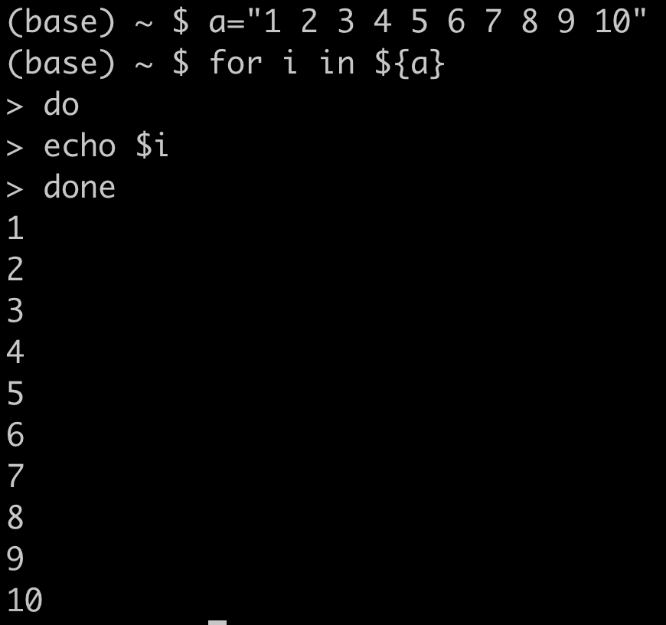
for
We can substitute the list after in with a variable that contains the list
Given some list, we can loop over the list and perform a series of tasks

Slide 9
for loops in shell scripts
Example_Job_Script.sh
Set a variable to a list of SRA accessions
Loop over the elements in that list and set the variable $sra to that variable

Slide 10
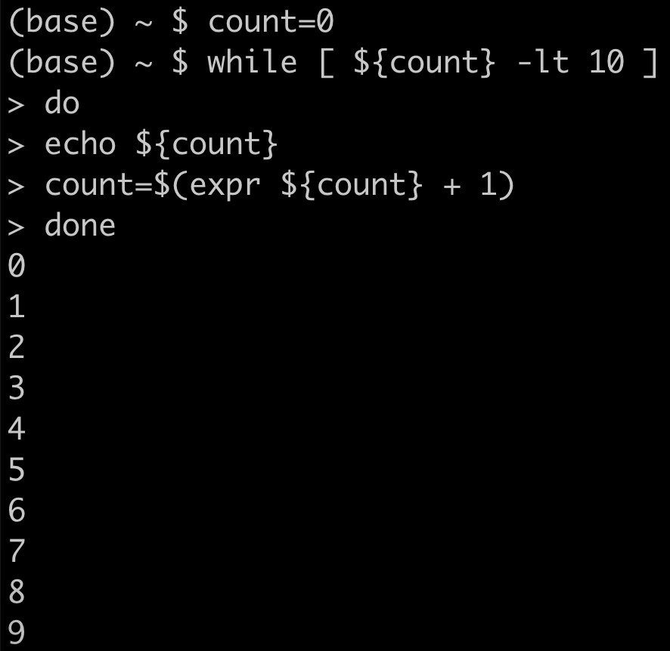
while
1. create a variable set to 0
2. while that variable
is less than 0
The loop will continue “while” some condition exists.
expr can be used to perform basic arithmetic operations
expr 5 + 1
Addition
expr 3 – 2
Subtraction
expr 2 * 2
Multiplication
expr 6 / 2
Division
3. print the variable
4. add 1 to the variable
NOTE: while must be followed by “do” and end in “done”

Slide 11
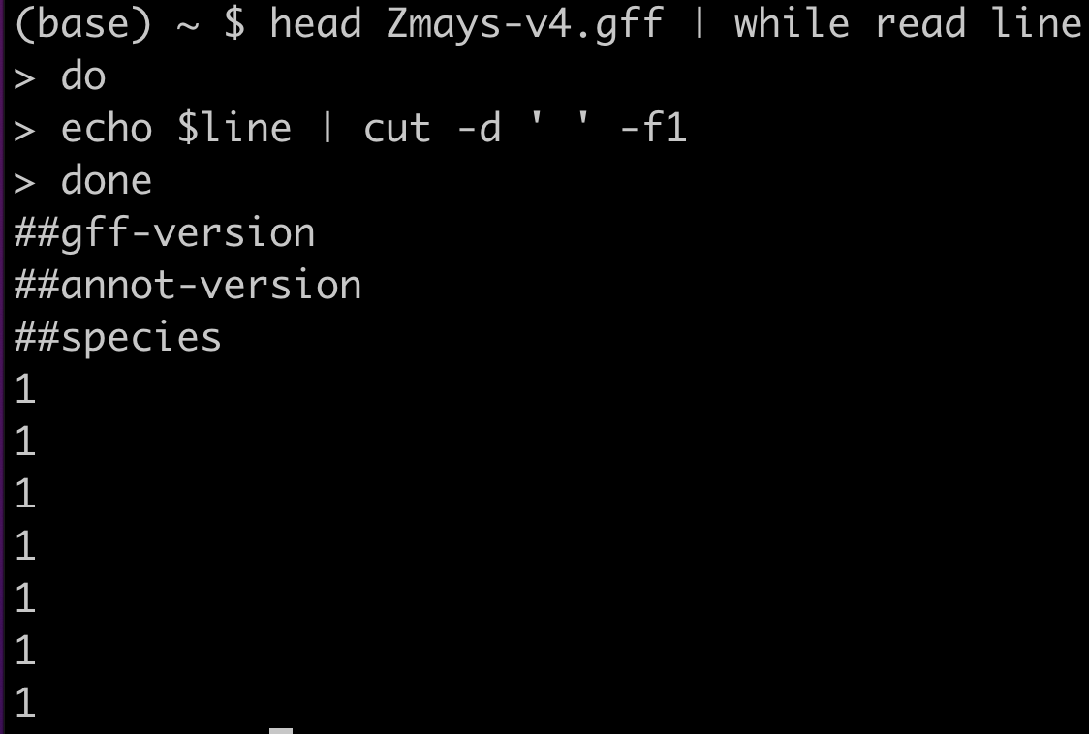
while read
use head to pipe first 10 lines into while with read. That line is read into variable “line”
We will print the line using echo and cut the first element
Combined with read command, while can be used to loop over each line in a file
Using the pipe | the file is fed into while using commands like cat, head, etc
NOTE: Read often converts tabs to spaces (not always). So in this case the $line variable is space delimited and I have to indicate this in cut using the -d argument
NOTE: while must be followed by “do” and end in “done”

Slide 12
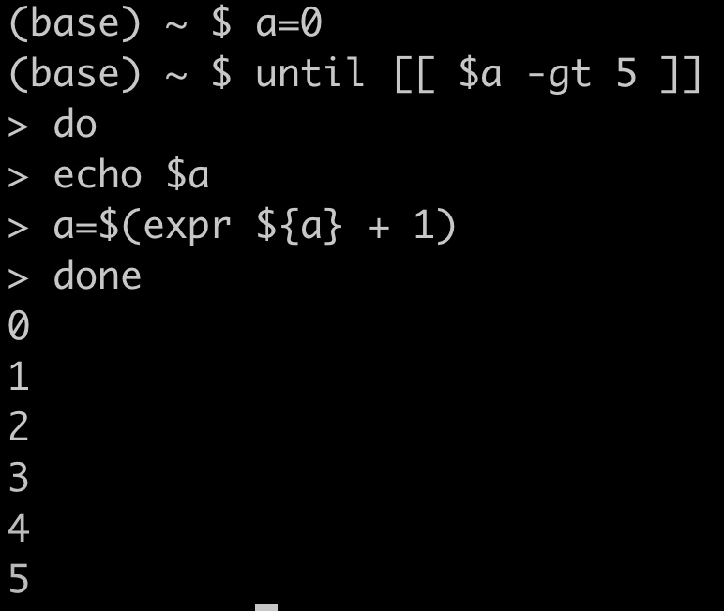
until
Keep looping through until some condition is met (think of it as the opposite of ‘while’)
set variable a to 0
Until the value of a is greater than 5, keep doing the loop
print $a to screen
add 1 to $a
NOTE: until must be followed by “do” and end in “done”

Slide 13
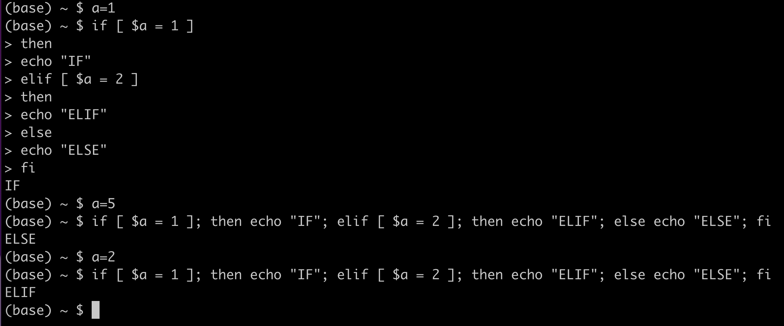
if/elif/else
if some condition is true, then do X, else if (elif) some other condition, then do y, else do z
set variable $a to 1
if a equals 1, conditions in brackets
then print “IF” to the screen
elif $a equals 2 conditions in brackets
then print “ELIF” to screen
else print “ELSE” to screen
fi indicates end of if statements
NOTE: if & elif must be followed by then
else is not followed by then

Slide 14
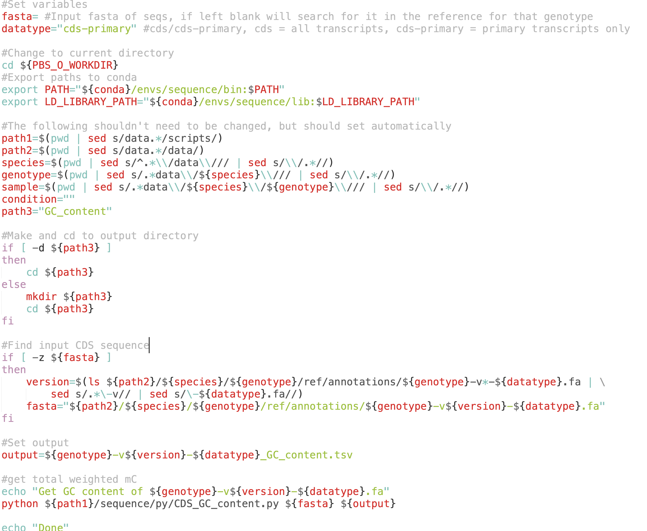
if/elif/else
if [ -d directory_name ]
if directory exists
if [ -f file_name ]
if file exists
if [ -z $variable ]
if variable is empty or undefined
if [[ ! -d directory_name ]]
if directory does not exist

Slide 15
Using Directories To Your Advantage
ORGANIZE YOUR DATA
Think about how to order and segregate samples, data, and results to maximize versatility of scripts and avoid mistakes.
Always a good idea to keep raw data separate so as to avoid accidental deletion or modification
If not careful in naming output, it is easy to overwrite results from previous work

Slide 16
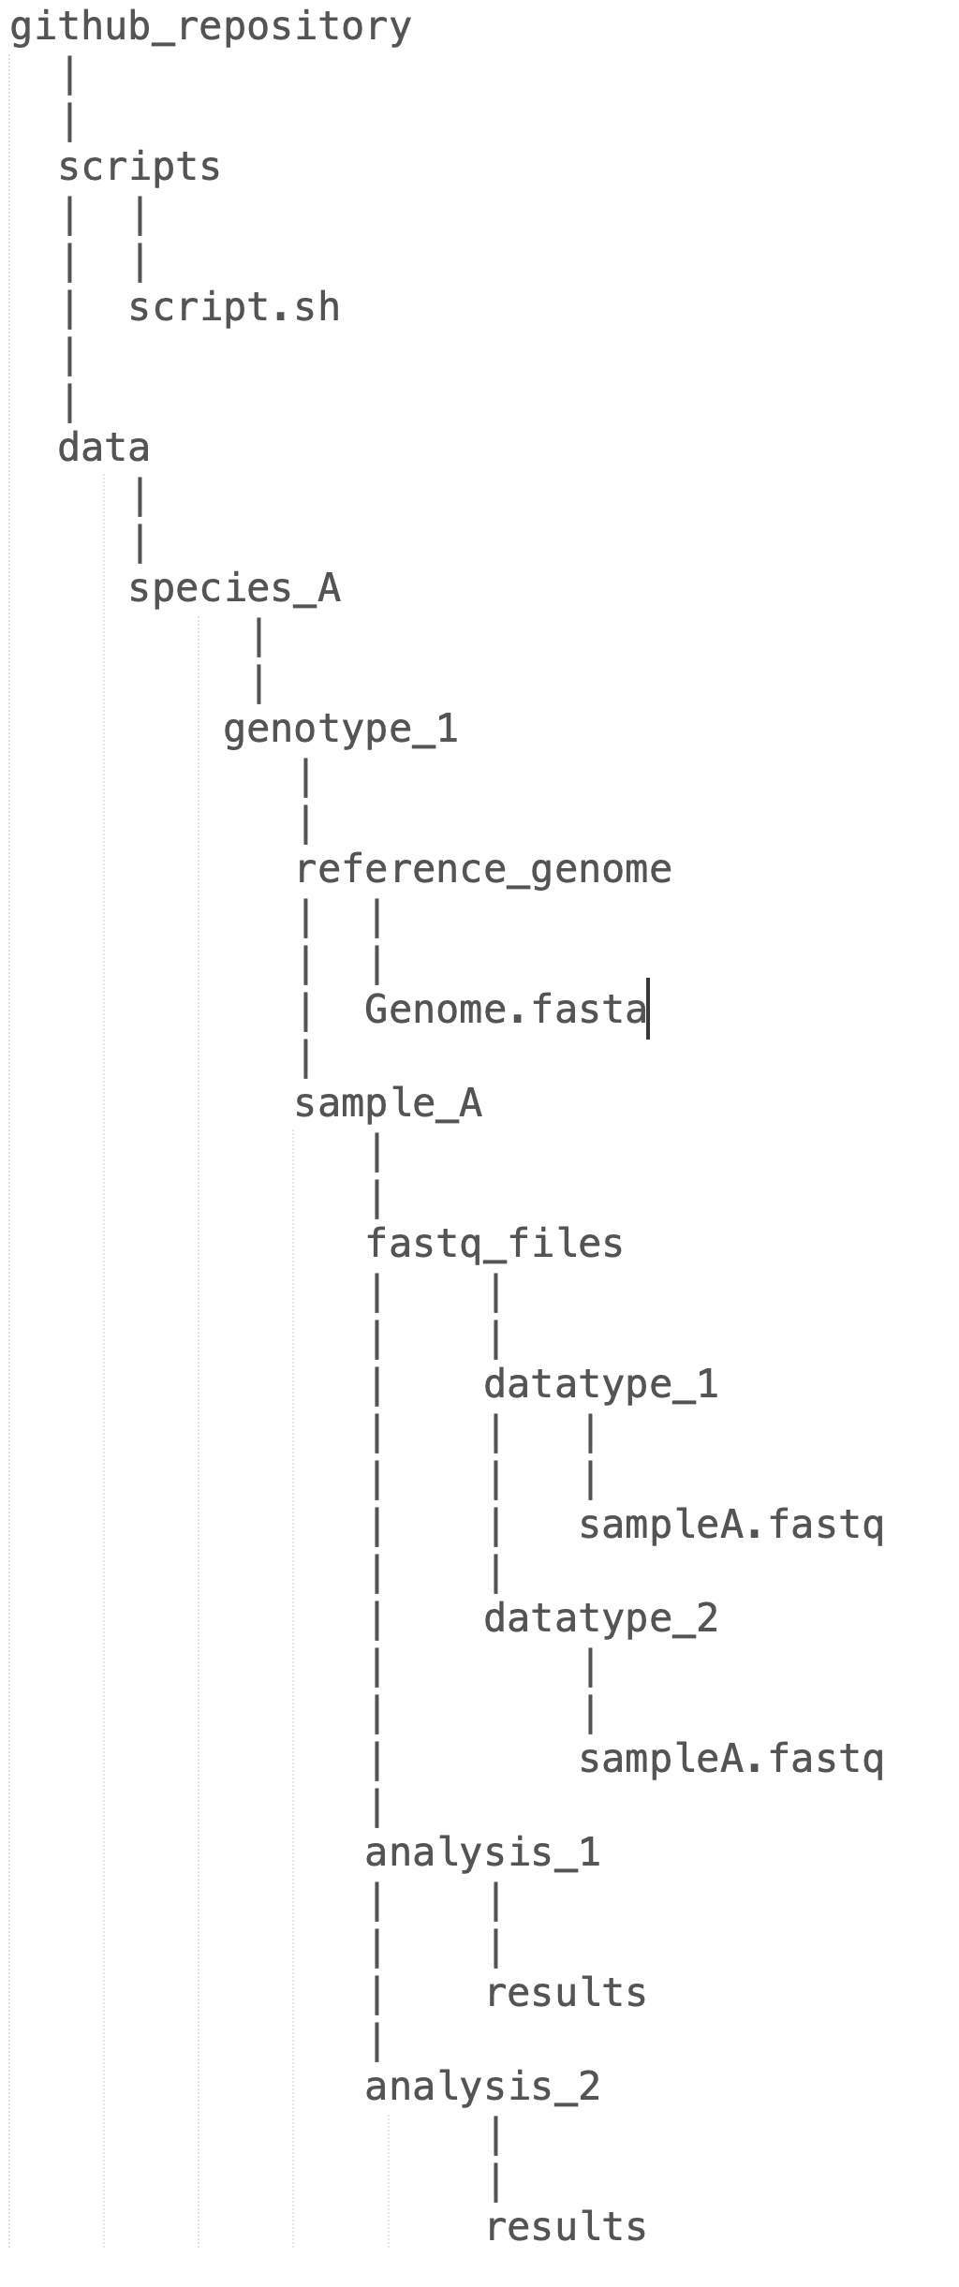
Using Directories To Your Advantage
Use whatever system works best for you
How I often do things (its complicated)
Separate directories for each sample/genotype/species/etc
Reference genome information kept separate from the samples
For each sample, separate directories for raw data (i.e. fastq)
For each sample, separate directories for results

Slide 17
Using Directories To Your Advantage
Whatever directory you submit a job in, becomes the working directory
cd $PBS_O_WORKDIR
Can use directory structure to help set variables

Slide 18
Snakemake
A workflow management system
Enables you to easily build workflows & pipelines
Uses Conda
Increases reproducibility
Makes it easy to adapt workflows to new systems & environments (e.g. clusters, computers, etc)
https://snakemake.github.io
Based on python
Do not have time/scope to cover

Slide 19
Upcoming
Lab Assignment #2 due at 5 pm
Lab Assignment #3 assigned
Due Wednesday Oct 5th at 5pm
Monday Oct 3rd Lecture 5: Gene Expression & Transcriptomics
Papers on D2L
Wednesday Oct 5th Lab 5 Introduction to R in Bioinformatics

