Slide 1
Lab 1: UNIX, Clusters, & Data Reproducibility
PLB 812

Slide 2
Unix & The Command Line

Slide 3
UNIX & The Command Line
UNIX
Open-source operating system
Apple/Mac is a derivative
Most common operating system used on large-computing clusters
Vast majority bioinformatics operate on UNIX
Powerful commands for manipulating text
Command Line
Text-based user interface
Contrast to “graphical user interface” or GUI
Access on your computer
Apple/Mac
Built in Terminal app
I prefer iterm2: https://iterm2.com
Windows
Cygwin: https://cygwin.com
PuTTY: https://putty.org

Slide 4
Getting Answers
Read the manual!
man <program>
Can access the manual of many programs with the “man” command, followed by the program name, e.g. man bowtie
-h or --help
Less detailed instructions can often be accessed by running the program with either –h or –help arguments, e.g. bowtie -h
The internet
Stack Overflow: https://stackoverflow.com
Not bioinformatics specific
Biostars: https://www.biostars.org
Especially good for bioinformatics questions
Learn how to phrase questions!
Describe what you are trying to do clearly
Provide the code and arguments used
Provide example data
If you get an error, provide as much information as possible

Slide 5
UNIX Resources
Command-line Bootcamp
http://korflab.ucdavis.edu/bootcamp.html
Excellent introduction to basics
Fairly comprehensive cheat sheet
http://academy.delmar.edu/Courses/ITSC1358/eBooks/Unix%28CommandsCheatSheet%29.pdf
I have also provided this as a pdf

Slide 6
Common UNIX Commands - Basics
cd <directory>
change to directory
cd ../ : move up to higher directory
ls
list contents of directory
pwd
show path of working directory
mkdir <dir_name>
make a directory
rmdir <dir_name>
remove an empty directory
touch <file>
create a file
if file exists, modify the timestamp
rm <file>
remove a file
rm –R <directory> will remove a non-empty directory
BE VERY CAREFUL WITH rm!
echo “Hello World”
prints “Hello Wold” to the screen
head <file>
show first N lines of a file
tail <file>
show last N lines of a file
more <file> or less <file>
will print a file to your screen line by line (more) or page by page (less)
cat <file>
will print entire file to screen
“concatanate” can combine files
cat file1 file2: print file 1 followed by file 2
cat file1 file2 > file3: “>” redirects contents, combining file1 & file2 in file3
vim <file>
open a file with the text editor vim
chmod
Used to change the permissions for files and directories
Determines who can access!
Good intro: https://www.makeuseof.com/tag/chmod-command-linux-file-permissions/

Slide 7
Working and Manipulating Files
Will revisit these in next lab
grep
Powerful search tool
awk
All around swiss-army knife
Can search, manipulate, extract, and perform calculations
sed
Text manipulation
Can perform search & replace functions
cut
Used to extract columns from a file
sort
Can sort files in various ways
tr
translate or delete characters
Somewhat analagous to sed
Better at handling some conversions (like tab-delimited files) than sed

Slide 8
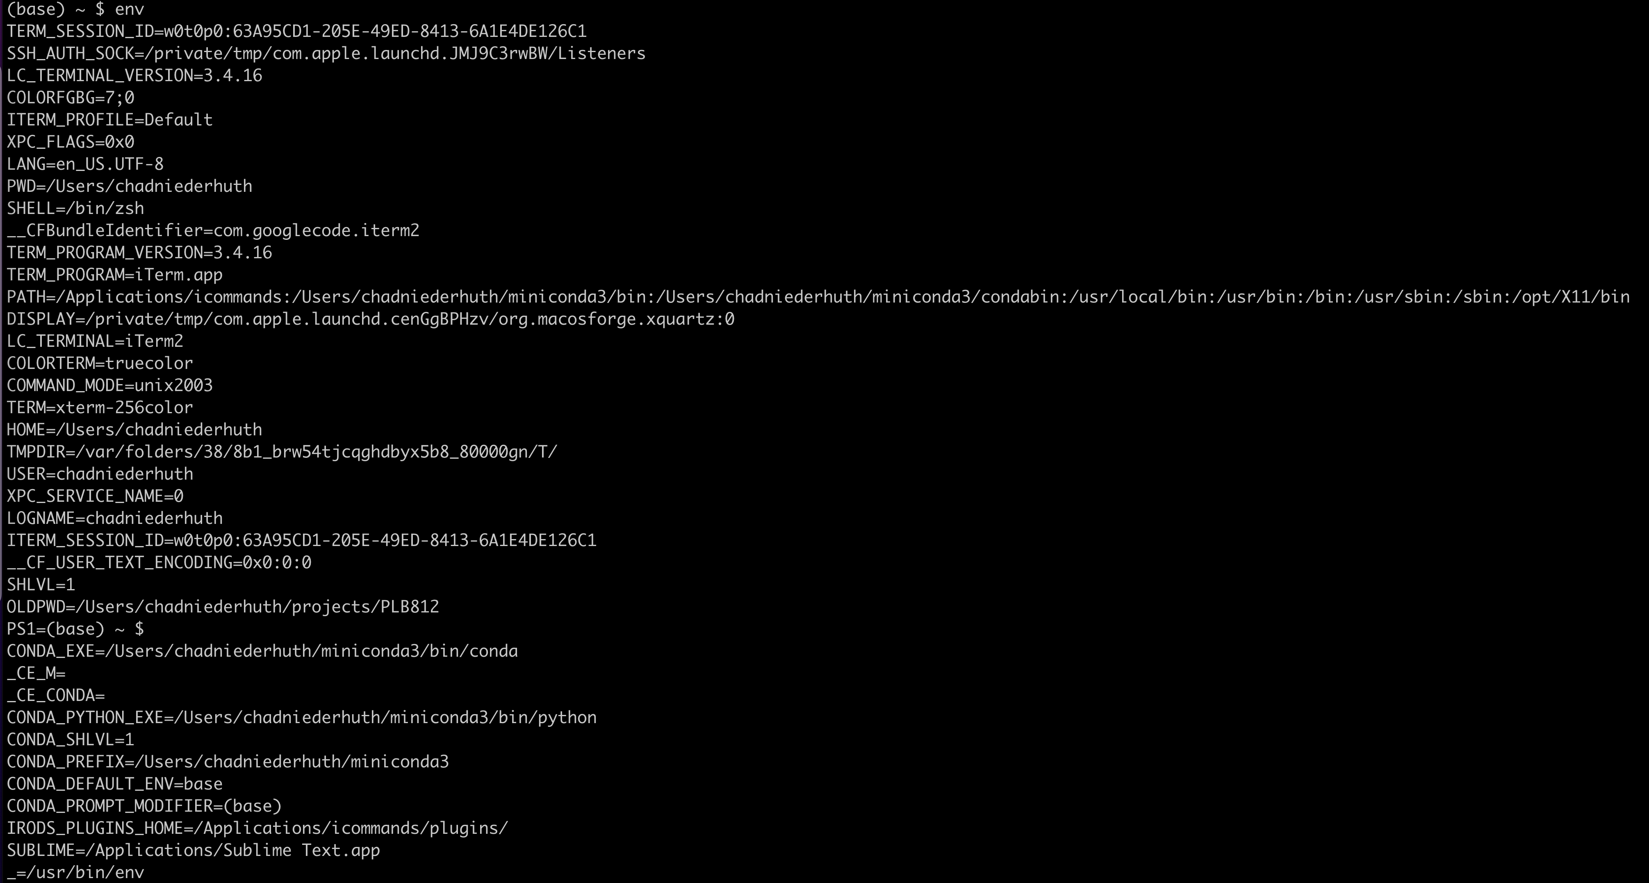
Environmental Variables

Slide 9
Environmental Variables
Define many different aspects of how your working environment operates
env: Lists current environmental variables
PATH
environmental variable listing locations to look for installed programs
exists as a colon separated list
UNIX looks in the first directory listed for program, then moves down the list sequentially
LD_LIBRARY_PATH
environmental variable listing locations of installed libraries used by programs
exists as a colon separated list
Specific variables be accessed using dollar sign with variable name
e.g. $PATH
echo $PATH: prints PATH variable to screen
Variables can be set by typing <variable_name>=<variable_value>
MYVARIABLE=7
echo $MYVARIABLE
Can add to PATH & LD_LIBRARY_PATH variable by setting the path with “=” sign and including “$PATH” or “$LD_LIBRARY_PATH” as a colon separated value with a dollar sign
PATH=/path/to/new/dir:$PATH
LD_LIBRARY_PATH=/path/to/new/dir:$LD_LIBRARY_PATH
Further explanation: https://www.geeksforgeeks.org/environment-variables-in-linux-unix/

Slide 10
bashrc
bashrc file can be used to customize your unix environment
Set frequently used environmental variables
Add aliases
aliases can be used to create custom commands
Hidden file
begins with a period, makes file invisible unless you use ls -a
vim .bashrc

Slide 11
File Transfer
sftp
secure file transfer protocol
Details: https://www.geeksforgeeks.org/sftp-file-transfer-protocol/
sftp <username>@hpcc.msu.edu
login into cluster with sftp
put file1
upload a file from your computer onto the cluster
get file2
download a file from the cluster to your computer
wget
wget <link to file>
can be used to download files from web
Also see curl: https://curl.se

Slide 12
Working on Remote Clusters

Slide 13

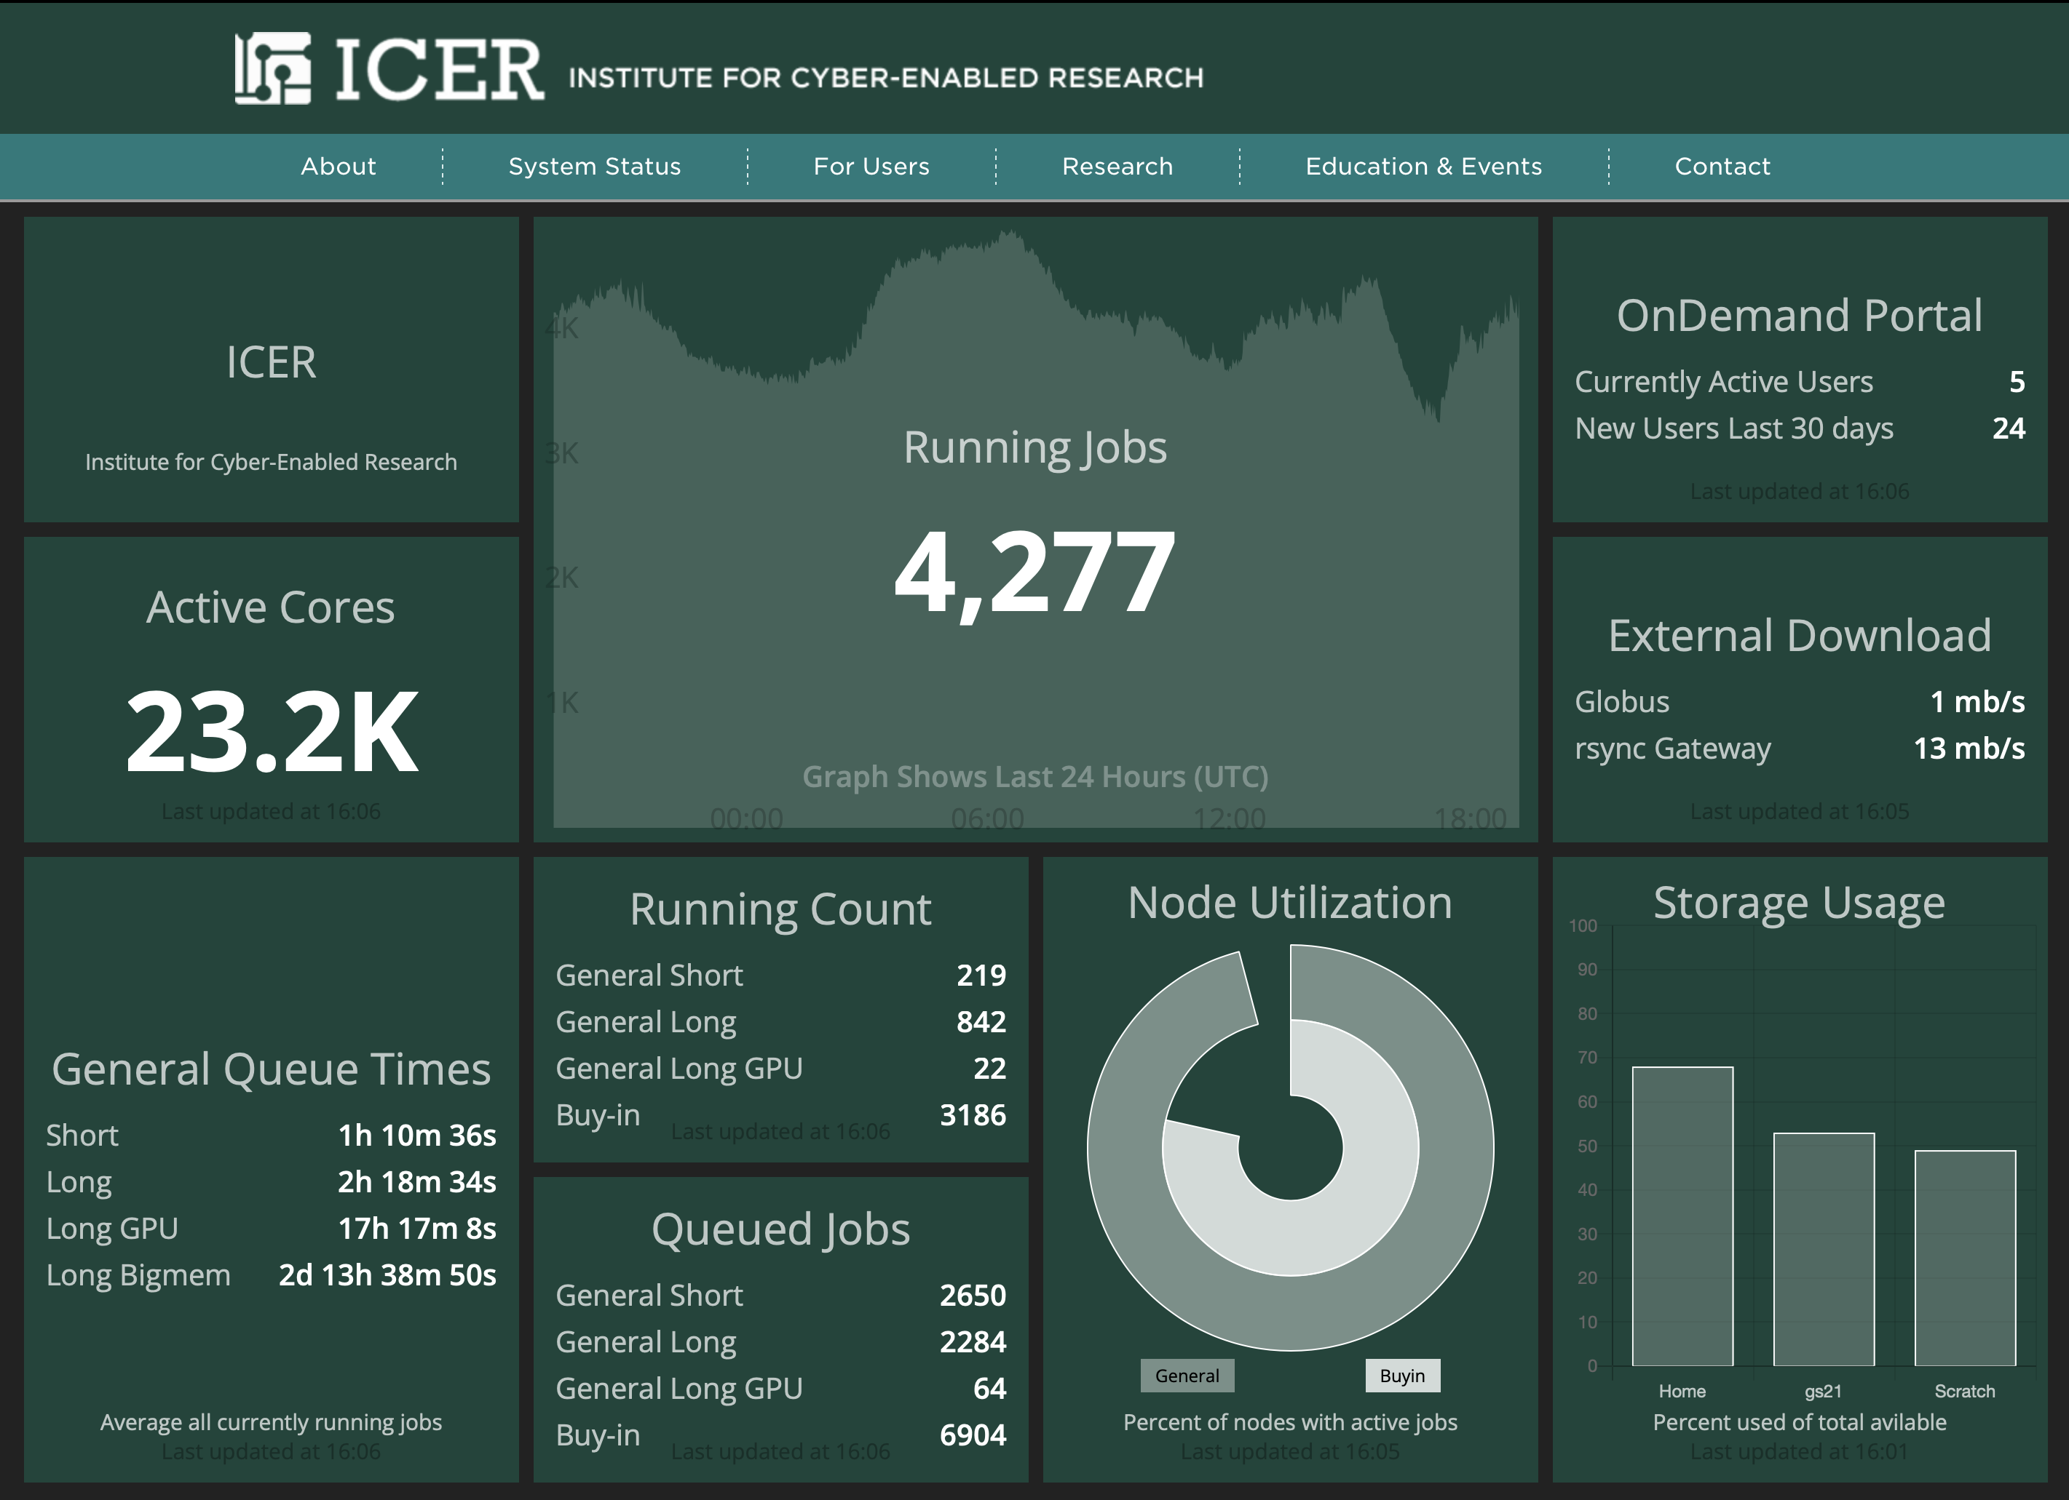
Clusters & Clouds
MSU High Performance Computing Center
Provide immense computing power
Clusters – array of computers & servers
Can be accessed remotely
Each server constitutes a “node”
The Cloud – array of computers & servers
Even bigger clusters made available on demand through the internet

Slide 14
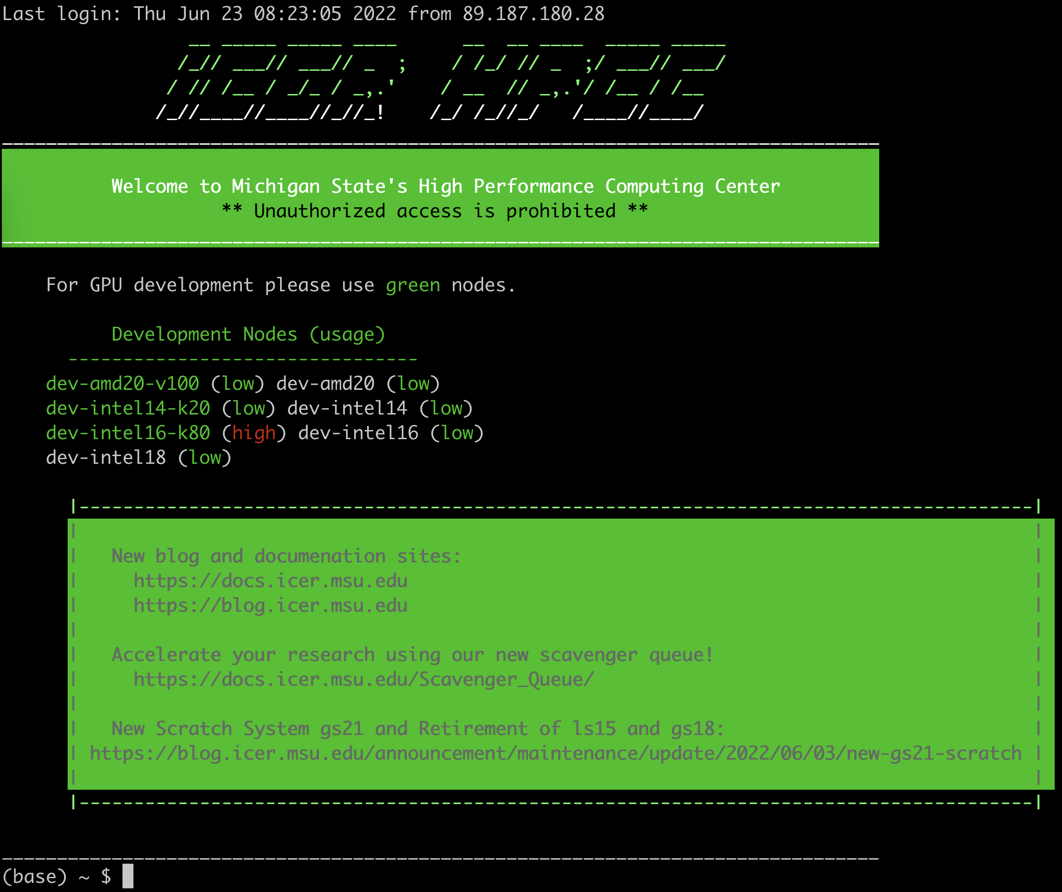
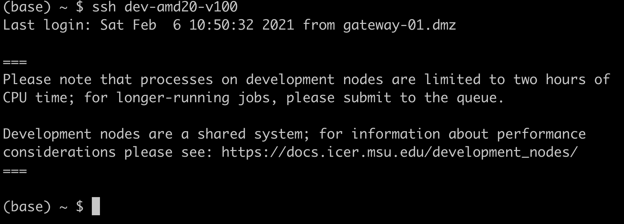
MSU HPCC
Documentation: https://docs.icer.msu.edu
Login with ssh:
ssh <username>@gateway.hpcc.msu.edu
Starts in the “Head Node”
Not for running analyses!
Should only be used for navigating
Development/Interactive nodes
Can work on interactively
Can be used for computation
Primarily for developing code
Login to development nodes with ssh:
ssh dev-amd20-v100

Slide 15
HPCC Installed Software
HPCC has a lot of installed software
Advantage: Installed with all dependencies
Disadvantage: Not always the most up to date
Disadvantage: Can’t export/share the environment for reproducibility
Installed software can be used with the module loading system
Documentation: https://docs.icer.msu.edu/How_to_find_and_load_software_modules/
module spider sra
Search for modules with “sra”
module load SRA-Toolkit/2.10.7-centos_linux64
Load the SRA Toolkit module
module unload SRA-Toolkit/2.10.7-centos_linux64
Unload the SRA Toolkit module

Slide 16
Installing Software - Conda
Conda: https://docs.conda.io/en/latest/
Package manager
Handles installation, version control, & dependencies
Enables reproducibility
Create different self-contained environments for different programs, program versions, and dependencies
Anaconda
Full version of Conda
Comes with lots of interactive apps
These wont work on the cluster, so just hogs memory
Miniconda
Stripped down version of Conda, basics only
Good for the cluster
Download: wget https://repo.anaconda.com/miniconda/Miniconda3-latest-Linux-x86_64.sh
Install: bash Miniconda3-latest-Linux-x86_64.sh

Slide 17
Installing Software - Conda
Conda basics
List of Conda commands https://docs.conda.io/projects/conda/en/latest/commands.html
See protocol from my lab “Using_Conda_on_the_HPCC.pdf”
conda create –n plb812
Create an “environment” for the class
conda activate plb812
Activate the environment
conda config --show-sources
Show the channels available to install from
conda config --add channels conda-forge
Add the channel conda-forge to list of channels to always use
conda search sra
Search for the SRA toolkit
conda install sra-tools
Install the SRA toolkit package
conda deactivate
Deactivate the environment

Slide 18
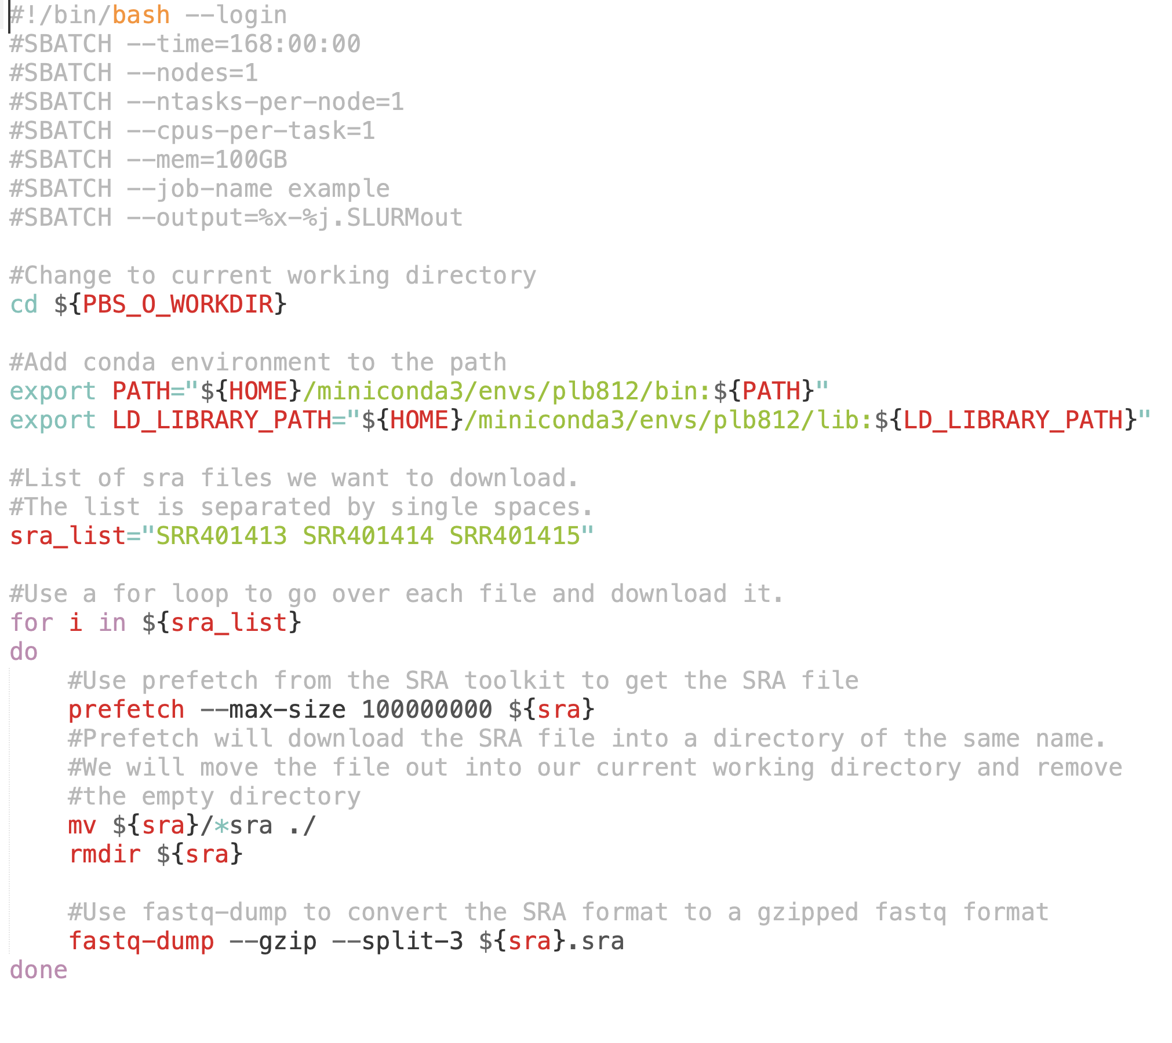
Job Scripts
Example_Job_Script.sh
Processed from top to bottom in order
Hashtags
Header lines – for job submission
Comments – ignored when running program
Headers
Used by computing cluster to request resources & set variables
Must begin with “#!/bin/bash”

Slide 19
Header Lines
Example_Job_Script.sh
#SBATCH --time=168:00:00
Amount of time requested
hours:mins:secs
Max 168 hours on cluster
#SBATCH --nodes=1
number of servers
if program is not MPI, set to 1
#SBATCH --ntasks=1
Number of tasks
Applies to MPI, for most apps, set to 1
#SBATCH --cpus-per-task=1
How many CPUS to request
For multi-threaded programs number should eqaul number of threads used
#SBATCH --mem=100GB
How much RAM do you need?
#SBATCH --job-name download_sra
Job Name
#SBATCH --output=%x-%j.SLURMout
Combined output file anything printed to screen & errors

Slide 20
Job Scripts - Software
Example_Job_Script.sh
If using HPCC installed programs
Code must include commands to load relevant modules
If using Conda installed programs
Need to add the conda env to the environmental variables “PATH” and “LD_LIBRARY_PATH”

Slide 21
Data Reproducibility

Slide 22
Reproducible Research in Genomics
Metadata
All relevant details about the data
More details the better
Make Code & Software Available
Software Version
Arguments and Parameters Used
Share environment (e.g. conda envs) if possible
Raw Data
Processed data may propagate errors
Enables new research questions to be addressed
Permits new methods to be used on old data
Long-term Storage and Distribution
NCBI & Genomics Databases
Supplementary Data
Github, Bitbucket, etc

Slide 23
Github – Getting Started
https://github.com
Command line cheat sheet: https://training.github.com/downloads/github-git-cheat-sheet/
Create a Github account
Create a personal access token: https://docs.github.com/en/authentication/keeping-your-account-and-data-secure/creating-a-personal-access-token
Create First Repository
Fork Repository PLB812

Slide 24
Github – basic commands
git clone https://github.com/<username>/PLB812
Clones the repository PLB812 to your computer
git add –all
Add all the changes made
git commit –m ‘My first commit’
Commit those changes
Not necessary to add a message in command line, but if you don’t you will be prompted to
Messages can be used to track changes with each commit
git push
Pushes changes to github
git pull
pull the latest version of the repository to your local computer

