Slide 1
Toward Generating a New Intrusion Detection Dataset and Intrusion Traffic Characterization
A Hierarchical ML Detection Framework Validated on CIC-IDS2017
Sharafaldin, I., Lashkari, A. H., & Ghorbani, A. A. (2018). Toward generating a new intrusion detection dataset and intrusion traffic characterization. ICISSP.
Project: NetTier-ML — Hierarchical IDS Experimental Validation
Kaicheng Nie
No：100993098
Ontario Tech University — 6800G Machine Learning — March 2026

Slide 2
Motivation: Why a New IDS Dataset?
The Problem
Datasets Analyzed
Network attacks growing exponentially in scale, complexity, and sophistication
Intrusion Detection Systems (IDS) are critical, but effectiveness depends on training data quality
Existing datasets are outdated: KDD99 (1999), NSL-KDD (2009), ISCX2012
Anomaly-based IDS suffer from lack of reliable, labeled, current datasets
11 publicly available datasets analyzed — none satisfies all evaluation criteria
11 Public IDS Datasets
None satisfies all 15 evaluation criteria (Ring et al. 2019)
KDD99 Age
27 Years Old
Still the most-cited IDS dataset — a critical gap
What Is Needed?
Realistic benign + attack traffic from a modern testbed
Full packet capture with flow-level and packet-level labeling
Diverse attack categories reflecting current threat landscape
Publicly available for reproducible IDS research
Key Insight: Without a reliable, modern dataset, anomaly-based IDS cannot be accurately developed, analyzed, or evaluated.
Sharafaldin, I., et al. (2018). ICISSP. | Ring, M., et al. (2019). Computers & Security, 86, 100-126.

Slide 3
Dataset Evaluation Framework (Ring et al. 2019)
Table 1
Comparison of IDS Datasets Against Key Evaluation Criteria
Criterion
KDD99
NSL-KDD
ISCX2012
UNSW-NB15
CIC-IDS2017
Year / Timeliness
1999
2009
2012
2015
2017
Real Network Traffic
No
No
Yes
Partial
Yes
Complete Capture (PCAP)
No
No
Yes
Yes
Yes
Labeled at Flow Level
Partial
Partial
Yes
Yes
Yes
Diverse Attack Types
4 types
4 types
4 types
9 types
7 families
Feature Extraction Tool
No
No
ISCXFlowMeter
Argus
CICFlowMeter
Publicly Available
Yes
Yes
Yes
Yes
Yes
Benign Traffic Profile
No
No
Yes
No
B-Profile
Ring, M., Wunderlich, S., Scheuring, D., Landes, D., & Hotho, A. (2019). A survey of network-based intrusion detection data sets. Computers & Security, 86, 100-126.

Slide 4
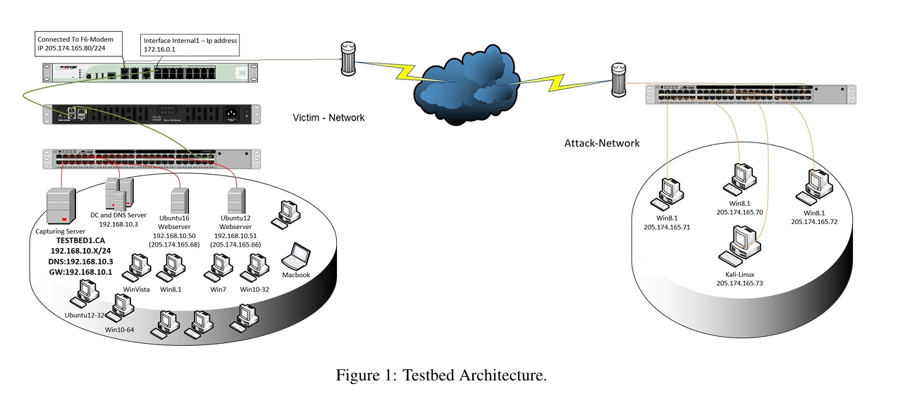
CIC-IDS2017: Dataset Architecture
Attack Schedule (5-Day Capture, July 2017)
Testbed and Data Pipeline
Monday
Benign traffic only (baseline)
B-Profile System: Generates realistic benign traffic (HTTP, HTTPS, FTP, SSH, Email)
CICFlowMeter: Extracts 80 bidirectional flow features from PCAP
Labeling: Flow-level + packet-level ground truth via timestamps and IP/Port
Network: 4 attacker machines, victim server, firewall, switch
Tuesday
Brute Force (FTP-Patator, SSH-Patator)
Wednesday
DoS (Slowloris, Hulk, GoldenEye) + Heartbleed
Thursday
Web Attacks (SQLi, XSS) + Infiltration
2.83M
80
15
Friday
Botnet (ARES) + Port Scan + DDoS (LOIT)
Total Flows
Flow Features
Classes
Figure 1: Testbed Architecture.
5 Days
7
Public
Capture Duration
Attack Families
UNB Available
7 Attack Families
DoS/DDoS: Slowloris, Slowhttptest, Hulk, GoldenEye, LOIT
Brute Force: FTP-Patator, SSH-Patator
Web Attacks: SQL Injection, XSS, Web Brute Force
Other: Botnet (ARES), Port Scan, Infiltration, Heartbleed
Benign: B-Profile synthetic realistic traffic
Note. This diagram illustrates the network topology of the testbed environment, which is separated into a victim network and an attack network. GW = gateway; IP = Internet Protocol. From "Toward Generating a New Intrusion Detection Dataset and Intrusion Traffic Characterization," by I. Sharafaldin, A. H. Lashkari, and A. A. Ghorbani, 2018, Proceedings of the 4th International Conference on Information Systems Security and Privacy (ICISSP), p. 110. Copyright 2018 by SCITEPRESS.
Sharafaldin, I., Lashkari, A. H., & Ghorbani, A. A. (2018). Toward generating a new intrusion detection dataset. ICISSP.

Slide 5
Our Project: Dataset Usage
Table 2
Dataset Configuration and Sample Distribution
Dataset
Purpose
Samples
Features
Classes
CIC-IDS2017
Primary training/testing
2.3M
80 to 76
15
CIC-IDS2017 S2
S2 train/val/test
235K/33K/67K
76
15
UNSW-NB15
Generalization test
149K/26K/82K
186
10
Preprocessing Pipeline
1. Feature Cleaning
2. Stratified Split
3. Stage 2 Mining
4. Normalization
Removed 4 constant/infinite-value columns (80 to 76)
Time-aware split preserving temporal order; 80/20
5-Fold CV Mining extracts 235K hard examples
StandardScaler on train; applied to val/test
Dataset selection follows Ring et al. (2019) 15-criteria framework. CIC-IDS2017 outperforms all prior datasets.
Ring, M., et al. (2019). Computers & Security, 86. | Hardware: Intel ARC 130T GPU (16GB), PyTorch 2.10.0+xpu

Slide 6
Hierarchical IDS Architecture: RF to TransECA-Net
Input Traffic
→
Stage 1: Random Forest
→
Filter
→
Stage 2: TransECA-Net
→
Output
76 features
Binary: Benign vs Attack
84.75% Benign
15-class classifier
Attack type
50 trees, tau=0.06
15.25% Suspicious
301,460 params
or Benign
Stage 1 — Random Forest
Stage 2 — TransECA-Net
Role: High-speed binary pre-filter
Config: 50 trees, max_depth=20
Threshold: tau=0.06, Recall=99.9%
Latency: 6.12 us/sample
Throughput: 163,399 samples/s
Passes only 15.25% to Stage 2
Architecture: 1D-CNN, ECA, Transformer
Transformer: d=128, heads=8, layers=3
Parameters: 301,460
Test Accuracy: 93.00%
Weighted F1: 0.95
Handles hard examples from Stage 1
Speed
Accuracy
Robustness
6.07x faster than DL-only (82us expected cost)
System Recall 92.9%, FPR 0.007%
Orthogonal weaknesses = attack surface isolation
Liu, Y. (2025). TransECA-Net. | Breiman, L. (2001). Random forests. Machine Learning, 45(1), 5-32.

Slide 7
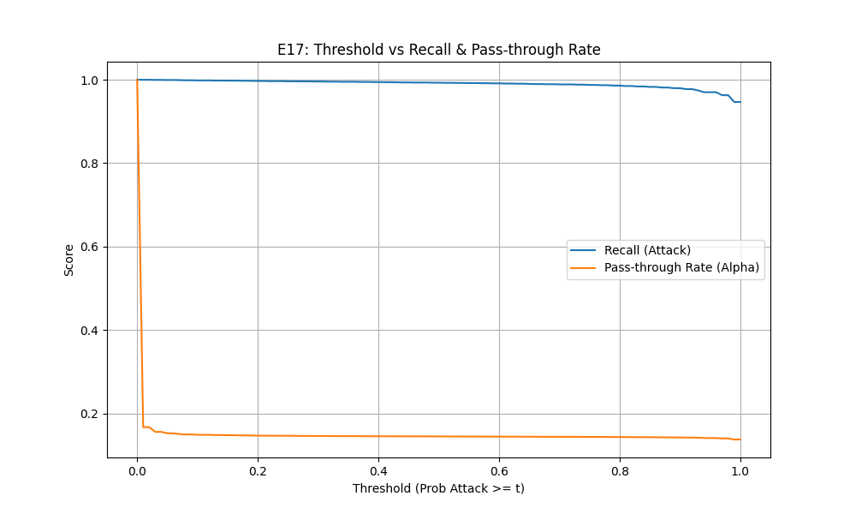
Stage 1: RF Baseline and Threshold Tuning
Table 3
Figure 2：Threshold Tuning Curve for Binary Pre-Filter (E17)
Stage 1 Random Forest Validation Results
Experiment
Method
Key Result
E1
5x3 Nested CV
F1-Macro = 0.796
E16
Time-aware Full Data
F1 = 1.00
E17: Threshold Optimization
0.06
99.9%
15.25%
Optimal Tau
Recall
Pass-through
E11: Inference Latency
6.12us
163K/s
Per Sample
Throughput
Key Insight
Gap between Nested CV (0.796) and full training (1.00) reflects data volume effect, not selection bias. 33% faster than Abu Al-Haija 2022.
Note. X-axis = confidence threshold (tau); Y-axis = recall and pass-through rate. Optimal tau = 0.06 balances 99.9% recall with 15.25% pass-through to Stage 2.
Cawley, G. C., & Talbot, N. L. C. (2010). On over-fitting in model selection. JMLR, 11, 2079-2107.

Slide 8
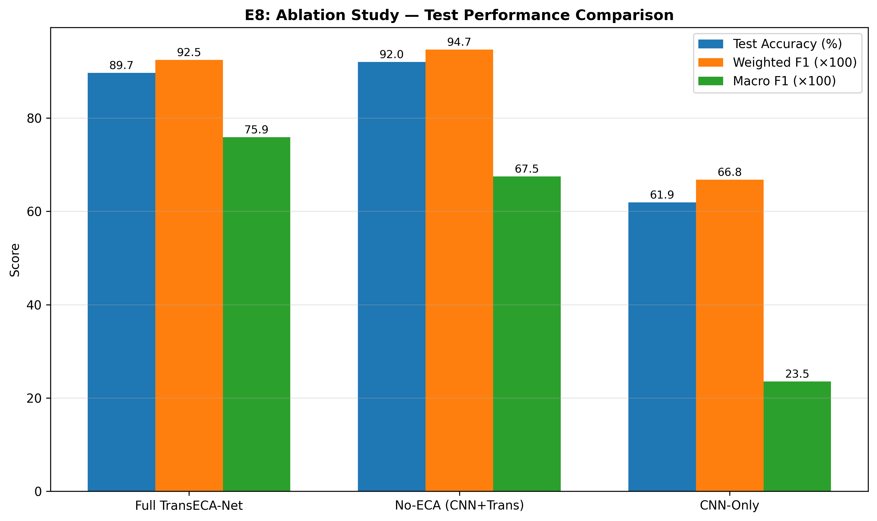
Stage 2: TransECA-Net and Ablation Study (E8)
Training Results
Figure 3 ：Ablation Study Component Performance Comparison (E8)
93.0%
0.95
Test Accuracy
Weighted F1
301K
64min
Parameters
Training Time
Table 4
Ablation Study: Component Contributions to TransECA-Net (E8)
Variant
Params
Acc
W-F1
M-F1
CNN-Only
2,703
61.89%
0.668
0.235
CNN+Transformer
301K
92.05%
0.947
0.675
Full TransECA
301K
89.71%
0.925
0.759
Key Findings
Transformer: Architecture core — adds +30pp Accuracy, +0.44 M-F1
ECA Attention: W-F1 drops slightly but M-F1 improves +0.085 — critical for rare attacks
Note. Bar chart compares accuracy, weighted F1, and macro F1 across three ablation variants: CNN-Only, CNN+Transformer, and Full TransECA-Net. ECA attention improves macro F1 by +0.085 for rare attack classes.
Liu, Y. (2025). TransECA-Net. | Kwon, D., et al. (2017). IEEE Communications Surveys & Tutorials, 21(1), 464-489.

Slide 9
Interpretability: SHAP and Integrated Gradients (E2 + E10)
E2: SHAP on Stage 1 (RF)
E10: IG + Attention on Stage 2
Table 5
Table 6
SHAP Feature Importance Rankings for Stage 1 Random Forest (E2)
Integrated Gradients and Attention Attribution for Stage 2 (E10)
#
Feature
SHAP
Gini Rank
Method
Top-1 Feature
Key Top-5
1
Bwd Pkt Length Std
0.032
#4
Integrated Gradients
Init Fwd Win Bytes (IG=2.107)
Flow Pkts/s, Bwd Hdr Len, Fwd Seg Min
2
Init Bwd Win Bytes
0.029
#23
Attention Rollout
Fwd IAT Mean
Fwd Pkt Max, Flow Bytes/s, Init Win
3
Bwd Pkt Len Mean
0.028
#3
ECA Channel Attn
mean=0.449, std=0.009
CV=0.020 (near-uniform)
4
Pkt Len Variance
0.025
#1
5
Fwd IAT Min
0.024
#22
Cross-Model Triangulation
Two methods (SHAP: Shapley axioms; IG: completeness axiom) on two architectures (RF vs TransECA) converge:
SHAP vs Gini rho = 0.9444
Both rank Init Win Bytes in Top-2; both focus on IAT statistics — aligned with Sharafaldin et al. (2018) domain knowledge.
SHAP promoted Init Bwd Win Bytes #23 to #2 (captures feature interaction via Shapley axioms vs Gini single-split)
Independent guarantees x Independent models = High credibility
Lundberg, S. M., & Lee, S. I. (2017). SHAP. | Sundararajan, M., et al. (2017). IG. | Sharafaldin, I., et al. (2018). CIC-IDS2017.

Slide 10
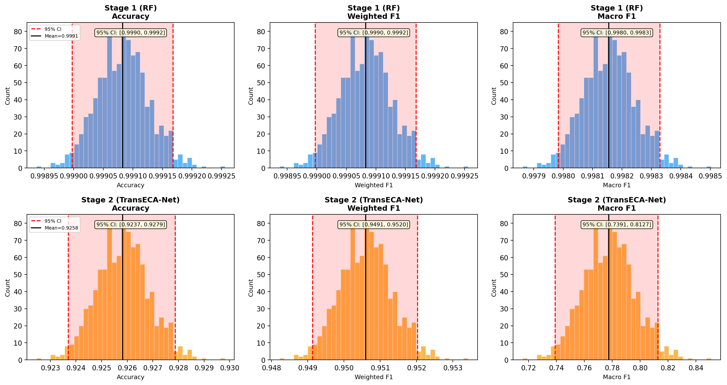
Statistical Reliability: Bootstrap CI (E6)
Table 7
Figure 4：Bootstrap Confidence Interval Distributions (E6)
Bootstrap 95% Confidence Intervals for Stage 1 and Stage 2 Metrics (E6)
Stage
Metric
Estimate
95% CI
Width
S1 RF
Acc
0.9991
[0.9990, 0.9992]
0.0002
S1 RF
W-F1
0.9991
[0.9990, 0.9992]
0.0002
S1 RF
M-F1
0.9982
[0.9980, 0.9983]
0.0003
S2 DL
Acc
0.9259
[0.9237, 0.9279]
0.0042
S2 DL
W-F1
0.9506
[0.9491, 0.9520]
0.0029
S2 DL
M-F1
0.7658
[0.7391, 0.8127]
0.0736
Analysis
S1 CI < 0.001: Large test set (n=462K) = highly reliable.
S2 M-F1 CI = 0.074: Extreme minority classes (Heartbleed n=11) dominate variance — inherent uncertainty, not model deficiency.
Note. Histograms show bootstrap distributions (1,000 iterations) for accuracy, weighted F1, and macro F1. Dashed lines indicate 95% percentile confidence interval boundaries per Efron (1979).
Efron, B. (1979). Bootstrap methods: Another look at the jackknife. The Annals of Statistics, 7(1), 1-26.

Slide 11
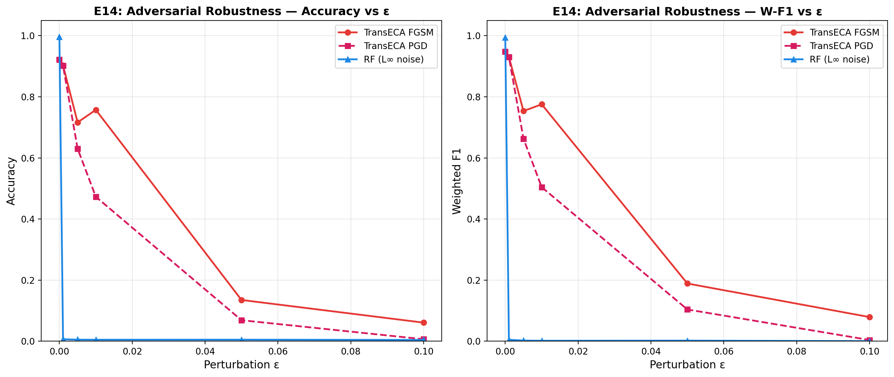
Adversarial Robustness Analysis (E14)
Table 8
Figure 5：Adversarial Robustness Degradation Curve (E14)
Adversarial Attack Accuracy Across Perturbation Budgets (E14)
Attack
Clean
e=0.001
e=0.01
e=0.1
RF (L-inf noise)
99.59%
46.94%
6.45%
0.43%
TransECA FGSM
92.16%
90.26%
75.73%
6.09%
TransECA PGD
92.16%
90.20%
47.28%
0.66%
1. RF Unexpectedly Fragile
e=0.001 drops 99.6% to 47%. Axis-aligned boundaries allow minimal perturbations to cross.
2. PGD Stronger than FGSM
At e=0.01: PGD 28.5pp lower (47% vs 76%). Multi-step optimization finds stronger examples.
3. Orthogonal Weaknesses
RF: fragile to noise, immune to gradients. TransECA: robust to noise, sensitive to gradients. No single attack breaches both.
System Evasion Rate (PGD e=0.01)
P(Evasion) = 0.1525 x 0.5272 = 8.04% (vs single-layer 52.72% — 6.6x reduction)
Note. Accuracy vs. perturbation budget (epsilon) for FGSM and PGD attacks on TransECA-Net and L-inf noise on RF. Adapted from Madry et al. (2018).
Madry, A., Makelov, A., Schmidt, L., Tsipras, D., & Vladu, A. (2018). Towards deep learning models resistant to adversarial attacks. ICLR.

Slide 12
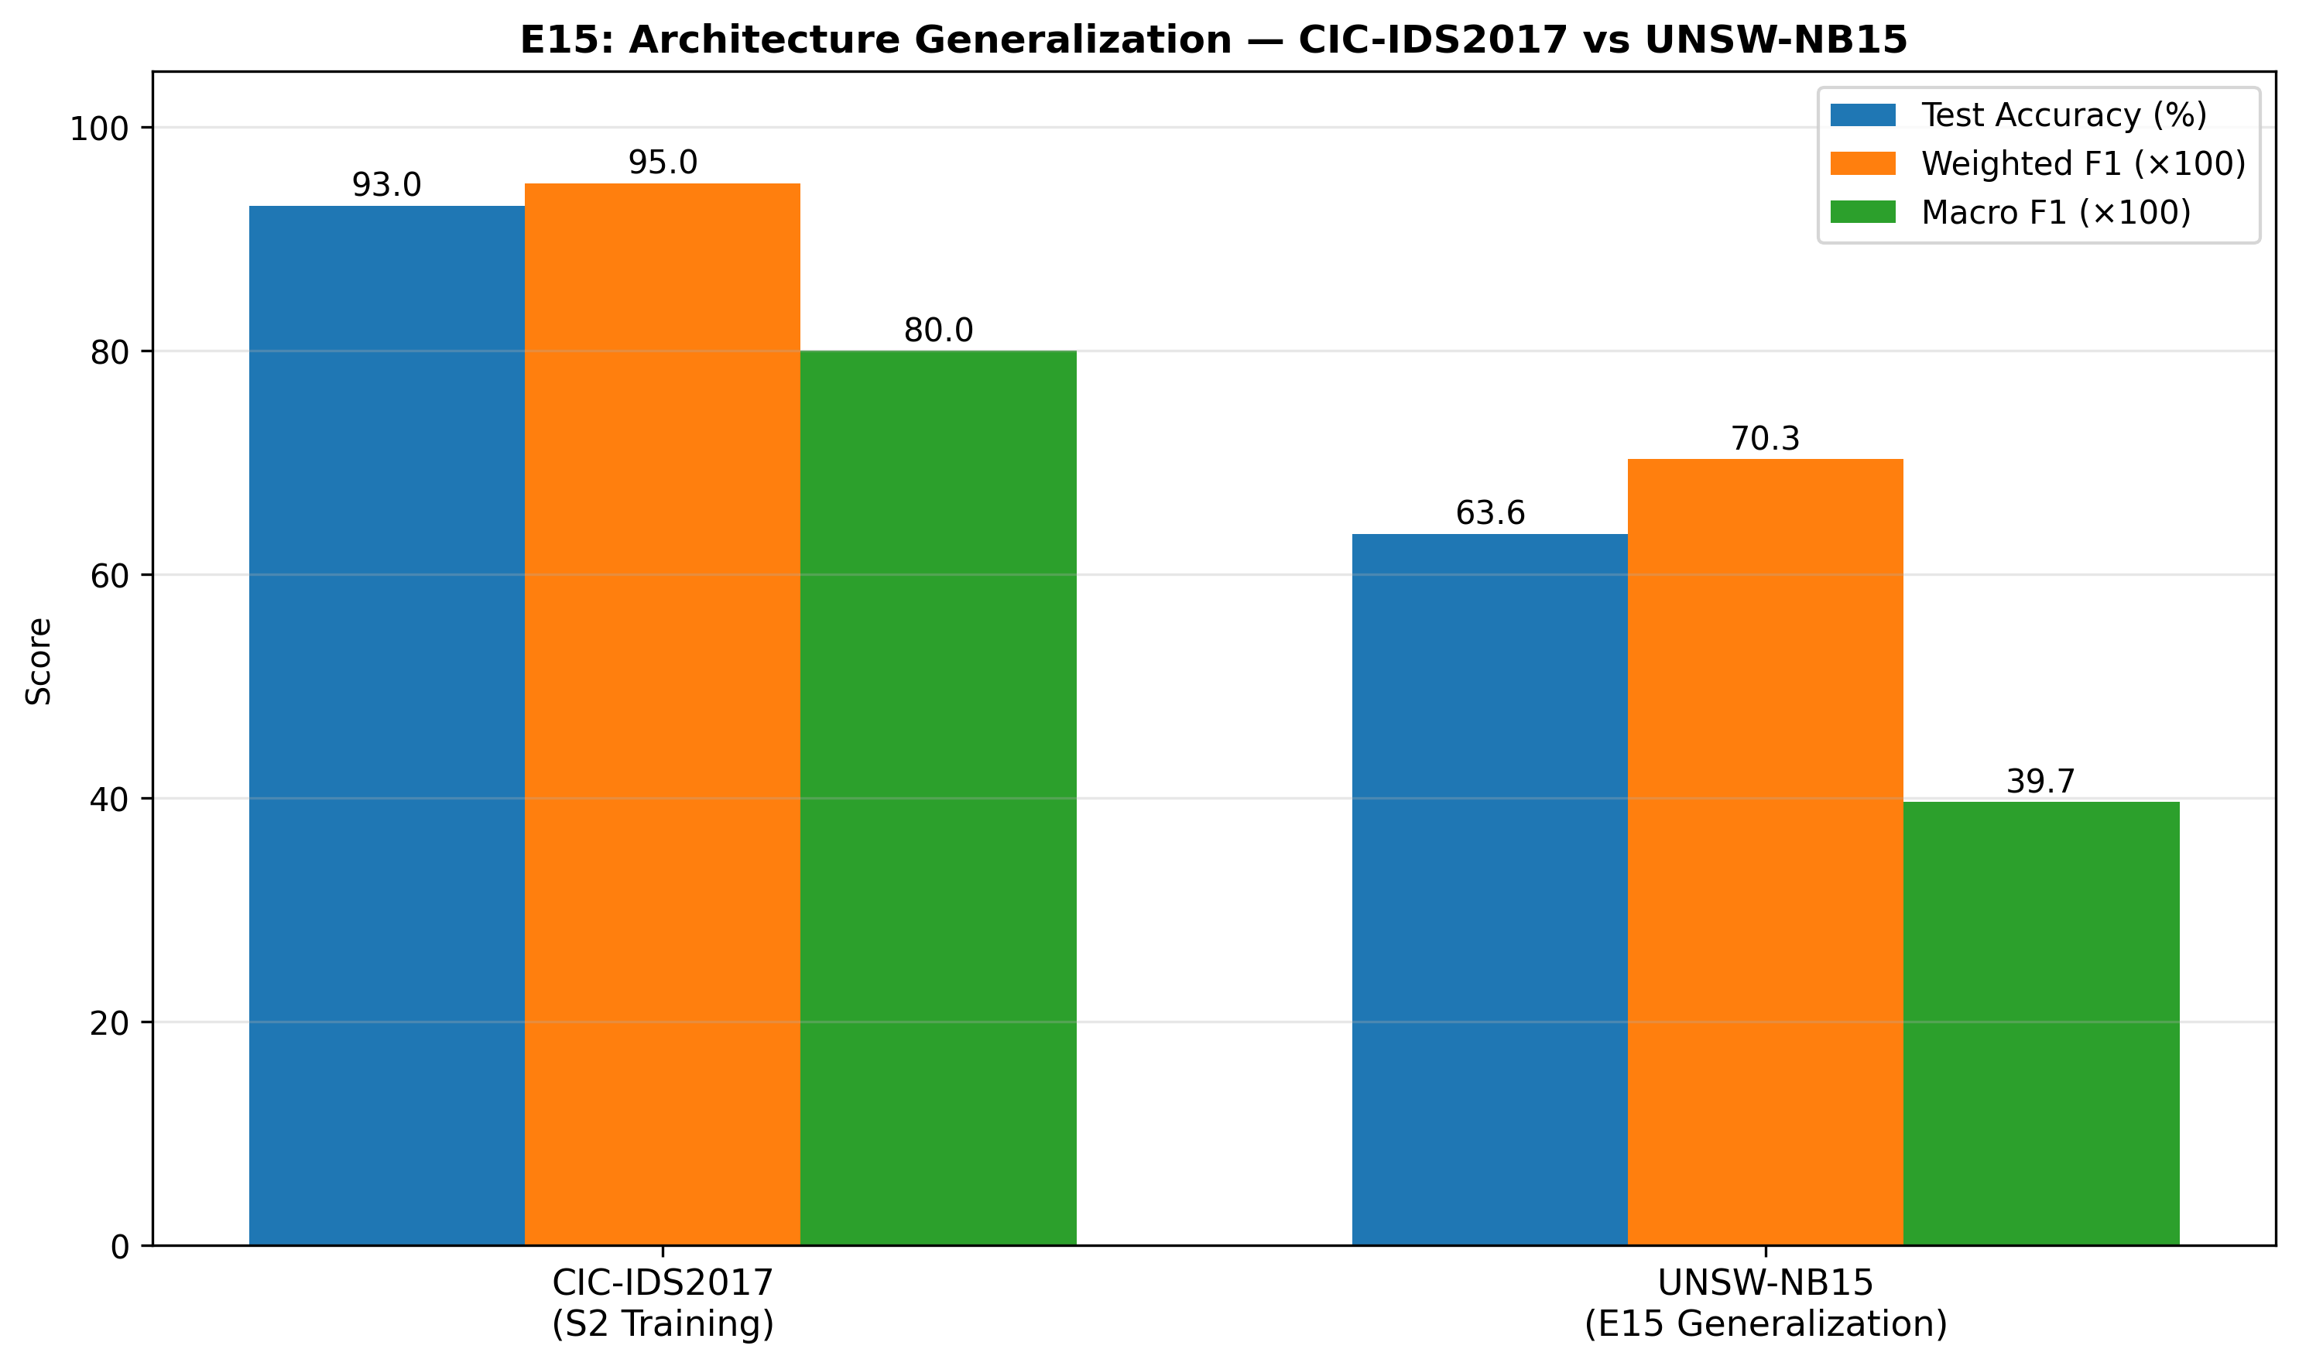
Cross-Dataset Generalization and Visualization (E15+E12)
Table 9
Figure 6：Cross-Dataset Performance Comparison (E15)
Cross-Dataset Generalization Performance: CIC-IDS2017 vs. UNSW-NB15 (E15)
Dataset
Acc
W-F1
M-F1
CIC-IDS2017
93.00%
0.950
0.80
UNSW-NB15
63.64%
0.703
0.397
Highlights: Generic F1=0.97, Reconnaissance F1=0.80 — architecture generalizes without modification.
Gap follows domain adaptation theory (Ben-David 2010): different feature spaces, labeling protocols.
E12: t-SNE / UMAP Visualization
+59%
-0.08
Silhouette Improvement
Embedding Silhouette
TransECA embeddings improve cluster separation by 59% vs raw features. Remaining negative Silhouette reflects inherent overlap among attack subclasses.
Note. Comparison of TransECA-Net performance when trained on CIC-IDS2017 vs. UNSW-NB15 (Moustafa & Slay, 2015). Same architecture, no modifications. Performance gap consistent with Ben-David et al. (2010) domain adaptation theory.
Ben-David, S., et al. (2010). A theory of learning from different domains. Machine Learning, 79(1-2), 151-175.

Slide 13
System-Level Summary: 6 Dimensions Validated
Table 10
Table 11
System-Level Performance Scorecard Across Six Evaluation Dimensions
Theoretical Prediction Verification Matrix (10 of 12 Confirmed)
Dimension
Metric
Value
Source
Prediction
Source
Result
Accuracy
Recall / FPR
92.9% / 0.007%
E17 x S2
Bagging reduces Variance
Breiman 01
Verified
Efficiency
Speedup
6.07x (82us)
E11+E17
DL High Variance
Kwon 17
Overturned
Interpretability
SHAP-IG rho
0.944
E2+E10
RF robust to noise
Assumption
Overturned
Generalization
UNSW W-F1
0.703 / +59%
E15+E12
PGD stronger than FGSM
Madry 18
Verified
Robustness
PGD Evasion
8.04%
E14
SHAP axioms
Lundberg 17
Verified
Statistics
S2 CI Width
0.003
E6
Learned features > raw
Kwon 17
Verified
Core Advantage: Not each layer being the strongest but orthogonal weaknesses + attack surface isolation across two layers.
Hierarchical cost reduction
Derivation
Verified
Cross-domain limited
Ben-David
Verified
CI Width prop n^(-1/2)
Efron 79
Verified
M-F1 CI by minority
Var 1/nk
Verified
Breiman, L. (2001). Machine Learning. | Madry, A., et al. (2018). ICLR. | Lundberg, S. M., & Lee, S. I. (2017). NeurIPS.

Slide 14
Conclusion and Future Directions
Key Contributions
Future Directions
CIC-IDS2017 Dataset
1. Few-Shot Learning for Rare Attacks
A reliable, labeled, publicly available IDS dataset with 7 attack families, 80 features — the modern foundation for IDS research.
Address extreme minority classes (Heartbleed n=11) with class-conditional augmentation.
Hierarchical RF to TransECA-Net
2. Adversarial Training
Two-stage architecture: 92.9% Recall, 0.007% FPR, 6.07x speedup. Validated through 13 experiments across 6 dimensions.
Harden TransECA-Net against gradient-based attacks within small perturbation ranges.
3. Domain Adaptation
Rigorous Validation
Reduce feature distribution distance across datasets for better cross-domain transfer.
Bootstrap CI, Nested CV, cross-dataset, adversarial attacks, SHAP-IG triangulation — 10/12 theoretical predictions verified.
4. Online / Incremental Learning
Adapt to temporal drift in network traffic for real-world deployment.
Key References
Sharafaldin, I., et al. (2018). ICISSP. | Ring, M., et al. (2019). Computers and Security, 86.
Breiman, L. (2001). Machine Learning, 45(1). | Madry, A., et al. (2018). ICLR.
Thank You — Questions?
Lundberg, S. M., & Lee, S. I. (2017). NeurIPS. | Sundararajan, M., et al. (2017). ICML.

Slide 15
References
Abu Al-Haija, Q., & Zein-Sabatto, S. (2022). An efficient deep-learning-based detection and classification system for cyber-attacks in IoT communication networks. Electronics, 11(3), 374.
Ben-David, S., Blitzer, J., Crammer, K., Kulesza, A., Pereira, F., & Vaughan, J. W. (2010). A theory of learning from different domains. Machine Learning, 79(1-2), 151-175.
Breiman, L. (2001). Random forests. Machine Learning, 45(1), 5-32.
Cawley, G. C., & Talbot, N. L. C. (2010). On over-fitting in model selection and subsequent selection bias in performance evaluation. Journal of Machine Learning Research, 11, 2079-2107.
Efron, B. (1979). Bootstrap methods: Another look at the jackknife. The Annals of Statistics, 7(1), 1-26.
Kwon, D., Kim, H., Kim, J., Suh, S. C., Kim, I., & Kim, K. J. (2017). A survey of deep learning-based network anomaly detection. Cluster Computing, 22(S1), 949-961.
Liu, Y. (2025). TransECA-Net: A lightweight transformer with efficient channel attention for network intrusion detection [Unpublished manuscript].
Lundberg, S. M., & Lee, S. I. (2017). A unified approach to interpreting model predictions. In Advances in Neural Information Processing Systems (NeurIPS), 30.
Madry, A., Makelov, A., Schmidt, L., Tsipras, D., & Vladu, A. (2018). Towards deep learning models resistant to adversarial attacks. In International Conference on Learning Representations (ICLR).
Ring, M., Wunderlich, S., Scheuring, D., Landes, D., & Hotho, A. (2019). A survey of network-based intrusion detection data sets. Computers & Security, 86, 100-126.
Sharafaldin, I., Lashkari, A. H., & Ghorbani, A. A. (2018). Toward generating a new intrusion detection dataset and intrusion traffic characterization. In Proceedings of the 4th International Conference on Information Systems Security and Privacy (ICISSP), 108-116.
Sundararajan, M., Taly, A., & Yan, Q. (2017). Axiomatic attribution for deep networks. In Proceedings of the 34th International Conference on Machine Learning (ICML), 3319-3328.
Moustafa, N., & Slay, J. (2015). UNSW-NB15: A comprehensive data set for network intrusion detection systems. In Military Communications and Information Systems Conference (MilCIS), 1-6.
APA 7th Edition Format

