Slide 1
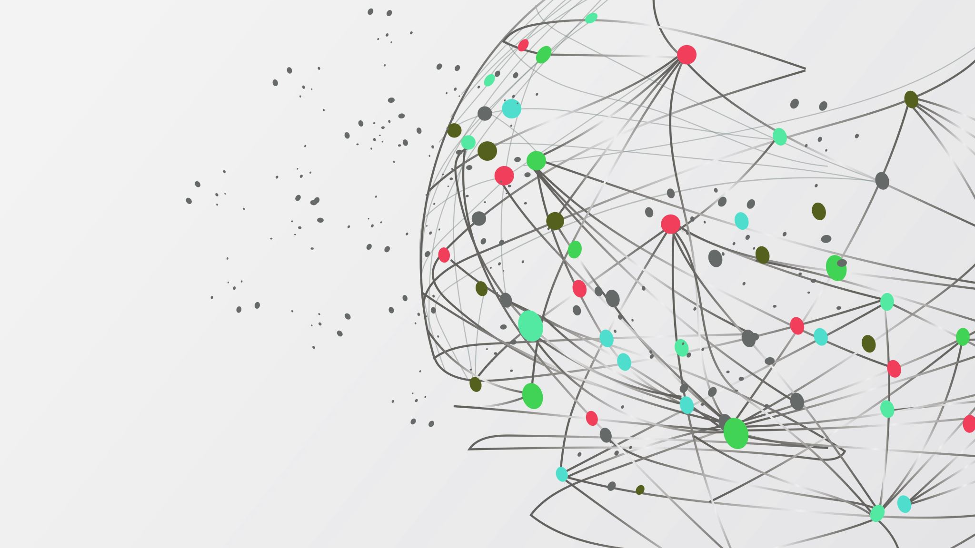
Hierarchical modelling
with EMC2
Niek Stevenson
MBNCSS 2026
Notes:
Timing: ~30 seconds.
Frame the lesson around one question: how do we learn about a population without pretending that participant estimates are noise-free?
Preview the route: pooling, measurement error, group inference, then EMC2's implementation.
[Sources]
- /Users/nstevenson/Documents/2026/BayesFlow_comp/mathpsych-editable-v7.pptx, slide 1 (visual template)

Slide 2

Psychological data are nested and noisy
• Repeated trials within people
• People differ in latent processes
• Trials are noisy samples
• Trial counts are often unequal
• Group-level claims are usually the goal
Notes:
Timing: ~1 minute.
Use a familiar repeated-measures example: many reaction times from each participant.
The hierarchy is not decoration; it mirrors how the data were generated and where the scientific question lives.
[Sources]
- /Users/nstevenson/Documents/2026/BayesFlow_comp/mathpsych-editable-v7.pptx, slide 2
- /Users/nstevenson/Documents/2026/MBNCSS26/Day2-Hierarchical/Model-Based Neuroscience & Cognition Summer School 2025.pptx, slides 3-11

Slide 3
Partial pooling
NO POOLING
COMPLETE
POOLING
PARTIAL
POOLING
separate fits
identical
distinct + related
P1
P1
P1
Separate fits
• no information sharing
Complete pooling
• no individual differences
Partial pooling
• distinct estimates
• movement follows precision
P2
P2
P2
P3
P3
P3
local estimates
unchanged
all estimates
become equal
low-precision data
move farther
Local value
model estimate
Notes:
Timing: ~1.25 minutes.
Ask the room which participant should move most under partial pooling.
Stress that partial pooling is adaptive, not a fixed compromise: stronger data move less.
Separate fitting becomes problematic when the resulting point estimates are treated as error-free observations in a second analysis.
[Sources]
- /Users/nstevenson/Documents/2026/BayesFlow_comp/mathpsych-editable-v7.pptx, slide 3
- /Users/nstevenson/Documents/2025/EMC2_tutorial/LatexFiles/main.tex, Two-Step Inference and Hierarchical Modeling sections

Slide 4
Trials, people, population: one model
Population parameters
μ, Σ
Participant 1
α₁
Participant 2
α₂
Participant n
αₙ
Trials inform participant parameters.
Participant parameters inform μ and Σ.
The population regularizes uncertain participants.
Inference flows both ways.
trials
y₁
trials
y₂
trials
yₙ
μ,Σ ∼ p(μ,Σ) αᵢ ∼ N(μ,Σ) yᵢ ∼ p(yᵢ | αᵢ)
Notes:
Timing: ~1.25 minutes.
Read the diagram top-down as a generative model, then bottom-up as posterior learning.
Participants are distinct, but connected through shared population parameters.
[Sources]
- /Users/nstevenson/Documents/2026/BayesFlow_comp/mathpsych-editable-v7.pptx, slide 4
- /Users/nstevenson/Documents/2025/EMC2_tutorial/LatexFiles/main.tex, Hierarchical Modeling section

Slide 5
Participant estimates are uncertain
ONE COEFFICIENT · NORMAL–NORMAL ILLUSTRATION
α̂ᵢ = αᵢ + εᵢ
Trial variability and limited or unequal trials determine τᵢ².
This uncertainty can reflect:
• response variability
• weakly informative trials
• different trial counts
estimate latent value finite-data noise
εᵢ ∼ N(0, τᵢ²)
A two-step analysis usually treats
α̂ᵢ as error-free.
Notes:
Timing: ~1 minute.
Define epsilon broadly as finite-data estimation error caused by trial variability and limited information; tau-squared is the variance of that participant's estimate.
Do not imply that every within-person fluctuation is merely bad data; it enters the likelihood and determines precision.
[Sources]
- /Users/nstevenson/Documents/2026/MBNCSS26/Day2-Hierarchical/Model-Based Neuroscience & Cognition Summer School 2025.pptx, slides 5-9
- /Users/nstevenson/Documents/2025/EMC2_tutorial/LatexFiles/main.tex, lines 473-489

Slide 6
Aggregates mix signal with estimation noise
ONE COEFFICIENT · NORMAL–NORMAL ILLUSTRATION
Varᵢ(α̂ᵢ) = σ² + Eᵢ[τᵢ²]
Across participants, observed variance contains:
• real between-person differences
• participant estimation error
Scarce trials enlarge the second term.
between-person signal
estimation error
If the second stage treats α̂ᵢ as noiseless,
Estimation error is mistaken as true heterogeneity
Notes:
Timing: ~1.25 minutes.
This decomposition assumes independent, mean-zero estimation error.
Sigma-squared denotes between-person variance; tau-squared-i denotes participant i's estimation variance, so the across-participant decomposition uses its average. With equal precision this reduces to sigma-squared plus tau-squared.
Tau-squared usually falls as the number and informativeness of trials increase, so the same population can appear more heterogeneous when participant estimates are weak.
Separate two-step fits cannot distinguish these two variance components without carrying estimate uncertainty forward.
[Sources]
- /Users/nstevenson/Documents/2026/MBNCSS26/Day2-Hierarchical/Model-Based Neuroscience & Cognition Summer School 2025.pptx, slides 12-16
- /Users/nstevenson/Documents/2025/EMC2_tutorial/LatexFiles/main.tex, equation var_est

Slide 7
Partial pooling follows precision
ONE COEFFICIENT · NORMAL–NORMAL ILLUSTRATION
σ²
λᵢ =
σ² + τᵢ²
A participant moves more when:
• their estimate is noisy
• they have fewer trials
A participant moves less when:
• their data are informative
POSTERIOR MEAN
α̃ᵢ = μ + λᵢ(α̂ᵢ − μ)
λ ≈ 0 strong shrinkage
λ ≈ 1 little shrinkage
Notes:
Timing: ~1.25 minutes.
Present lambda as reliability in a simple normal-normal approximation with known participant-level estimate variance—not as a universal closed-form formula for cognitive models.
The general principle survives: posterior shrinkage reflects likelihood information relative to population variability.
[Sources]
- /Users/nstevenson/Documents/2026/MBNCSS26/Day2-Hierarchical/Model-Based Neuroscience & Cognition Summer School 2025.pptx, slides 19 and 23

Slide 8
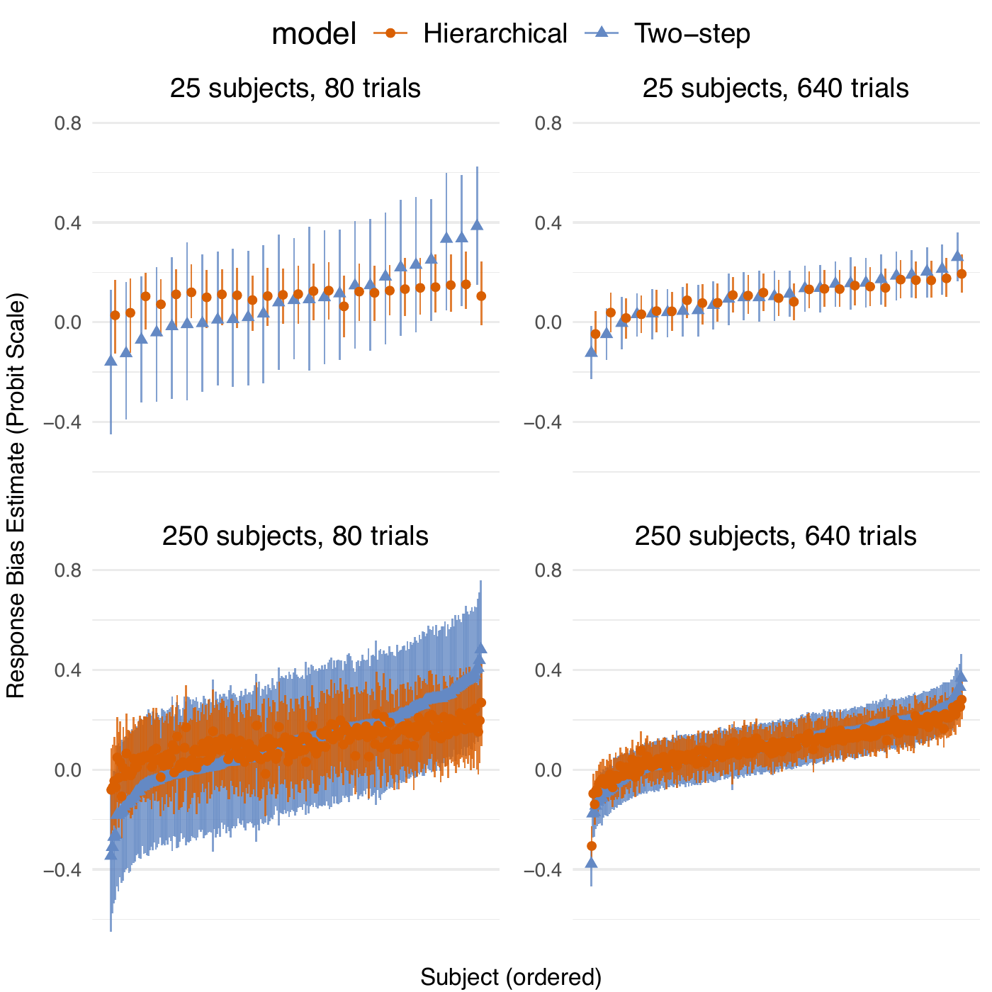
Sparse data shrink more
Orange: hierarchical estimates
Blue: separate two-step fits
Few trials:
extremes move toward the population
Many trials:
the methods nearly agree
Notes:
Timing: ~1.5 minutes.
Read across the columns first: 80 trials versus 640 trials.
Then compare rows: more participants estimate the population more precisely, which can strengthen pooling of weak local estimates.
Do not describe shrinkage as bias removal at the individual level; it is regularization under the population model.
[Sources]
- /Users/nstevenson/Documents/2025/EMC2_tutorial/LatexFiles/figs/shrinkage.pdf
- /Users/nstevenson/Documents/2025/EMC2_tutorial/LatexFiles/main.tex, Framework Benefits: Regularization

Slide 9
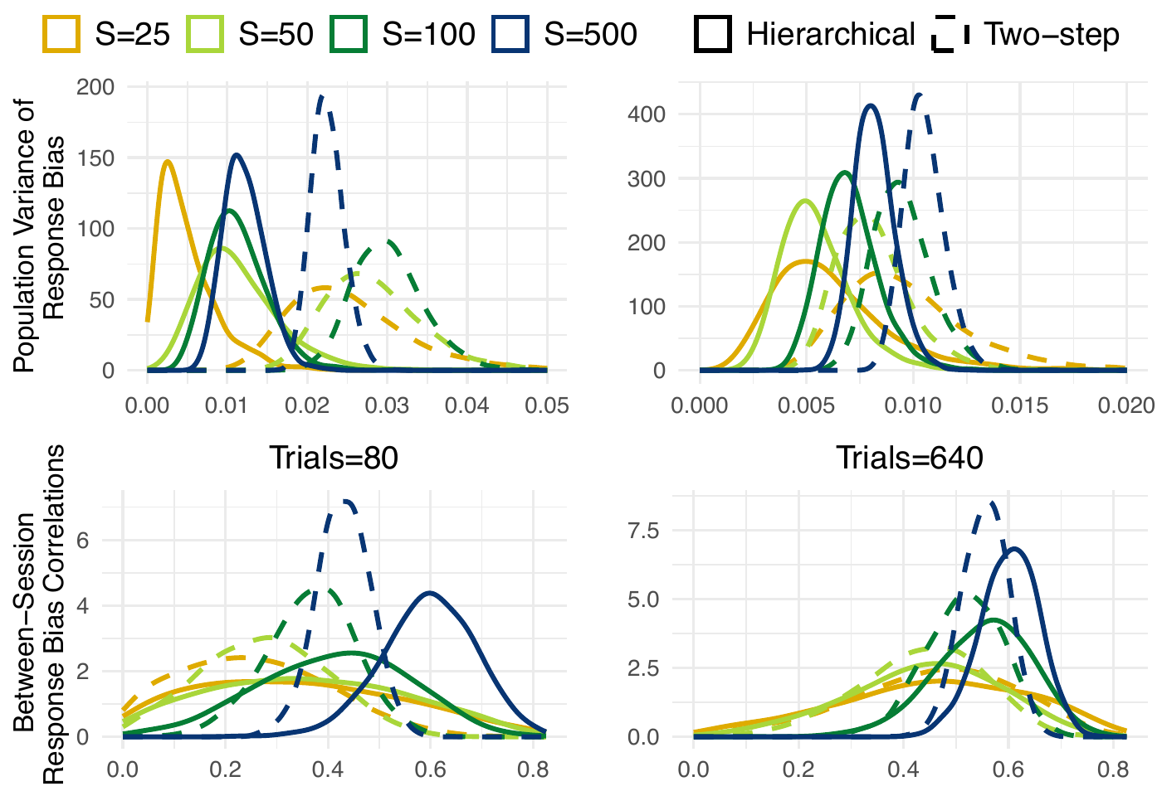
Noise distorts group inference
Two-step inference can:
• inflate population variance
• attenuate correlations
• ignore participant uncertainty
Notes:
Timing: ~1.75 minutes.
This crop uses the first two rows of the original figure: response-bias population variance and between-session response-bias correlation. Columns are 80 and 640 trials.
Dashed lines are two-step; solid lines are hierarchical. Two-step variance is inflated and correlations are attenuated when local estimates are noisy.
Regression bias is not automatic: it requires estimation error related to the predictor. Classical outcome noise alone would mainly increase uncertainty.
This figure uses a broader subject-count grid, including S=500, than the shrinkage figure on the previous slide; treat them as separate simulations.
[Sources]
- /Users/nstevenson/Documents/2025/EMC2_tutorial/LatexFiles/figs/posteriors.pdf
- /Users/nstevenson/Documents/2025/EMC2_tutorial/LatexFiles/main.tex, Framework Benefits: Inference

Slide 10
Group inference in EMC2
Group targets
μ, Σ, β
Participant 1
α₁
Participant 2
α₂
Participant n
αₙ
μ: mean at reference/centred predictors
Σ: residual heterogeneity + correlations
β: predictor effects
All uncertainty propagates upward.
data
y₁
data
y₂
data
yₙ
μᵢ = Wᵢβ αᵢ ∼ N(μᵢ,Σ) yᵢ ∼ p(yᵢ | αᵢ)
Notes:
Timing: ~1.5 minutes.
Separate the three inferential targets: location, heterogeneity/covariance, and regression effects.
A posterior contrast or Bayes factor is computed from these population quantities, not by exporting point estimates into another analysis.
[Sources]
- /Users/nstevenson/Documents/2025/EMC2_tutorial/LatexFiles/main.tex, Population-level GLM section
- /Users/nstevenson/Documents/2026/BayesFlow_comp/mathpsych-editable-v7.pptx, slide 4

Slide 11
Every free coefficient varies by participant
Intercept-only population
μ, Σ
Participant 1
α₁
Participant 2
α₂
Participant n
αₙ
• each participant has αᵢₖ
• Xᵢαᵢ yields trial parameters
• μ and Σ link participants
choices + RTs
y₁
choices + RTs
y₂
choices + RTs
yₙ
θᵢ = Xᵢαᵢ αᵢ ∼ N(μ,Σ)
Notes:
Timing: ~1.5 minutes.
Be precise: every local coefficient included in the cognitive-model design is participant-specific. Shared beta, mu, and Sigma are not participant-specific, and trial-level theta values are deterministic functions of X alpha.
The covariance matrix can express correlations among participant coefficients.
[Sources]
- /Users/nstevenson/Documents/2025/EMC2_tutorial/LatexFiles/main.tex, Data-level EAM and Population-level GLM sections
- /Users/nstevenson/Documents/2026/BayesFlow_comp/mathpsych-editable-v7.pptx, slide 4

Slide 12
Selective in brms; automatic in EMC2
EMC2: participant variation is implicit
design(list(v ~ x), ...)
brms / lme4: choose what varies
No (1 | subject) is written.
EMC2 assumes
y ~ x
x + (1 + x | subject).
population terms only
y ~ x + (1 | subject)
only the participant intercept varies
y ~ x + (1 + x | subject)
participant intercept and x slope vary
The term inside ( | subject) states which coefficients vary.
Notes:
Timing: ~1.5 minutes.
This is a hierarchy crosswalk, not a brms lesson; the response likelihoods are different.
In brms/lme4, terms outside the bar are population terms and the subject-level bar explicitly selects which coefficients vary.
In EMC2, a subjects column is required but (1 | subject) is omitted: every free coefficient returned by design() gets a participant index.
Thus EMC2 v ~ x corresponds at the hierarchy level to a population intercept and x effect plus a participant-varying intercept and x slope.
Call this a constrained subset only at the participant hierarchy or linear-predictor level; EMC2 also uses specialized evidence-accumulation likelihoods.
[Sources]
- /Users/nstevenson/Documents/2025/EMC2_tutorial/Rfiles/Manning2022/analysis.Rmd, subject-level design section
- https://paulbuerkner.com/brms/reference/brmsformula.html

Slide 13
EMC2 has two formula levels
2 GROUP DESIGN
group_design(list(
v ~ age,
v_conditionB ~ group
), ...)
1 SUBJECT DESIGN
design(list(v ~ condition, a ~ 1), ...)
Explains the population means of existing coefficients.
μᵢ = Wᵢβ, αᵢ ∼ N(μᵢ, Σ)
Defines the free coefficients every participant has.
It does not add the participant hierarchy.
αᵢ = (v₀ᵢ, v₁ᵢ, a₀ᵢ, …)
Coefficients omitted from group_design() retain
an intercept-only mean and variance.
Notes:
Timing: ~1.5 minutes.
design() defines the local cognitive-model coefficients. Every free coefficient it returns has an alpha value for every participant; only known constants are excluded.
The displayed v_conditionB assumes treatment coding with level B. In actual code, every group_design() left-hand side must exactly match a name returned by sampled_pars(subject_design).
group_design() regresses the means of those existing alpha coefficients on person-level predictors. It does not create the participant effect.
If a coefficient is omitted from group_design(), EMC2 retains its hierarchical intercept and variance; it merely has no population predictor effect.
EMC2 can also include higher-level terms such as (1 | university) inside group_design(); the constraint described here is specifically the primary participant layer.
Sigma is the residual between-participant covariance matrix after the population regression.
[Sources]
- /Users/nstevenson/Documents/2025/EMC2_tutorial/Rfiles/Manning2022/analysis.Rmd, subject-level design and group design sections
- /Users/nstevenson/Documents/2025/EMC2_tutorial/Rfiles/analysis.R, group_design examples

Slide 14
EMC2 exploits participant blocks
Shared population
μ, Σ
Block 1
α₁
Block 2
α₂
Block n
αₙ
Conditional on μ and Σ:
• participant blocks are independent
• αᵢ updates blockwise or in parallel
• population updates reconnect them
data
y₁
data
y₂
data
yₙ
TRADE-OFF
Fewer arbitrary crossed or multi-membership
structures than brms.
p({αᵢ}ᵢ₌₁ⁿ | y,μ,Σ) ∝ ∏ᵢ₌₁ⁿ p(yᵢ | αᵢ) p(αᵢ | μ,Σ)
Notes:
Timing: ~1.25 minutes.
Participants are conditionally—not marginally—independent. They still borrow information because mu and Sigma are learned from everybody.
Conditional independence is not unique to EMC2. EMC2's advantage is that its participant-complete architecture preserves this partition and its specialized computation exploits it.
More general shared, crossed, or multi-membership structures are easier to express in brms/Stan but can prevent a pure participant-wise partition.
[Sources]
- /Users/nstevenson/Documents/2025/EMC2_tutorial/LatexFiles/main.tex, Factorized Hierarchical Model appendix
- https://paulbuerkner.com/brms/reference/brmsformula.html

Slide 15
Three rules to carry forward
1 Let precision determine how much participants pool.
2 Make group claims from μ, Σ, or β—not by treating participant point estimates as error-free.
Notes:
Timing: ~45 seconds.
Close by returning to the original question: learn about the population without pretending participant estimates are observed without error.
The core EMC2 idea is a full participant coefficient vector tied together by a population distribution or regression, implemented through scalable blocks.
[Sources]
- /Users/nstevenson/Documents/2025/EMC2_tutorial/LatexFiles/main.tex
- /Users/nstevenson/Documents/2026/MBNCSS26/Day2-Hierarchical/Model-Based Neuroscience & Cognition Summer School 2025.pptx

