Slide 1

Model-Based Neuroscience & Cognition Summer School 2026 Evidence-accumulation models (EAMs)

Slide 2
Formal Generative Models: Definitions
Generative Model: A mathematical structure (typically instantiated as a computer program) that generates simulated data.
Model Parameters: Variables whose values determine the data generated by the model. They can be either fixed a priori (constants) or determined based on empirical data (estimated parameters).
Model Estimation: Choosing a set of parameter values that provide a best match between some observed data and the data generated by the model.
Fit Metric / Objective Function: a measure of the quality of the data-model match, goodness-of-fit or deviance (badness-of-fit, e.g., sum-square-error).
Model Selection: a method of selecting from a set of estimated models the one that is “best” in the sense of matching both that data from which it was estimated and potential future data it aims to explain.
Parameter-based inference: Inferences about (latent) psychological processes made based on parameters that describe them rather than indirectly based on observed (manifest) behaviour.

Slide 3
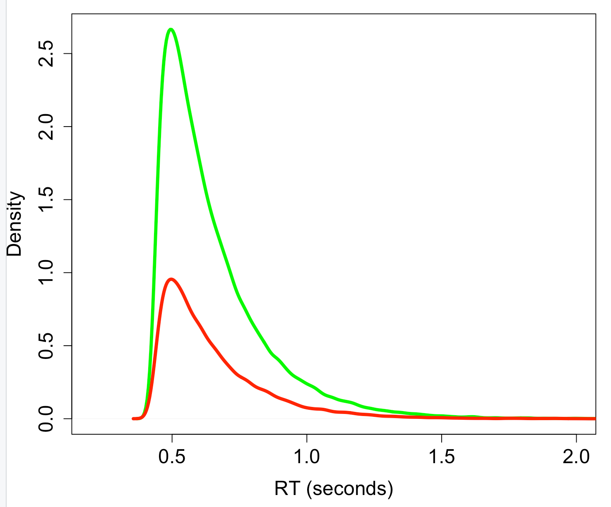
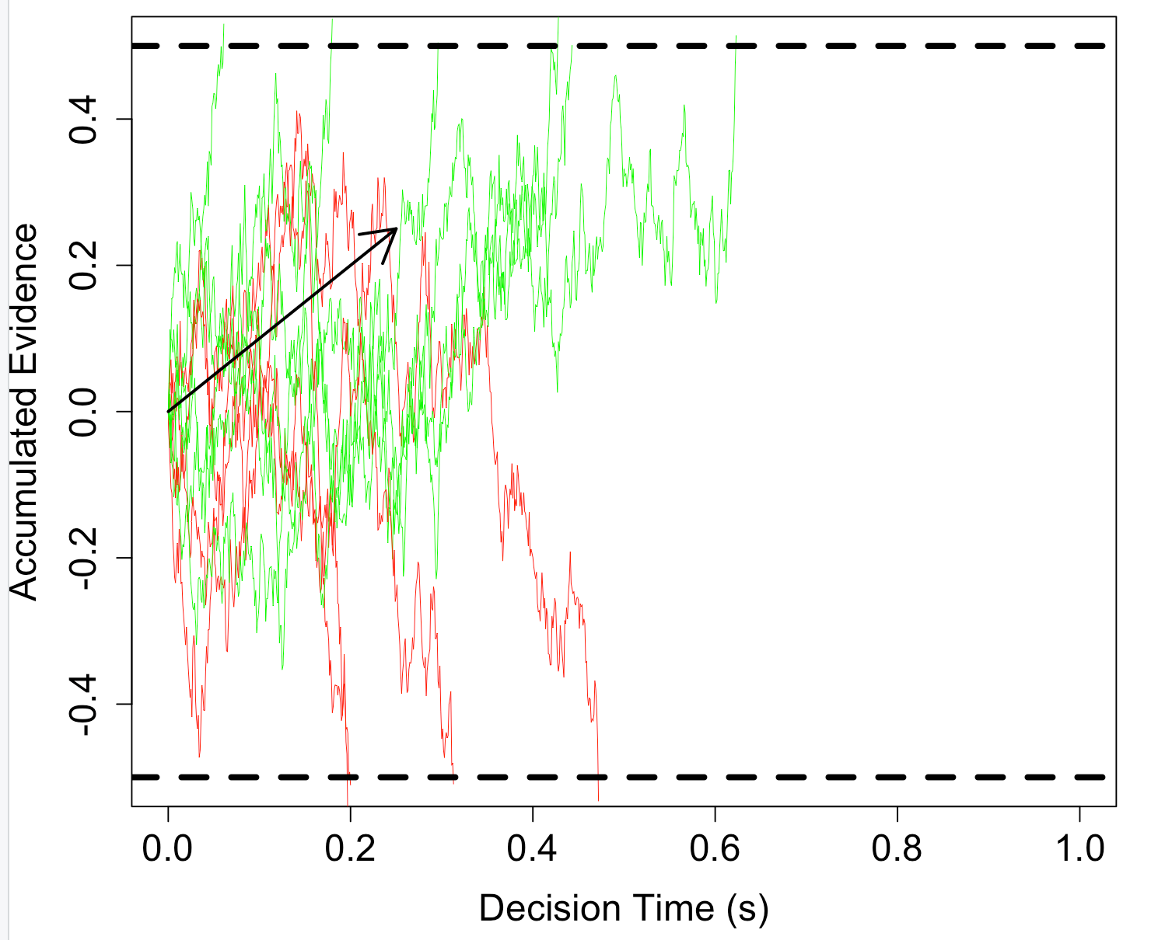
Uncertainty & Noise in Dynamic Models of Choice
Aleatoric data: Response time (RT) distribution, the time to make a choice varies randomly over repeated measurement occasions even with identical stimuli (defective for choice).
This is explained by a process that seeks to reduce epistemic uncertainty about which stimulus is present by summing samples from the stimulus (Wiener Decision Model, WDM).
We will also use Bayesian methods to estimate these Evidence Accumulation Models (EAMs) from data and quantify our uncertainty about their parameters.
First, we will do some exercises in the 1-EAMs.R script simulating the WDM/DDM/RDM/LBA/LNR

Slide 4
The “Full" DDM
Three between-trial parameter variabilities.
Expensive to compute
Hard to estimate
Necessary to capture key benchmark patterns (except perhaps st0).
Voss, A., & Voss, J. (2007). Fast-dm: A free program for efficient diffusion model analysis. Behavior Research Methods, 39(4), 767–775.
Boehm, U., Annis, J., Frank, M.J., Hawkins, G.E., Heathcote, A., Kellen, D., …, Matzke, D., & Wagenmakers, E.-J. (2018). Estimating between-trial variability parameters of the diffusion decision model: Expert advice and recommendations. Journal of Mathematical Psychology, 87, 46-75.
Ratcliff, R., & Rouder, J. N. (1998). Modeling response times for two-choice decisions. Psychological Science, 9(5), 347–356.

Slide 5
The Linear Ballistic Accumulator (LBA)
Only between-trial noise
Rates ~ normal (mean_v, sd_v)
Start point ~ uniform (0-A)
One accumulator per response.
Threshold b (gap B = b-A)
Non-decision time ter (or t0)
A, B, sd_v, ter positive (log scale)
Must fix an accumulator parameter for scale (typically sd_v)
Brown, S. D., & Heathcote, A. (2008). The simplest complete model of choice response time: Linear ballistic accumulation. Cognitive Psychology, 57(3), 153–178.
Donkin, C., Brown, S. D., & Heathcote, A. (2009). The overconstraint of response time models: Rethinking the scaling problem. Psychonomic Bulletin & Review, 16(6), 1129–1135.

Slide 6
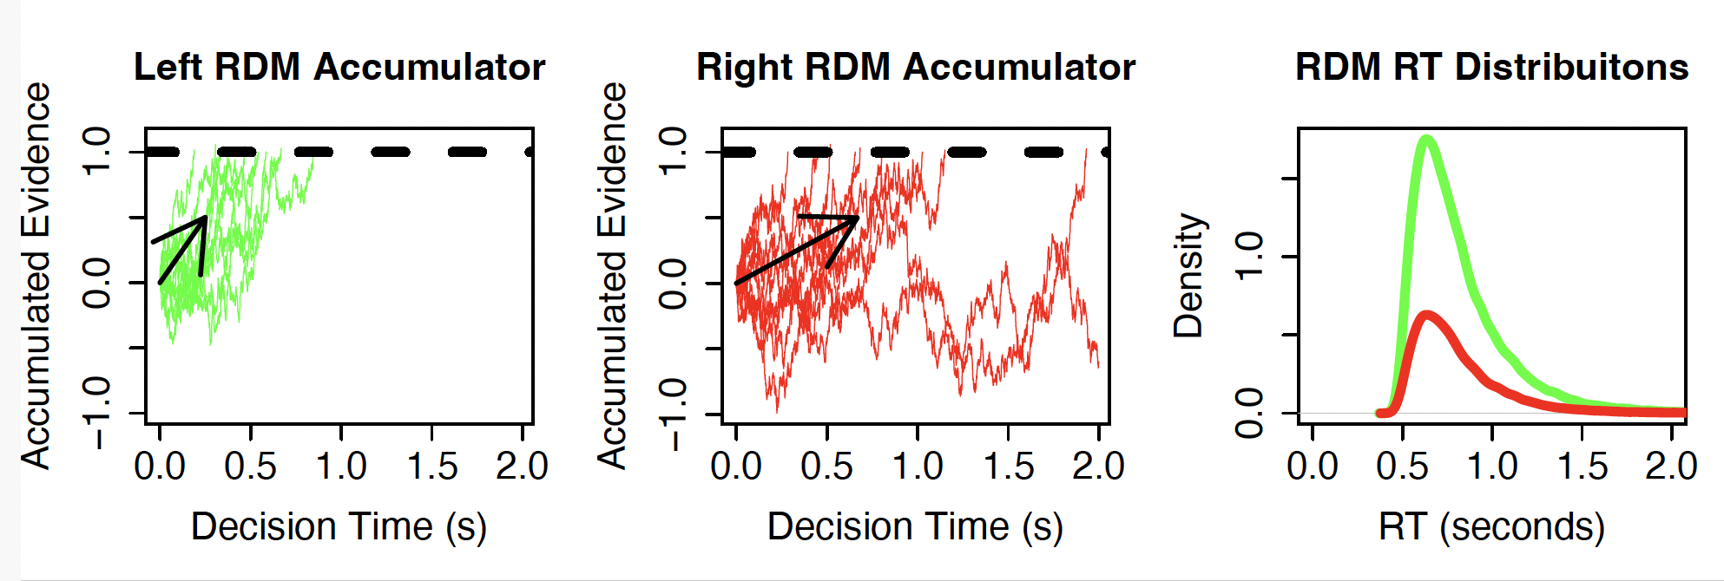
Racing Diffusion Model (RDM)
Same parameter names as the LBA except sv -> s
A=0 (typically, whereas always A> 0 in the LBA)
Tillman, G., Zandt, T. V., & Logan, G. D. (2020). Sequential sampling models without random between-trial variability: the racing diffusion model of speeded decision making. Psychonomic Bulletin & Review, 27(5), 911–936.

Slide 7
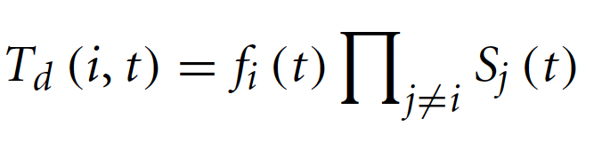
Lognormal Race (LNR)
Suppose a linear accumulator starts a distance d from a threshold and increases in activation linearly with rate v. Hence, the time to reach the threshold is t=d/v.
Suppose both the distance and rate have Lognormal distributions from trial to trial, Where N(μ, σ ²) is a normal random variable with mean μ and variance σ² :
We assume from here that d and v are independent, in which case:
That is, the time for the accumulator to achieve threshold also has an exact Lognormal (LN) distribution.
The LNR likelihood (also LBA and RDM) follows from the independent race equation:

Slide 8
Model-Based Neuroscience & Cognition Summer School 2026 Fitting the DDM

Slide 9
The Flanker Task
You collect data on yourself performing a “Flanker” task, then analyse it with the FlankerAnalysis.R script.
You see an array of arrows and indicate whether the middle arrow points left or right. Correct responses earn points; in some blocks fast responses earn a bonus.
>>>>>
Congruent – flankers match the target
800
trials in total
2 × 2 × 2 design · 100 trials per cell
>><>>
Incongruent – flankers oppose the target
Stimulus
Is the target (middle) arrow pointing to the left or to the right?
Three Factors
Congruent / Incongruent
Do the surrounding arrows point the same way as the target (congruent) or the opposite way (incongruent)?
Emphasis
Instruction to focus on accuracy (more points for correct answers) or on speed (a bonus for responding fast).

Slide 10
Familiarize yourself with the task
Open RStudio, source the task, and run a short practice:
source("FlankerTask.R")
practice <- doExperiment("your name", nblocks=4, ntrials=4) # 4 blocks of 4 trials
NB1 Click in the console window before you respond.
NB2 Make the plot window large enough to see displays clearly.
NB3 Never press a key twice — it becomes the next trial's response.
NB4 You respond with the z and m keys by default (adjustable in FlankerTask.R).
Each row of the practice data frame is one trial: condition (E, S, CI), response (R), RT in seconds, and score.

Slide 11
Collect Your Data
Run the full experiment (about one hour):
data <- doExperiment("your name") # 10 blocks of 80 trials
Or split it into shorter sessions, then merge:
data1 <- doExperiment("your name", ntrials=40) # 10 blocks of 40 trials
data2 <- doExperiment("your name", ntrials=40) # another 10 blocks of 40
# — or split by blocks instead —
data1 <- doExperiment("your name", nblocks=5) # 5 blocks of 80 trials
data2 <- doExperiment("your name", nblocks=5) # another 5 blocks of 80
data <- rbind(data1, data2) # merge the sessions
Save your data to disk:
save(data, file = "MyFlankerData.RData")
⚠ One key per trial. A double press is read as the next trial's response — a spuriously fast RT.

Slide 12
Other Conflict Tasks
Simon (easy / practice)
The same experiment code defines other conflict tasks via its arguments.
# Simon (easy / practice)
doExperiment("ajh", 4, 4,
instruction = "Choose left for red and
right for green.",
stim = c("XXX","XXX","XXX","XXX"),
stimcol = c("red","green","red","green"),
responses = c("red","green"),
correct = c("red","green","red","green"),
offset = c(-.3,.3,.3,-.3),
jitter = FALSE, fastrt = 0.6)
Stroop
# Stroop
doExperiment("ajh", 4, 4,
instruction = "Choose the colour in which
the word is printed.",
stim = c("RED","GREEN","RED","GREEN"),
stimcol = c("red","green","green","red"),
responses = c("red","green"),
correct = c("red","green","green","red"),
jitter = FALSE, fastrt = 0.6)
Simon — Remembered Mapping (harder)
# Simon where the labels must be remembered
# (hard / experiment version)
doExperiment("ajh", 4, 4,
instruction = "Choose left for red and right for green.",
stim = c("XXX","XXX","XXX","XXX"),
stimcol = c("red","green","red","green"),
responses = c("left","right"),
correct = c("left","right","left","right"),
offset = c(-.3,.3,.3,-.3),
jitter = FALSE, fastrt = 0.6)
Same display as the easy Simon, but responses and correct use left / right instead of the colour names — so the colour→side mapping must be held in memory.

Slide 13
Linear Designs
We will make extensive use of R’s linear model language for specifying designs, e.g., two main effects and an interaction:
y ~ A + B + A:B
which is the same as y ~ A*B
Wilkinson, G. N., & Rogers, C. E. (1973). Symbolic description of factorial models for analysis of variance. Journal of the Royal Statistical Society: Series C (Applied Statistics), 22, 392–399.
Marginality: a higher order term can only be included if its constituents are also included.
e.g., y ~ A + B is OK but y ~ A + A:B is not
My take on marginality
Heathcote, A. & Matzke, D. (2023). The limits of marginality. Computational Brain & Behavior, 6, 28–34. https://link.springer.com/content/pdf/10.1007/s42113-021-00120-3.pdf
The wider debate
https://link.springer.com/article/10.1007/s42113-021-00113-2
https://link.springer.com/article/10.1007/s42113-022-00160-3

Slide 14
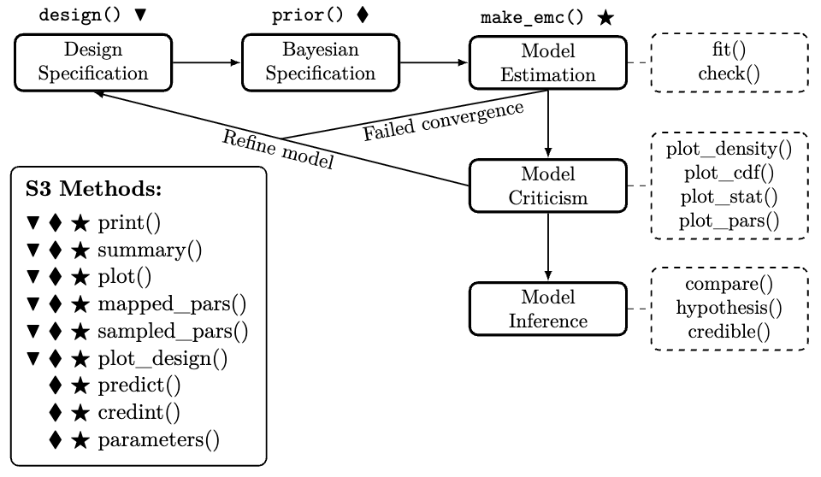
EMC2 Workflow
https://osf.io/preprints/psyarxiv/2e4dq_v4

Slide 15
The “Full" DDM
Three between-trial parameter variabilities.
Expensive to compute
Hard to estimate
Necessary to capture key benchmark patterns (except perhaps st0).
Voss, A., & Voss, J. (2007). Fast-dm: A free program for efficient diffusion model analysis. Behavior Research Methods, 39(4), 767–775.
Boehm, U., Annis, J., Frank, M.J., Hawkins, G.E., Heathcote, A., Kellen, D., …, Matzke, D., & Wagenmakers, E.-J. (2018). Estimating between-trial variability parameters of the diffusion decision model: Expert advice and recommendations. Journal of Mathematical Psychology, 87, 46-75.
Ratcliff, R., & Rouder, J. N. (1998). Modeling response times for two-choice decisions. Psychological Science, 9(5), 347–356.

Slide 16
Model-Based Neuroscience & Cognition Summer School 2026 Model Comparison

Slide 17
Likelihood: The key to Bayesian cognitive modeling
Likelihood = probability of the parameters given the data.
We will focus on cases in which the likelihood can be computed directly.
When this is not the case you can use simulation-based methods if your model is generative.
An early approach used functions like R’s “density” to get an approximate likelihood, as in these papers.
Turner, B. M., Sederberg, P. B., & McClelland, J. L. (2016). Bayesian analysis of simulation-based models. Journal of Mathematical Psychology, 72, 191–199.
Holmes, W. R. (2015). A practical guide to the Probability Density Approximation (PDA) with improved implementation and error characterization. Journal of Mathematical Psychology, 68, 13–24.
However, this has been superseded by methods based on neural networks (e.g., ”BayesFlow”, see https://arxiv.org/abs/2003.06281) taught on the final day. Some of this has been integrated into EMC2 and will be released over the next year.

Slide 18
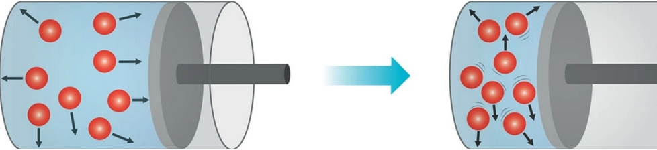
“All models are wrong, but some are useful”¹
Models of complex systems are necessarily approximations that ignore some aspects a system, e.g., the Gas Law
Pressure x Volume = n x R x Temperature (n: # molecules, R: gas constant)
Such approximate models can be useful in two key senses.
Foregrounding the main constants and variables that determine how a complex system acts, promoting understanding and explanation.
Accurately predicting new data (i.e., “out-of-sample” data).
¹Box, G. E. P. (1979), "Robustness in the strategy of scientific model building", in Launer, R. L.; Wilkinson, G. N. (eds.), Robustness in Statistics, Academic Press, pp. 201–236, doi:10.1016/B978-0-12-438150-6.50018-2, ISBN 9781483263366.

Slide 19
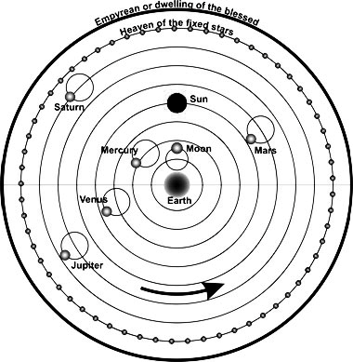
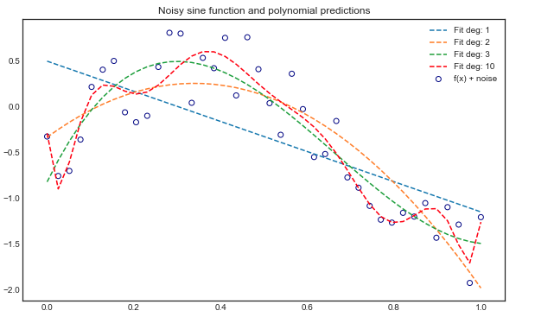
Model Complexity
¹Probably not his actual words: https://www.irishphilosophy.com/ 2014/
05/27/who-sharpened-occams-razor/
Useful models tend to be parsimonious
Occam’s Razor: “entities should not be multiplied beyond necessity”¹ e.g., Ptolemaic epicycles.
Overfitting: adjusting many parameters to get a very accurate fit causes poor prediction
Model Selection Metrics
Out-of-sample prediction
deviance + complexity penalty
Observed data = structure + noise

Slide 20
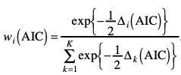
Likelihood and Model Selection
Rather than the likelihood we often work with its logarithm (more numerically stable) and:
Deviance = - 2 x Log Likelihood
Measure of misfit, smaller = better fit
Point-estimate complexity penalties:
AIC (Akaike Information Criterion)
Minimum Deviance + 2 x # parameters
BIC (Bayesian Information Criterion)
Minimum Deviance + # parameters x log(# data points)
ICs can be turned into weights (0-1 scale)

Slide 21
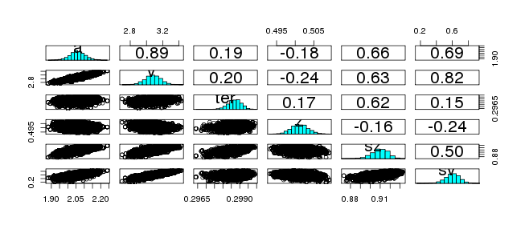
Correlated (sloppy) posteriors.
Model selection for cognitive models
Complexity is not just parameter counting: Need to take account of “functional form complexity”

Slide 22
Bayesian Information Criteria
Bayesian ICs are based on posterior deviance
Deviance of mean of posterior parameters (Dmean): = best fit (sometimes min(D) better)
Mean of posterior deviances (meanD): slightly penalized fit
Effective number of parameters pD = meanD – dMean
Deviance Information Criterion: DIC = meanD + pD
Bayesian Predictive Information Criterion: BPIC = meanD + 2*pD
ICs for a set of models can be turned into model weights/probabilities:
DIC wDIC BPIC wBPIC EffectiveN meanD Dmean minD
WDM -1439 0.000 -1428 0.000 11 -1450 -1458 -1460
SZ -1506 0.000 -1491 0.000 15 -1521 -1530 -1536
st0 -1638 0.297 -1619 0.282 19 -1657 -1666 -1676
sv -1502 0.000 -1490 0.000 12 -1514 -1521 -1525
SZsv -1504 0.000 -1489 0.000 15 -1519 -1530 -1534
SZst0 -1638 0.348 -1619 0.344 19 -1657 -1667 -1676
st0sv -1638 0.311 -1619 0.360 19 -1657 -1666 -1675
DDM -1634 0.045 -1613 0.014 21 -1655 -1667 -1677

Slide 23
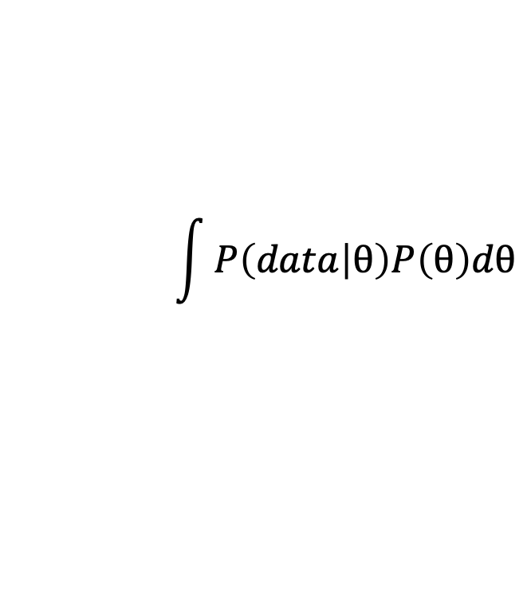
Bayes Factors
$$\int{P\left(data | θ\right)P\left(θ\right)dθ}$$
Bayesian Factors are based on the marginal likelihood
As the marginal likelihood is the probability of the data given the
model integrated over the prior , unlike the ICs it is intrinsically sensitive to the prior
EMC2 reports the marginal deviance (MD=-2 x marginal likelihood)
Bayes factors are the ratios of marginal deviances (or likelihoods)
Just as with the ICs they can be turned into weights/posterior model probabilities.
MD wMD DIC wDIC BPIC wBPIC EffectiveN meanD Dmean minD
WDM -1382 0.000 -1439 0.000 -1428 0.000 11 -1450 -1458 -1460
SZ -1447 0.000 -1506 0.000 -1491 0.000 15 -1521 -1530 -1536
st0 -1573 0.540 -1638 0.297 -1619 0.282 19 -1657 -1666 -1676
sv -1444 0.000 -1502 0.000 -1490 0.000 12 -1514 -1521 -1525
SZsv -1445 0.000 -1504 0.000 -1489 0.000 15 -1519 -1530 -1534
SZst0 -1570 0.117 -1638 0.348 -1619 0.344 19 -1657 -1667 -1676
st0sv -1572 0.284 -1638 0.311 -1619 0.360 19 -1657 -1666 -1675
DDM -1568 0.059 -1634 0.045 -1613 0.014 21 -1655 -1667 -1677
It has only recently become practical to calculate marginal likelihoods for cogntive models, with bridge sampling being the prefered technique.
Boehm, U., Evans, N. J, Gronau, Q. F., Matzke, M., Wagenmakers, E-J., & Heathcote, A. (2023). Inclusion Bayes factors for mixed
hierarchical diffusion decision models. Psychological Methods. https://doi.org/10.1037/met0000582

