Slide 1
Bayesian hierarchical SEM for model-based psychological research
Niek Stevenson

Slide 2
Individual differences
Cronbach’s divide (1957, 1975)

Slide 3
Individual differences
Cronbach’s divide (1957, 1975)
Cognitive models target experimental manipulations

Slide 4
Individual differences
Cronbach’s divide (1957, 1975)
Cognitive models target experimental manipulations
Individual differences are increasingly of interest
Performance across multiple tasks

Slide 5
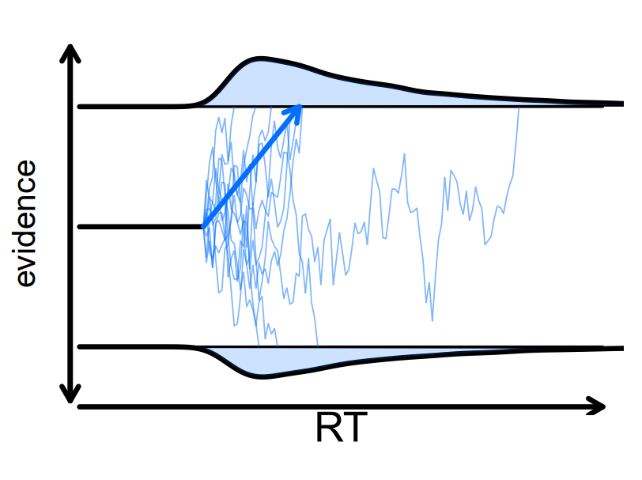
EAMs
v
t0
a

Slide 6
EAMs
Are people with higher drift rates more efficient across tasks?
v
t0
a

Slide 7
EAMs
Are people with higher drift rates more efficient across tasks?
Higher thresholds more cautious across tasks?
v
t0
a

Slide 8
Correlational Challenges

Slide 9
Correlational Challenges
Dimensionality

Slide 10
Correlational Challenges
Dimensionality
Interpretation

Slide 11
Dimensionality
Correlations grow quadratically with the number of constructs

Slide 12
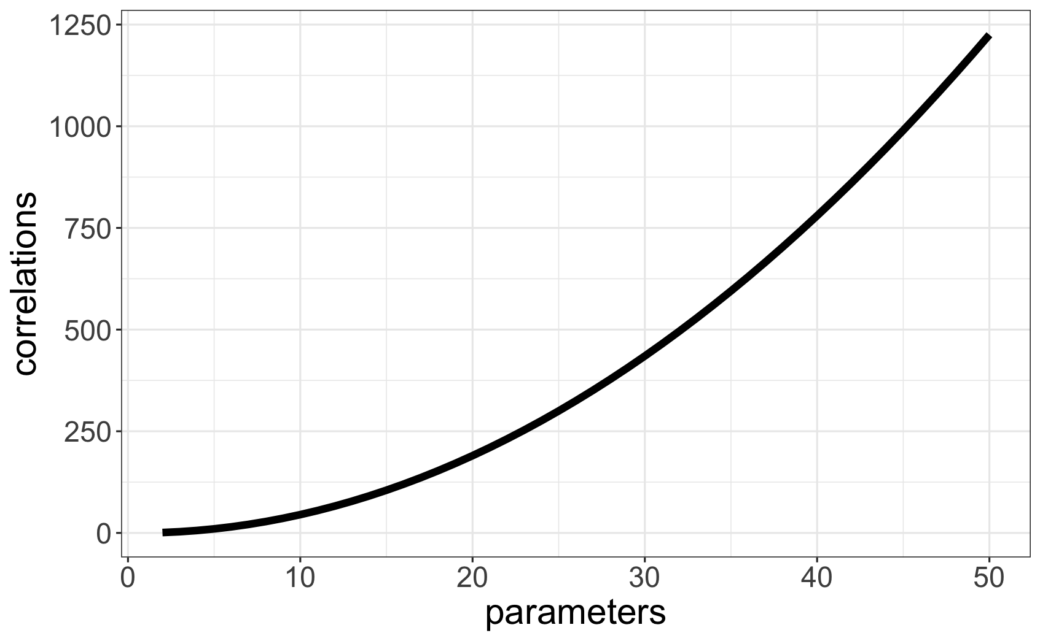
Dimensionality
Correlations grow quadratically with the number of constructs

Slide 13
Interpretation
Too many correlations muddy the water

Slide 14
Interpretation
Too many correlations muddy the water
Often the question of interest spans tasks/contexts

Slide 15
Interpretation
Too many correlations muddy the water
Often the question of interest spans tasks/contexts
“Are drift rates consistent across tasks?”

Slide 16
Factor analysis

Slide 17
Factor analysis
Dimensionality reduction tool
Facilitates interpretation

Slide 18
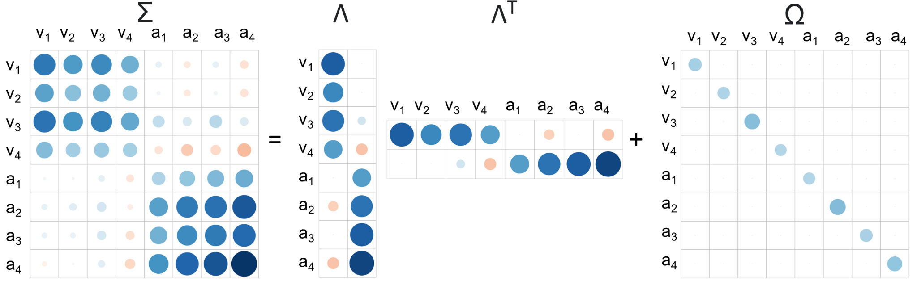
Factor analysis
Dimensionality reduction tool
Facilitates interpretation

Slide 19
Factor analysis
Dimensionality reduction tool
Facilitates interpretation

Slide 20
Conventional Approach
Two-step:

Slide 21
Conventional Approach
Two-step:
Get parameters per person per task/condition
Correlate/run FA/SEM

Slide 22
Two-step Approach
Two-step model ignores uncertainty in participant level estimates
Unaccounted variance dilutes relationship estimates:

Slide 23
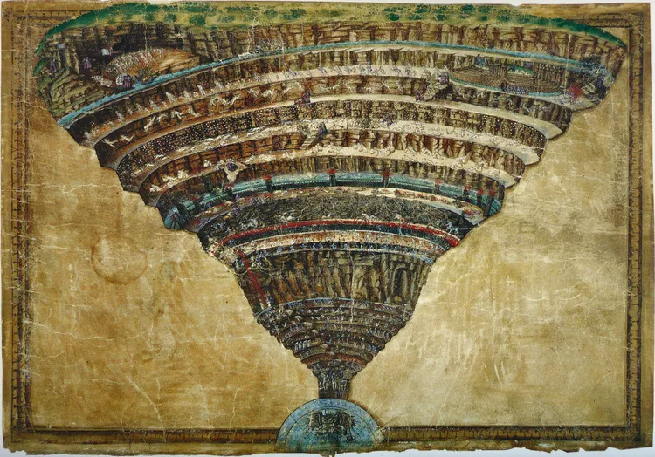
Two-step Approach
Two-step model ignores uncertainty in participant level estimates
Unaccounted variance dilutes relationship estimates:
Attenuation
Attenuation

Slide 24
Hierarchical Model
Account for uncertainty at all data-levels
Provides accurate estimates of the relationships

Slide 25
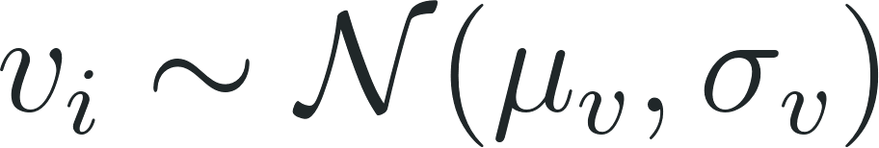
Hierarchical Cognitive Models
Typically applied in a mean-variance group-model for subject i:

Slide 26
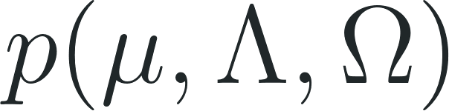
Hierarchical Cognitive Models
Typically applied in a mean-variance group-model for subject i:
Factor Analysis:
prior:

Slide 27
Hierarchical Cognitive Models
Typically applied in a mean-variance group-model for subject i:
Still attenuates as correlations estimated in a second step
Factor Analysis:

Slide 28
Structural equation models

Slide 29
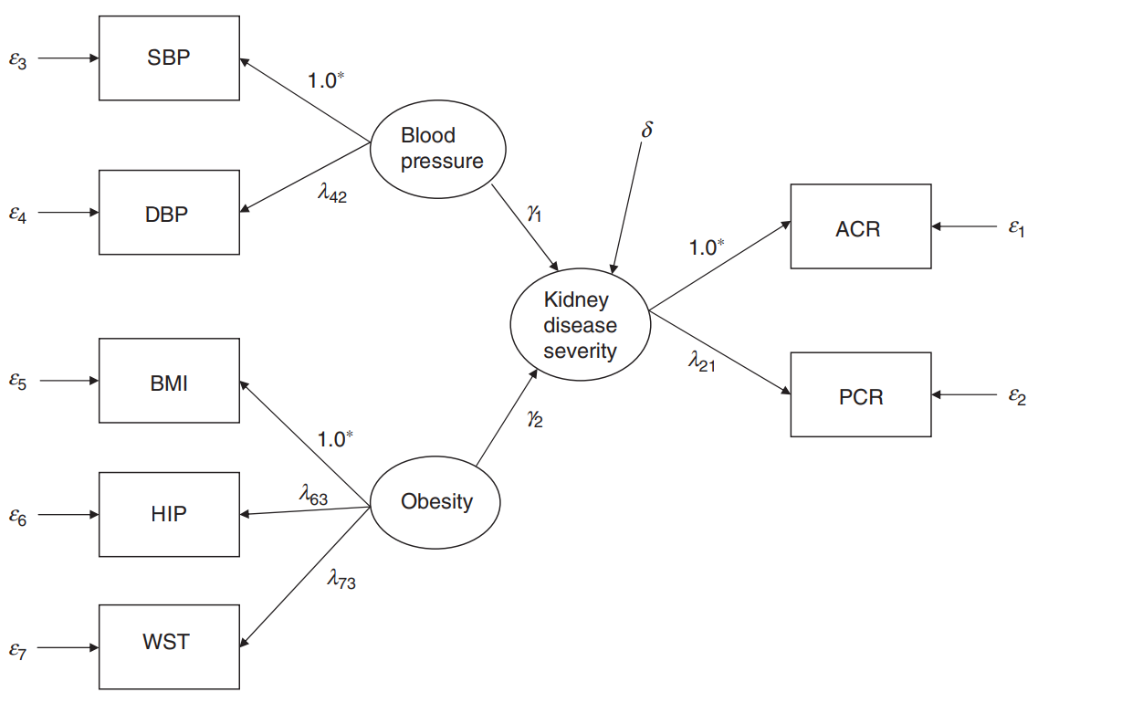
What are structural equation models?
Hip
Waist
Song & Lee (2012). Journal of Mathematical Psychology

Slide 30
What are structural equation models?
Hip
Waist
Song & Lee (2012). Journal of Mathematical Psychology

Slide 31
What are structural equation models?
Catch-most tool to test psychological hypotheses
Tests for higher-order latent constructs and their relationships

Slide 32
What are structural equation models?
Catch-most tool to test psychological hypotheses
Tests for higher-order latent constructs and their relationships
Are BMI, hip index and waist index related (Obesity)
Do obesity and blood pressure predict kidney disease severity?

Slide 33
What are structural equation models?
Catch-most tool to test psychological hypotheses
Tests for higher-order latent constructs and their relationships
Are BMI, hip index and waist index related (Obesity)
Do obesity and blood pressure predict kidney disease severity?
Measurement model: y = λη + kx + ε
Structural model: η = πη + bx + δ

Slide 34
Structural equation models
Overarching framework for linking variables/parameters to latent factors
Allows for higher order relationships between the latent factors
Relationships between external covariates and latent factors

Slide 35
Application EAMs

Slide 36
Application EAMs
Seven conflict decision-making tasks (Eisenberg et al., 2019; Nat. Com.)
190 participants, around 100 trials per person per task
What decision-making processes are shared across tasks

Slide 37
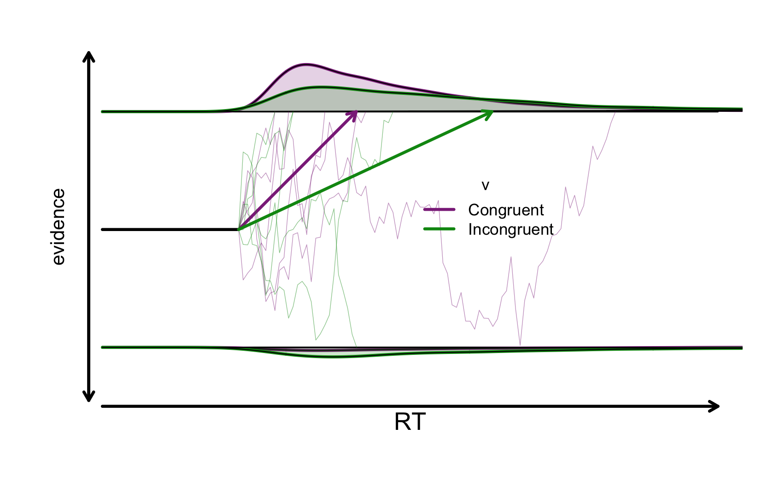
d
v
t0
a

Slide 38
Applications: EAMs
Is age related to evidence accumulation (v), ability to handle conflict (d) or response caution (a)?

Slide 39
Applications: EAMs
Is age related to evidence accumulation (v), ability to handle conflict (d) or response caution (a)?
Conventional:
Regress age on the different parameters for each task

Slide 40
Applications: EAMs
Is age related to evidence accumulation (v), ability to handle conflict (d) or response caution (a)?
Conventional:
Regress age on the different parameters for each task
Too many parameters
No statistical tests for across task associations

Slide 41
Applications: EAMs
Is age related to evidence accumulation (v), ability to handle conflict (d) or response caution (a)?
Conventional:
Regress age on the different parameters for each task
Too many parameters
No statistical tests for across task associations
SEM:
Construct across tasks factors for each parameter
Regress age on these different factors

Slide 42
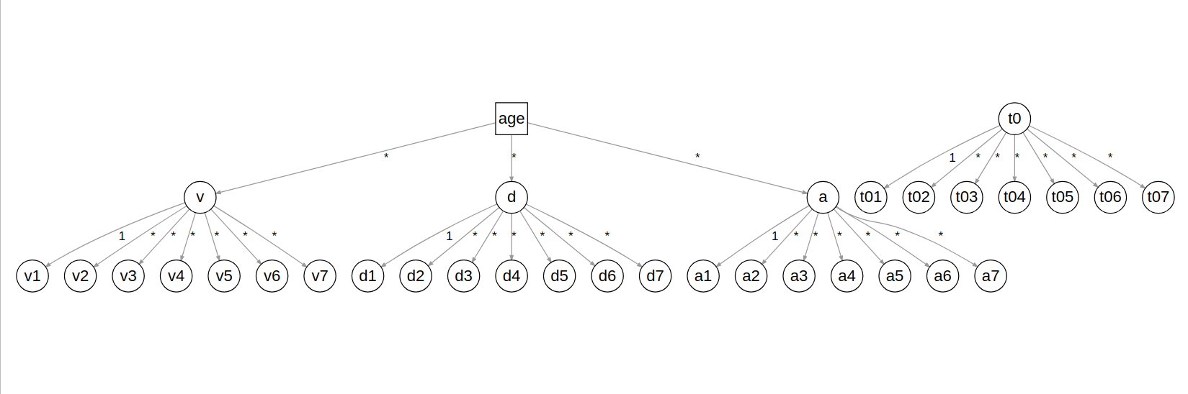
Model specification

Slide 43
Results

Slide 44
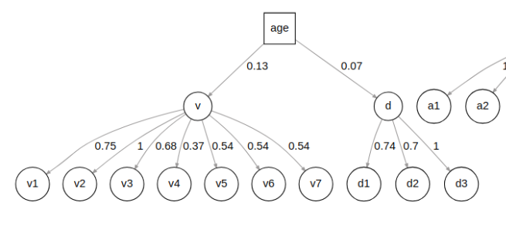
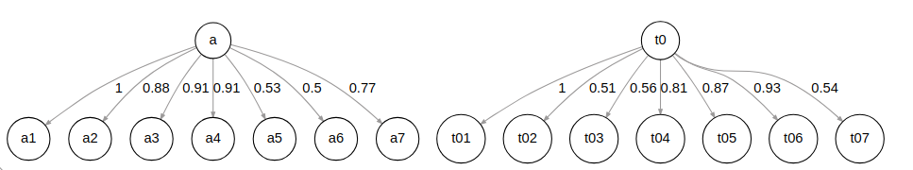

Slide 45
Results
Age positively related to drift rate (BF₁₀ > 100; Garton et al., 2019; Psychology and Aging)

Slide 46
Results
Age positively related to drift rate (BF₁₀ > 100; Garton et al., 2019; Psychology and Aging)
Age negatively related to conflict processing (BF₁₀ = 5.25)

Slide 47
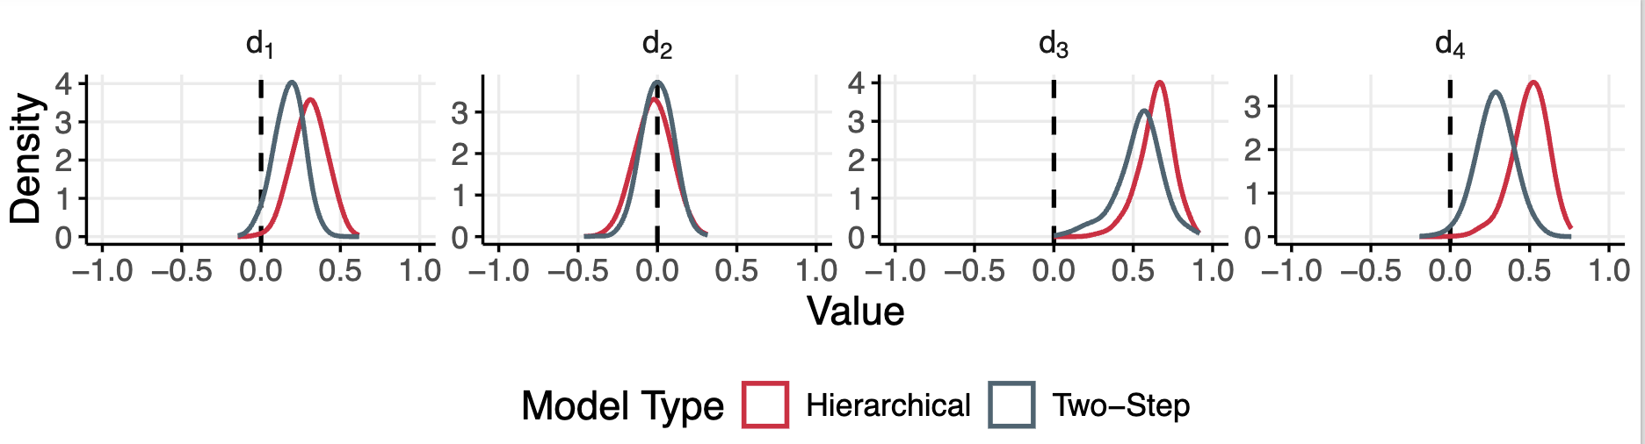
Attenuation

Slide 48
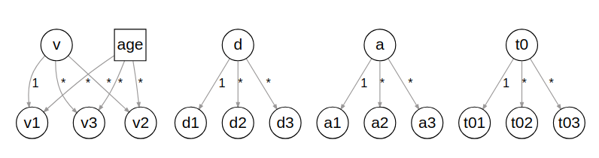
Alternatives - measurement invariance
Null model

Slide 49
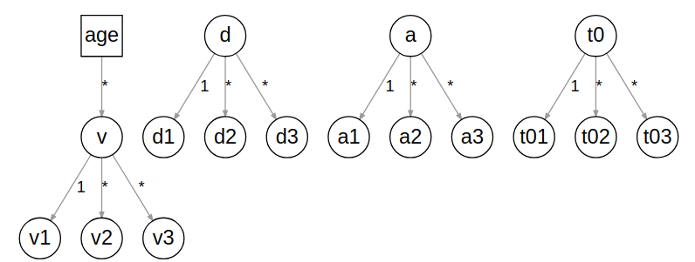
Alternatives - measurement invariance
Null model
Invariant
model

Slide 50
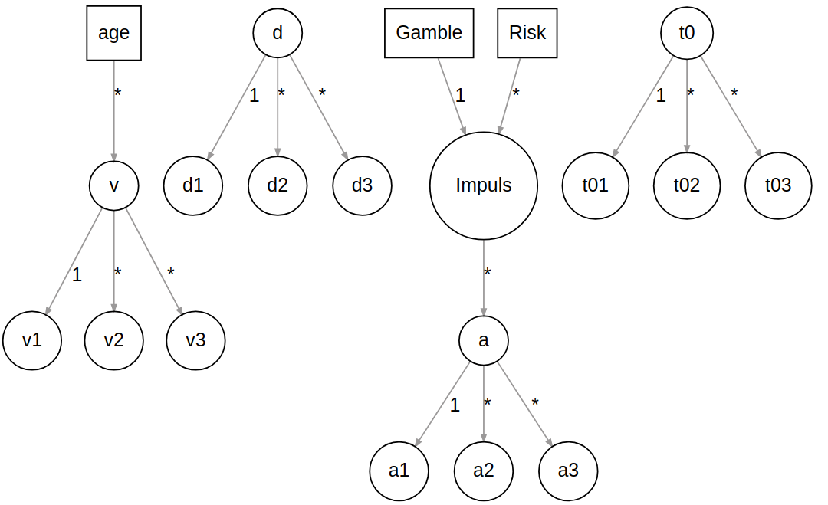
Alternatives - Impulsivity predicts response caution

Slide 51
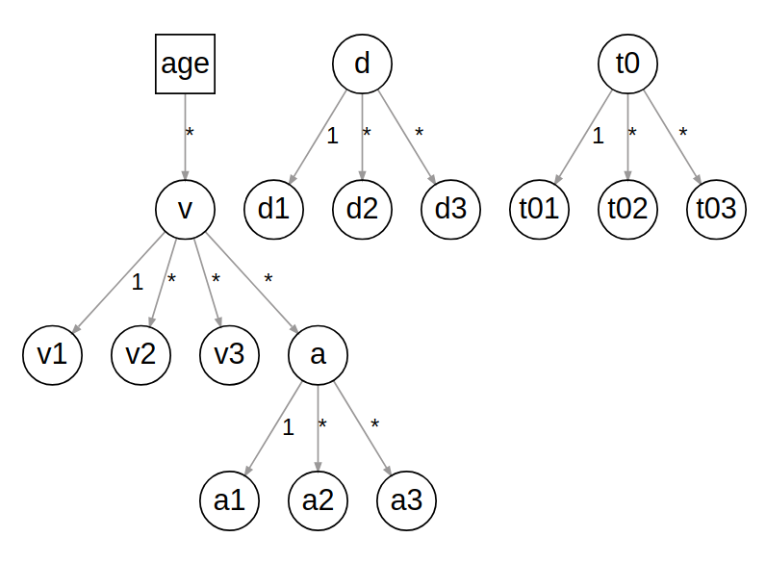
Alternatives - drift predicts response caution

