Slide 1

Model-Based Neuroscience & Cognition Summer School 2026 Expressing Psychological Theories with EAMs

Slide 2
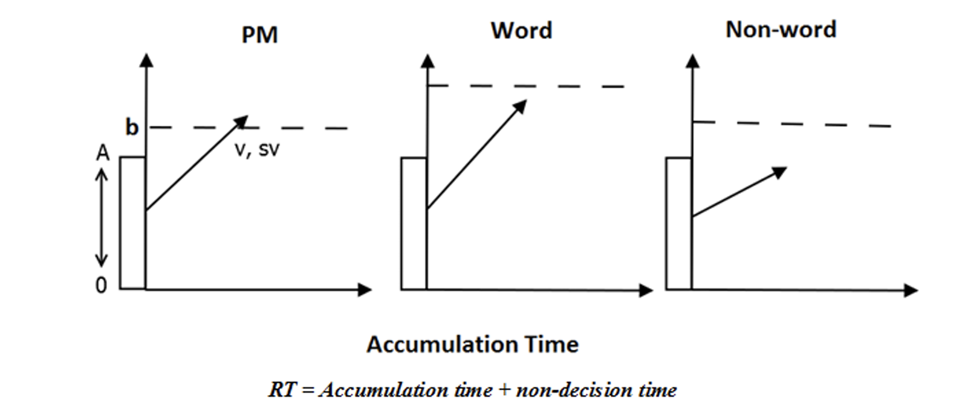
Prospective Memory
Ongoing-task quality (qual):
- The difference between the matching ("correct") ongoing task accumulation rate and mismatching
accumulation rate. Indexes how good ongoing-task processing is (discrimination quality)
Ongoing-task urgency (urg):
- The sum of matching and mismatching ongoing-task accumulation rates. Indexes how fast processing is.

Slide 3
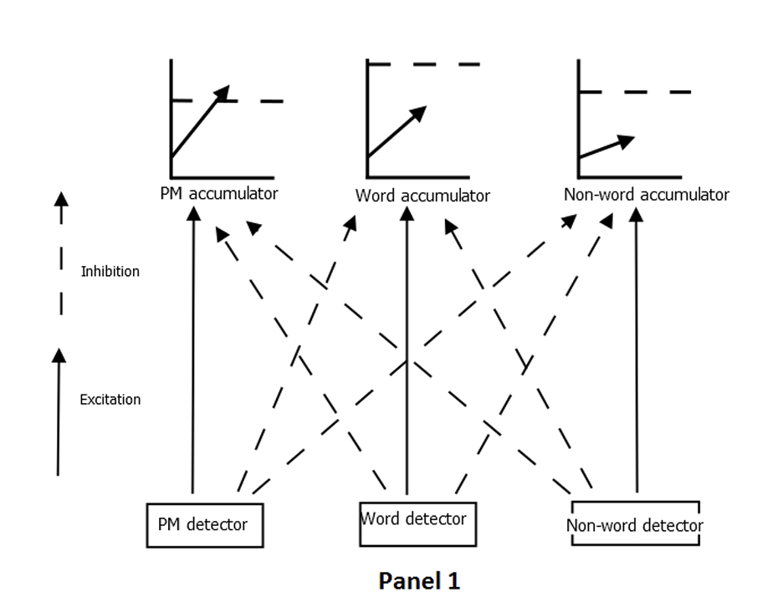
Prospective Memory Decision Control (PMDC)
Proactive Control
- For example, an increase in ongoing-
task thresholds in PM conditions
relative to control.
- Measures how participants strategically
delay ongoing-task responding to make
more time for PM accumulation/retrieval

Slide 4
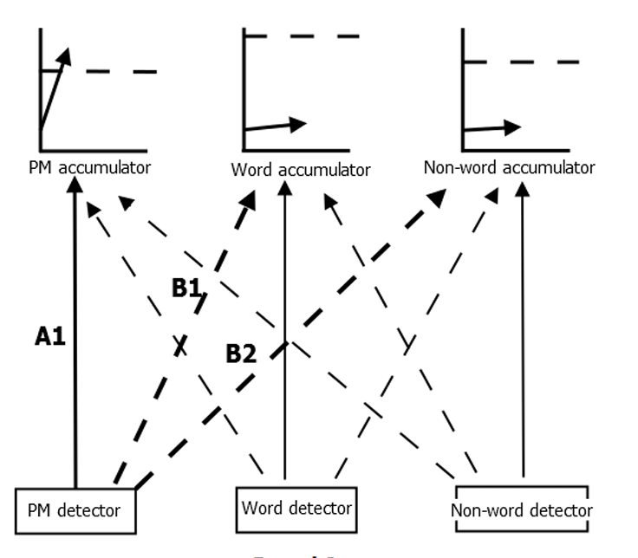
Reactive Control
Feedforward inhibition induced by PM inputs (inh)
- The difference between ongoing-
task accumulation rates in non-PM
vs. PM trials.
- Indexes the extent to which PM
inputs slow the accumulation of the
on-going task.

