Slide 1
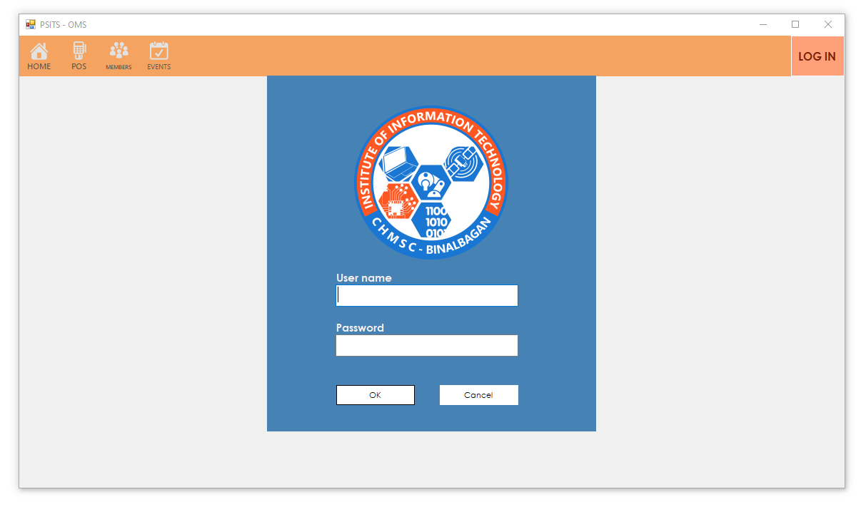
LOG IN

Slide 2
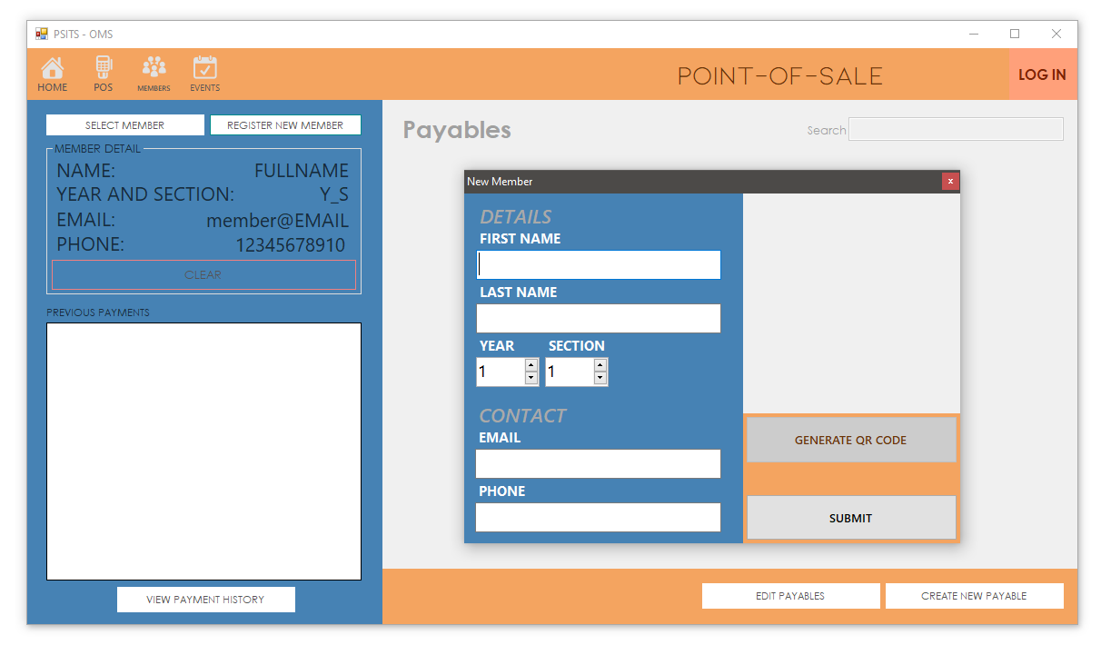
REGISTER NEW MEMBER

Slide 3
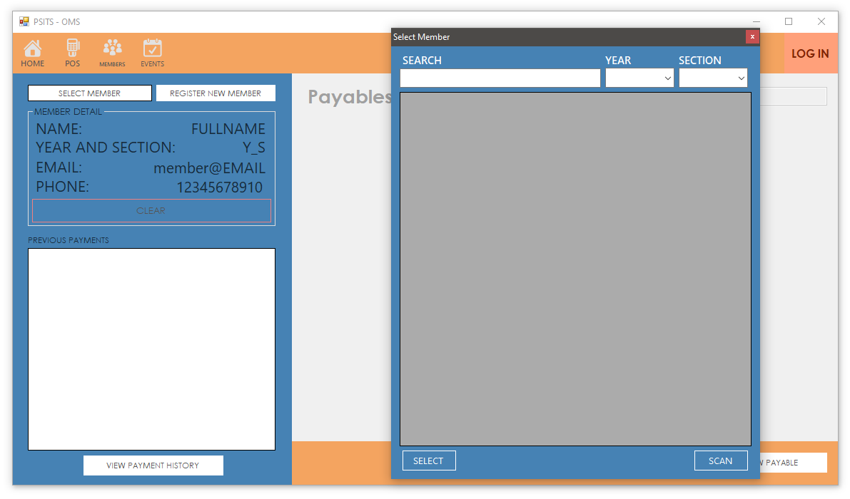
SELECT MEMBER FOR TRANSACTION

Slide 4
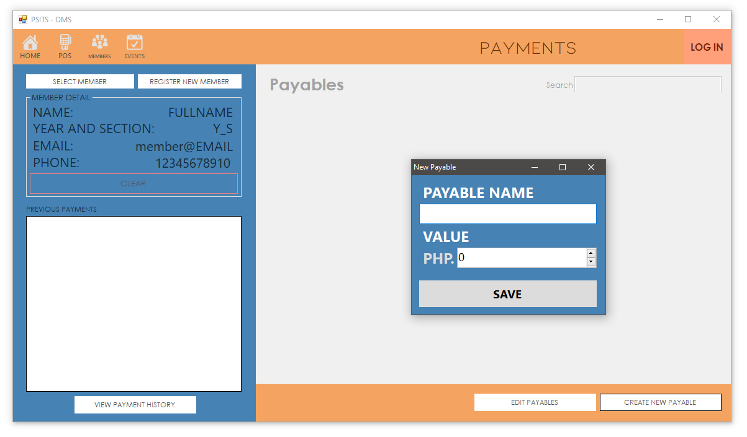
CREATE NEW PAYABLE

Slide 5

ABOUT US

Slide 6
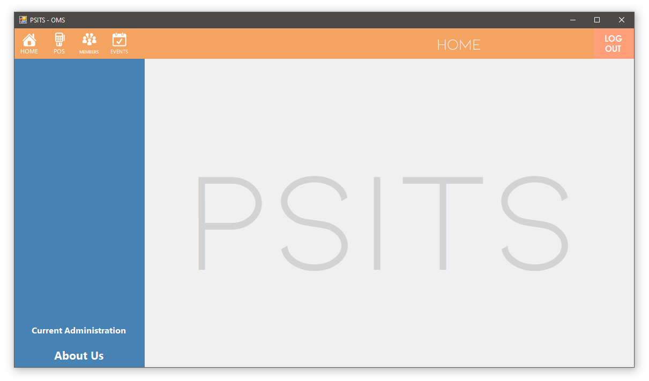
HOME

Slide 7
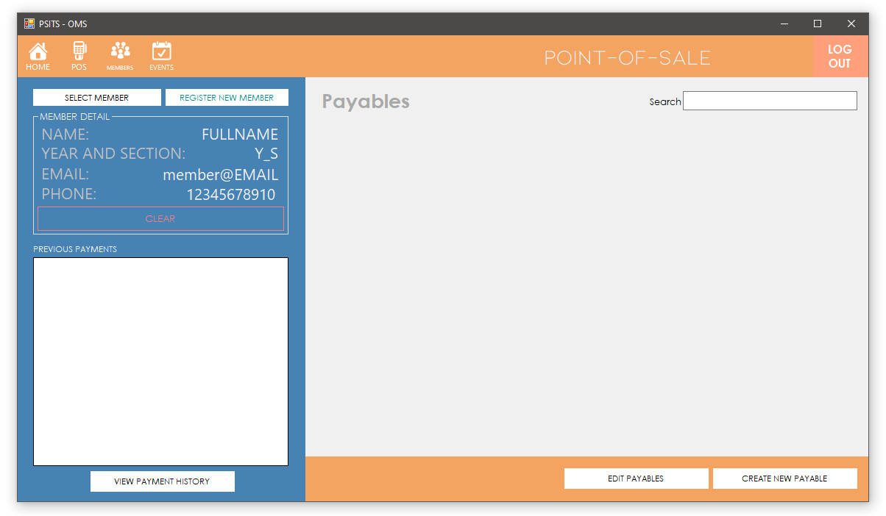
PAYMENT NAME
PAYMENT NAME
PAYMENT NAME
PHP. 123.45
PHP. 123.45
PHP. 123.45
PAY
PAY
PAY
POS

Slide 8
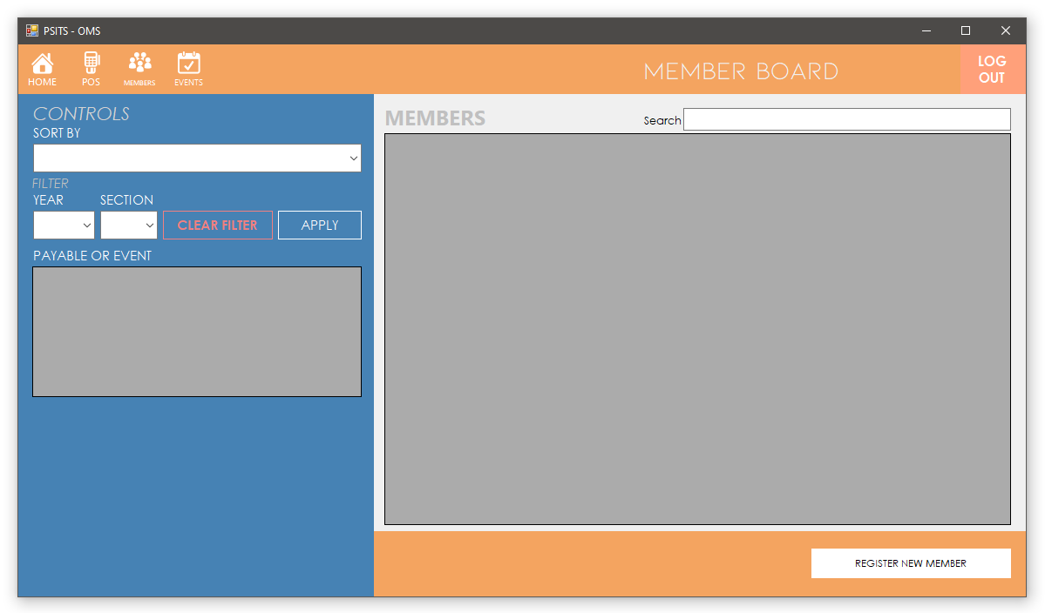
MEMBERS

Slide 9
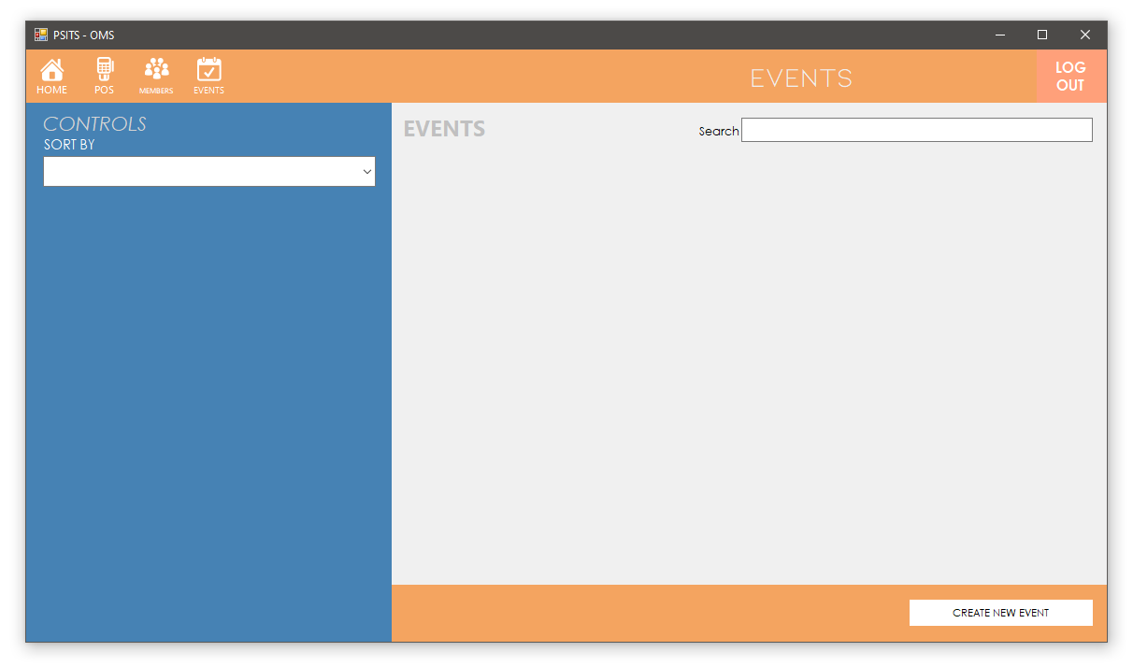
EVENT NAME
EVENT NAME
NO. OF PAYEES:
123
NO. OF PAYEES:
123
NO. OF ATTENDEES:
123
NO. OF ATTENDEES:
123
REQUIRED:
NO
REQUIRED:
YES
DATE:
1/1/2019
DATE:
1/1/2019
ATTENDANCE
ATTENDANCE
EVENTS

Slide 10
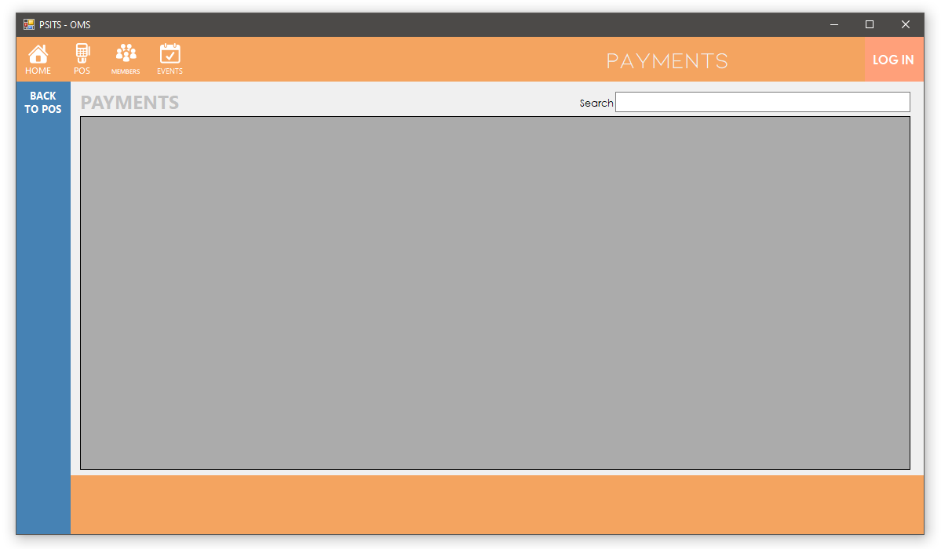
PAYMENT HISTORY

