Slide 1
Review of Machine Learning

Slide 2
Legal Notices and Disclaimers
This presentation is for informational purposes only. INTEL MAKES NO WARRANTIES, EXPRESS OR IMPLIED, IN THIS SUMMARY.
Intel technologies’ features and benefits depend on system configuration and may require enabled hardware, software or service activation. Performance varies depending on system configuration. Check with your system manufacturer or retailer or learn more at intel.com.
This sample source code is released under the Intel Sample Source Code License Agreement.
Intel and the Intel logo are trademarks of Intel Corporation in the U.S. and/or other countries.
*Other names and brands may be claimed as the property of others.
Copyright © 2017, Intel Corporation. All rights reserved.

Slide 3

What is Machine Learning?
Machine learning allows computers to learn and infer from data.
Notes:
Roughly speaking, stats on steroids.

Slide 4
Types of Machine Learning
Supervised
data points have known outcome
Unsupervised
data points have unknown outcome

Slide 5
Types of Supervised Learning
Regression
outcome is continuous (numerical)
Classification
outcome is a category
Notes:
Special case of classification is binary classification, where you have 2 classes

Slide 6
Machine Learning Vocabulary
Target: predicted category or value of the data (column to predict)
Features: properties of the data used for prediction (non-target columns)
Example: a single data point within the data (one row)
Label: the target value for a single data point

Slide 7
Machine Learning Vocabulary (Synonyms)
Target: Response, Output, Dependent Variable, Labels
Features: Predictors, Input, Independent Variables, Attributes
Example: Observation, Record, Instance, Datapoint, Row
Label: Answer, y-value, Category

Slide 8
Supervised Learning Overview
fit
data with answers
+
model
model
predict
predicted answers
data without answers
+
model

Slide 9
Regression: Numeric Answers
movie data with
revenue
fit
model
model
+
movie data (unknown revenue)
predict
predicted revenue
+
model

Slide 10
Classification: Categorical Answers
labeled
data
fit
+
model
model
unlabeled data
predict
+
model
labels

Slide 11
Classification: Categorical Answers
fit
emails labeled as spam/not spam
+
model
model
predict
unlabeled emails
spam or not spam
+
model

Slide 12
Three Types of Classification Predictions
Hard Prediction: Predict a single category for each instance.
Ranking Prediction: Rank the instances from most likely to least likely. (binary classification)
Probability Prediction: Assign a probability distribution across the classes to each instance.

Slide 13
Metrics for Classification
Hard Prediction: Accuracy, Precision, Recall (Sensitivity), Specificity, F1 Score
Ranking Prediction: AUC (ROC), Precision-Recall Curves
Probability Prediction: Log-loss (aka Cross-Entropy), Brier Score

Slide 14
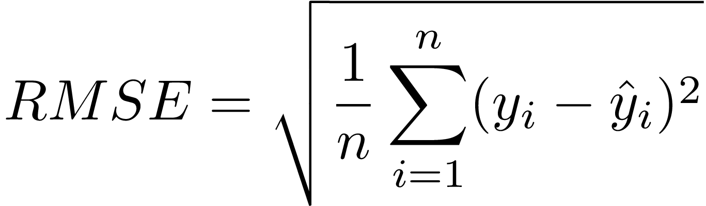
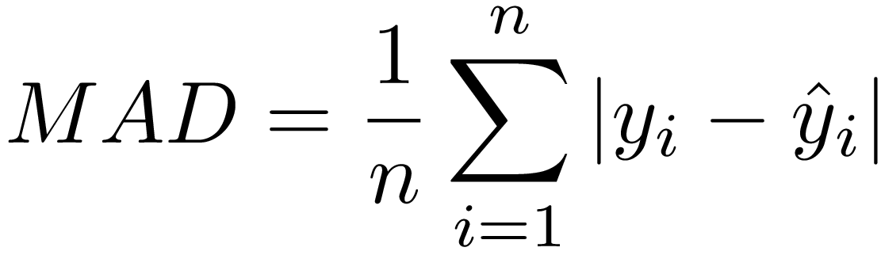
Metrics for Regression
Root Mean Square Error (RMSE)
        Mean Absolute Deviation

Slide 15
Fitting Training and Test Data
Training
Data
X_train
model.fit( X_train, Y_train )
model
Y_train
Test
Data
X_test
model
.predict( X_test )
Y_predict
error_metric( Y_test, Y_predict)
test error
Y_test

Slide 16
Using Training and Test Data
Training
Data
fit the model
measure performance
- predict label with model
- compare with actual value
- measure error
Test
Data

Slide 17
Using Training and Test Data
Training Data
Test Data
x10⁸
x10⁸
4.0
4.0
3.0
3.0
2.0
2.0
1.0
1.0
0.0
1.0
2.0
x10⁸
0.0
1.0
2.0
x10⁸

Slide 18
Using Training and Test Data
Training Data
Test Data
x10⁸
x10⁸
4.0
4.0
3.0
3.0
2.0
2.0
1.0
1.0
0.0
1.0
2.0
x10⁸
0.0
1.0
2.0
x10⁸
Fit the model

Slide 19
Using Training and Test Data
Training Data
Test Data
x10⁸
x10⁸
4.0
4.0
3.0
3.0
2.0
2.0
1.0
1.0
0.0
1.0
2.0
x10⁸
0.0
1.0
2.0
x10⁸
Make predictions

Slide 20
Using Training and Test Data
Training Data
Test Data
x10⁸
x10⁸
4.0
4.0
3.0
3.0
2.0
2.0
1.0
1.0
0.0
1.0
2.0
x10⁸
0.0
1.0
2.0
x10⁸
Measure error

Slide 21
How Well Does the Model Generalize?
Polynomial Degree = 1
Polynomial Degree = 4
Polynomial Degree = 15
Model
True Function
Samples
Y
Y
Y
X
X
X
Poor on Training Set
Poor at Predicting
Very Good on Training Set
Poor at Predicting
Just Right

Slide 22
Underfitting vs Overfitting
Polynomial Degree = 1
Polynomial Degree = 4
Polynomial Degree = 15
Model
True Function
Samples
Y
Y
Y
X
X
X
Underfitting
Just Right
Overfitting

Slide 23
Bias – Variance Tradeoff
Polynomial Degree = 1
Polynomial Degree = 4
Polynomial Degree = 15
Model
True Function
Samples
Y
Y
Y
X
X
X
High Bias
Low Variance
Low Bias
High Variance
Just Right

Slide 24



Gradient Descent
Start with a cost function J($β$):
$$J\left(β\right)$$
Global Minimum
$$β$$
Then gradually move towards the minimum.
Notes:
Let’s talk about gradient descent.
The idea is to get closer to the minimum of a given function, iteratively.
How?

Slide 25
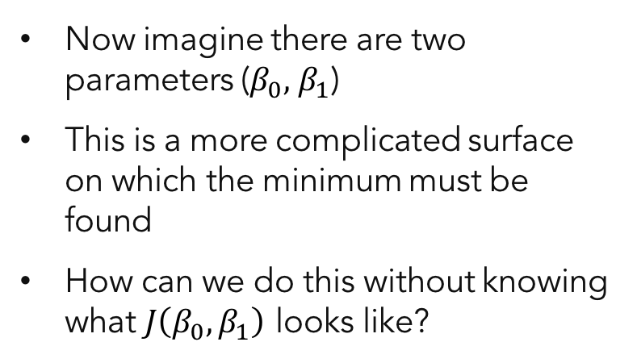



Gradient Descent with Linear Regression
Now imagine there are two parameters ($β_{0}, { β}_{1}$)
This is a more complicated surface on which the minimum must be found
How can we do this without knowing what $J\left(β_{0},β_{1}\right)$ looks like?
$$J\left(β_{0},β_{1}\right)$$
$$β_{1}$$
$$β_{0}$$
Notes:
In practice, we won’t have visual representations like this.

Slide 26
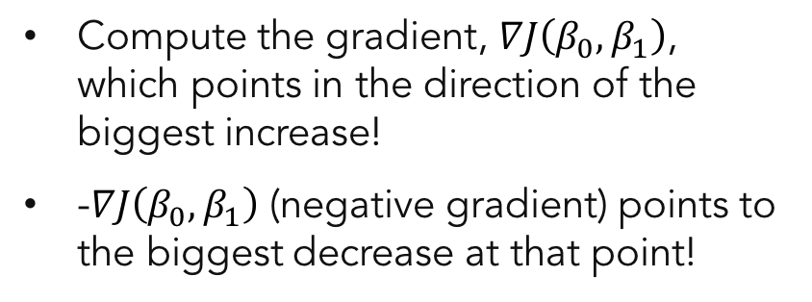



Gradient Descent with Linear Regression
$$J\left(β_{0},β_{1}\right)$$
Compute the gradient, $∇J\left(β_{0},β_{1}\right)$, which points in the direction of the biggest increase!
-$∇J\left(β_{0},β_{1}\right)$ (negative gradient) points to the biggest decrease at that point!
$$β_{1}$$
$$β_{0}$$
Notes:
Math to the rescue! Gradient of a function gives us the direction of biggest decrease at that point.

Slide 27

Gradient Descent with Linear Regression
$$J\left(β_{0},β_{1}\right)$$
The gradient is the a vector whose coordinates consist of the partial derivatives of the parameters
$$∇J\left(β_{0},…,β_{n}\right)= <\frac{∂J}{∂β_{0}}\text{, }…,\frac{∂J}{∂β_{n}}>$$
$$β_{1}$$
$$β_{0}$$
Notes:
Recall, this is the gradient.

Slide 28
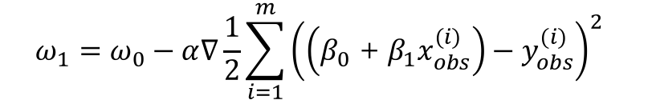
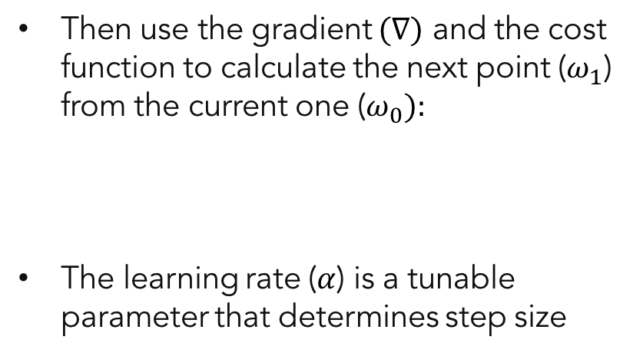


Gradient Descent with Linear Regression
$$J\left(β_{0},β_{1}\right)$$
Then use the gradient $(∇)$ and the cost function to calculate the next point ($ω_{1}$) from the current one ($ω_{0}):$
The learning rate ($α$) is a tunable parameter that determines step size
$$ω_{0}$$
$$ω_{1}=ω_{0}−α∇\frac{1}{2}\sum_{i=1}^{m}{{\left(\left(β_{0}\text{ + }β_{1}x_{obs}^{(i)}\right)−y_{obs}^{(i)}\right)}^{2} }$$
$$ω_{1}$$
$$β_{1}$$
$$β_{0}$$
Notes:
The constant which determines how far we go in a given direction is called “the learning rate”. It’s given by alpha in the formula. It is the “step size”
Point is, the gradient computation is local. And the meaning of the direction is invalid once we got ourselves away from the original point. So gradient needs to be recomputed.
In this example, we have the loss function for linear reg.

Slide 29

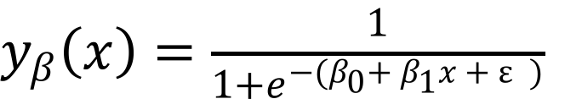

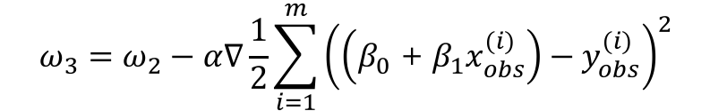


Gradient Descent with Linear Regression
$$J\left(β_{0},β_{1}\right)$$
Each point can be iteratively calculated from the previous one
$$ω_{2}=ω_{1}−α∇\frac{1}{2}\sum_{i=1}^{m}{{\left(\left(β_{0}\text{ + }β_{1}x_{obs}^{(i)}\right)−y_{obs}^{(i)}\right)}^{2} }$$
$$ω_{0}$$
$$ω_{1}$$
$$ω_{2}$$
$$ω_{3}=ω_{2}−α∇\frac{1}{2}\sum_{i=1}^{m}{{\left(\left(β_{0}\text{ + }β_{1}x_{obs}^{(i)}\right)−y_{obs}^{(i)}\right)}^{2} }$$
$$ω_{3}$$
$$β_{1}$$
$$β_{0}$$
Notes:
After a few steps, we’re going to reach a minimum and the gradient will be zero (or below a certain tolerance factor).
At that point, there’s nowhere to go anymore => convergence!
There is a chance it can get stuck at a local minimum.
That’s why initialization is important. Alternatively, if your loss function is convex, local = global! (true for most of the popular algos)
So in the case of Linear regression, recall that our loss function is this.

Slide 30

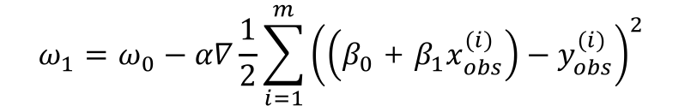

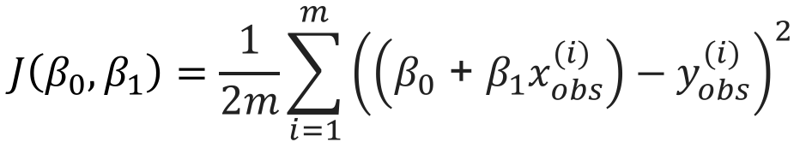
Stochastic Gradient Descent
$$J\left(β_{0},β_{1}\right)$$
Use a single data point to determine the gradient and cost function instead of all the data
$$ω_{0}$$
$$ω_{1}=ω_{0}−α∇\frac{1}{2}\sum_{i=1}^{m}{{\left(\left(β_{0}\text{ + }β_{1}x_{obs}^{(i)}\right)−y_{obs}^{(i)}\right)}^{2} }$$
$$ω_{1}$$
$$β_{1}$$
$$ω_{1}=ω_{0}−α∇\frac{1}{2}{\left(\left(β_{0}\text{ + }β_{1}x_{obs}^{(0)}\right)−y_{obs}^{(0)}\right)}^{2}$$
$$β_{0}$$
Notes:
Another technique; STOCHASTIC Gradient descent.
Instead of computing the gradient of the full loss function, we compute the gradient of a single point’s contribution.

Slide 31




Stochastic Gradient Descent
$$J\left(β_{0},β_{1}\right)$$
Use a single data point to determine the gradient and cost function instead of all the data
Path is less direct due to noise in single data point—"stochastic"
$$ω_{0}$$
$$ω_{1}=ω_{0}−α∇\frac{1}{2}{\left(\left(β_{0}\text{ + }β_{1}x_{obs}^{(0)}\right)−y_{obs}^{(0)}\right)}^{2}$$
$$ω_{1}$$
$$ω_{2}$$
$$ω_{3}$$
$$ω_{4}$$
…
$$ω_{4}=ω_{3}−α∇\frac{1}{2}{\left(\left(β_{0}\text{ + }β_{1}x_{obs}^{(3)}\right)−y_{obs}^{(3)}\right)}^{2}$$
$$β_{1}$$
$$β_{0}$$
Notes:
Path is a little bit less direct, it may take more iterations.
But it allows us to train models on datasets with a lot of rows (100s of thousands or more).
It also allows us to update our models easily. With each new training record, compute the gradient that that point creates, and move!

Slide 32
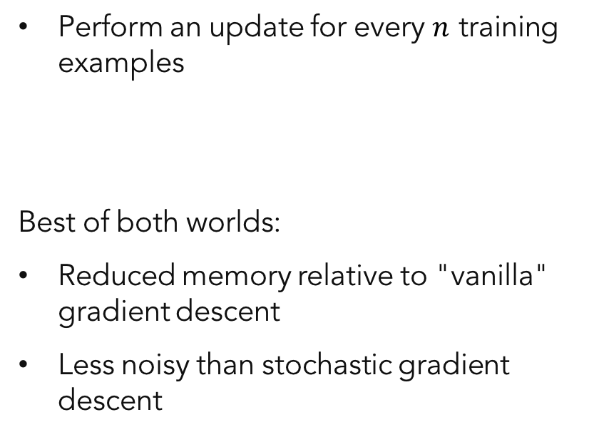
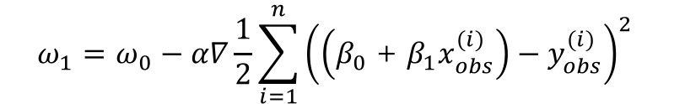
Mini Batch Gradient Descent
$$J\left(β_{0},β_{1}\right)$$
Perform an update for every $n$ training examples
Best of both worlds:
  Reduced memory relative to "vanilla" gradient descent
  Less noisy than stochastic gradient descent
$$ω_{1}=ω_{0}−α∇\frac{1}{2}\sum_{i=1}^{n}{{\left(\left(β_{0}\text{ + }β_{1}x_{obs}^{(i)}\right)−y_{obs}^{(i)}\right)}^{2} }$$
$$ω_{0}$$
$$ω_{1}$$
$$β_{1}$$
$$β_{0}$$

