Slide 1
Recurrent Neural Networks (RNNs)

Slide 2
Legal Notices and Disclaimers
This presentation is for informational purposes only. INTEL MAKES NO WARRANTIES, EXPRESS OR IMPLIED, IN THIS SUMMARY.
Intel technologies’ features and benefits depend on system configuration and may require enabled hardware, software or service activation. Performance varies depending on system configuration. Check with your system manufacturer or retailer or learn more at intel.com.
This sample source code is released under the Intel Sample Source Code License Agreement.
Intel and the Intel logo are trademarks of Intel Corporation in the U.S. and/or other countries.
*Other names and brands may be claimed as the property of others.
Copyright © 2017, Intel Corporation. All rights reserved.

Slide 3
Issue: Variable length sequences of words
With images, we forced them into a specific input dimension
Not obvious how to do this with text.
For example, classify tweets as positive, negative, or neutral.
Tweets can have a variable number of words.
What to do?

Slide 4
Issue: Ordering of words is important
Want to do better than “bag of words” implementations
Ideally, each word is processed or understood in the appropriate context.
Need to have some notion of “context”.
Words should be handled differently depending on “context”
Also, each word should update the context.

Slide 5
Idea: Use the notion of “recurrence”
Input words one by one
Network outputs two things:
Prediction: What would be the prediction if the sequence ended with that word
State: Summary of everything that happened in the past
This way, can handle variable lengths of text
The response to a word depends on the words that preceded it.

Slide 6
Idea: Use the notion of “recurrence”
STATE
Notes:
Key takeaway from this and following slides is that one input leads to two outputs: a prediction and a state.

Slide 7
Idea: Use the notion of “recurrence”
STATE
Notes:
Shows state output.

Slide 8
Idea: Use the notion of “recurrence”
STATE
Notes:
Shows prediction output.

Slide 9
Idea: Use the notion of “recurrence”
STATE
Notes:
Back to original architecture. Setup for “unrolling” RNN.

Slide 10
“Unrolling” the RNN
STATE
STATE
STATE
STATE
Notes:
Sequential process.
Output at (t-1) becomes input for (t) which leads to a chain like shown in picture.

Slide 11
“Unrolling” the RNN
o₁
o₂
o₃
o₄
V
V
V
V
s₁
s₂
s₃
s₄
STATE
STATE
STATE
STATE
W
W
W
W
U
U
U
U
w₁
w₂
w₃
w₄
Notes:
Note: in Keras (and other treatments of RNN) the state that is passed through W is the same as the output of the RNN.
So then the V matrix would be part of a separate “Dense” layer

Slide 12
“Unrolling” the RNN
?
?
+
++
STATE
STATE
STATE
STATE
“This”
“is”
“great”
“!”
Notes:
Example: first two words have unknown sentiment while last two words have positive and very positive sentiments.

Slide 13
“Unrolling” the RNN
In Keras, this part is accomplished by a subsequent Dense layer
o₁
o₂
o₃
o₄
V
V
V
V
s₁
s₂
s₃
s₄
STATE
STATE
STATE
STATE
W
W
W
W
U
U
U
U
w₁
w₂
w₃
w₄

Slide 14
“Unrolling” the RNN
This part is the core RNN
o₁
o₂
o₃
o₄
V
V
V
V
s₁
s₂
s₃
s₄
STATE
STATE
STATE
STATE
W
W
W
W
U
U
U
U
w₁
w₂
w₃
w₄

Slide 15
“Unrolling” the RNN
Keras calls this part the “kernel” (e.g. kernel_initializer,…)
o₁
o₂
o₃
o₄
V
V
V
V
s₁
s₂
s₃
s₄
STATE
STATE
STATE
STATE
W
W
W
W
U
U
U
U
w₁
w₂
w₃
w₄

Slide 16
“Unrolling” the RNN
Keras calls this part “recurrent” (recurrent_initializer,…)
o₁
o₂
o₃
o₄
V
V
V
V
s₁
s₂
s₃
s₄
STATE
STATE
STATE
STATE
W
W
W
W
U
U
U
U
w₁
w₂
w₃
w₄

Slide 17
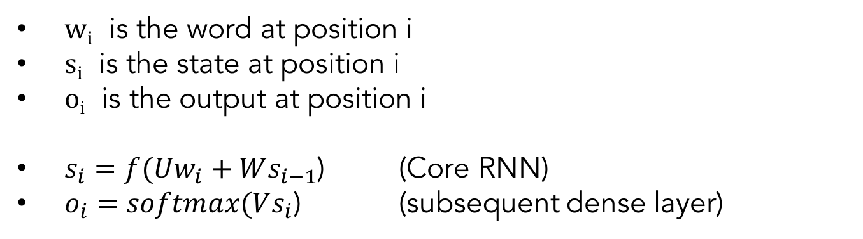
Mathematical Details
w_{i} is the word at position i
s_{i} is the state at position i
o_{i} is the output at position i
$s_{i}=f(Uw_{i}+Ws_{i−1}$) (Core RNN)
$o_{i}=softmax(Vs_{i}$) (subsequent dense layer)

Slide 18
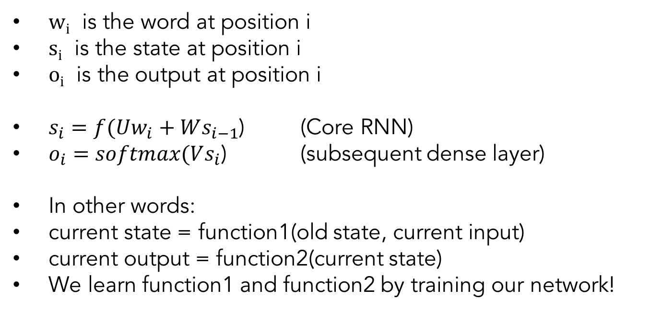
Mathematical Details
w_{i} is the word at position i
s_{i} is the state at position i
o_{i} is the output at position i
$s_{i}=f(Uw_{i}+Ws_{i−1}$) (Core RNN)
$o_{i}=softmax(Vs_{i}$) (subsequent dense layer)
In other words:
current state = function1(old state, current input)
current output = function2(current state)
We learn function1 and function2 by training our network!
Notes:
It’s worth spending some time on this.
- U encodes the input.
- W modifies the information from the previous state.
- They get added together and passed through the activation function.

Slide 19
More Mathematical Details
r = dimension of input vector
s = dimension of hidden state
t = dimension of output vector (after dense layer)
U is a s x r matrix
W is a s x s matrix
V is a t x s matrix
Note: The weight matrices U,V,W are the same across all positions

Slide 20
Practical Details
Often, we train on just the ”final” output and ignore the intermediate outputs.
Slight variation called Backpropagation Through Time (BPTT) is used to train RNNs
Sensitive to length of sequence (due to “vanishing/exploding gradient” problem)
In practice, we still set a maximum length to our sequences.
If input is shorter than maximum, we “pad” it.
If input is longer than maximum, we truncate.

Slide 21
Other Uses of RNNs
We have focused on text/words as application.
But, RNNs can be used for other sequential data
Time-Series Data
Speech Recognition
Sensor Data
Genome Sequences

Slide 22
Weaknesses of RNNs
Nature of state transition means it is hard to keep information from distant past in current memory without reinforcement.
In the next lecture, we will introduce LSTMs, which have a more complex mechanism for updated the state.
Notes:
This goes back to the $s_{i}=f(Uw_{i}+Ws_{i−1}$) equation.
Since we add them together, the information from the previous state necessarily gets diluted.

