Slide 1
Introduction to Neural Nets

Slide 2
Legal Notices and Disclaimers
This presentation is for informational purposes only. INTEL MAKES NO WARRANTIES, EXPRESS OR IMPLIED, IN THIS SUMMARY.
Intel technologies’ features and benefits depend on system configuration and may require enabled hardware, software or service activation. Performance varies depending on system configuration. Check with your system manufacturer or retailer or learn more at intel.com.
This sample source code is released under the Intel Sample Source Code License Agreement.
Intel and the Intel logo are trademarks of Intel Corporation in the U.S. and/or other countries.
*Other names and brands may be claimed as the property of others.
Copyright © 2017, Intel Corporation. All rights reserved.

Slide 3
Motivation for Neural Nets
Use biology as inspiration for mathematical model
Get signals from previous neurons
Generate signals (or not) according to inputs
Pass signals on to next neurons
By layering many neurons, can create complex model
Notes:
Inspiration for NNs come from biology, specifically neurons.
We model neurons as a node, with input connections, and output connections.
By having many neurons, layers, we can capture a lot of hidden value in the dataset

Slide 4
Neural Net Structure
Input
(Feature Vector)
Output
(Label)
Can think of it as a complicated computation engine
We will ”train it” using our training data
Then (hopefully) it will give good answers on new data
Notes:
In neural nets, we don’t’ just think in terms of networks, but also layers.
Can make the point here that there are a lot of parameters, can capture non-linearities, etc that could not be realized without hidden layers

Slide 5
Basic Neuron Visualization
activation
function
Notes:
Let’s walk through the basic computation of a single neuron

Slide 6
Basic Neuron Visualization
Data from
previous layer
activation
function
Notes:
Input connections

Slide 7
Basic Neuron Visualization
Some form of computation
transforms the inputs
activation
function
Notes:
Once input arrives, we do some computation

Slide 8
Basic Neuron Visualization
The neuron outputs the
transformed data
activation
function
Notes:
And output the result(s) to the next layer.
Note that there can be more than one connection being output to the next layer
The activation function is the same for all of that.
The parameters of computation is different.

Slide 9
Basic Neuron Visualization
x₁
w₁
activation
function
w₂
x₂
w₃
x₃
Notes:
More concretely, x1, x2, x3 are the inputs. They are real numbers
We have coefficients w1, w2, and w3. they are real numbers as well. They form 1 row vector [w1, w2, w3]

Slide 10
Basic Neuron Visualization
x₁
w₁
activation
function
w₂
x₂
w₃
b
x₃
1
Notes:
And classically, we add another special input, called “bias term”.
This is the analogue of intercept in Linear regression
So our row vector of parameters is [w1, w2, w3, b]

Slide 11
Basic Neuron Visualization
x₁
w₁
z = x₁w₁+ x₂w₂+ x₃w₃+b
activation
function
f(z)
w₂
x₂
w₃
b
x₃
1
Notes:
And we perform this linear algebra operation (dot product), and get a value z
Finally, the neuron outputs f(z), where f is the activation function.
If there were more than 1 output connections, we would have
X1, x2, x3 the same
New weights, say, [v1, v2, v3, d]
And the process would be the same.

Slide 12

In Vector Notation
$$z=b+\sum_{i=1}^{m}{x_{i}w_{i}}$$
$$z=b+x^{T}w$$
$$a=f(z)$$
z = “net input”
b = “bias term”
f = activation function
a = output to next layer
Notes:
So we see that vectors, matrices, dot products, i.e. linear algebra plays a crucial role in NNs.
most of the operations are matrix multiplication, or element-wise operations on matrices / vectors

Slide 13
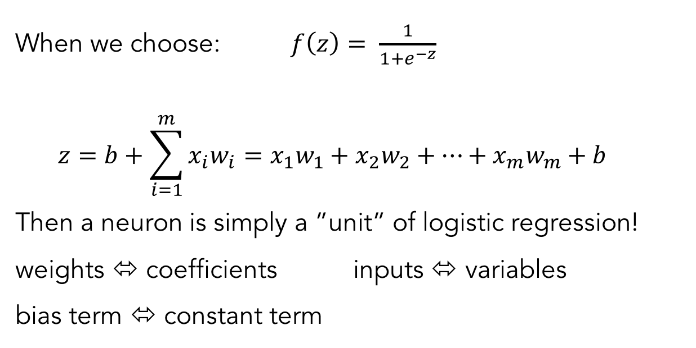
Relation to Logistic Regression
When we choose: $f\left(z\right)= \frac{1}{1+e^{−z}}$
$$z=b+\sum_{i=1}^{m}{x_{i}w_{i}=x_{1}w_{1}+x_{2}w_{2}+…+x_{m}w_{m}+b}$$
Then a neuron is simply a ”unit” of logistic regression!
weights ⬄ coefficients inputs ⬄ variables
bias term ⬄ constant term
Notes:
Let’s talk about activation functions a little bit. If we chose the sigmoid function (recall from logreg);
We recover the prediction equation for logreg!
So this neuron is just doing logreg on the inputs.

Slide 14
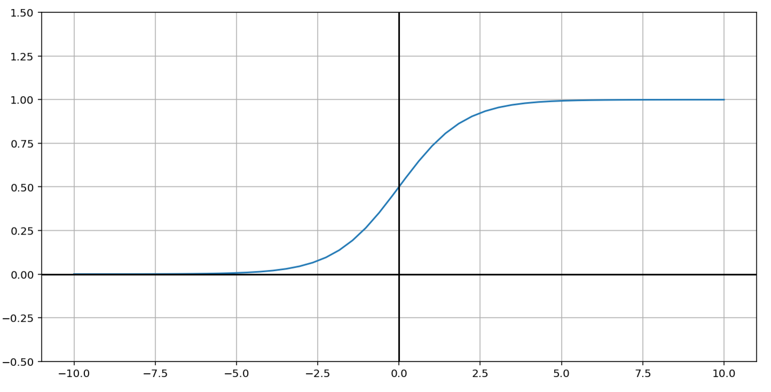
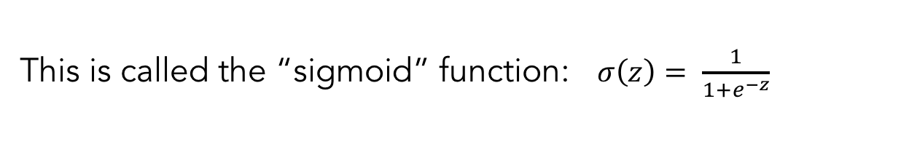
Relation to Logistic Regression
This is called the “sigmoid” function: $σ\left(z\right)= \frac{1}{1+e^{−z}}$
Notes:
This is what the sigmoid function looks like.

Slide 15
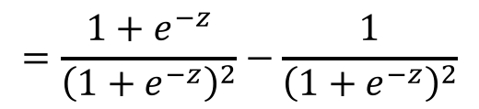
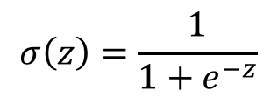
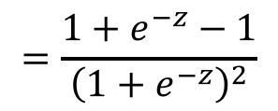
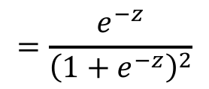
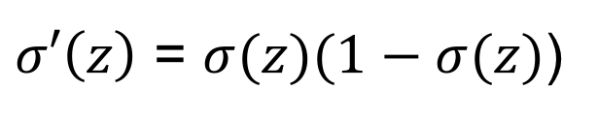
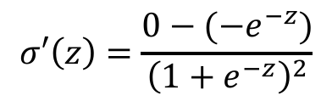
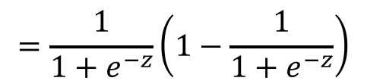
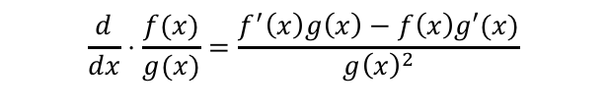
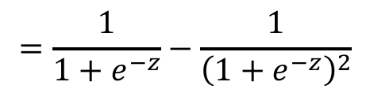
Nice Property of Sigmoid Function
$$σ\left(z\right)=\frac{1}{1+e^{−z}}$$
Quotient rule
$$\frac{d}{dx}⋅\frac{f(x)}{g(x)}=\frac{f^{′}\left(x\right)g\left(x\right)−f\left(x\right)g′(x)}{g{\left(x\right)}^{2}}$$
$$σ′\left(z\right)=\frac{0−(−e^{−z})}{{\left(1+e^{−z}\right)}^{2}}$$
$$=\frac{e^{−z}}{{\left(1+e^{−z}\right)}^{2}}$$
$$=\frac{{1+e}^{−z}−1}{{\left(1+e^{−z}\right)}^{2}}$$
$$=\frac{{1+e}^{−z}}{{\left(1+e^{−z}\right)}^{2}}−\frac{1}{{\left(1+e^{−z}\right)}^{2}}$$
$$=\frac{1}{1+e^{−z}}−\frac{1}{{\left(1+e^{−z}\right)}^{2}}$$
$$=\frac{1}{1+e^{−z}}\left(1−\frac{1}{1+e^{−z}}\right)$$
$σ′\left(z\right)$ = $σ(z)(1−σ(z)$)
This will be helpful!
Notes:
Here is a mathematical / algebraic fact, which is tremendously useful in the fitting of the NNs.
We won’t need to use it unless you’re interested in the math behind NNs

Slide 16
Example Neuron Computation
x₁
w₁
z = x₁w₁+ x₂w₂+ x₃w₃+b
(sigmoid)activation
function
f(z)
w₂
x₂
w₃
b
x₃
1
Notes:
To really hit it home, let’s do an actual computation step by step.

Slide 17
Example Neuron Computation
.9
2
z = x₁w₁+ x₂w₂+ x₃w₃+b
(sigmoid)activation
function
f(z)
3
.2
-1
.5
.3
1
Notes:
Let’s say our weights were [2, 3, -1, .5], .5 being the bias term.
And let’s say our inputs are [.9, .2, .3], and for the bias term, input is always 1.

Slide 18
Example Neuron Computation
.9
2
z = .9(2)+ .2(3)+ .3(-1)+.5 = 2.6
(sigmoid)activation
function
f(z)
3
.2
-1
.5
.3
1
Notes:
So what will our z be?
Dot product, we get 2.6

Slide 19
Example Neuron Computation
.9
2
z = .9(2)+ .2(3)+ .3(-1)+.5 = 2.6
(sigmoid)activation
function
f(z)=f(3.5)=1/(1+exp(-2.6))
= .93
3
.2
-1
.5
.3
1
Notes:
Finally, f(z) is sigmoid function applied to 2.6, which is 0.93

Slide 20
Example Neuron Computation
.9
2
z = .9(2)+ .2(3)+ .3(-1)+.5 = 2.6
(sigmoid)activation
function
f(z)=f(3.5)=1/(1+exp(-2.6))
= .93
3
.2
-1
Neuron would output the value .93
.5
.3
1
Notes:
So we output 0.93

Slide 21
Why Neural Nets?
Why not just use a single neuron? Why do we need a larger network?
A single neuron (like logistic regression) only permits a linear decision boundary.
Most real-world problems are considerably more complicated!
Notes:
deeper structures allow the buildup of more “intermediate” results that are then used to make the final prediction
The layers in between act like “feature generation” for the final layer, which predicts the output.

Slide 22


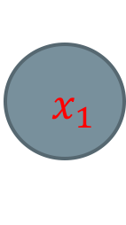


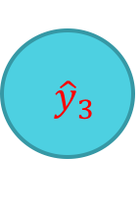


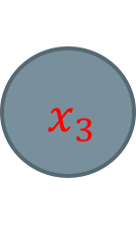




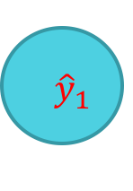
Feedforward Neural Network
$$σ$$
$$σ$$
$$x_{1}$$
$${ \hat{y}}_{1}$$
$$σ$$
$$σ$$
$${ x}_{2}$$
$${ \hat{y}}_{2}$$
$$σ$$
$$σ$$
$${ x}_{3}$$
$${ \hat{y}}_{3}$$
$$σ$$
$$σ$$
Notes:
Let’s revisit the structure of the NN.

Slide 23
Weights
$$σ$$
$$σ$$
$$x_{1}$$
$${ \hat{y}}_{1}$$
$$σ$$
$$σ$$
$${ x}_{2}$$
$${ \hat{y}}_{2}$$
$$σ$$
$$σ$$
$${ x}_{3}$$
$${ \hat{y}}_{3}$$
$$σ$$
$$σ$$
Notes:
The connections in between the layers are “weights”.

Slide 24
Input Layer
$$σ$$
$$σ$$
$$x_{1}$$
$${ \hat{y}}_{1}$$
$$σ$$
$$σ$$
$${ x}_{2}$$
$${ \hat{y}}_{2}$$
$$σ$$
$$σ$$
$${ x}_{3}$$
$${ \hat{y}}_{3}$$
$$σ$$
$$σ$$
Notes:
The first layer is called the input layer.
In some sense, every layer is the next layer’s input layer, but terminology-wise, the first one is the input layer.

Slide 25
Hidden Layers
$$σ$$
$$σ$$
$$x_{1}$$
$${ \hat{y}}_{1}$$
$$σ$$
$$σ$$
$${ x}_{2}$$
$${ \hat{y}}_{2}$$
$$σ$$
$$σ$$
$${ x}_{3}$$
$${ \hat{y}}_{3}$$
$$σ$$
$$σ$$
Notes:
These are hidden layers.

Slide 26
Output Layer
$$σ$$
$$σ$$
$$x_{1}$$
$${ \hat{y}}_{1}$$
$$σ$$
$$σ$$
$${ x}_{2}$$
$${ \hat{y}}_{2}$$
$$σ$$
$$σ$$
$${ x}_{3}$$
$${ \hat{y}}_{3}$$
$$σ$$
$$σ$$
Notes:
Just get the student familiar with the terminology

Slide 27



Weights (represented by matrices)
$$W^{(1)}$$
$$W^{(2)}$$
$$W^{(3)}$$
$$σ$$
$$σ$$
$$x_{1}$$
$${ \hat{y}}_{1}$$
$$σ$$
$$σ$$
$${ x}_{2}$$
$${ \hat{y}}_{2}$$
$$σ$$
$$σ$$
$${ x}_{3}$$
$${ \hat{y}}_{3}$$
$$σ$$
$$σ$$
Notes:
Weights between layers can be represented as a matrix, by putting every incoming weight to a given node as a row vector, and stacking those rows on top.
So, between the input layer and the first hidden layer, we have a 4 x 3 matrix.

Slide 28



Net Input (sum of weighted inputs, before activation function)
$$z^{(2)}$$
$$z^{(3)}$$
$$σ$$
$$σ$$
$$z^{(4)}$$
$$x_{1}$$
$${ \hat{y}}_{1}$$
$$σ$$
$$σ$$
$${ x}_{2}$$
$${ \hat{y}}_{2}$$
$$σ$$
$$σ$$
$${ x}_{3}$$
$${ \hat{y}}_{3}$$
$$σ$$
$$σ$$
Notes:
Once we have the weights, then we can compute the net inputs
It just corresponds to a matrix multiplication.

Slide 29




Activations (output of neurons to next layer)
$$a^{(2)}$$
$$a^{(3)}$$
$$a^{(1)}$$
$$σ$$
$$σ$$
$$a^{(4)}$$
$$x_{1}$$
$${ \hat{y}}_{1}$$
$$σ$$
$$σ$$
$${ x}_{2}$$
$${ \hat{y}}_{2}$$
$$σ$$
$$σ$$
$${ x}_{3}$$
$${ \hat{y}}_{3}$$
$$σ$$
$$σ$$
Notes:
Once the net input is prepared, it is fed into the activation function, and passed as input to the next layer.

Slide 30

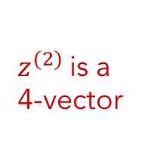
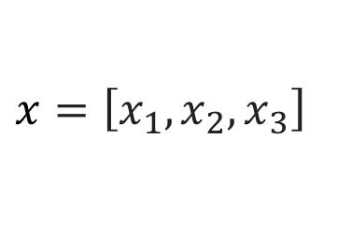
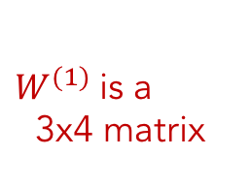





Matrix representation of computation
$$z^{(2)}$$
$$a^{(2)}$$
For a single data point (instance)
$$W^{(1)}$$
$$σ$$
$$x_{1}$$
$$x=\left[x_{1},x_{2},x_{3}\right]$$
$W^{(1)}$is a
3x4 matrix
$$σ$$
$${(x= a}^{(1)})$$
$${ x}_{2}$$
$z^{(2)}$is a
4-vector
$$σ$$
$$z^{(2)}=xW^{(1)}$$
$a^{(2)}$is a
4-vector
$${ x}_{3}$$
$$a^{(2)}=σ(z^{\left(2\right)})$$
$$σ$$
Notes:
We will see this in action in the exercises

Slide 31

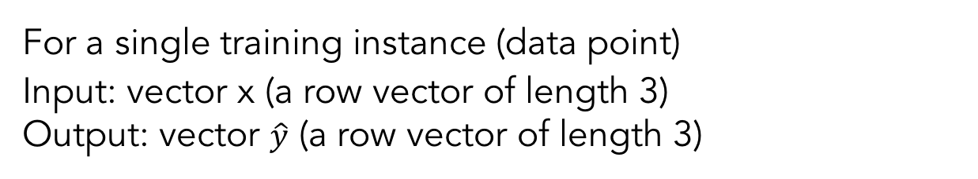





Continuing the Computation
For a single training instance (data point)
Input: vector x (a row vector of length 3)
Output: vector $\hat{y}$ (a row vector of length 3)
$$z^{(2)}=xW^{(1)}$$
$$a^{(2)}=σ(z^{\left(2\right)})$$
$$z^{(3)}=a^{(2)}W^{(2)}$$
$$a^{(3)}=σ(z^{\left(3\right)})$$
$$z^{(4)}=a^{(3)}W^{(3)}$$
$$\hat{y}=softmax(z^{\left(4\right)})$$

Slide 32

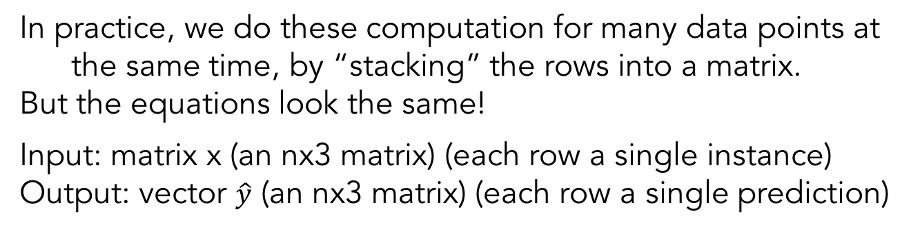





Multiple data points
In practice, we do these computation for many data points at the same time, by “stacking” the rows into a matrix.
But the equations look the same!
Input: matrix x (an nx3 matrix) (each row a single instance)
Output: vector $\hat{y}$ (an nx3 matrix) (each row a single prediction)
$$z^{(2)}=xW^{(1)}$$
$$a^{(2)}=σ(z^{\left(2\right)})$$
$$z^{(3)}=a^{(2)}W^{(2)}$$
$$a^{(3)}=σ(z^{\left(3\right)})$$
$$z^{(4)}=a^{(3)}W^{(3)}$$
$$\hat{y}=softmax(z^{\left(4\right)})$$
Notes:
This is a useful practical detail to emphasize, or at least expose the student to. We can do all the operations on the pervious slide for a single datapoint (row)
So then just stack the rows into a matrix, and everything still works nicely.

Slide 33
Now we know how feedforward NNs do Computations.
Next, we will learn how to adjust the weights to learn from data.
Notes:
So far we only talked about one forward pass.
That process does not involve learning / fitting.
We will talk about that next.

