Slide 1
Backpropagation in Neural Nets

Slide 2
Legal Notices and Disclaimers
This presentation is for informational purposes only. INTEL MAKES NO WARRANTIES, EXPRESS OR IMPLIED, IN THIS SUMMARY.
Intel technologies’ features and benefits depend on system configuration and may require enabled hardware, software or service activation. Performance varies depending on system configuration. Check with your system manufacturer or retailer or learn more at intel.com.
This sample source code is released under the Intel Sample Source Code License Agreement.
Intel and the Intel logo are trademarks of Intel Corporation in the U.S. and/or other countries.
*Other names and brands may be claimed as the property of others.
Copyright © 2017, Intel Corporation. All rights reserved.

Slide 3
How to Train a Neural Net?
Input
(Feature Vector)
Output
(Label)
Put in Training inputs, get the output
Compare output to correct answers: Look at loss function J
Adjust and repeat!
Backpropagation tells us how to make a single adjustment using calculus.
Notes:
Last time we saw how a NN computes the output given an input, in 1 single forward pass.
Where does the training occur then?
We compare the output to the known truth, and calculate our loss J
According to our loss function, we adjust weights, and repeat.
The adjustment is basically gradient descent, however computing that for all the weights is difficult.
It involves a technique called “backpropagation”.

Slide 4
How have we trained before?
Gradient Descent!
        Make prediction
        Calculate Loss
        Calculate gradient of the loss function w.r.t. parameters
        Update parameters by taking a step in the opposite direction
        Iterate
Notes:
For most classical ML algorithms, the training happens at the gradient descent step.

Slide 5
How have we trained before?
Gradient Descent!
        Make prediction
        Calculate Loss
        Calculate gradient of the loss function w.r.t. parameters
        Update parameters by taking a step in the opposite direction
        Iterate
Notes:
Let’s focus on these steps and let’s see it visually.

Slide 6
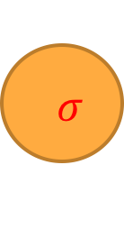

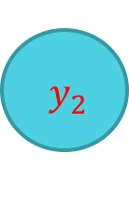
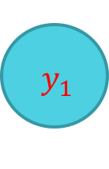


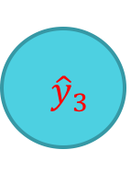

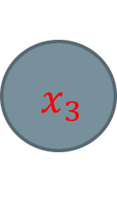


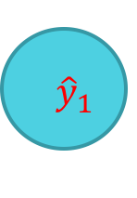

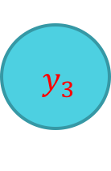
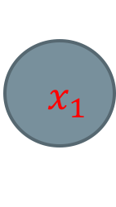


Feedforward Neural Network
$$σ$$
$$σ$$
$$x_{1}$$
$${ \hat{y}}_{1}$$
$${ y}_{1}$$
$$σ$$
$$σ$$
$${ x}_{2}$$
$${ \hat{y}}_{2}$$
$${ y}_{2}$$
$$σ$$
$$σ$$
$${ x}_{3}$$
$${ \hat{y}}_{3}$$
$${ y}_{3}$$
$$σ$$
$$σ$$
Notes:
Let’s see this visually again:

Slide 7
Forward Propagation
Pass in
Input
$$σ$$
$$σ$$
$$x_{1}$$
$${ \hat{y}}_{1}$$
$${ y}_{1}$$
$$σ$$
$$σ$$
$${ x}_{2}$$
$${ \hat{y}}_{2}$$
$${ y}_{2}$$
$$σ$$
$$σ$$
$${ x}_{3}$$
$${ \hat{y}}_{3}$$
$${ y}_{3}$$
$$σ$$
$$σ$$
Notes:
Inputs are passed in.
Inputs are constant, they are rows of our training data.

Slide 8
Forward Propagation
Calculate each Layer
$$σ$$
$$σ$$
$$x_{1}$$
$${ \hat{y}}_{1}$$
$${ y}_{1}$$
$$σ$$
$$σ$$
$${ x}_{2}$$
$${ \hat{y}}_{2}$$
$${ y}_{2}$$
$$σ$$
$$σ$$
$${ x}_{3}$$
$${ \hat{y}}_{3}$$
$${ y}_{3}$$
$$σ$$
$$σ$$
Notes:
Perform the matrix multiplications and activation functions in order to calculate each layer.

Slide 9
Forward Propagation
Get Output
$$σ$$
$$σ$$
$$x_{1}$$
$${ \hat{y}}_{1}$$
$${ y}_{1}$$
$$σ$$
$$σ$$
$${ x}_{2}$$
$${ \hat{y}}_{2}$$
$${ y}_{2}$$
$$σ$$
$$σ$$
$${ x}_{3}$$
$${ \hat{y}}_{3}$$
$${ y}_{3}$$
$$σ$$
$$σ$$
Notes:
And then get our predictions.

Slide 10

Forward Propagation
Evaluate:
$$J\left(y_{i},\hat{y_{i}}\right)$$
$$σ$$
$$σ$$
$$x_{1}$$
$${ \hat{y}}_{1}$$
$${ y}_{1}$$
$$σ$$
$$σ$$
$${ x}_{2}$$
$${ \hat{y}}_{2}$$
$${ y}_{2}$$
$$σ$$
$$σ$$
$${ x}_{3}$$
$${ \hat{y}}_{3}$$
$${ y}_{3}$$
$$σ$$
$$σ$$
Notes:
Compare the predictions to the known ground truths.
Specifically, calculate the loss function.

Slide 11
How have we trained before?
Gradient Descent!
        Make prediction
        Calculate Loss
        Calculate gradient of the loss function w.r.t. parameters
        Update parameters by taking a step in the opposite direction
        Iterate
Notes:
Let’s now see how step 3 works.

Slide 12
How to calculate gradient?
Chain rule
Notes:
Mike wanted to insert something here.

Slide 13
How to Train a Neural Net?
How could we change the weights to make our Loss Function lower?
Think of neural net as a function F: X -> Y
F is a complex computation involving many weights W_k
Given the structure, the weights “define” the function F (and therefore define our model)
Loss Function is J(y,F(x))
Notes:
The goal is to change the weights to make the loss function lower.
Thinking of the NN as a function, the loss function is a function of J(y, F(X))

Slide 14
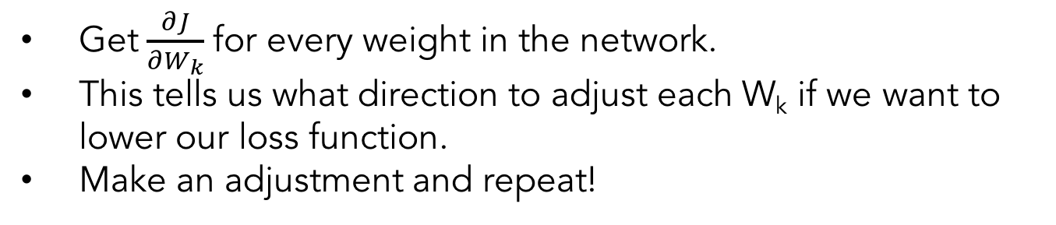
How to Train a Neural Net?
Get$\frac{∂J}{∂W_{k}}$ for every weight in the network.
This tells us what direction to adjust each W_{k} if we want to lower our loss function.
Make an adjustment and repeat!
Notes:
With this setting, from an abstract mathematical standpoint, there is no difference between this and classical ML gradient descent.
It’s just that the function involved is much more complicated, and computation of gradients is mathematically and computationally more challenging.

Slide 15

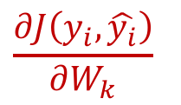


Feedforward Neural Network
$$W^{(2)}$$
$$W^{(3)}$$
$$\frac{∂J\left(y_{i},\hat{y_{i}}\right)}{∂W_{k}}$$
$$W^{(1)}$$
Want:
$$σ$$
$$σ$$
$$x_{1}$$
$${ \hat{y}}_{1}$$
$${ y}_{1}$$
$$σ$$
$$σ$$
$${ x}_{2}$$
$${ \hat{y}}_{2}$$
$${ y}_{2}$$
$$σ$$
$$σ$$
$${ x}_{3}$$
$${ \hat{y}}_{3}$$
$${ y}_{3}$$
$$σ$$
$$σ$$
Notes:
So we want to be able to compute the partial derivative of the loss function w.r. to the weights Wk

Slide 16
Calculus to the Rescue
Use calculus, chain rule, etc. etc.
Functions are chosen to have “nice” derivatives
Numerical issues to be considered
Notes:
The math gets pretty messy very quick, but to give you a flavor of what happens;
The matrix multiplications, and the activation functions, are chosen to have nice derivatives.
There are numerical issues that arise too.

Slide 17
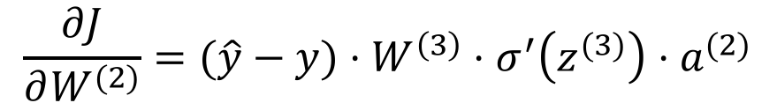

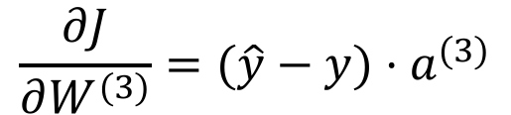
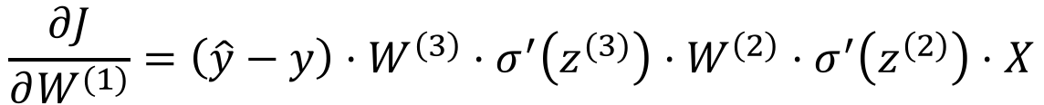
Punchline
$$\frac{∂J}{∂W^{(3)}}=(\hat{y}−y)⋅a^{(3)}$$
$$\frac{∂J}{∂W^{(2)}}=(\hat{y}−y)⋅W^{\left(3\right)}⋅σ^{′}\left(z^{(3)}\right)⋅a^{(2)}$$
$$\frac{∂J}{∂W^{(1)}}=\left(\hat{y}−y\right)⋅W^{\left(3\right)}⋅σ^{′}\left(z^{(3)}\right)⋅W^{\left(2\right)}⋅σ^{′}\left(z^{\left(2\right)}\right)⋅X$$
Recall that: $σ′\left(z\right)$ = $σ(z)(1−σ(z)$)
Though they appear complex, above are easy to compute!
Notes:
In this example network we’ve been seeing, equations work out to be these:
Early layers reuse computation from later layers. --> BACK propagation.
You see how the gradient of W1 uses the gradient of W2 (point in the formula)
Early layers have more terms -> smaller numbers -> vanishing gradient

Slide 18
Backpropagation
$$W^{(2)}$$
$$W^{(3)}$$
$$\frac{∂J\left(y_{i},\hat{y_{i}}\right)}{∂W_{k}}$$
$$W^{(1)}$$
Want:
$$σ$$
$$σ$$
$$x_{1}$$
$${ \hat{y}}_{1}$$
$${ y}_{1}$$
$$σ$$
$$σ$$
$${ x}_{2}$$
$${ \hat{y}}_{2}$$
$${ y}_{2}$$
$$σ$$
$$σ$$
$${ x}_{3}$$
$${ \hat{y}}_{3}$$
$${ y}_{3}$$
$$σ$$
$$σ$$
Notes:
So visually, the flow is this.

Slide 19

Backpropagation
$$W^{(2)}$$
$$\frac{∂J\left(y_{i},\hat{y_{i}}\right)}{∂W_{3}}$$
$$W^{(1)}$$
$$σ$$
$$σ$$
$$x_{1}$$
$${ \hat{y}}_{1}$$
$${ y}_{1}$$
$$σ$$
$$σ$$
$${ x}_{2}$$
$${ \hat{y}}_{2}$$
$${ y}_{2}$$
$$σ$$
$$σ$$
$${ x}_{3}$$
$${ \hat{y}}_{3}$$
$${ y}_{3}$$
$$σ$$
$$σ$$
Notes:
We first compute this, math turns out to be simpler for the last layer.

Slide 20
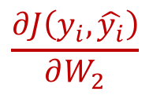
Backpropagation
$$\frac{∂J\left(y_{i},\hat{y_{i}}\right)}{∂W_{2}}$$
$$\frac{∂J\left(y_{i},\hat{y_{i}}\right)}{∂W_{3}}$$
$$W^{(1)}$$
$$σ$$
$$σ$$
$$x_{1}$$
$${ \hat{y}}_{1}$$
$${ y}_{1}$$
$$σ$$
$$σ$$
$${ x}_{2}$$
$${ \hat{y}}_{2}$$
$${ y}_{2}$$
$$σ$$
$$σ$$
$${ x}_{3}$$
$${ \hat{y}}_{3}$$
$${ y}_{3}$$
$$σ$$
$$σ$$
Notes:
Using that value, we compute the partial derivative for the previous layer. Back propagation!

Slide 21
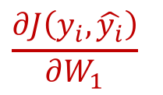
Backpropagation
$$\frac{∂J\left(y_{i},\hat{y_{i}}\right)}{∂W_{1}}$$
$$\frac{∂J\left(y_{i},\hat{y_{i}}\right)}{∂W_{2}}$$
$$\frac{∂J\left(y_{i},\hat{y_{i}}\right)}{∂W_{3}}$$
$$σ$$
$$σ$$
$$x_{1}$$
$${ \hat{y}}_{1}$$
$${ y}_{1}$$
$$σ$$
$$σ$$
$${ x}_{2}$$
$${ \hat{y}}_{2}$$
$${ y}_{2}$$
$$σ$$
$$σ$$
$${ x}_{3}$$
$${ \hat{y}}_{3}$$
$${ y}_{3}$$
$$σ$$
$$σ$$
Notes:
We go all the way back like that.

Slide 22
How have we trained before?
Gradient Descent!
        Make prediction
        Calculate Loss
        Calculate gradient of the loss function w.r.t. parameters
        Update parameters by taking a step in the opposite direction
        Iterate
Notes:
Step 4, once we have the gradient, we just take a step in the opposite direction.
Specifically; w = w – learning_rate * gradient
This part is the same as in ML.

Slide 23
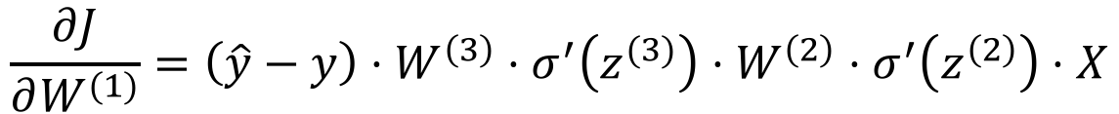
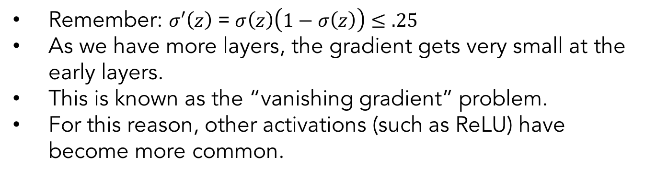
Vanishing Gradients
Recall that:
$$\frac{∂J}{∂W^{(1)}}=\left(\hat{y}−y\right)⋅W^{\left(3\right)}⋅σ^{′}\left(z^{(3)}\right)⋅W^{\left(2\right)}⋅σ^{′}\left(z^{\left(2\right)}\right)⋅X$$
Remember: $σ′\left(z\right)$ = $σ\left(z\right)\left(1−σ\left(z\right)\right)≤.25$
As we have more layers, the gradient gets very small at the early layers.
This is known as the “vanishing gradient” problem.
For this reason, other activations (such as ReLU) have become more common.
Notes:
Let’s talk about the numerical issues a bit.
Gradient, for the sigmoid activation function, is always smaller than .25
So the more layers we have, the smaller the gradient will turn out to be.

Slide 24
Other Activation Functions
Notes:
Let’s talk about other activation functions, which can be better choices than sigmoid, for deep networks.

Slide 25
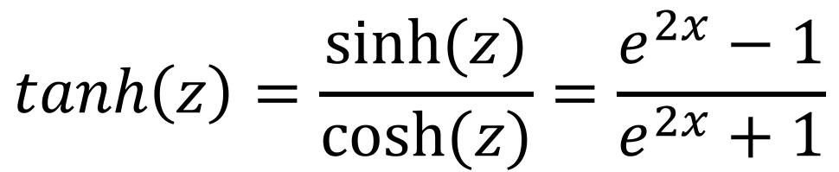
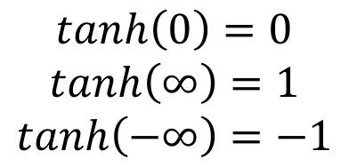
Hyperbolic Tangent Function
Hyperbolic tangent function
Pronounced “tanch”
$$tanh\left(z\right)=\frac{sinh⁡(z)}{cosh⁡(z)}=\frac{e^{2x}−1}{e^{2x}+1}$$
$$tanh\left(0\right)=0$$
$$tanh\left(∞\right)=1$$
$$tanh\left(−∞\right)=−1$$

Slide 26
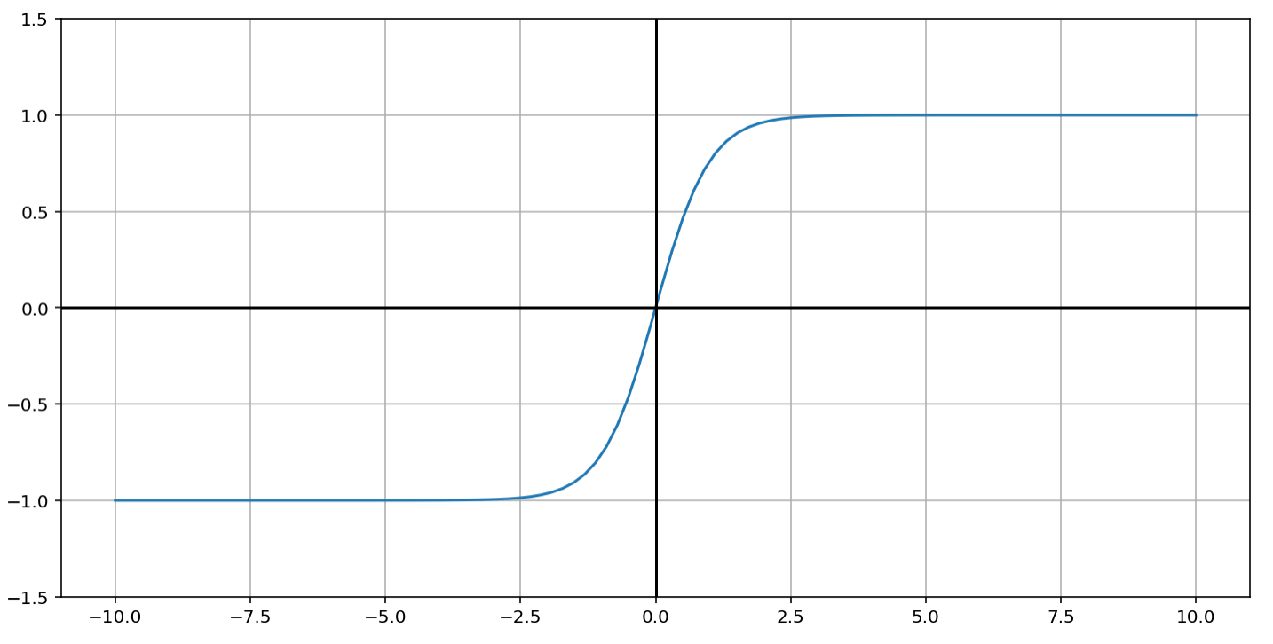
Hyperbolic Tangent Function

Slide 27
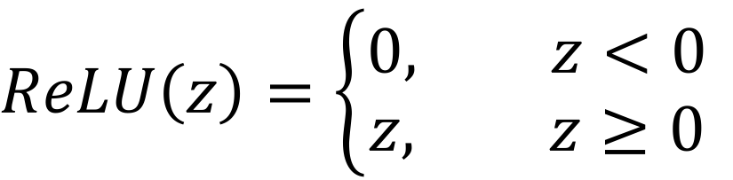

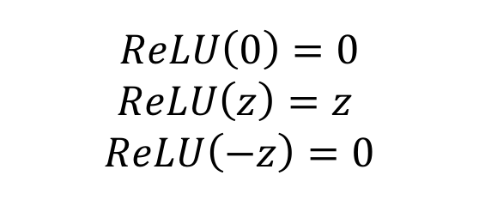
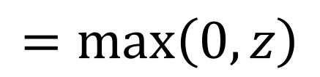
Rectified Linear Unit (ReLU)
$$ReLU\left(z\right)=\left\{\begin{aligned}0, z<0 \\ &z, z≥0\end{aligned}\right.$$
$$=max\left(0, z\right)$$
$$ReLU\left(0\right)=0$$
$$ReLU\left(z\right)=z$$
$$ReLU\left(−z\right)=0$$
$$for (z≫0)$$

Slide 28
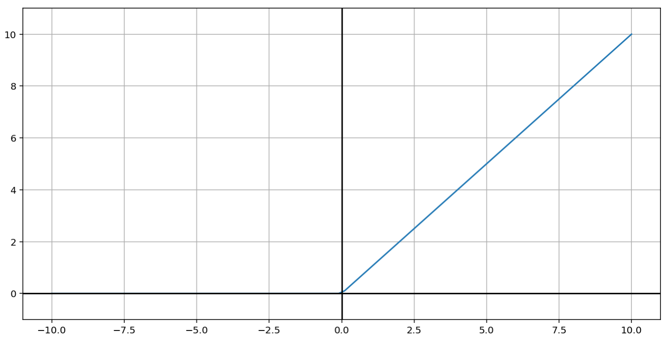
Rectified Linear Unit (ReLU)

Slide 29
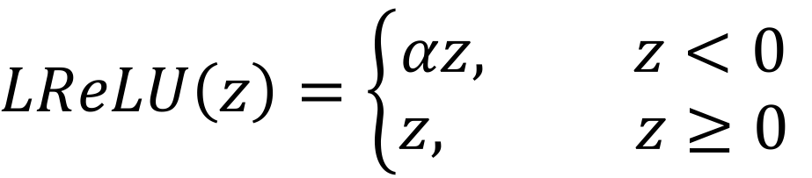

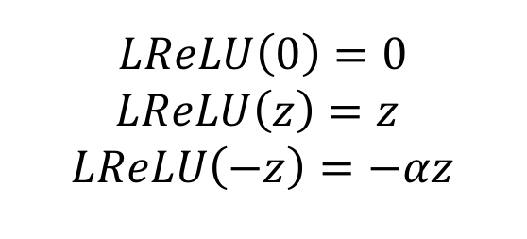
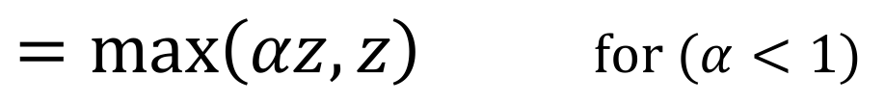
“Leaky” Rectified Linear Unit (ReLU)
$$LReLU\left(z\right)=\left\{\begin{aligned}αz, z<0 \\ &z, z≥0\end{aligned}\right.$$
$=max\left(αz, z\right)$ $for (α<1)$
$$LReLU\left(0\right)=0$$
$$LReLU\left(z\right)=z$$
$$LReLU\left(−z\right)=−αz$$
$$for (z≫0)$$
Notes:
Worth mentioning that having a zero gradient means something will never change. This is the main reason for having Leaky Relu vs plain Relu

Slide 30
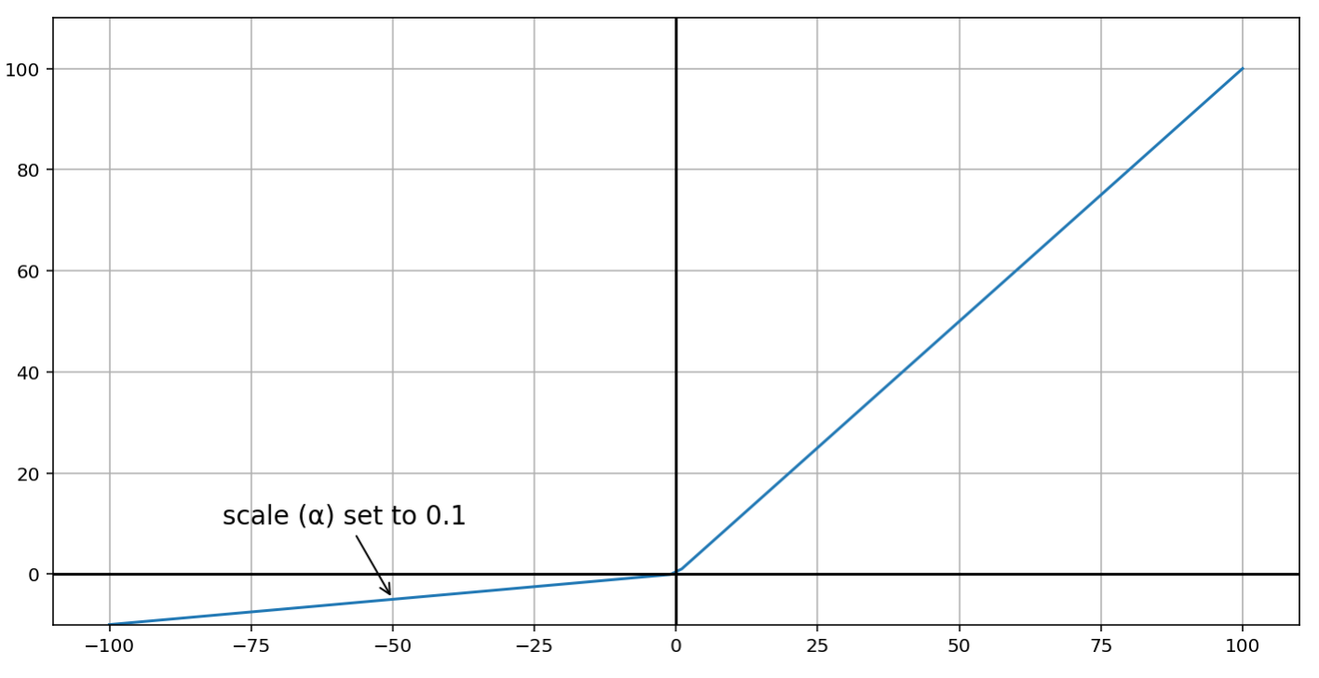
“Leaky” Rectified Linear Unit (ReLU)

Slide 31
What next?
We now know how to make a single update to a model given some data.
But how do we do the full training?
We will dive into these details in the next lecture.

