Slide 1
Details of Training
Neural Nets

Slide 2
Legal Notices and Disclaimers
This presentation is for informational purposes only. INTEL MAKES NO WARRANTIES, EXPRESS OR IMPLIED, IN THIS SUMMARY.
Intel technologies’ features and benefits depend on system configuration and may require enabled hardware, software or service activation. Performance varies depending on system configuration. Check with your system manufacturer or retailer or learn more at intel.com.
This sample source code is released under the Intel Sample Source Code License Agreement.
Intel and the Intel logo are trademarks of Intel Corporation in the U.S. and/or other countries.
*Other names and brands may be claimed as the property of others.
Copyright © 2017, Intel Corporation. All rights reserved.

Slide 3
What next?
Given an example (or group of examples), we know how to compute the derivative for each weight.
How exactly do we update the weights?
        How often? (after each training data point? after all the training data points?)
Notes:
There are choices one could make in the weight updating process which would make the training faster / better / etc

Slide 4
What next? – Gradient Descent
W_new = W_old - lr * derivative
Classical approach – get derivative for entire data set, then take a step in that direction
Pros: Each step is informed by all the data
Cons: Very slow, especially as data gets big
Notes:
lr = learning rate = step size
This is batch gradient descent. It involves the entire batch. Better steps, but slower steps.

Slide 5
Another approach: Stochastic Gradient Descent
Get derivative for just one point, and take a step in that direction
Steps are “less informed” but you take more of them
Should “balance out”
Probably want a smaller step size
Also helps “regularize”

Slide 6
Compromise approach: Mini-batch
Get derivative for a ”small” set of points, then take a step in that direction
Typical mini batch sizes are 16, 32
Strikes a balance between two extremes

Slide 7
Comparison of Batching Approaches
Notes:
This is a good summary. Might mention that full batch is still quite meandering, just less so than the others.

Slide 8
Batching Terminology
Full-batch: Use entire data set to compute gradient before updating
Mini-batch: Use a smaller portion of data (but more than single example) to compute gradient before updating
Stochastic Gradient Descent (SGD): Use a single example to compute gradient before updating (though sometimes people use SGD to refer to minibatch, also)

Slide 9
Batching Terminology
An Epoch refers to a single pass through all of the training data.
In full batch gradient descent, there would be one step taken per epoch.
In SGD / Online learning, there would be n steps taken per epoch (n = training set size)
In Minibatch there would be (n/batch size) steps taken per epoch
When training, it is common to refer to the number of epochs needed for the model to be “trained”.
Notes:
Worth throwing out the idea that you want about the same movement per epoch.
So either many small steps (smaller batches) or fewer large steps (bigger batches)
But must adjust learning rate accordingly

Slide 10
Note on Data Shuffling
To avoid any cyclical movement and aid convergence, it is recommended to shuffle the data after each epoch.
This way, the data is not seen in the same order every time, and the batches are not the exact same ones.
Notes:
They were exposed to this idea in the first exercise…

Slide 11
Feedforward Neural Network
FULL BATCH
Batch 1
Batch 2
Batch 3
Batch 4
Batch 5

Slide 12
Training in Action
Batch 1
Step 1
Batch 2
Batch 3
Batch 4
Batch 5

Slide 13
Training in Action
Batch 1
Batch 2
Step 2
Batch 3
Batch 4
Batch 5

Slide 14
Training in Action
Batch 1
Batch 2
Batch 3
Step 3
Batch 4
Batch 5

Slide 15
Training in Action
Batch 1
Batch 2
Batch 3
Batch 4
Step 4
Batch 5

Slide 16
Training in Action
Batch 1
Batch 2
Batch 3
Batch 4
Batch 5
Step 5

Slide 17
Training in Action
Batch 1
Batch 2
Batch 3
Batch 4
Batch 5
First Epoch Complete!

Slide 18
Shuffle the Data!
Batch 1
Batch 2
Batch 3
Batch 4
Batch 5

Slide 19
Shuffle the Data!
Step 6
Notes:
Do it again.

Slide 20
The Keras Package
Keras allows easy construction, training, and execution of Deep Neural Networks
Written in Python, and allows users to configure complicated models directly in Python
Uses either Tensorflow or Theano “under the hood”
Uses either CPU or GPU for computation
Uses numpy data structures, and a similar command structure to scikit-learn (model.fit , model.predict, etc.)
Notes:
Can add that there is increasing integration with TensorFlow.
TensorFlow has adopted Keras as its “official” front end.

Slide 21
Typical Command Structure in Keras
Build the structure of your network.
Compile the model, specifying your loss function, metrics, and optimizer (which includes the learning rate).
Fit the model on your training data (specifying batch size, number of epochs)
Predict on new data
Evaluate your results
Notes:
A few differences between keras and sklearn
In keras, we build the network, tell it how many layers, what are activation functions etc.
And then we compile the model (doesn’t exist in sklearn)
Rest is the same.

Slide 22
Building the model
Keras provides two approaches to building the structure of your model:
Sequential Model: allows a linear stack of layers – simpler and more convenient if model has this form
Functional API: more detailed and complex, but allows more complicated architectures
We will focus on the Sequential Model.
Notes:
One note about how training / test loss are calculated in Keras:
You may see that training loss is higher than test loss in Keras models.
This behavior stems from difference in procedure on how keras calculates training loss vs test loss
Training loss is averaged over many batches in an epoch, whereas test loss is based on the final parameters of that epoch and consequently may turn out to be lower.

Slide 23
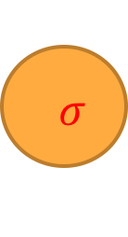

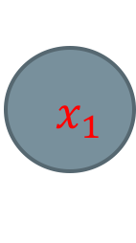


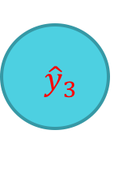


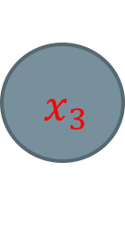




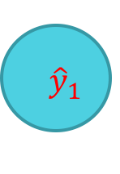
Running Example, this time in Keras
Let’s build this Neural Network structure shown below in Keras:
$$σ$$
$$σ$$
$$x_{1}$$
$${ \hat{y}}_{1}$$
$$σ$$
$$σ$$
$${ x}_{2}$$
$${ \hat{y}}_{2}$$
$$σ$$
$$σ$$
$${ x}_{3}$$
$${ \hat{y}}_{3}$$
$$σ$$
$$σ$$

Slide 24
Keras - Sequential Model
First, import the Sequential function and initialize your model object:
from keras.models import Sequential
model = Sequential()

Slide 25
Keras - Sequential Model
Then we add layers to the model one by one.
from keras.layers import Dense, Activation
# For the first layer, specify the input dimension
model.add(Dense(units=4, input_dim=3))
# Specify an activation function
model.add(Activation(sigmoid'))
# For subsequent layers, the input dimension is presumed from
# the previous layer
model.add(Dense(units=4))
model.add(Activation(sigmoid'))
model.add(Dense(units=3))
model.add(Activation('softmax'))
Notes:
They will do this directly in the accompanying exercise.
First layer has input dim 3, and 4 nodes (units=4)
Look at the final line. That’s a different activation function. Let’s talk about that a little bit.

Slide 26
Multiclass Classification with Neural Networks
For binary classification problems, we have a final layer with a single node and a sigmoid activation.
This has many desirable properties
Gives an output strictly between 0 and 1
Can be interpreted as a probability
Derivative is “nice”
Analogous to logistic regression
Is there a natural extension of this to a multiclass setting?

Slide 27
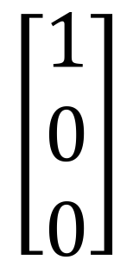
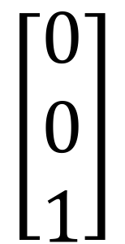
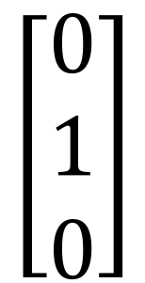
Multiclass Classification with Neural Networks
Reminder: one hot encoding for categories
Take a vector with length equal to the number of categories
Represent each category with one at a particular position (and zero everywhere else)
$$\left[\begin{matrix}1 \\ 0 \\ 0\end{matrix}\right]$$
$$\left[\begin{matrix}0 \\ 1 \\ 0\end{matrix}\right]$$
$$\left[\begin{matrix}0 \\ 0 \\ 1\end{matrix}\right]$$
Cat
Dog
Toaster
Notes:
Might voice over about why it would be a bad idea to have cat = 1, dog = 2, toaster = 3
(i.e. don’t want any ordinal relation between categories (dog should not be ”between” cat and toaster)

Slide 28
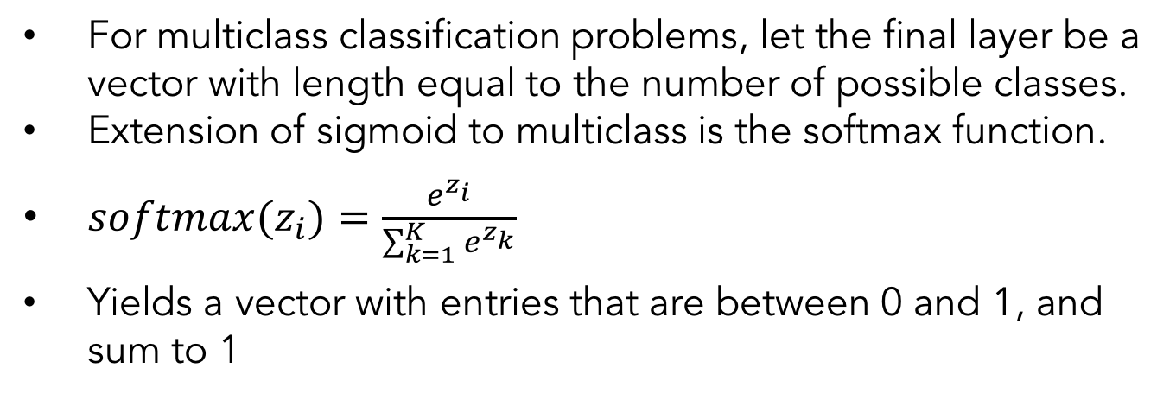
Multiclass Classification with Neural Networks
For multiclass classification problems, let the final layer be a vector with length equal to the number of possible classes.
Extension of sigmoid to multiclass is the softmax function.
    $softmax(z_{i})=\frac{e^{z_{i}}}{\sum_{k=1}^{K}{e^{z_{k}}}}$
Yields a vector with entries that are between 0 and 1, and sum to 1
Notes:
Can voice over emphasizing the exponential aspect of the scaling.
E.g. [3,1,1] does not become [.6, .2, .2] but rather [.78, .11, .11] since we are “exp”-ing before normalizing.
Can be interpreted as probabilities.

Slide 29
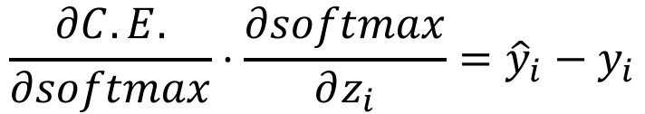
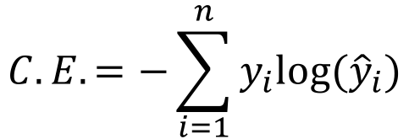
Multiclass Classification with Neural Networks
For loss function use “categorical cross entropy”
This is just the log-loss function in disguise
$$C.E.=−\sum_{i=1}^{n}{y_{i}log⁡({\hat{y}}_{i})}$$
Derivative has a nice property when used with softmax
$$\frac{∂C.E.}{∂softmax}⋅\frac{∂softmax}{∂z_{i}}={\hat{y}}_{i}−y_{i}$$
Notes:
Can voice over that (typically) yi is either 1 or 0, so you are getting log(yi^hat) for the “actual” right answer.
Same as saying, “what likelihood did your model assign to this data set?”

Slide 30
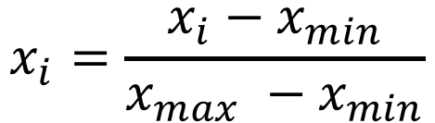
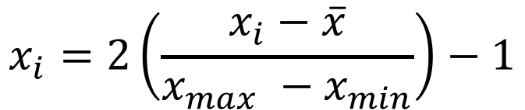
Ways to scale inputs
Linear scaling to the interval [0,1]
Linear scaling to the interval [-1,1]
$$x_{i}=\frac{x_{i}−x_{min}}{x_{max} −x_{min}}$$
$$x_{i}=2\left(\frac{x_{i}−\overline{x}}{x_{max} −x_{min}}\right)−1$$
Notes:
Voice over that it adds to numerical stability to have inputs be on the same scale. Good practice.

Slide 31
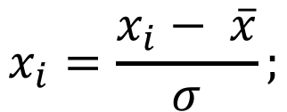
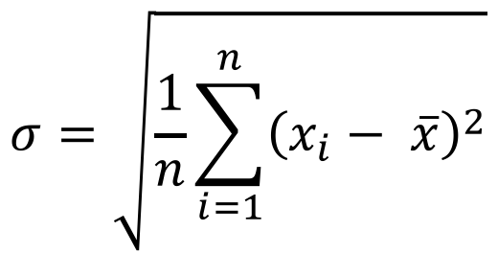
Ways to scale inputs
Standardization (making variable approx. std. normal)
$$σ=\sqrt{\frac{1}{n}\sum_{i=1}^{n}{{\left(x_{i}− \overline{x}\right)}^{2}}}$$
$$x_{i}=\frac{x_{i}− \overline{x}}{σ};$$

