Slide 1
Regularization Techniques for Deep Learning

Slide 2
Legal Notices and Disclaimers
This presentation is for informational purposes only. INTEL MAKES NO WARRANTIES, EXPRESS OR IMPLIED, IN THIS SUMMARY.
Intel technologies’ features and benefits depend on system configuration and may require enabled hardware, software or service activation. Performance varies depending on system configuration. Check with your system manufacturer or retailer or learn more at intel.com.
This sample source code is released under the Intel Sample Source Code License Agreement.
Intel and the Intel logo are trademarks of Intel Corporation in the U.S. and/or other countries.
*Other names and brands may be claimed as the property of others.
Copyright © 2017, Intel Corporation. All rights reserved.

Slide 3
Regularizing Neural Networks
We have several means by which to help “regularize” neural networks – that is, to prevent overfitting
Regularization penalty in cost function
Dropout
Early stopping
Stochastic / Mini-batch Gradient descent (to some degree)

Slide 4
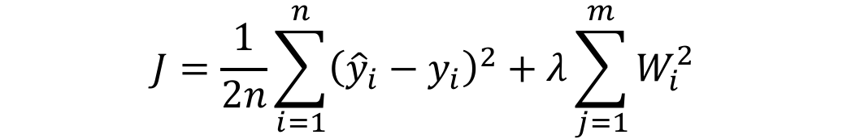
Penalized Cost function
One option is to explicitly add a penalty to the loss function for having high weights.
This is a similar approach to Ridge Regression
$$J=\frac{1}{2n}\sum_{i=1}^{n}{{\left({\hat{y}}_{i}−y_{i}\right)}^{2}}+λ\sum_{j=1}^{m}{W_{i}^{2}}$$
Can have an analogous expression for Categorical Cross Entropy

Slide 5
Dropout
Dropout is a mechanism where at each training iteration (batch) we randomly remove a subset of neurons
This prevents the neural network from relying too much on individual pathways, making it more “robust”
At test time we “rescale” the weight of the neuron to reflect the percentage of the time it was active
Notes:
This is a popular technique.

Slide 6
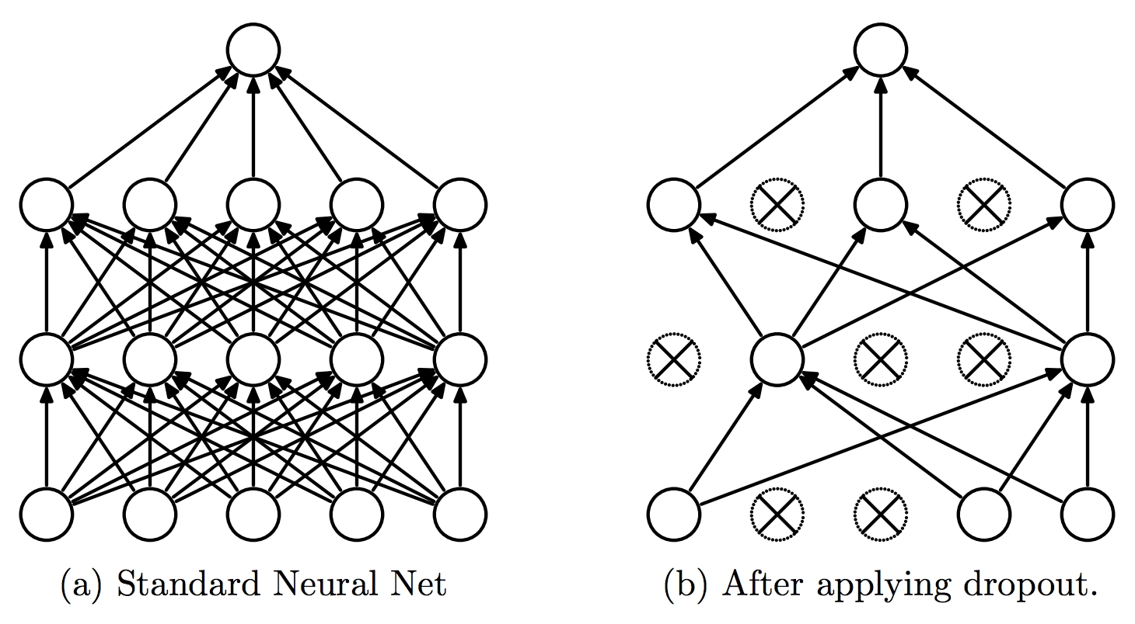
Dropout - Visualization
Notes:
Recall, at each iteration, we remove nodes randomly. So it is different from having less neurons to begin with.

Slide 7
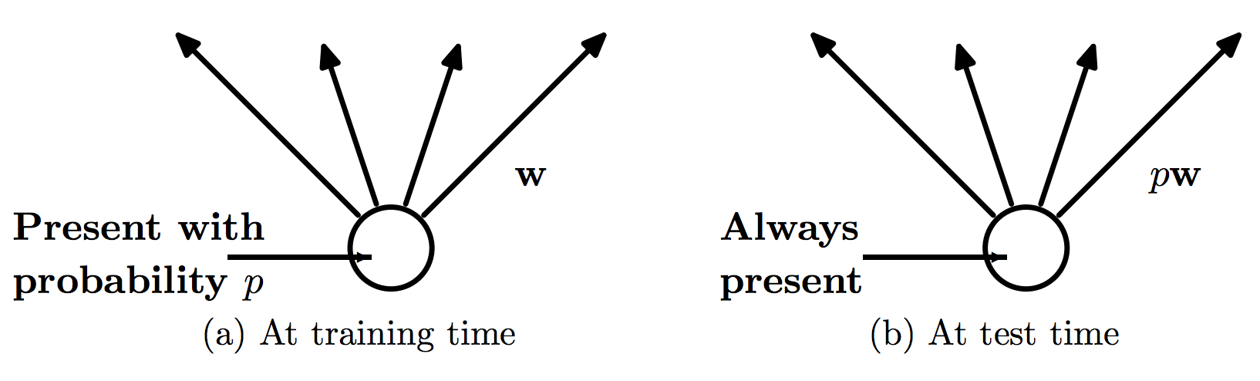
Dropout - Visualization
If the neuron was present with probability p, at test time we scale the outbound weights by a factor of p.
Notes:
It is important to emphasize how the weight of the neuron is “scaled” during execution. If the neuron was “off” with probability .5 during training and ended with a weight of 4, we actually give that neuron a weight of 4*.5 = 2.

Slide 8
Early Stopping
Another, more heuristical approach to regularization is early stopping.
This refers to choosing some rules after which to stop training.
Example:
Check the validation log-loss every 10 epochs.
If it is higher than it was last time, stop and use the previous model (i.e. from 10 epochs previous)

Slide 9

Optimizers
We have considered approaches to gradient descent which vary the number of data points involved in a step.
However, they have all used the standard update formula:
There are several variants to updating the weights which give better performance in practice.
These successive “tweaks” each attempt to improve on the previous idea.
The resulting (often complicated) methods are referred to as “optimizers”.
$$W≔W−α⋅∇J$$
Notes:
In general, I don’t know how helpful it is to go into the gory details of these optimizers. I think it is more useful to present them as successive improvements and refinements of how to choose a step size (and direction) at each point.

Slide 10
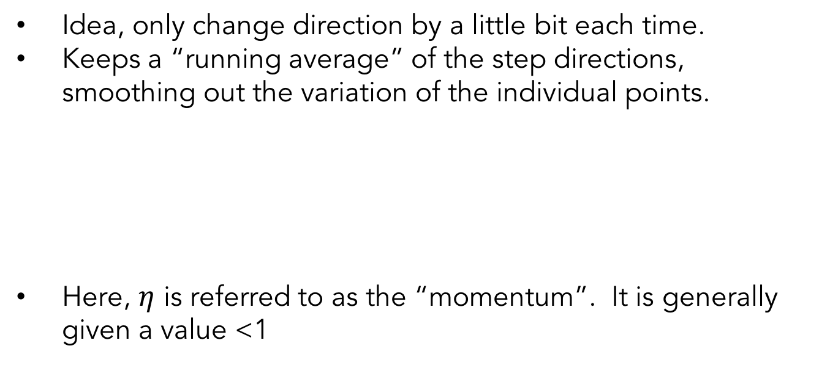


Momentum
Idea, only change direction by a little bit each time.
Keeps a “running average” of the step directions, smoothing out the variation of the individual points.
Here, $η$ is referred to as the “momentum”. It is generally given a value <1
$$v_{t}≔η⋅v_{t−1}−α⋅∇J$$
$$W≔W−v_{t}$$
Notes:
Example optimizer 1

Slide 11
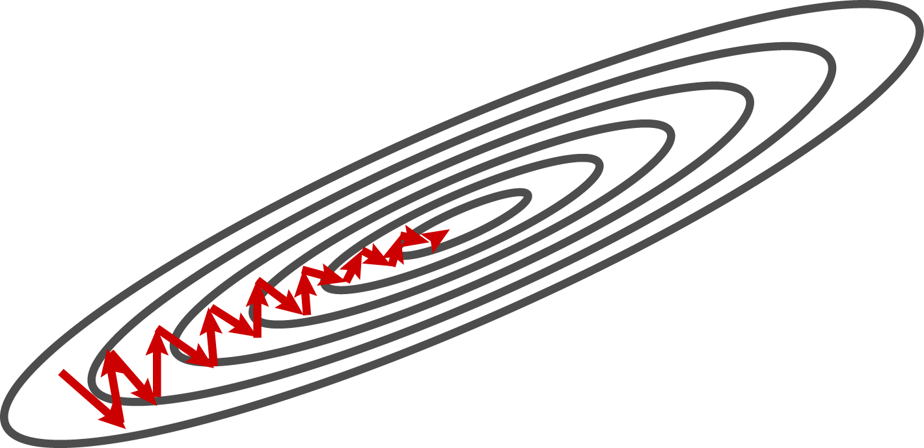
Gradient Descent vs Momentum
Notes:
This is what regular gradient descent would do

Slide 12
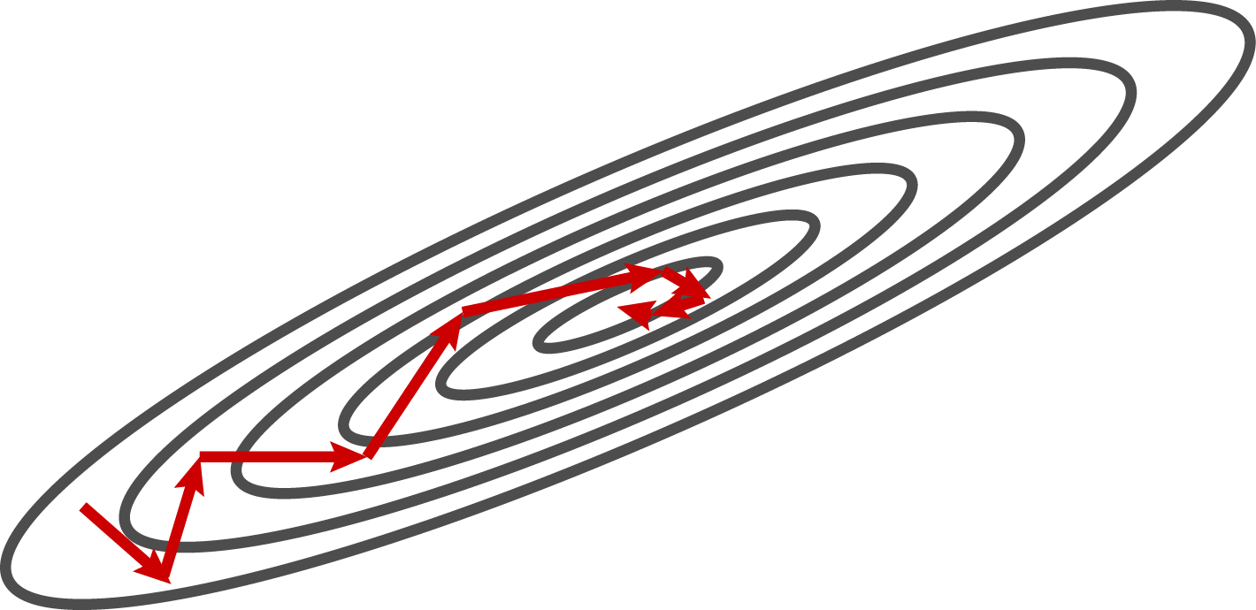
Gradient Descent vs Momentum
Notes:
With momentum, it is a bit smoother.

Slide 13

Nesterov Momentum
Idea: Control “overshooting” by looking ahead.
Apply gradient only to the “non-momentum” component.
$$v_{t}=η⋅v_{t−1}−α⋅∇(J−η⋅v_{t−1})$$
$$W≔W−v_{t}$$
Notes:
The part in the gradient is the “nonmomentum” component.

Slide 14
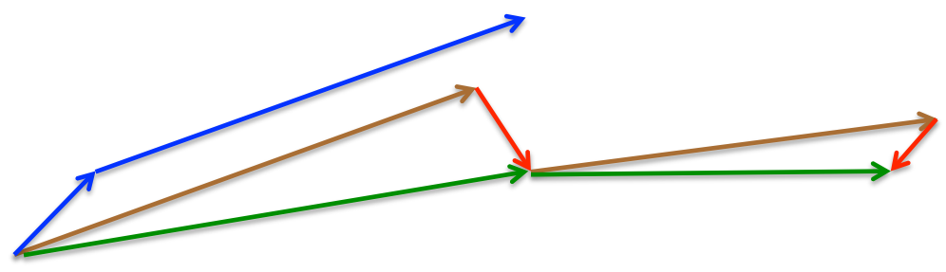
Nesterov Momentum
Momentum Vector
Gradient/correction
Nesterov steps
Standard momentum steps

Slide 15
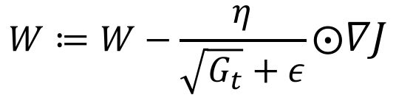
AdaGrad
Idea: scale the update for each weight separately.
Update frequently-updated weights less
Keep running sum of previous updates
Divide new updates by factor of previous sum
$$W≔W−\frac{η}{\sqrt{G_{t}}+ε}⨀∇J$$

Slide 16
RMSProp
Quite similar to AdaGrad.
Rather than using the sum of previous gradients, decay older gradients more than more recent ones.
More adaptive to recent updates

Slide 17

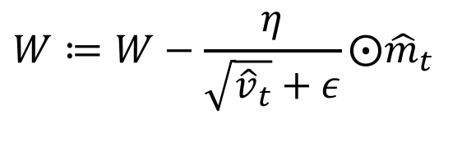
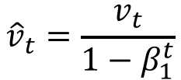
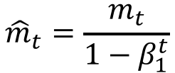

Adam
Idea: use both first-order and second-order change information and decay both over time.
$$m_{t}=β_{1}m_{t−1}+(1−β_{1})∇J$$
$$v_{t}=β_{2}v_{t−1}+\left(1−β_{2}\right)∇J$$
$${\hat{m}}_{t}=\frac{m_{t}}{1−β_{1}^{t}}$$
$${\hat{v}}_{t}=\frac{v_{t}}{1−β_{1}^{t}}$$
$$W≔W−\frac{η}{\sqrt{{\hat{v}}_{t}}+ε}⨀{\hat{m}}_{t}$$

Slide 18
Which one should I use?!
RMSProp and Adam seem to be quite popular now.
Difficult to predict in advance which will be best for a particular problem.
Still an active area of inquiry.
Notes:
The reality is that it is very hard to predict what will work well in a particular situation.
All you can really do is try a few and observe what seems to be working.

