Slide 1
ConvNets and Transfer Learning

Slide 2
Legal Notices and Disclaimers
This presentation is for informational purposes only. INTEL MAKES NO WARRANTIES, EXPRESS OR IMPLIED, IN THIS SUMMARY.
Intel technologies’ features and benefits depend on system configuration and may require enabled hardware, software or service activation. Performance varies depending on system configuration. Check with your system manufacturer or retailer or learn more at intel.com.
This sample source code is released under the Intel Sample Source Code License Agreement.
Intel and the Intel logo are trademarks of Intel Corporation in the U.S. and/or other countries.
*Other names and brands may be claimed as the property of others.
Copyright © 2017, Intel Corporation. All rights reserved.

Slide 3
Review
Do some review of concepts from the last lecture
We will revisit kernel, stride, and pooling in the context of the Le-Net 5 model.
Notes:
The previous lecture covered lots of material, so the goal now is to review and reinforce those concepts as well as to introduce the LeNet model.

Slide 4
LeNet-5
Created by Yann LeCun in the 1990s
Used on the MNIST data set.
Novel Idea: Use convolutions to efficiently learn features on data set.

Slide 5
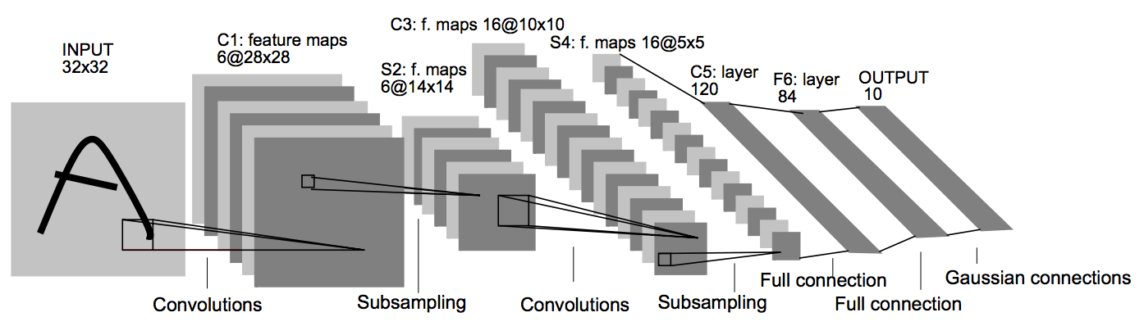
LeNet – Structure Diagram
Input: A 32 x 32 grayscale image (28 x 28) with 2 pixels of padding all around.

Slide 6
LeNet – Structure Diagram
Next, we have a convolutional layer.

Slide 7
LeNet – Structure Diagram
This is a 5x5 convolutional layer with stride 1.

Slide 8
LeNet – Structure Diagram
This means the resulting “filter” has dimension 28x28. (Why?)
Notes:
Answer: because the 32x32 pixels included padding.
The centers of the 5x5 kernels will be in 28x28 different places.
Or another way to think about this conceptually is that the dimension will be (32 - grid_size_height + 1) which is 32-5+1=28.
You can draw a few simple examples to show how this works if the students find it confusing.

Slide 9
LeNet – Structure Diagram
They use a depth of 6. This means there are 6 different kernels that are learned.

Slide 10
LeNet – Structure Diagram
They use a depth of 6. This means there are 6 different kernels that are learned.
So the output of this layer is 6x28x28.

Slide 11
LeNet – Structure Diagram
What is the total number of weights in this layer?

Slide 12
LeNet – Structure Diagram
What is the total number of weights in this layer?
Answer: Each kernel has 5x5=25 weights
(plus a bias term, so actually 26 weights).
So total weights = 6x26 = 156.

Slide 13
LeNet – Structure Diagram
Next is a 2x2 pooling layer (with stride 2)

Slide 14
LeNet – Structure Diagram
So output size is 6x14x14 (we downsample by a factor of 2)

Slide 15
LeNet – Structure Diagram
So output size is 6x14x14 (we downsample by a factor of 2)
Note: The original paper actually does a more complicated pooling then max or avg pooling, but this is considered obsolete now.

Slide 16
LeNet – Structure Diagram
No weights! (pooling layers have no weights to be learned – it is a fixed operation.)

Slide 17
LeNet – Structure Diagram
Another 5x5 convolutional layer with stride 2.
This time the depth is 16.
Notes:
Rehash that we drop from 14x14 to 10x10 because the centers of the 5x5 kernels will only visit 10x10 places. Or 14-5+1=10.
We do not add padding to the 14x14 outputs.

Slide 18
LeNet – Structure Diagram
Output size: 16 x 10 x 10
How many weights? (tricky!)
Notes:
Don’t forget that the kernels go across the depth of the input channel!

Slide 19
LeNet – Structure Diagram
The kernels “take in” the full depth of the previous layer.
So each 5x5 kernel now “looks at” 6x5x5 pixels.
Each kernel has 6x5x5 = 150 weights + bias term = 151.

Slide 20
LeNet – Structure Diagram
So, total weights for this layer = 16*151 = 2416.

Slide 21
LeNet – Structure Diagram
Another 2x2 pooling layer.
Output is 16 x 5 x 5.

Slide 22
LeNet – Structure Diagram
We “flatten” this to a
length 400 vector (not shown)
Notes:
16*5*5=400

Slide 23
LeNet – Structure Diagram
The following layers are just fully connected layers!

Slide 24
LeNet – Structure Diagram
From 400 to 120

Slide 25
LeNet – Structure Diagram
Then from 120 to 84

Slide 26
LeNet – Structure Diagram
Then from 84 to 10

Slide 27
LeNet – Structure Diagram
And a softmax output of size 10 for the 10 digits

Slide 28
LeNet-5
How many total weights in the network?
Conv1: 1*6*5*5 + 6 = 156
Conv3: 6*16*5*5 + 16 = 2416
FC1: 400*120 + 120 = 48120
FC2: 120*84 + 84 = 10164
FC3: 84*10 + 10 = 850
Total: = 61706
Less than a single FC layer with [1200x1200] weights!
Note that Convolutional Layers have relatively few weights.
Notes:
Be sure to point out just how few weights the convolutional networks have. This is the real power of these techniques.

Slide 29
Transfer Learning

Slide 30
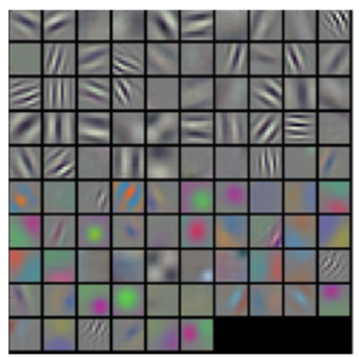
Motivation
Early layers in a Neural Network are the hardest (i.e. slowest) to train
Due to vanishing gradient property
But these ”primitive” features should be general across many image classification tasks

Slide 31
Motivation
Later layers in the network are capturing features that are more particular to the specific image classification problem.
Later layers are easier (quicker) to train since adjusting their weights has a more immediate impact on the final result.

Slide 32
Motivation
Famous, Competition-Winning Models are difficult to train from scratch
Huge datasets (like ImageNet)
Long number of training iterations
Very heavy computing machinery
Time experimenting to get hyper-parameters just right

Slide 33
Transfer Learning
However, the basic features (edges, shapes) learned in the early layers of the network should generalize.
Results of the training are just weights (numbers) that are easy to store.
Idea: keep the early layers of a pre-trained network, and re-train the later layers for a specific application
This is called Transfer Learning.

Slide 34
Transfer Learning
Convolutions
Fully Connected
softmax classifier

Slide 35
Transfer Learning
Convolutions
Fully Connected
softmax classifier

Slide 36
Transfer Learning
Train last layer
on new data
Convolutions
Fully Connected

Slide 37
Transfer Learning
Train last layer
on new data
Perhaps, after a while
train back a few more layers
(or even the whole network)
Convolutions
Fully Connected
Notes:
Can mention that this is more art than science right now:
- How long to train the last layer
- Whether or not to go back further and retrain more layers
- And so on

Slide 38
Transfer Learning Options
The additional training of a pre-trained network on a specific new dataset is referred to as “Fine-Tuning”
There are different options on “how much” and “how far back” to fine-tune.
Should I train just the very last layer?
Go back a few layers?
Re-train the entire network (from the starting point of the existing network)?
Notes:
Again, something of an art; we will give some guidelines.

Slide 39
Guiding Principles for Fine-Tuning
While there are no “hard and fast” rules, there are some guiding principles to keep in mind.
  The more similar your data and problem are to the source data of the pre-trained network, the less fine-tuning is necessary.
                E.g. Using a network trained on ImageNet to distinguish “dogs” from “cats” should need relatively little fine-tuning. It already distinguished different breeds of dogs and cats, so likely has all the features you will need.

Slide 40
Guiding Principles for Fine-Tuning
The more data you have about your specific problem, the more the network will benefit from longer and deeper fine-tuning.
E.g. If you have only 100 dogs and 100 cats in your training data, you probably want to do very little fine-tuning. If you have 10,000 dogs and 10,000 cats you may get more value from longer and deeper fine-tuning.

Slide 41
Guiding Principles for Fine-Tuning
If your data is substantially different in nature than the data the source model was trained on, Transfer Learning may be of little value.
E.g. A network that was trained on recognizing typed Latin alphabet characters would not be useful in distinguishing cats from dogs. But it likely would be useful as a starting point for recognizing Cyrillic Alphabet characters.

