Slide 1
Convolutional Neural Net Architectures

Slide 2
Legal Notices and Disclaimers
This presentation is for informational purposes only. INTEL MAKES NO WARRANTIES, EXPRESS OR IMPLIED, IN THIS SUMMARY.
Intel technologies’ features and benefits depend on system configuration and may require enabled hardware, software or service activation. Performance varies depending on system configuration. Check with your system manufacturer or retailer or learn more at intel.com.
This sample source code is released under the Intel Sample Source Code License Agreement.
Intel and the Intel logo are trademarks of Intel Corporation in the U.S. and/or other countries.
*Other names and brands may be claimed as the property of others.
Copyright © 2017, Intel Corporation. All rights reserved.

Slide 3
AlexNet
Created in 2012 for the ImageNet Large Scale Visual Recognition Challenge (ILSVRC)
Task: predict the correct label from among 1000 classes
Dataset: around 1.2 million images
Considered the “flash point” for modern deep learning
Demolished the competition.
Top 5 error rate of 15.4%
Next best: 26.2%
Notes:
I would emphasize these two points:
This was WAY better than anything before
Still not super great – Top 5 error metric is VERY forgiving. Don’t have to get the right answer, just have the right answer in your top 5 list.
Still was a huge jump

Slide 4
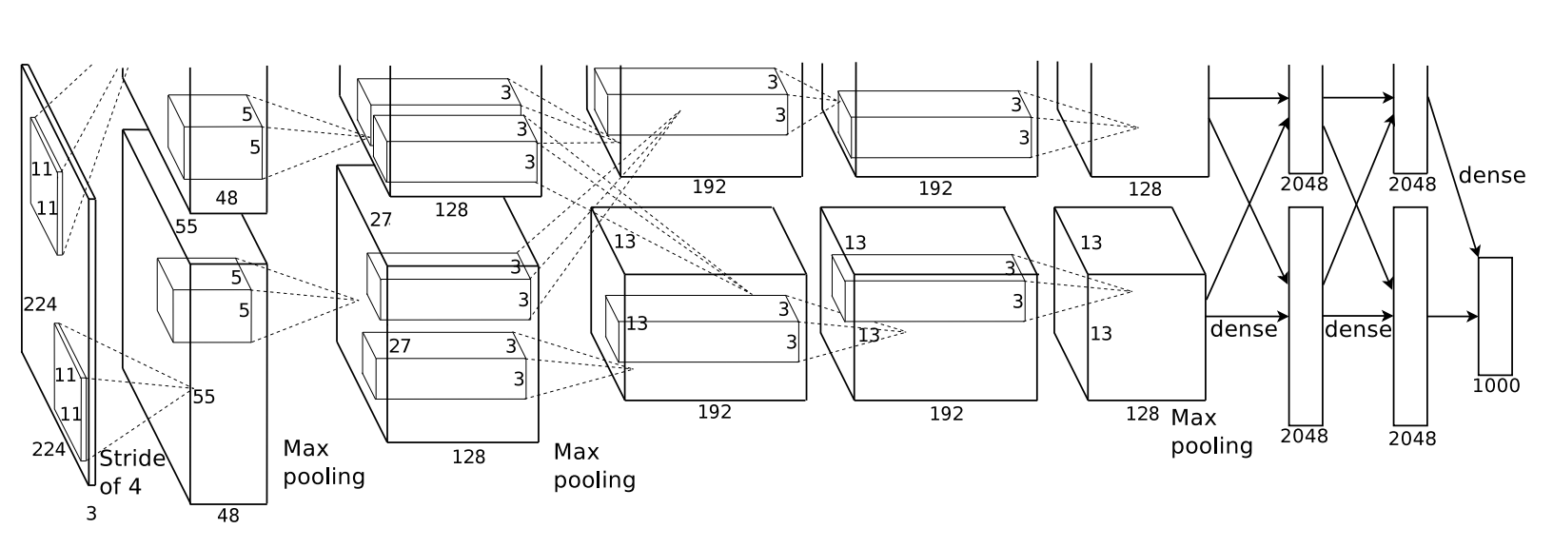
AlexNet - Model Diagram
Notes:
For some reason even the version of this diagram from the paper is cut off on top…

Slide 5
AlexNet - Details
They performed data augmentation for training
Includes Cropping, horizontal flipping, and other manipulations

Slide 6
AlexNet - Details
They performed data augmentation for training
            Cropping, horizontal flipping, and other manipulations
Basic Template:
  Convolutions with ReLUs
  Sometimes add maxpool after convolutional layer
  Fully connected layers at the end before a softmax classifier

Slide 7
VGG
Simplify Network Structure
Avoid Manual Choices of Convolution Size
Very Deep Network with 3x3 Convolutions
These “effectively” give rise to larger convolutions
Reference:
Very Deep Convolutional Networks for Large-Scale Image Recognition
  Karen Simonyan and Andrew Zisserman, 2014

Slide 8
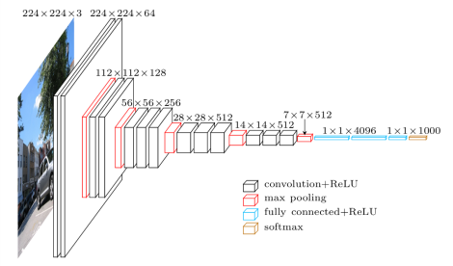
VGG16 Diagram
Notes:
Don’t have to walk through the details. Just to show how deep it is.
Same concepts and ideas from LeNet.

Slide 9
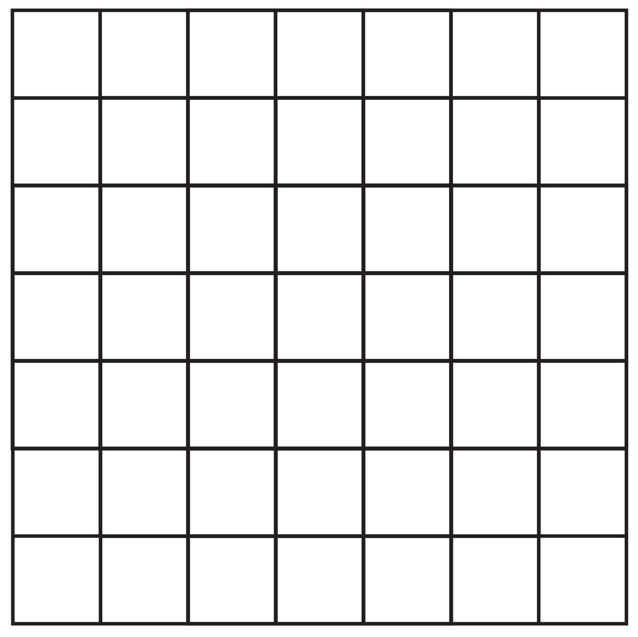
VGG
Layer 1
Layer 2
Layer 3
(Input)
Notes:
Don’t get too bogged down in the next series of slides. It’s an animation that shows the basic process.
The key is to make sure students get the general idea.

Slide 10


VGG
Layer 1
Layer 2
Layer 3
(Input)

Slide 11
VGG
Layer 1
Layer 2
Layer 3
(Input)

Slide 12
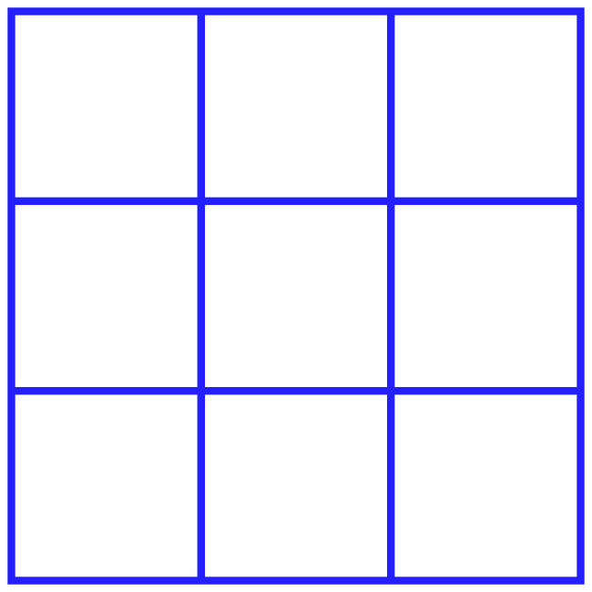

VGG
We can say that the “receptive field” of Layer 2 is 3x3
Each output has been influenced by a 3x3 patch of inputs
Layer 2
Layer 2
Layer 3
Layer 1
Layer 3
Layer 1
(Input)

Slide 13
VGG
What about on Layer 3?
Layer 2
Layer 2
Layer 3
Layer 1
Layer 3
Layer 1
(Input)

Slide 14
VGG
This output on Layer 3 uses a 3x3 patch from Layer 2
How much from Layer 1 does it use?
Layer 2
Layer 2
Layer 3
Layer 1
Layer 3
Layer 1
(Input)
Notes:
Again, this animation may be a bit overkill but it’s worth showing them the kernels and convolutions again to reinforce the concepts.

Slide 15
VGG
Layer 2
Layer 2
Layer 3
Layer 1
Layer 3
Layer 1
(Input)

Slide 16
VGG
Layer 2
Layer 2
Layer 3
Layer 1
Layer 3
Layer 1
(Input)

Slide 17
VGG
Layer 2
Layer 2
Layer 3
Layer 1
Layer 3
Layer 1
(Input)

Slide 18
VGG
Layer 2
Layer 2
Layer 3
Layer 1
Layer 3
Layer 1
(Input)

Slide 19
VGG
Layer 2
Layer 2
Layer 3
Layer 1
Layer 3
Layer 1
(Input)

Slide 20
VGG
Layer 2
Layer 2
Layer 3
Layer 1
Layer 3
Layer 1
(Input)

Slide 21
VGG
Layer 2
Layer 2
Layer 3
Layer 1
Layer 3
Layer 1
(Input)

Slide 22
VGG
Layer 2
Layer 2
Layer 3
Layer 1
Layer 3
Layer 1
(Input)

Slide 23
VGG
Layer 2
Layer 2
Layer 3
Layer 1
Layer 3
Layer 1
(Input)

Slide 24
VGG
Each square in Layer 3 “sees” a 5x5 grid from Layer 1
Layer 2
Layer 2
Layer 3
Layer 1
Layer 3
Layer 1
(Input)

Slide 25




VGG
Two 3x3, stride 1 convolutions in a row → one 5x5
Three 3x3 convolutions → one 7x7 convolution
Benefit: fewer parameters
One 3x3 layer
One 7x7 layer
$$3×3×C×C=9C^{2}$$
$$7×7×C×C=49C^{2}$$
Three 3x3 layers
$49C^{2}$ → $27C^{2}$ → $≈$45% reduction!
$$3×(9C^{2})=27C^{2}$$

Slide 26
VGG
One of the first architectures to experiment with many layers (More is better!)
Can use multiple 3x3 convolutions to simulate larger kernels with fewer parameters
Served as ”base model” for future works

Slide 27
Inception
Szegedy et al 2014
Idea: network would want to use different receptive fields
Want computational efficiency
Also want to have sparse activations of groups of neurons
Hebbian principle: “Fire together, wire together”
Solution: Turn each layer into branches of convolutions
Each branch handles smaller portion of workload
Concatenate different branches at the end

Slide 28
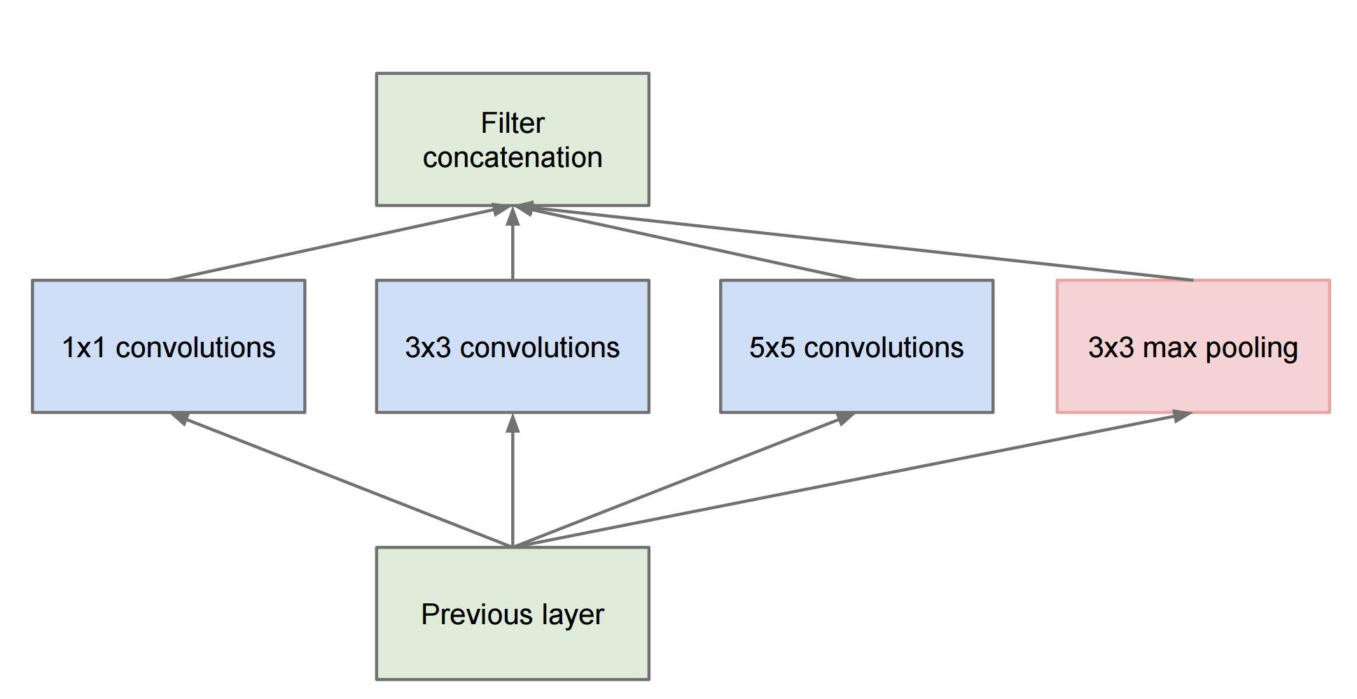
Inception
Basic idea: replace single 3x3 convolutions with module

Slide 29
Inception
Problem: reducing filters from previous layer via 3x3 and 5x5 convolutions is inefficient
Notes:
Remember that convolutions act on the entire depth of the input.
So a 5x5 convolution learns 5x5x (input depth) weights

Slide 30
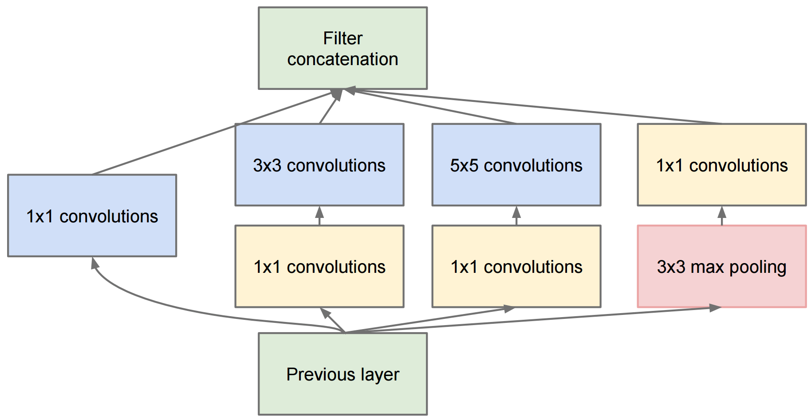
Inception

Slide 31
Inception
Instead, reduce parameters by reducing filter depth with 1x1 convolutions
Notes:
A 1x1 convolution sounds meaningless, but remember the depth.
The 1x1 convolution basically “compresses” the depth so that the subsequent 3x3 and 5x5 layers have fewer inputs.
- Therefore fewer weights

Slide 32
Inception
We also control the number of filters from max pool branch with a 1x1 conv
Notes:
Similarly, we “compress” the depth of the output from the 3x3 max pooling component.

Slide 33
Inception
This whole “block” serves the function of a previous convolutional layer.

Slide 34
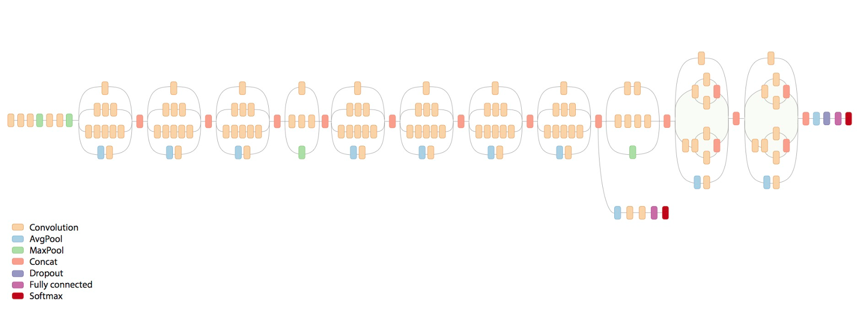
Inception V3 schematic
Notes:
This is a much later version using the same concept.
Key is to point out that the previously described “block” serves the role of a layer in earlier architectures.

Slide 35
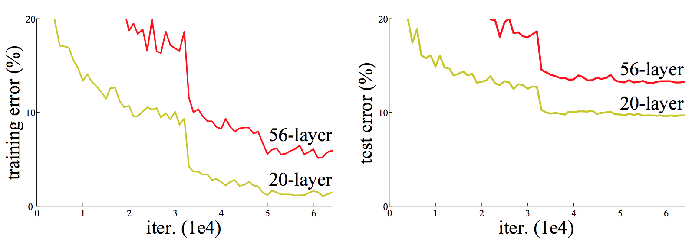
ResNet - Motivation
Issue: Deeper Networks performing worse on training data!
(as well as test data)
Notes:
This is history to set up the motivation for the idea behind ResNet.
Researchers were building deeper and deeper networks but started finding these issues.
The very deep (56-layer) networks should (in concept) be fitting the training data better (even if they overfit) but that was not happening.
Seemed that the early layers were just not getting updated.
The signal got lost (due to vanishing gradient type issues).

Slide 36
ResNet
Surprising because deeper networks should overfit more.
So what’s happening?
Early layers of Deep Networks are very slow to adjust.
Analogous to “Vanishing Gradient” issue.
In theory, should be able to just have an “identity” transformation that makes the deeper network behave like a shallower one

Slide 37
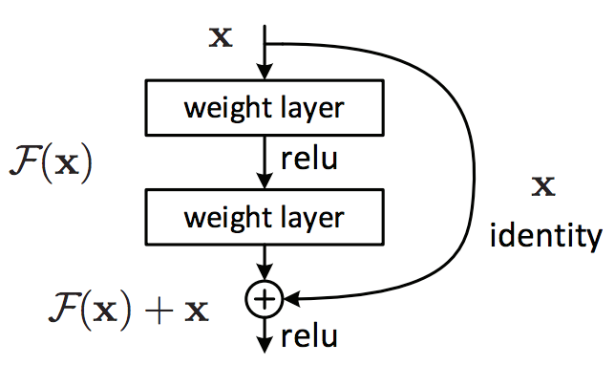
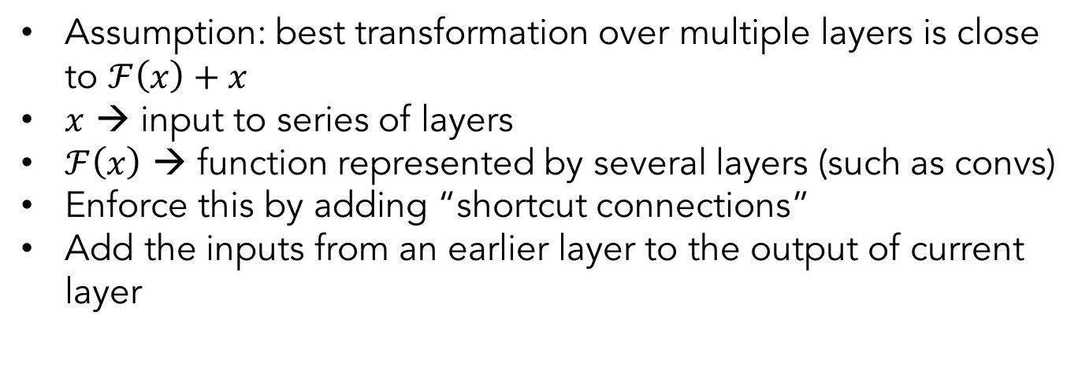
ResNet
Assumption: best transformation over multiple layers is close to $ℱ\left(x\right)+x$
$x$ → input to series of layers
$ℱ\left(x\right)$ → function represented by several layers (such as convs)
Enforce this by adding “shortcut connections”
Add the inputs from an earlier layer to the output of current layer
Notes:
Idea: basically, keep passing the initial information (unchanged) to the next layer (as well as all the transformed info).

Slide 38
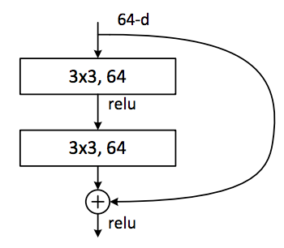
ResNet
Add previous layer back in to current layer!
Similar idea to “boosting”
Notes:
Similar to the idea of boosting – can keep going back to raw data.

