Slide 1
Advanced Techniques for CNNs and Keras

Slide 2
Legal Notices and Disclaimers
This presentation is for informational purposes only. INTEL MAKES NO WARRANTIES, EXPRESS OR IMPLIED, IN THIS SUMMARY.
Intel technologies’ features and benefits depend on system configuration and may require enabled hardware, software or service activation. Performance varies depending on system configuration. Check with your system manufacturer or retailer or learn more at intel.com.
This sample source code is released under the Intel Sample Source Code License Agreement.
Intel and the Intel logo are trademarks of Intel Corporation in the U.S. and/or other countries.
*Other names and brands may be claimed as the property of others.
Copyright © 2017, Intel Corporation. All rights reserved.

Slide 3
Data Augmentation
One practical obstacle to building image classifiers is obtaining labeled training data.
Finding images is difficult.
Labeling images is time consuming and costly.
How can me make the most out of the labelled data we have?
Notes:
This is a good practical point to mention.
Besides all the mathematical issues of making image classification models, often the biggest practical hurdle is obtaining labeled data.

Slide 4
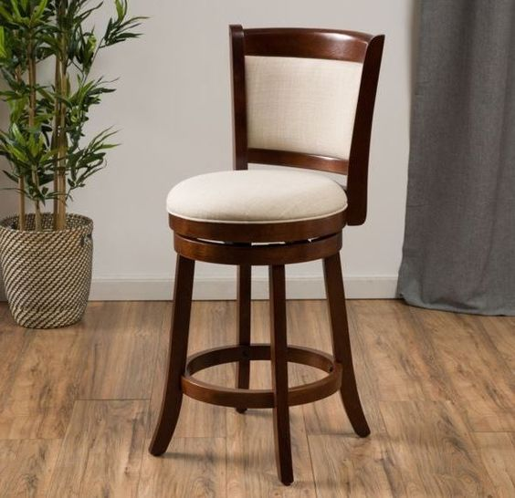
Data Augmentation
If this is a chair:

Slide 5
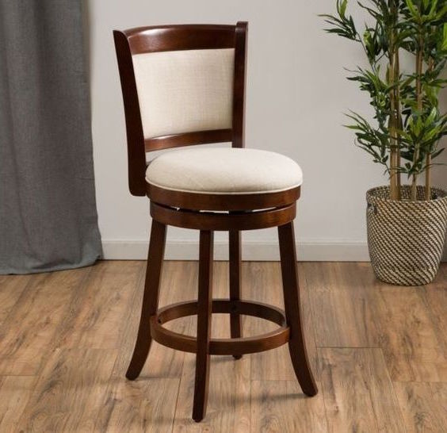
Data Augmentation
If this is a chair…
Then so is this!

Slide 6
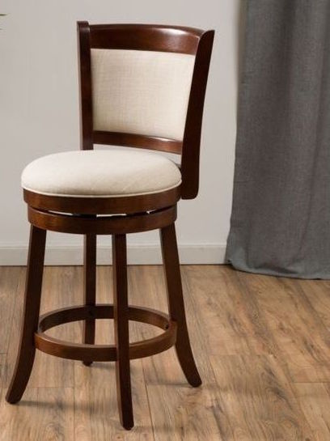
Data Augmentation
If this is a chair…
Also this:

Slide 7

Data Augmentation
If this is a chair…
Also this:

Slide 8
Data Augmentation
By slightly altering images, we can increase our effective data size.
Also allows the neural network to learn invariance to certain transformations.
But we need to be careful – this can have unintended consequences.
Notes:
The “invariance” point is a good one to emphasize.
By showing lots of examples, the network learns which aspects of the image are relevant to its category and which aren’t.
For example, in the previous images, data augmentation can make sure it learns that the plant is not relevant to being called a ”chair”.

Slide 9


Data Augmentation
Would not want a self-driving car to think these mean the same thing!
Notes:
Of course, you don’t want to teach it invariance if the problem is not actually invariant.

Slide 10
Data Flows in Keras
Keras has a convenient mechanism for Data Augmentation.
Requires use of “Data Generators”
To date, we have used the standard model.fit mechanism
Holds entire dataset in memory
Reads the batches one by one out of memory

Slide 11
Data Flows in Keras
Alternative mechanism is to use a “data generator”
Idea: define a generator object which “serves” the batches of data.
Then use model.fit_generator instead of model.fit
Generators can be used to serve images from disk to conserve working memory
Notes:
Note: we don’t do much with working from large file directories in the exercises (since it is cumbersome).
So it may be worth mentioning the role generators play when reading off of disk.

Slide 12
ImageDataGenerator
Keras has an ImageDataGenerator class which permits “real-time” data-augmentation.
When a batch of images is served, you can specify random changes to be made to the image.
These include shifting, rotating, flipping, and various normalizations of the pixel values.
Notes:
Since it does it “on the fly”, it is much simpler than making a bunch of transformed images and adding them to the training data.

Slide 13
ImageDataGenerator
keras.preprocessing.image.ImageDataGenerator(
featurewise_center=False, samplewise_center=False, featurewise_std_normalization=False, samplewise_std_normalization=False,
zca_whitening=False,
rotation_range=0.,
width_shift_range=0.,
height_shift_range=0.,
shear_range=0., zoom_range=0., channel_shift_range=0., fill_mode='nearest', cval=0.,
horizontal_flip=False, vertical_flip=False,
rescale=None, preprocessing_function=None, data_format=K.image_data_format())
Lots of options! We’ll discuss a few.

Slide 14
Shifting Images
keras.preprocessing.image.ImageDataGenerator(
width_shift_range=0.,
height_shift_range=0.,
...)
These determine the range of possible horizontal or vertical shifts to make to the image.
Measured as a percentage of the ima
width_shift_range=0.1, then it will shift up to 20 pixels to the left or right.

Slide 15
Shifting Images (how to fill in)
keras.preprocessing.image.ImageDataGenerator(
...,
fill_mode='nearest', cval=0.,
...)
When shifting, we don’t wish to change the proportions of the image.
We need to “fill in” the pixels on the other side.
cvalt"constant”, ”nearest”, “reflect”, “wrap”.

Slide 16
Rotating Images
keras.preprocessing.image.ImageDataGenerator(
...,
rotation_range=0.,
...)
This allows us to specify a range of possible rotations
Mea
suren degrees
rotation_range=30 means up to a 30 degree rotation (in either direction)

Slide 17
Flipping Images
keras.preprocessing.image.ImageDataGenerator(
...,
horizontal_flip=False, vertical_flip=False,
...)
Whether or not to randomly flip in a horizontal or vertical direction.

Slide 18
Keras Functional API
So far we have primarily used the Keras Sequential method.
Very convenient when each additional layer takes the results of the previous layer.
However, suppose we have more than one input to a particular layer.
Suppose we have multiple outputs, and want different loss functions for these outputs.
More complicated graph structures require the Functional API.

Slide 19
Keras Functional API - principles
Every layer is “callable” on a tensor, and returns a tensor.
Specifically designate inputs using the Input layer.
Merge outputs into a single output using keras.layers.concatentate
Stack layers in a similar fashion to the Sequential model.
Use Model to specify inputs and outputs of your model.
When compiling, can specify different losses for different outputs, and specify how they should be weighted.

