Slide 1
LSTM (Long-Short Term Memory) RNNs

Slide 2
Legal Notices and Disclaimers
This presentation is for informational purposes only. INTEL MAKES NO WARRANTIES, EXPRESS OR IMPLIED, IN THIS SUMMARY.
Intel technologies’ features and benefits depend on system configuration and may require enabled hardware, software or service activation. Performance varies depending on system configuration. Check with your system manufacturer or retailer or learn more at intel.com.
This sample source code is released under the Intel Sample Source Code License Agreement.
Intel and the Intel logo are trademarks of Intel Corporation in the U.S. and/or other countries.
*Other names and brands may be claimed as the property of others.
Copyright © 2017, Intel Corporation. All rights reserved.

Slide 3
Issue: Standard RNNs have poor memory
Transition Matrix necessarily weakens signal
Need a structure that can leave some dimensions unchanged over many steps
This is the problem addressed by so-called Long-Short Term Memory RNNs (LSTM).
Notes:
This goes back to the $s_{i}=f(Uw_{i}+Ws_{i−1}$) from last lecture

Slide 4
Idea: Make “remembering” easy
Define a more complicated update mechanism for the changing of the internal state.
By default, LSTMs remember the information from the last step.
Items are overwritten as an active choice.

Slide 5
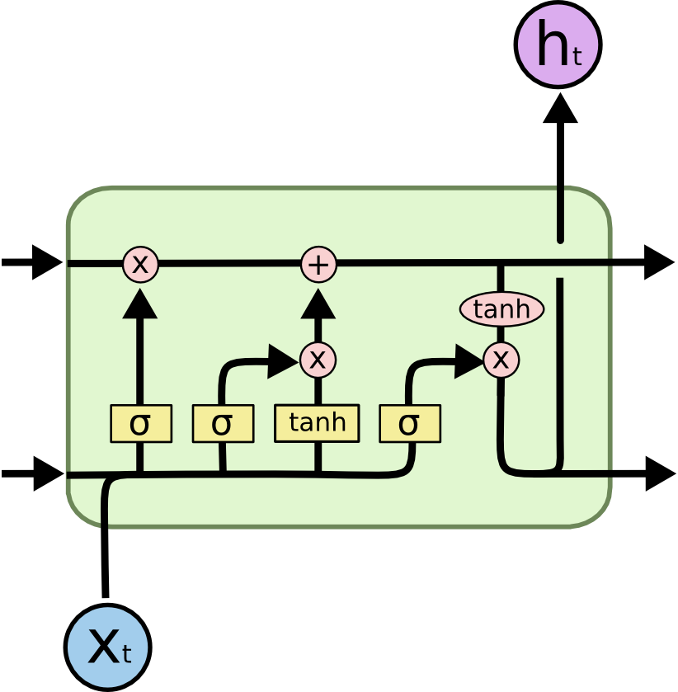




LSTM diagram
output
$$c_{t−1}$$
$$c_{t}$$
cell state
$$h_{t−1}$$
$$h_{t}$$
output (which also
feeds into next unit)
input
http://colah.github.io/posts/2015-08-Understanding-LSTMs/
Notes:
This is (obviously) a very complicated mechanism.
It is not apparent why this structure is “right” as opposed to many other ways one might imagine to accomplish the same thing.
** The key is that there is an easy mechanism for things to stay untouched in the $c_{t}$variable. **

Slide 6
LSTM diagram
cell state gets updated in two stages
$$c_{t−1}$$
$$c_{t}$$
$$h_{t−1}$$
$$h_{t}$$
Notes:
A “conveyor belt” metaphor is often used to describe this part.
It is easy for things to remain unchanged.

Slide 7
LSTM diagram
Decide what to “forget”
cell state gets updated in two stages
$$c_{t−1}$$
$$c_{t}$$
$$h_{t−1}$$
$$h_{t}$$

Slide 8
LSTM diagram
Add in “new”
information
cell state gets updated in two stages
$$c_{t−1}$$
$$c_{t}$$
$$h_{t−1}$$
$$h_{t}$$

Slide 9



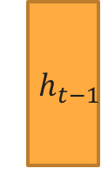

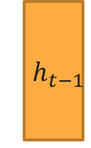
LSTM diagram
Decide what to “forget”
$${ h}_{t−1}$$
$${ h}_{t−1}$$
$$c_{t−1}$$
$$c_{t}$$
$${ x}_{t}$$
$$f_{t}$$
$${ x}_{t}$$
$$h_{t−1}$$
$$h_{t}$$
$$\left[h_{t−1},x_{t}\right]$$
concatenation of vectors

Slide 10
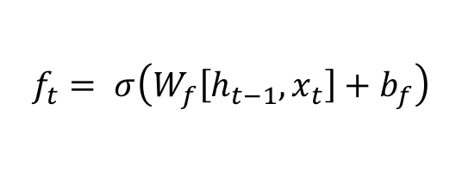
LSTM diagram
Decide what to “forget”
$$c_{t−1}$$
$$c_{t}$$
$$f_{t}$$
$$f_{t}= σ\left(W_{f}\left[h_{t−1},x_{t}\right]+b_{f}\right)$$
$$h_{t−1}$$
$$h_{t}$$
based on previous output and current input

Slide 11
LSTM diagram
Decide what to “forget”
$$c_{t−1}$$
$$c_{t}$$
$$f_{t}$$
$$f_{t}= σ\left(W_{f}\left[h_{t−1},x_{t}\right]+b_{f}\right)$$
$$h_{t−1}$$
$$h_{t}$$
based on previous output and current input

Slide 12
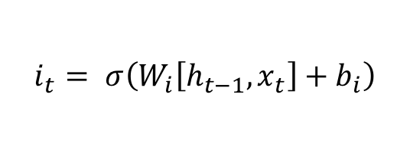



LSTM diagram
Add in “new”
information
$$c_{t−1}$$
$$c_{t}$$
$$i_{t}$$
$$i_{t}= σ\left(W_{i}\left[h_{t−1},x_{t}\right]+b_{i}\right)$$
$$C_{t}^{′}$$
$$C_{t}^{′}=tanh\left(W_{C}\left[h_{t−1},x_{t}\right]+b_{C}\right)$$
$$h_{t−1}$$
$$h_{t}$$

Slide 13
LSTM diagram
Add in “new”
information
$$c_{t−1}$$
$$c_{t}$$
$$i_{t}$$
$$i_{t}= σ\left(W_{i}\left[h_{t−1},x_{t}\right]+b_{i}\right)$$
$$C_{t}^{′}$$
$$C_{t}^{′}=tanh\left(W_{C}\left[h_{t−1},x_{t}\right]+b_{C}\right)$$
$$h_{t−1}$$
$$h_{t}$$

Slide 14
LSTM diagram
Add in “new”
information
$$c_{t−1}$$
$$c_{t}$$
$$i_{t}$$
$$i_{t}= σ\left(W_{i}\left[h_{t−1},x_{t}\right]+b_{i}\right)$$
$$C_{t}^{′}$$
$$C_{t}^{′}=tanh\left(W_{C}\left[h_{t−1},x_{t}\right]+b_{C}\right)$$
$$h_{t−1}$$
$$h_{t}$$

Slide 15

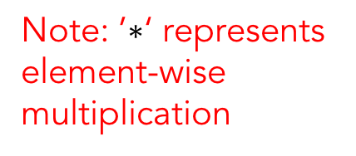
LSTM diagram
Note: ’$∗$‘ represents element-wise multiplication
$$c_{t−1}$$
$$c_{t}$$
$$C_{t}=f_{i}∗C_{t−1}+i_{t}∗C_{t}^{′}$$
$$h_{t−1}$$
$$h_{t}$$
forget the old
(or not)
add the new (or not)

Slide 16
LSTM diagram
Note: ’$∗$‘ represents element-wise multiplication
$$c_{t−1}$$
$$c_{t}$$
$$C_{t}=f_{i}∗C_{t−1}+i_{t}∗C_{t}^{′}$$
$$h_{t−1}$$
$$h_{t}$$
forget the old
(or not)
add the new (or not)

Slide 17
LSTM diagram
Note: ’$∗$‘ represents element-wise multiplication
$$c_{t−1}$$
$$c_{t}$$
$$C_{t}=f_{i}∗C_{t−1}+i_{t}∗C_{t}^{′}$$
$$h_{t−1}$$
$$h_{t}$$
forget the old
(or not)
add the new (or not)

Slide 18

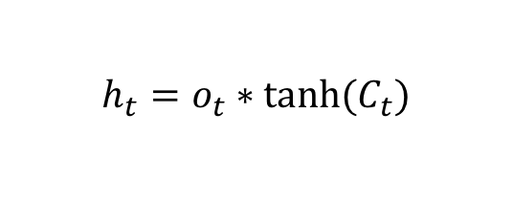
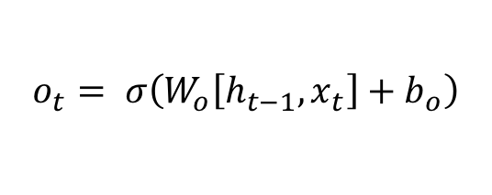
LSTM diagram
Final stage computes the output
$$c_{t−1}$$
$$c_{t}$$
$$o_{t}$$
$$o_{t}= σ\left(W_{o}\left[h_{t−1},x_{t}\right]+b_{o}\right)$$
$$h_{t}=o_{t}∗tanh⁡(C_{t})$$
$$h_{t−1}$$
$$h_{t}$$

Slide 19
LSTM diagram
Final stage computes the output
$$c_{t−1}$$
$$c_{t}$$
$$o_{t}$$
$$o_{t}= σ\left(W_{o}\left[h_{t−1},x_{t}\right]+b_{o}\right)$$
$$h_{t}=o_{t}∗tanh⁡(C_{t})$$
$$h_{t−1}$$
$$h_{t}$$
Note: No weights here

Slide 20
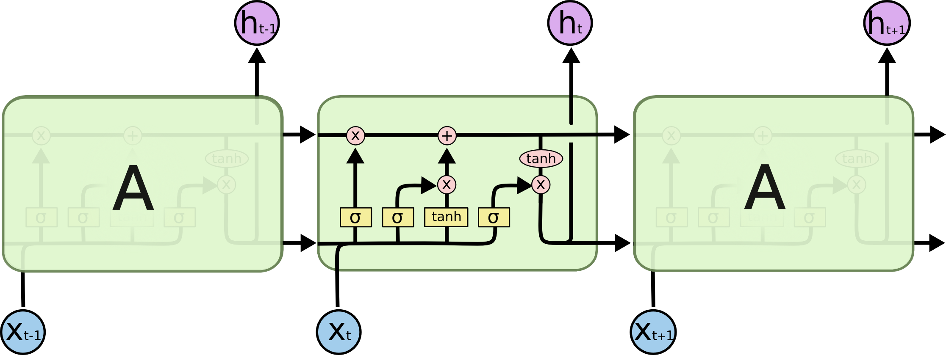
LSTM unrolled
Notes:
Similar to “unrolling” the RNN. Here we see a chain of LSTM structures.

Slide 21
Final Points
This is the most common version of LSTM, but there are many different “flavors”.
Gated Recurrent Unit (GRU)
Depth-Gated RNN
LSTMs have considerably more parameters than plain RNNs.
Most of the big performance improvements in NLP have come from LSTMs, not plain RNN.

