Slide 1
Introduction to Convolutional Neural Networks

Slide 2
Legal Notices and Disclaimers
This presentation is for informational purposes only. INTEL MAKES NO WARRANTIES, EXPRESS OR IMPLIED, IN THIS SUMMARY.
Intel technologies’ features and benefits depend on system configuration and may require enabled hardware, software or service activation. Performance varies depending on system configuration. Check with your system manufacturer or retailer or learn more at intel.com.
This sample source code is released under the Intel Sample Source Code License Agreement.
Intel and the Intel logo are trademarks of Intel Corporation in the U.S. and/or other countries.
*Other names and brands may be claimed as the property of others.
Copyright © 2017, Intel Corporation. All rights reserved.

Slide 3
Motivation – Image Data
So far, the structure of our neural network treats all inputs interchangeably.
No relationships between the individual inputs
Just an ordered set of variables
We want to incorporate domain knowledge into the architecture of a Neural Network.
Notes:
Images though, have intrinsic properties which could and should be taken advantage of, in the models.

Slide 4
Motivation
Image data has important structures, such as;
                ”Topology” of pixels
                Translation invariance
                Issues of lighting and contrast
                Knowledge of human visual system
                Nearby pixels tend to have similar values
                Edges and shapes
                Scale Invariance – objects may appear at different sizes in the image.
Notes:
The variables (i.e. pixels) have a natural “topology” (spatial component) that is meaningful. This makes images different from say, loan default prediction where the variables do not have a natural topology.
CNNs are based on what we know about the structure of images and also what we know about the human visual system. The human visual system has “receptive fields” which respond to horizontal bars, vertical bars, etc.

Slide 5
Motivation – Image Data
Fully connected would require a vast number of parameters
MNIST images are small (32 x 32 pixels) and in grayscale
Color images are more typically at least (200 x 200) pixels x 3 color channels (RGB) = 120,000 values.
A single fully connected layer would require (200x200x3)² = 14,400,000,000 weights!
Variance (in terms of bias-variance) would be too high
So we introduce “bias” by structuring the network to look for certain kinds of patterns
Notes:
From a dimensionality standpoint, taking advantage of these structures mean much fewer parameters!
We still have a TON of parameters, but better than tons of tons of parameters.
Idea: expect to see the same basic features anywhere in the image. So don’t learn different things for each location in the image (at least in the early layers)

Slide 6
Motivation
Features need to be “built up”
Edges -> shapes -> relations between shapes
Textures
Cat = two eyes in certain relation to one another + cat fur texture.
Eyes = dark circle (pupil) inside another circle.
Circle = particular combination of edge detectors.
Fur = edges in certain pattern.
Notes:
We don’t input these “features”, network learns them.
What we do is simplify network’s job by not inputting all the pixels as inputs to fully connected layers
Instead, we input a ”convoluted” version of that.

Slide 7
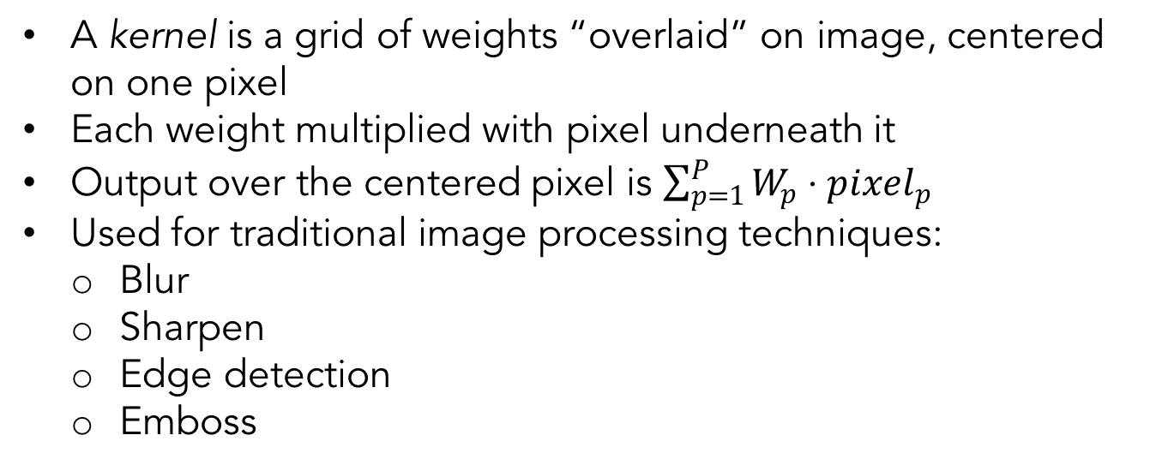
Kernels
A kernel is a grid of weights “overlaid” on image, centered on one pixel
Each weight multiplied with pixel underneath it
Output over the centered pixel is $\sum_{p=1}^{P}{W_{p}⋅pixel_{p}}$
Used for traditional image processing techniques:
  Blur
  Sharpen
  Edge detection
  Emboss
Notes:
The way we capture these structures is by making use of “kernels”

Slide 8
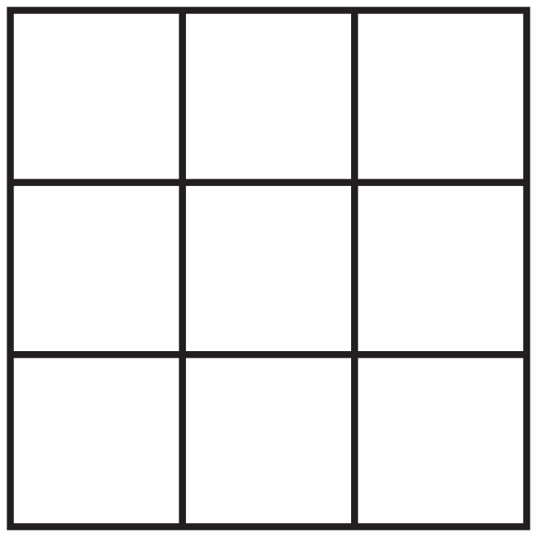
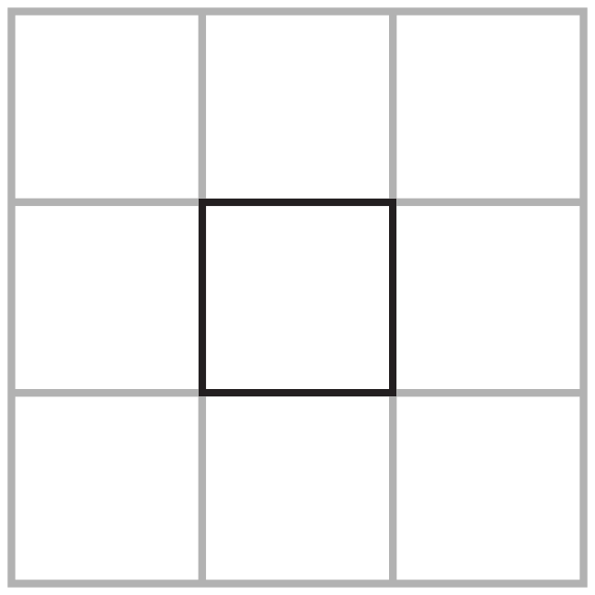
Kernel: 3x3 Example
Input
Kernel
Output
3
2
1
-1
0
1
1
2
3
-2
0
2
1
1
1
-1
0
1
Notes:
Input, kernel

Slide 9
Kernel: 3x3 Example
Output
-1
0
1
3
2
1
-2
0
2
1
2
3
-1
0
1
1
1
1
Notes:
Overlay, and again, it’s a dot product.

Slide 10
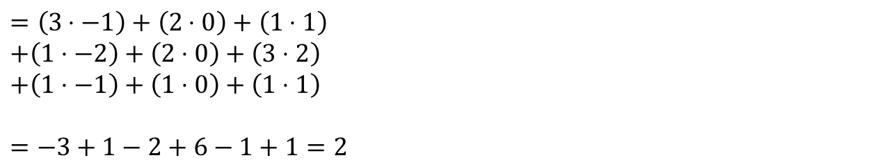
Kernel: 3x3 Example
Input
Kernel
Output
3
2
1
-1
0
1
1
2
3
-2
0
2
2
1
1
1
-1
0
1
$$=\left(3⋅−1\right)+\left(2⋅0\right)+\left(1⋅1\right)$$
$$+\left(1⋅−2\right)+\left(2⋅0\right)+\left(3⋅2\right)$$
$$+\left(1⋅−1\right)+\left(1⋅0\right)+\left(1⋅1\right)$$
$=−3+1−2+6−1+1=2$
Notes:
So the output is just the dot product of entries, and the output in this example is 2.
We captured the essence of those 9 pixels.

Slide 11
Kernels as Feature Detectors
Can think of kernels as a ”local feature detectors”
Vertical Line Detector
Horizontal Line Detector
Corner Detector
-1
1
-1
-1
-1
-1
-1
-1
-1
-1
1
-1
1
1
1
-1
1
1
-1
1
-1
-1
-1
-1
-1
1
1

Slide 12
Convolutional Neural Nets
Primary Ideas behind Convolutional Neural Networks:
Let the Neural Network learn which kernels are most useful
Use same set of kernels across entire image (translation invariance)
Reduces number of parameters and “variance” (from bias-variance point of view)
Notes:
This is key. We learn many different kernels, but they all “operate” across the entire image.
CNN will learn the best kernels that pertain to your training dataset, your problem.

Slide 13
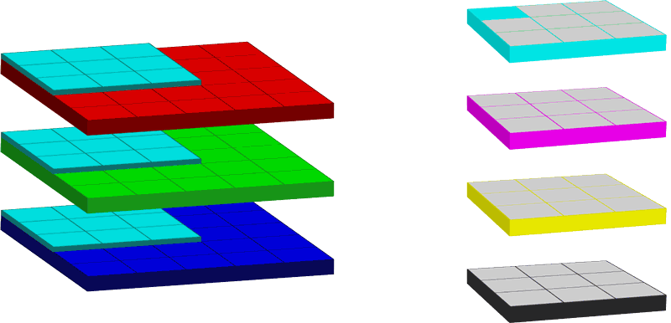
Convolutions
Notes:
Convolution is the application of a kernel to the image (RGB)

Slide 14
Convolution Settings – Grid Size
Grid Size (Height and Width):
The number of pixels a kernel “sees” at once
Typically use odd numbers so that there is a “center” pixel
Kernel does not need to be square
Height: 3, Width: 3
Height: 1, Width: 3
Height: 3, Width: 1
Notes:
We can specify how we want to apply the kernel. This changes the output dimensions, among other things.

Slide 15
Convolution Settings - Padding
Padding
Using Kernels directly, there will be an “edge effect”
Pixels near the edge will not be used as “center pixels” since there are not enough surrounding pixels
Padding adds extra pixels around the frame
So every pixel of the original image will be a center pixel as the kernel moves across the image
Added pixels are typically of value zero (zero-padding)
Notes:
This is for the edge pixels for which kernel can’t fit the image, if we want that pixel at the center..

Slide 16
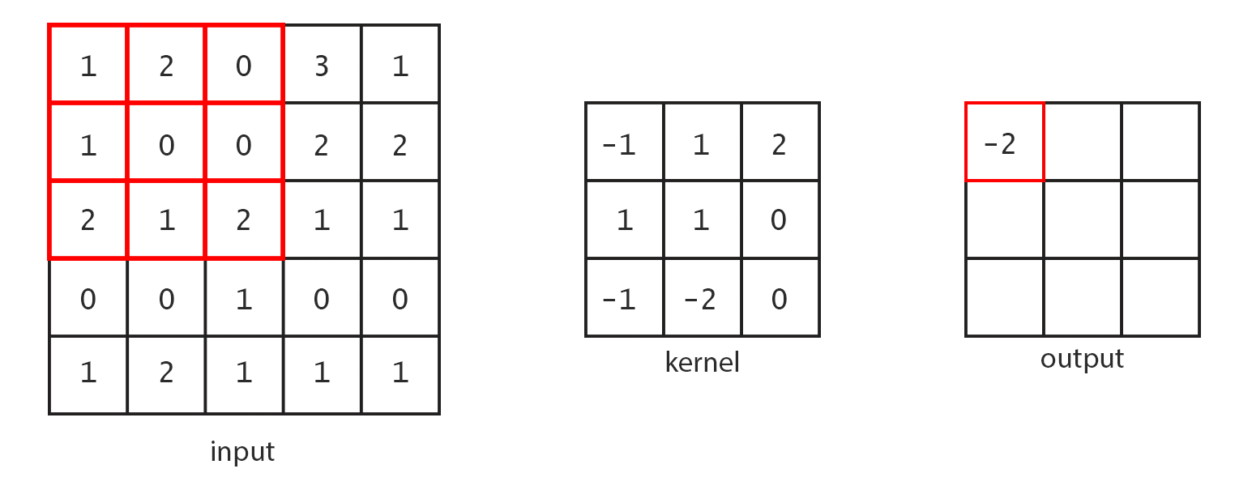
Without Padding
Notes:
We calculate the upper left entry of the output by multiplying the kernel against the upper left 3x3 patch of the input (and summing).

Slide 17
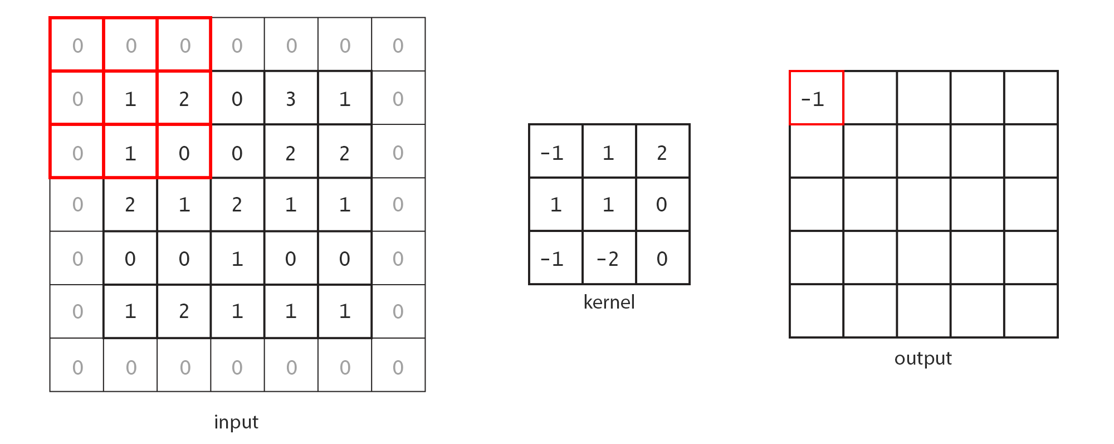
With Padding
Notes:
Get the student familiar with the relation between the input size, kernel, and output size.
If there is no padding, the output will be smaller than the input since we ”lose” a little at the boundary.

Slide 18
Convolution Settings
Stride
The ”step size” as the kernel moves across the image
Can be different for vertical and horizontal steps (but usually is the same value)
When stride is greater than 1, it scales down the output dimension
Notes:
Smaller stride = higher “resolution” of output image

Slide 19
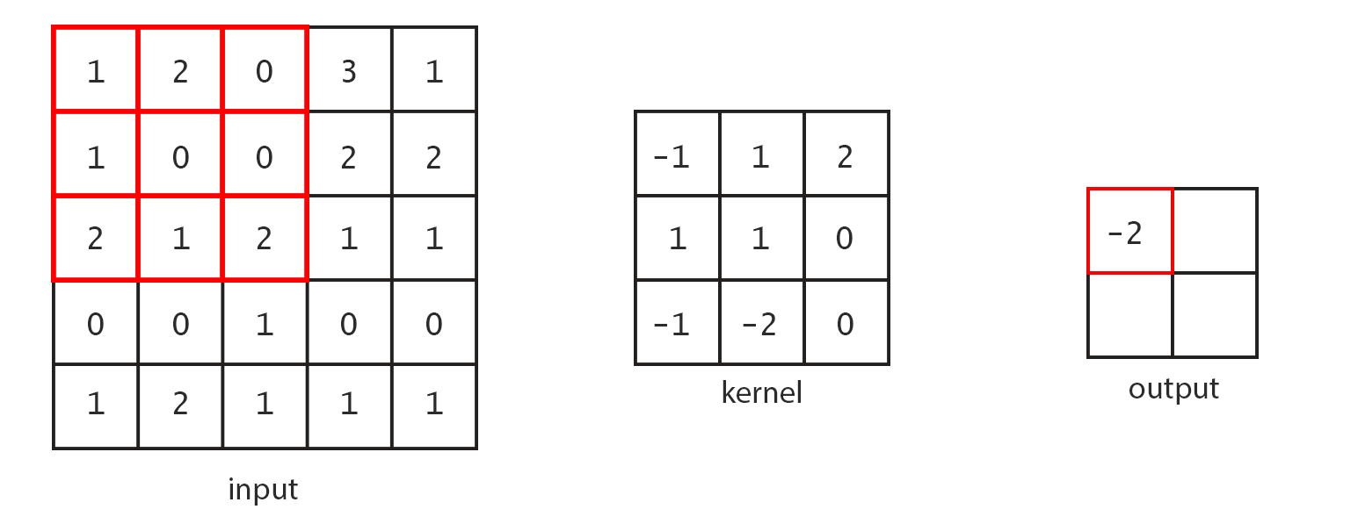
Stride 2 Example – No Padding
3
0

Slide 20
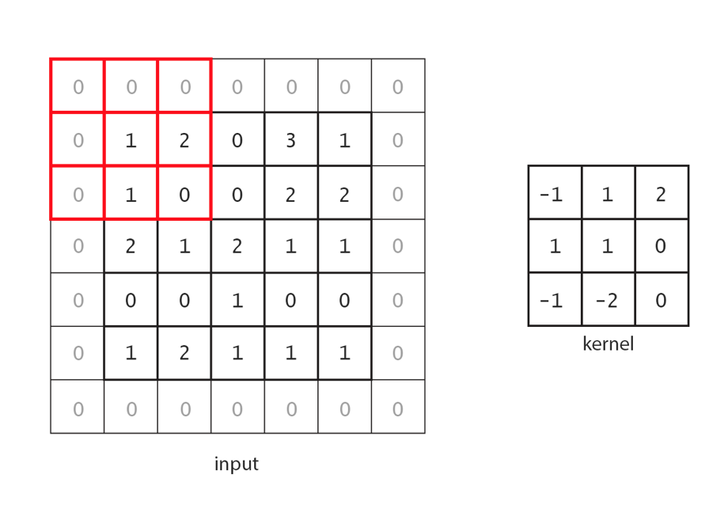
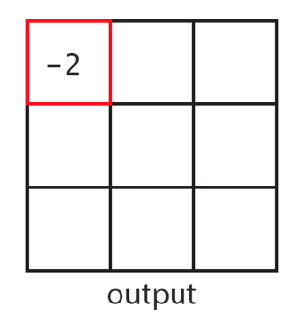

Stride 2 Example – With Padding
-1
2
3
Notes:
We can have strides and padding at the same time too.
Notice how the output size depends on these parameters.

Slide 21
Convolutional Settings - Depth
In images, we often have multiple numbers associated with each pixel location.
These numbers are referred to as “channels”
RGB image – 3 channels
CMYK – 4 channels
The number of channels is referred to as the “depth”
So the kernel itself will have a “depth” the same size as the number of input channels
Example: a 5x5 kernel on an RGB image
  There will be 5x5x3 = 75 weights
Notes:
Important to emphasize that the kernel will look at the entire depth of the input.
On first layer, the depth will be just RGB or CMYK, but for later layers the input depth may be quite high, so the kernels will have a lot of weights.
They will see this when we walk through some architectures in later lectures.

Slide 22
Convolutional Settings - Depth
The output from the layer will also have a depth
The networks typically train many different kernels
Each kernel outputs a single number at each pixel location
So if there are 10 kernels in a layer, the output of that layer will have depth 10.

Slide 23
Pooling
Idea: Reduce the image size by mapping a patch of pixels to a single value.
Shrinks the dimensions of the image.
Does not have parameters, though there are different types of pooling operations.
Notes:
Move on to pooling.
Can emphasize that there are no weights to be learned here. It is just a prescribed operation.

Slide 24
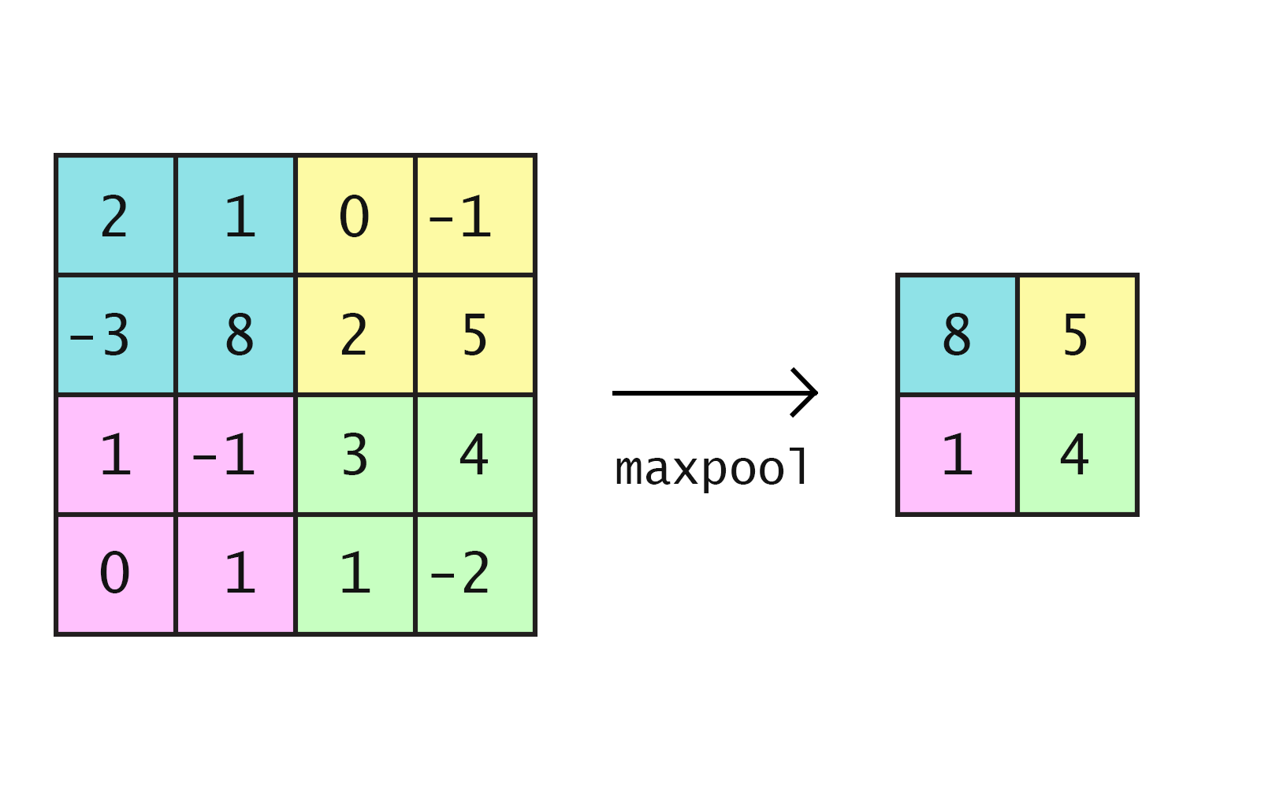
Pooling: Max-pool
For each distinct patch, represent it by the maximum
2x2 maxpool shown below

Slide 25
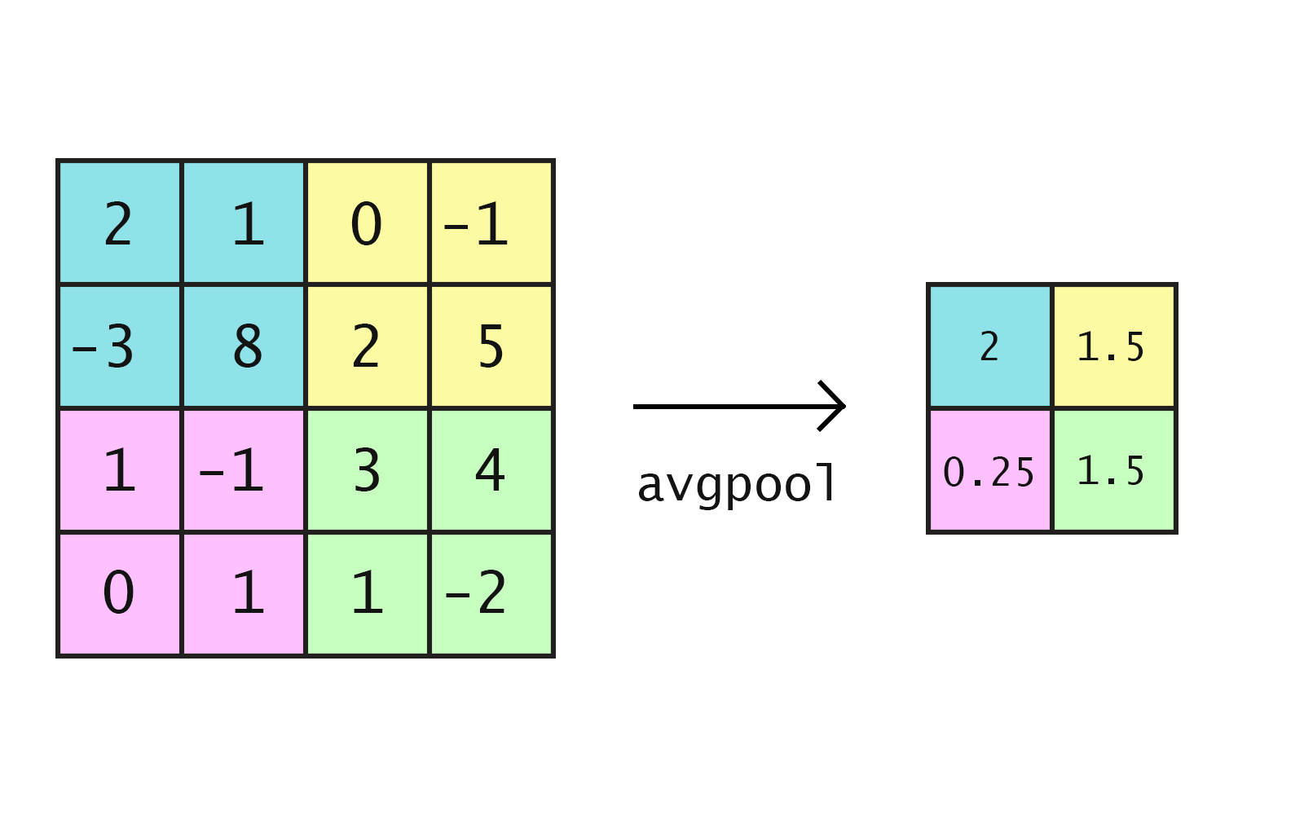
Pooling: Average-pool
For each distinct patch, represent it by the average
2x2 avgpool shown below.

