Slide 1
Machine Learning Fundamentals
Deep Learning with TensorFlow – Day 2

Slide 2
Legal Notices and Disclaimers
This presentation is for informational purposes only. INTEL MAKES NO WARRANTIES, EXPRESS OR IMPLIED, IN THIS SUMMARY.
Intel technologies’ features and benefits depend on system configuration and may require enabled hardware, software or service activation. Performance varies depending on system configuration. Check with your system manufacturer or retailer or learn more at intel.com.
This sample source code is released under the Intel Sample Source Code License Agreement.
Intel and the Intel logo are trademarks of Intel Corporation in the U.S. and/or other countries.
*Other names and brands may be claimed as the property of others.
Copyright © 2017, Intel Corporation. All rights reserved.

Slide 3
Things to cover in slides
Gradient descent
Linear regression
Logistic regression
Training/validation/test splits
Loss function, derivatives
Full batch, mini batch/stochastic gradient descent
Regularization
Epoch
Supervised vs unsupervised training
TensorFlow: Optimizer class, global step

Slide 4
Key things to take away from today
Loss functions
Gradient descent
Automatic differentiation

Slide 5
What is Machine Learning?

Slide 6
Machine Learning
Abstractly:
Giving computers the ability to learn automatically
Concretely:
Using math/stats to estimate a model by using data

Slide 7
Remember Excel?

Slide 8
Remember Excel?

Slide 9
Kinds of Machine Learning Tasks
Regression: predict continuous valued output
  House $ based on attributes
  How far to the left or right to turn a car
Classification: predict discreet categories of output
  Which kind of animal is in a picture?
  What sort of anomaly is in an x-ray scan, if any?

Slide 10
A regression task
y is continuous

Slide 11
Kinds of Machine Learning Methods
Supervised: train model using specific labeled or known data points
  The model is trying to hit a target
  Targets or Labels:
    Price of a house
    The correct steering angle for a car
    Category of an item
    Boolean: Yes/No, Risk/Safe
Unsupervised: train model without labels
  Model is trying to find patterns of input data
  Examples:
    Clustering
    Autoencoders
Notes:
Dimensionality reduction (PCA & friends) andManifold learning/methods are also unsupervised.

Slide 12
A is supervised learning task
Label: y
Input: x

Slide 13
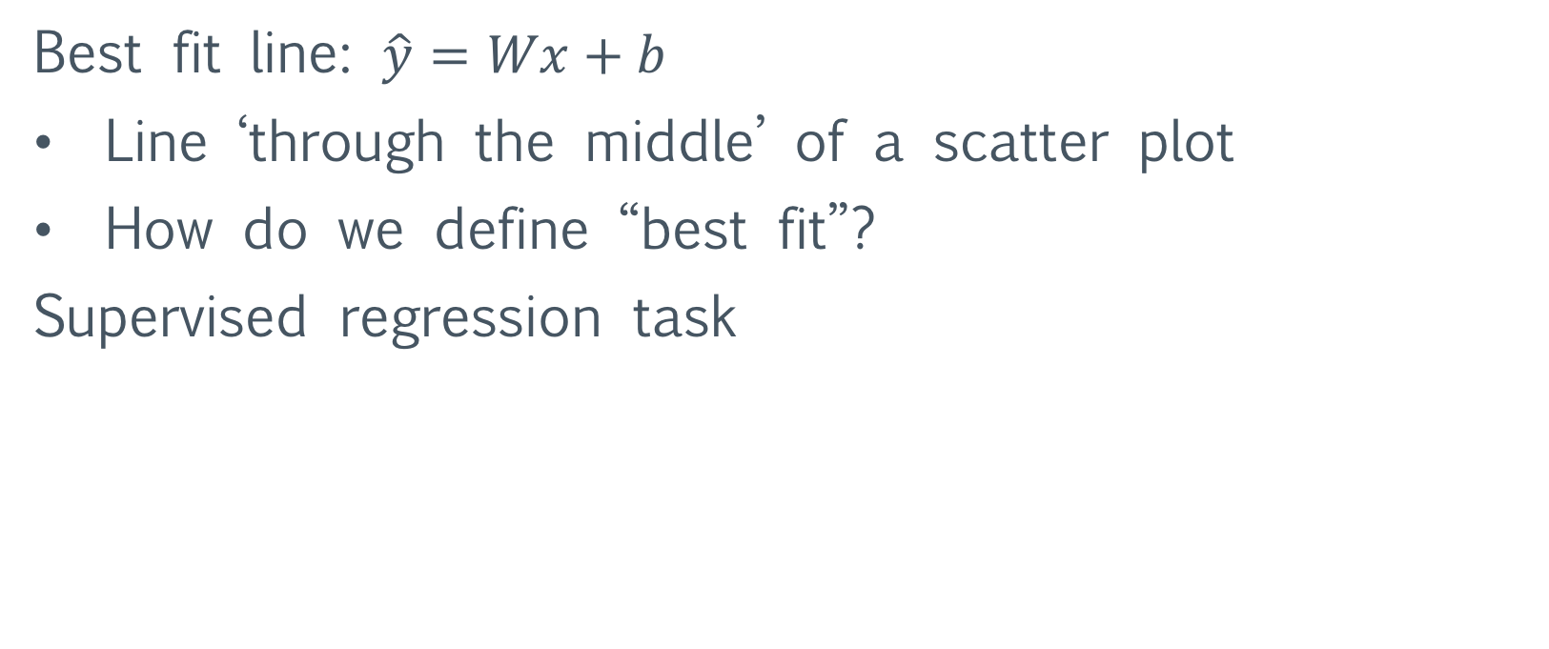
Linear Regression
Best fit line: $\hat{y}=Wx+b$
Line ‘through the middle’ of a scatter plot
How do we define “best fit”?
Supervised regression task

Slide 14
Cost Function: J
Idea:
Create a measure model wrongness: a cost function or J and use math to minimize how wrong we are
Question: how to determine what cost function to use?
Answer A:
  Use statistical theory to find an MLE,
  create measure that empirically works,
  think hard for a long time
Answer B: Reuse the work of smart people

Slide 15
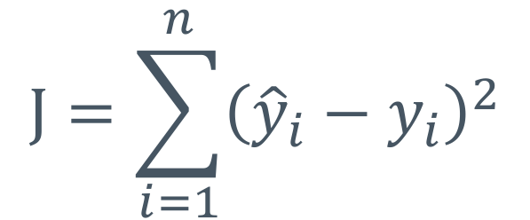

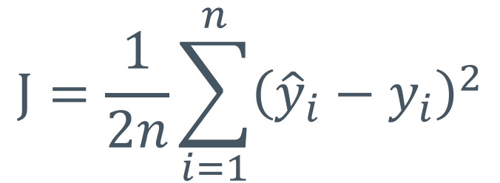
Cost function for linear regression
Sum over all n
training examples
Classical: sum of squared errors, or SSE
$$\text{J}=\sum_{i=1}^{n}{{\left({\hat{y}}_{i}−y_{i}\right)}^{2}}$$
$${\hat{y}}_{i}=Wx_{i}+b;$$
A little nicer: mean squared errors: MSE
  Simply divide error by the number of examples
  If # training examples increases, your error doesn’t
$$\text{J}=\frac{1}{2n}\sum_{i=1}^{n}{{\left({\hat{y}}_{i}−y_{i}\right)}^{2}}$$
2 is here to make
math nicer soon

Slide 16
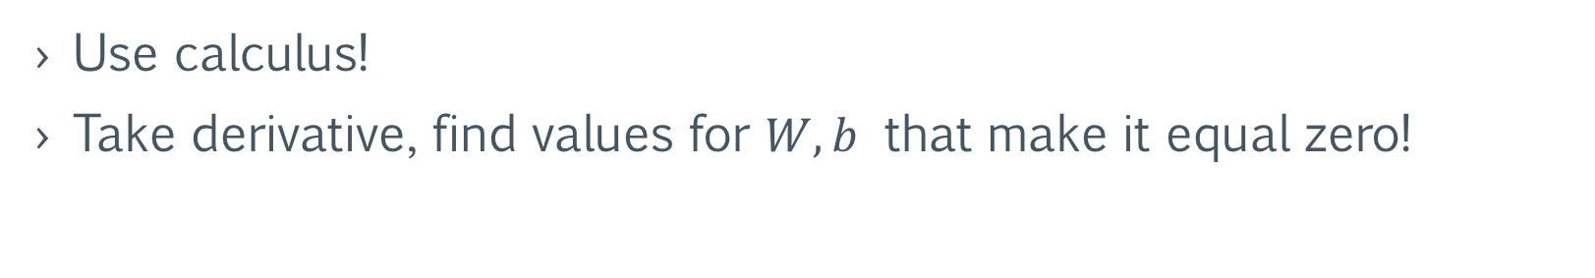
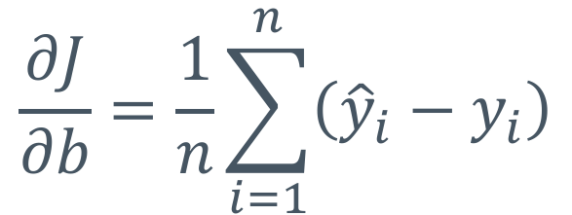
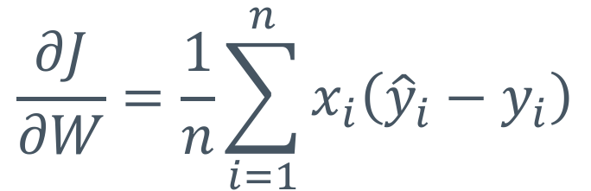
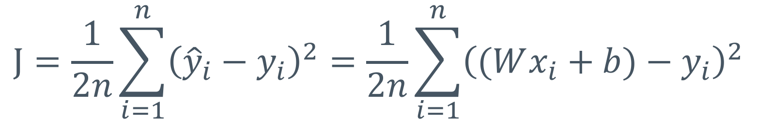
How to minimize loss?
Use calculus!
Take derivative, find values for $W,b$ that make it equal zero!
$$\text{J}=\frac{1}{2n}\sum_{i=1}^{n}{{\left({\hat{y}}_{i}−y_{i}\right)}^{2}}=\frac{1}{2n}\sum_{i=1}^{n}{{\left((Wx_{i}+b)−y_{i}\right)}^{2}}$$
$$\frac{∂J}{∂W}=\frac{1}{n}\sum_{i=1}^{n}{x_{i}\left({\hat{y}}_{i}−y_{i}\right)}$$
$$\frac{∂J}{∂b}=\frac{1}{n}\sum_{i=1}^{n}{\left({\hat{y}}_{i}−y_{i}\right)}$$
Make both equal 0

Slide 17

How to make derivative equal zero?
For linear regression: can use linear algebra to solve exactly
$$\hat{W}={\left(X^{T}X\right)}^{−1}X^{T}Y$$
W and b are lumped together here
Problems
For big X, hard to compute inverse
Inverse is ill-conditioned
Not all models have a nice closed form linear algebra solution!
What to do?
Notes:
Recall in many formulations, the data D = {x_1 … x_n} are “augmented” with a constant column vector x_0 = 1. Then the b weight is simply w_0. Most of our models *do not* do this (i.e., we keep b as a special, standalone weight.)
ill-conditioned means that the numerical calculations needed to find it will “blow up” and give inaccurate answers, even with the best care and attention to detail. It’s a fundamental limitation of floating-point numbers.

Slide 18
Gradient Descent
Guess and check for data scientists

Slide 19
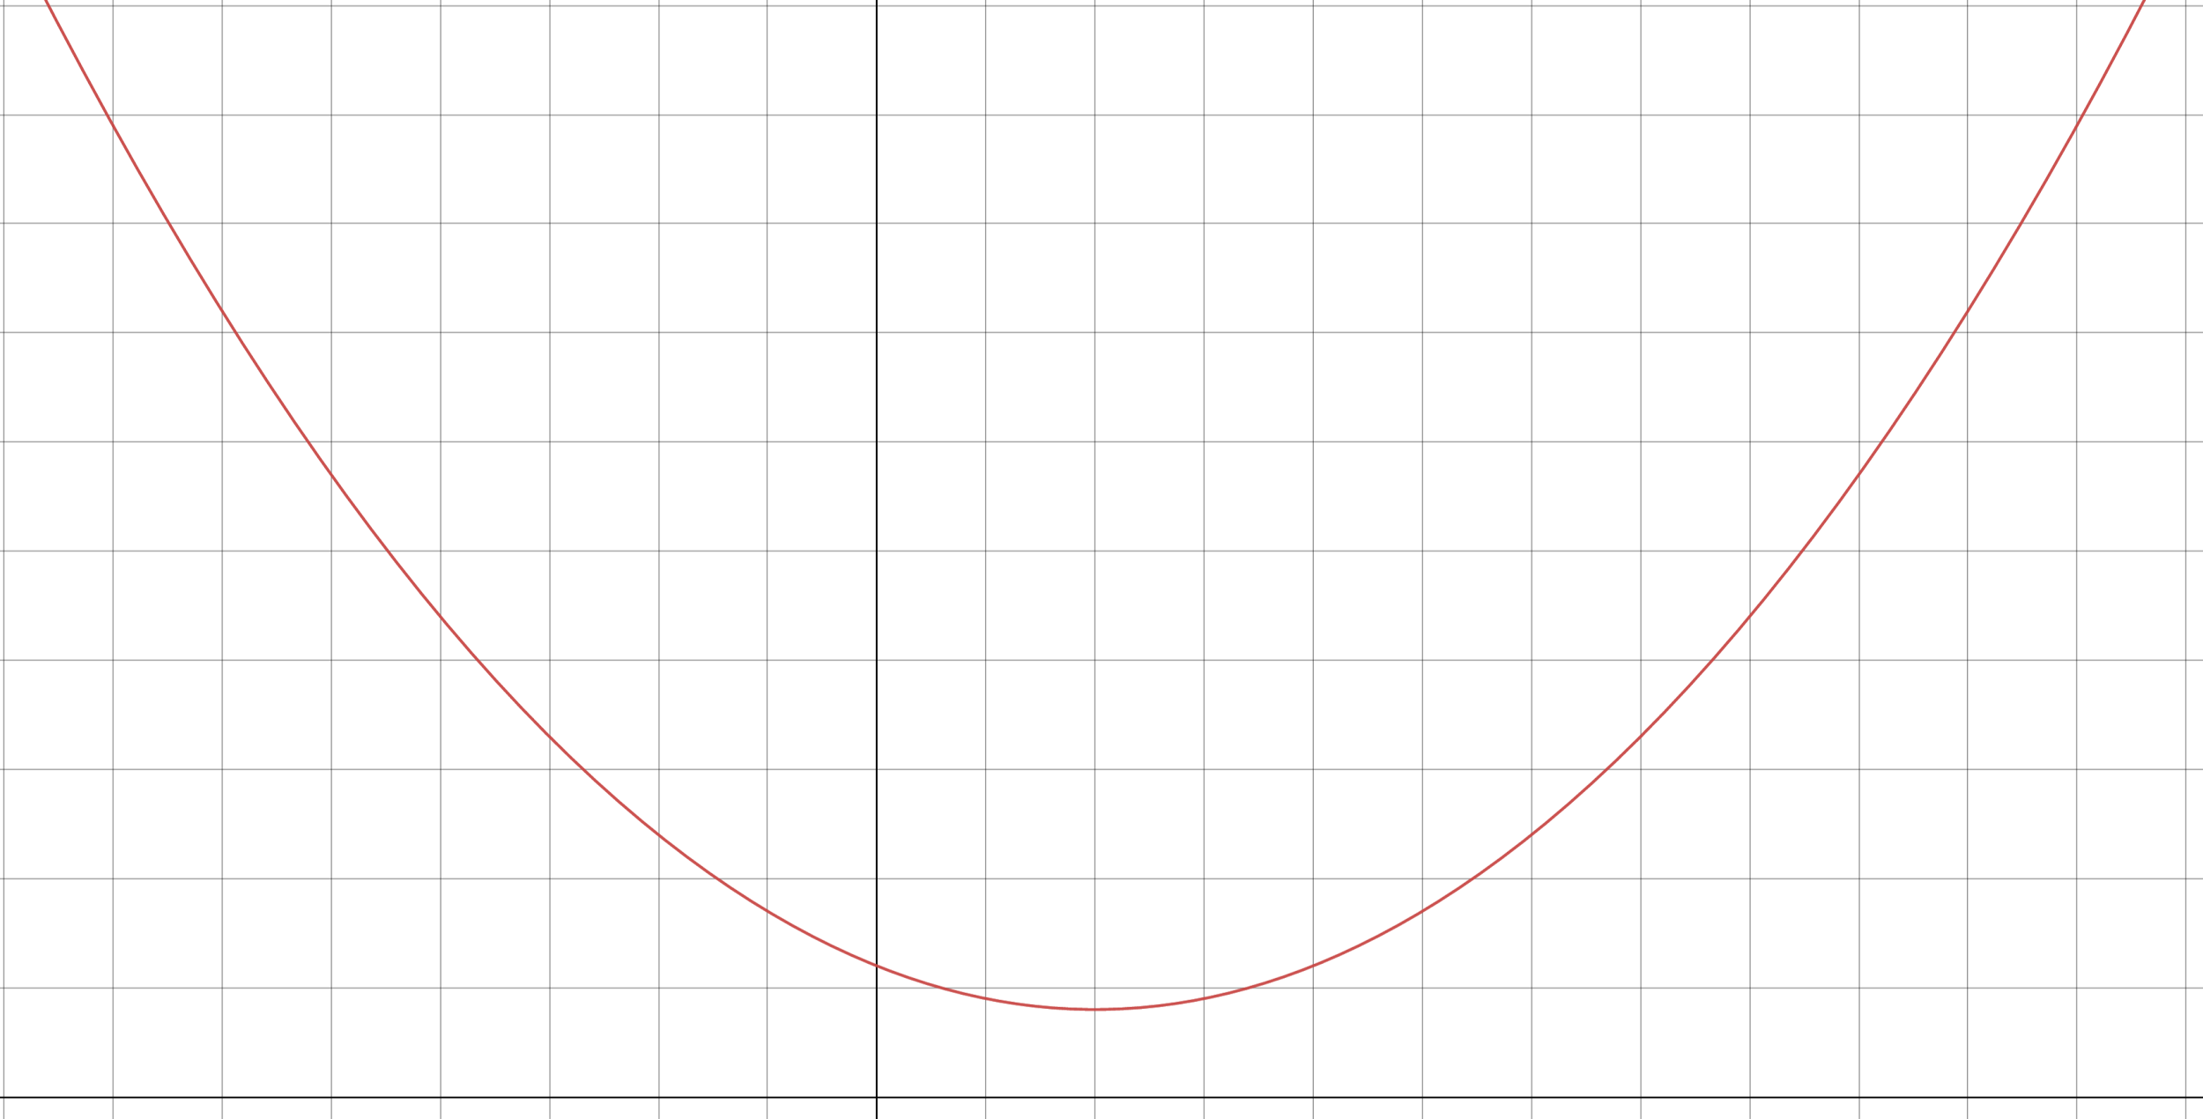
J (cost)
W

Slide 20
J (cost)
Random guess put us here
W

Slide 21

J (cost)
$$\frac{∂J}{∂W}$$
W

Slide 22

J (cost)
$$\frac{∂J}{∂W}<0$$
W

Slide 23

J (cost)
Move to the right!
$$\frac{∂J}{∂W}<0$$
W

Slide 24

J (cost)
$$\frac{∂J}{∂W}<0$$
W
$$∆W$$

Slide 25
J (cost)
Cost at new weight value
W

Slide 26

J (cost)
$$\frac{∂J}{∂W}$$
W

Slide 27

J (cost)
$$\frac{∂J}{∂W}<0$$
W

Slide 28

J (cost)
Move to the right!
$$\frac{∂J}{∂W}<0$$
W

Slide 29
J (cost)
W

Slide 30

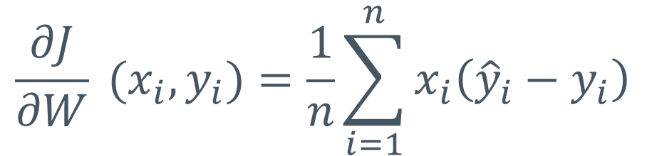
The process of doing gradient descent (math-version)
Find the derivative of loss w.r.t to weights over training data
  Plug data into our derivative function, and sum up over data points
The number we’ll use to adjust the weight
$$∆W=\sum_{i=1}^{n}{\frac{∂J}{∂W}\left(x_{i}, y_{i}\right)}$$
Derivative of MSE
$$\frac{∂J}{∂W} (x_{i},y_{i})=\frac{1}{n}\sum_{i=1}^{n}{x_{i}\left({\hat{y}}_{i}−y_{i}\right)}$$

Slide 31
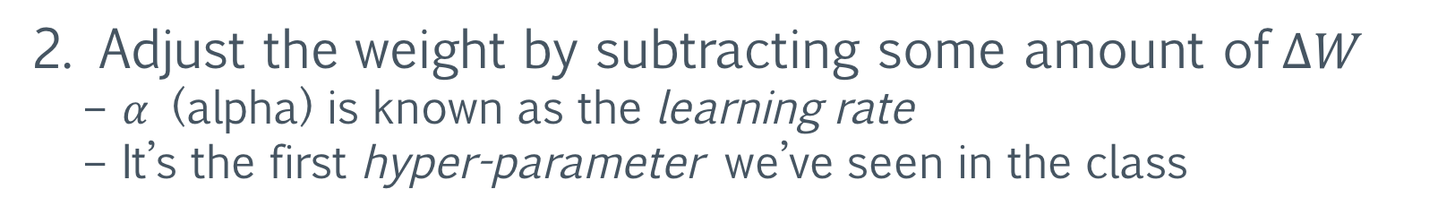
The process of doing gradient descent (math-version)
2. Adjust the weight by subtracting some amount of $∆W$
  $α$ (alpha) is known as the learning rate
  It’s the first hyper-parameter we’ve seen in the class
$$W:=W−α∙∆W$$
Minus adjusts W in the correct direction
3. Repeat until model is “done training”
  We can also adjust the learning rate as we train

Slide 32

Adjusting the learning rate
J (cost)
$$\frac{∂J}{∂W}<0$$
W
$$α∙∆W$$

Slide 33


Adjusting the learning rate
J (cost)
$$\frac{∂J}{∂W}<0$$
Bigger $α$
W
$$α∙∆W$$

Slide 34

Adjusting the learning rate
J (cost)
$$\frac{∂J}{∂W}<0$$
Smaller $α$
W
$$α∙∆W$$

Slide 35
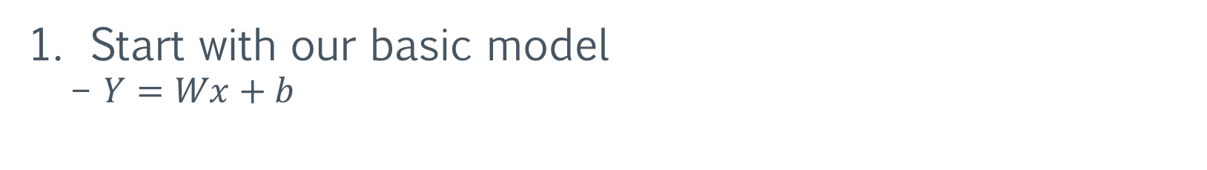
Process of gradient decent (computation graph)
Start with our basic model
  $Y=Wx+b$
Y
X
mul
add
W
var
b
var

Slide 36
Process of gradient decent (computation graph)
2. Define our cost function
  In this case tf.square(add – y)
  Built in: tf.squared_difference(add, y)
Y
X
mul
cost
(J)
add
W
var
b
var

Slide 37
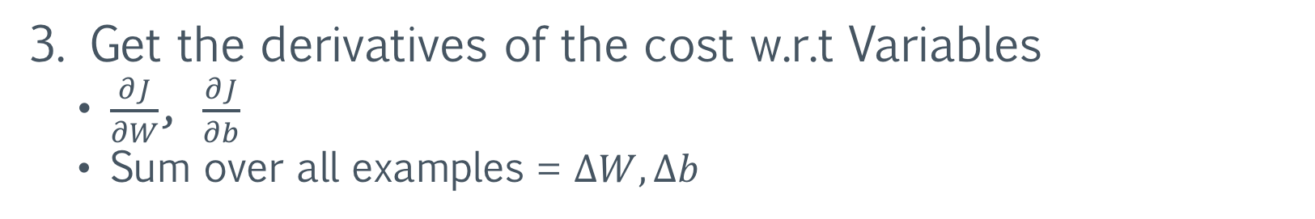
Process of gradient decent (computation graph)
3. Get the derivatives of the cost w.r.t Variables
  $\frac{∂J}{∂W}$, $\frac{∂J}{∂b}$
  Sum over all examples = $∆W, ∆b$
Y
X
mul
derivatives
cost
(J)
add
W
var
b
var

Slide 38
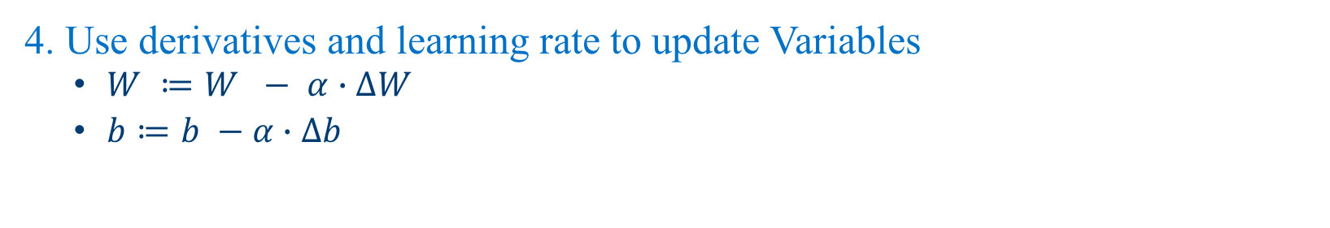

Process of doing gradient decent (computation graph)
4. Use derivatives and learning rate to update Variables
  $W ≔W − α∙∆W$
  $b≔b −α∙∆b$
Y
$$α$$
X
mul
derivatives
Weight
updates
cost
(J)
add
W
var
b
var

Slide 39
Cost needs to be defined like other operations in TF
cost = tf.reduce_mean(tf.squared_difference(add, Y))
Y
$$α$$
X
mul
derivatives
Weight
updates
cost
(J)
add
W
var
b
var

Slide 40
Derivatives and updates use a tf.Optimizer
Optimizer computes derivatives and applies them to Variables
Y
$$α$$
X
mul
derivatives
Weight
updates
cost
(J)
add
W
var
b
var

Slide 41
The Optimizer super-class
Two building block methods:
compute_gradients()
  Given a loss and list of Variables, will compute partial derivatives
  opt = tf.train.GradientDescentOptimizer(learning_rate)
  grads = opt.compute_gradients(loss, [W, b])
  You can then perform additional tweaks, if you’d like (not today)
apply_gradients()
  Creates an Operation that updates the variables, given gradients
  train = opt.apply_gradients(grads)
  …
  sess.run(train, feed_dict)
Notes:
Compute_gradients and apply_gradients are normally invoked together with Optimizer.minimize which is on the next slide. We would still use compute_gradients if we wanted an opportunity to update the gradients in some (non-builtin) way before applying them. TL;DR – compute_grad + apply_grad = minimize

Slide 42
Helper function: Optimizer.minimize()
opt.minimize()
  Given a loss target, creates an Operation that automatically computes and applies gradients for all trainable Variables that affect the loss
  Same as using compute_gradients and apply_gradients without adjusting the gradient values
  Easiest- use this unless you are manually adjusting gradients
  train = tf.train.GradientDescentOptimizer(learning_rate).minimize(loss)
  …
  sess.run(train, feed_dict)

Slide 43
How does tf.Optimizer work?
Let’s look at the model up through the loss function
Y
X
mul
cost (J)
y_hat
add
minus
square
sum
W
var
b
var

Slide 44
How does tf.Optimizer work?
The output of the sum Operation is our cost, J
Y
X
mul
cost (J)
y_hat
add
minus
square
sum
W
var
b
var

Slide 45
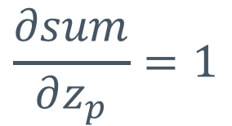
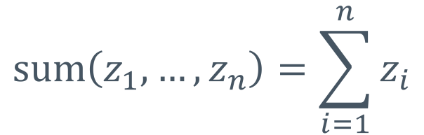
What is derivative of sum function w.r.t any input?
$$\text{sum}\left(z_{1},…, z_{n}\right)=\sum_{i=1}^{n}{z_{i}}$$
$$\frac{∂sum}{∂z_{p}}=1$$
cost (J)
sum

Slide 46
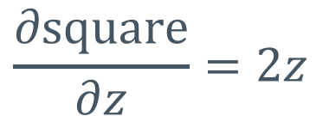


What is derivative of square function w.r.t any input?
$$\frac{∂\text{square}}{∂z}=2z$$
$$\text{square}\left(z\right)=z^{2}$$
$$\frac{∂\text{sum}}{∂z_{p}}$$
cost (J)
square
sum

Slide 47
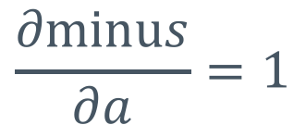

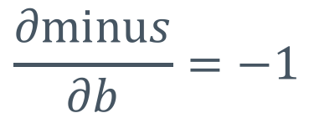


What is derivative of minus w.r.t either input?
$$\frac{∂\text{minu}s}{∂a}=1$$
$$\frac{∂\text{minu}s}{∂b}=−1$$
$$\text{m}\text{inus}\left(a, b\right)=a−b$$
$$\frac{∂\text{square}}{∂z}$$
$$\frac{∂sum}{∂z_{p}}$$
cost (J)
minus
square
sum

Slide 48

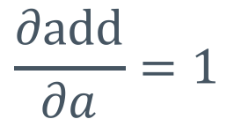



What is derivative of add w.r.t either input?
$$\frac{∂\text{add}}{∂a}=1$$
$$\frac{∂\text{add}}{∂b}=1$$
$$\text{a}\text{dd}\left(a, b\right)=a+b$$
$$\frac{∂\text{minus}}{∂b}$$
$$\frac{∂\text{square}}{∂z}$$
$$\frac{∂sum}{∂z_{p}}$$
$$\frac{∂\text{minus}}{∂a}$$
cost (J)
add
minus
square
sum

Slide 49
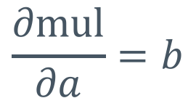
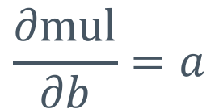



What is derivative of multiplication w.r.t either input?
$$\frac{∂\text{mul}}{∂a}=b$$
$$\frac{∂\text{mul}}{∂b}=a$$
$$\text{m}\text{ul}\left(a, b\right)=a×b$$
$$\frac{∂\text{minus}}{∂b}$$
$$\frac{∂\text{square}}{∂z}$$
$$\frac{∂sum}{∂z_{p}}$$
$$\frac{∂\text{add}}{∂a}$$
$$\frac{∂\text{minus}}{∂a}$$
mul
cost (J)
$$\frac{∂\text{add}}{∂b}$$
add
minus
square
sum

Slide 50


What is derivative of multiplication w.r.t either input?
$$\frac{∂\text{mul}}{∂a}=b$$
$$\frac{∂\text{mul}}{∂b}=a$$
$$\text{m}\text{ul}\left(a, b\right)=a×b$$
$$\frac{∂\text{minus}}{∂b}$$
$$\frac{∂\text{mul}}{∂a}$$
$$\frac{∂\text{square}}{∂z}$$
$$\frac{∂sum}{∂z_{p}}$$
$$\frac{∂\text{add}}{∂a}$$
$$\frac{∂\text{minus}}{∂a}$$
mul
cost (J)
$$\frac{∂\text{mul}}{∂b}$$
add
minus
square
sum
$$\frac{∂\text{add}}{∂b}$$

Slide 51



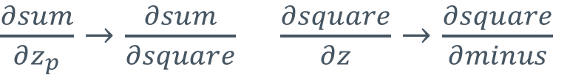




Now, we move from generic arguments to specific links (outputs) in our graph.
$\frac{∂sum}{∂z_{p}}→\frac{∂sum}{∂square}$ $\frac{∂square}{∂z}→\frac{∂square}{∂minus}$
$$\frac{∂\text{minus}}{∂Y}$$
Y
$$\frac{∂\text{mul}}{∂X}$$
$$\frac{∂\text{square}}{∂minus}$$
$$\frac{∂sum}{∂square}$$
$$\frac{∂\text{add}}{∂mul}$$
$$\frac{∂\text{minus}}{∂add}$$
X
mul
cost (J)
$$\frac{∂\text{mul}}{∂W}$$
add
minus
square
sum
$$\frac{∂\text{add}}{∂b}$$
W
var
b
var
Notes:
Note: this means that we replace our “abstract” derivative rules (partial of minus wrt a and b) with the specific inputs from the prior nodes (partial of minus wrt add and Y).

Slide 52

Now we can use the chain rule to get derivative w.r.t weights!
$$\frac{∂\text{minus}}{∂Y}$$
Y
$$\frac{∂\text{mul}}{∂X}$$
$$\frac{∂\text{square}}{∂minus}$$
$$\frac{∂sum}{∂square}$$
$$\frac{∂\text{add}}{∂mul}$$
$$\frac{∂\text{minus}}{∂add}$$
X
mul
cost (J)
$$\frac{∂\text{mul}}{∂W}$$
add
minus
square
sum
$$\frac{∂\text{add}}{∂b}$$
W
var
b
var

Slide 53
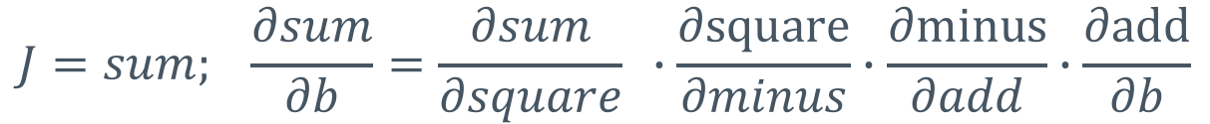
With respect to b:
$$J=sum; \frac{∂sum}{∂b}=\frac{∂sum}{∂square} ∙\frac{∂\text{square}}{∂minus}∙\frac{∂\text{minus}}{∂add}∙\frac{∂\text{add}}{∂b}$$
$$\frac{∂\text{square}}{∂minus}$$
$$\frac{∂sum}{∂square}$$
$$\frac{∂\text{minus}}{∂add}$$
cost (J)
$$\frac{∂\text{add}}{∂b}$$
add
minus
square
sum
b
var

Slide 54
Remember the “cancelling” effect of chain rule:
$$J=sum; \frac{∂sum}{∂b}=\frac{∂sum}{∂square} ∙\frac{∂\text{square}}{∂minus}∙\frac{∂\text{minus}}{∂add}∙\frac{∂\text{add}}{∂b}$$
$$\frac{∂\text{square}}{∂minus}$$
$$\frac{∂sum}{∂square}$$
$$\frac{∂\text{minus}}{∂add}$$
cost (J)
$$\frac{∂\text{add}}{∂b}$$
add
minus
square
sum
b
var

Slide 55
Similar process for derivative with respect to W
$$J=sum; \frac{∂sum}{∂W}=\frac{∂sum}{∂square} ∙\frac{∂square}{∂minus}∙\frac{∂minus}{∂add}∙\frac{∂add}{∂mul}∙\frac{∂mul}{∂W}$$
$$\frac{∂\text{square}}{∂minus}$$
$$\frac{∂sum}{∂square}$$
$$\frac{∂\text{add}}{∂mul}$$
$$\frac{∂\text{minus}}{∂add}$$
mul
cost (J)
$$\frac{∂\text{mul}}{∂W}$$
add
minus
square
sum
W
var

Slide 56
This is automatic differentiation
By using easily differentiable pieces, we get the derivative with respect to arbitrary inputs
Generalizes as long as you use differentiable pieces
This is how TensorFlow, Theano, Torch, etc. work
  Each differentiable Operation has a “gradient” function that defines how to take the derivative w.r.t its different inputs
This is essentially Backpropagation

Slide 57
Vectorization

Slide 58
Parallelizing our math
So far, we’ve limited our model:
  Single-variable regression
    Or, at least explicit placeholders for each input x
  Only processing one example at a time
We can do better on both:
  Multi-variable regression - with only one placeholder input!
  Process many pieces of data in a “batch”

Slide 59
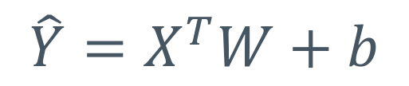
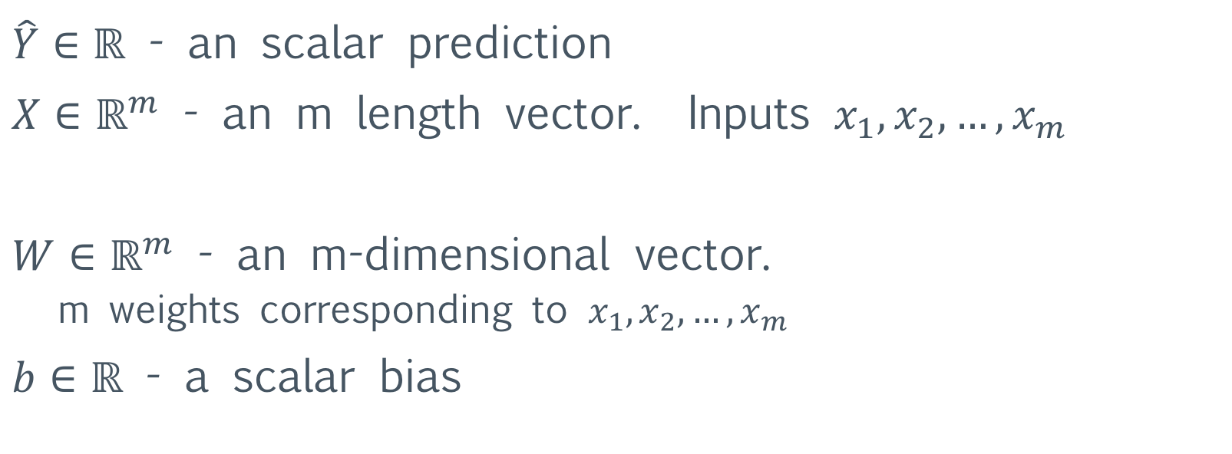
Vectorization #1: multi-variable regression
Let’s modify the function for our linear model:
$$\hat{Y}=X^{T}W+b$$
$\hat{Y}∈ℝ$ - an scalar prediction
$X∈ℝ^{m}$ - an m length vector. Inputs $x_{1},x_{2},…, x_{m}$
$W∈ℝ^{m}$ - an m-dimensional vector.
  m weights corresponding to $x_{1},x_{2},…, x_{m}$
$b∈ℝ$ - a scalar bias

Slide 60
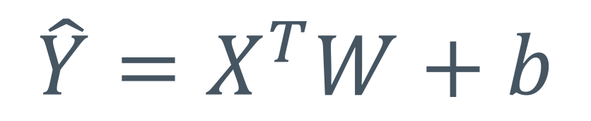
Vectorization #1: multi-variable regression
Double check that matrix dimensions work out
$$\hat{Y}=X^{T}W+b$$
[1]
[1,m]
x
[m,1]
[1]
[1]

Slide 61
How to accomplish this in TensorFlow
Give x placeholder and W weight a vector shape:
x = tf.placeholder(tf.float32, shape=[m, 1])
W = tf.Variable(tf.truncated_normal([m,1]))
Use matrix multiplication and transpose to calculate
y_hat = tf.matmul(tf.transpose(x), W) + b
Notes:
Recall we used tf.placeholder(tf.float32, name=“input1”) for a scalar input. The shape of that would have been shape=[]. Also note, X.T is [1 x m] so X is [m x 1],

Slide 62
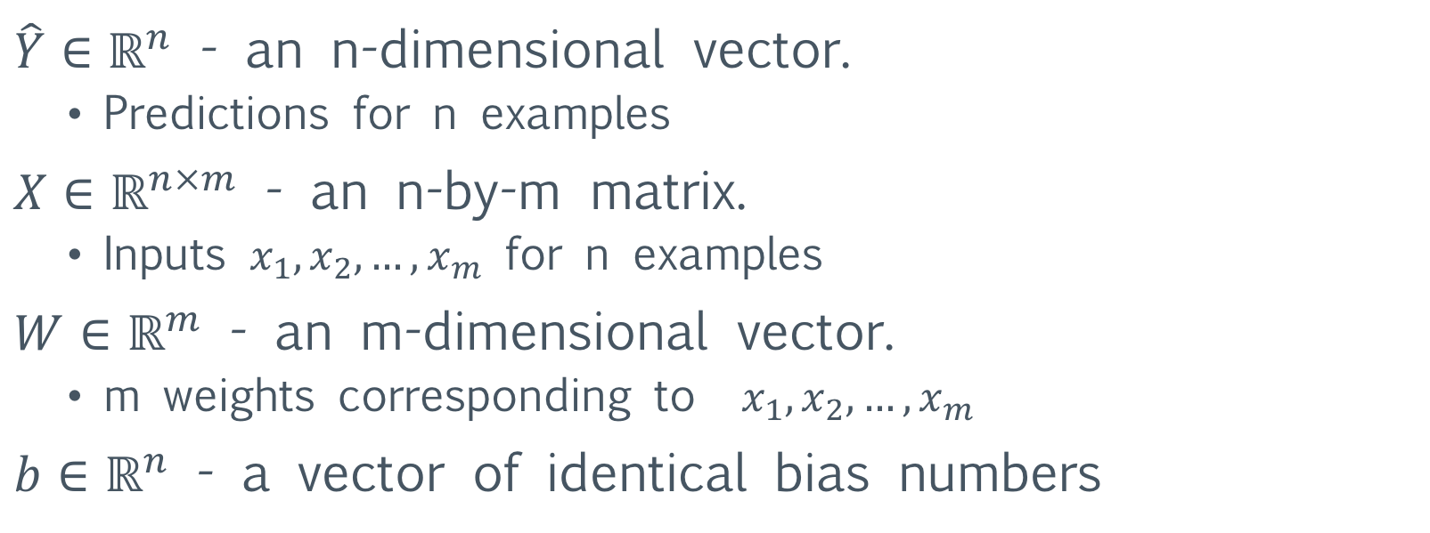
Vectorization #2: Batch examples
Let’s modify the function for our linear model:
$$\hat{Y}=X^{T}W+b$$
$\hat{Y}∈ℝ^{n}$ - an n-dimensional vector.
  Predictions for n examples
$X∈ℝ^{n×m}$ - an n-by-m matrix.
  Inputs $x_{1},x_{2},…, x_{m}$ for n examples
$W∈ℝ^{m}$ - an m-dimensional vector.
  m weights corresponding to $x_{1},x_{2},…, x_{m}$
$b∈ℝ^{n}$ - a vector of identical bias numbers

Slide 63
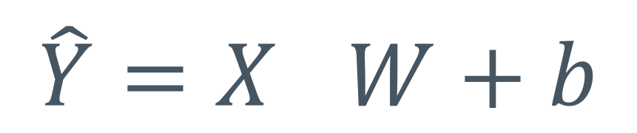
Vectorization #2: Batch examples
Double check that matrix dimensions work out
$$\hat{Y}=X^{}W+b$$
[n,1]
[n,m]
x
[m,1]
[n,1]
[n,1]
Notes:
Warning, warning. We do NOT have X.T any more. This is just plain vanilla X. So, the dims are swapped wrt the prior example.

Slide 64
How to accomplish this in TensorFlow
Give x placeholder matrix shape, W vector shape:
x = tf.placeholder(tf.float32, shape=[None, m])
W = tf.Variable(tf.truncated_normal([m,1]))
  None in a TensorFlow shape means that any length is allowed
  Allows you to input any amount of training examples
Use matrix multiplication to calculate
y_hat = tf.matmul(x, W) + b
This is what we’ll end up doing for most of this class.
Notes:
Warning, warning. We do NOT have X.T any more. This is just plain vanilla X. So, the dims are swapped wrt the prior example.

Slide 65
Odds and ends

Slide 66
Training, validation, and test sets
In order to better evaluate our model, we split our data into training, validation, and test sets
Training data is used to train the model as we discussed
Validation data is used to periodically evaluate the model on held-out data.
Test data is only ever used once, as a final evaluation of the model
Common split percentages are 60%, 20%, 20%
Notes:
This slide is a bit dogmatic. If definitely represents one view of train/valid/test. Another common scenario (in practice and in terminology as commonly used) is: 1. there is an initial hold out set (that is for “final” evaluation) 2. there may either be train/test or train/valid/test. The choice in 2 is whether there are hyper parameters to optimize.

Slide 67
Training, validation, and test sets
We do this to evaluate how much our model is overfitting the data, or “memorizing” answers
We want the model to generalize to examples not in the training data

Slide 68
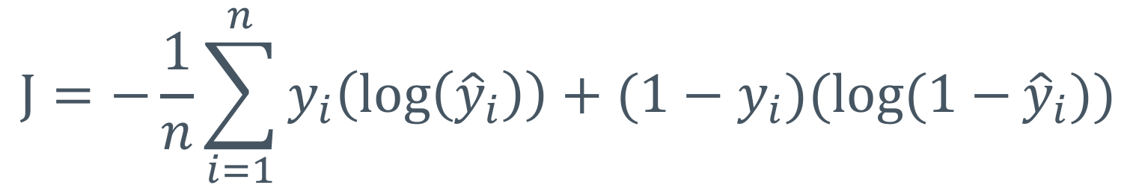
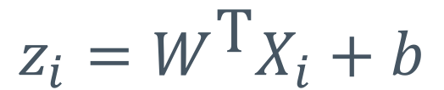
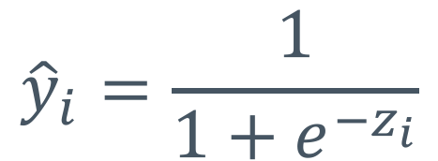
Logistic regression (binary classification)
$$\text{J}=−\frac{1}{n}\sum_{i=1}^{n}{y_{i}\left(\log\left({\hat{y}}_{i}\right)\right)+(1−y_{i})(log⁡(1−}{\hat{y}}_{i}))$$
$${\hat{y}}_{i}=\frac{1}{1+e^{−z_{i}}}$$
$$z_{i}=W^{\text{T}}X_{i}+b$$
Notes:
J is the cross-entropy loss; y^hat_i is the logistic function. Note that z_i is a linear thing (linear regression and logistic regression are both “generalized linear models”.

Slide 69
But wait, there’s more!
Regularization
Input normalization
But we’ll hold off until next week.

