Slide 1
Introduction to Neural Networks
Deep Learning with TensorFlow – Day 3

Slide 2
Legal Notices and Disclaimers
This presentation is for informational purposes only. INTEL MAKES NO WARRANTIES, EXPRESS OR IMPLIED, IN THIS SUMMARY.
Intel technologies’ features and benefits depend on system configuration and may require enabled hardware, software or service activation. Performance varies depending on system configuration. Check with your system manufacturer or retailer or learn more at intel.com.
This sample source code is released under the Intel Sample Source Code License Agreement.
Intel and the Intel logo are trademarks of Intel Corporation in the U.S. and/or other countries.
*Other names and brands may be claimed as the property of others.
Copyright © 2017, Intel Corporation. All rights reserved.

Slide 3
Input Normalization

Slide 4
Normalization and rescaling of inputs
Ideally, we want all inputs to have roughly the same scale
Helps stabilize learning
How to adjust inputs?
Notes:
Similar to scaling data for regression so that coefficients are on comparable scale (movie budgets in millions versus number of staff in hundreds)

Slide 5
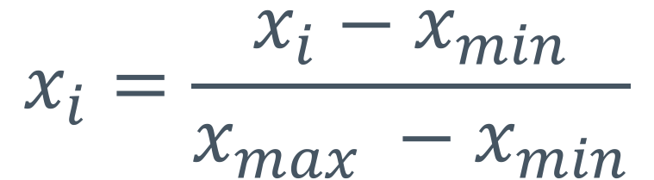
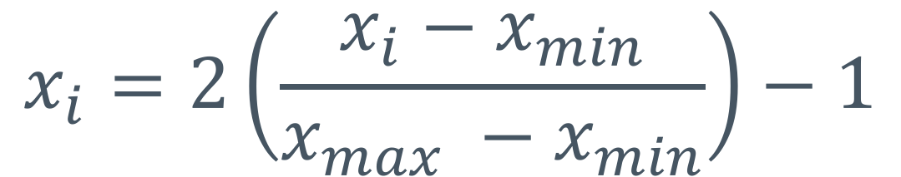
Shifting and rescaling
To have inputs range [0, 1]:
To have inputs range [-1, 1]:
$$x_{i}=\frac{x_{i}−x_{min}}{x_{max} −x_{min}}$$
$$x_{i}=2\left(\frac{x_{i}−x_{min}}{x_{max} −x_{min}}\right)−1$$
Notes:
There are many, many alternatives here.

Slide 6


Normalizing
Mean zero, standard deviation one
$$σ=\sqrt{\frac{1}{n}\sum_{i=1}^{n}{{\left(x_{i}− \overline{x}\right)}^{2}}}$$
$$x_{i}=\frac{x_{i}− \overline{x}}{σ};$$
Notes:
“z scores” gives us a set of x_i with mean 0 and stddev 1.0

Slide 7
Overhead view of cost curve
Un-Normalized
Normalized
Notes:
Z-scoring will take the x and y variability to 1.0. But, it won’t remove correlation (uneven spread) on diagonal. That’s what PCA is for. Consider this graphic an idealized scenario.

Slide 8
Regularization

Slide 9
Regularization
Goal: prevent overfitting
Want network to generalize beyond training data
How to do this?
One way: stop large weights from dominating
How? Penalize models with large weights
Notes:
Overfitting is where we “teach to the training data” (similar to the phrase “teaching to the test”) at the expense of learning the real underlying phenomena.

Slide 10

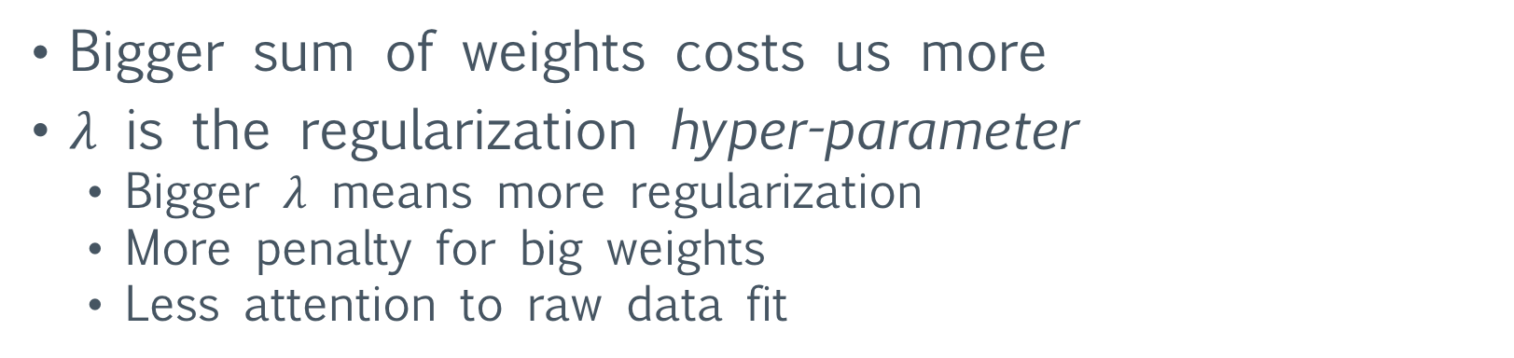
L2 Regularization
Adjust loss function to include a second term
$$J=\frac{1}{2n}\sum_{i=1}^{n}{{\left({\hat{y}}_{i}−y_{i}\right)}^{2}}+λ\sum_{j=1}^{m}{w_{i}^{2}}$$
Bigger sum of weights costs us more
$λ$ is the regularization hyper-parameter
  Bigger $λ$ means more regularization
  More penalty for big weights
  Less attention to raw data fit

Slide 11
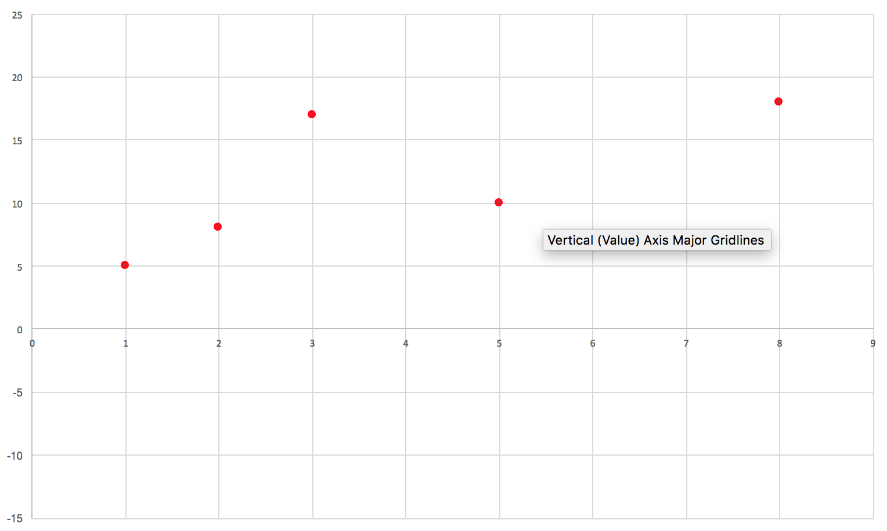
Scatter Plot

Slide 12
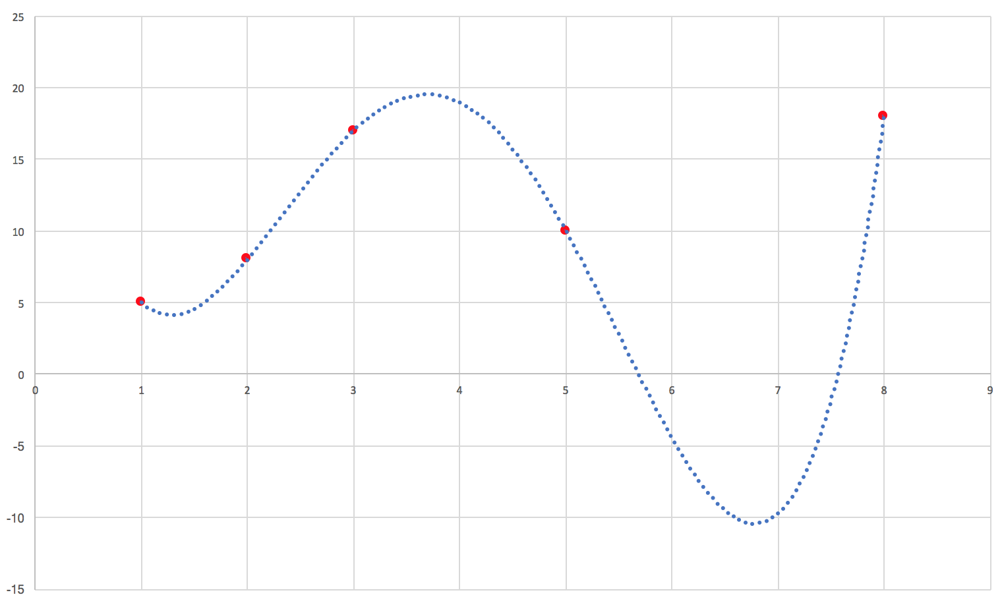
Overfitting
Notes:
We fit the red data points exactly. Great! But how does it do when we test? Who knows.

Slide 13
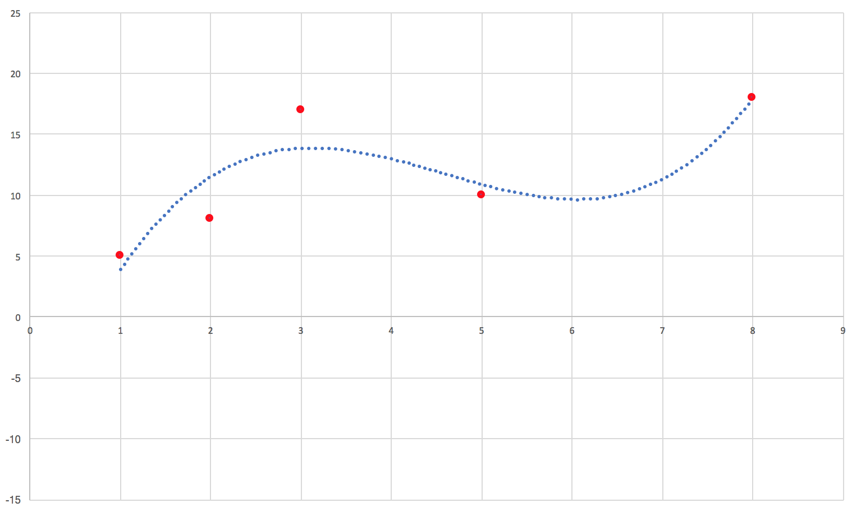
Possible model after regularization
Notes:
Much smoother. We don’t have the right-hand dip. We miss our data by a bit …. But hopefully our data is more “regular” like this smoother model.

Slide 14
Too much regularization!
Notes:
We’ve overdone it. We are super flat, but we can’t wiggle enough to capture the pattern. This is also called being too “biased”.

Slide 15
Different types of regularization
We’ll see different techniques that act as a form of regularization
  Not always just a term of the loss function
  Dropout (next class!)
Key takeaway:
regularization = less memorization

Slide 16
Neural Networks

Slide 17
Basic Idea
Use biology as inspiration for math model
Neurons:
  Get signals from previous neurons
  Generate signal (or not) according to inputs
  Pass that signal on to future neurons
By layering many neurons, can create complex model

Slide 18
The basic “neuron” visualization
activation
function
Notes:
Build up over the next few slides.

Slide 19
Reads roughly the same as a TensorFlow graph
activation
function

Slide 20
Reads roughly the same as a TensorFlow graph
Data flows into neuron
from previous layers
activation
function

Slide 21
Reads roughly the same as a TensorFlow graph
Some form of computation
transforms the inputs
activation
function

Slide 22
Reads roughly the same as a TensorFlow graph
The neuron outputs the
transformed data
activation
function

Slide 23


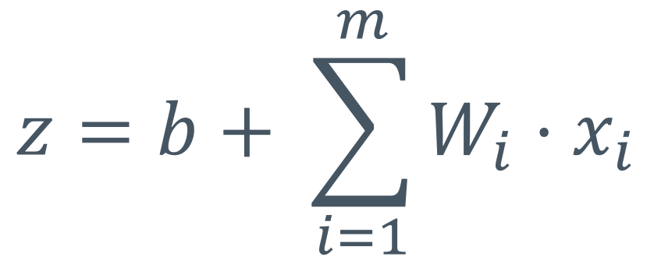
Mathematical Description of a Neuron
$$z=b+ \sum_{i=1}^{m}{W_{i}⋅x_{i}}$$
$$=W^{t}x+b$$
$$a=f\left(z\right)$$

Slide 24
Mathematical Description of a Neuron
$$z=b+ \sum_{i=1}^{m}{W_{i}⋅x_{i}}$$
z = net input
m inputs
$$=W^{t}x+b$$
$$a=f\left(z\right)$$
Notes:
Z (net input) is bringing together all of the input side of the neuron (all the incoming arrows).

Slide 25
Mathematical Description of a Neuron
$$z=b+ \sum_{i=1}^{m}{W_{i}⋅x_{i}}$$
Vectorized
$$=W^{t}x+b$$
$$a=f\left(z\right)$$

Slide 26
Mathematical Description of a Neuron
$$z=b+ \sum_{i=1}^{m}{W_{i}⋅x_{i}}$$
$$=W^{t}x+b$$
Activation value
Activation function
$$a=f\left(z\right)$$

Slide 27
Inside a single neuron (TensorFlow graph)
Inputs
matmul
add
activation
W
var
b
var
Notes:
Matmul does the dot product step (sum of products)

Slide 28
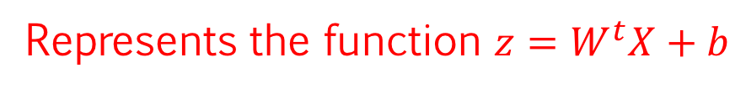
Inside a single neuron (TensorFlow graph)
Represents the function $z=W^{t}X+b$
Inputs
matmul
add
activation
W
var
b
var

Slide 29
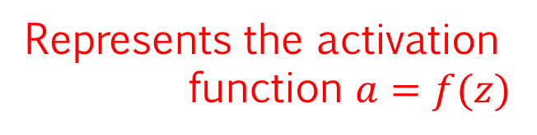
Inside a single neuron (TensorFlow graph)
Inputs
matmul
Represents the activation
function $a=f(z)$
add
activation
W
var
b
var

Slide 30
Inside a single neuron (TensorFlow graph)
X: [m x 1] vector of inputs
Inputs
matmul
(leaving out transpose op for now)
W: [m x 1] vector of weights
add
activation
W
var
b
var

Slide 31
Inside a single neuron (TensorFlow graph)
Inputs
matmul
Result of matmul is scalar
add
activation
W
var
b
var
Bias is scalar

Slide 32
Inside a single neuron (TensorFlow graph)
Inputs
matmul
The add operation outputs z
add
activation
z
W
var
b
var

Slide 33
Inside a single neuron (TensorFlow graph)
The activation function applies
a non-linear transformation and
passes it along to the next layer
Inputs
matmul
add
activation
W
var
b
var

Slide 34
Batched version
X: [n x m] matrix of inputs (batched)
Inputs
matmul
W: [m x 1] vector of weights
add
activation
W
var
b
var
Notes:
That is, what about running for more than one example at a time. Scale up the first dimension from 1 --> N.

Slide 35
Batched version
Inputs
matmul
Result of matmul is vector
(one entry for each example)
add
activation
W
var
b
var
Bias is scalar
(each prediction gets same bias added)

Slide 36
Batched version
Inputs
matmul
The add operation outputs z as a vector
one entry for each example
add
activation
z
W
var
b
var

Slide 37
Batched version
Inputs
matmul
Activation is a vector, one entry
for each input example
add
activation
W
var
b
var

Slide 38


A classical visualization of neurons
inputs
$$x_{1}$$
$$x_{2}$$
a
+1
Notes:
The next few slides talk about some of the ways neural network/neuron diagrams summarize (compress) themselves.

Slide 39
A classical visualization of neurons
$$x_{1}$$
$$x_{2}$$
a
bias neuron
(constant 1)
+1
Notes:
Note, we may use “bias” to mean the bias neuron and/or the bias weight. Since 1 * bias_weight = bias_weight, it’s not too important. The amount of the bias is the important part!

Slide 40
A classical visualization of neurons
$$x_{1}$$
Activation function
$$x_{2}$$
a
+1

Slide 41
Where are the weights?
Weights are shown to be arrows
in classical visualizations of NNs
$$x_{1}$$
$$x_{2}$$
a
+1

Slide 42



Where are the weights?
$$W_{1}$$
$$x_{1}$$
$$W_{2}$$
$$x_{2}$$
a
+1
$$b$$
Notes:
That is, in the classical neural network diagrams, the weights are implicitly give by the edges.

Slide 43
Where is the net value (z)?
Not shown!
Usually given via formulas in papers
$$x_{1}$$
$$x_{2}$$
a
+1

Slide 44
To keep visual noise down, we’ll use this notation for now
$$x_{1}$$
$$x_{2}$$
a
+1
Notes:
So remember, it has a net input (computed from x_i and 1 through the bias and weights) feeding to the activation a.

Slide 45
Our first activation function

Slide 46
Basic idea
Model inspired by biological neurons
Biological neurons either pass no signal, full signal, or something in between
Want a function that is like this and has an easy derivative.

Slide 47
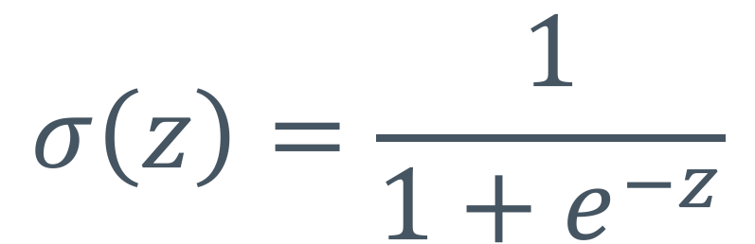
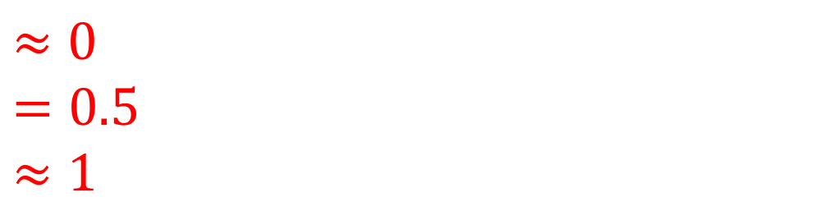
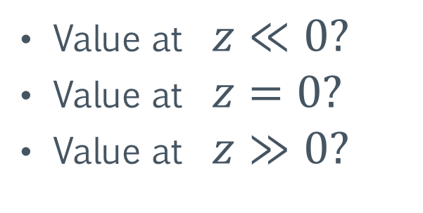
Sigmoid (logistic)
$$σ\left(z\right)=\frac{1}{1+e^{−z}}$$
Value at $z≪0?$
Value at $z=0?$
Value at $z≫0?$
$$≈0$$
$$=0.5$$
$$≈1$$
Notes:
Specifically, get towards -5 or -10, and we are “very” close to zero. At 5 or 10, we are “very” close to 1.

Slide 48
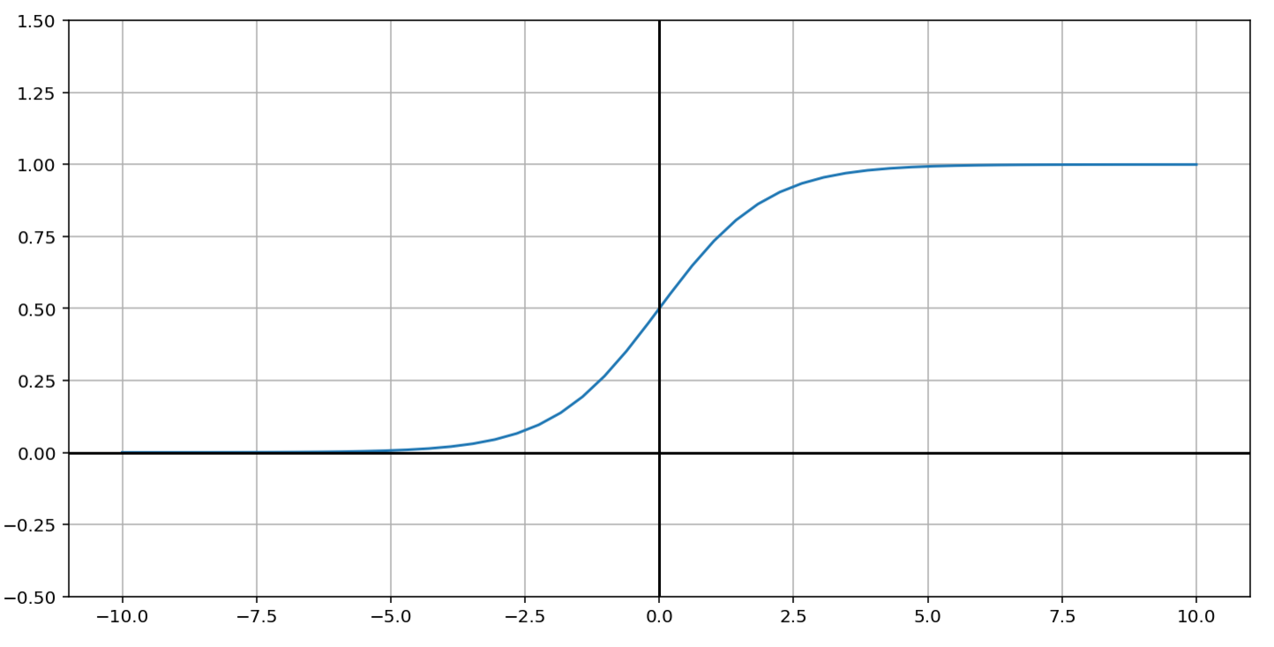
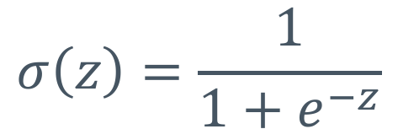
Sigmoid (logistic)
$$σ\left(z\right)=\frac{1}{1+e^{−z}}$$
Notes:
We’ll recreate this in the notebook, so don’t stress here.

Slide 49
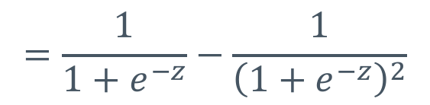
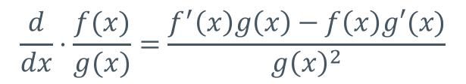
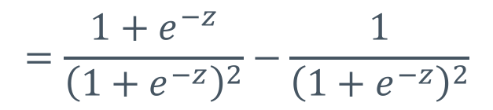
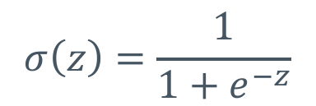
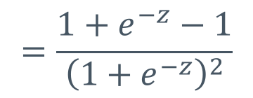
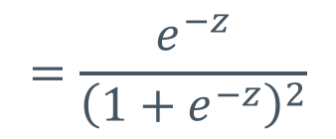
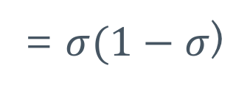
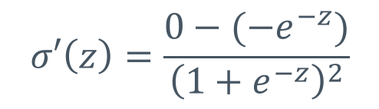
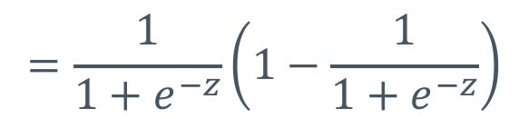
Easy derivative?
Quotient rule
$$σ\left(z\right)=\frac{1}{1+e^{−z}}$$
$$\frac{d}{dx}⋅\frac{f(x)}{g(x)}=\frac{f^{′}\left(x\right)g\left(x\right)−f\left(x\right)g′(x)}{g{\left(x\right)}^{2}}$$
$$σ′\left(z\right)=\frac{0−(−e^{−z})}{{\left(1+e^{−z}\right)}^{2}}$$
$$=\frac{e^{−z}}{{\left(1+e^{−z}\right)}^{2}}$$
$$=\frac{{1+e}^{−z}−1}{{\left(1+e^{−z}\right)}^{2}}$$
$$=\frac{{1+e}^{−z}}{{\left(1+e^{−z}\right)}^{2}}−\frac{1}{{\left(1+e^{−z}\right)}^{2}}$$
$$=\frac{1}{1+e^{−z}}−\frac{1}{{\left(1+e^{−z}\right)}^{2}}$$
$$=\frac{1}{1+e^{−z}}\left(1−\frac{1}{1+e^{−z}}\right)$$
= $σ(1−σ$)

Slide 50
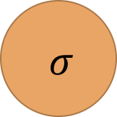
We can plug in the sigmoid as our activation function
$$x_{1}$$
$$x_{2}$$
$$σ$$
+1

Slide 51
Depending on the inputs and weights, the neuron will output a value between (0, 1)
$$x_{1}$$
$$x_{2}$$
$$σ$$
+1

Slide 52
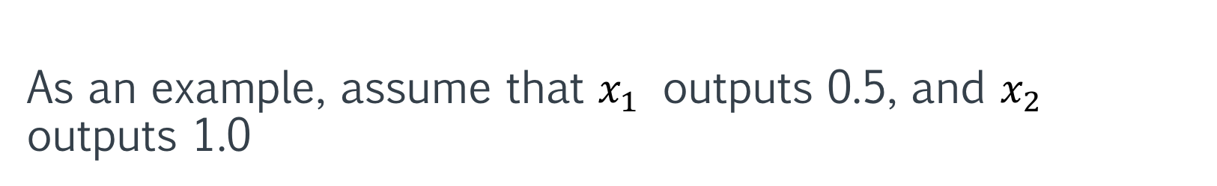
As an example, assume that $x_{1}$ outputs 0.5, and $x_{2}$ outputs 1.0
0.5
$$x_{1}$$
1.0
$$x_{2}$$
$$σ$$
+1

Slide 53
Recall that the bias neuron always outputs 1.0
0.5
$$x_{1}$$
1.0
$$x_{2}$$
$$σ$$
1.0
+1

Slide 54
We can now indicate the weights on the connecting edges
0.5
$$x_{1}$$
-40
1.0
$$x_{2}$$
5
$$σ$$
1.0
5
+1

Slide 55
When training, we adjust the weights parameters to create outputs that better fit the data
0.5
$$x_{1}$$
-40
1.0
$$x_{2}$$
5
$$σ$$
1.0
5
+1

Slide 56


With these values, we end up with net $z=−10$
0.5
$$z=\left(0.5⋅−40\right)+\left(1.0⋅5\right)+(1.0⋅5)$$
$$x_{1}$$
-40
1.0
$$x_{2}$$
5
$$σ$$
1.0
5
+1

Slide 57


We then plug z into the sigmoid function to get our output
0.5
$$σ\left(z\right)=σ(−10)≈0.0$$
$$x_{1}$$
-40
1.0
$$≈0.0$$
$$x_{2}$$
5
$$σ$$
1.0
5
+1

Slide 58

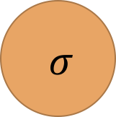
The output can then be passed onto another neuron, with a weight associated with that connection
0.5
$$x_{1}$$
-40
1.0
$$≈0.0$$
$$x_{2}$$
5
$$σ$$
$$σ$$
10
1.0
5
+1

Slide 59
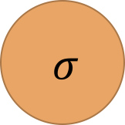

Inputs don’t need to be limited to passing data into a single neuron. They can pass data to as many as we like.
$$x_{1}$$
$$σ$$
$$x_{2}$$
$$σ$$
+1

Slide 60
Layers of Neurons

Slide 61
Neural Layers
Typically, neurons are grouped into layers.
Each neuron in the layer receives input from the same neurons
  Weights are different for each neuron
All neurons in this layer output to the same neurons in a subsequent layer
Notes:
This is a common “middle” layer in neural networks. They don’t *have* to be completely connected coming in and going out.

Slide 62
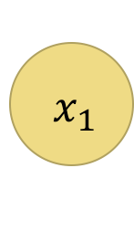
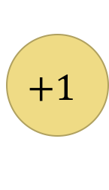
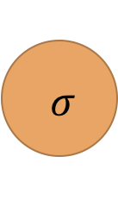

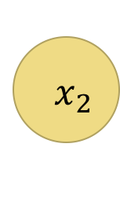
A single neural layer
$$σ$$
$$x_{1}$$
$$σ$$
$${ x}_{2}$$
$$σ$$
$$+1$$
$$σ$$
Notes:
More details on next slide: X_1 outputs to each of the sigmoids (activations). Same for x_2 and +1.

Slide 63
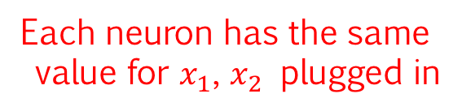
A single neural layer
But having different weights means
neurons respond to inputs differently
Each neuron has the same
value for $x_{1}$, $x_{2}$ plugged in
$$σ$$
$$x_{1}$$
$$σ$$
$${ x}_{2}$$
$$σ$$
$$+1$$
$$σ$$

Slide 64
What does a layer of neurons look like in TF?
Almost identical to single neuron!
Inputs
matmul
add
sigmoid
W
var
b
var

Slide 65
Weights: now a matrix (instead of vector)
X: [n x m] matrix of inputs
Inputs
matmul
W: [m x h]
matrix of weights
add
activation
h is # neurons
W
var
b
var

Slide 66
Bias is now a vector (instead of a scalar)
Result of matmul is [n x h] matrix
Each row is the activations of neurons for a single example
Inputs
matmul
add
activation
W
var
b
var
Bias is [h x 1] vector
(Each neuron gets its own bias)

Slide 67
Z is a matrix
Add outputs an [n x h] matrix.
Each row corresponds to the z values at
each neuron for an individual example
Inputs
matmul
add
activation
z
W
var
b
var

Slide 68
Activation is a matrix
Activation is [n x h]
Each row corresponds to the activation
values at each neuron per example
Inputs
matmul
add
activation
W
var
b
var

Slide 69
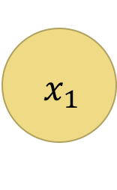
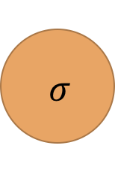

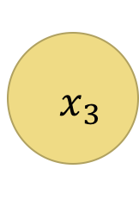

Matrix multiplication as layer transforms
We dictate the size of each layer
by defining different sized weights
$$σ$$
$$x_{1}$$
$$σ$$
Bias isn’t shown here
(usually “implied”)
$${ x}_{2}$$
$$σ$$
$${ x}_{3}$$
$$σ$$

Slide 70

$$current_{value}=X∈ℝ^{n×3}$$
X is [n x 3]
(n data points)
$$σ$$
$$x_{1}$$
$$σ$$
$${ x}_{2}$$
$$σ$$
$${ x}_{3}$$
$$σ$$

Slide 71

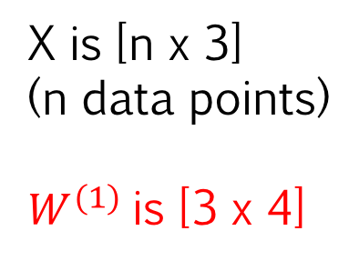
$$current_value=XW^{\left(1\right)}∈ℝ^{n×4}$$
X is [n x 3]
(n data points)
$W^{(1)}$is [3 x 4]
$$σ$$
$$x_{1}$$
$$σ$$
$${ x}_{2}$$
$$σ$$
$${ x}_{3}$$
$$σ$$

Slide 72
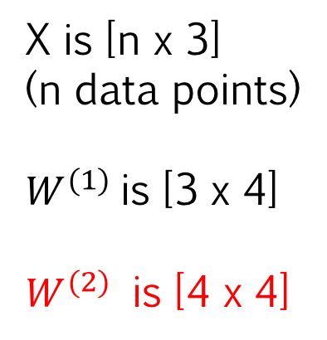
$$current_value=XW^{\left(1\right)}W^{(2)}∈ℝ^{n×4}$$
X is [n x 3]
(n data points)
$W^{(1)}$is [3 x 4]
$W^{(2)}$ is [4 x 4]
$$σ$$
$$σ$$
$$x_{1}$$
$$σ$$
$$σ$$
$${ x}_{2}$$
$$σ$$
$$σ$$
$${ x}_{3}$$
$$σ$$
$$σ$$

Slide 73
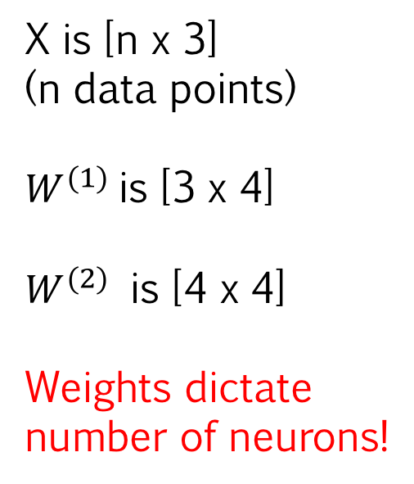
$$current_value=XW^{\left(1\right)}W^{(2)}∈ℝ^{n×4}$$
X is [n x 3]
(n data points)
$W^{(1)}$is [3 x 4]
$W^{(2)}$ is [4 x 4]
Weights dictate
number of neurons!
$$σ$$
$$σ$$
$$x_{1}$$
$$σ$$
$$σ$$
$${ x}_{2}$$
$$σ$$
$$σ$$
$${ x}_{3}$$
$$σ$$
$$σ$$

Slide 74
Weight sizes, in general:
W => [num_previous_neurons, num_new_neurons]
=> [previous_size, current_size]
b => [num_new_neurons]
=> [current_size]
Notes:
Size is the number of nodes in the layer.

Slide 75
A Feedforward Network
Notes:
The next block of slides just introduce a very standard NN with complete layer interconnections … and basic terminology.

Slide 76
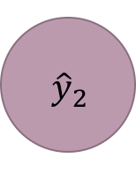
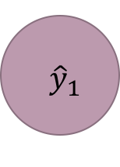
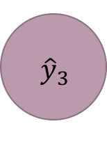
Feedforward neural network
$$σ$$
$$σ$$
$$x_{1}$$
$${ \hat{y}}_{1}$$
$$σ$$
$$σ$$
$${ x}_{2}$$
$${ \hat{y}}_{2}$$
$$σ$$
$$σ$$
$${ x}_{3}$$
$${ \hat{y}}_{3}$$
$$σ$$
$$σ$$

Slide 77
Weights
$$σ$$
$$σ$$
$$x_{1}$$
$${ \hat{y}}_{1}$$
$$σ$$
$$σ$$
$${ x}_{2}$$
$${ \hat{y}}_{2}$$
$$σ$$
$$σ$$
$${ x}_{3}$$
$${ \hat{y}}_{3}$$
$$σ$$
$$σ$$

Slide 78
Input layer
$$σ$$
$$σ$$
$$x_{1}$$
$${ \hat{y}}_{1}$$
$$σ$$
$$σ$$
$${ x}_{2}$$
$${ \hat{y}}_{2}$$
$$σ$$
$$σ$$
$${ x}_{3}$$
$${ \hat{y}}_{3}$$
$$σ$$
$$σ$$

Slide 79
Hidden layers
$$σ$$
$$σ$$
$$x_{1}$$
$${ \hat{y}}_{1}$$
$$σ$$
$$σ$$
$${ x}_{2}$$
$${ \hat{y}}_{2}$$
$$σ$$
$$σ$$
$${ x}_{3}$$
$${ \hat{y}}_{3}$$
$$σ$$
$$σ$$

Slide 80
Output layer
$$σ$$
$$σ$$
$$x_{1}$$
$${ \hat{y}}_{1}$$
$$σ$$
$$σ$$
$${ x}_{2}$$
$${ \hat{y}}_{2}$$
$$σ$$
$$σ$$
$${ x}_{3}$$
$${ \hat{y}}_{3}$$
$$σ$$
$$σ$$

Slide 81
Annotations
$$σ$$
$$σ$$
$$x_{1}$$
$${ \hat{y}}_{1}$$
$$σ$$
$$σ$$
$${ x}_{2}$$
$${ \hat{y}}_{2}$$
$$σ$$
$$σ$$
$${ x}_{3}$$
$${ \hat{y}}_{3}$$
$$σ$$
$$σ$$
Notes:
There are many, many different conventions for labeling/numbering layers in network. Some call the above a two or three layer (two hidden layers …. Get three by including output layer).

Slide 82




Layer numbers
$$σ$$
$$σ$$
$$x_{1}$$
$${ \hat{y}}_{1}$$
$$σ$$
$$σ$$
$${ x}_{2}$$
$${ \hat{y}}_{2}$$
$$σ$$
$$σ$$
$${ x}_{3}$$
$${ \hat{y}}_{3}$$
$$σ$$
$$σ$$
$$l^{(1)}$$
$$l^{(2)}$$
$$l^{(3)}$$
$$l^{(4)}$$

Slide 83




Activations
$$a^{(2)}$$
$$a^{(3)}$$
$$a^{(1)}$$
$$σ$$
$$σ$$
$$a^{(4)}$$
$$x_{1}$$
$${ \hat{y}}_{1}$$
$$σ$$
$$σ$$
$${ x}_{2}$$
$${ \hat{y}}_{2}$$
$$σ$$
$$σ$$
$${ x}_{3}$$
$${ \hat{y}}_{3}$$
$$σ$$
$$σ$$

Slide 84



Weights
$$w^{(1)}$$
$$σ$$
$$w^{(2)}$$
$$σ$$
$$w^{(3)}$$
$$x_{1}$$
$${ \hat{y}}_{1}$$
$$σ$$
$$σ$$
$${ x}_{2}$$
$${ \hat{y}}_{2}$$
$$σ$$
$$σ$$
$${ x}_{3}$$
$${ \hat{y}}_{3}$$
$$σ$$
$$σ$$

Slide 85



Net inputs
$$z^{(2)}$$
$$z^{(3)}$$
$$σ$$
$$σ$$
$$z^{(4)}$$
$$x_{1}$$
$${ \hat{y}}_{1}$$
$$σ$$
$$σ$$
$${ x}_{2}$$
$${ \hat{y}}_{2}$$
$$σ$$
$$σ$$
$${ x}_{3}$$
$${ \hat{y}}_{3}$$
$$σ$$
$$σ$$

