Slide 1
Backpropagation and Dropout
Deep Learning with TensorFlow –4

Slide 2
Legal Notices and Disclaimers
This presentation is for informational purposes only. INTEL MAKES NO WARRANTIES, EXPRESS OR IMPLIED, IN THIS SUMMARY.
Intel technologies’ features and benefits depend on system configuration and may require enabled hardware, software or service activation. Performance varies depending on system configuration. Check with your system manufacturer or retailer or learn more at intel.com.
This sample source code is released under the Intel Sample Source Code License Agreement.
Intel and the Intel logo are trademarks of Intel Corporation in the U.S. and/or other countries.
*Other names and brands may be claimed as the property of others.
Copyright © 2017, Intel Corporation. All rights reserved.

Slide 3
Batching

Slide 4
Full batch gradient descent
So far in this class, we’ve passed the full training dataset into our model for each training step
Pro: we get an exact derivative for the training set
Con: Right now- it’s really slow. Soon, it won’t be computationally feasible.
What can we do?

Slide 5
Mini-batching
Idea: Estimate derivative with a sample of training data
Pro: much faster to compute
Con: don’t get the exact derivative
Side effect: can potentially get out of local minima, if loss function has them

Slide 6
Stochastic Gradient Descent (SGD)
At an extreme, use a single example to estimate derivative
  Mini-batch with a size of 1
Also known as online training
Movement along the error curve is much more sporadic
But also much easier to compute
Notes:
Note that it can be as computationally “bad” to use a single example as to use too many. You lose data caching / movement benefits. Apparently some people refer to single example learning as “online learning”; that conflicts with older machine learning uses of the term to refer to any system that can update itself over time (also called incremental learning).

Slide 7
What steps might look like for different batch sizes
Stochastic
Mini-batch
Full batch
1
Batch size
N
Faster, less accurate step
Slower, more accurate step
Notes:
This shouldn’t imply that full batch will perfectly optimize directly.

Slide 8
Batching terminology cheat-sheet
Full-batch gradient descent
  Use all of training data per step
Mini-batch gradient descent
  Use small portion of training data per step
Stochastic gradient descent (SGD)
  Use single example per step
  Occasionally refers to mini-batch gradient descent
Notes:
I would say sGD “usually” refers to mini-batch. Don’t be too dogmatic about these terms: five different groups will use five different permutations of these terms.

Slide 9
Epochs
An epoch refers to one entire pass through the dataset
  The number of times a model has seen each training example

Slide 10
Shuffling
If we are using our data piecemeal, we must be careful:
Don’t want to oversample
Avoid reusing same mini-batch over and over
Solution: shuffle training data after each epoch
Shuffle, make batches, repeat

Slide 11
Splitting data up into batches
FULL BATCH
Batch 1
Batch 2
Batch 3
Batch 4
Batch 5

Slide 12
Splitting data up into batches
Batch 1
Step 1
Batch 2
Batch 3
Batch 4
Batch 5

Slide 13
Splitting data up into batches
Batch 1
Batch 2
Step 2
Batch 3
Batch 4
Batch 5

Slide 14
Splitting data up into batches
Batch 1
Batch 2
Batch 3
Step 3
Batch 4
Batch 5

Slide 15
Splitting data up into batches
Batch 1
Batch 2
Batch 3
Batch 4
Step 4
Batch 5

Slide 16
Splitting data up into batches
Batch 1
Batch 2
Batch 3
Batch 4
Batch 5
Step 5

Slide 17
First epoch completed
Batch 1
Batch 2
Batch 3
Batch 4
Batch 5

Slide 18
Shuffle the data!
Batch 1
Batch 2
Batch 3
Batch 2
Batch 4
Batch 5

Slide 19
Continue training
Step 6
Batch 2
Notes:
Read this as: at step 6, some example from orange/yellow/green (in the prior epoch) are now grouped together to form the first batch of the second epoch.

Slide 20
Multi-class classification

Slide 21



One-hot vectors
A vector that usually represents a single choice from among many options
One entry is 1, the rest are 0
$$\left[\begin{matrix}1 \\ 0 \\ 0\end{matrix}\right]$$
$$\left[\begin{matrix}0 \\ 1 \\ 0\end{matrix}\right]$$
$$\left[\begin{matrix}0 \\ 0 \\ 1\end{matrix}\right]$$
Cat
Dog
Toaster

Slide 22
Multi-class classification
Goal: We want our model to be able to predict from one of many discreet classes
  E.g., Cat, dog, toaster, etc.
Idea: train model to output some sort of predictive vector
  Each entry in the vector corresponds to a single class’s score
How?
Notes:
i.e.: output of [.25, 17.2, 3.8] means “likely a dog”

Slide 23
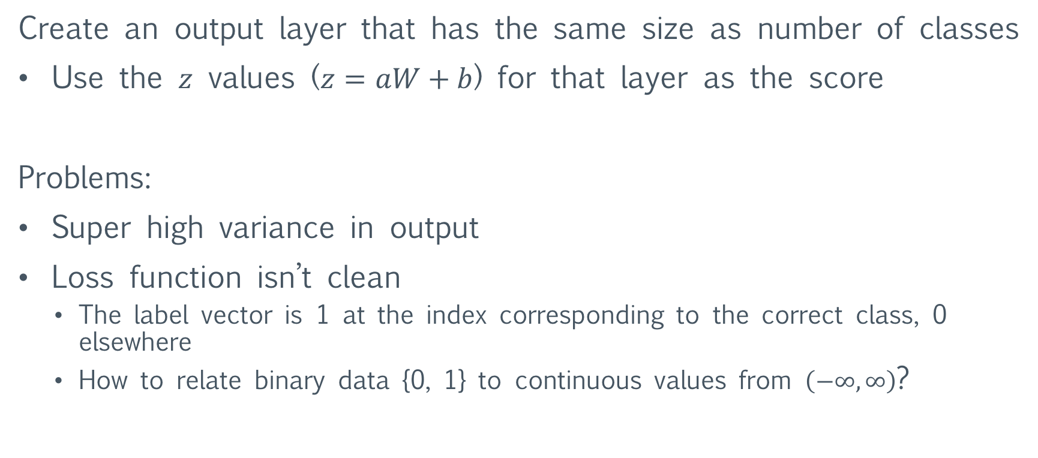
Thought 1: Just use a regular vector
Create an output layer that has the same size as number of classes
Use the $z$ values ($z=aW+b$) for that layer as the score
Problems:
Super high variance in output
Loss function isn’t clean
  The label vector is 1 at the index corresponding to the correct class, 0 elsewhere
  How to relate binary data {0, 1} to continuous values from $\left(−∞,∞\right)$?
Notes:
Classic problems of logistic regression (and why we don’t just use linear regression against a class)

Slide 24
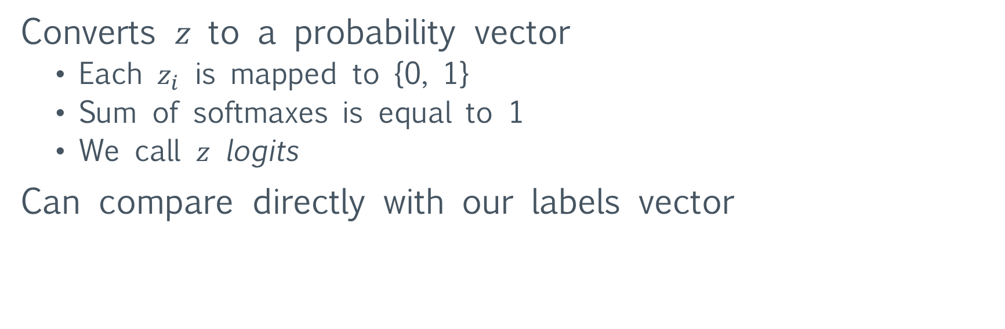
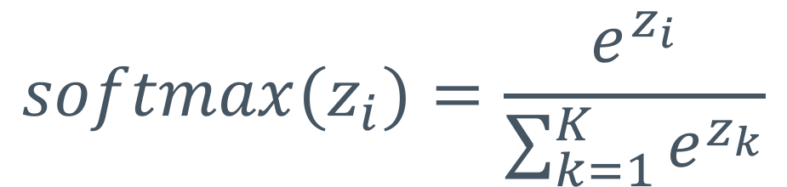
A better way: Softmax
$$softmax(z_{i})=\frac{e^{z_{i}}}{\sum_{k=1}^{K}{e^{z_{k}}}}$$
Converts $z$ to a probability vector
  Each $z_{i}$ is mapped to {0, 1}
  Sum of softmaxes is equal to 1
  We call $z$ logits
Can compare directly with our labels vector
Notes:
This is all fundamentally the same as logistic regression. To get a single class, we just take the index of the largest softmax value.
Next slide: our loss/cost function

Slide 25
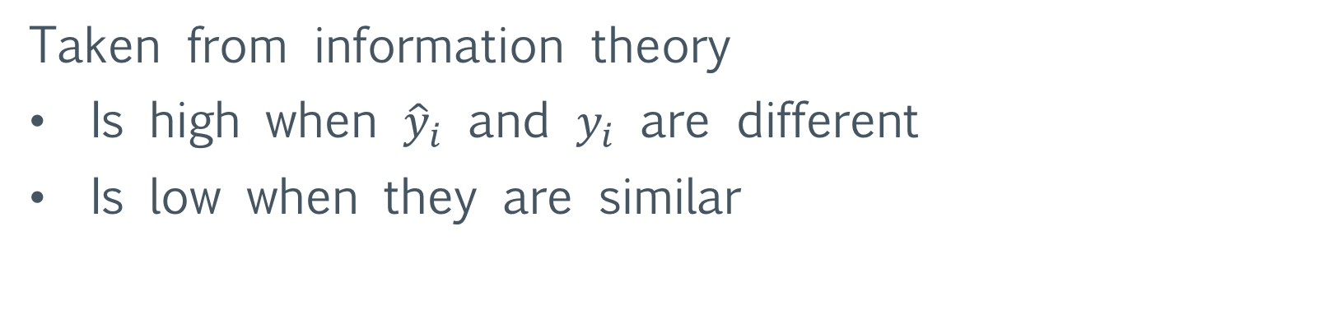
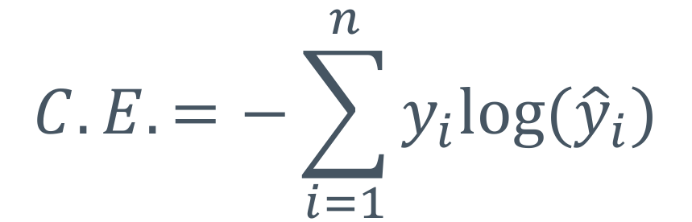
Loss function: Cross entropy
$$C.E.=−\sum_{i=1}^{n}{y_{i}log⁡({\hat{y}}_{i})}$$
Taken from information theory
Is high when ${\hat{y}}_{i}$ and $y_{i}$ are different
Is low when they are similar
Notes:
Of course, we also need the derivative to descend the gradient! Derivative is on next slide

Slide 26
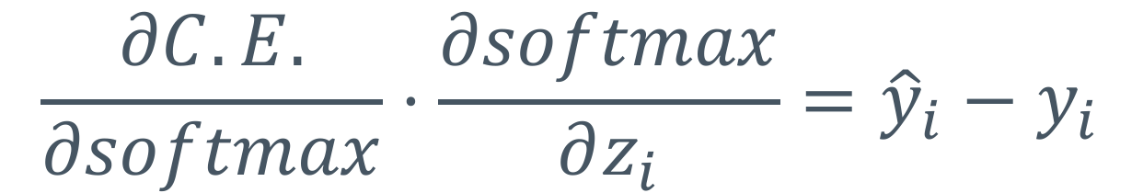
Derivative of cross-entropy with softmax input
$$\frac{∂C.E.}{∂softmax}⋅\frac{∂softmax}{∂z_{i}}={\hat{y}}_{i}−y_{i}$$
Super easy to compute!

Slide 27
Backpropagation

Slide 28
Backpropagation
Idea: use the chain rule to find derivative of cost function with respect to each set of weights
Works basically the same as the automatic differentiation example we went over last week

Slide 29
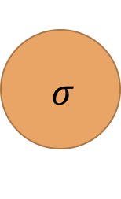


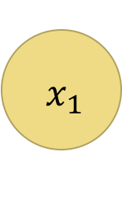
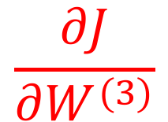




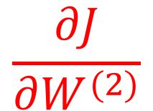

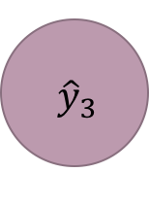
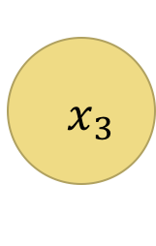

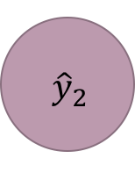


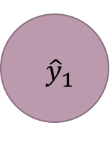


$$\frac{∂J}{∂W^{(1)}}$$
$$\frac{∂J}{∂W^{(2)}}$$
$$\frac{∂J}{∂W^{(3)}}$$
Want:
(Biases included in $W$)
$$a^{(2)}$$
$$a^{(3)}$$
$$a^{(1)}$$
$$σ$$
$$σ$$
$$a^{(4)}$$
$$x_{1}$$
$${ \hat{y}}_{1}$$
Cost
(J)
$$σ$$
$$σ$$
$${ x}_{2}$$
$${ \hat{y}}_{2}$$
$$σ$$
$$σ$$
$${ x}_{3}$$
$${ \hat{y}}_{3}$$
$$σ$$
$$σ$$
$$W^{(1)}$$
$$W^{(2)}$$
$$W^{(3)}$$

Slide 30




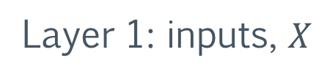
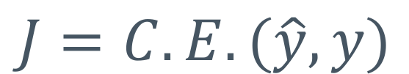


Equations for the model
$$J=C.E.(\hat{y}, y)$$
Layer 1: inputs, $X$
Layer 2: first hidden layer
$$z^{(2)}=XW^{(1)}$$
$$a^{(2)}=σ(z^{\left(2\right)})$$
Layer 3: second hidden layer
$$z^{(3)}=a^{(2)}W^{(2)}$$
$$a^{(3)}=σ(z^{\left(3\right)})$$
Layer 4: output
$$z^{(4)}=a^{(3)}W^{(3)}$$
$$\hat{y}=softmax(z^{\left(4\right)})$$
Notes:
J = C.E. Means cost function is cross-entropy error between y_hat and y

Slide 31
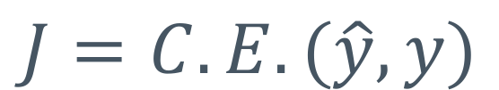




Getting partial derivatives
$$J=C.E.(\hat{y}, y)$$
$$z^{(2)}=XW^{(1)}$$
$$a^{(2)}=σ(z^{\left(2\right)})$$
$$z^{(3)}=a^{(2)}W^{(2)}$$
$$a^{(3)}=σ(z^{\left(3\right)})$$
$$z^{(4)}=a^{(3)}W^{(3)}$$
$$\hat{y}=softmax(z^{\left(4\right)})$$
Notes:
Note, J is really “at the end” of these equations, not at the start. It’s there as a “title” for the slide.

Slide 32
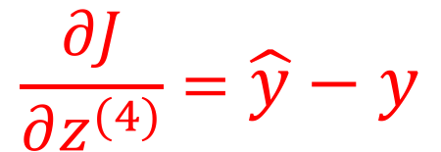
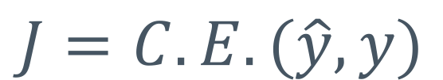
Getting partial derivatives
$$J=C.E.(\hat{y}, y)$$
$$z^{(2)}=XW^{(1)}$$
$$a^{(2)}=σ(z^{\left(2\right)})$$
$$z^{(3)}=a^{(2)}W^{(2)}$$
$$a^{(3)}=σ(z^{\left(3\right)})$$
$$\frac{∂J}{∂z^{(4)}}=\hat{y}−y$$
Notes:
Recall the simple derivative for cross-entropy error (which is the y_hat – y in the bottom right corner)

Slide 33
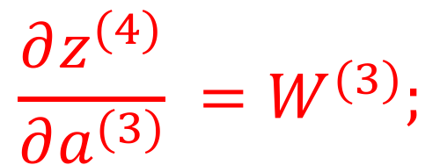
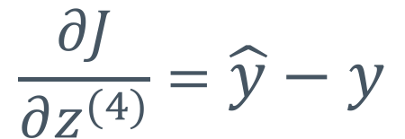
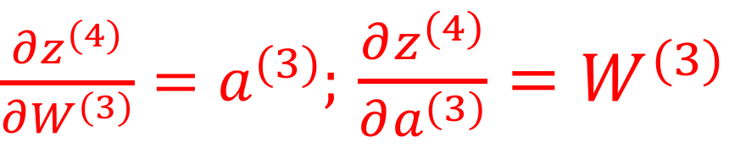
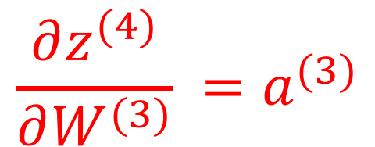
Getting partial derivatives
$$z^{(2)}=XW^{(1)}$$
$$a^{(2)}=σ(z^{\left(2\right)})$$
$$z^{(3)}=a^{(2)}W^{(2)}$$
$$a^{(3)}=σ(z^{\left(3\right)})$$
$\frac{∂z^{(4)}}{∂W^{(3)}}=a^{(3)};$ $\frac{∂z^{(4)}}{∂a^{(3)}}=W^{(3)}$
$$\frac{∂J}{∂z^{(4)}}=\hat{y}−y$$
Notes:
And now we start “propogating” the derivatives (chain-ruling) backwards

Slide 34
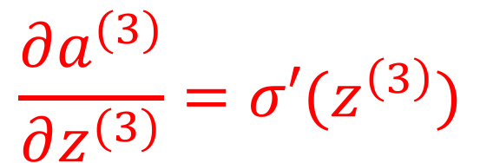
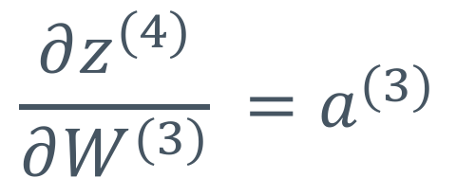
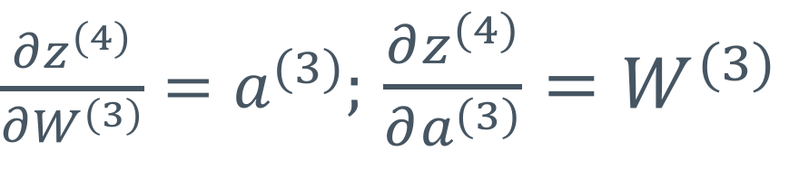
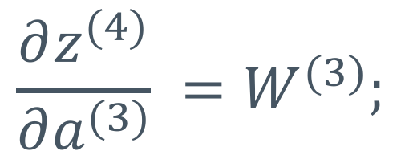
Getting partial derivatives
$$z^{(2)}=XW^{(1)}$$
$$a^{(2)}=σ(z^{\left(2\right)})$$
$$\frac{∂a^{(3)}}{∂z^{(3)}}=σ′(z^{\left(3\right)})$$
$$z^{(3)}=a^{(2)}W^{(2)}$$
$\frac{∂z^{(4)}}{∂W^{(3)}}=a^{(3)};$ $\frac{∂z^{(4)}}{∂a^{(3)}}=W^{(3)}$
$$\frac{∂J}{∂z^{(4)}}=\hat{y}−y$$
Notes:
Recall that for the logistic/sigmoid sigma: sigma^prime = sigma(1-sigma). Another “nice” form.

Slide 35
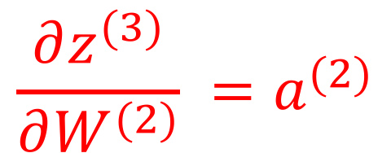
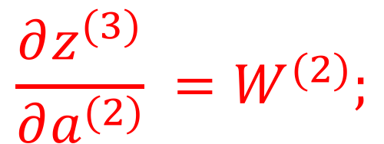
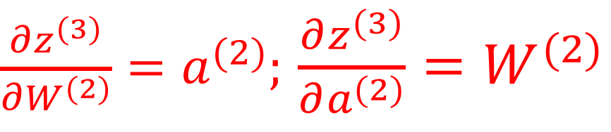
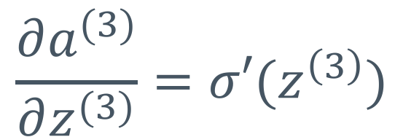
Getting partial derivatives
$$z^{(2)}=XW^{(1)}$$
$$a^{(2)}=σ(z^{\left(2\right)})$$
$$\frac{∂a^{(3)}}{∂z^{(3)}}=σ′(z^{\left(3\right)})$$
$\frac{∂z^{(3)}}{∂W^{(2)}}=a^{(2)};$ $\frac{∂z^{(3)}}{∂a^{(2)}}=W^{(2)}$
$\frac{∂z^{(4)}}{∂W^{(3)}}=a^{(3)};$ $\frac{∂z^{(4)}}{∂a^{(3)}}=W^{(3)}$
$$\frac{∂J}{∂z^{(4)}}=\hat{y}−y$$

Slide 36
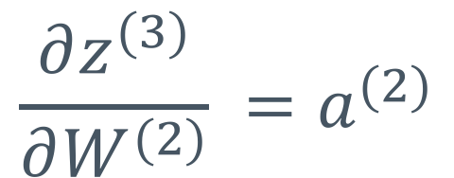
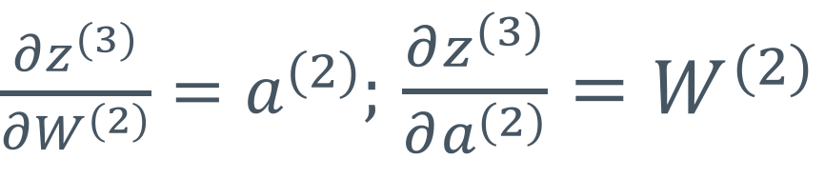
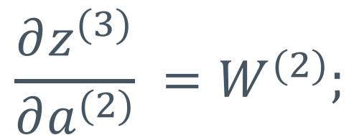
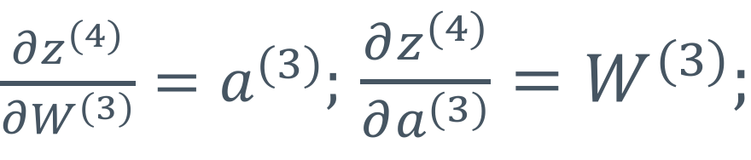
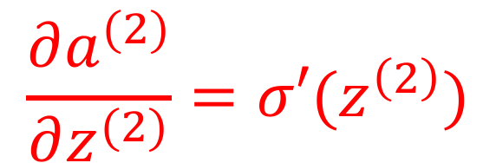
Getting partial derivatives
$$\frac{∂a^{(2)}}{∂z^{(2)}}=σ′(z^{\left(2\right)})$$
$$z^{(2)}=XW^{(1)}$$
$$\frac{∂a^{(3)}}{∂z^{(3)}}=σ′(z^{\left(3\right)})$$
$\frac{∂z^{(3)}}{∂W^{(2)}}=a^{(2)};$ $\frac{∂z^{(3)}}{∂a^{(2)}}=W^{(2)}$
$\frac{∂z^{(4)}}{∂W^{(3)}}=a^{(3)};$ $\frac{∂z^{(4)}}{∂a^{(3)}}=W^{(3)};$
$$\frac{∂J}{∂z^{(4)}}=\hat{y}−y$$

Slide 37
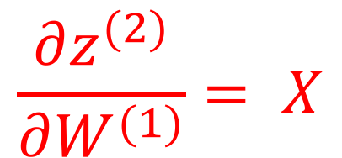
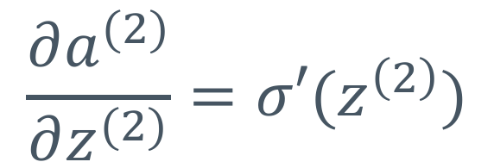
Getting partial derivatives
$$\frac{∂z^{(2)}}{∂W^{(1)}}= X$$
$$\frac{∂a^{(2)}}{∂z^{(2)}}=σ′(z^{\left(2\right)})$$
$$\frac{∂a^{(3)}}{∂z^{(3)}}=σ′(z^{\left(3\right)})$$
$\frac{∂z^{(3)}}{∂W^{(2)}}=a^{(2)};$ $\frac{∂z^{(3)}}{∂a^{(2)}}=W^{(2)}$
$\frac{∂z^{(4)}}{∂W^{(3)}}=a^{(3)};$ $\frac{∂z^{(4)}}{∂a^{(3)}}=W^{(3)};$
$$\frac{∂J}{∂z^{(4)}}=\hat{y}−y$$

Slide 38
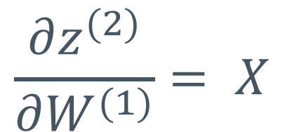
Can now use the chain rule!
$$\frac{∂z^{(2)}}{∂W^{(1)}}= X$$
$$\frac{∂a^{(2)}}{∂z^{(2)}}=σ′(z^{\left(2\right)})$$
$$\frac{∂a^{(3)}}{∂z^{(3)}}=σ′(z^{\left(3\right)})$$
$\frac{∂z^{(3)}}{∂W^{(2)}}=a^{(2)};$ $\frac{∂z^{(3)}}{∂a^{(2)}}=W^{(2)}$
$\frac{∂z^{(4)}}{∂W^{(3)}}=a^{(3)};$ $\frac{∂z^{(4)}}{∂a^{(3)}}=W^{(3)};$
$$\frac{∂J}{∂z^{(4)}}=\hat{y}−y$$
Notes:
All the partials are filled in. Put them together on the next slide.

Slide 39
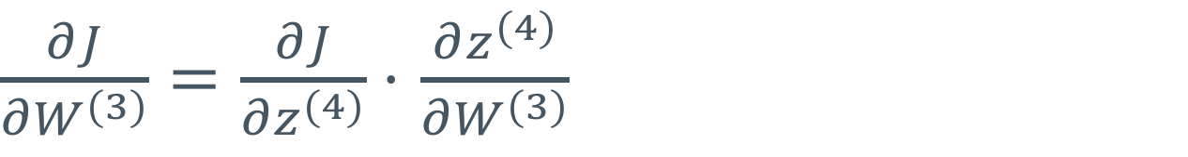
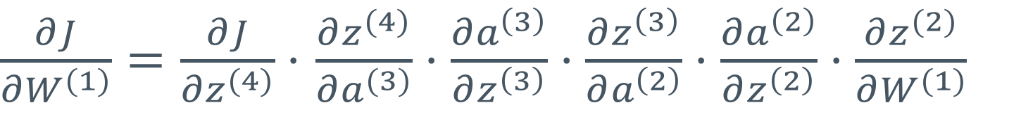
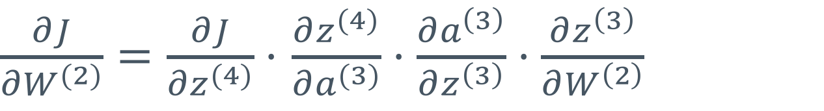
Can now use the chain rule!
$\frac{∂J}{∂W^{(3)}}=\frac{∂J}{∂z^{(4)}}⋅$ $\frac{∂z^{(4)}}{∂W^{(3)}}$
$\frac{∂J}{∂W^{(2)}}=\frac{∂J}{∂z^{(4)}}⋅$ $\frac{∂z^{(4)}}{∂a^{(3)}}⋅\frac{∂a^{\left(3\right)}}{∂z^{\left(3\right)}}⋅\frac{∂z^{\left(3\right)}}{∂W^{\left(2\right)}}$
$\frac{∂J}{∂W^{(1)}}=\frac{∂J}{∂z^{(4)}}⋅$ $\frac{∂z^{(4)}}{∂a^{(3)}}⋅\frac{∂a^{\left(3\right)}}{∂z^{\left(3\right)}}⋅\frac{∂z^{\left(3\right)}}{∂a^{\left(2\right)}}⋅\frac{∂a^{\left(2\right)}}{∂z^{\left(2\right)}}⋅\frac{∂z^{(2)}}{∂W^{(1)}}$
Notes:
We’ll fill in pieces on the next slide.

Slide 40
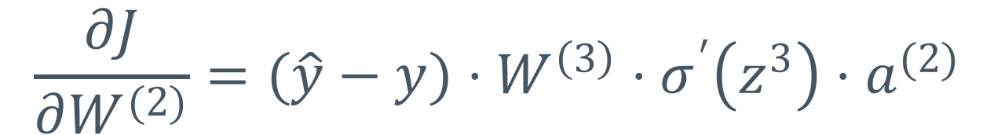

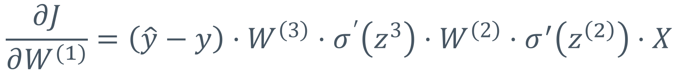
Fill in for specific values
$$\frac{∂J}{∂W^{(3)}}=(\hat{y}−y)⋅a^{(3)}$$
$$\frac{∂J}{∂W^{(2)}}=(\hat{y}−y)⋅W^{\left(3\right)}⋅σ^{′}\left(z^{3}\right)⋅a^{(2)}$$
$$\frac{∂J}{∂W^{(1)}}=\left(\hat{y}−y\right)⋅W^{\left(3\right)}⋅σ^{′}\left(z^{3}\right)⋅W^{\left(2\right)}⋅σ^{′}\left(z^{\left(2\right)}\right)⋅X$$
Notes:
We’ll get into more intuition, but think about the fact that (y_hat – y) will be zero if they are the same (we are correct). That would mean that we don’t want to adjust that weight.

Slide 41
Visual intuition

Slide 42
Visually, what we are doing is attributing error to specific weights
$$a^{(2)}$$
$$a^{(3)}$$
$$a^{(1)}$$
$$σ$$
$$σ$$
$$a^{(4)}$$
$$x_{1}$$
$${ \hat{y}}_{1}$$
Cost
(J)
$$σ$$
$$σ$$
$${ x}_{2}$$
$${ \hat{y}}_{2}$$
$$σ$$
$$σ$$
$${ x}_{3}$$
$${ \hat{y}}_{3}$$
$$σ$$
$$σ$$
$$W^{(1)}$$
$$W^{(2)}$$
$$W^{(3)}$$

Slide 43



First, we pass data into the model to get a prediction.
$$a^{(2)}$$
$$a^{(3)}$$
$$a^{(1)}$$
$$σ$$
$$σ$$
$$a^{(4)}$$
$$x_{1}$$
$${ \hat{y}}_{1}$$
Cost
(J)
$$σ$$
$$σ$$
$${ x}_{2}$$
$${ \hat{y}}_{2}$$
$$σ$$
$$σ$$
$${ x}_{3}$$
$${ \hat{y}}_{3}$$
$$σ$$
$$σ$$
$$W^{(1)}$$
$$W^{(2)}$$
$$W^{(3)}$$

Slide 44



This is known as forward propagation, or forward-prop
$$a^{(2)}$$
$$a^{(3)}$$
$$a^{(1)}$$
$$σ$$
$$σ$$
$$a^{(4)}$$
$$x_{1}$$
$${ \hat{y}}_{1}$$
Cost
(J)
$$σ$$
$$σ$$
$${ x}_{2}$$
$${ \hat{y}}_{2}$$
$$σ$$
$$σ$$
$${ x}_{3}$$
$${ \hat{y}}_{3}$$
$$σ$$
$$σ$$
$$W^{(1)}$$
$$W^{(2)}$$
$$W^{(3)}$$

Slide 45
This leaves us with the cost function
$$a^{(2)}$$
$$a^{(3)}$$
$$a^{(1)}$$
$$a^{(4)}$$
Cost
(J)
$$W^{(1)}$$
$$W^{(2)}$$
$$W^{(3)}$$
Notes:
Since we have training data (known labels), we can calculate the cost.

Slide 46
Use the chain rule, work our way back, apply local derivatives at each layer
$$a^{(2)}$$
$$a^{(3)}$$
$$a^{(1)}$$
$$a^{(4)}$$
$${ \hat{y}}_{1}$$
Cost
(J)
$${ \hat{y}}_{2}$$
$${ \hat{y}}_{3}$$
$$W^{(1)}$$
$$W^{(2)}$$
$$W^{(3)}$$

Slide 47







At this point we can take the derivative w.r.t $W^{(3)}$
$$a^{(2)}$$
$$a^{(3)}$$
$$a^{(1)}$$
$$σ$$
$$σ$$
$$a^{(4)}$$
$$x_{1}$$
$${ \hat{y}}_{1}$$
Cost
(J)
$$σ$$
$$σ$$
$${ x}_{2}$$
$${ \hat{y}}_{2}$$
$$σ$$
$$σ$$
$${ x}_{3}$$
$${ \hat{y}}_{3}$$
$$σ$$
$$σ$$
$$W^{(1)}$$
$$W^{(2)}$$
$$W^{(3)}$$

Slide 48
Then w.r.t $a^{(3)}$ to continue the chain
$$a^{(2)}$$
$$a^{(3)}$$
$$a^{(1)}$$
$$σ$$
$$σ$$
$$a^{(4)}$$
$$x_{1}$$
$${ \hat{y}}_{1}$$
Cost
(J)
$$σ$$
$$σ$$
$${ x}_{2}$$
$${ \hat{y}}_{2}$$
$$σ$$
$$σ$$
$${ x}_{3}$$
$${ \hat{y}}_{3}$$
$$σ$$
$$σ$$
$$W^{(1)}$$
$$W^{(2)}$$
$$W^{(3)}$$

Slide 49
This process continues as we attempt to get the derivative for each weight.
$$a^{(2)}$$
$$a^{(3)}$$
$$a^{(1)}$$
$$σ$$
$$σ$$
$$a^{(4)}$$
$$x_{1}$$
$${ \hat{y}}_{1}$$
Cost
(J)
$$σ$$
$$σ$$
$${ x}_{2}$$
$${ \hat{y}}_{2}$$
$$σ$$
$$σ$$
$${ x}_{3}$$
$${ \hat{y}}_{3}$$
$$σ$$
$$σ$$
$$W^{(1)}$$
$$W^{(2)}$$
$$W^{(3)}$$

Slide 50
Until we have found all the derivatives we need
$$a^{(2)}$$
$$a^{(3)}$$
$$a^{(1)}$$
$$σ$$
$$σ$$
$$a^{(4)}$$
$$x_{1}$$
$${ \hat{y}}_{1}$$
Cost
(J)
$$σ$$
$$σ$$
$${ x}_{2}$$
$${ \hat{y}}_{2}$$
$$σ$$
$$σ$$
$${ x}_{3}$$
$${ \hat{y}}_{3}$$
$$σ$$
$$σ$$
$$W^{(1)}$$
$$W^{(2)}$$
$$W^{(3)}$$

Slide 51

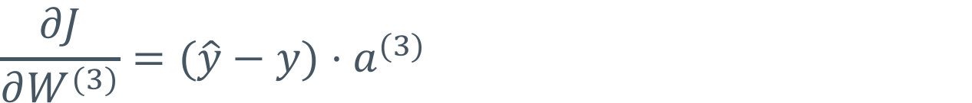
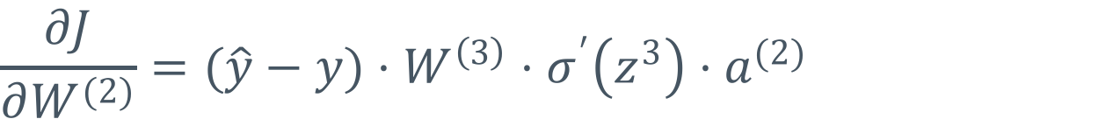
The error signal: $δ$
Looking at these equations, we may notice a pattern:
$$\frac{∂J}{∂W^{(3)}}=(\hat{y}−y)⋅a^{(3)}$$
$$\frac{∂J}{∂W^{(2)}}=(\hat{y}−y)⋅W^{\left(3\right)}⋅σ^{′}\left(z^{3}\right)⋅a^{(2)}$$
$$\frac{∂J}{∂W^{(1)}}=\left(\hat{y}−y\right)⋅W^{\left(3\right)}⋅σ^{′}\left(z^{3}\right)⋅W^{\left(2\right)}⋅σ^{′}\left(z^{\left(2\right)}\right)⋅X$$
Notes:
[error] then
zero or more of [weight * output (activation derivative)] pairs
and then input

Slide 52


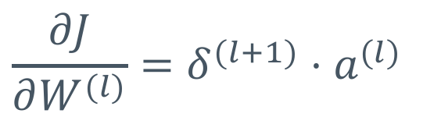
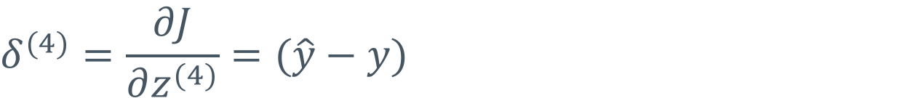
The error signal: $δ$
Let’s call the error signal to a layer, $δ^{(l)}$, the derivative of the cost function w.r.t. net inputs $z^{(l)}$
$$δ^{(4)}=\frac{∂J}{∂z^{(4)}}=(\hat{y}−y)$$
We can use the error signal to compute the derivative w.r.t the previous layer’s weight and error signal
$${\frac{∂J}{∂W^{(l)}}=δ}^{(l+1)}⋅a^{(l)}$$
$$δ^{(l)}=δ^{(l+1)}⋅W^{\left(l\right)}⋅σ′(z^{\left(l\right)})$$
Notes:
My error signal (bottom right corner) is the:
incoming error (from the RHS of the graph) times my weights times the derivative of my output/activation
And we can apply it recursively back to the first layer.

Slide 53





$${\frac{∂J}{∂W^{(l)}}=δ}^{(l+1)}⋅a^{(l)}$$
$$δ^{(l)}=δ^{(l+1)}⋅W^{\left(l\right)}⋅σ′(z^{\left(l\right)})$$
$$δ^{(4)}$$
$$\frac{∂J}{∂W^{(3)}}=(\hat{y}−y)⋅a^{(3)}$$
$$δ^{(3)}$$
$$\frac{∂J}{∂W^{(2)}}=(\hat{y}−y)⋅W^{\left(3\right)}⋅σ^{′}\left(z^{3}\right)⋅a^{(2)}$$
$$δ^{(2)}$$
$$\frac{∂J}{∂W^{(1)}}=\left(\hat{y}−y\right)⋅W^{\left(3\right)}⋅σ^{′}\left(z^{3}\right)⋅W^{\left(2\right)}⋅σ^{′}\left(z^{\left(2\right)}\right)⋅X$$

Slide 54
Error signal in practices
Allows you to easily code a repeatable pattern when implementing backpropagation by hand
That said, you probably won’t be thinking about the error signal when you use TensorFlow
May come up in papers you read or other resources you learn from in the future

Slide 55
Mental break

Slide 56
A potential problem.
Take a look at this formula for the gradient w.r.t. $W^{(1)}$:
$$\frac{∂J}{∂W^{(1)}}=\left(\hat{y}−y\right)⋅W^{\left(3\right)}⋅σ^{′}\left(z^{3}\right)⋅W^{\left(2\right)}⋅σ^{′}\left(z^{\left(2\right)}\right)⋅X$$
We’re going to want a deep network!
  More layers allows more complex representations
Is there something that might get screwy due to the functions we’re using?

Slide 57

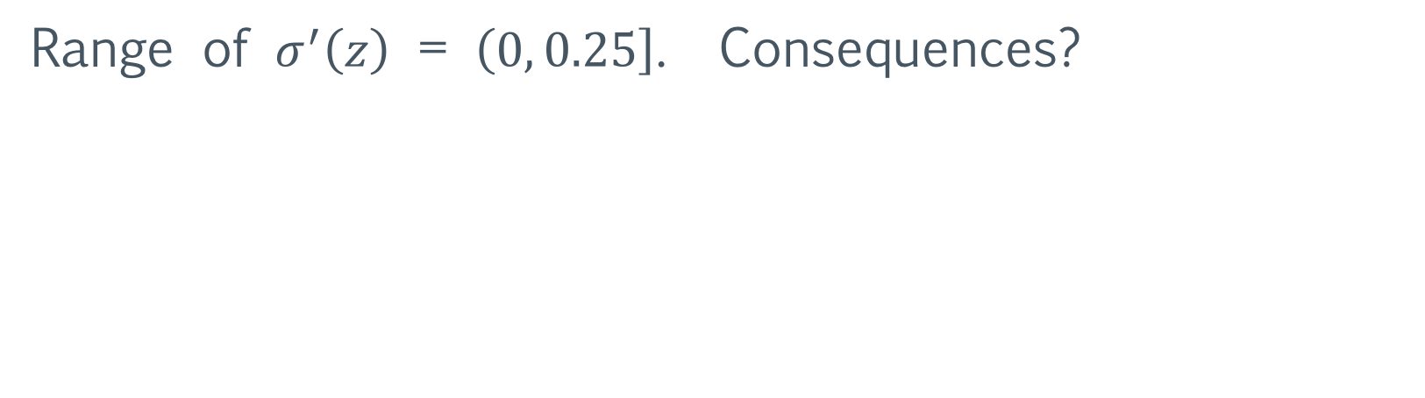
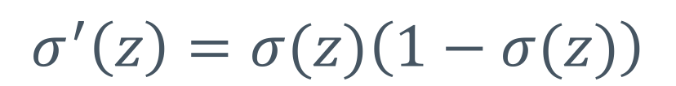
Range of $σ^{′}\left(z\right)$?
Recall derivative of the sigmoid function:
$$σ^{′}\left(z\right)=σ(z)\left(1−σ(z)\right)$$
Range of $σ^{′}\left(z\right)$ = $\left(0, 0.25\right]$. Consequences?
Notes:
Note, the derivative of our sigmoid looks vaguely bell-curve shaped. It’s max is at zero. The sigmoid itself takes the value .5 there. So, .5 * (1-.5) = .25.

Slide 58

What happens to our gradient, as layers increase?
Assume we have many layers
$\frac{∂J}{∂W^{(1)}}=\left(\hat{y}−y\right)⋅W^{\left(L−1\right)}⋅σ^{′}\left(z^{L−2}\right)⋅W^{\left(L−2\right)}⋅σ^{′}\left(z^{\left(L−2\right)}\right)⋅$… $W^{\left(2\right)}⋅σ^{′}\left(z^{\left(2\right)}\right)⋅X$
Gradient gets multiplied by numbers strictly between $(0, 0.25]$ repeatedly
And, the gradient goes to zero! (Ugh.)
Notes:
Common problem when we take a product of probabilities. In that case, we often take logs which converts the product into additions.

Slide 59
What happens if gradient is close to zero?
The model can’t train!
This is called the vanishing gradient problem
Notes:
Near zero gradient is a very “flat” surface (close to a horizontal line in 2D). And we can’t go anywhere unless we have a massive step size.

Slide 60
Not training is bad.
So we can’t make a model too deep right now.
But we want a deep network for better models!
If the sigmoid is the problem, can we change it?
Alternative activation functions

Slide 61
Suite of activation functions

Slide 62
Non-linearities for deep learning
These functions are the most commonly used in deep learning
All of them have easy derivatives
Notes:
We’ll investigate the derivatives in the notebook.

Slide 63



Sigmoid (logistic)
$$σ\left(z\right)=\frac{1}{1+e^{−z}}$$
Value at $z≪0?$
Value at $z=0?$
Value at $z≫0?$
$$≈0$$
$$=0.5$$
$$≈1$$

Slide 64


Sigmoid (logistic)
$$σ\left(z\right)=\frac{1}{1+e^{−z}}$$

Slide 65


Hyperbolic tangent (tanh)
$$tanh\left(z\right)=\frac{sinh⁡(z)}{cosh⁡(z)}=\frac{e^{2x}−1}{e^{2x}+1}$$
Value at $z≪0?$
Value at $z=0?$
Value at $z≫0?$
$$≈−1$$
$$=0.$$
$$≈1$$

Slide 66


Hyperbolic Tangent
$$tanh\left(z\right)=\frac{sinh⁡(z)}{cosh⁡(z)}=\frac{e^{2x}−1}{e^{2x}+1}$$

Slide 67



Rectified Linear Unit (ReLU)
$$ReLU\left(z\right)=\left\{\begin{aligned}0, z<0 \\ &z, z≥0\end{aligned}\right.$$
$$=max\left(0, z\right)$$
Value at $z≪0?$
Value at $z=0?$
Value at $z≫0?$
$$=0$$
$$=0.$$
$$=z$$
Notes:
Note that this has a nice piecemeal derivative but it isn’t smooth at x=0

Slide 68


Rectified Linear Unit
$$ReLU\left(z\right)=\left\{\begin{aligned}0, z<0 \\ &z, z≥0\end{aligned}\right.$$

Slide 69




Leaky ReLU
$$LReLU\left(z\right)=\left\{\begin{aligned}αz, z<0 \\ &z, z≥0\end{aligned}\right.$$
$$=max\left(αz, z\right)$$
Value at $z≪0?$
Value at $z=0?$
Value at $z≫0?$
$$=αz$$
$$=0.$$
$$=z$$
Notes:
Typical value of $α$ is very small positive value (0.01)

Slide 70


Leaky ReLU
$$LReLU\left(z\right)=\left\{\begin{aligned}αz, z<0 \\ &z, z≥0\end{aligned}\right.$$

Slide 71
Dropout
Srivastava, Hinton, Krizhevsky, Sutskever and Salakhutdinov, 2014

Slide 72
Dropout overview
Neural networks can represent extremely complex data
Very large number of parameters allows NNs to memorize a dataset
We want to regularize (smooth) their solution
Prevent single neurons from dominating
Require other neurons to be more flexible
Randomly zero the output of neurons during training
  Other neurons have to adapt

Slide 73

Dropout model
Notes:
Note, we do this mathematically (with zeros) not by constructing a whole new network!

Slide 74

Dropout layer
Gates
Notes:
The gates control whether the input gets through. When a node is dropped, the gate is close and the output on the other side is simply zero.

Slide 75


Knocking out and rescaling neurons
During training, we randomly drop each neuron with probability $1−p$
Notes:
Note: we’re using p as the “keep prob” which is consistent with TensorFlow. Some of the literature uses p as the “drop prob” and uses q = 1-p as the “keep prob”. Also note: TensorFlow scales (up : by 1/p > 1) at training time instead of (down : p < 1) at testing time. They are mathematically equivalent.

Slide 76

Knocking out and rescaling neurons
When running the model, we scale the outputs of the neuron by $p$

Slide 77
Knocking out and rescaling neurons
This ensures that the expected value of the weights stays the same at run time

Slide 78

Concept of a “pseudo-ensemble”
Notes:
Ensembles are learning systems that are composed of a combination of sub-learning systems. So, imagine a neural network, a decision tree, and an SVM all make a prediction and then you somehow weight/combine those predications. That overall output is an ensemble prediction.

Slide 79
Model 1

Slide 80

Model 2

Slide 81
Model 3 etc.
Notes:
And our “test” network is a combination (a weighted linear combination) of model 1, model 2, and model 3.

Slide 82

Dropout: bottom line
Empirically shown to be useful for neural networks
Relatively easy to manually implement
Automatically included with TensorFlow!
tf.nn.dropout(inputs, keep_prob)
Scales weights for you
Uses keep probability instead of drop probability
$keep_prob=p$

Slide 83
Neural Net vs. MNIST dataset

Slide 84
MNIST: Our first “real” dataset
MNIST:
labeled hand-written digits from 0-9
Each digit picture is grayscale,
28x28 pixels
Game plan:
convert 2D matrices of pixels into vectors
pass into our neural network
Notes:
And we’ll delve into this in the notebook

