Slide 1
Introduction to
Convolutional Networks

Slide 2
Legal Notices and Disclaimers
This presentation is for informational purposes only. INTEL MAKES NO WARRANTIES, EXPRESS OR IMPLIED, IN THIS SUMMARY.
Intel technologies’ features and benefits depend on system configuration and may require enabled hardware, software or service activation. Performance varies depending on system configuration. Check with your system manufacturer or retailer or learn more at intel.com.
This sample source code is released under the Intel Sample Source Code License Agreement.
Intel and the Intel logo are trademarks of Intel Corporation in the U.S. and/or other countries.
*Other names and brands may be claimed as the property of others.
Copyright © 2017, Intel Corporation. All rights reserved.

Slide 3
Last time:
Managed to get seemingly good results with basic network
98% Test Accuracy on MNIST:
ReLU,
3 hidden layers of depth 1200
15 epochs
98% for a minimal amount of training time seems pretty good!
What are we missing?

Slide 4
Considerations
MNIST has relatively clean images
Numbers are:
  Centered
  Approximately same size
Image only has number in it - background is black

Slide 5
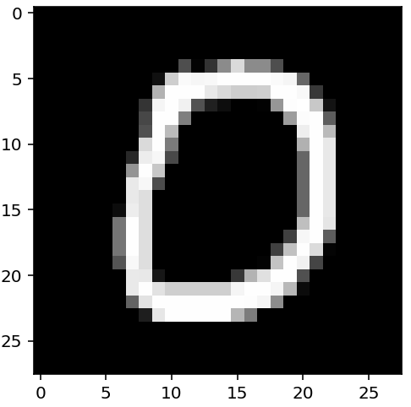
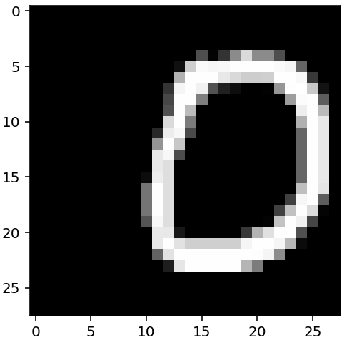
Problem 1: Translation invariance
Each pixel is independent input
If we translate the input, the model breaks down
  We need to train (and test) models on translated data for more realistic scenario

Slide 6
Problem 2: Huge number of parameters
1200x1200 matrix of weights = 1.4 million weights
More weights → need more data
More weights → hard to scale on hardware
  Memory constraints!
What can we do?

Slide 7
Kernels
Notes:
Many notions of kernel in mathematics have to do with a center and a region around (and/or distances around and/or weighting by that distance). In this case, we apply a kernel as a template over a small region of an image

Slide 8
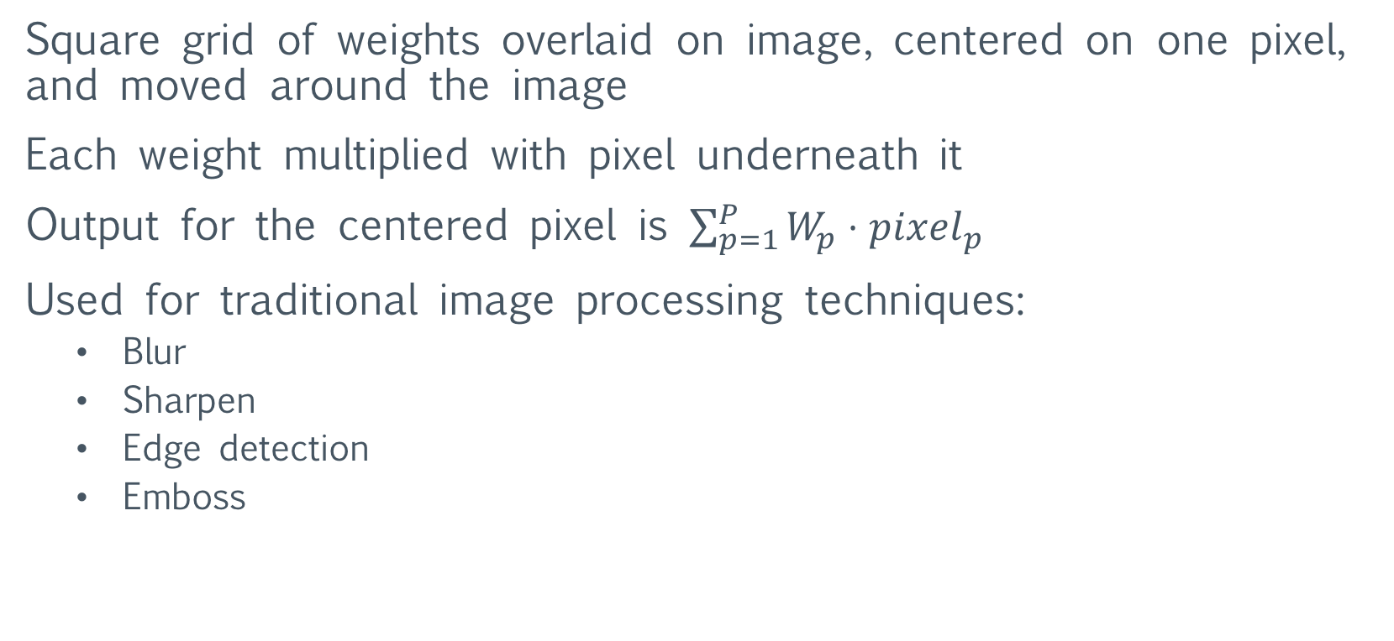
What are kernels?
Square grid of weights overlaid on image, centered on one pixel, and moved around the image
Each weight multiplied with pixel underneath it
Output for the centered pixel is $\sum_{p=1}^{P}{W_{p}⋅pixel_{p}}$
Used for traditional image processing techniques:
  Blur
  Sharpen
  Edge detection
  Emboss
Notes:
Example coming … don’t get hung up “hand waving” here.

Slide 9
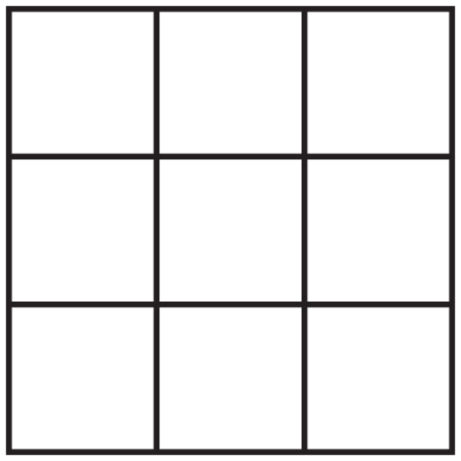
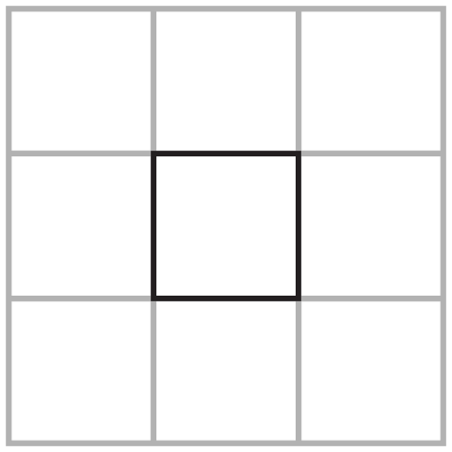
Example: 3x3
Input
Kernel
Output
3
2
1
-1
0
1
1
2
3
-2
0
2
1
1
1
-1
0
1

Slide 10
Imagine kernel is stacked on top of input
Output
-1
0
1
3
2
1
-2
0
2
1
2
3
-1
0
1
1
1
1

Slide 11


Example: 3x3
Input
Kernel
Output
3
2
1
-1
0
1
1
2
3
-2
0
2
1
1
1
-1
0
1
$$=\left(3⋅−1\right)$$

Slide 12

Example: 3x3
Input
Kernel
Output
3
2
1
-1
0
1
1
2
3
-2
0
2
1
1
1
-1
0
1
$$=\left(3⋅−1\right)+(2⋅0)$$

Slide 13

Example: 3x3
Input
Kernel
Output
3
2
1
-1
0
1
1
2
3
-2
0
2
1
1
1
-1
0
1
$$=\left(3⋅−1\right)+\left(2⋅0\right)+(1⋅1)$$

Slide 14

Example: 3x3
Input
Kernel
Output
3
2
1
-1
0
1
1
2
3
-2
0
2
1
1
1
-1
0
1
$$=\left(3⋅−1\right)+\left(2⋅0\right)+\left(1⋅1\right)+(1⋅−2)$$

Slide 15
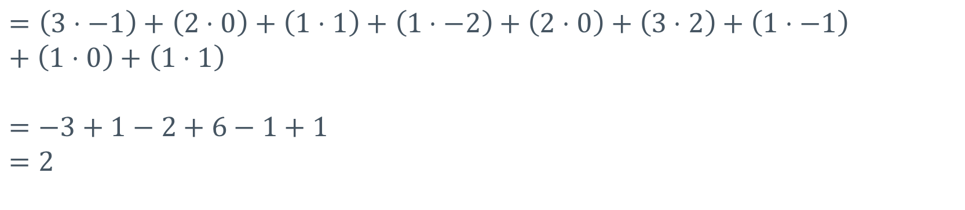
Example: 3x3
Input
Kernel
Output
3
2
1
-1
0
1
1
2
3
-2
0
2
2
1
1
1
-1
0
1
$$=\left(3⋅−1\right)+\left(2⋅0\right)+\left(1⋅1\right)+\left(1⋅−2\right)+\left(2⋅0\right)+\left(3⋅2\right)+\left(1⋅−1\right)+\left(1⋅0\right)+\left(1⋅1\right)$$
$$=−3+1−2+6−1+1$$
$$=2$$

Slide 16
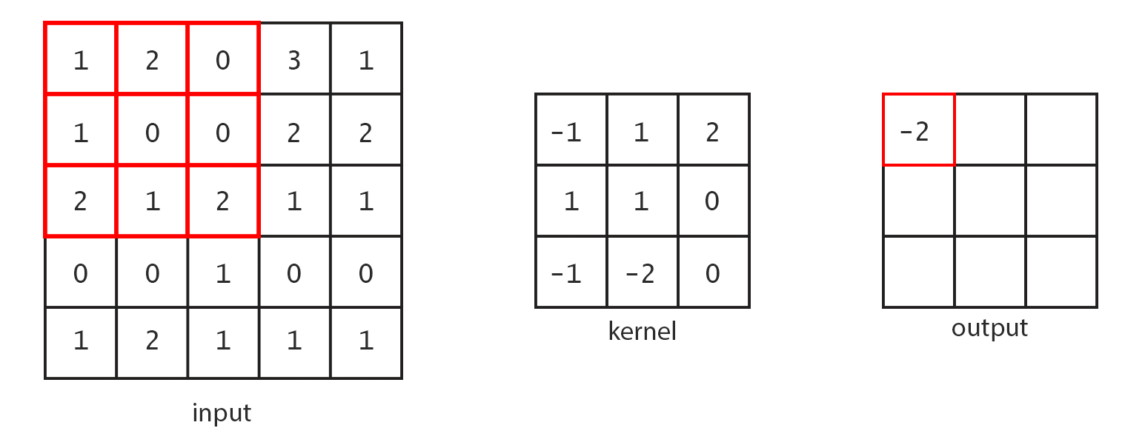
Here’s what the process looks like over a larger input:
Notes:
No build up slides here … there’s a nice animated gif in the notebook.

Slide 17
Interactive Kernel Demonstration
http://setosa.io/ev/image-kernels/
Notes:
These are more “applied” kernels, your mileage might vary.

Slide 18
Convolutional Neural Networks

Slide 19
Convolutional Neural Networks
Idea: let neural network learn suitable kernels for task

Slide 20
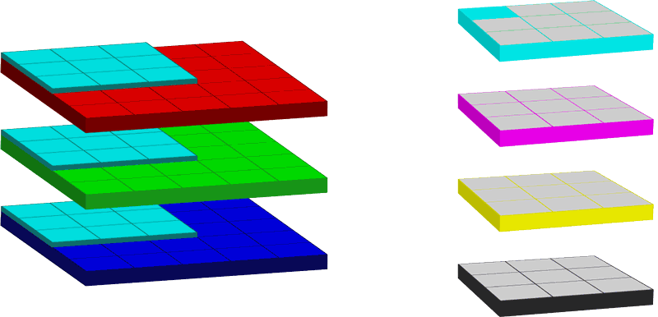
Convolution operation
Notes:
These are supposed to be either (1) a set of kernels for RGB (red green blue) or (2) a the same for CMYK (cyan magenta yellow black)
For our purposes, the convolution operation can be seen as a means for combining a kernel (which we will learn the weights of by training) with inputs (either pixels from an image or outputs from a prior network layer).

Slide 21
Convolution settings
Notes:
Lessons from a Dropped Ball at http://colah.github.io/posts/2014-07-Understanding-Convolutions/ is a nice way to break into understanding convolutions in a larger mathematical context. It isn’t strictly necessary for us here.

Slide 22
Height and width
Number of pixels the kernel operates on
Both dimensions must be odd
  B/c we need a reasonable center pixel
Kernel doesn’t have to be square
Height: 3, Width: 3
Height: 1, Width: 3
Height: 3, Width: 1
Notes:
Odd dims b/c centering in even numbers is a problem and we don’t want to get into averaging/splitting between pixels.

Slide 23
Stride
Stride is the step size from center to center
Also has height/width component
  Generally height/width are the same
If greater than 1, will scale down the output dimensions
Notes:
Aka, if we stride bigger than 1,1 …. We will be “skipping over” some potential center pixels and thus we will be reducing on output. Examples to come!

Slide 24
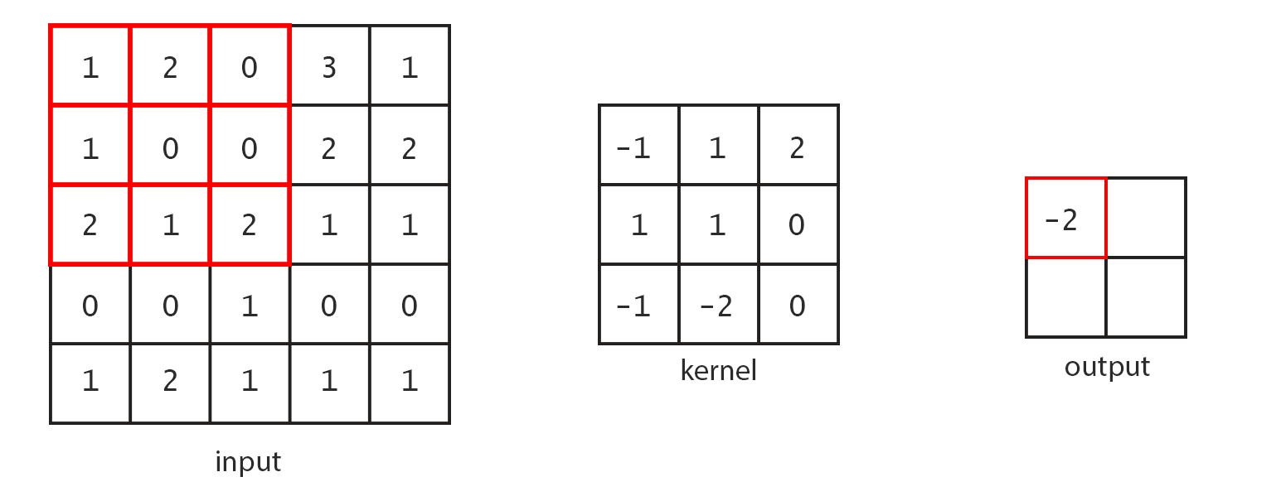
Stride 2 convolution

Slide 25
Padding
Notice: the standard convolution down samples input
[5x5]
[3x3]
Notes:
That is, the standard convolution combines the input with the kernel and doesn’t have any way of filling in the input’s “fringe” (where the kernel can’t be centered due to its shape).

Slide 26
Padding
Padding adds pseudo-pixels off-the-edge of the input
  Padding is all zero values
One unit of padding means one ring of zero pixels around the input
Amount of padding is usually either:
No padding
  TensorFlow calls this ‘VALID’ (i.e., use only valid input size)
Enough to offset the kernel size and output the same dimensions
  TensorFlow calls this ‘SAME’ (i.e., same input/output size)
    3x3 kernel → padding 1
    5x5 kernel → padding 2
    7x7 kernel → padding 3

Slide 27
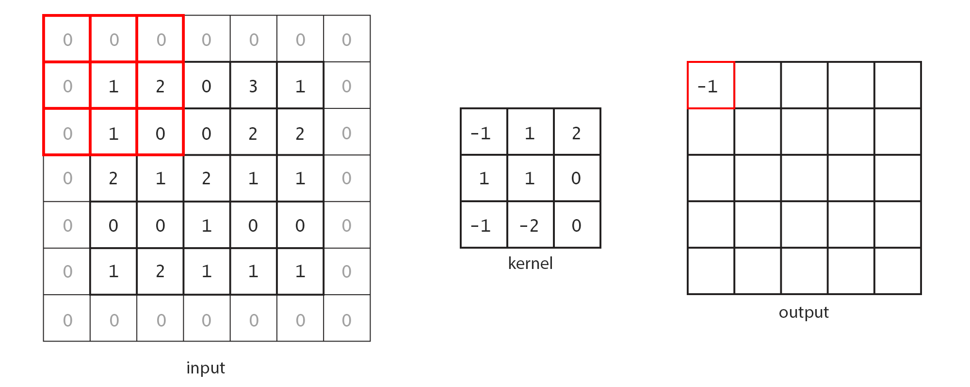
Padding: 1 (‘SAME’)
Notes:
Same means same output size as the input size. Means we have to add pseud—pixels around the input to fill things out.

Slide 28
Depth – Number of Output Channels
Channels: multiple numbers (colors) associated with same pixel
  3-color RGB → 3 channels
  4-color CMYK → 4 channels
Number of separate kernels needed in a layer
Notes:
Be careful: “deep networks” generally refers to the notion of many layers. Width of a layer is how many nodes it has. Read your academic papers closely.

Slide 29
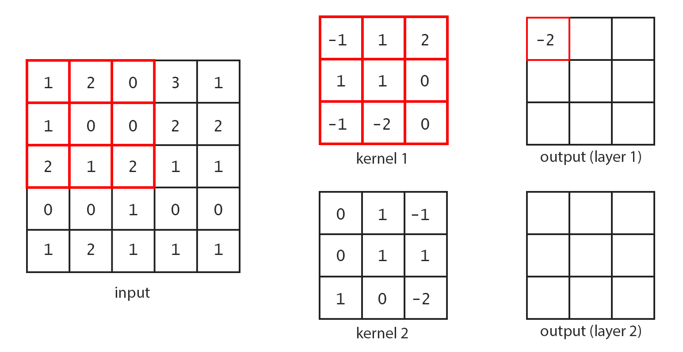
Output channels: 2
Notes:
If we want two output channels, we need two kernels. Note, we might have 0,1,2, or more inputs feeding several kernels.

Slide 30
Input Depth
Each kernel has the same depth as the number of input channels
Each input on each channel has a single weight associated with it
Notes:
Depth here is used in the sense of a dimension of the matrix: [rows,cols] -> [depth, rows, cols] (or possibly [rows, cols, depth]). Some people prefer the term panels b/c it eliminates confusion with how tall the neural network is (number of layers in the whole network).

Slide 31
Convolution In TensorFlow:
tf.nn.conv2d(input, filter, strides, padding)
input: 4d tensor [batch_size, height, width, channels]
filter: 4d: [height, width, channels_in, channels_out]
  Generally a Variable
strides: 4d: [1, vert_stride, horiz_strid, 1]
  First and last dimensions must be 1 (helps with under-the-hood math)
padding: string: ‘SAME’ or ‘VALID’
Notes:
For the input, this is (number of images, height image, width image, number of color channes)
For the filter, channels_in and channels_out is similar to a fully_connected_layer and num_nodes_in, num_nodes_out

Slide 32
Pooling
Notes:
Could call this aggregation or summarization … computing means, maxes, etc.

Slide 33
Pooling
Idea: reduce neighboring pixels
Reduce dimensions of inputs (height and width)
No parameters!

Slide 34
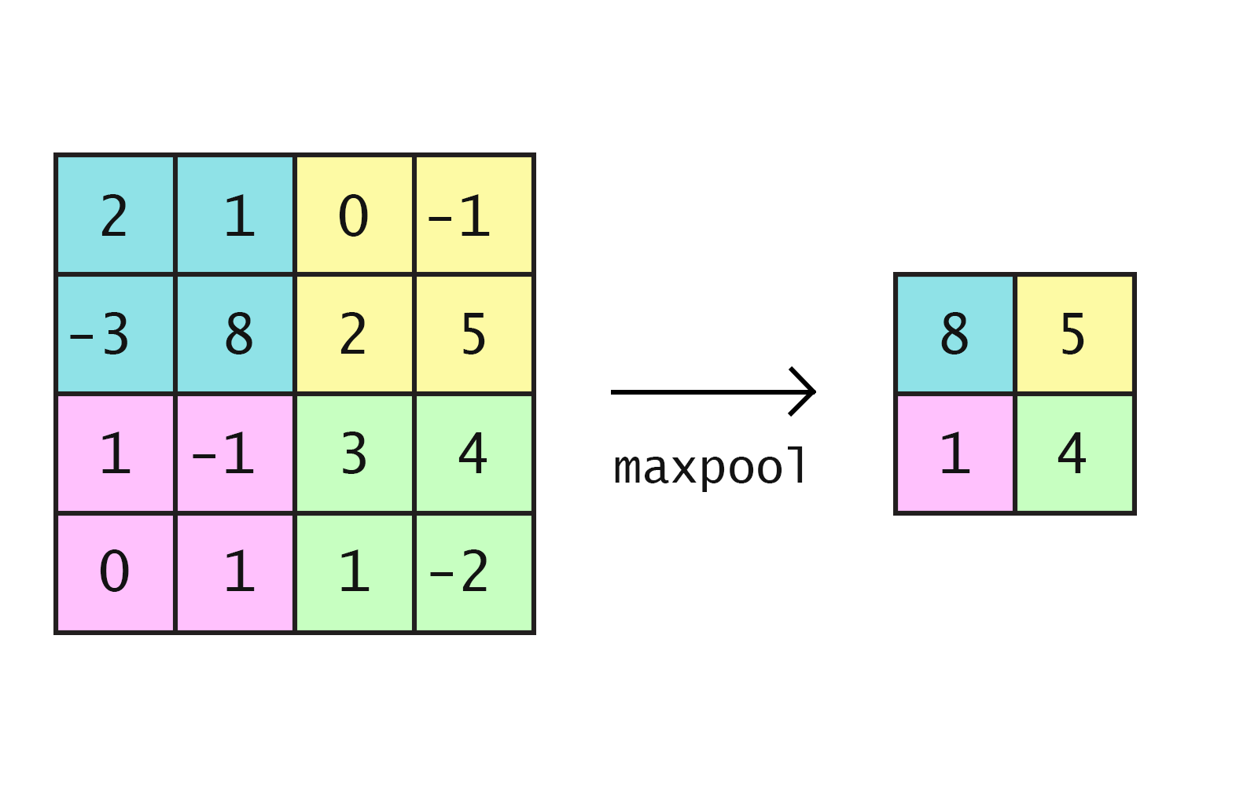
Max pooling

Slide 35
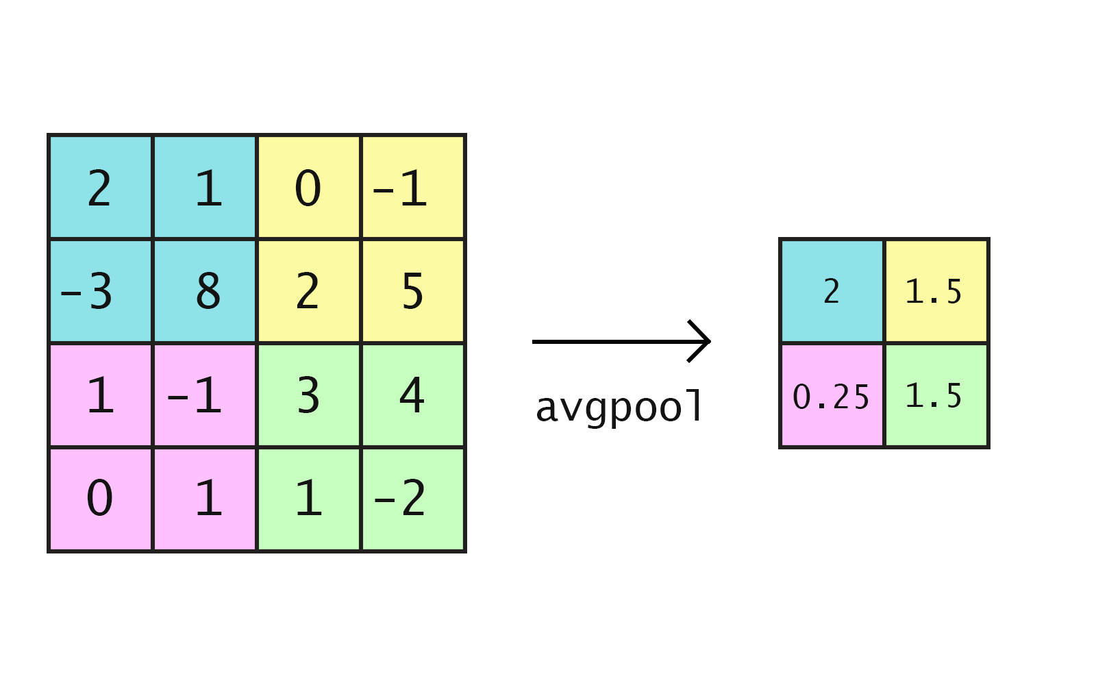
Average pooling

Slide 36
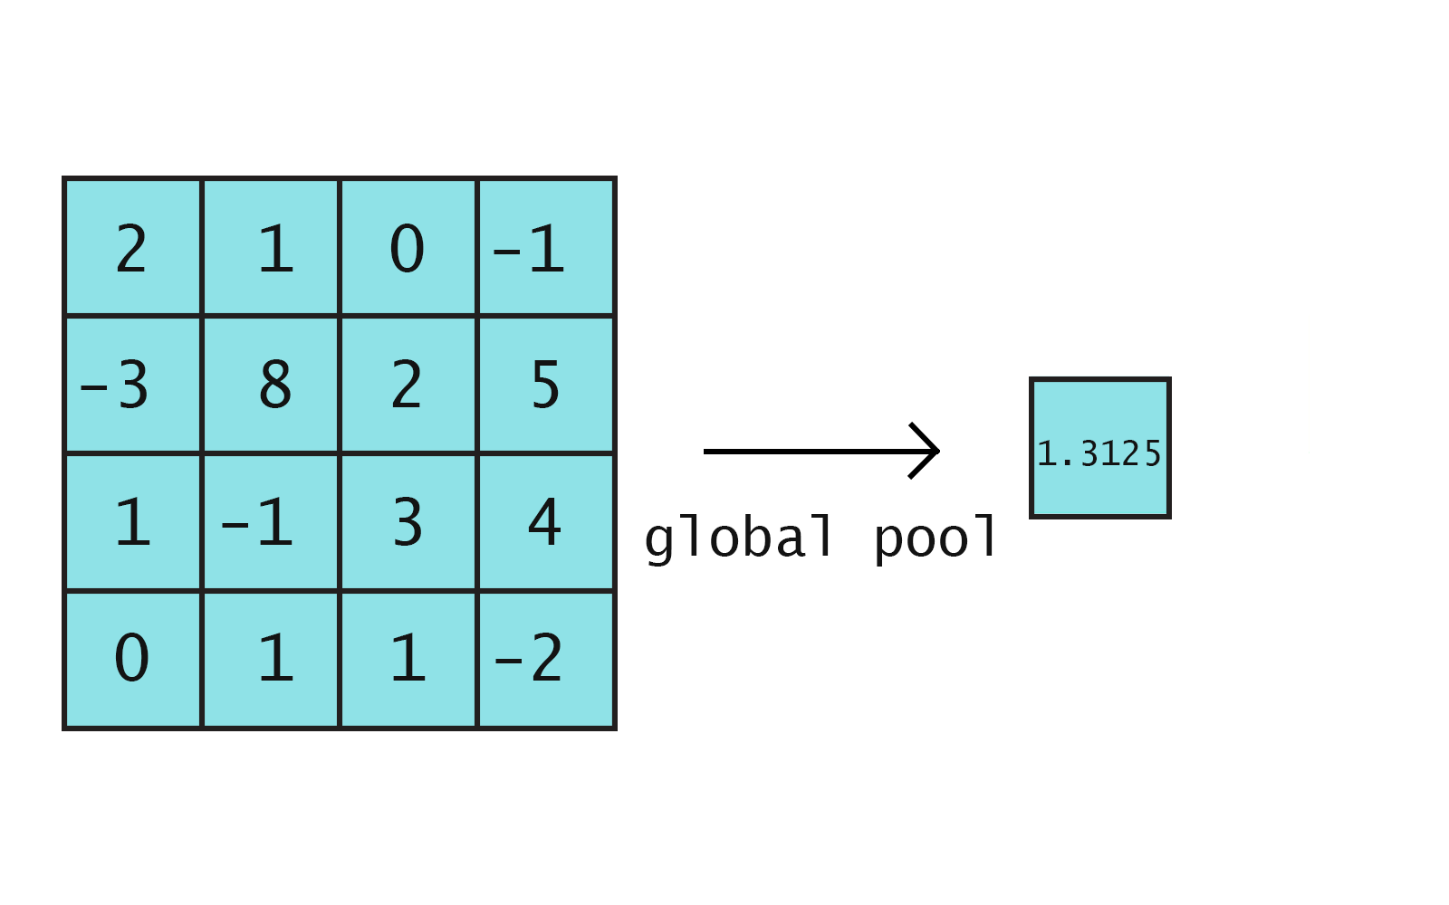
Global pooling
(Average pool over whole layer)

Slide 37
Additional convolution operation resource
Andrej Karpathy’s convolutional network website
Created for Stanford’s CS231n course
http://cs231n.github.io/convolutional-networks/

Slide 38
LeNet-5

Slide 39
LeNet
Created by Yann LeCun in the 1990s
Used on the MNIST dataset
Idea: Use convolutions to efficiently learn features on image data
Notes:
An image feature could be something like an edge detector or the orientation of the image. In classical image processing, a lot of hard work goes into manually processing images to extract features.

Slide 40
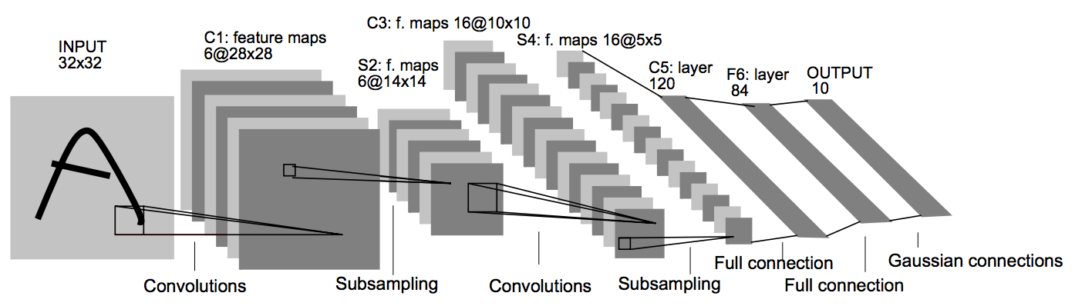
Network diagram
Notes:
We discuss some of this here, but we’ll make it concrete in the notebook.

Slide 41
Network diagram
Input: 28x28, with 2 pixels of padding (on all sides)

Slide 42
Network diagram
Convolution size: 5x5 (not labeled, but in paper)

Slide 43
Network diagram
First convolutional layer depth: 6

Slide 44
Network diagram
Pooling: 2x2, stride 2
Note: in the paper, the model uses a more complex parameter based pooling operation.
Max/average pooling turns out to work better in practice

Slide 45
Network diagram
Convolution size: 5x5

Slide 46
Network diagram
Second convolutional layer depth: 16

Slide 47
Network diagram
Pooling: 2x2, stride 2

Slide 48
Network diagram
Flatten from 5x5x16 to 400x1

Slide 49
Network diagram
Fully connected layer: from 400 to 120

Slide 50
Network diagram
Fully connected layer: from 120 to 84

Slide 51
Network diagram
Fully connected layer: from 84 to 10

Slide 52
Network diagram
Softmax

Slide 53
Table description of LeNet-5
Layer Name | Parameters
1. Convolution | 5x5, stride 1, padding 2 (‘SAME’)
2. Max Pool | 2x2, stride 2
3. Convolution | 5x5, stride 1, padding 2 (‘SAME’)
4. Max Pool | 2x2, stride 2
5. Fully connected (ReLU) | Depth: 120
6. Fully connected (ReLU) | Depth: 84
7. Output (fully connected ReLU) | Depth: 10

Slide 54
Count parameters
Conv1: 1*6*5*5 + 6 = 156
Pool2: 0
Conv3: 6*16*5*5 + 16 = 2416
Pool4: 0
FC1: 400*120 + 120 = 48120
FC2: 120*84 + 84 = 10164
FC3: 84*10 + 10 = 850
Total: = 61706
Less than a single FC layer with [1200x1200] weights!
Notes:
61706 / (1200^2) is about .42 … we we’ve got less than half the number of parameters for a *single* FC layer

Slide 55
Xavier (and He) Initialization

Slide 56
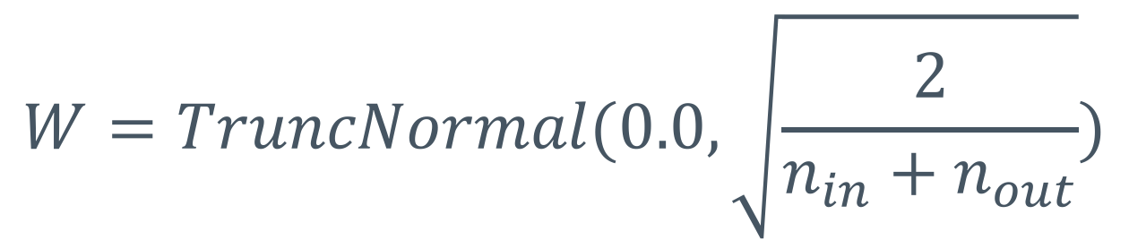
Xavier Initialization
Want to initialize our weights such that the variance of the output of our activation is 1
Xavier Glorot and Bengio derived the following initialization scheme for activations with mean zero inputs:
$$W=TruncNormal(0.0,\sqrt{\frac{2}{n_{in}+n_{out}}})$$
Notes:
N_in, n_out … number of inputs/outputs for that layer
Truncnorm = truncated normal distribution
Aka, std deviation is root (2 / n_in + n_out)
Link to paper:
http://jmlr.org/proceedings/papers/v9/glorot10a/glorot10a.pdf

Slide 57
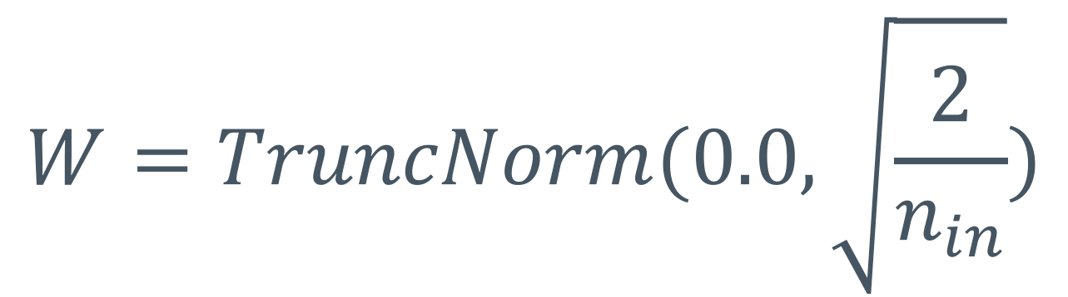
Recommendation for ReLUs
He et al. derived an initialization scheme specifically for ReLUs (which don’t have a zero mean)
$$W=TruncNorm(0.0,\sqrt{\frac{2}{n_{in}}})$$
Notes:
Truncnorm = truncated normal distribution
Aka, std deviation is root (2 / n_in)
Link to paper:
https://arxiv.org/abs/1502.01852

Slide 58
Simplifies the training procedure.
Allows us to train “end-to-end”, without pre-training
Less time spent dealing with exploding gradients
No longer have to hand-tweak everything

