Slide 1
AlexNet and Optimizers
Deep Learning with TensorFlow - Day 6

Slide 2
Legal Notices and Disclaimers
This presentation is for informational purposes only. INTEL MAKES NO WARRANTIES, EXPRESS OR IMPLIED, IN THIS SUMMARY.
Intel technologies’ features and benefits depend on system configuration and may require enabled hardware, software or service activation. Performance varies depending on system configuration. Check with your system manufacturer or retailer or learn more at intel.com.
This sample source code is released under the Intel Sample Source Code License Agreement.
Intel and the Intel logo are trademarks of Intel Corporation in the U.S. and/or other countries.
*Other names and brands may be claimed as the property of others.
Copyright © 2017, Intel Corporation. All rights reserved.

Slide 3
AlexNet

Slide 4
AlexNet
Created in 2012 for the ImageNet Large Scale Visual Recognition Challenge (ILSVRC)
Task: predict the correct label from among 1000 classes
Dataset: around 1.2 million images
Considered the “flash point” for modern deep learning
Demolished the competition.
  Top 5 error rate of 15.4%
  Next best: 26.2%

Slide 5
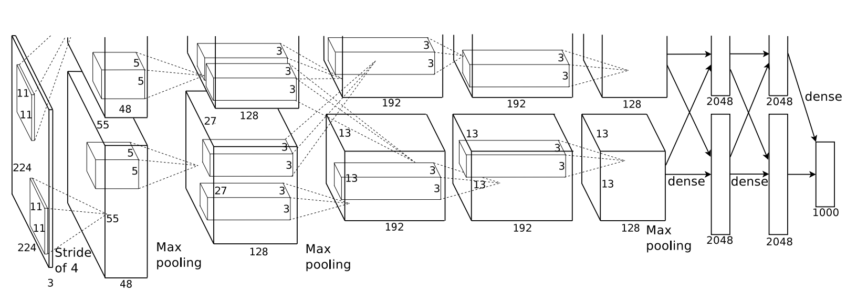
Model diagram
Notes:
The split layers allowed the model to run on two different GPUs. The 224s should be 227. The shapes are very difficult to infer from the diagram. We discuss this more in the notebook.

Slide 6
Model diagram
Should be 227x227 (no one knows why it was written as 224x224 in the paper)

Slide 7
Notes:
They perform data augmentation for training
  Cropping, horizontal flipping, and more
  Useful to help make more use out of given training data
They split up the model across two GPUs, as illustrated in previous image
  This generally doesn’t happen in modern CNN architectures
  We can replicate this effect by splitting Tensors in two
Notes:
There’s a bunch of distortion code on line, if you want to add that to your image processing pipeline. In the notebooks, we simply rescale the images. But, you can replace that by rescale and distort …. And also generate pseudo-data from the originals. Thus, you could have 100 input images and do 10 transofrms on each to get a total of 1000 images.

Slide 8
AlexNet: main takeaways
CNNs are very powerful for image processing
Didn’t change too much about LeNet-5
  Added extra depth, computation
Basic template:
  Convolutions with ReLUs
  Sometimes add maxpool after convolutional layer
  Fully connected layers at the end before a softmax classifier
GPUs are really good for this sort of computation!

Slide 9
Saving and Loading Models

Slide 10
Saving TensorFlow Models
So far: our TensorFlow models have been transient
  We build, train, and play with them. Then they poof into the ether
We need to be able to save our models for later use!
TensorFlow has built in mechanisms for saving/restoring

Slide 11
How TensorFlow stores data
Recall that TensorFlow keeps the Graph definition separate from the current values of Variables
The same thing occurs with saving data to disk.
Session
default
input1
a
Graph: default
my_add_op
c
my_mul_op
d
Variable values:
“var” : 0.0
input2
b
store
inc
init
var
assign
init
Initial value: 0.0

Slide 12
How TensorFlow stores data
Graph info (ops, connections, etc) is stored in a GraphDef protocol buffer
Session
default
input1
a
Graph: default
my_add_op
c
my_mul_op
d
Variable values:
“var” : 0.0
input2
b
store
inc
init
var
assign
init
Initial value: 0.0

Slide 13
How TensorFlow stores data
A MetaGraph encapsulates the graph definition along with relevant meta data. Stored as a .meta file
MetaGraph
Session
default
Meta data
Collections
Saver info
input1
a
Graph: default
my_add_op
c
my_mul_op
d
Variable values:
“var” : 0.0
input2
b
store
inc
init
var
assign
init
Initial value: 0.0

Slide 14
How TensorFlow stores data
Variable state (weights, biases, etc) is stored in two files: a .index file and a .data file (older file format = .ckpt)
Session
default
input1
a
Graph: default
my_add_op
c
my_mul_op
d
Variable values:
“var” : 0.0
input2
b
store
inc
init
var
assign
init
Initial value: 0.0
Notes:
In the notebook, we get files like:
alexnet.data-00000-of-00001
alexnet.index
alexnet.meta
alexnet.meta.tmp0722f7c68ff64203b56731c9b801714a
alexnet.meta.tmp18f07137a89f4a4d9d87b63330f539c6

Slide 15
The Saver class
The Saver class is designed to manage saving and loading both Variable checkpoints and MetaGraphs
The simplest use case when saving:
with graph.as_default():
..create a graph, define some variables
saver = tf.train.Saver()
with tf.Session(graph=graph) as sess:
..train the model
saver.save(sess, ‘./my_model’)
Notes:
Saves files into the ./my_model directory

Slide 16
The Saver class
Then, to load a model:
new_graph = tf.Graph()
with new_graph.as_default():
saver = tf.train.import_meta_graph(‘./my_model.meta’)
with tf.Session(graph=new_graph) as sess:
saver.restore(sess, ‘./my_model’)
..continue training
Notes:
“loads” the saved model into new_graph. You can also import_meta_graph into the graph associated with a session (inside a with session: block)

Slide 17
Saving multiple checkpoints over time
You can pass in a global_step to the Saver.save() method
  Adds a numeric suffix to the exported files, e.g. ‘my_model-100’
  Allows you to easily save versions of a trained model over time
You can automatically get the latest version name with tf.train.latest_checkpoint()
saver.save(sess, ‘./my_model’, global_step=global_step)
saver.restore(sess, tf.train.latest_checkpoint(‘./’))

Slide 18
Optimizer Alternatives
Notes:
Linked at end: for instructor reference I’ll put it here: http://sebastianruder.com/optimizing-gradient-descent/

Slide 19

Standard update rule for gradient descent
Recall our weight update with gradient descent
$$W≔W−α⋅ΔW$$
Can we change this update rule to speed up training?

Slide 20



Idea 1: Momentum
Assuming our error curve is bowl-ish shaped, can assume we’ll be going in roughly the same direction over time
We alter our weight update by a factor of previous update
$$v_{t}≔η⋅v_{t−1}−α⋅ΔW$$
$$W≔W−v_{t}$$
$η$ is often referred to as the “momentum”
Notes:
We’ve used momentum in a few models. v_(t-1) is the prior direction

Slide 21
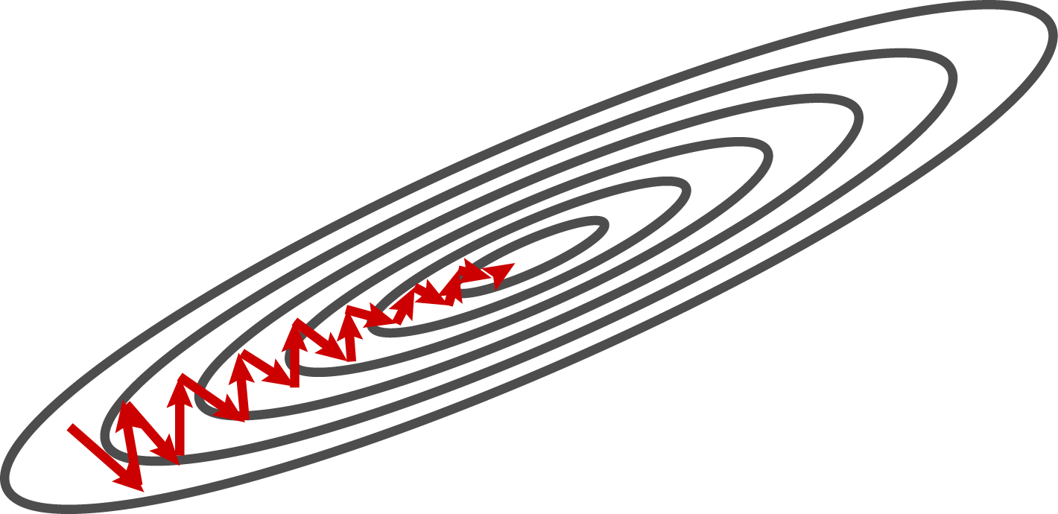
Without Momentum

Slide 22
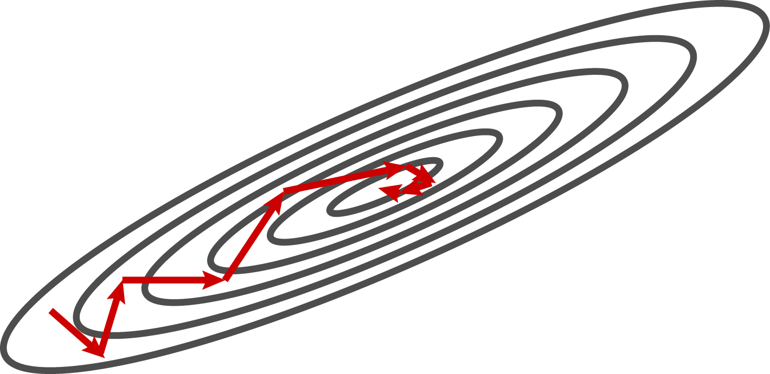
With Momentum
Notes:
The idea being that we don’t make turns that are “as sharp” because we have some (eta) prefer to continue going the prior direction

Slide 23
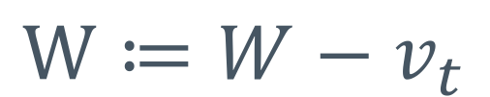
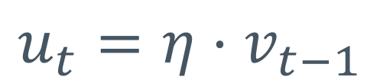
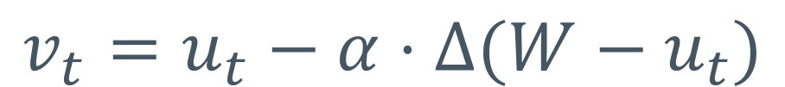
Nesterov Momentum
Momentum might accidentally “roll up the other side of the hill”
Nesterov momentum looks ahead before updating weights
$$u_{t}=η⋅v_{t−1}$$
$$v_{t}=u_{t}−α⋅Δ(W−u_{t})$$
$$W≔W−v_{t}$$
Notes:
U_t is our momentum step (brown vector). V_t is a “correction” to that step (red vector). See next slide.

Slide 24
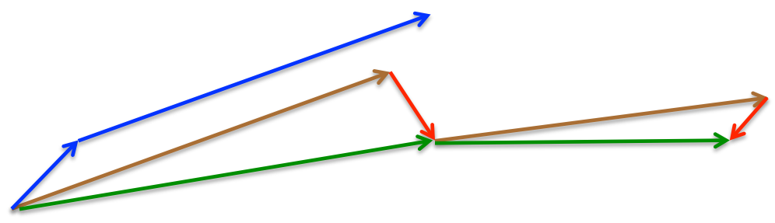
Nesterov Momentum
Momentum Vector
Gradient/correction
Nesterov steps
Standard momentum steps
Source: Lecture by Geoffrey Hinton
Notes:
Basically we take a “momentum step” (the brown vector) and then a “gradient based step” (the red vector). The red vector is our “correction” to our overactive momentum term.

Slide 25
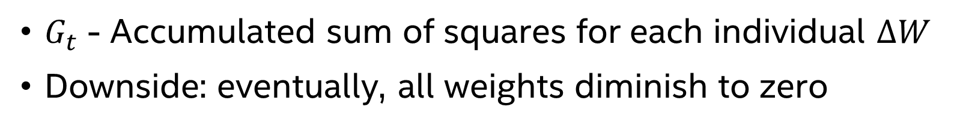
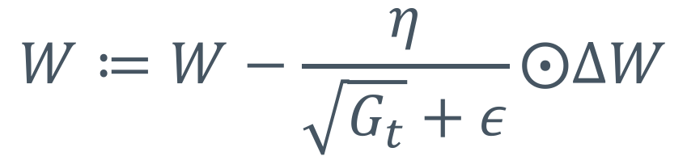
AdaGrad
Idea: scale each weight’s updates separately
Update frequently-updated weights less
Keep running tally of previous updates
Divide new updates by factor of previous tally
$$W≔W−\frac{η}{\sqrt{G_{t}}+ε}⨀ΔW$$
$G_{t}$ - Accumulated sum of squares for each individual $ΔW$
Downside: eventually, all weights diminish to zero
Notes:
Aka, step size (learning rate) for different features can vary. Great for sparse/rare data (they need bigger updates to maintain their importance). Circle-dot is elementwise multiplication.

Slide 26

AdaDelta and RMSProp
Variation on AdaGrad- seeks to reduce diminishing gradients
  Developed separately, but very similar algorithms
Basic idea: decay squared gradients (instead of full sum)
RMSProp update:
$$G_{t}=γ⋅G_{t−1}+\left(1−γ\right)∆W^{2}$$
$$W≔W−\frac{η}{\sqrt{G_{t}}+ε}⨀ΔW$$
Note: In AdaDelta, $γ$ (gamma/momentum) is $ρ$ (rho) as named parameter in TensorFlow
Notes:
Deals with AdaGrad’s history mechanism (for remembering past steps) by replacing memory of all steps with a decaying weighted average of those steps. RMS is similar.

Slide 27
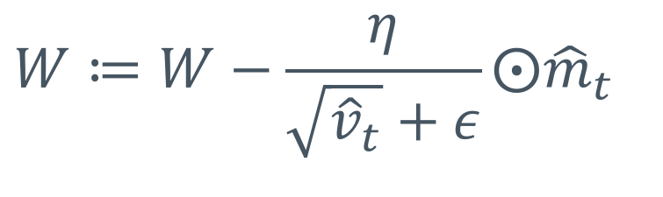
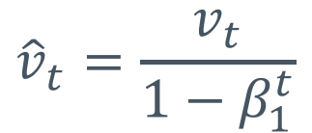
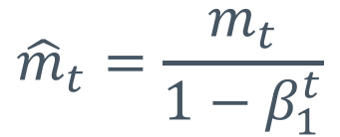
Adam
Idea: decaying tally of both sum squares and regular sum of weight updates:
$$m_{t}=β_{1}m_{t−1}+(1−β_{1})∆W$$
$$v_{t}=β_{2}v_{t−1}+\left(1−β_{2}\right)∆W^{2}$$
$${\hat{m}}_{t}=\frac{m_{t}}{1−β_{1}^{t}}$$
$${\hat{v}}_{t}=\frac{v_{t}}{1−β_{1}^{t}}$$
$$W≔W−\frac{η}{\sqrt{{\hat{v}}_{t}}+ε}⨀{\hat{m}}_{t}$$
Notes:
AdaDelta keeps a (decaying) history of squared gradients. Adam keeps a decaying history of (sum-of)-squares and sum-of-gradients (unsquared). Working together, they estimate the first two moments (mean and variance) of the gradients [think first and second order approximations]. Then, correct for biases.

Slide 28
Good news!
TensorFlow has optimizers built in:
tf.train.MomentumOptimizer()
tf.train.MomentumOptimizer(…, use_nesterov=True)
tf.train.AdagradOptimizer()
tf.train.AdadeltaOptimizer()
tf.train.AdamOptimizer()
Link to API documentation

Slide 29
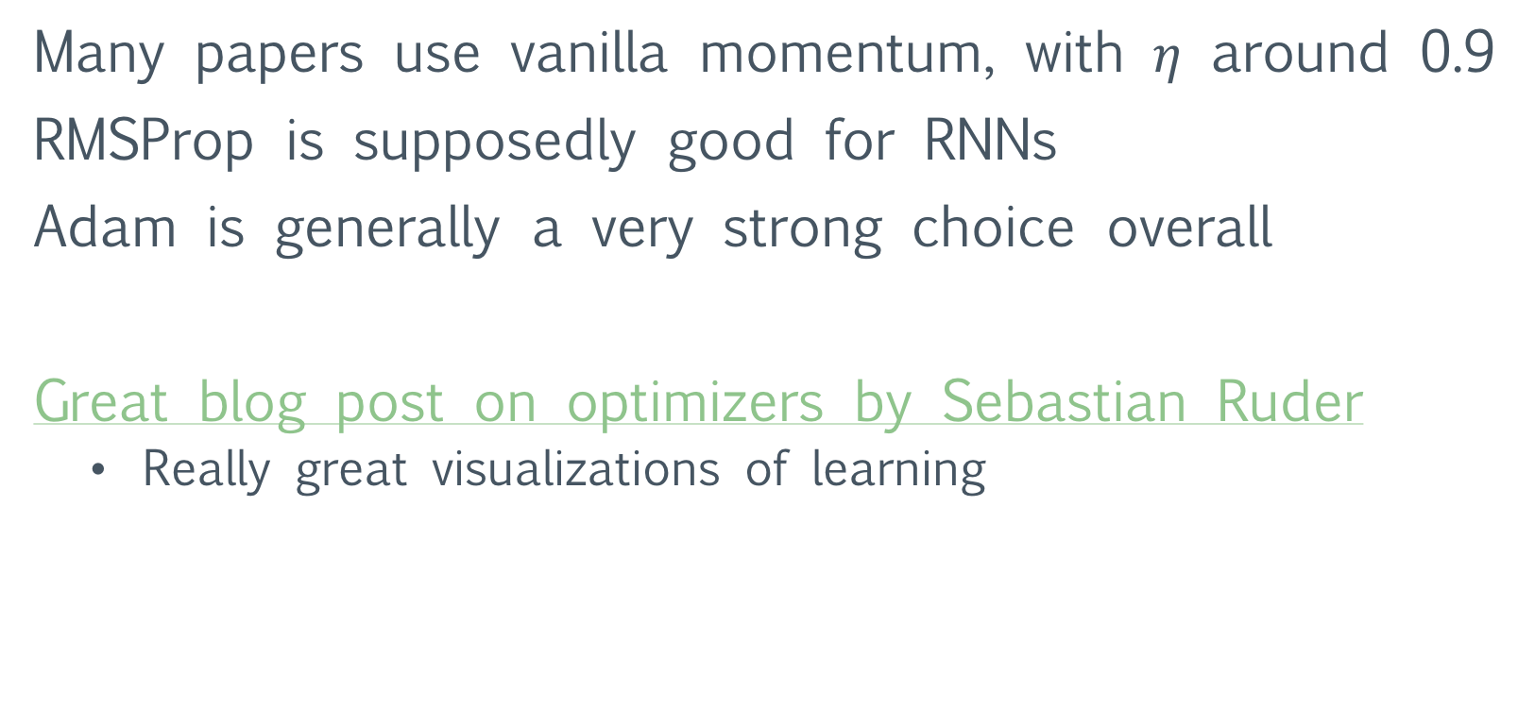
Which to use?
Many papers use vanilla momentum, with $η$ around 0.9
RMSProp is supposedly good for RNNs
Adam is generally a very strong choice overall
Great blog post on optimizers by Sebastian Ruder
  Really great visualizations of learning

