Slide 1
Transfer Learning
Deep Learning with TensorFlow 7

Slide 2
Legal Notices and Disclaimers
This presentation is for informational purposes only. INTEL MAKES NO WARRANTIES, EXPRESS OR IMPLIED, IN THIS SUMMARY.
Intel technologies’ features and benefits depend on system configuration and may require enabled hardware, software or service activation. Performance varies depending on system configuration. Check with your system manufacturer or retailer or learn more at intel.com.
This sample source code is released under the Intel Sample Source Code License Agreement.
Intel and the Intel logo are trademarks of Intel Corporation in the U.S. and/or other countries.
*Other names and brands may be claimed as the property of others.
Copyright © 2017, Intel Corporation. All rights reserved.

Slide 3
Transfer Learning

Slide 4
Training huge models is a bottleneck
Requires managing huge dataset
Takes a long time → more difficult to tune hyperparameters
Expensive
  Many hours on rented GPU instance(s)
  Electricity cost on owned hardware
But we want to use powerful models for our own problems

Slide 5
Transfer Learning
Idea: layers in trained model might generalize
If we just change the later layers, can use previously trained model to solve new problem!
Nice thing: many pre-trained models available

Slide 6
Our general CNN template
convolutions
fully connected
softmax classifier

Slide 7
What if the most decision-making for classification comes at final layer?
convolutions
fully connected
softmax classifier

Slide 8
We could simply use the rest of the network as is and learn weights for a new final layer
new classifier
convolutions
fully connected
softmax classifier
Notes:
The new layer is also a softmax. We could also insert other layers if we choose.

Slide 9
We only train weights for the last layer
learn weights here
The rest stay constant (can also train a bit for fine-tuning)
Notes:
If we have (very) limited data, we really don’t want to be training too many parameters.

Slide 10
This technique is called transfer learning
Bootstrap your custom model from similar
Saves days or weeks of training time

Slide 11
Transfer Learning in TensorFlow (classification)
Get handle to output from second-to-last layer
Create a new fully connected layer
  number of neurons equal to the number of output classes)
Create new softmax cross-entropy loss
Create a training op to minimize the new loss
  Set var_list parameter to be just the new layer variables
Train with new data!
Notes:
This slide will be important in the notebook!

Slide 12
Accessing Ops and Tensors

Slide 13
Accessing arbitrary Operations/Tensors
In general, we have been simply holding onto pointers for our Tensor objects in TensorFlow:
c = tf.multiply(a, b) # c is a Tensor object
But what if we don’t have pointer due to using pre-built models or layer functions which don’t return handles?

Slide 14
Accessing arbitrary Operations/Tensors
graph.get_operation_by_name()
graph.get_tensor_by_name()
functions allow us to get handles to Operations/Tensors by passing in a string name:
with graph.as_default():
tf.multiply(a, b, name=‘mul’) # forgot to assign handle!
c = graph.get_tensor_by_name(‘mul:0’) # got Tensor handle!
Notes:
Note, we normally don’t do this because we forgot to make an assignment. When we load new models, we won’t have a reference to the internal ops/tensors.

Slide 15
Op names
Be careful when getting handles to Operations vs Tensors
Operation names are the names you pass in as name argument (they don’t have number at end)
c_op = graph.get_operation_by_name(‘mul’)

Slide 16
Tensor names
Tensors have numeric suffix along with parent Op’s name
Number corresponds to the output index from Op
Some Ops have multiple output Tensors
  example: tf.nn.moments()
c = graph.get_tensor_by_name(‘mul:0’)
mean = graph.get_tensor_by_name(‘moments:0’)
var = graph.get_tensor_by_name(‘moments:1’)

Slide 17
Batch Normalization
Ioffe and Szegedy
Notes:
We currently don’t apply this in the notebooks. [but we should]
Good discussion here: http://ruishu.io/2016/12/27/batchnorm/

Slide 18
Internal Covariate Shift
Change in distributions of activations during training due to weights changing
Slows down training
  Weights have to keep figuring out how to respond to different activations
If we can keep neuron activations (more) normally distributed, weights can settle down more quickly

Slide 19



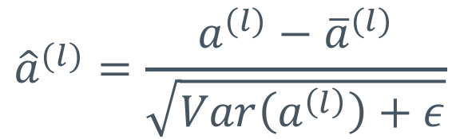
Batch Normalization
Idea: normalize (“whiten”) the activations of each layer
Then add learnable “weight” and “bias” terms for final output
$BN\left(a^{\left(l\right)}\right)$ is what gets passed to next layer
$${\hat{a}}^{(l)}=\frac{a^{(l)}−{\overline{a}}^{(l)}}{\sqrt{Var\left(a^{\left(l\right)}\right)+ε}}$$
Epsilon $ε$ prevents divide by zero
$$BN\left(a^{\left(l\right)}\right)=γ{\hat{a}}^{\left(l\right)}+β$$
Note: paper uses $x$ and $y$ to refer to initial activations and final activations.
Changed here for consistency with class
Notes:
Top equation is just z-score of activations (with epsilon to prevent divide by zero). Pass on a wgt * z_score + bias
Note: if variance is zero, we have a constant value for a. So, a – mean(a) will be all zeros.

Slide 20
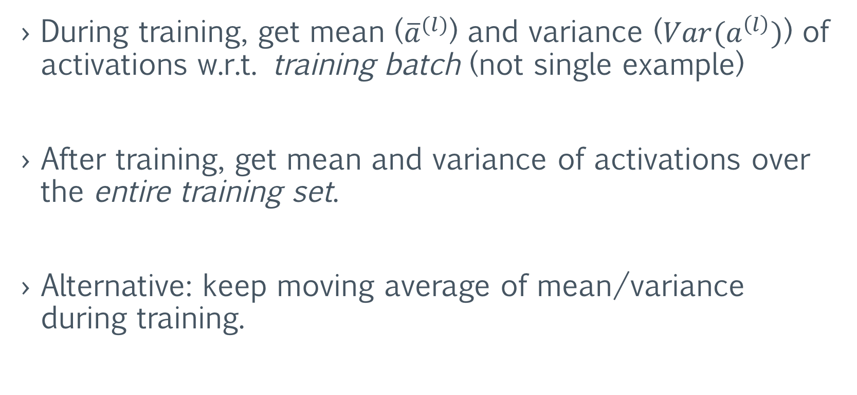
Batch norm: training vs final
During training, get mean (${\overline{a}}^{(l)}$) and variance ($Var(a^{\left(l\right)})$) of activations w.r.t. training batch (not single example)
After training, get mean and variance of activations over the entire training set.
Alternative: keep moving average of mean/variance during training.

Slide 21
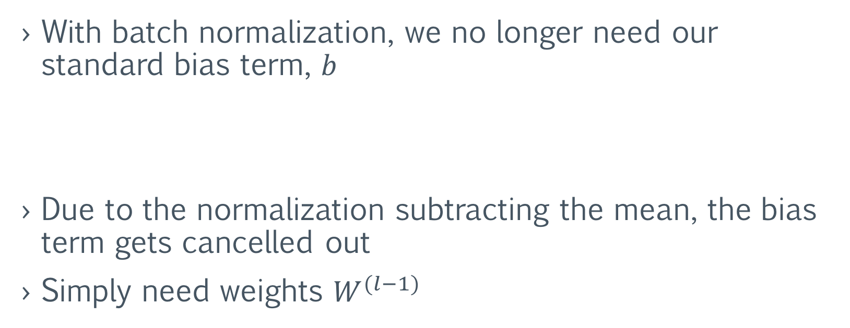
Implementation Note
With batch normalization, we no longer need our standard bias term, $b$
Due to the normalization subtracting the mean, the bias term gets cancelled out
Simply need weights $W^{(l−1)}$
$z^{(l)}=a^{\left(l−1\right)}W^{\left(l−1\right)}+b$ or $z^{(l)}=conv(a^{\left(l−1\right)}W^{\left(l−1\right)}+b)$
$z^{(l)}=a^{\left(l−1\right)}W^{\left(l−1\right)}$ or $z^{(l)}=conv(a^{\left(l−1\right)}W^{\left(l−1\right)})$
Notes:
I belive the point is we have a bias in our batch-normalization formulation … so if we subtract the mean, and then add backa in a bias and then add another bias, we’re doing repeated work that mathematically cancels out. So, just do the batch-normalization bias at the end.

Slide 22
Batch Normalization in TensorFlow
Method 1: Manually
z = tf.matmul(a_prev, W)
a = tf.nn.relu(z)
a_mean, a_var = tf.nn.moments(a, [0])
scale = tf.Variable(tf.ones([depth/channels]))
beta = tf.Variable(tf.zeros ([depth/channels]))
bn = tf.nn.batch_normalizaton(a, a_mean, a_var, beta, scale, 1e-3)
For testing, replace a_mean, a_var with full training statistics
Notes:
Aka, replace values to use during testing

Slide 23
Batch Normalization in TensorFlow
Method 2: Built-in layer function
z = tf.matmul(a_prev, W)
a = tf.nn.relu(z)
bn = tf.layers.batch_normalization(a)
Keeps a decaying average of activation mean and variance
Much simpler than doing manually
Can still replace with full training mean/variance if desired

Slide 24
Results of Batch Normalization
Speeds up training dramatically
Enables increased learning rate with less chance of exploding gradients
Reduces effectiveness/need for dropout
Final model is more accurate
In summary: use batch normalization.

Slide 25
Deeper Networks and Receptive Field
VGGNet
Notes:
We won’t use VGG until next week, but due to time/space constraints, we need to discuss it now.

Slide 26
VGG Net
Very Deep Convolutional Networks for Large-Scale Image Recognition
  Karen Simonyan and Andrew Zisserman, 2014
Problem: networks involve many manual decisions
How to choose between different size convolutions?
Idea: Simplify network and add many more layers

Slide 27
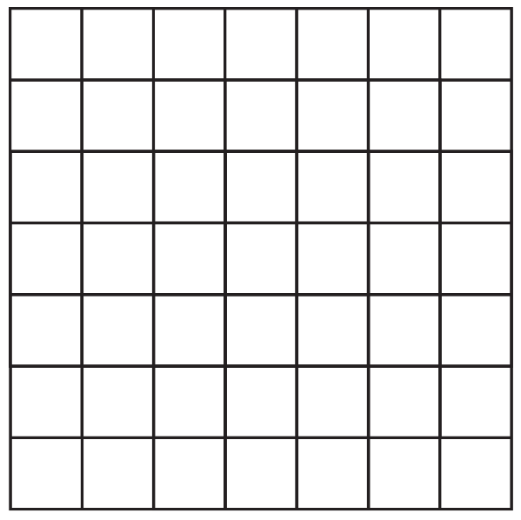
Receptive field
Idea: Each subsequent 3x3 convolution effectively “sees” a larger portion of the inputs
Layer 1
Layer 2
Layer 3
(Input)

Slide 28


Receptive field
A single output in Layer 2 is the result of “seeing” a 3x3 grid from Layer 1
Layer 1
Layer 2
Layer 3
(Input)

Slide 29


Receptive field
We can say that the “receptive field” of Layer 2 is 3x3
Each output has been influenced by a 3x3 patch of inputs
Layer 1
Layer 2
Layer 3
(Input)

Slide 30
Receptive field
What about on Layer 3?
Layer 1
Layer 2
Layer 3
(Input)

Slide 31
Receptive field
This output on Layer 3 uses a 3x3 patch from Layer 2
How much from Layer 1 does it use?
Layer 1
Layer 2
Layer 3
(Input)

Slide 32
Receptive field
Layer 1
Layer 2
Layer 3
(Input)

Slide 33
Receptive field
Layer 1
Layer 2
Layer 3
(Input)

Slide 34
Receptive field
Layer 1
Layer 2
Layer 3
(Input)

Slide 35
Receptive field
Layer 1
Layer 2
Layer 3
(Input)

Slide 36
Receptive field
Layer 1
Layer 2
Layer 3
(Input)

Slide 37
Receptive field
Layer 1
Layer 2
Layer 3
(Input)

Slide 38
Receptive field
Layer 1
Layer 2
Layer 3
(Input)

Slide 39
Receptive field
Layer 1
Layer 2
Layer 3
(Input)

Slide 40
Receptive field
Layer 1
Layer 2
Layer 3
(Input)

Slide 41
Receptive field
Each square in Layer 3 “sees” a 5x5 grid from Layer 1
Layer 1
Layer 2
Layer 3
(Input)

Slide 42


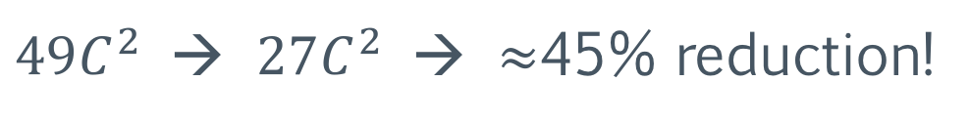

Receptive Field
Two 3x3, stride 1 convolutions in a row is effectively a 5x5
Three 3x3 convolutions is effectively a 7x7 convolution
Benefit: fewer parameters!
One 3x3 layer
One 7x7 layer
$$3×3×C×C=9C^{2}$$
$$7×7×C×C=49C^{2}$$
Three 3x3 layers
$49C^{2}$ → $27C^{2}$ → $≈$45% reduction!
$$3×(9C^{2})=27C^{2}$$
assume C input/output channels

Slide 43
Ramifications of VGGNet
One of the first papers to experiment with many layers
  More is better!
Can use multiple 3x3 convolutions to simulate larger kernels with fewer parameters
Served as ”base model” for future works

