Slide 1
Devices and TensorFlow
Deep Learning with TensorFlow Day 8

Slide 2
Legal Notices and Disclaimers
This presentation is for informational purposes only. INTEL MAKES NO WARRANTIES, EXPRESS OR IMPLIED, IN THIS SUMMARY.
Intel technologies’ features and benefits depend on system configuration and may require enabled hardware, software or service activation. Performance varies depending on system configuration. Check with your system manufacturer or retailer or learn more at intel.com.
This sample source code is released under the Intel Sample Source Code License Agreement.
Intel and the Intel logo are trademarks of Intel Corporation in the U.S. and/or other countries.
*Other names and brands may be claimed as the property of others.
Copyright © 2017, Intel Corporation. All rights reserved.

Slide 3
RNNs and Seq2Seq (briefly)
Notes:
We are massively compressing this and just providing a bit of background. We’ll use (TF’s builtin seq2seq) it in the notebook.

Slide 4
Modelling sequences of data
Thus far, our models required data be set to a specific size
What if we want to be able to model text?
Sentences can be of any length!
What would our model look like?

Slide 5
Idea: Recurrence
STATE
Notes:
That is, we have both persistent state –and- data flow through us.

Slide 6
Idea: Recurrence
Have some sort of “state” that gets passed back into itself
STATE
Notes:
As input to the next training/testing step

Slide 7
Idea: Recurrence
At each “step”, output a prediction from the current state
STATE

Slide 8
Idea: Recurrence
The ”state” is just a vector of neurons,
similar to a FF network
STATE

Slide 9
Unrolled view of an RNN
STATE
STATE
STATE
STATE
T_1
T_2
T_3
T_4
Notes:
Neuron is getting different inputs at t_1,2,3,4 …. Along with its own prior state from time t minus 1

Slide 10
At each step, we pass in an input
STATE
STATE
STATE
STATE
“This”
“is”
“great”
“!”
Notes:
Sequences can be measure over time, sentences, stock prices, etc.

Slide 11
As we go along, the network makes a prediction, which changes as it gets more info
?
?
+
++
STATE
STATE
STATE
STATE
“This”
“is”
“great”
“!”

Slide 12
Sequence to sequence
$${\hat{y}}_{t}$$
$${\hat{y}}_{t+1}$$
<eos>
<go>
$${\hat{y}}_{t}$$
$${\hat{y}}_{t+1}$$
$$x_{t}$$
$$x_{t+1}$$
<eos>
Notes:
Classic prediction of a (suffix) sequence from a (prefix) sequence.

Slide 13
Sequence to sequence
$${\hat{y}}_{t}$$
$${\hat{y}}_{t+1}$$
<eos>
<go>
$${\hat{y}}_{t}$$
$${\hat{y}}_{t+1}$$
$$x_{t}$$
$$x_{t+1}$$
<eos>
Encoder

Slide 14
Sequence to sequence
$${\hat{y}}_{t}$$
$${\hat{y}}_{t+1}$$
<eos>
<go>
$${\hat{y}}_{t}$$
$${\hat{y}}_{t+1}$$
$$x_{t}$$
$$x_{t+1}$$
<eos>
Decoder

Slide 15
Sequence to sequence
$${\hat{y}}_{t}$$
$${\hat{y}}_{t+1}$$
<eos>
<go>
$${\hat{y}}_{t}$$
$${\hat{y}}_{t+1}$$
$$x_{t}$$
$$x_{t+1}$$
<eos>
Encoded input

Slide 16






Show and Tell
Instead of this:
$${\hat{y}}_{t}$$
$${\hat{y}}_{t+1}$$
<eos>
<go>
$${\hat{y}}_{t}$$
$${\hat{y}}_{t+1}$$
$$x_{t}$$
$$x_{t+1}$$
<eos>
Notes:
Show and tell is an image caption generator

Slide 17




Show and Tell
Try this!
$${\hat{y}}_{t}$$
$${\hat{y}}_{t+1}$$
<eos>
<go>
$${\hat{y}}_{t}$$
$${\hat{y}}_{t+1}$$

Slide 18
Show and Tell
Idea: instead of encoding with an RNN, use a CNN
Use flattened output vector as the initial input of RNN
Run one step of RNN to calculate “initial hidden state”
Then have the RNN decode words as before
https://arxiv.org/pdf/1411.4555.pdf
Notes:
Show and tell is an image caption generator, examples on next slide
Go from image (convolution network) → encoded input … then produce a sequence of words (caption)

Slide 19
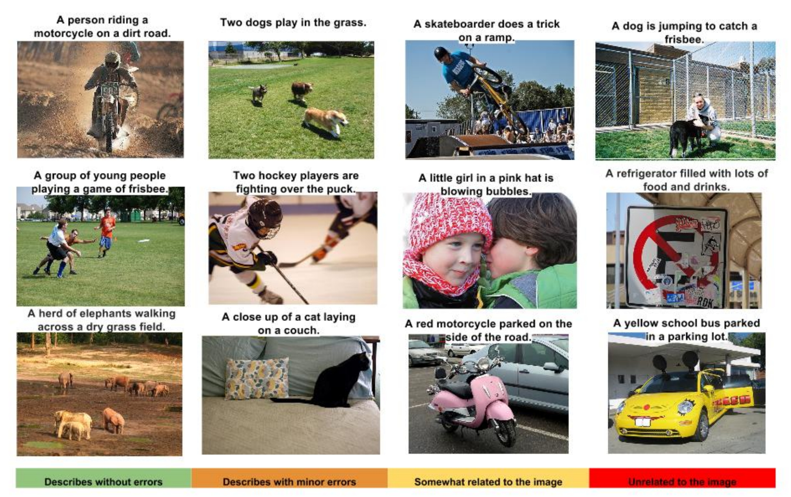
Success and limitations

Slide 20
TFRecords

Slide 21
TFRecords format
TensorFlow has its own file format for storing training data
Allows you to store related data together, instead of having to merge them together at run time, e.g.
  raw image data
  labels
  text
  any other metadata
One file can hold an entire training set (or a sharded chunk)

Slide 22
How to create TFRecords
Open a tf.python_io.TFRecordWriter
writer = tf.python_io.TFRecordWriter(path)
2. Create a tf.train.Feature for each value you want to save
# Raw image bytes feature
img = tf.train.BytesList(value=[image_bytes])
image = tf.train.Feature(bytes_list=img)
# Integer label feature
lbl = tf.train.Int64List(value=[label])
label = tf.train.Feature(int64_list=lbl)

Slide 23
How to create TFRecords
3. Create a tf.train.Features object that holds all features:
features = tf.train.Features(feature=
{‘image_bytes’: image,
‘label’: label}
4. Wrap Features inside of a tf.train.Example class
example = tf.train.Example(features=features)
5. Write the Example to the records file
writer.write(example.SerializeToString())

Slide 24
Queues

Slide 25
An alternative to feed_dict
So far, we’ve passed data to our model via a feed dictionary
Unfortunately, this isn’t the fastest mechanism:
  It has to jump back and forth between the Python and C++ layers for each step
  It waits to load data into GPU until after the previous run is finished
What can we do instead?

Slide 26
TensorFlow Queues
TensorFlow has built-in support for asynchronous queues
Creates batches of data in the background
Can immediately start next batch after one batch is done
Easiest to use with TFRecords!

Slide 27
Basic Queue pattern

Slide 28
Basic Queue pattern
Training data
filenames

Slide 29
Basic Queue pattern
Training data
filenames
Filename queue
filenames

Slide 30
Basic Queue pattern
Training data
filenames
Filename queue
filenames
Load data
raw tensor data

Slide 31
Basic Queue pattern
Training data
filenames
Filename queue
filenames
Load data
raw tensor data
Preprocess
preprocessed data

Slide 32
Basic Queue pattern
Training data
filenames
Filename queue
filenames
Load data
raw tensor data
Preprocess
preprocessed data
Shuffle/batch queue
training batches

Slide 33
Basic Queue pattern
Training data
filenames
Filename queue
filenames
Load data
raw tensor data
Preprocess
preprocessed data
Shuffle/batch queue
training batches

Slide 34
Using the Queue in a Graph
Once you’ve created the queue, you end up with handles to batches of training data:
image_batch, label_batch = tf.train.shuffle_batch(…)
Use these the same way you would a placeholder!

Slide 35
Extra bits for managing threads:
Coordinator manages the
pool of threads
coord = tf.train.Coordinator()
threads = tf.train.start_queue_runners(sess=sess)
try:
while not coord.should_stop():
…sess.run(..)
except tf.errors.OutOfRangeError:
print(‘done!’)
finally:
coord.request_stop()
coord.join(threads)

Slide 36
Extra bits for managing threads:
coord = tf.train.Coordinator()
threads = tf.train.start_queue_runners(sess=sess)
try:
while not coord.should_stop():
…sess.run(..)
except tf.errors.OutOfRangeError:
print(‘done!’)
finally:
coord.request_stop()
coord.join(threads)
Starts the threads created
in the Graph

Slide 37
Extra bits for managing threads:
coord = tf.train.Coordinator()
threads = tf.train.start_queue_runners(sess=sess)
try:
while not coord.should_stop():
…sess.run(..)
except tf.errors.OutOfRangeError:
print(‘done!’)
finally:
coord.request_stop()
coord.join(threads)
Coordinator can receive
signals to stop training

Slide 38
Extra bits for managing threads:
coord = tf.train.Coordinator()
threads = tf.train.start_queue_runners(sess=sess)
try:
while not coord.should_stop():
…sess.run(..)
except tf.errors.OutOfRangeError:
print(‘done!’)
finally:
coord.request_stop()
coord.join(threads)
We’ll get an OutOfRangeError
when we’ve gone through all data
(or when we’ve gone through the
max number of epochs)

Slide 39
Extra bits for managing threads:
coord = tf.train.Coordinator()
threads = tf.train.start_queue_runners(sess=sess)
try:
while not coord.should_stop():
…sess.run(..)
except tf.errors.OutOfRangeError:
print(‘done!’)
finally:
coord.request_stop()
coord.join(threads)
Requests threads to stop

Slide 40
Extra bits for managing threads:
coord = tf.train.Coordinator()
threads = tf.train.start_queue_runners(sess=sess)
try:
while not coord.should_stop():
…sess.run(..)
except tf.errors.OutOfRangeError:
print(‘done!’)
finally:
coord.request_stop()
coord.join(threads)
Waits for all threads to
finish before continuing
Notes:
This is the “raw” API. You can consider wrapping it in a nicer interface: for example, something that raises StopIteration (and cleans up) when done … so you could just use it like a for loop

Slide 41
Multi-GPU

Slide 42
Getting more power!
“Device” – A computational device. CPU, GPU, etc.

Slide 43
Multi-device graph
graph
CPU:0
GPU:0
GPU:1

Slide 44
By default, operations will be placed on GPU:0
>>> a = tf.placeholder(tf.float32)
graph
CPU:0
GPU:0
GPU:1

Slide 45
By default, operations will be placed on GPU:0
>>> b = tf.placeholder(tf.float32)
graph
CPU:0
GPU:0
GPU:1

Slide 46
By default, operations will be placed on GPU:0
>>> c = tf.matmul(a, b)
graph
CPU:0
GPU:0
GPU:1

Slide 47
Unless there isn’t a GPU implementation for an Op
>>> read = tf.image.decode_jpeg(image)
graph
CPU:0
GPU:0
GPU:1

Slide 48
We can explicitly place Ops on a device
>>> with tf.device(‘/gpu:1’):
c = tf.matmul(a,b)
graph
CPU:0
GPU:0
GPU:1

Slide 49
TensorFlow automatically handles cross-device data
>>>
graph
CPU:0
GPU:0
GPU:1

Slide 50
Two main ways to parallelize model
Model Parallel
Create a huge model that spans multiple GPUs
Data parallel
Same model on each GPU and pass different data to each
Notes:
Data parallel is like “SIMD” with single instruction being a “single model”

Slide 51
Model-Parallel
graph
CPU:0
GPU:0
GPU:1

Slide 52
Model-Parallel
Different computations occur on different devices
graph
CPU:0
GPU:0
GPU:1

Slide 53
Problem: communication across devices is slow
graph
CPU:0
GPU:0
GPU:1

Slide 54
Want to minimize as much as possible!
graph
CPU:0
GPU:0
GPU:1

Slide 55
Data parallel
graph
CPU:0
GPU:0
GPU:1
Merge gradients
Update
Variables

Slide 56
More common pattern for models
graph
CPU:0
GPU:0
GPU:1
Merge gradients
Update
Variables

Slide 57
Data parallel
Identical models compute gradients for different data
graph
CPU:0
GPU:0
GPU:1
Merge gradients
Update
Variables

Slide 58
Data parallel
Gradients Variables can then be merged/averaged across all GPUs
graph
CPU:0
GPU:0
GPU:1
Merge gradients
Update
Variables

Slide 59
Data parallel
Gradients for Variables can then be merged/averaged across all GPUs
graph
CPU:0
GPU:0
GPU:1
Merge gradients
Update
Variables

Slide 60
Basic idea for data parallel models
Placed on CPU:
  Variables (including global step), shared updates
  Queues, preprocessing steps
  Initializers, merged summaries, Savers
Placed on GPU:
  Replicated model computation
  Individual loss functions

Slide 61
More generally
Placed on CPU:
  Anything that needs to be shared between model replicas
Placed on GPU:
  Anything that doesn’t need to be shared

Slide 62
How we’re going to accomplish this:
Modify our layer functions to create Variables on CPU
Reuse Variables via variable_scope() for each GPU
Loop over each GPU in our system, placing models on each
Average the calculated gradient from each GPU for updates

