Slide 1
Kursusoversigt
Plan for de enkelte minimoduler:
Introduktion, metode og procedure for eksperimentel modelbestemmelse. Grafisk modeltilpasning. System identifikation
Modellering, modelbeskrivelse og simulering
Senstools til parameterestimering
Parameter nøjagtighed og følsomhed. Frekvensdomænet
Design af inputsignaler.

Slide 2
The merits of the method
a simple fundamental approach, illustrated graphically
continuous-time models with physically significant parameters
any model structure is appropriate, linear and non-linear, distributed and lumped parameters, time delay etc.
stochastic aspects are reduced to a minimum
robustness to violations of theoretical assumptions and approximations
a sensitivity approach useful for choice of model structure, for experiment design, and for accuracy verification
all in all, compatibility with physical insight
the method and the presentation is developed with generally preferred learning styles in mind

Slide 3
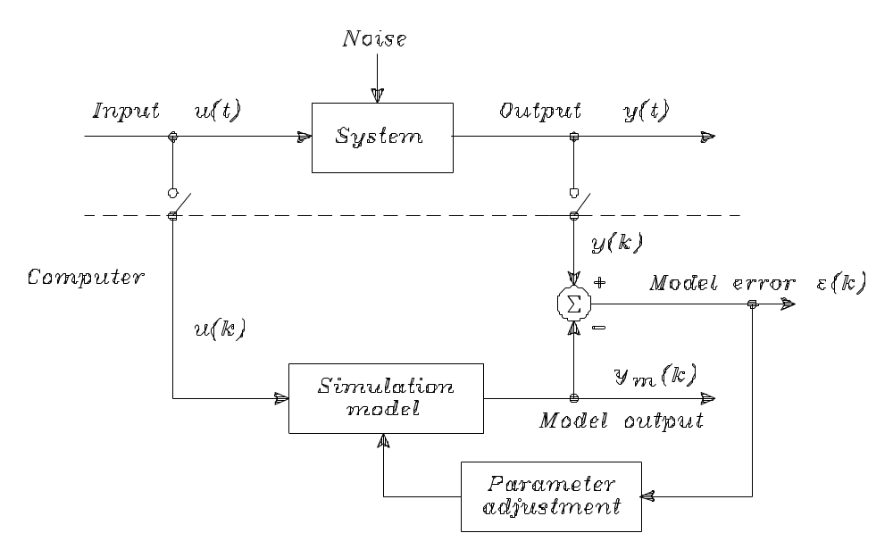
Parameter estimation principle
The model parameters are adjusted until minimum of the model error, i.e. the deviation between the sampled system output and the simulated model output.

Slide 4
Procedure for experimental modelling
Model structure determination:The model structure is determined from basic physical laws and empirical considerations. A simulation program is constructed.
Experiment design: In particular, a good input signal is important. I is either chosen from common-sense considerations, or designed as a signal optimizing characteristic parameter sensitivity measures.
Experiment:The process is excited by the input signal, and corresponding sequences of input and output signal values are sampled and stored in a computer.
Parameter estimation:The simulation model parameters are adjusted until minimum of the deviation between the sampled system output and the simulated model output (the model error). As a measure for this deviation is used a performance function containing the sum of the squared deviations at the sampling instants.
Model validation: The correctness of the model structure and the accuracy of the parameter estimates are evaluated, based on the model fit and characteristic parameter sensitivity measures

Slide 5
Applications
Senstools and the sensitivity approach for experimental modelling has been applied in numerous research and student projects. Examples are:
ships and marine systems
wind turbines,
loudspeakers
induction motors and DC-motors
heat exchangers
human tissue for hyperthermia cancer therapy
kidney and cerebellar blood flow.

Slide 6

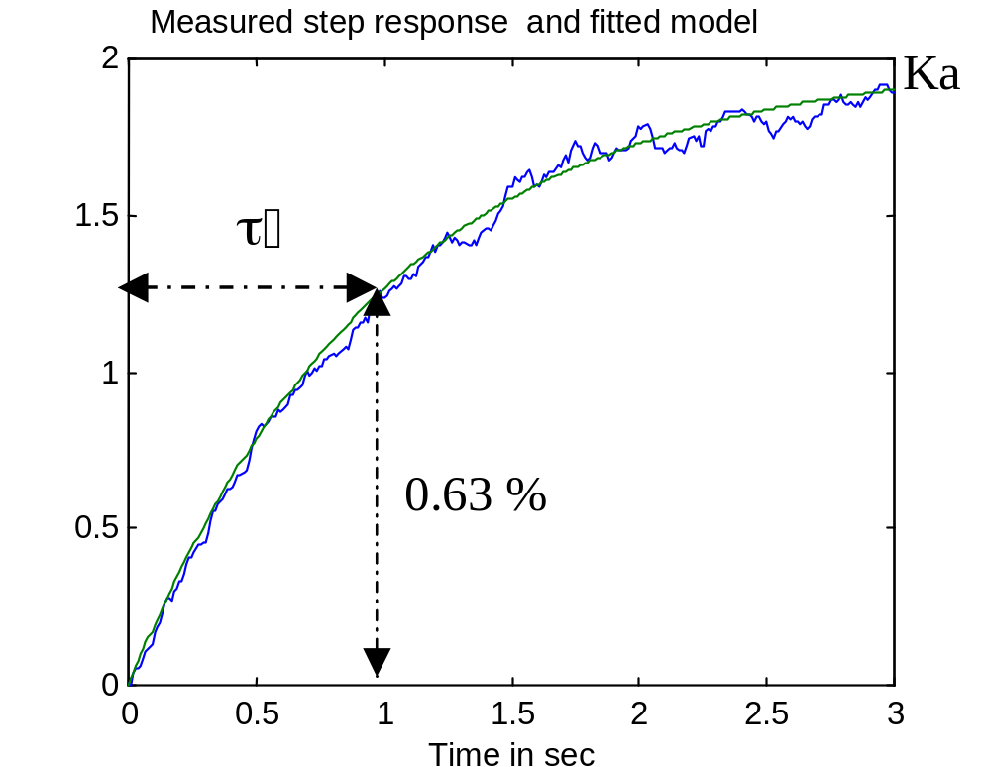
Graphical model fitting – time domain
Determination of K and τ by fitting a first order model to measured step response

Slide 7
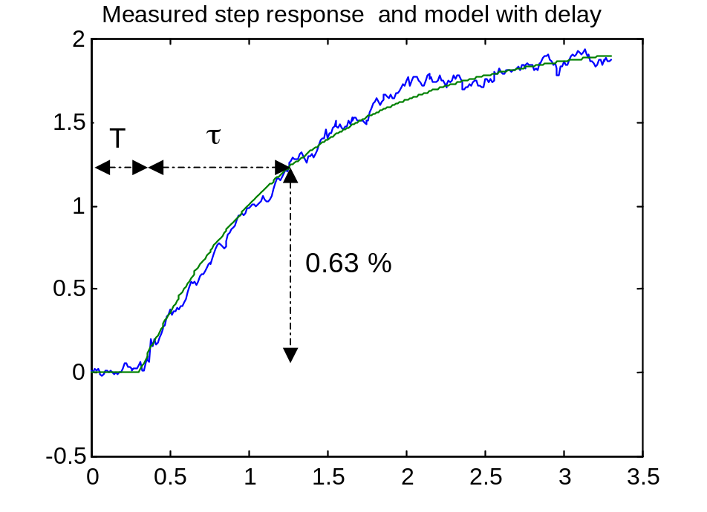
Graphical model fitting – time domain
Fitting a first order model with time delay to measured step response

Slide 8
System identification principle
The model parameters are adjusted until minimum of the model error, i.e. the deviation between the sampled system output and the simulated model output.

Slide 9
System identification methods
The methods are characterizes by model type:
A. Linear discrete-time model: Classical system identification
B. Neural network: Strongly nonlinear systems with a complicated structure
C. General simulation model: Any mathematical model, that can be simulated e.g. with Matlab. It requires a realistic physical model structure, typically developed by theoretical modelling. The method: direct estimation of physical parameters

Slide 10
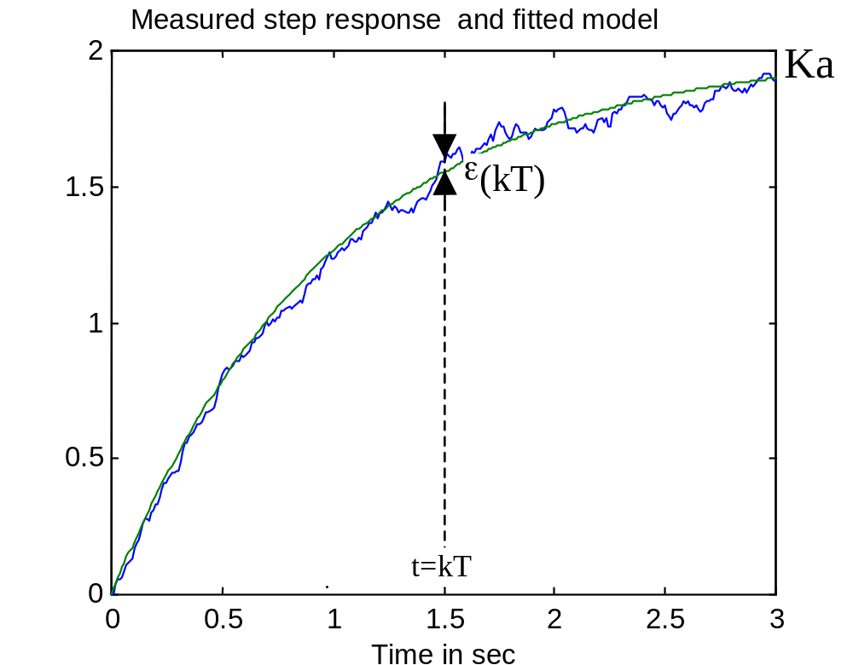
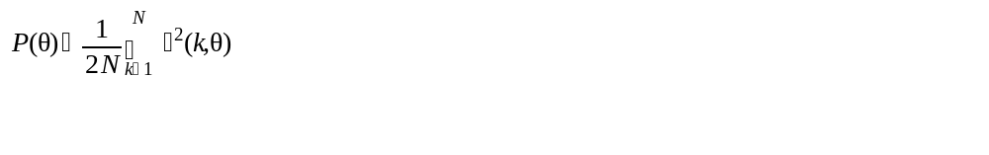
Computer fitting by minimization

Slide 11
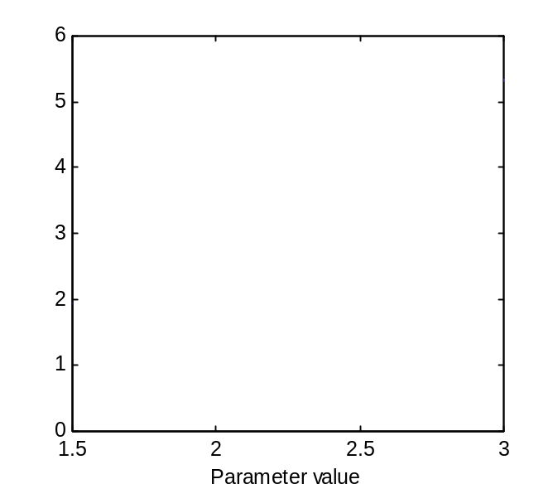
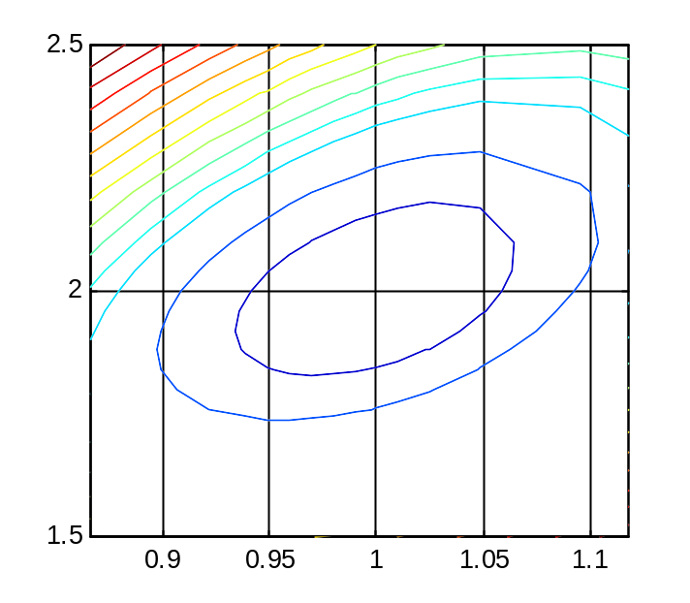
Performance function as a function of θ
One parameter θ = τ Two parameters θ = [K τ]

Slide 12
Finding minimum of a function
Condition for minimum
First partial derivative (gradient vector) is zero
Second partial derivative (Hessian) is positive definite
Numerical methods for minimum search
Steepest descent
Newton (DEMO)
The Gauss-Newton method

Slide 13
Direct estimation of physical parameters
Determination of model output (simulation)
Determination of model gradient ψ by numerical differentiation
Determination of gradient G and Hessian H from ψ
Determination of parameter values minimizing the performance function P (Gauss-Newton algorithm)

Slide 14
Resumé
The fundamental principle for
system identification is
It converts the parameter fitting problem to the problem of minimizing a performance function P
This can be done by a Gauss-Newton procedure
But it requires a simulation model. Next mm: simulation with Matlab

