Slide 1
MM2: Modeling, model description and simulation
Models and modeling: concepts
  definitions
  simulation
  mathematical models
Model descriptions
  Transfer functions
  state space
  block diagrams
Discretization methods
Simulation of linear and nonlinear dynamic systems with Matlab

Slide 2
Models and modeling: concepts
  Definitions:
  Model: a representation - in a usable form - of the essential aspects of a system
System identification: building mathematical models of
dynamic systems based on observed data from the system:
many measurement data are obtained as sampled values of the
inputs and outputs
a computer is used for processing the data
model parameters are estimated by minimization of an error
criterion.

Slide 3
Characterization of models and modeling
Models:
mathematical – other
parametric – nonparametric
continuous-time - discrete-time
input/output - state-space
linear – nonlinear
dynamic – static
time-invariant - time-varying
SISO - MIMO
Modelling / system identification:
theoretical (physical) – experimental
white-box - grey-box - black-box
structure determination - parameter estimation
time-domain - frequency-domain
direct - indirect

Slide 4
Physical parameters
Physical parameters are model parameters with an apparent physical meaning or significance
Typically they are the coefficients in basic physical laws, e.g. Newtons, Hooks, Ohms, and Kirchoffs laws
Some corresponding physical parameters are
mechanical parameters: mass, friction coefficients, stiffness
electrical parameters: resistance, inductance, capacitance
thermal parameters: thermal resistance, specific heat
besides: static gain, time constant, natural frequency and damping ratio
Non-physical parameters: coefficients in z-transform of state space description

Slide 5
Simulation
Purpose
To obtain an understanding of the system
Prediction of future system output
Design and test of control systems
Optimization of constructions
Training of system operators on real time simulators
Model parameter estimation from experiments
A computer simulation requires:
a discrete-time model
means for performing experiments on the model, e.g. giving specific inputs signals and parameter values
graphical tools for presenting the results.

Slide 6

Mathematical models
Model descriptions
  Transfer functions
  state space
  block diagrams
Notation for continuous-time and discrete-time models:
Complex Laplace variable s differential operator p: x(t)=∂x(t)/∂t=px(t)
Complex Z-transform variable z and shift operator q: x(k+1)=qx(k)
Block diagram of nonlinear system (DC-motor):

Slide 7
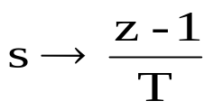
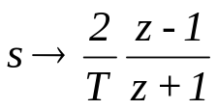

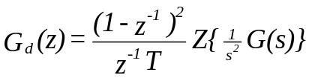

Discretization methods
Name | Algorithm | Characteristics
Eulers forward rule |  | x’(t) constant over the period
Tustin (Bilinear Transformation) |  | x’(t) varies linearly over the period
Step Invariant (ZOH equivalent) |  | u(t) constant over the period
Ramp Invariant (Tr H equivalent) |  | u(t) varies linearly over the period
Pole-zero mapping

Slide 8
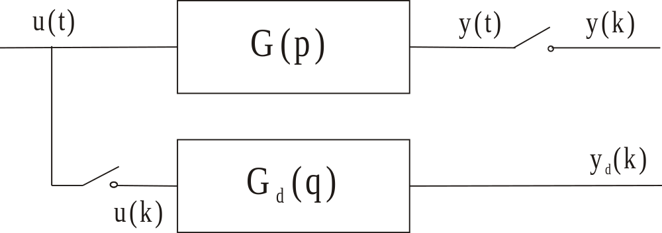
Invariance transformations
Given an analog system G(p). Determine the transfer function G_{d}(q) of a digital
system (the model) so the outputs are equal at the sampling times t=kT: y_{d}(k)=y(k)

Slide 9
Simulating linear and nonlinear systems with Matlab
Senstools require a Matlab function: y=simproces(u,t,par)
Example: linear system K/(1+ sτ)
Using state space and for-loop
Using ’filter’
Using ’lsim’
Evaluation of the three methods:
is slow (loops in Matlab shall be avoided if possible), and should only be used only for nonlinear systems.
and c) are similar in performance

Slide 10
Simulating nonlinear system with Matlab
r(t)
e(t)
u
u(t)
-
e
u
o
e
K
y(t)
o
e
1
1 + p
+
_
-
u
o

o
Saturation:
e < - e_{o}: u = - u_{o}
- e_{o} < e < e_{o}: u = k e
e_{o} < e: u = u_{o}
This can be implemented in Matlab as
u=ke;
if e>e0, u=u0; end
if e<e0, u=-u0; end
Using logical operations (a false statement has the value 0) more efficient as:
u=k*e-(abs(e)>e0)*k*(e-sign(e)*e0);
as u_{o}=ke_{o} can be written as u_{o}=ke-k(e-e_{o}) and -u_{o}=ke-k(e+e_{o})

Slide 11
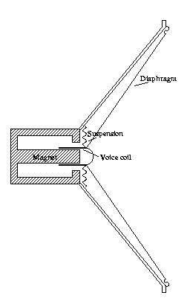
Modelling and simulation of loudspeaker
Symbols used:
u applied voltage [V]
i current in voice coil [A]
x displacement of voice coil [m]
R resistance of voice coil [Ohm]
Bl force factor [N/A]
m mass of moving system [kg]
r viscous friction coefficient [Ns/m]
k suspension stiffness [N/m]

Slide 12
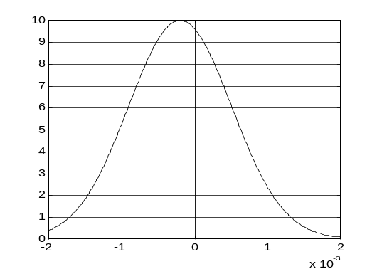
Nonlinear loudspeaker model
Displacement dependent force factor:
Blx=Bl*exp(-c1*(x+c2)^2);

