Slide 1

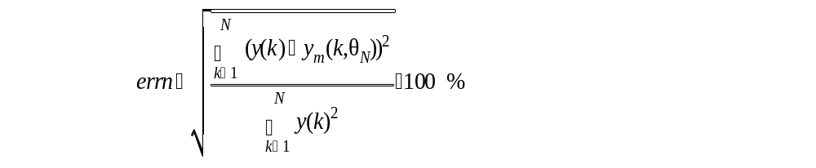
Parameter accuracy and sensitivity
Model verification: a reliable measure of the accuracy of the obtained model
An accurate model require:
A good fit between system- and model output conveyed by
  normed root mean output error
  plot of system and model output
Good parameter sensitivity measures
Evaluation based on physical insight and common sense

Slide 2
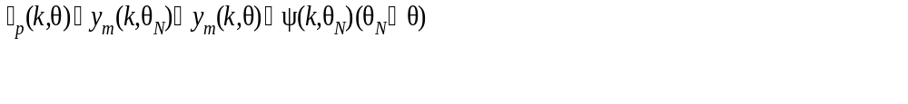
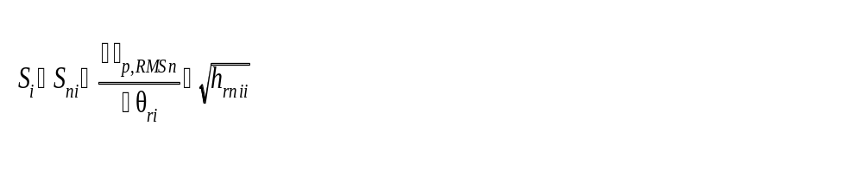
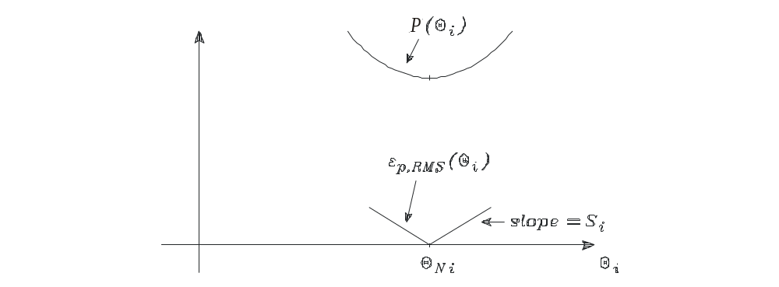
Parameter sensitivity
Parameter dependent model output error
Parameter sensitivity

Slide 3
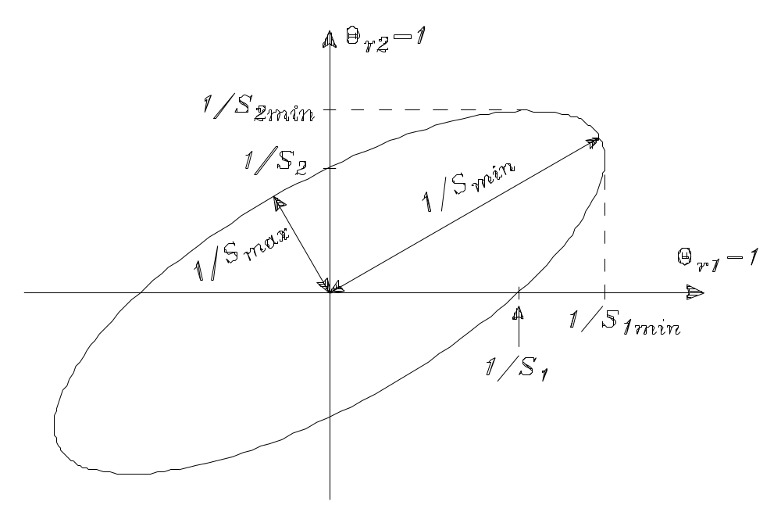
Sensitivity ellipse
_{p,RMSn} (_{r}) = 1
S_{i} sensitivity of θ_{i} alone
S_{i min} minimum sensitivity of θ_{i}
S_{min} minimum sensitivity in any direction
S_{max} maximum sensitivity in any direction

Slide 4
Sensitivity measures and requirements
These characteristic measures are handy also – and in particular – for more than 2 parameters (ellipsoid)
S_{min} minimum sensitivity, inverse of major half axis - as large as possible
S_{i min} minimum sensitivity of θ_{i} - as large as possible
R= S_{max} /S_{min} ratio of maximum and minimum sensitivity in any direction
or ratio of half axis - as close to 1 as possible
R_{i}= S_{i}/S_{imin} ratio of sensitivity of θ_{i} alone and minimum sensitivity of θ_{i}
- as close to 1 as possible.
R_{i} >>1 indicates correlation between two or more parameters

Slide 5
Parameter accuracy
Parameter errors can be divided into
stochastic parameter uncertainty caused by noise
deterministic error caused by error in the model structure
(undermodelling)

Slide 6

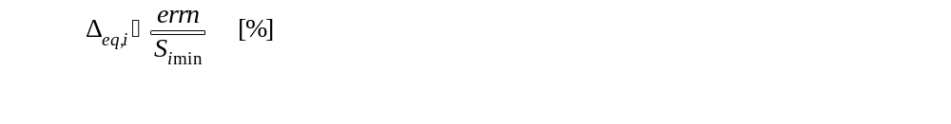
Resumé – parameter accuracy and sensitivity
Use the sensitivity measures: S_{i} S_{i min} R= S_{max} /S_{min} R_{i}= S_{i} /S_{imin} for evaluating the situation, e.g. the need for another model structure og input
The parameter accuracy can be expressed by
Noise only:
Undermodelling only:

Slide 7
Frequency-domain considerations
The frequency domain can be used for
A better understanding of time-domain system identification methods
  A time-domain fit is equal to a weighed frequency-domain fit
Fitting a model to frequency-domain measurements
  Requires time consuming measurements, but simple calculations

Slide 8
Resumé - Frequency-domain considerations
A least squares fit in the time domain is equal to a weighed least squares fit of the frequency function. The frequency weighting factor is
Q(ω) = |U_{N}(ω)|²
that is, the fit is best in the frequency range, where the input signal power is high.
The fit can be further weighted by filtering the signals u(k) and y(k) by a so called prefilter L(q), giving a weighting factor
Q(ω) = |L(ω) |²|U_{N} (ω) |²
The model parameters can alternatively be estimated by fitting the model to a measured frequency function, using a frequency-domain performance function of the type
P_{f}(θ) = (1/2N)∑ | G_{of}(jω_{k})-G_{f} (jω_{k},θ) | ²
Again a frequency weighting can be obtained by choosing different input sine amplitudes.

