Slide 2
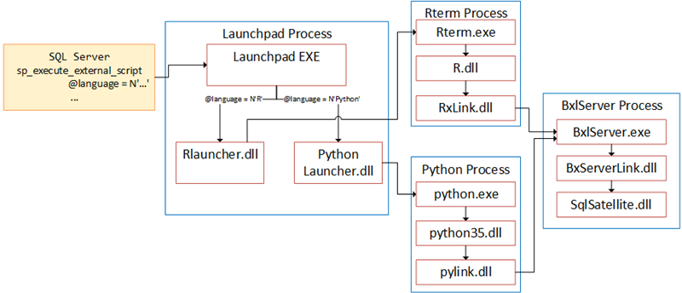
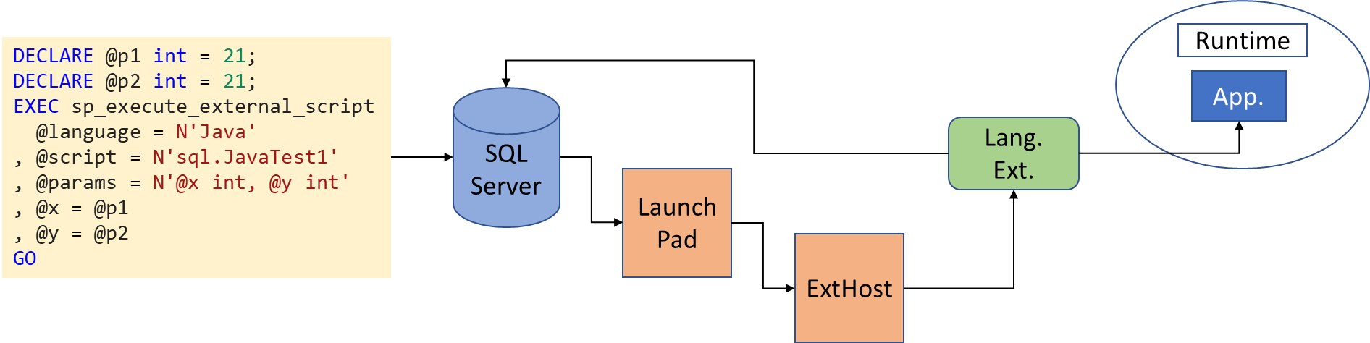

Slide 3
DECLARE @p1 int = 21;
DECLARE @p2 int = 21;
EXEC sp_execute_external_script
@language = N'Java'
, @script = N'sql.JavaTest1'
, @params = N'@x int, @y int'
, @x = @p1
, @y = @p2
GO
Runtime
App.
SQL
Server
Lang. Ext.
LaunchPad
ExtHost

Slide 4
Rterm Process
LaunchPad Process
Rterm.exe
SQL
Server
LaunchPad EXE
R.dll
EXEC sp_execute_external_script
@language = N'R/Python'
, @script = N'…'
GO
BxlServer Process
@language=N'R'
@language=N'Python'
RxLink.dll
BxlServer.exe
RLauncher.dll
Python
Launcher.dll
BxServerLink.dll
Python Process
python.exe
SqlSatellite.dll
python35.dll
pylink.dll

Slide 5
External Runtime
LaunchPad Process
jvm.dll
SQL
Server
LaunchPad.exe
EXEC sp_execute_external_script
@language = N'Java'
, @script = N'…'
GO
@language!=N'R/Python'
Application (Java dll)
ExtHost Process
ExtHost.exe
External Language.dll

