Slide 1
Performance patterns for machine learning services in SQL Server
BRK3261
Nellie Gustafsson
Umachandar Jayachandran

Slide 2
Agenda
Why machine learning in SQL Server?
How to leverage:
  SQL Compute context
  sp_execute_external_script features
  PREDICT T-SQL Function
Call to action
Questions

Slide 3
Why machine learning with SQL Server?
Reduce or eliminate
data movement with
in-database analytics
Operationalize machine learning models
Get enterprise scale, performance, and security

Slide 4

SQL Server Machine Learning Services
R/Python Integration Design
  Invokes runtime outside of SQL Server process
  Batch-oriented operations
SQL Compute context
Features in sp_execute_external_script
  Streaming data from SQL
  Parallel execution of SQL query & R/Python scripts
Native scoring ^{New in 2017!}

Slide 5
Key performance considerations
How long does it take for data movement?
    Use XEvents or exec sp_execute_external_script
    @language = N’R’, @script = N‘’, @input_data_1 = <sql_query>
How can you separate CPU usage of SQL & R/Python?
  Use EXTERNAL RESOURCE POOL for CPU affinity
How can you allocate more memory to R/Python?
  Default is 20%
  Use EXTERNAL RESOURCE POOL to adjust memory limit
  Use ‘max server memory’ sp_configure option to reduce SQL footprint

Slide 6
SQL Compute Context

Slide 7
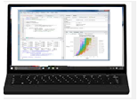
Typical Machine Learning workflow against database
train <- sqlQuery(connection,
“select * from nyctaxi_sample”)
model <- glm(formula, train)
1
Pull Data
Data Scientist Workstation
SQL Server
3
Any R/Python IDE
Model Output
2
Execution

Slide 8
Machine Learning workflow using SQL compute context
cc <- RxInSqlServer( connectionString, computeContext)
rxLogit(formula, cc)
2
Execution
1
Script
SQL Server 2017
Data Scientist Workstation
rx* output
SQL Server
3
Any R/Python IDE
4
Model or Predictions
Machine Learning Services
R/Python Runtime

Slide 9
SQL Compute Context from R/Python client
Requirement
Use rx* functions
Key Benefits
Push compute to server
Eliminate data movement from server to client
Use server resources for ML script execution

Slide 10
Demo - SQL Compute context

Slide 11
sp_execute_external_script

Slide 12
Push data from SQL Server to external runtime
Requirements:
Enough memory for R / Python processes to store & process the data
Key Benefits:
Only option for CRAN-R or Python functions (non rx*)
Entire query result is copied into R/Python process
Disadvantages:
Bound by memory allocated to R / Python processes
Concurrency can be limited

Slide 13


Push data from SQL Server to external runtime
sp_execute_external_script
@input_data_1 = N’
SELECT * FROM TrainingData’
InputDataset:
data.frame
OR
Pandas
dataframe

Slide 14
Pushing data from query to external runtime
exec sp_execute_external_script
@language = N'R'
, @script = N'
# build classification model to predict tipped or not
model_generation_duration <- system.time(
logitObj <- glm(tipped ~ passenger_count + trip_distance + trip_time_in_secs +
direct_distance, data = InputDataSet,
family = binomial(link=logit)))[3];
# First, serialize a model and put it into a database table
modelbin <- serialize(logitObj, NULL);
'
, @input_data_1 = N'SELECT * FROM nyctaxi_training_sample'
, @params = N'@modelbin varbinary(max) OUTPUT, @model_generation_duration float OUTPUT'
, @modelbin = @model OUTPUT
, @model_generation_duration = @model_generation_duration OUTPUT;

Slide 15
Demo – Push data to R/Python

Slide 16
Streaming execution of R / Python scripts
Requirements:
No dependency between rows (ex: scoring)
Key Benefits:
Execute script over chunks of data
Process data that doesn’t fit in memory
Can be used from client (rx* function) or server

Slide 17
Streaming
Dataset = 15000 Rows
Sp_execute_external_script
@r_rowsPerRead = 5000
Execute R Script
Execute R Script
5000
Predict()
Predict()
5000
Predict()
5000
SQL Server
Execution
Timeline

Slide 18
Streaming from Server
exec sp_execute_external_script
@language = N'R’
, @script = N'
# unserialize model
logitObj <- unserialize(modelbin);
# build classification model to predict tipped or not
system.time(OutputDataSet <- data.frame(predict(logitObj, newdata = InputDataSet,
type = "response")))[3];
‘
, @input_data_1 = N’
SELECT tipped, passenger_count, trip_time_in_secs, trip_distance, d.direct_distance
FROM dbo.nyctaxi_sample TABLESAMPLE (50 PERCENT) REPEATABLE (98074)
CROSS APPLY [CalculateDistance](pickup_latitude, pickup_longitude,
dropoff_latitude, dropoff_longitude) as d’
, @params = N'@modelbin varbinary(max), @r_rowsPerRead int’
, @modelbin = @model
, @r_rowsPerRead = 5000;

Slide 19
Demo - Streaming

Slide 20
Parallel processing
Requirements:
Parallel query plan for the input SELECT statement
No dependency between rows (ex: scoring) – Trivial Parallelism
Use rx* function for training in parallel
Key Benefits:
Scales to large data sets
Leverage multiple CPUs
Integrates with SQL Server parallel query execution
Batch mode execution of external script operation ^{New in 2017!}

Slide 21
Parallel processing – Trivial Parallelism
Predict()
sp_execute_external_script
@script = N’Predict…’,
@parallel = 1
(MAXDOP = 2)
<Results>
Predict()
<Results>

Slide 22
Trivial parallelism
exec sp_execute_external_script
@language = N'R’
, @script = N'
# unserialize model
logitObj <- unserialize(modelbin);
# build classification model to predict tipped or not
system.time(OutputDataSet <- data.frame(predict(logitObj, newdata = InputDataSet,
type = "response")))[3];
‘
, @input_data_1 = N’
SELECT tipped, passenger_count, trip_time_in_secs, trip_distance, d.direct_distance
FROM dbo.nyctaxi_sample TABLESAMPLE (50 PERCENT) REPEATABLE (98074)
CROSS APPLY [CalculateDistance](pickup_latitude, pickup_longitude,
dropoff_latitude, dropoff_longitude) as d
OPTION(MAXDOP 2) -- Needed only to control DOP’
, @parallel = 1
, @params = N'@modelbin varbinary(max), @r_rowsPerRead int’
, @modelbin = @model
, @r_rowsPerRead = 5000;

Slide 23
Demo - Trivial Parallelism

Slide 24
SQL Compute Context from server
Requirements:
Training in parallel
Scoring & writing results in parallel
Key Benefits:
Scales to large data sets
Leverage multiple CPUs
Integrates with parallel query execution

Slide 25
Parallel Training or Scoring (rx* functions)
rxCall…
+BxlServer
m1
sp_execute_external_script
@script = N’rxLogit…’, @input_data_1 = N’
SELECT….’
(MAXDOP = 2)
+ m2
<Model Object>
rxCall…
+BxlServer

Slide 26
Parallel training using rx* function
exec sp_execute_external_script
@language = N'R’
, @script = N'
# Define the connection string
connStr <- paste("Driver=SQL Server;Server=", instance_name, ";Database=", database_name, ";Trusted_Connection=true;", sep="");
# Set ComputeContext
cc <- RxInSqlServer(connectionString = connStr, numTasks = 4);
# Pull data from query
featureDataSource = RxSqlServerData(sqlQuery = input_query, connectionString = connStr, computeContext = cc);
# Table to write data to, using compute context
tipPredictions = RxSqlServerData(table = "nyc_taxi_tip_predictions", connectionString = connStr);
# Unserialize model
logitObj <- unserialize(modelbin);
# Predict tipped or not based on model
Predictions -> rxPredict(logitObj, data = featureDataSource, outData = tipPredictions, overwrite = TRUE);’
, @params = N'@input_query nvarchar(max)’
, @input_query = N'SELECT * FROM nyctaxi_training_sample'

Slide 27
Demo - Parallel Training

Slide 28
Native Scoring using PREDICT function
Requirements:
rx* models only
Serialized model from rxSerializeModel (R)
Serialized model from rx_serialize_model (Python)
Key Benefits:
Runs natively in SQL Server (No R / Python dependency)
Low latency for execution
Ideal for highly concurrent scoring of few rows
Can be used in INSERT/UPDATE/MERGE statement directly

Slide 29
PREDICT function
DECLARE @model varbinary(max) = (
SELECT native_model
FROM models
WHERE model_name = 'Fraud Detection Model’);
INSERT INTO dbo.potential_fraud_transactions
(score, transactionKey)
SELECT p.Label_prob, t.transactionKey
FROM PREDICT(MODEL = @model, DATA = new_transaction)
WITH(Label_prob float) as p;

Slide 30
Demo - Native Scoring

Slide 31
Summary
Improve performance of your ML scripts by using:
  SQL Compute context from client (rx* functions)
  Streaming to reduce memory usage
  Trivial parallelism for scoring (predict or rxPredict)
  Parallel training and scoring using rx* functions
  Native PREDICT function for low latency scoring

Slide 32
Call to action
Resources
  SQL Server Samples on GitHub – R Services & ML Services
  Getting started tutorials: AKA.MS/MLSQLDEV
  Configure instance: SSMS Reports for ML Services
  ML cheat sheet
  Microsoft documentation: SQL Server Machine Learning Services

Slide 33
Thank you! negust@microsoft.com umajay@microsoft.com

Slide 34
Please evaluate this session
From
your
Please expand notes window at bottom of slide and read.
Then Delete this text box.
PC or tablet: visit MyIgnite https://myignite.microsoft.com/evaluations
Phone: download and use the
Microsoft Ignite mobile app https://aka.ms/ignite.mobileapp
Your input is important!

Slide 35


Process of deploying predictive analytics
Make your apps intelligent by consuming predictions
Deploy with sp_execute_external_
script and R code to predict with the model
Train a model with sp_execute_external_
script and save in DB
Develop, explore and experiment in your favorite R IDE
Develop
Train
Deploy
Consume

Slide 36
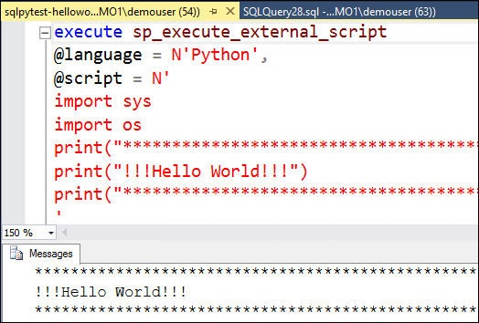
Ways of executing R/Python scripts on server
From Client IDE
From stored procedure (sp_execute_external_script)
1.Client
2. Stored procedure
SQL Compute Context
SQL Server

Slide 37
Demo – 1MM scoring

Slide 38
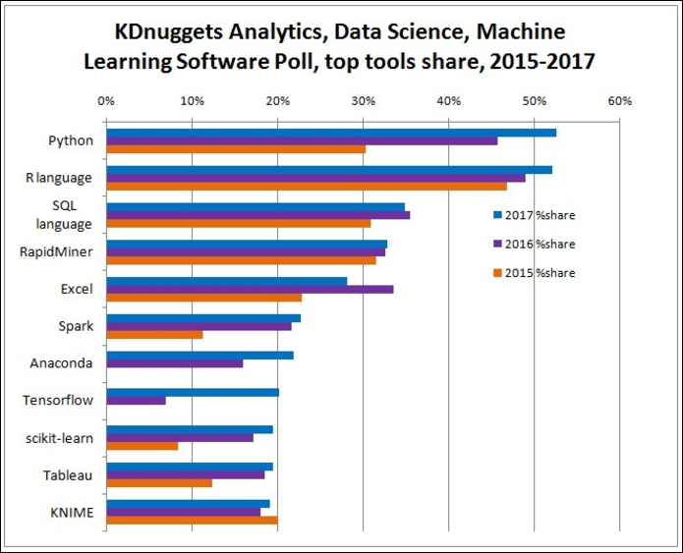
What is Machine Learning?
Uses data mining and learning techniques to train models using historical data to predict future outcomes
Examples
  Predict store sales based on historical performance
  Predict default of a loan based on loan/transaction history
  Predict sentiment of a new tweet or review or call log
  Classify customers into groups based on transaction characteristics
  Classify images and extract features from images

Slide 39

The SQL Extensibility Architecture
Windows Jobobject
MSSQLSERVER Service
MSSQLLAUNCHPAD Service
Windows “satellite” process
Windows “satellite” process
launchpad.exe
Windows “satellite” process
sqlservr.exe
R/Python “satellite” processes
Named pipe
sp_execute_external_script
R/Python Launcher
“What” and “How”
to “launch”
R/Python “satellite” process
sqlsatellite.dll
TCP

Slide 40
SQL compute context from T-SQL
Use to train or predict in parallel (rx* functions)
Scale to datasets that don’t fit in memory
+ BxlServer
rxLogIt or rxPredict with SQLCC
sp_execute_external_script
@script = N’
RxSqlServerData(…)
rxLogIt’, @input_data_1 = N’’
+ BxlServer
sp_execute_external_script
@script = N’
<rxcall>’,
@input_data_1 = N’SELECT….’
+ BxlServer
rxCall streamed or serial
Parallel
Query
rxCall
parallel execution

Slide 41
Streaming from Client
# Query to select 20% of the data for testing purposes
input_query <- "SELECT TOP(20) PERCENT
pr_review_sk, pr_review_content, pr_review_rating,
CASE WHEN pr_review_rating <3 THEN 1
WHEN pr_review_rating =3 THEN 2 ELSE 3 END AS tag
FROM product_reviews";
# Set ComputeContext
cc <- RxInSqlServer(connectionString = connStr);
rxSetComputeContext(cc);
test <- RxSqlServerData(connectionString = connStr, sqlQuery = input_query);
prediction <- rxPredict(model, data = test, extraVarsToWrite = "tag",
overwrite = TRUE, rowsPerRead = 5000)

Slide 42
Dynamic Management Views
DMV | Description
sys.dm_exec_requests | New column: external_script_request_id
sys.dm_external_script_requests | Returns running external scripts, DOP & assigned user account
sys.dm_external_script_execution_stats | Number of executions for rx* functions in RevoScaleR package
sys.dm_os_performance_counters | New “External Scripts” performance counters

Slide 43
Extended Events
Three classes of events: SQL Server, Launchpad & BxlServer
SQL Server Launch events
  Available under debug channel
  Start of satellite & successful launch of satellite event
Satellite events can be used to diagnose R script execution
  Enable debug channel to see more events
  Authentication, Startup, Shutdown events
  Communication between SQL Server & BxlServer
  Data Transfer between SQL Server & BxlServer
Launchpad & BxlServer events
  Enabled using a configuration XML file. Documented here

Slide 44
External Resource Pools
Set CPU, affinity, memory limit & max processes for external runtimes
Enforced using Windows Jobobjects
“default” external resource pool
  Enabled on all editions of SQL Server. Can be modified in EE
  Default memory setting is 20% of available RAM
Workload group can be tied to a SQL resource pool & external resource pool

Slide 45
Windows Job objects
Launchpad creates jobobjects for external resource pools
Instance counter names:
  <SQL INSTANCE_ NAME>_External_Resource_Pool_<ID>_<Timestamp>
Job Object
  Ex: Current % Processor Time, Process Count - Active
Job Object Details
  Get details on specific R or BxlServer process or Total
  Ex: IO Data Bytes/sec, Working Set
Requires CU1 fix to view the counters in Windows Performance Monitor

