Slide 1

C# + MCP + Azure AI
Building Conversational Enterprise Applications That Actually Work
Niels Berglund
AI / Software Architect Lead Derivco
niels.it.berglund@gmail.com
https://nielsberglund.com
https://linkedin.com/in/nielsberglund

Slide 2
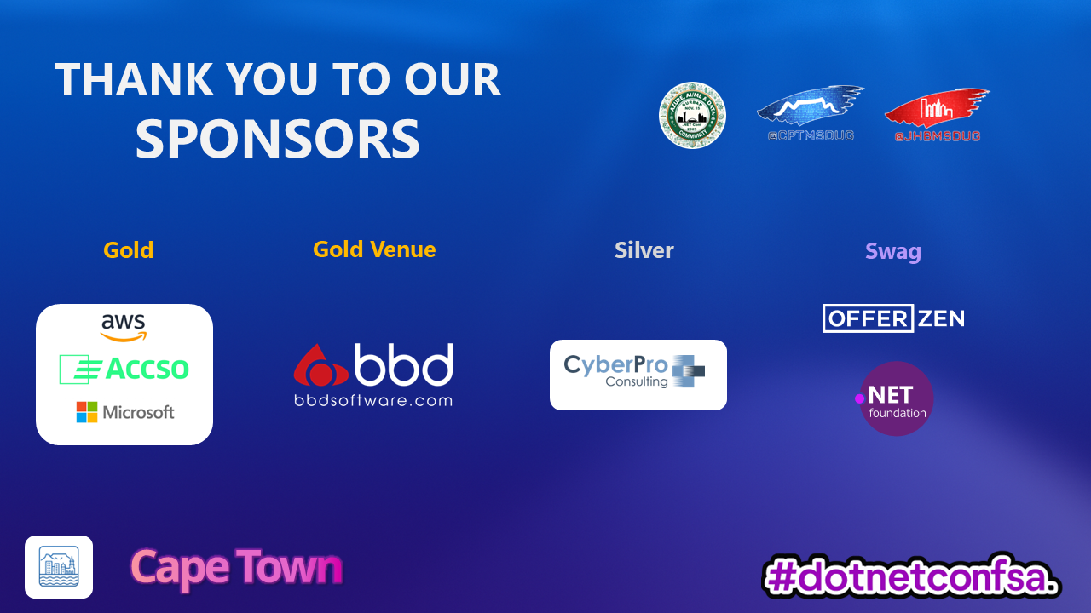

Slide 3

The Date
30 November 2022
Notes:
The world as we know it began on this date. What happened then?
ChatGPT was released, and the world became aware of GenAI.

Slide 4
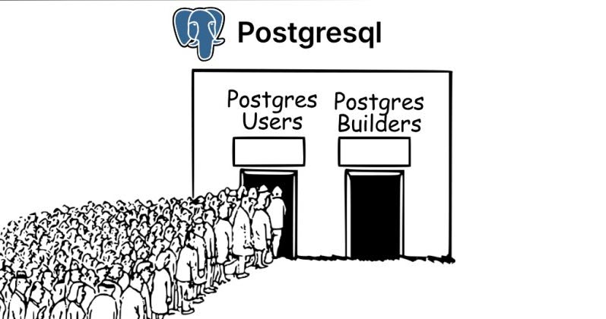
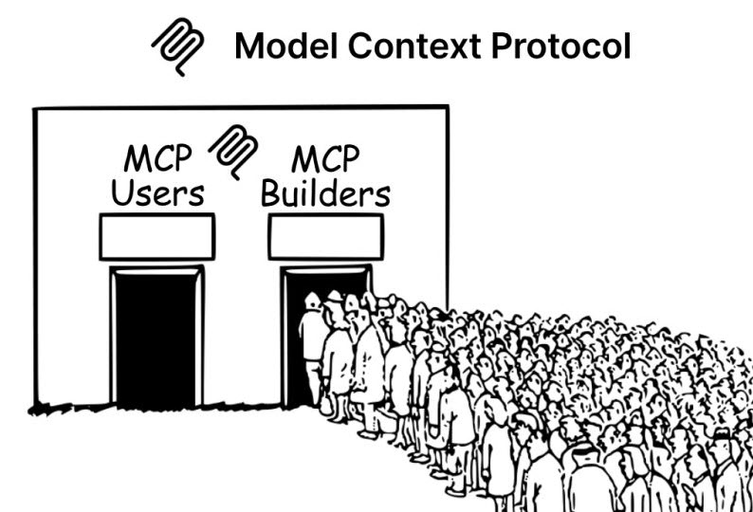
The MCP Tutorial Problem

Slide 5
What We're Building Today
Event Management Web App
Chat interface for database operations
Natural language → SQL Operations
Real business logic (capacity checks, conflicts, validation)
Reporting and analytics

Slide 6
What is MCP? (The 60-Second Version)
Standard protocol for AI-to-tool communication
Your C# App ↔ MCP Protocol ↔ MCP Server ↔ SQL Database
"Think REST API, but designed for AI agents"

Slide 7
MCP Architecture Components
MCP Host
Your .NET app.
MCP Server
Data Source
MCP Client
Data Source
MCP Server
MCP Client

Slide 8
Why MCP Matters for Enterprise Apps
✅ Standardized AI-to-tool integration
✅ Security and permission boundaries
✅ Context management built-in
✅ Tool discovery and invocation
✅ Reusable servers across apps

Slide 9
The MSSQL MCP Server
What it provides:
Database schema inspection
CRUD operations
Query execution
Table creation and management

Slide 10
Our Architecture Today
ASP.NET Core Web App
|-- Blazor/React UI (Chat)
|-- C# Backend
|-- Azure AI Integration
MSSQL MCP Server (Node.js)
SQL Server Database
(Event Management Schema

Slide 11
Demo Roadmap: Our Coding Path
Setting up the solution & MCP connection
Building the chat interface
Schema creation through conversation
Adding speakers and sessions
Handling registration logic
Generating reports

Slide 12
What We Actually Built
Quick stats:
  Lines of C# code: ~500
  MCP tool calls: ~7.
  Zero explicit tool calls chosen by the user.
  Zero SQL written by user.

Slide 13
Key Takeaways
Integration > Creation: Use existing MCP servers
LLM as Orchestrator: Let it handle the tool selection
Business Logic Matters: Validation, error handling, UX
Prompt Engineering: Clear, specific instructions

Slide 14
Thank You
Questions?
Niels Berglund
niels.it.berglund@gmail.com
https://nielsberglund.com
https://linkedin.com/in/nielsberglund

