Slide 1
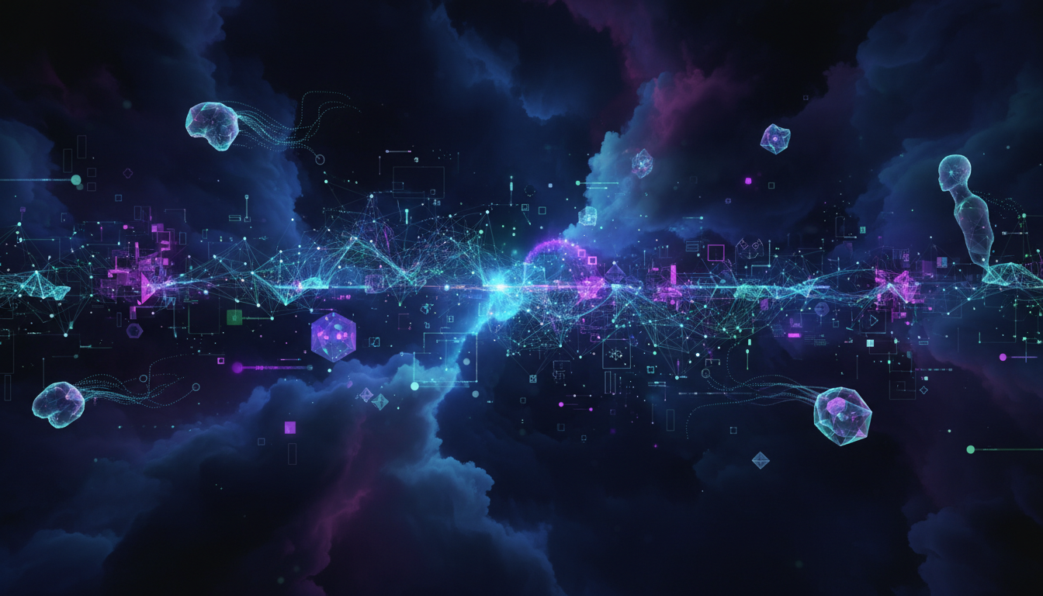
Generative AI for Beginners
Build Your First Agent with Azure AI Foundry
From zero to AI hero - watch your first agent come alive in just a few lines of code
Niels Berglund
AI / Software Architect Lead Derivco
niels.it.berglund@gmail.com
https://nielsberglund.com
https://linkedin.com/in/nielsberglund

Slide 2
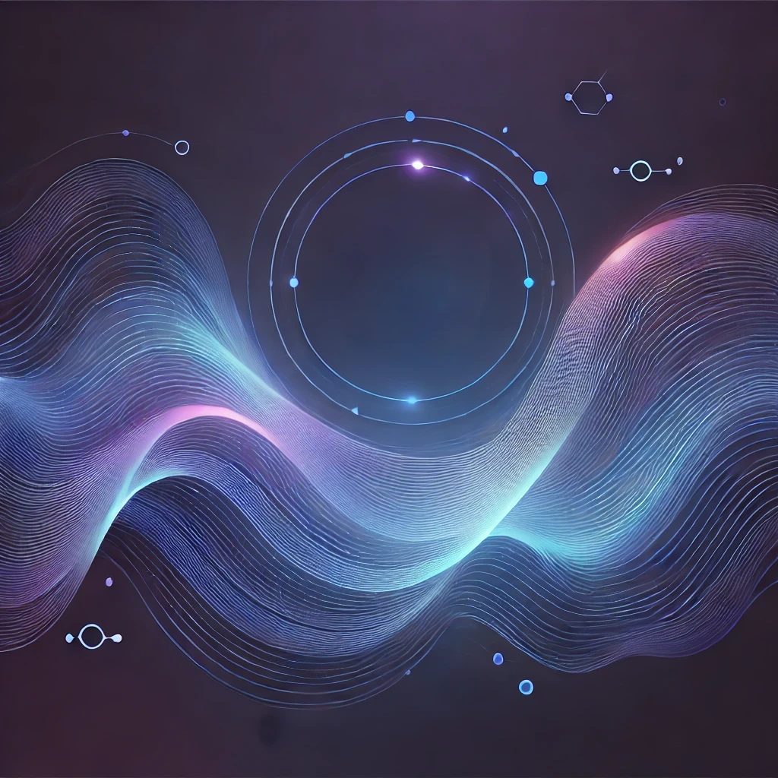
What We'll Build Today
✓ An AI agent in Azure AI Foundry
✓ A working application connected to the agent
✓ End-to-end demo you can use
In the next hour: from nothing to working!
You'll leave with code you can use

Slide 3
The Date
30 November 2022
Notes:
The world as we know it began on this date. What happened then?
ChatGPT was released, and the world became aware of GenAI.

Slide 4
What is Generative AI?
AI models that create new content
Examples:
• Text (conversations, summaries, code)
• Images (art, designs)
• Audio (voice, music)
Think: AI that can generate, not just analyze

Slide 5
What is an AI Agent?
AI that can take actions (not just chat)
Agent vs. Simple Chatbot:
• Chatbot: answers questions
• Agent: performs tasks, makes decisions
Real-world examples:
• Customer support that creates tickets
• Research assistant that finds information
• Code helper that writes and tests code

Slide 6
Why Azure AI Foundry?
✓ All-in-one platform for building AI solutions
✓ No need to be an ML expert
✓ Enterprise-ready, secure, scalable
✓ Built-in tools for testing and deployment
Perfect for beginners and experts alike!

Slide 7
Today's Architecture
USER YOUR APPLICATION AZURE AI FOUNDRY (Agent) RESPONSE back to user
"Don't worry, this is easier than it looks!"

Slide 8
Let's Build! Part 1 - The Agent
What we'll do:
✓ Set up Azure AI Foundry
✓ Create an agent
✓ Configure prompts
✓ Test in playground
Minimal slides from here - let's code!

Slide 9
Let's Build! Part 2 - The Application
What we'll do:
✓ Create a simple front-end app
✓ Connect to our agent
✓ Handle user input/output
✓ See it work end-to-end
Keep watching - this is where it gets fun!

Slide 10
What We Built Today
✓ Created an AI agent in Azure AI Foundry
✓ Configured it with prompts
✓ Gave it knowledge, and the ability to execute code
✓ Connected it to a real application
✓ Made it work end-to-end
And you can do this too!

Slide 11
Key Takeaways
✓ Generative AI is accessible to everyone
✓ Azure AI Foundry makes it easier
✓ You don't need to be an AI expert
✓ Start small, iterate, improve
✓ The code is simpler than you think

Slide 12
Thank You Questions?
Niels Berglund
niels.it.berglund@gmail.com
https://nielsberglund.com
https://linkedin.com/in/nielsberglund

