Slide 1

Inside the Black Box
How MCP Servers Turn Converations Into Database Operations
Niels Berglund
AI / Software Architect Lead Derivco
niels.it.berglund@gmail.com
https://nielsberglund.com
https://linkedin.com/in/nielsberglund

Slide 2

The Date
30 November 2022
Notes:
The world as we know it began on this date. What happened then?
ChatGPT was released, and the world became aware of GenAI.

Slide 3
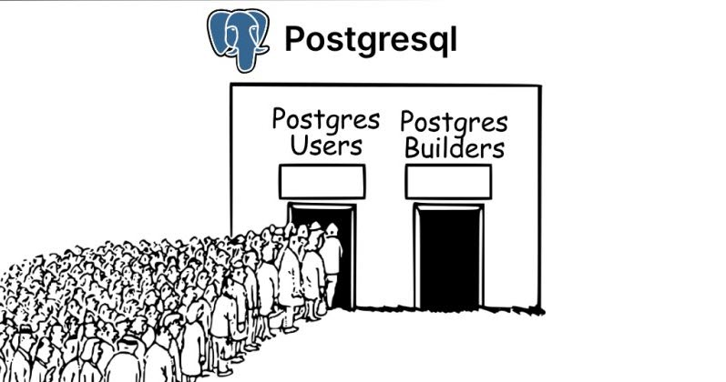
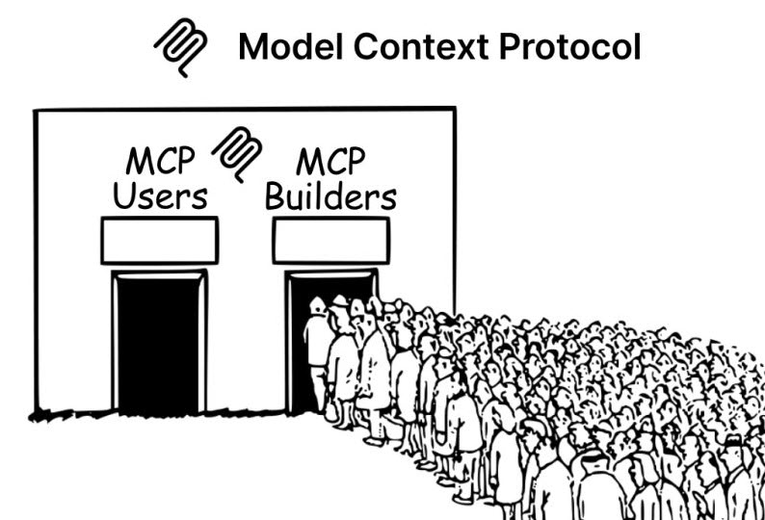
The MCP Tutorial Problem
Notes:
Everyone talks about MCP. Today we're actually watching it work. Minimal slides, maximum code. Let's go.

Slide 4
What We're Doing Today - I
Demo

Slide 5
What We're Doing Today - II
Watch MCP in Action
Niels says: "Do "stuff" for my conference"
THE BLACK BOX
SQL Server: CRUD in the DB
We're opening that black box

Slide 6
What is MCP? (The 60-Second Version)
Standard protocol for AI-to-tool communication
Your C# App ↔ MCP Protocol ↔ MCP Server ↔ SQL Database
"Think REST API, but designed for AI agents"

Slide 7
MCP Architecture Components
Your .NET app.
MCP Host
MCP Client
MCP Server
Data Source
AI Agent/LLM
MCP Client
MCP Server
Data Source

Slide 8
Why MCP Matters for Enterprise Apps
✅ Standardized AI-to-tool integration
✅ Security and permission boundaries
✅ Context management built-in
✅ Tool discovery and invocation
✅ Reusable servers across apps
Notes:
"Look, here's why this actually matters in your enterprise app. Without MCP, every time you want to connect AI to a database, or a CRM, or a file system, you're writing custom integration code. Custom auth, custom error handling, custom everything. And if you want to switch from Azure OpenAI to Claude? Good luck - you're rewriting everything.
MCP changes this. It's a standard protocol - think of it like REST for AI-to-tool communication. The MSSQL MCP Server we're using today? I could use it from a Python app tomorrow. Or a Node.js app. Or with Claude instead of Azure AI. Same server, zero code changes.
Security-wise, MCP gives you a proper boundary. The AI isn't executing arbitrary SQL - it's calling tools that the MCP server exposes. Want to prevent DELETE operations? Configure the MCP server. Want audit logs? They're built in.
Context wise: the AI tools need to know about the db schema, and you stuff that in the context everytime. Here the MCP Server provides tools that the AI can ask
Tool discovery: the MCP Server tells the AI what tools are available
And here's the business case: companies building AI apps right now are spending 80% of their time on integration plumbing and 20% on actual features. MCP flips that. You spend your time building features, not reinventing authentication and error handling.
This isn't academic. Microsoft is betting on this. They built the MSSQL MCP Server we're using. They're integrating MCP into VS Code, into Azure. This is becoming the standard, and if you're building enterprise AI apps, you want to be on the right side of that standard."

Slide 9
The MSSQL MCP Server
What it provides:
Database schema inspection
CRUD operations
Query execution
Table creation and management

Slide 10
Our Architecture Today
ASP.NET Core Web App
|-- UI (Chat)
|-- C# Backend
|-- Azure AI Integration
MSSQL MCP Server (Node.js)
SQL Server Database
(Event Management Schema

Slide 11
Demo Roadmap: Our Coding Path
Setting up the solution & MCP connection
Building the chat interface
Schema creation through conversation
Adding speakers and sessions
Handling registration logic
Generating reports

Slide 12
What We Actually Built
Quick stats:
  Lines of C# code: ~500
  MCP tool calls: ~7.
  Zero explicit tool calls chosen by the user.
  Zero SQL written by user.

Slide 13
Key Takeaways
Integration > Creation: Use existing MCP servers
LLM as Orchestrator: Let it handle the tool selection
Business Logic Matters: Validation, error handling, UX
Prompt Engineering: Clear, specific instructions

Slide 14
Thank You
Questions?
Niels Berglund
niels.it.berglund@gmail.com
https://nielsberglund.com
https://linkedin.com/in/nielsberglund

