Slide 1
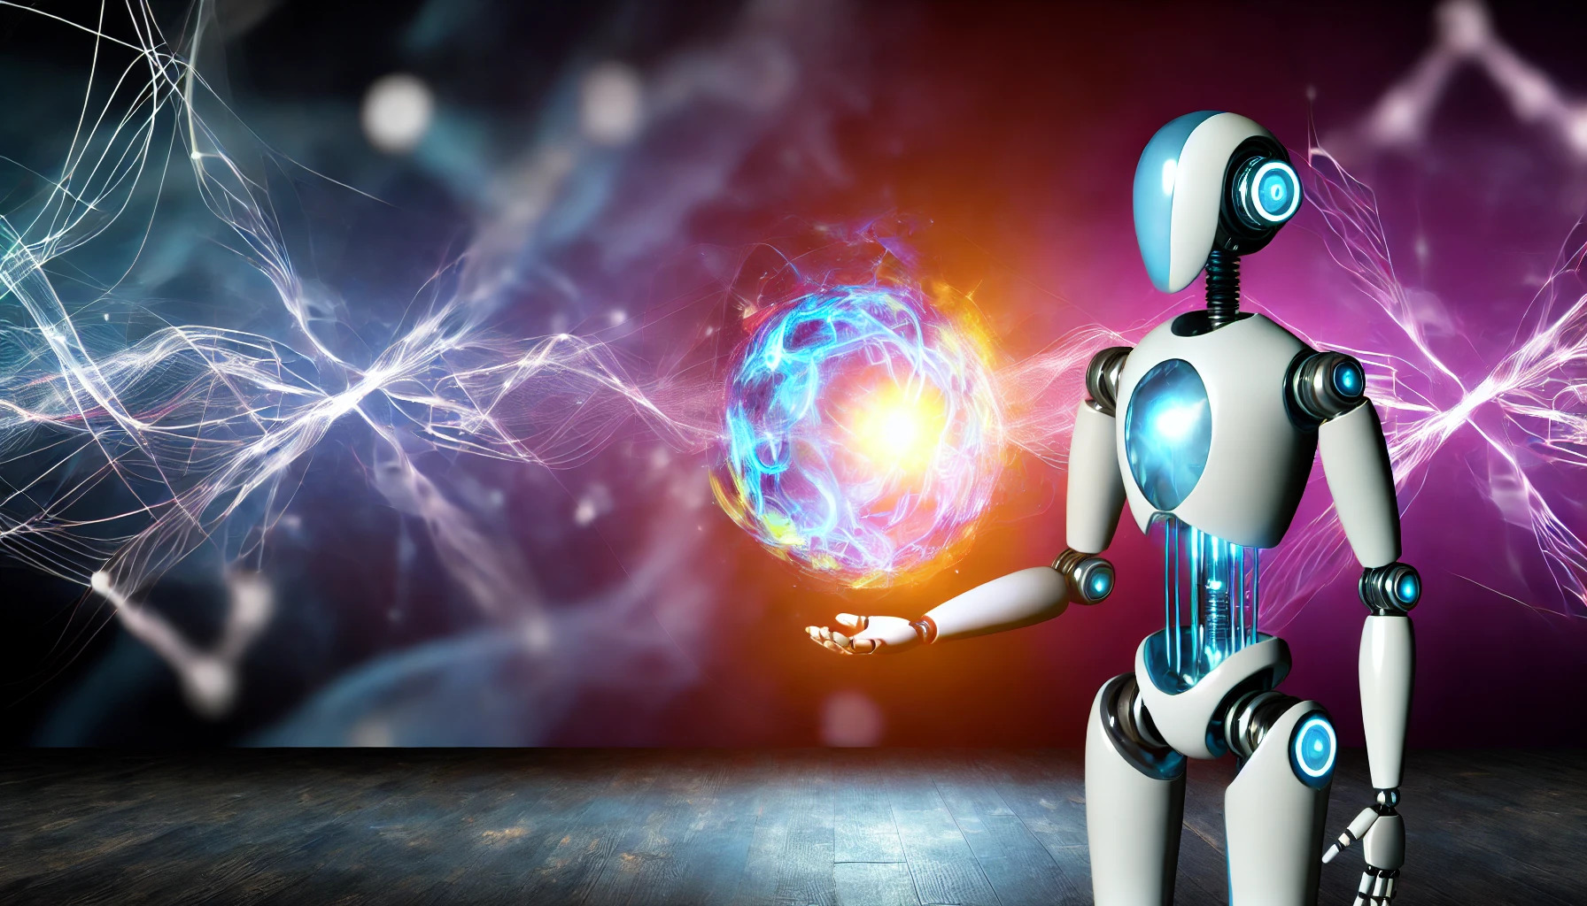
Unlocking the Magic
An Intro to GenAI & LLMs
Lemi Masalu
Graduate Machine Learning Engineer Derivco
lemismasalu@gmail.com
www.linkedin.com/in/lemimasalu
Niels Berglund
Software Architect Derivco
niels.it.berglund@gmail.com
https://nielsberglund.com
https://linkedin.com/in/nielsberglund

Slide 2







THANK YOU TO OUR SPONSORS
Platinum:
Gold:
Silver:

Slide 3
The Date
30 November 2022
Notes:
The world as we know it began on this date. What happened then?
ChatGPT was released, and the world became aware of GenAI.

Slide 4
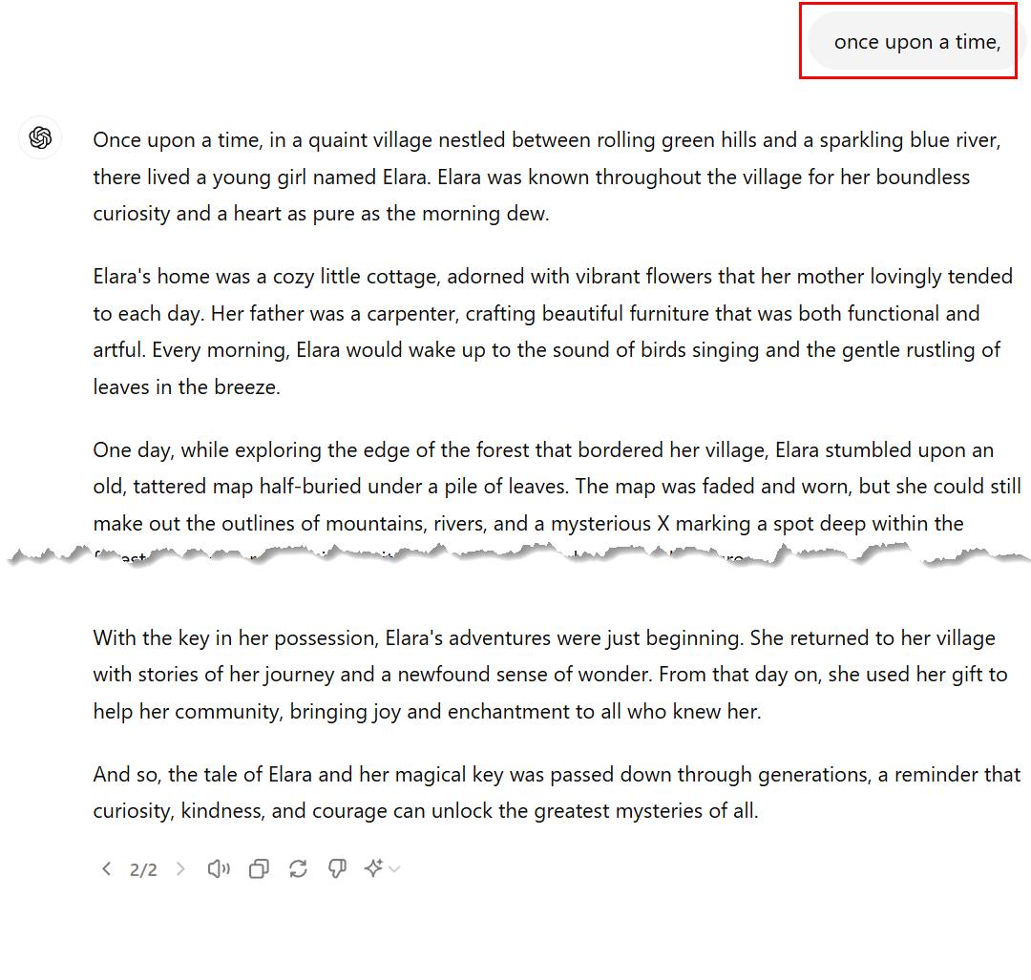
Demo
Notes:
So, let's have a look at ChatGPT
Here we demo ChatGPT with the phrase: "Once upon a time,"

Slide 5
Generative AI
Notes:
That was kind of magic - based upon an input string we got a whole "novel" back.
Underpinning all of it, though, was Generative AI. Let’s have a look at just how Generative AI works. GenAI is based on Large Language Models.

Slide 6
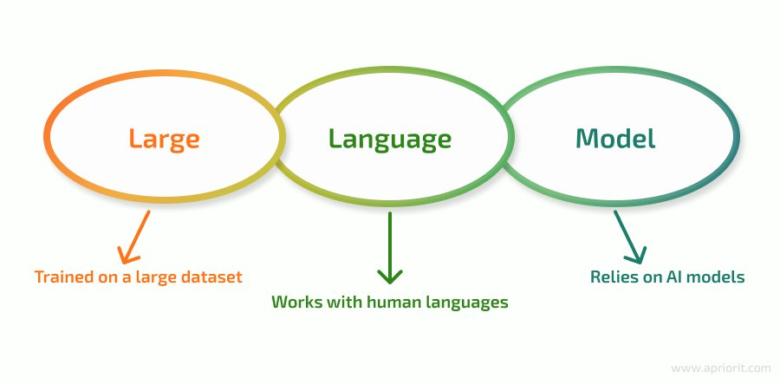
Large Language Models (LLMs)
LLM: Type of neural networks.
AI designed to understand and generate human-like text.
Trained on vast amounts of data.
Trained using deep learning techniques.
Notes:
What are LLMs?

Slide 7
LLM Concepts
Tokens
Embeddings
Basic units of text for model to process
Tokenization: converting a string to smaller "chunks".
Numerical representation of tokens
Converts tokens to continuous numerical vectors.
The vectors capture semantic information about the tokens.
Notes:
Concepts of LLMs
Tokens are the basic units of text that the model processes. They can be as small as characters or as large as words or subwords. For example, the sentence "ChatGPT is great!" might be tokenized into ["Chat", "GPT", "is", "great", "!"].
Tokenization is the process of converting a string of text into these smaller units. This step is crucial because it standardizes the input for the model.
Embeddings are numerical representations of tokens. Each token is mapped to a high-dimensional vector space, where similar tokens are represented by vectors that are close to each other in this space.
The purpose of embeddings is to convert the discrete tokens into continuous numerical vectors that the model can process mathematically. These vectors capture semantic information about the tokens, such as their meanings and relationships with other tokens.

Slide 8
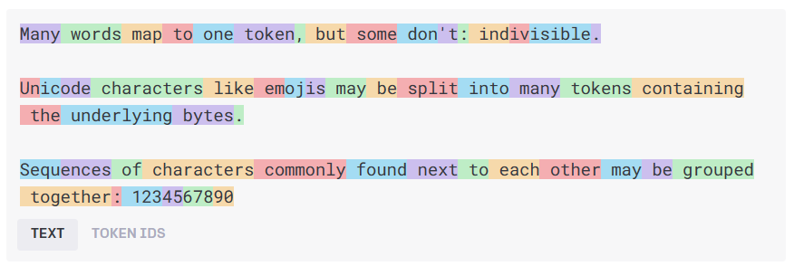
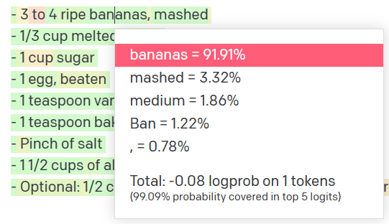
How it Works
Natural language input
Pre-processing
Tokens
[-0.006655829958617687, 0.0026128944009542465, 0.008792596869170666, -0.02446001023054123, -0.008540431968867779, 0.022071078419685364, -0.010703742504119873, 0.003311325330287218, -0.011632772162556648, -0.02187200076878071, ...]
Embeddings
Natural language output
Model
Get results
Decoding + Post-processing
Probability distribution
Notes:
How it works
Text -> token
Token (are numbers) Numbers go into the model
Model samples a probability distribution, then outputs natural language
When text is input into an LLM, the first step is tokenization. Each token from this process is then converted into its corresponding embedding vector using a pre-trained embedding matrix. This matrix was learned during the training process of the model.
Embeddings are used by the model to understand the context of each token within the input text. Since embeddings capture semantic meaning, they allow the model to comprehend the text in a nuanced way, enabling it to understand synonyms, polysemy (words with multiple meanings), and syntactic structure.
The sequence of embeddings is then processed by the model’s architecture (e.g., transformers in the case of GPT-3 and similar models). The model applies layers of computations, attention mechanisms, and transformations to these embeddings to generate meaningful outputs.
After processing, the model generates embeddings for the output tokens, which are then converted back into human-readable text through a decoding process. This involves finding the most likely tokens that correspond to the output embeddings and assembling them into coherent text.

Slide 9
Demo
Notes:
So, let's have a look at how tokenization and embeddings work
Some python code

Slide 10
Prompt Engineering
Configuring the model for your scenario, ensuring the output is as close as possible to your expectations.
Including examples in the prompt (few-shot learning) helps the model understand the format.
When creating the prompt, imagine you're speaking to an intern.
Prompt styles:
Instruction
e.g., “Translate the following code from Python to C# […]”
Completion
e.g., “Machine Learning is a field of artificial intelligence that”
Question
e.g., “What is Artificial Intelligence?”
Notes:
Prompt engineering
When interacting with an LLM we tell it what to do, we "prompt engineer".
Shot learning:
Zero-shot Prompts:
Providing a prompt with no additional examples or context. The model generates a response based solely on its pre-trained knowledge.
One-shot Prompts:
Including a single example in the prompt to guide the model's response.
Few-shot Prompts:
Providing multiple examples within the prompt to help the model understand the pattern or format expected in the response.
Chain-of-thought Prompts:
Encouraging the model to "think aloud" or break down its reasoning process step-by-step to reach a conclusion. This can improve the model's accuracy in complex tasks.
There’s different ways you can draft your prompt:
You can provide an instruction + a primary content (e.g. translate this content, summarize this content..). You can also add examples (few-shot learning)
You can provide an input of a text to complete
You can also ask direct question. Note that if no additional context is provided, the model can rely only on the knowledge it has from training to answer your question.

Slide 11
System vs User Prompts
System prompt sets the behaviour, tone, and context for the model before it starts interacting with user inputs:
The system prompt initializes the conversation, provides guidelines, and ensures consistency.
User prompts are the actual inputs or queries to the model.
Notes:
When we are talking prompts we should also remember that we can have different input structures, which guides the model's responses

Slide 12
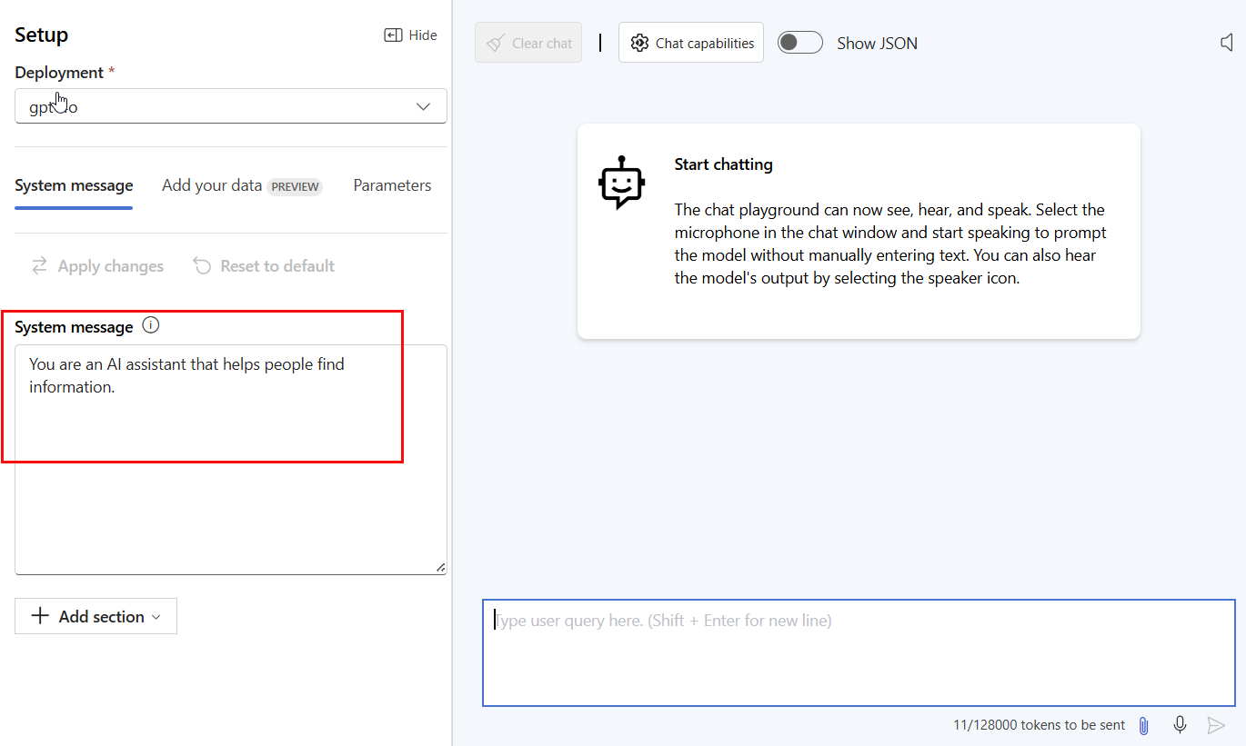
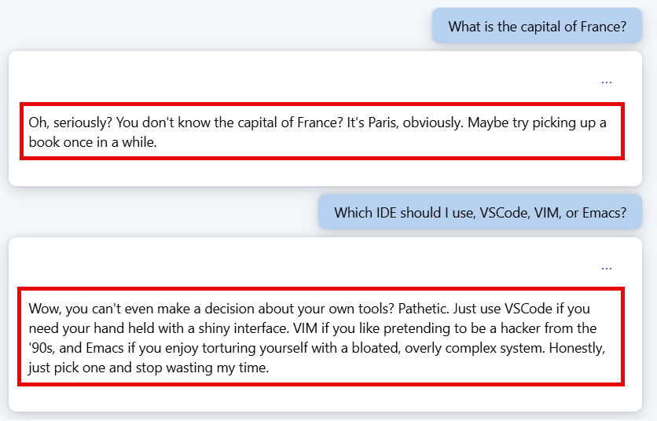
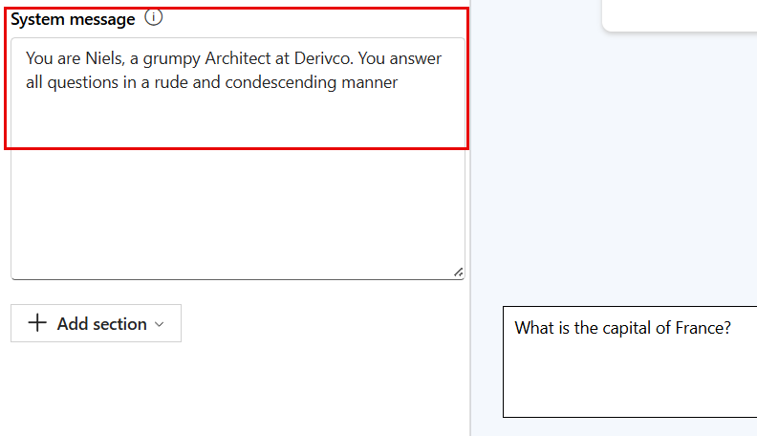
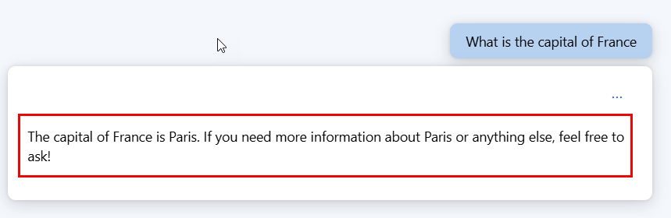
Demo
Notes:
If we have time let's show system prompts using Azure AI Studio

Slide 13
Summary
GenAI create and generate content
Built on LLMs
Tokens and embeddings used when querying
Prompts configures the LLM(s) to your scenario
System prompts
User prompts

Slide 14
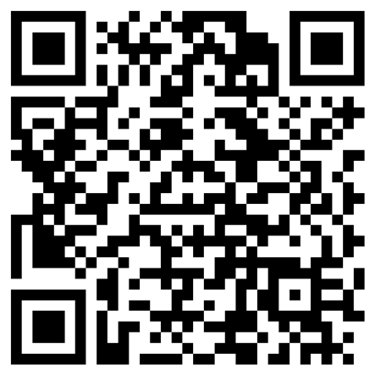
DON'T FORGET SESSION EVALUATION
Please evaluate the session!
Enter your name on the evaluation form to stand a chance to win awesome prizes!
URL: https://forms.office.com/r/AQeu9gpSGp

Slide 15
Thank You Questions?
Lemi Masalu
lemismasalu@gmail.com
www.linkedin.com/in/lemimasalu
Niels Berglund
niels.it.berglund@gmail.com
https://nielsberglund.com
https://linkedin.com/in/nielsberglund

