Slide 1





Thanks to the Sponsors Days like today are only possible because of them.

Slide 2
Thanks to the Sponsors Days like today are only possible because of them.

Slide 3
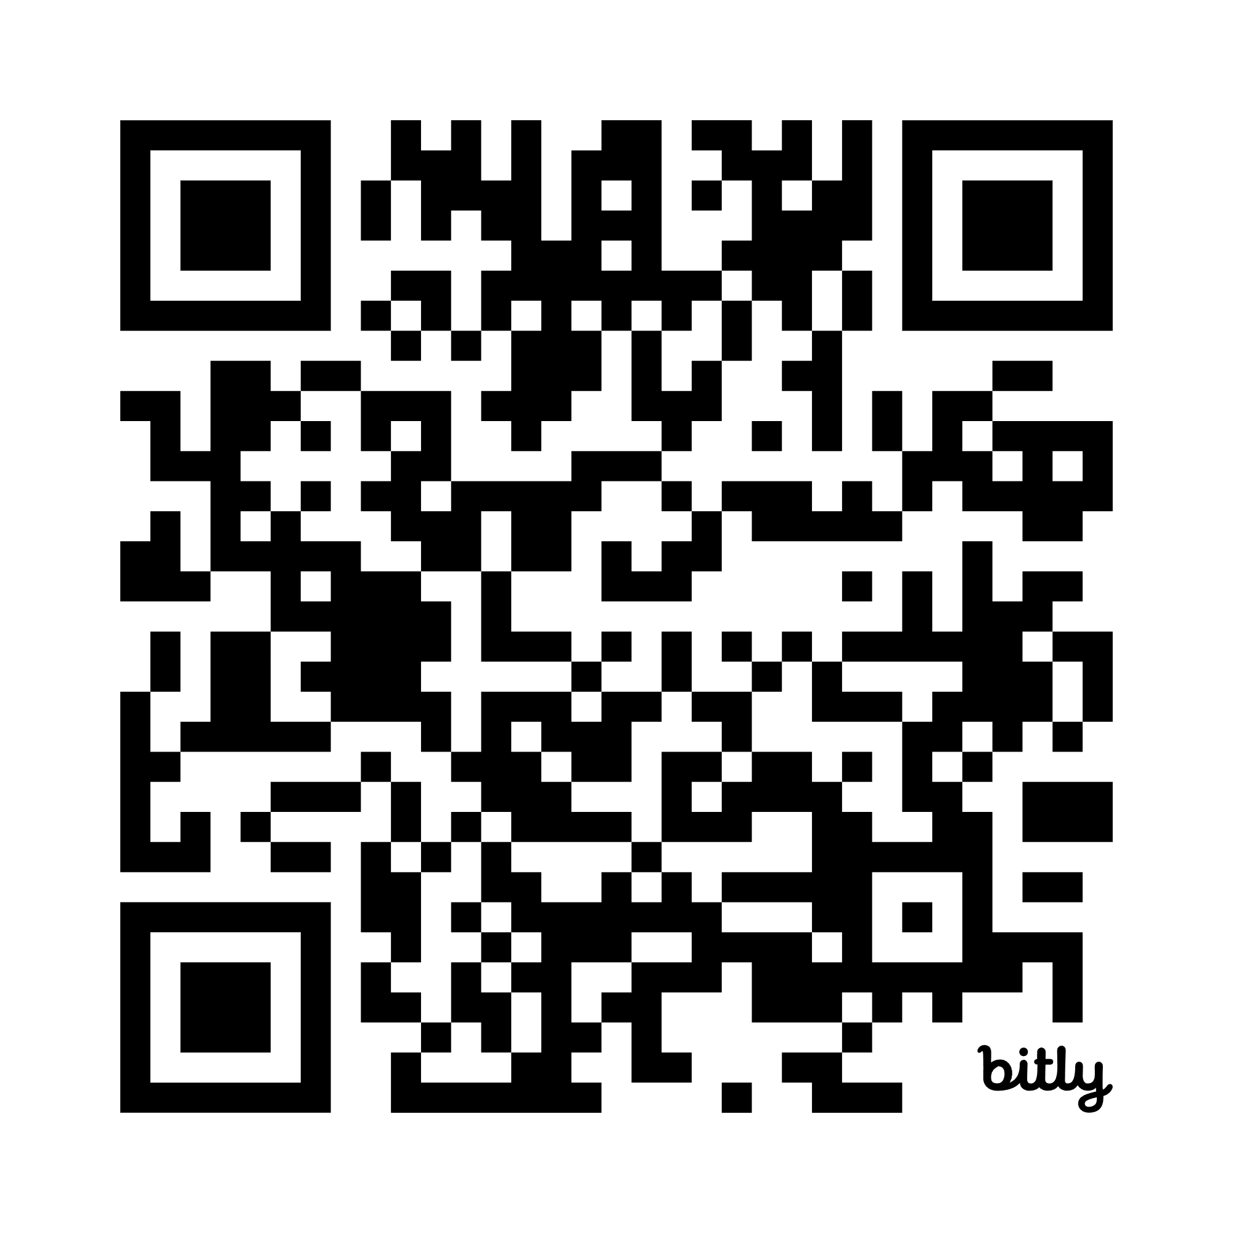
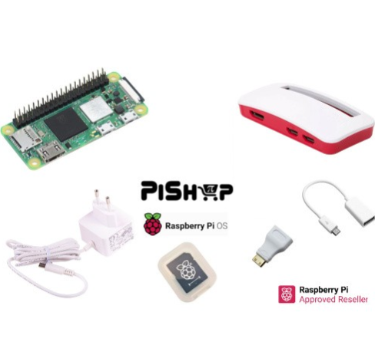
SESSION FEEDBACK Please use this QR Code to complete the speaker feedback form. Each completed form gives you an entry to win one of our awesome prizes.
bit.ly/4ohBmt6

Slide 4
Thanks to the Sponsors Days like today are only possible because of them.

Slide 5
SESSION FEEDBACK Please use this QR Code to complete the speaker feedback form. Each completed form gives you an entry to win one of our awesome prizes.
bit.ly/4ohBmt6

