Slide 1





Thanks to the Sponsors Days like today are only possible because of them.

Slide 2
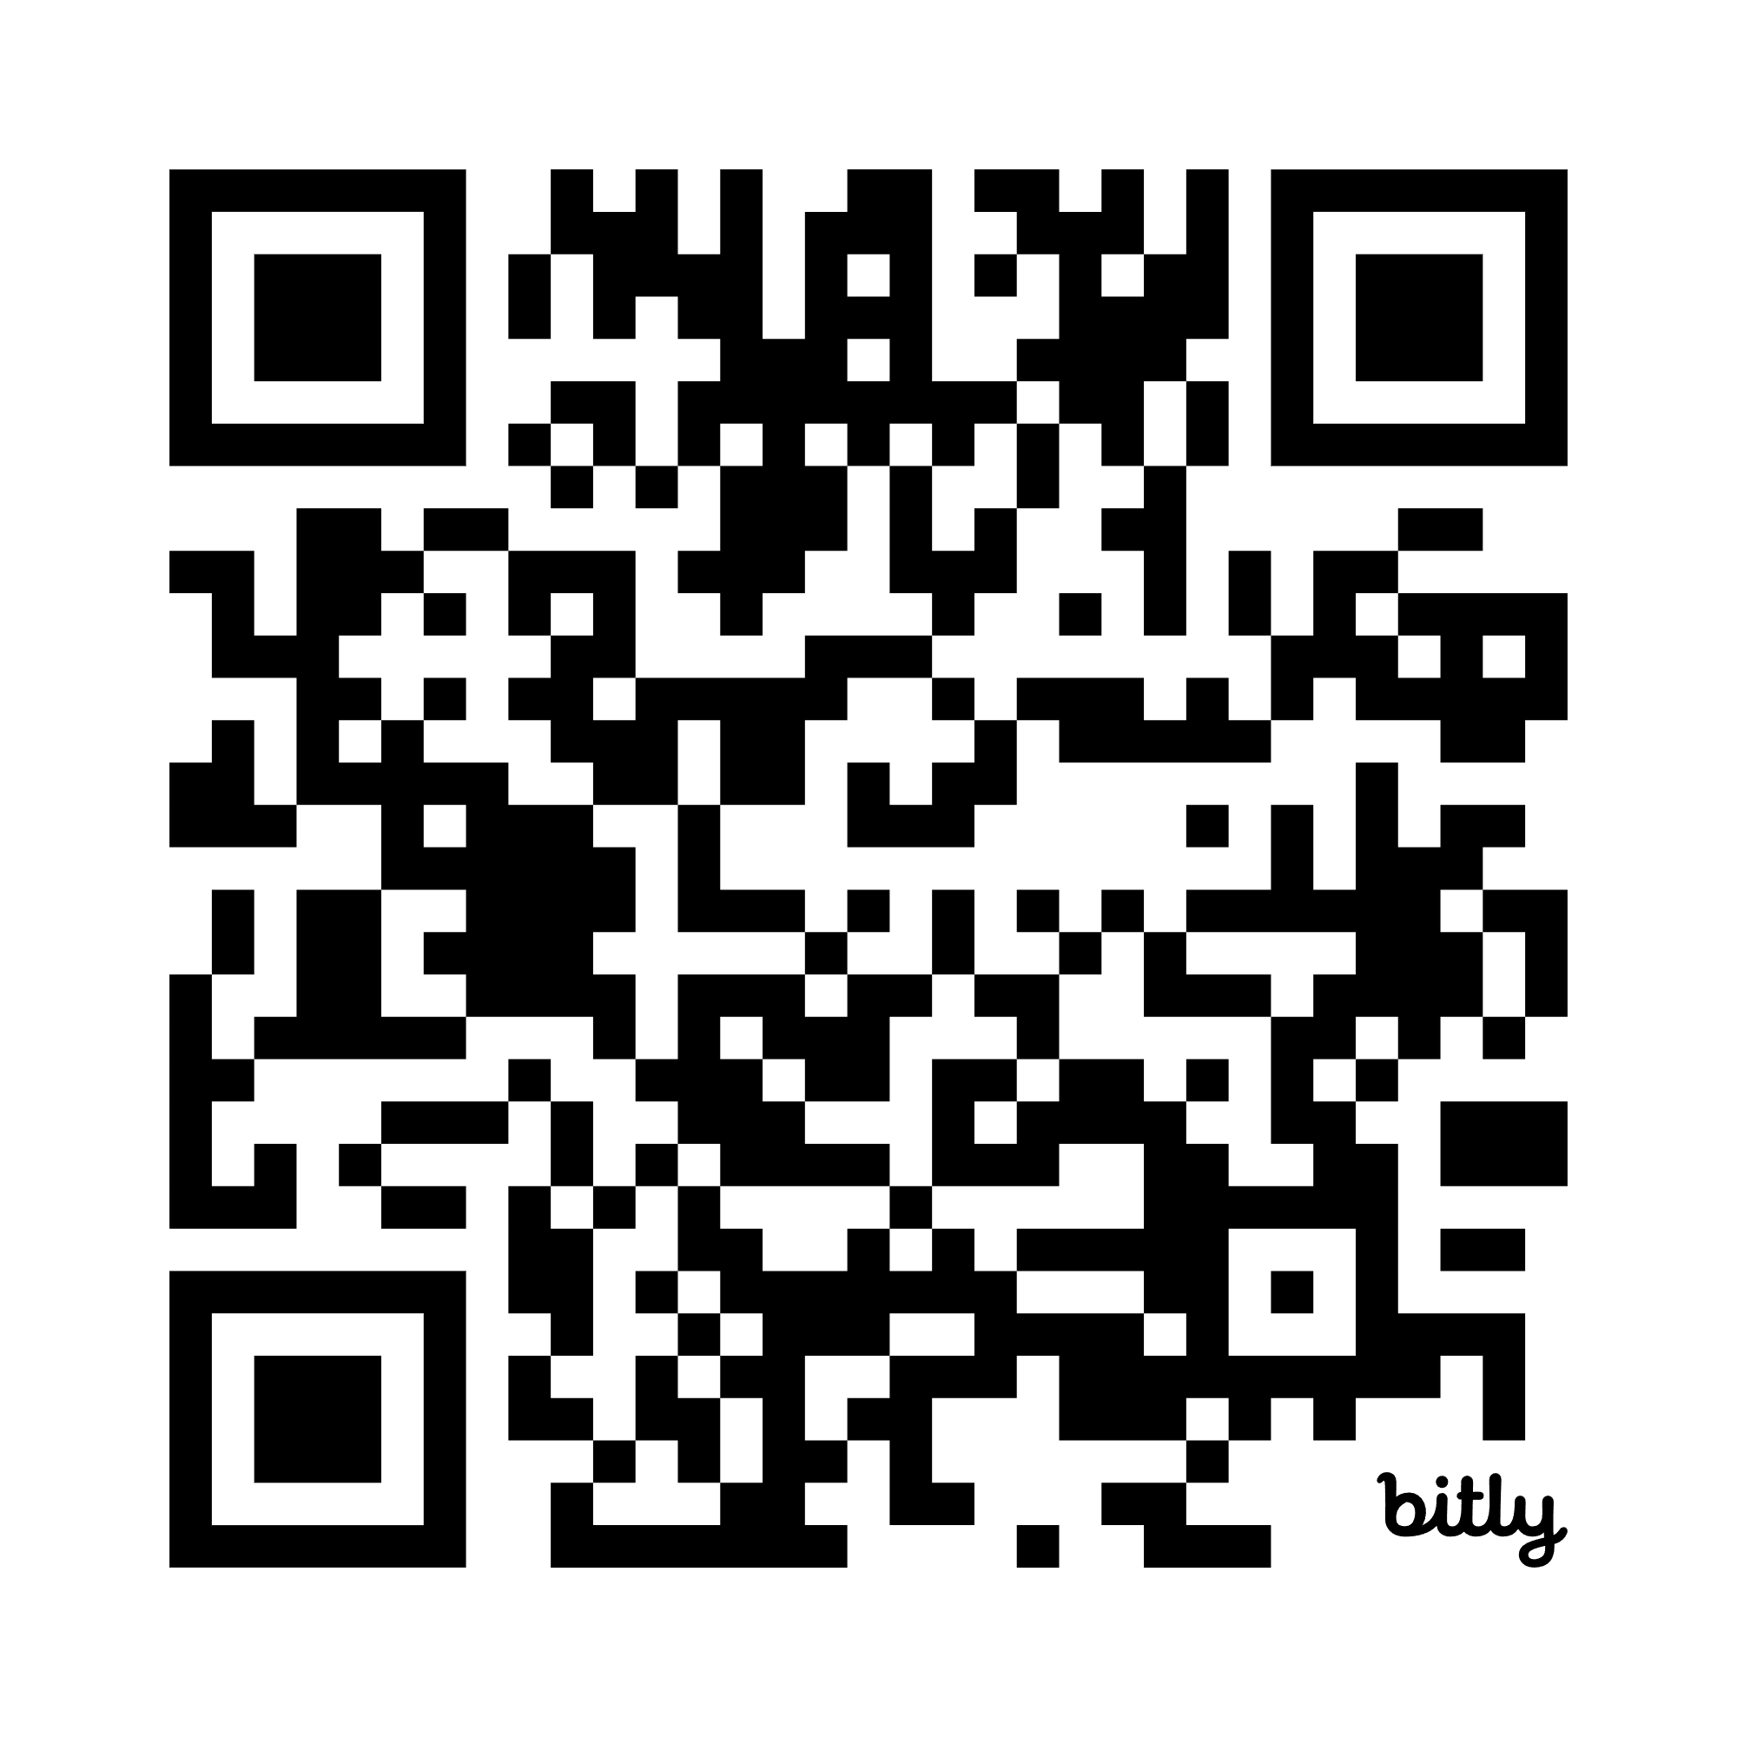
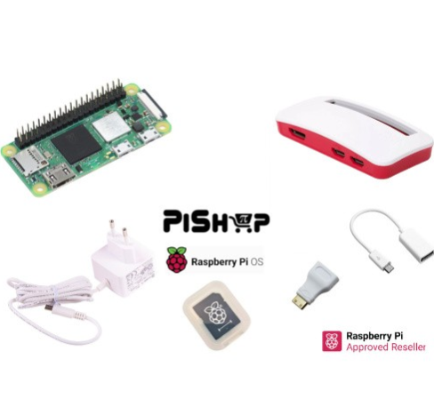
SESSION FEEDBACK Please use this QR Code to complete the speaker feedback form. Each completed form gives you an entry to win one of our awesome prizes.
bit.ly/4ohBmt6

Slide 3
Thanks to the Sponsors Days like today are only possible because of them.

Slide 4
SESSION FEEDBACK Please use this QR Code to complete the speaker feedback form. Each completed form gives you an entry to win one of our awesome prizes.
bit.ly/4ohBmt6

