Slide 1






Thanks to the Sponsors Days like today are only possible because of them.

Slide 2
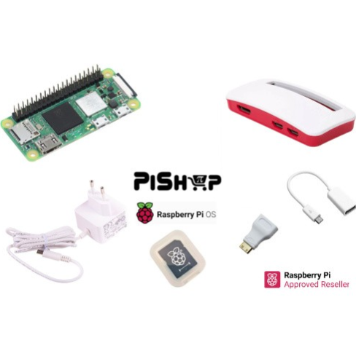
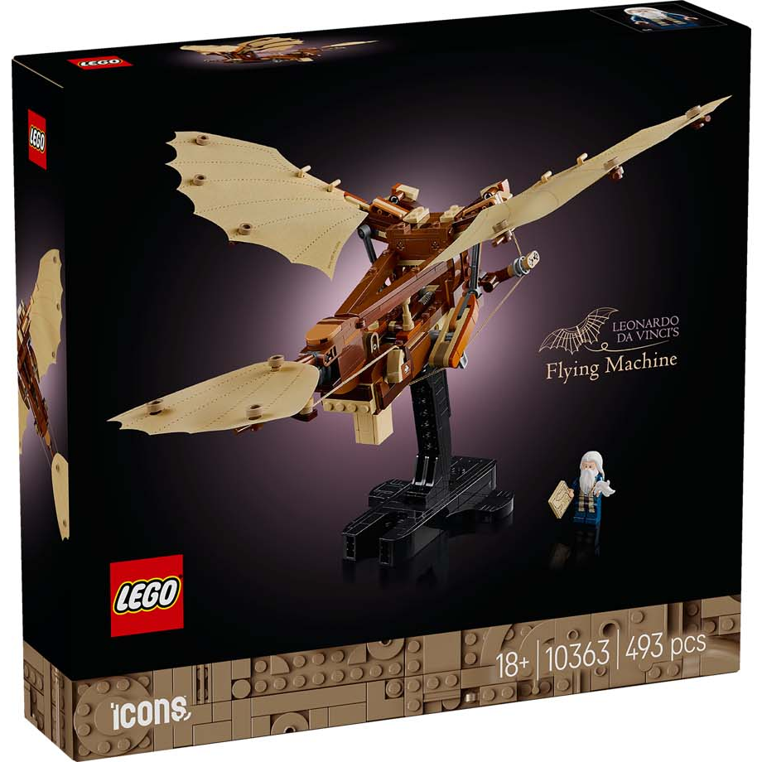
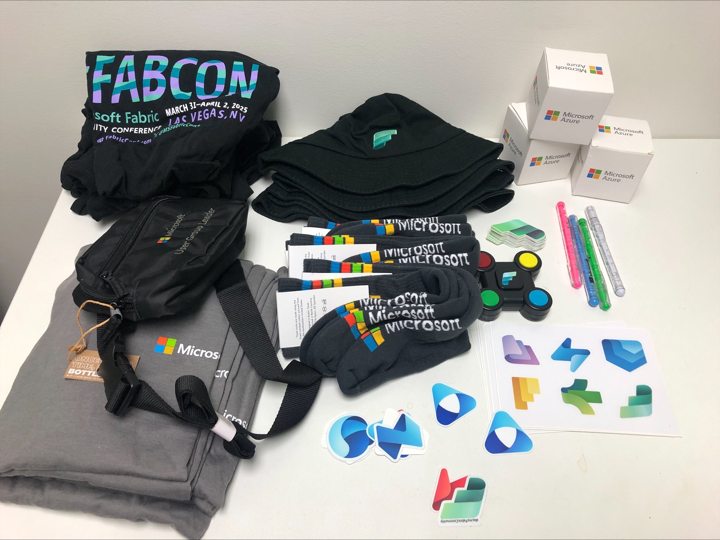
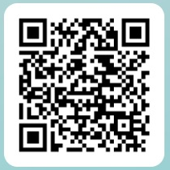
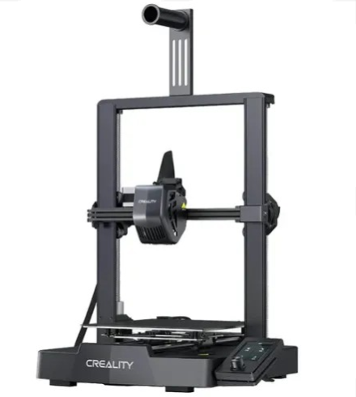
SESSION FEEDBACK Please use this QR Code to complete the speaker feedback form. Each completed form gives you an entry to win one of our awesome prizes.

