Slide 1
EE 2361: Introduction to Microcontrollers
Peng Li
lipeng@umn.edu
06/24/2015

Slide 2
Topics
String Operations in Assembly
Embedded C Programming
Timer

Slide 3
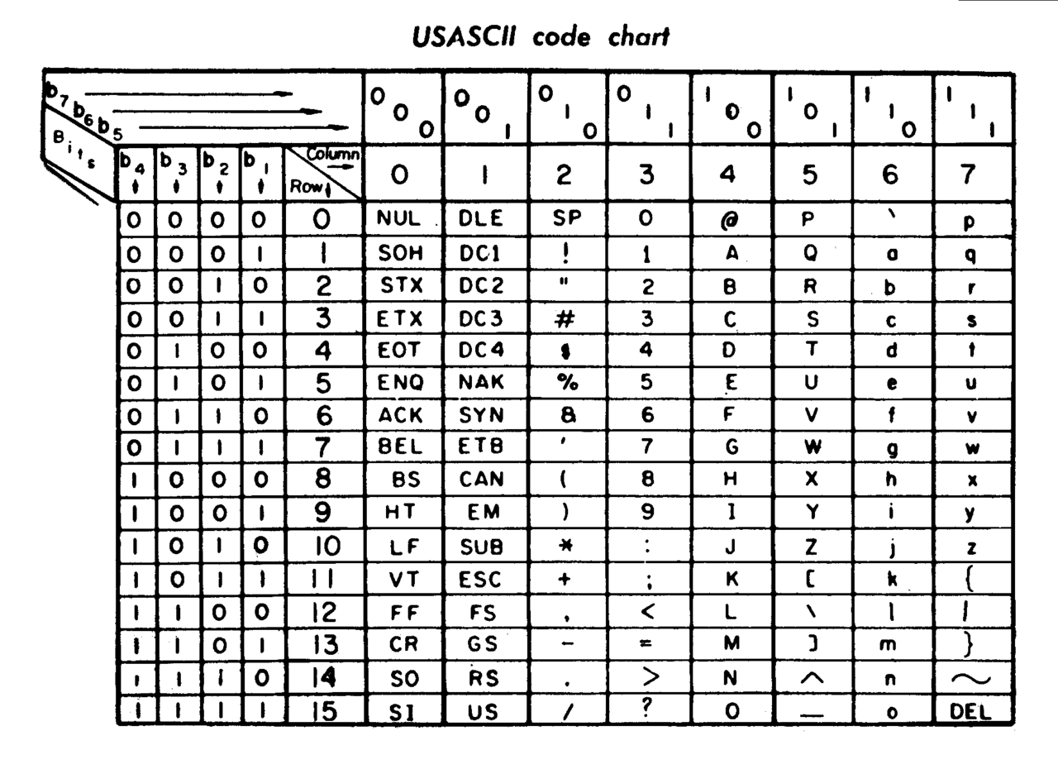
ASCII Code
Download from https://en.wikipedia.org/wiki/ASCII

Slide 4
Exercise
1. Represent Character “A” using ASCII code.
2. Represent Character “b” using ASCII code.
3. Represent Character “0” using ASCII code.
4. Represent 0 (which is NULL, means the end of a string) using ASCII code.

Slide 5
Unicode
ASCII code can only represent 128 characters. What if we want to represent characters in Latin, Chinese, Japanese, etc…
Unicode has more than 16 bits, and can represent more than 110,000 characters.

Slide 6
String in the Memory
Put the string “apple” in the memory.
op1: .byte ‘a’, ‘p’, ‘p’, ‘l’, ‘e’, 0 or .ascii “apple\0”
Assume op1 is in address 0x02AE: ‘a’ = 0x61, ‘p’ = 0x70, ‘l’ = 0x6C, ‘e’ = 0x65
Address | MSB | LSB
0x02AE | 0x70 (‘p’) | 0x61 (‘a’)
0x02B0 | 0x6C (‘l’) | 0x70 (‘p’)
0x02B2 | 0x00 (NULL) | 0x65 (‘e’)

Slide 7
Example
Implement strlen function using assembly. The function returns the length of a string. (think about how to implement this function in C)
“strlenB.s” in moodle.

Slide 8
Embedded C
Easier to move data PORTB = 0x1234; PORTB = 0b 0001 0010 0011 0100;
Exercise Translate this assembly instruction into C: bclr PORTB, #8

Slide 9
Embedded C
Bit Operations: PORTB |= 0x8 CLKDIV ^= 0x68 ……
Shift Operations: Counter >>= 4

Slide 10
Exercise
Convert the following assembly instruction to C: btg PORTB, #1

Slide 11
Embedded C
Bit representation example
CLKDIVbits.RCDIV0 Bit RCDIV0 of file register CLKDIV Format: File Register Name + “bits.” + Bit Name

Slide 12
Embedded C
Using loops instead of branch:
For loop: for (i = 0; i < 10; i ++) { …… }
While loop: while (a != 0) { …… }

Slide 13
Exercise
Convert the following assembly codes into C: mov #5,w3 loop1: inc PORTB dec WREG3 bra nz, loop1

Slide 14
Embedded C
Common Mistakes if (a = b) if (a == b) Which one is correct?

Slide 15
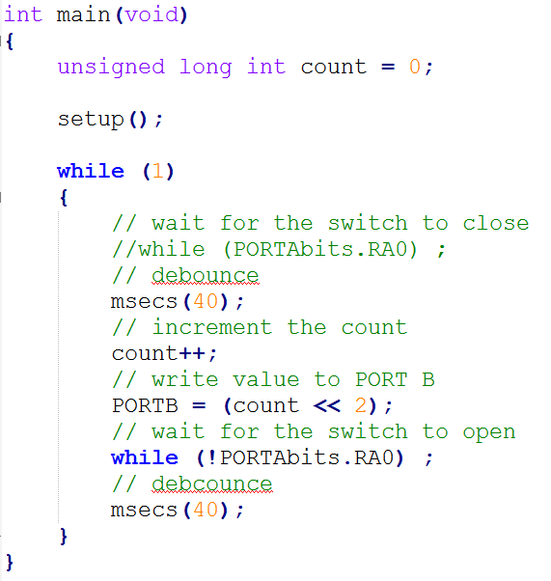
firstC.c

Slide 16
Timer
Can we use instruction cycles to estimate time?
Why do we need a timer?

Slide 17
PIC 24 Timer
Page 125 of datasheet

Slide 18
Timer Configuration

Slide 19
T1CON Register
Page 126 of datasheet

Slide 20
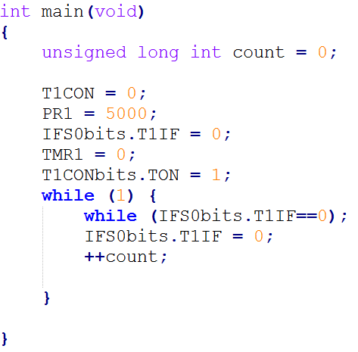
t1_first.c

Slide 21
Reading Assignment
Kia’s video: https://www.youtube.com/watch?v=UGIpA_xpOdA

