Slide 1
EE 2361: Introduction to Microcontrollers
Peng Li
lipeng@umn.edu
07/15/2015

Slide 2
Topics
Coding Example for PWM
UART

Slide 3
PWM Example (oc_varPwm.c)
Goal: Use the output compare module and polling to generate a signal that has the following properties: (1) its rising edges are 4us apart. (2) the signal goes through a cycle in which the high pulse width increases from 1us, to 3us with increments of 1us.
Method: use Output Compare PWM mode in a loop.
Calculations: Period = 4us, so PR2 = 63 High Pulse = 1us, Duty Cycle = 25%, OC1RS = (PR2 + 1) * Duty Cycle = 16. High Pulse = 2us, Duty Cycle = 50%, OC1RS = (PR2 + 1) * Duty Cycle = 32. High Pulse = 3us, Duty Cycle = 75%, OC1RS = (PR2 + 1) * Duty Cycle = 48.
Use Window > Simulator > Analyzer to see the output.

Slide 4
Data Communication Between Devices
Chip to chip (other microcontroller)
Chip to computer (chip)
UART: Universal Asynchronous Receiver Transmitter.
One of the serial communication method.

Slide 5
How UART Works
Chip A
Chip B
01000111
TX
RX
1010010
RX
TX

Slide 6
Full Duplex vs. Half Duplex
Chip A
Chip B
TX
RX
01000111
RX
TX
Half Duplex:
Only a single wire is available.
Receiving and transmitting a data frame cannot happen at the same time. They will have to share the data link.

Slide 7
Full Duplex vs. Half Duplex
Chip A
Chip B
01000111
TX
RX
PIC24
1010010
RX
TX
Full Duplex:
One wire for each direction.
Receiving and transmitting a data frame can happen at the same time.

Slide 8
Data Frame
Chip A
Chip B
DataFrame1
DataFrame2
…
TX
RX
……
DataFrame8
DataFrame7
RX
TX
Data is transmitted/received frame by frame.

Slide 9
Data Frame
What Data Frame Looks Like:
1 Start Bit + 8 Data Bits + (1 Parity Bit) + 1 Stop Bit
‘0’
Optional
‘1’

Slide 10
Parity Bit
For Error Detection, but it is optional.
If it is enabled, we have two options. Even Parity or Odd Parity.
Even Parity: If the number of ‘1’ in the data bits is an even number, set this bit to 0. Otherwise, set it to 1.
Odd Parity: If the number of ‘1’ in the data bits is an odd number, set this bit to 1. Otherwise, set it to 0.

Slide 11
Parity Bit Example
8 Data Bits | Number of 1s | Even Parity | Odd Parity
01011011 | 5 | 010110111 | 010110110
01010101 | 4 | 010101010 | 010101011
00000000 | 0 | 000000000 | 000000001
11111111 | 8 | 111111110 | 111111111
Even Parity Bit = (# of 1s) (mod 2)
Odd Parity Bit = (# of 1s + 1) (mod 2)

Slide 12
Baud Rate
Number of pulses (bits) per second.
Example: 1 kBd = 1000 Bd = 1000 pulses (bits) per second. Each pulse takes 0.1ms.
To be able to transfer date between receiver and transmitter. Both need to have the same data frame format and Baud Rate.

Slide 13
PIC24F UART
Full-Duplex, 8 or 9-bit Data Transmission.
Even, Odd or No Parity Options.
One or Two Stop Bits.
Baud Rates Ranging from 1Mbps to 15 bps at 16 MHz instruction clock frequency.
Transmit and Receive Interrupts.
Two UART modules.

Slide 14

UART Baud Rate Generator
UxBRG register controls the period of the UART Baud Rate.
Question: Given that Fcy = 16MHz, what is the maximum and minimum Baud Rate that can be generated?

Slide 15
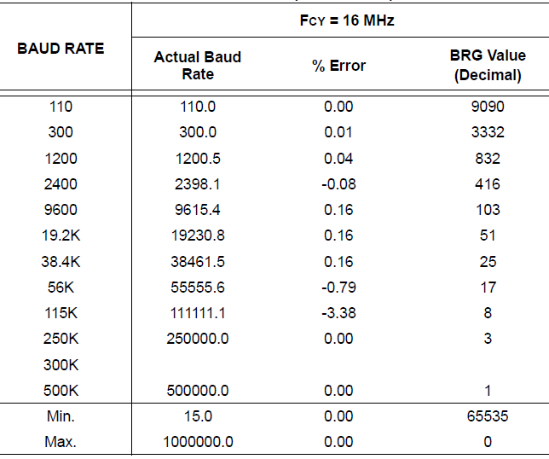
Baud Rate Table

Slide 16
Baud Rate Error Calculation
Error = (Calculated Baud Rate – Desired Baud Rate) / Desired Baud Rate

Slide 17
UART Configuration
One Start bit + eight or nine data bits + one or two Stop bits.
Most Common Format (default setting): One Start bit + 8 Data bits (no parity) + one Stop bit.

Slide 18
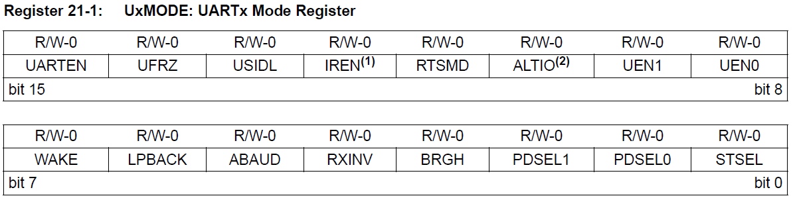
UART Control Register (UxMODE)
PDSEL<1:0> - Number of data bits.
11 = 9-bit data, no parity
10 = 8-bit data, even parity
01 = 8-bit data, odd parity
00 = 8-bit data, no parity
STSEL - Number of Stop bits.
1 = 2 Stop bits
0 = 1 Stop bit.
UARTEN – Enable/Disable UART
1 = Enable
0 = Disable

Slide 19
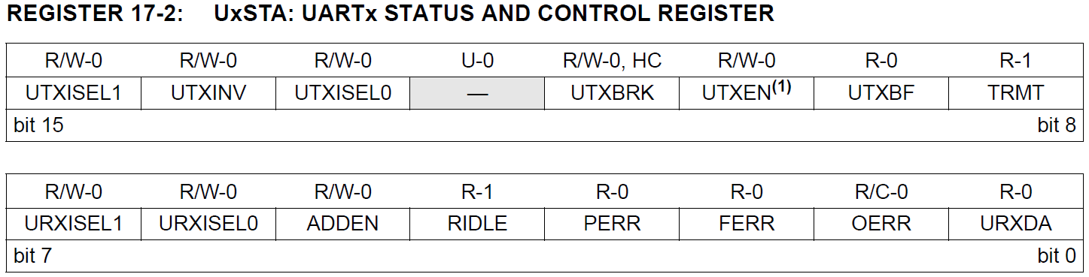
UART Status and Control Register (UxSTA)
UAXEN – Transmit Enable/Disable bit
1 = Transmit Enable
0 = Transmit Disable

Slide 20
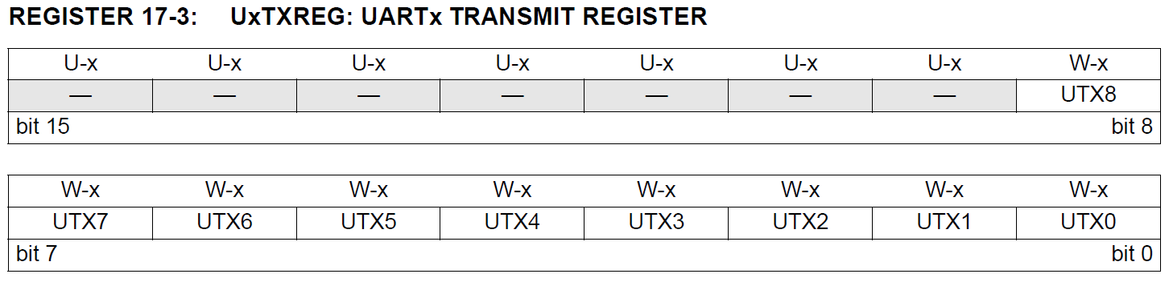
UART Transmit Register (UxTXREG)

Slide 21
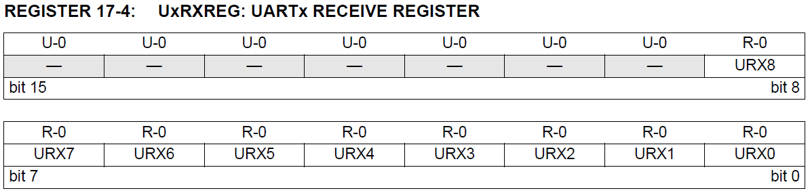
UART Receive Register (UxRXREG)

