Slide 1
EE 2361: Introduction to Microcontrollers
Peng Li
lipeng@umn.edu
07/17/2015

Slide 2
Topics
UART

Slide 3
UART Configuration
One Start bit + eight or nine data bits + one or two Stop bits.
Most Common Format (default setting): One Start bit + 8 Data bits (no parity) + one Stop bit.

Slide 4
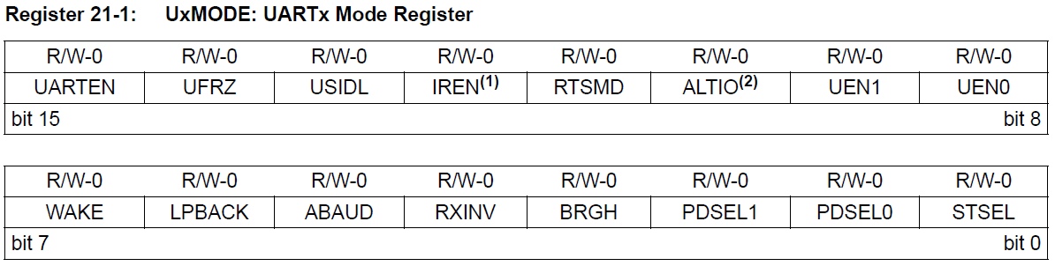
UART Control Register (UxMODE)
PDSEL<1:0> - Number of data bits.
11 = 9-bit data, no parity
10 = 8-bit data, even parity
01 = 8-bit data, odd parity
00 = 8-bit data, no parity
STSEL - Number of Stop bits.
1 = 2 Stop bits
0 = 1 Stop bit.
UARTEN – Enable/Disable UART
1 = Enable
0 = Disable

Slide 5
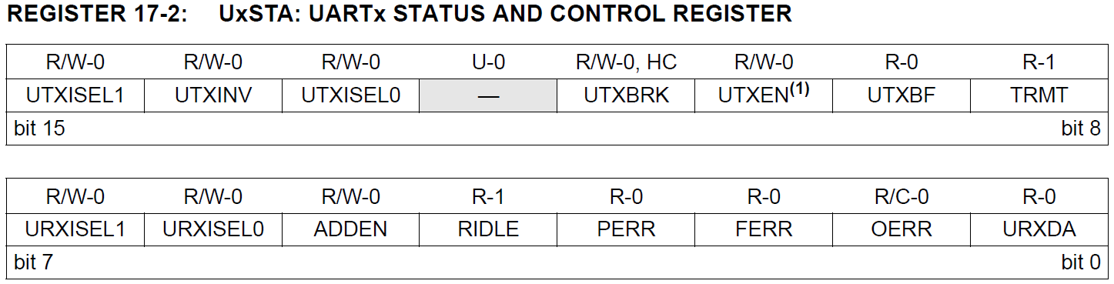
UART Status and Control Register (UxSTA)
UAXEN – Transmit Enable/Disable bit
1 = Transmit Enable
0 = Transmit Disable

Slide 6
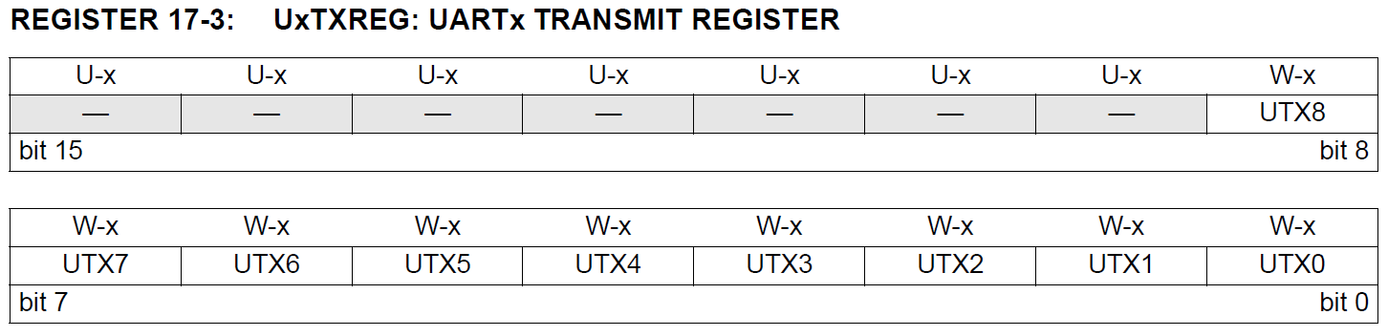
UART Transmit Register (UxTXREG)

Slide 7
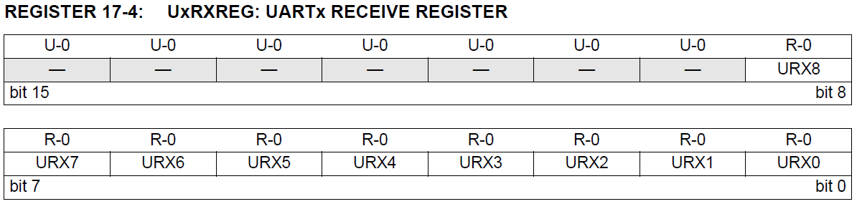
UART Receive Register (UxRXREG)

Slide 8
UART Interrupt
UART | Flag | Enable | Pirority
UART 1 Receiver | IFS0<11> | IEC0<11> | IPC2<14:12>
UART 1 Transmitter | IFS0<12> | IEC0<12> | IPC3<2:0>
UART 2 Receiver | IFS1<14> | IEC1<14> | IPC7<10:8>
UART 2 Transmitter | IFS0<15> | IEC1<15> | IPC7<14:12>

Slide 9
Transmitting in 8-bit Data Mode
1. Set up the UART:
a) Write appropriate values for data, parity and Stop bits. (UxMODE: PDSEL<1:0>, STSEL)
b) Write appropriate baud rate value to the UxBRG register.
c) Set up transmit interrupt enable and priority bits.
2. Enable the UART. (UxMODE: UARTEN )
3. Set the UTXEN bit (UxSTA: UTXEN).
4. Write data byte to lower byte of UxTXREG word. The serial bit stream will start shifting out with next rising edge of the baud clock.
5. An interrupt flag will be set when the transfer starts. (Ready to transfer the next character.)

Slide 10
Receiving in 8-bit Data Mode
1. Set up the UART:
a) Write appropriate values for data, parity and Stop bits. (UxMODE: PDSEL<1:0>, STSEL)
b) Write appropriate baud rate value to the UxBRG register.
c) Set up receive interrupt enable and priority bits.
2. Enable the UART. (UxMODE: UARTEN )
3. A receive interrupt will be generated when one or more data characters have been received.
4. Read UxRXREG.

Slide 11
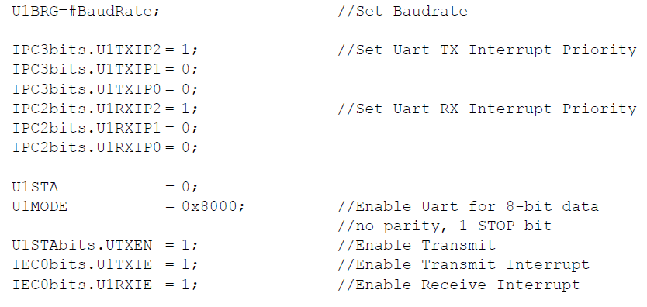
UART Transmit/Receive Initialization Coding Example

Slide 12
UART PIN Configuration
UART Pin | Register | Configuration Bits | Direction
U1RX | RPINR18 | U1RXR<4:0> | Input
U2RX | RPINR19 | U2RXR<4:0> | Input
U1TX | RPOR1 | RP3R<4:0> | Output
U2TX | RPOR2 | RP5R<4:0> | Output

Slide 13
UART PIN Configuration
PPSUnLock;
PPSInput(PPS_U1RX, PPS_RP6);
PPSOutput(PPS_RP3, PPS_U1TX);
PPSLock;

Slide 14
UART Coding Example
Using MPLAB to emulate UART input & output.
Output --- Project Properties -> Simulator -> in front of "option categories", choose UART IO and enable UART IO.
Input --- Stimulus -> Register Injection -> UxRXREG -> Message in Trigger -> Select the data file in Data Filename -> Select Pkt in Format -> Prepare the data file in your favorite editor.

Slide 15
UART Input File Example
wait 100 ms
41
wait 10 ms
43
wait 20 ms
3c
wait 200 ms
"This is a message put in via a message file and echoed to the UART output tab.“
wait 1 ms
0D 0A
"Remember, no matter where you go, there you are.“
You can enter either data or strings.
Note that Data is in HEX format.
wait statement controls the delay.

Slide 16
UART Coding Example (uart_pic24.c)
Write and simulate a program which uses the UART to receive and echo characters (8-bit only) at 38400 baud.
Use polled I/O for output and use interrupts for input.
Use RB3/RP3 for Tx and RB7/RP7 for Rx.
For the input, use a 64-byte receive buffer configured as a circular buffer.
Assume no flow-control.

