Slide 1
Chapter 12: Analog-to-Digital Converter
The PIC18 Microcontroller
Han-Way Huang
Minnesota State University, Mankato
June 2004
Modified by Kia Bazargan @ Univ of Minnesota
Copyright @ 2005 Delmar Thompson

Slide 2
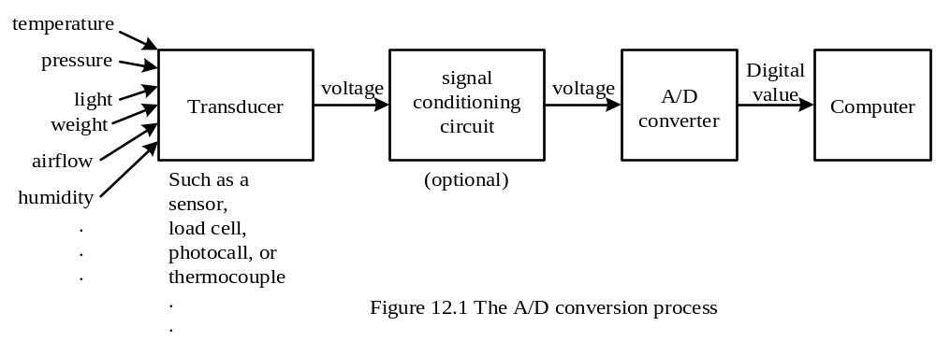
Basics of A/D Conversion
Can convert only electrical voltages to digital values
A transducer is needed to convert a non-electric quantity into an electrical voltage
Different names of transducers are used for different physical quantities
A data acquisition system is used to referred to those systems that perform A/D conversions.
Copyright @ 2005 Delmar Thompson

Slide 3
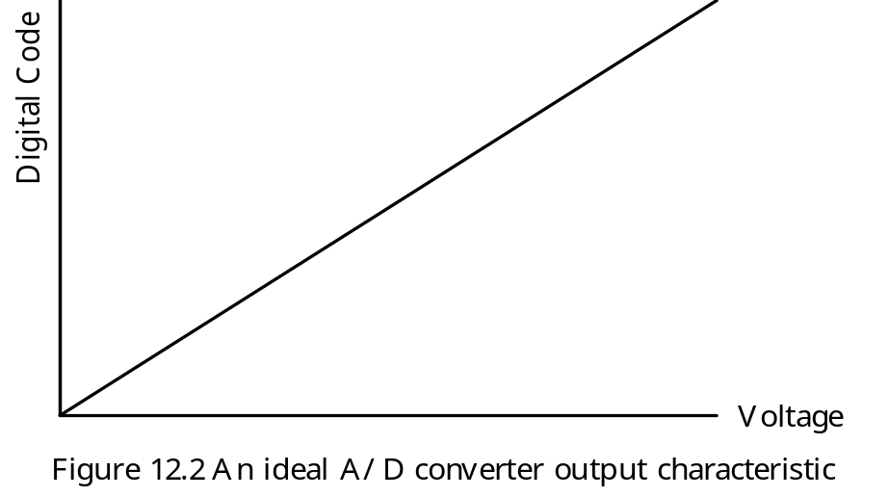
Analog Voltage and Digital Code Characteristic
1. Characteristic of an Ideal A/D Converter
- Needs infinite number of bits to encode the A/D conversion result
- Unachievable and impractical
Copyright @ 2005 Delmar Thompson

Slide 4
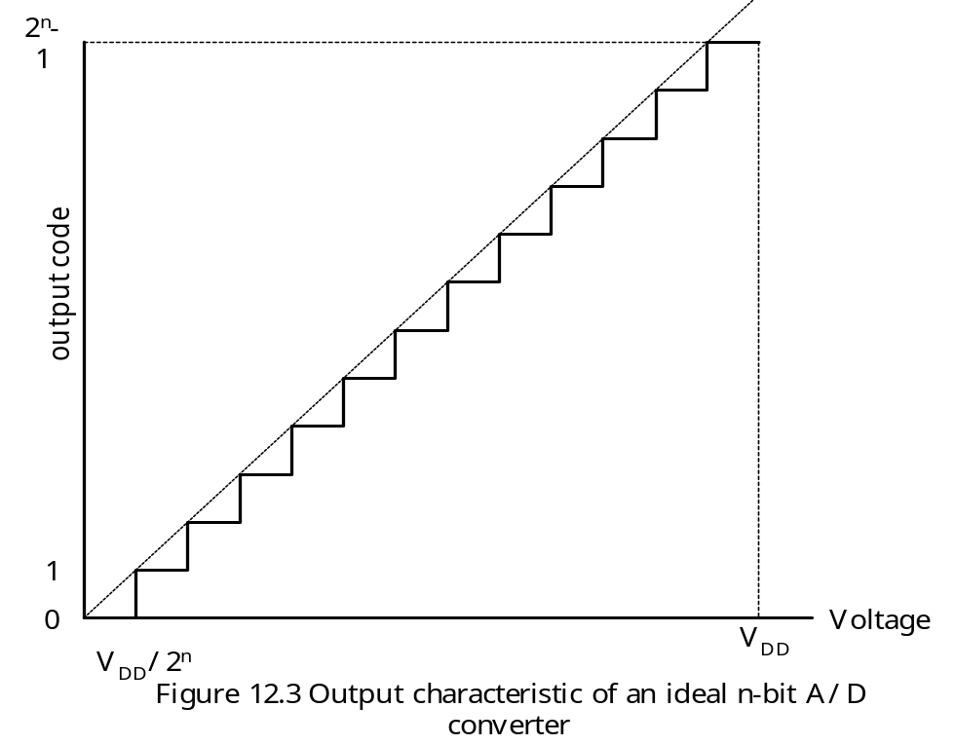
Characteristic of an Ideal n-bit A/D Converter
The area between dotted line and staircase is called the quantization error.
The resolution of this A/D converter is V_{DD}/2^{n}.
Average conversion error is V_{DD}/2^{n+1}.
A real A/D converter has nonlinearity.
Copyright @ 2005 Delmar Thompson

Slide 5
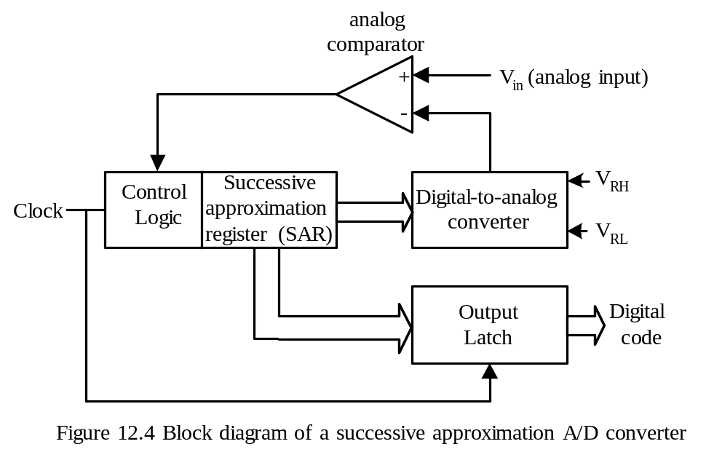
A/D Conversion Algorithms
Parallel (Flash) A/D converter
Slope and double-slope A/D converter
Sigma-Delta A/D converter
Successive Approximation A/D converter
Successive Approximation A/D Conversion Method
- Most commonly used A/D conversion method for 8-bit and 16-bit microcontrollers.
Copyright @ 2005 Delmar Thompson

Slide 6
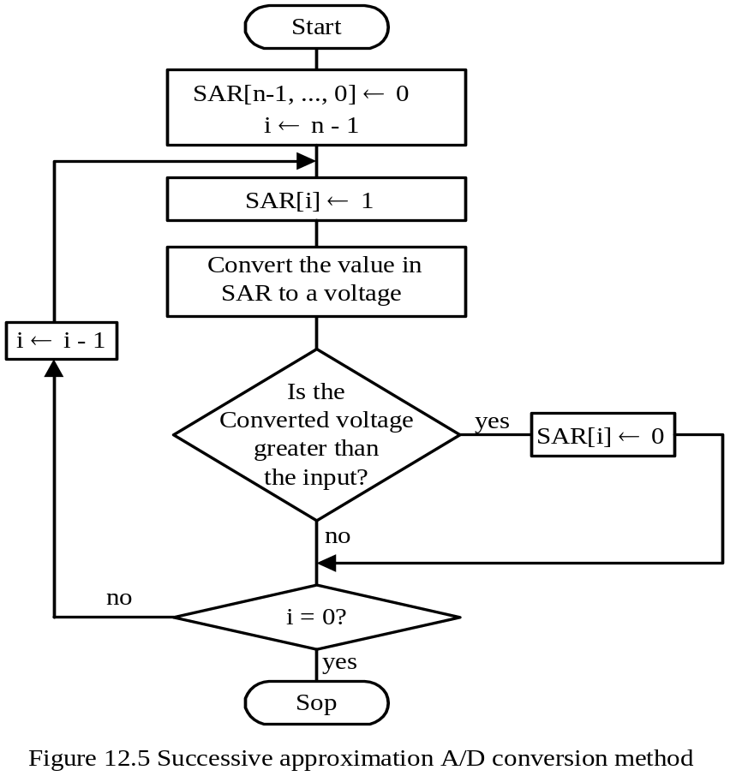
Successive Approximation Method
Copyright @ 2005 Delmar Thompson

Slide 7
Optimal Voltage Range for A/D Conversion
A/D converter requires a low reference voltage (V_{REF-}) and a high reference voltage (V_{REF+}) to perform conversion.
Most A/D converters are ratiomertic:
1. An analog input of V_{REF-} is converted to digital code 0.
2. An analog input of V_{REF+} is converted to digital code 2^{n} – 1.
3. An analog input of k V is converted to digital code
(2^{n} – 1) × (k - V_{REF-}) ÷ (V_{REF+} - V_{REF-})
- The A/D conversion result k corresponds to the following analog input:
V_{K} = V_{REF-} + (V_{REF+} - V_{REF-}) × k ÷ (2^{n} – 1)
Most systems use V_{DD} and 0V as V_{REF+} and V_{REF-}, respectively.
The output of a transducer should be scaled and shifted to the range of 0V ~ V_{DD} in order to achieve the best accuracy
Copyright @ 2005 Delmar Thompson

Slide 8
Example 12.1 Suppose that there is a 10-bit A/D converter with V_{REF-} = 1 V and V_{REF+} = 4V. Find the corresponding voltage values for the A/D conversion results of 25, 80, 240, 500, 720, 800, and 900.
Copyright @ 2005 Delmar Thompson

Slide 9
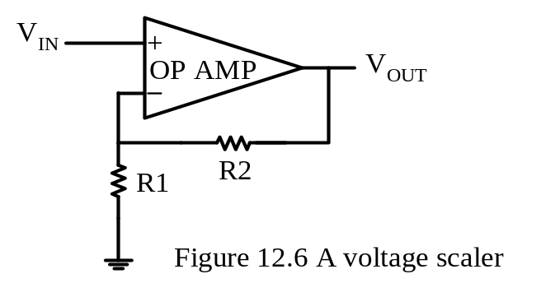
Scaling Circuit
Used to amplify the transducer output from a range of 0V ~ V_{Z} to 0 ~ V_{DD}.
Usually V_{Z} is smaller than V_{DD}.
Voltage gain of the circuit in Figure 12.6 is
A_{V} = V_{OUT} ÷ V_{IN} = (R₁ + R₂) ÷ R₁ = 1 + R₂/R₁ (12.2)
- Both R₁ and R₂ must be commercially available resistors.
Copyright @ 2005 Delmar Thompson

Slide 10
Scaling Circuit
A_{V} = V_{OUT} ÷ V_{IN} = (R₁ + R₂) ÷ R₁ = 1 + R₂/R₁
Example 12.2 Suppose the transducer output voltage ranges from 0V to 200 mV. Choose the appropriate values for R1 and R2 to scale this range to 0~5V.
Solution:
R2/R1 = (V_{OUT} /V_{IN}) – 1 = 24
Choose 240 KΩ for R₂ and 10 KΩ for R₁.
Copyright @ 2005 Delmar Thompson

Slide 11
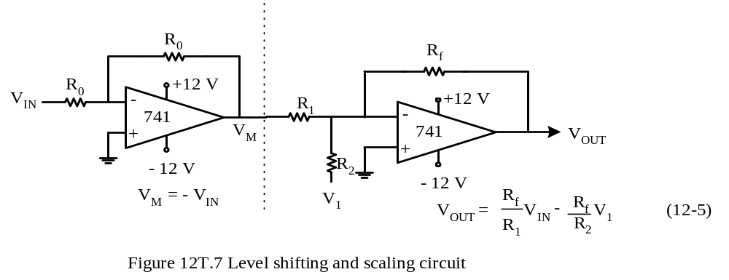
Summing circuit (Fig 12.7-a of the textbook)
V_{IN}
Copyright @ 2005 Delmar Thompson

Slide 12

Inverting voltage follower circuit (Fig 12.7-b of the textbook)
Copyright @ 2005 Delmar Thompson

Slide 13

Voltage Translation Circuit
Needed to shift and scale the transducer output in a range of –V_{X} ~ V_{Z} to 0V ~ V_{DD}.
Copyright @ 2005 Delmar Thompson

Slide 14

Example 12.3 Choose appropriate resistor values and the adjusting voltage so that the circuit shown in Figure 12.7c can shift the voltage from the range of –1.2V ~ 3.0V to the range of 0V ~ 5V.
Solution: Applying Equation 12.5:
0 = -1.2 × (Rf/R1) – (Rf/R2) × V1
5 = 3.0 × (Rf/R1) – (Rf/R2) × V1
Copyright @ 2005 Delmar Thompson

