Slide 1
EE 2361: Introduction to Microcontrollers
Peng Li
lipeng@umn.edu
07/27/2015

Slide 2
Topics
ADC

Slide 3
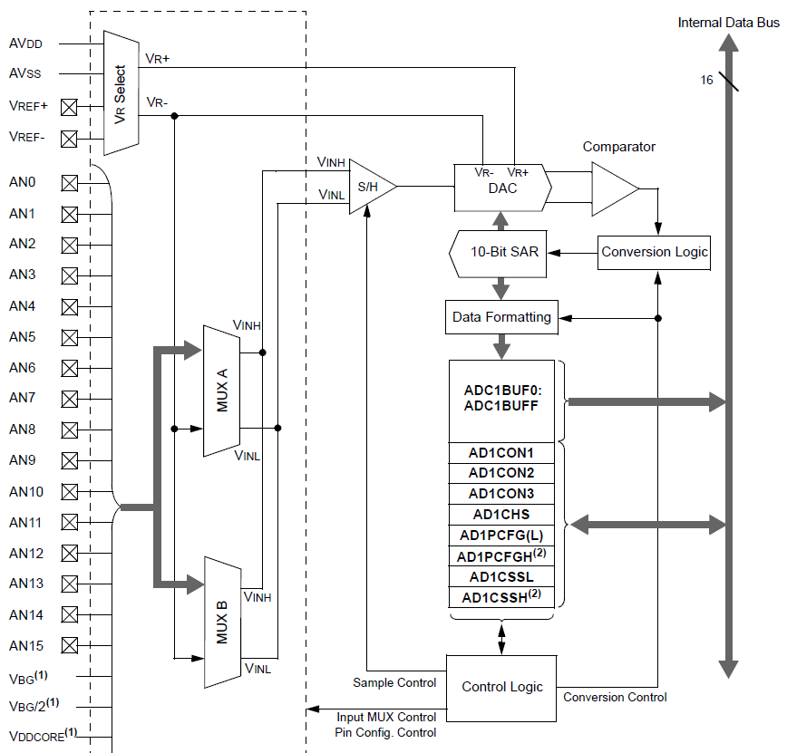
Page 3 of PIC24 ADC datasheet.

Slide 4
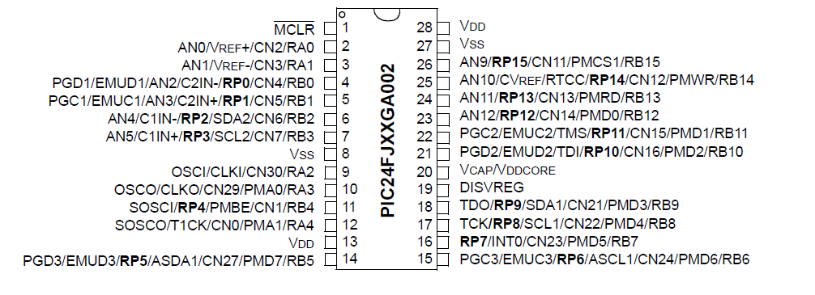
PIC24 Pin Diagram

Slide 5
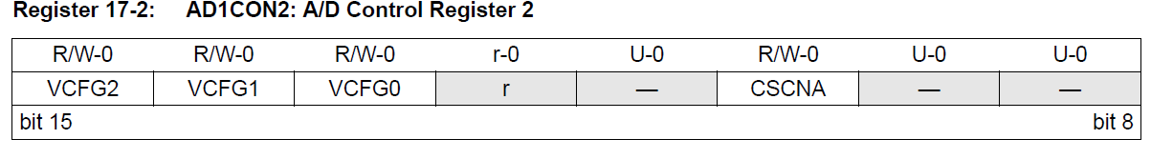
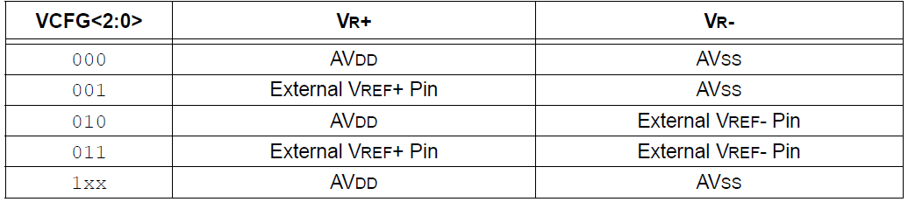
Selecting the Reference Voltage
The voltage references for A/D conversions are selected using the VCFG<2:0> control bits of AD1CON2 register.
The external voltage reference pins are shared with the AN0 and AN1 inputs.
Page 8 of PIC24 ADC datasheet.

