Slide 1
EE 2361: Introduction to Microcontrollers
Peng Li
lipeng@umn.edu
07/29/2015

Slide 2
Topics
ADC

Slide 3
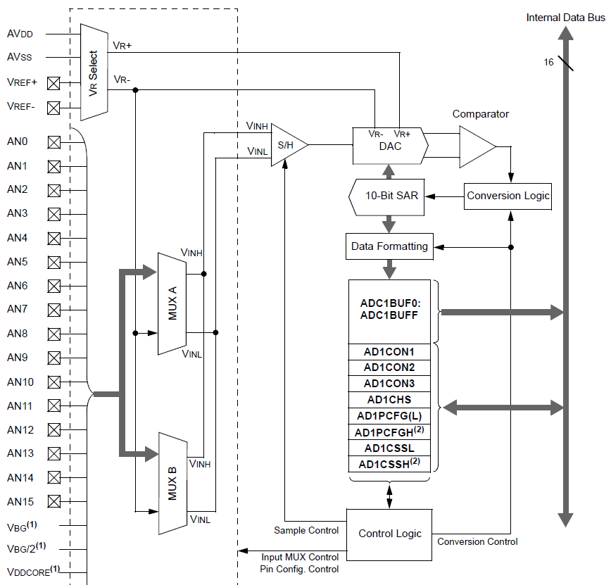
Page 3 of PIC24 ADC datasheet.

Slide 4
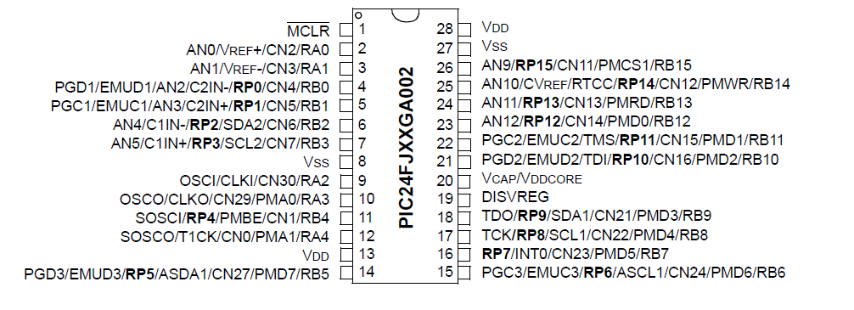
PIC24 Pin Diagram

Slide 5
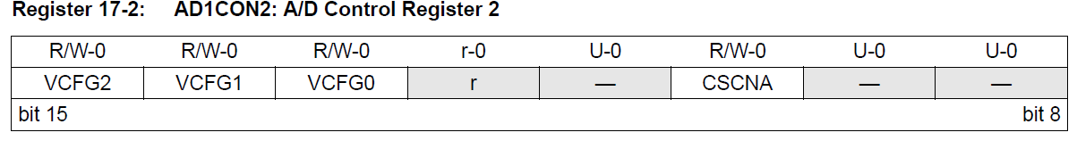
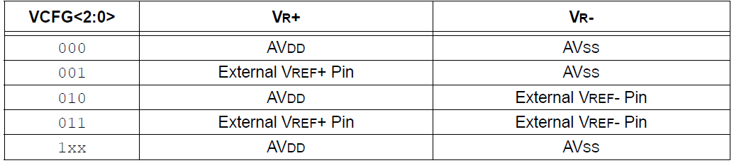
Selecting the Reference Voltage
The voltage references for A/D conversions are selected using the VCFG<2:0> control bits of AD1CON2 register.
The external voltage reference pins are shared with the AN0 and AN1 inputs.
Page 8 of PIC24 ADC datasheet.

Slide 6
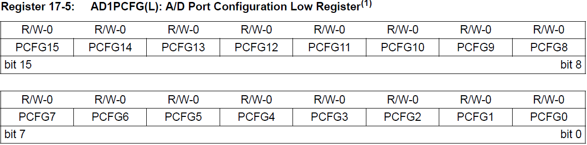
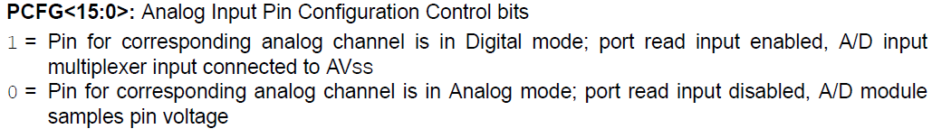
Configuring Analog Port Pins
Examples:
AD1PCFG = 0xFFFB; // AN2 is configured as the analog input.
AD1PCFG = 0xFFF0; // AN0-3 are configured as the analog input.

Slide 7
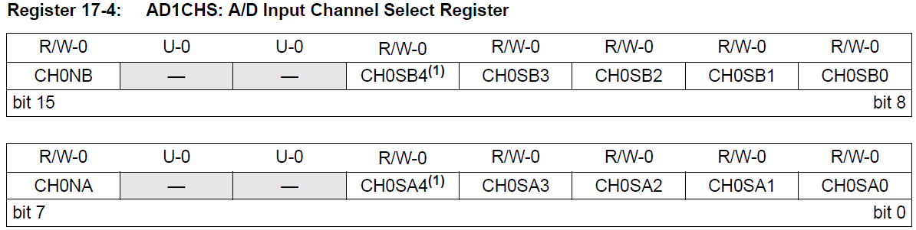

Selecting Analog Channels
Examples:
AD1CHS = 0x0000; // AN0 will be connected to the positive input of S/H amplifier; V_{R-} will be connected to the negative input of S/H amplifier.
AD1CHS = 0x0085; // AN5 will be connected to the positive input of S/H amplifier; AN1 will be connected to the positive input of S/H amplifier.
Page 10 of PIC24 ADC datasheet.

Slide 8
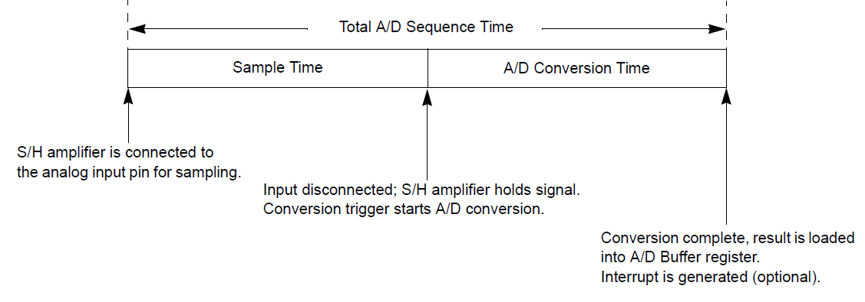
A/D Sample/Convert Sequence
Sample time is the time that the A/D module’s S/H amplifier is connected to the analog input pin.
Conversion time is the time required for the A/D Converter to convert the voltage held by the S/H amplifier.
An A/D conversion requires one A/D clock cycle (T_{AD}) to convert each bit of the result, plus two additional clock cycles, or a total of 12 T_{AD} cycles for a 10-bit conversion.

Slide 9
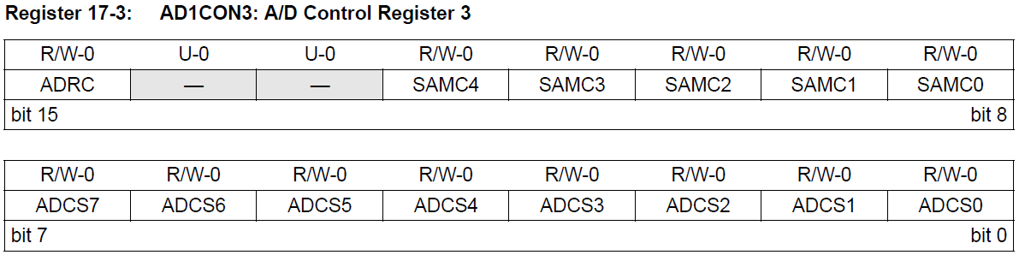
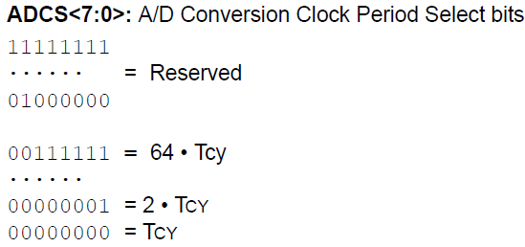
Selecting the A/D Conversion Clock
The period of the A/D conversion clock is software selected using a 6-bit counter (64 possible options), specified by the ADCS bits in the AD1CON3 register.
Page 9 of PIC24 ADC datasheet.

Slide 10
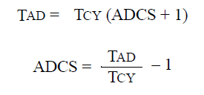
A/D Conversion Clock Period
For correct A/D conversions, the A/D conversion clock (T_{AD}) must be selected to ensure a minimum T_{AD} time of 75 ns.

Slide 11
Controller the Sampling Process
Manual Sampling
Automatic Sampling

Slide 12
Controller the Sampling Process
Manual Sampling:
Clear ASAM bit (AD1CON1<2>)
Setting SAMP bit (AD1CON1<1>) causes the A/D begin sampling.
Clearing the SAMP bit ends sampling and automatically begins the conversion. Make sure a sufficient delay between setting and clearing SAMP (2 or 3 T_{AD}).
Sampling will not resume until the SAMP bit is once again set.

Slide 13
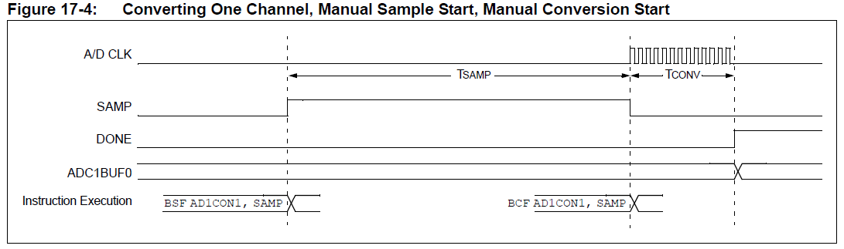
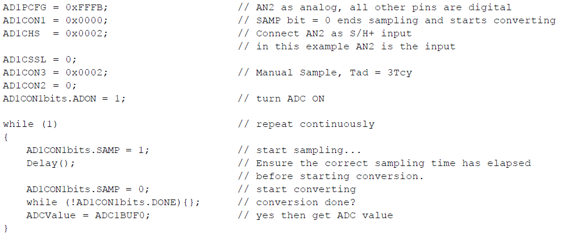
Controller the Sampling Process
Page 18 of PIC24 ADC datasheet.

Slide 14
Controller the Sampling Process
Automatic Sampling: set ASAM bit (AD1CON1<2>). This will cause the A/D to automatically begin sampling after a conversion has been completed.
Page 18 of PIC24 ADC datasheet.

Slide 15
Monitoring Sample Status
The SAMP bit indicates the sampling state of the A/D. Generally, when the SAMP bit clears, indicating the end of sampling, the DONE bit is automatically cleared to indicate the start of conversion.
If SAM is ‘0’ while DONE is ‘1’, the A/D is in an inactive state.

Slide 16
Monitoring Sample Status
Page 7 of PIC24 ADC datasheet.

Slide 17
Aborting a Sample
It only works in Manual Sampling Mode.
Clearing SAMP bit will terminate sampling.

Slide 18
Controlling the Conversion Process
When to trigger the conversion: SSRC<2:0> bits (AD1CON1<7:5>) select the source of the conversion trigger.
Manual Control (SSRC<2:0> = 0b000)
Clocked Conversion Trigger (SSRC<2:0> = 0b111)
INT0 (SSRC<2:0> = 0b001)
32-bit Timer ((SSRC<2:0> = 0b010))

Slide 19
Controlling the Conversion Process – Manual Control
SSRC<2:0> = 000
In this configuration, clearing the SAMP bit (AD1CON1<1>) starts the conversion sequence.
The user’s program must time the setting and clearing of the SAMP bit to ensure adequate sampling time of the input signal (2 or 3 T_{AD}).
Examples, Fig 17-4 & 5.

Slide 20
Controlling the Conversion Process – Clocked Conversion Trigger
SSRC<2:0> = 111
The SAMC bits (AD1CON3<12:8>) select the number of T_{AD} clock cycles between the start of sampling and the start of conversion.
The SAMC bits must always be programmed for at least 1 clock cycle.

Slide 21
Controlling the Conversion Process – Clocked Conversion Trigger

Slide 22
Controlling the Conversion Process – Clocked Conversion Trigger

Slide 23
Controlling the Conversion Process – Free-Running Sample Conversion Sequence
Clocked Conversion Trigger + Auto-Sample Start Mode
ASAM = 1
SSRC<2:0> = 111
The SAMC bits (AD1CON3<12:8>) select the number of T_{AD} clock cycles between the start of sampling and the start of conversion.
The SAMC bits must always be programmed for at least 1 clock cycle.

Slide 24
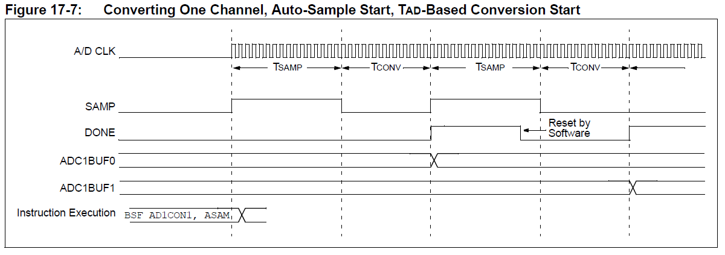
Controlling the Conversion Process – Free-Running Sample Conversion Sequence

Slide 25
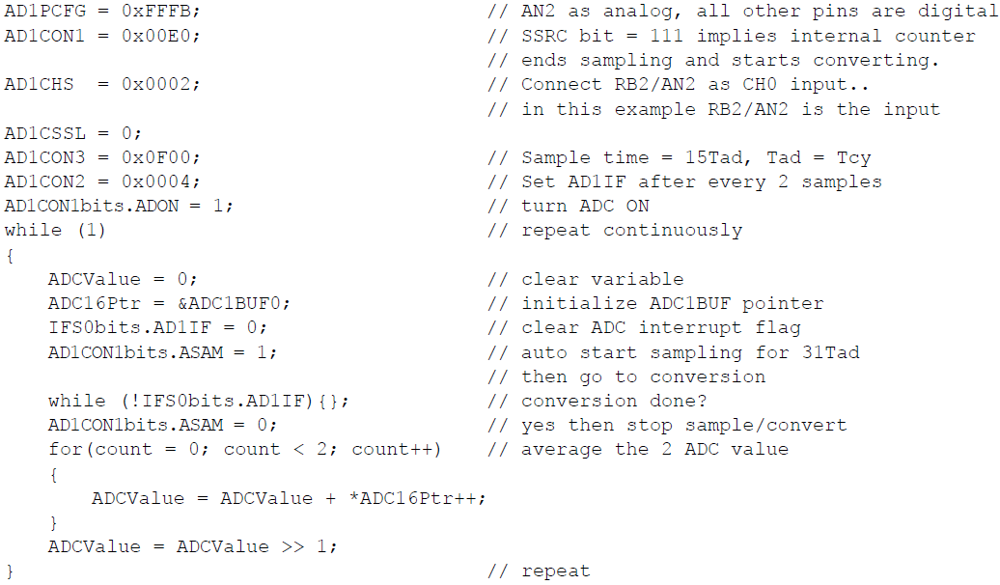
Controlling the Conversion Process – Free-Running Sample Conversion Sequence

Slide 26
Controlling the Conversion Process – Event Trigger Conversion Start
External Interrupt INT0 Trigger
32-bit Timer Trigger (timer 2 & 3)
We won’t cover these in class. Details can be found in Section 17.7.3 of PIC24 DAC datasheet.

Slide 27
Aborting a Conversion
Clearing the ADON bit during a conversion will abort the current conversion.
The A/D results buffer will not be updated with the partially completed A/D conversion sample.

Slide 28
Monitoring Sample/Conversion Status
When the SAMP bit clears (the end of sampling), the DONE bit is automatically cleared to indicate the start of conversion.
If SAMP is ‘0’ while DONE is ‘1’, the A/D is in an inactive state.

Slide 29
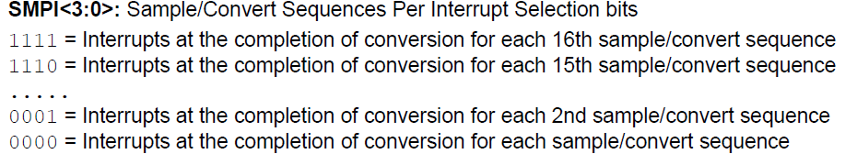
Generating A/D interrupts
The SMPI<3:0> bits (AD1CON2<5:2>) control the generation of the ADIF interrupt flag.

Slide 30
A/D Results Buffer
The results buffer is a RAM array of sixteen words.
ADC1BUF0
ADC2BUF1
…
ADC2BUEF
ADC2BUFF

Slide 31
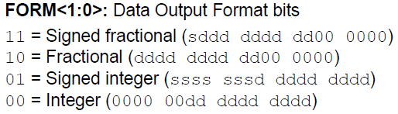
A/D Buffer Data Format
The results of each A/D conversion are 10 bits wide.
The FORM<1:0> bits (AD1CON1<9:8>) select the format.

Slide 32
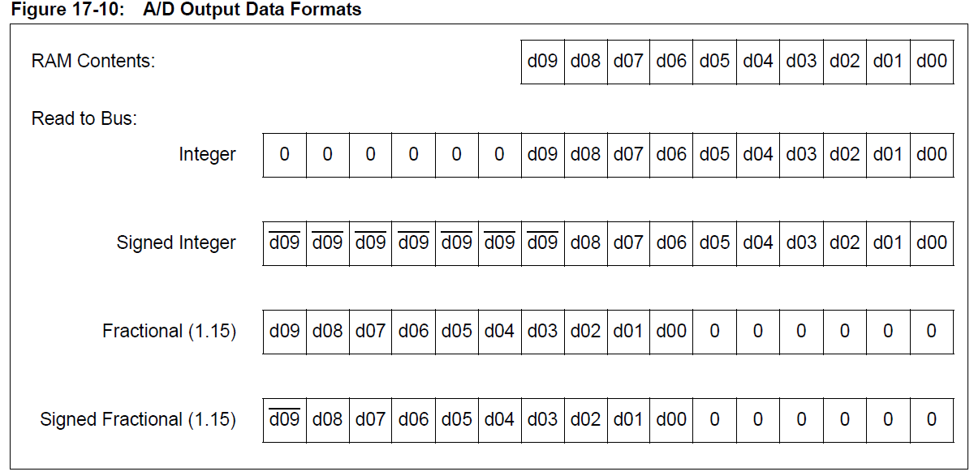
A/D Buffer Data Format

Slide 33
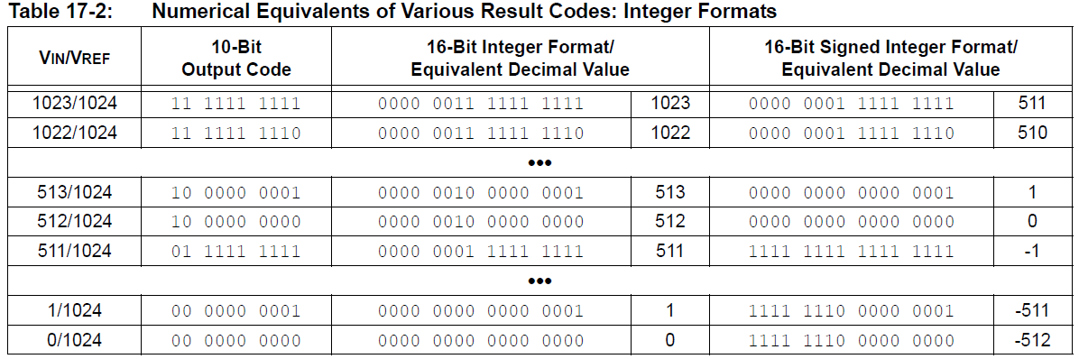
A/D Buffer Data Format
FORM = 0b00
FORM = 0b01

Slide 34
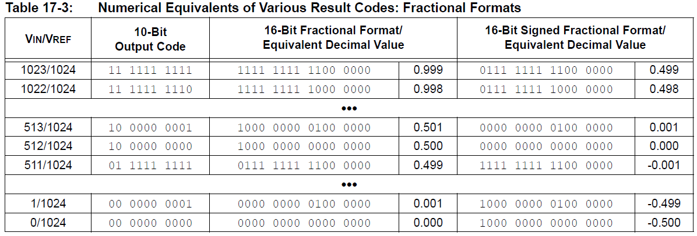
A/D Buffer Data Format
FORM = 0b10
FORM = 0b11

Slide 35
Example
Sampling and converting a single channel multiple times.
One A/D input – AN0.
Results are stored in the ADC1BUF buffer.
This process repeats 16 times until the buffer is full and then the module generates an interrupt.
The entire process will then repeat.

Slide 36
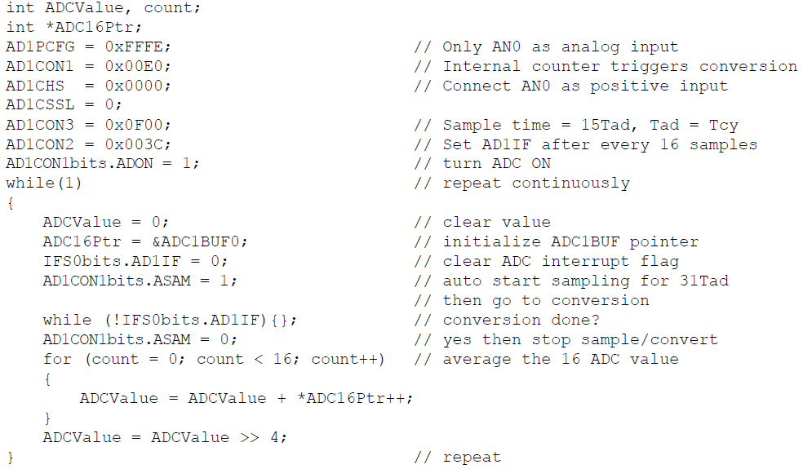

Slide 37
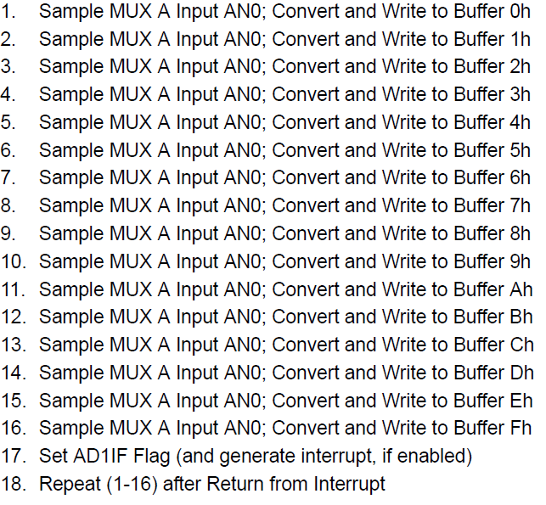
Operational Sequence

Slide 38
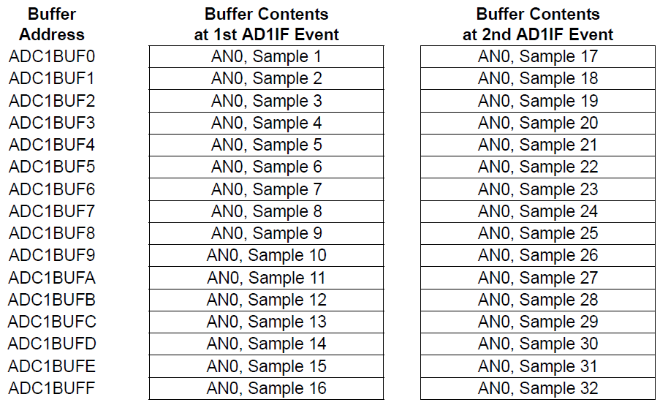
Results Stored in Buffer

Slide 39
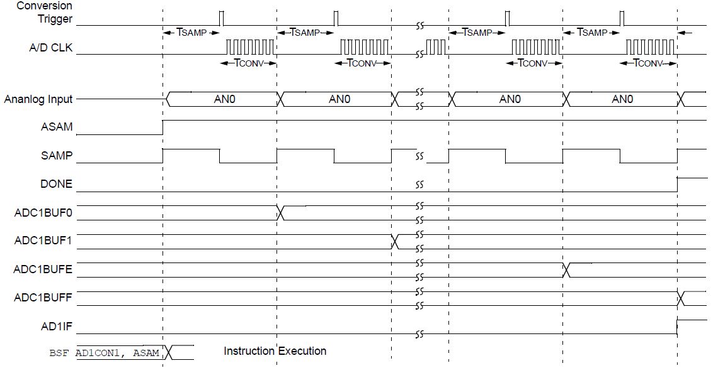
Timing Diagram

Slide 40
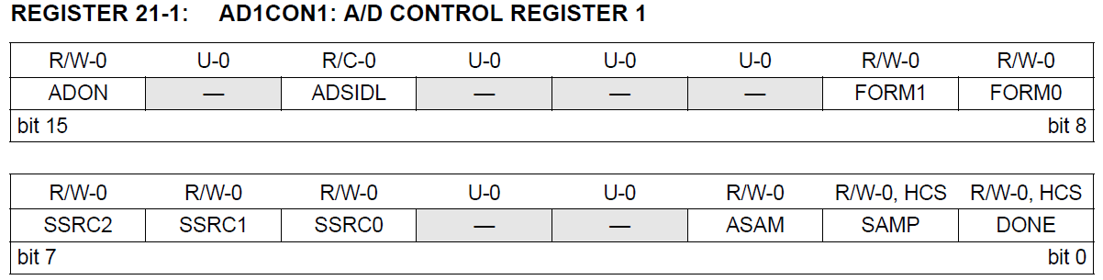

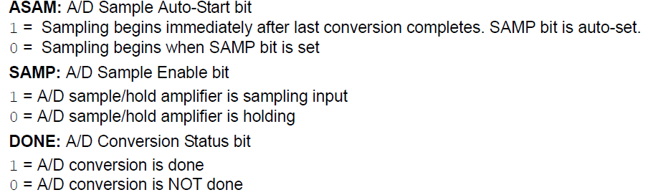
AD1CON1

