Slide 1
EE 2361: Introduction to Microcontrollers
Peng Li
lipeng@umn.edu
07/31/2015

Slide 2
Topics
ADC

Slide 3
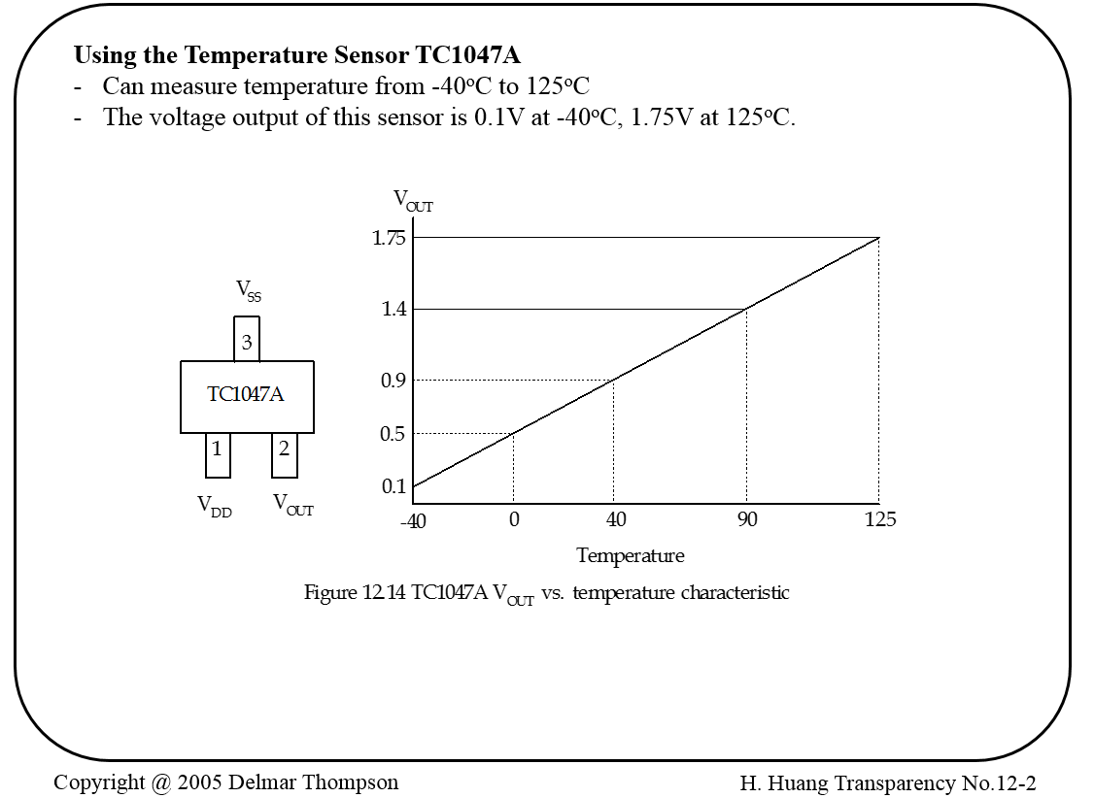

Slide 4
Exercise
1. Describe a circuit connection (including the signal conditioning circuit) to shift and scale the output of the TC1047A to 0~3.3V. (We will use AN0)

Slide 5
Exercise
2. How to interoperate the ADC results? For example, if the data in the ADC1BUF0 is “0x03FF”, the temperature will be 125ºC. If the data in the ADC1BUF0 is “0x0000”, the temperature will be -40ºC.

Slide 6
Exercise
3. We want to update the measurement results ten times per second. Each result is an average 16 samples. If the instruction clock cycle is 16MHz, setup the T_{AD} to the fastest speed with the limitation T_{AD} < 75ns. T_{SAMP} = 3T_{AD} .

Slide 7
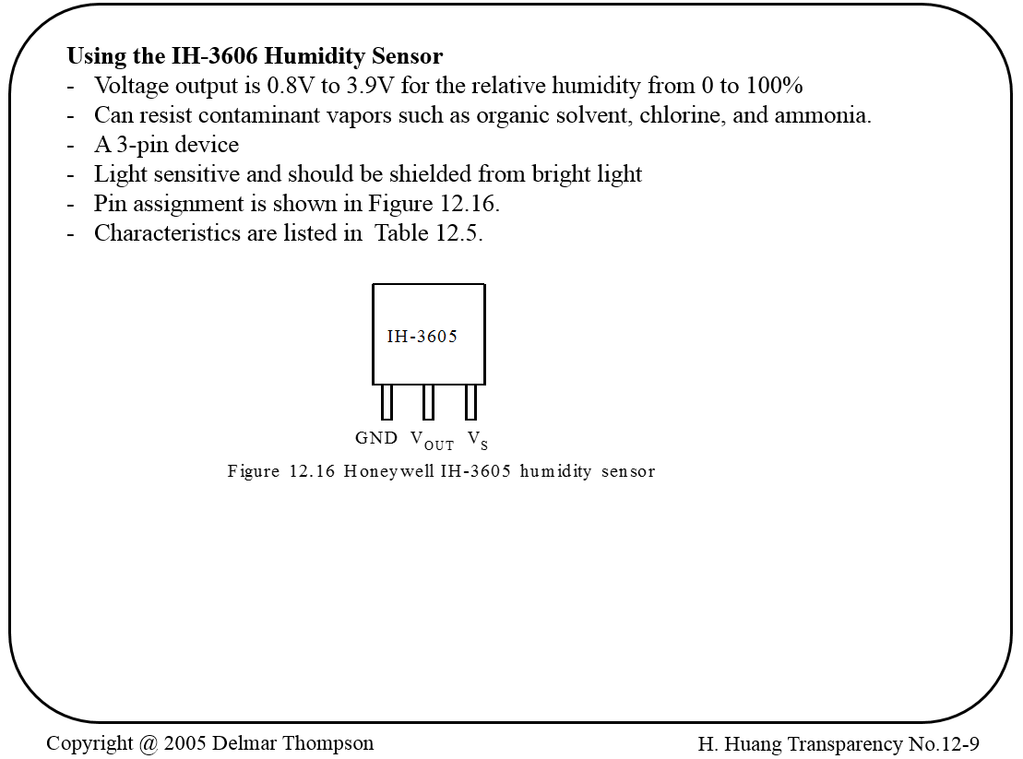

Slide 8
Exercises
1. Describe a circuit connection (including the signal conditioning circuit) to shift and scale the output of the IH-3605 to 0~3.3V. (We will use AN0)
2. How to interoperate the ADC results? For example, if the data in the ADC1BUF0 is “0x03FF”, the humidity will be 100%. If the data in the ADC1BUF0 is “0x0000”, the humidity will be 0%.
3. We want to update the measurement results ten times per second. Each result is an average 16 samples. If the instruction clock cycle is 16MHz, setup the T_{AD} to the fastest speed with the limitation T_{AD} < 75ns. T_{SAMP} = 3T_{AD} .

Slide 9
MPLAB Example
Pic24_adc_OneChannel.c
To simulate ADC, right click on the project name in the Projects window, select Properties, Simulator, in front of Option Categories, choose ADC, and enable ADC1. SIMULATE timing. Play around with ADCS to see if the simulator responds to different values of TAD.
To provide input to ADC1BUF0, do the following: Window > Simulator > Stimulus Click on the Register Injection tab, under Reg/Var select ADC1BUF0, under Trigger choose Demand, and under Data Filename choose a simple text file (that you create outside mplab), which contains a line of text with these values: 23 9F 123 245. Under Register Injection / Wrap select Yes (to wrap-around the input file when it reaches the end), and under Format choose Hex.

Slide 10
ADC Multiple Channel
Pic24_adc_FourChannels.c
Set up the ADC for manual sampling trigger of multiple signals (AN0 - AN3). Measure (using the simulator) the actual time the ADC takes to do a conversion.

