Slide 1
Chapter 4: Differential Amplifiers
4.1 Single-Ended and Differential Operation
4.2 Basic Differential Pair
4.3 Common-Mode Response
4.4 Differential Pair with MOS Loads
4.5 Gilbert Cell

Slide 2
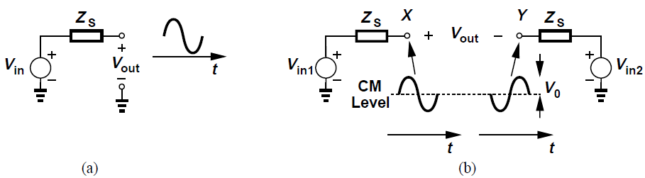
Single-Ended and Differential Operation
A “single-ended” signal is one that is measured with respect to a fixed potential, usually the ground [Fig. (a)]
A differential signal is one that is measured between two nodes that have equal and opposite signal excursions around a fixed potential [Fig. (b)]
The “center” potential in differential signaling is called the “common-mode” (CM) level
bias value of the voltages, i.e., value in the absence of signals

Slide 3
Single-Ended and Differential Operation
Suppose each single-ended output in Fig. (b) has a peak amplitude of V₀
Then single-ended peak-to-peak swing is 2V₀ and differential peak-to-peak swing is 4V₀
For example, if voltage at X (w.r.t. ground) is V₀cosωt + V_{CM} and that at Y is -V₀cosωt + V_{CM}, then the peak-to-peak swing of V_{X} - V_{Y} is 4V₀

Slide 4
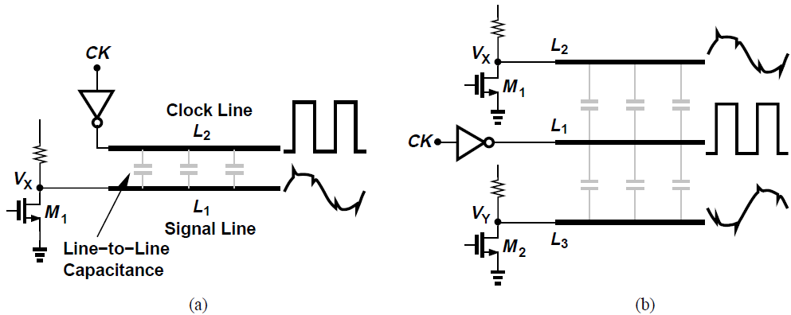
Advantages of Differential Operation
Higher immunity to “environmental” noise in differential operation as compared to single-ended signaling
In Fig. (a), transitions on the clock line L₂ corrupt the signal on sensitive signal line L₁ due to capacitive coupling between the lines
If the sensitive signal is distributed as two equal and opposite phases as in Fig. (b), the clock line placed midway disturbs the differential phases equally and keeps the difference intact, called common-mode (CM) rejection

Slide 5
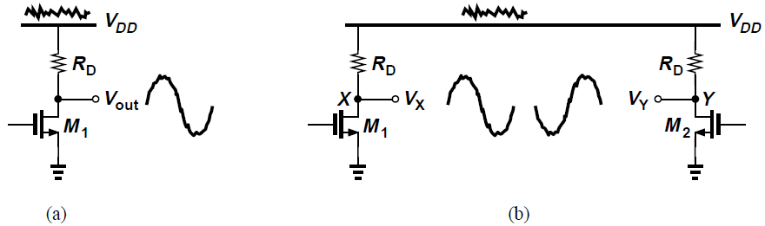
Advantages of Differential Operation
CM rejection also occurs with noisy supply voltages
In the CS stage of Fig. (a), if V_{DD} varies by ΔV, then V_{out} changes by roughly the same amount, i.e., output is susceptible to noise on V_{DD}
In the symmetric circuit of Fig. (b), noise on V_{DD} affects V_{X} and V_{Y}, but not V_{X} – V_{Y} = V_{out}
The differential circuit is more robust to supply noise than its single-ended counterpart

Slide 6
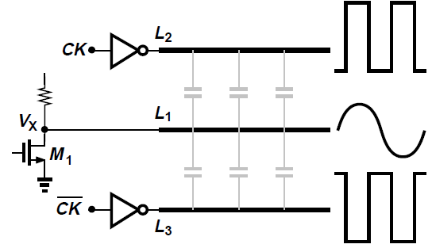
Advantages of Differential Operation
Differential operation is as beneficial for sensitive signals (“victims”) as for noisy lines (“aggressors”)
Clock signal is distributed in differential form on two lines
With perfect symmetry, the components coupled from CK and C̅K to the signal line cancel each other

Slide 7
Advantages of Differential Operation
Differential signaling increases maximum achievable voltage swings
In the above differential circuit, the maximum output swing at X or Y is equal to V_{DD} – (V_{GS} – V_{TH})
For V_{X} – V_{Y}, the maximum swing is 2[V_{DD} – (V_{GS} – V_{TH})]
Other advantages of differential circuits include simpler biasing and higher linearity
Advantages of differential operation outweigh the possible increase in area

Slide 8
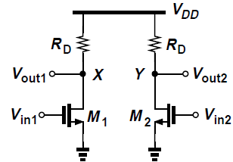
Basic Differential Pair: Introduction
The simple differential circuit shown incorporates two identical single-ended paths to process the two phases
The two differential inputs V_{in1} and V_{in2}, having a certain CM level V_{in,CM} are applied to the gates
The outputs are differential too and swing around the output CM level V_{out,CM}
This circuit offers all advantages of differential signaling: supply noise rejection, higher output swings, etc.

Slide 9
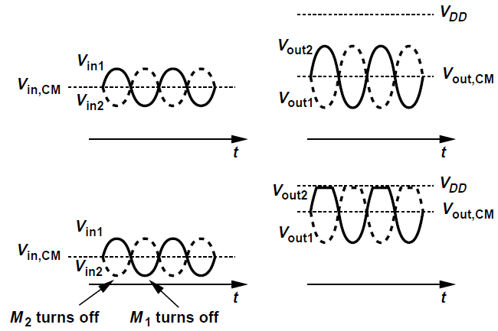
Basic Differential Pair: Introduction
As the input CM level, V_{in,CM} changes, so do the bias currents of M₁ and M₂, thus varying both the transconductance of the devices and the output CM level
As shown in Fig. (b), if the input CM level is excessively low, the minimum values of V_{in1} and V_{in2} may turn off M₁ and M₂, leading to severe clipping at the output
Bias currents of the devices should have minimal dependence on the input CM level

Slide 10
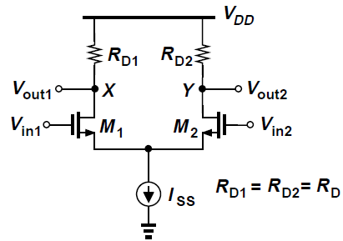
Basic Differential Pair
A “differential pair” incorporates a current source I_{SS} to make I_{D1} + I_{D2} independent of V_{in,CM}
If V_{in1} = V_{in2}, the bias current of both M₁ and M₂ is I_{SS}/2 and the output CM level is V_{DD} – R_{D}I_{SS}/2

Slide 11
Basic Differential Pair: Qualitative Analysis
When V_{in1} is much more negative than V_{in2}, M₁ is off, M₂ is on and I_{D2} = I_{SS}, V_{out1} = V_{DD} and V_{out2}=V_{DD} – R_{D}I_{SS}
As V_{in1} is brought closer to V_{in2}, M₁ gradually turns on, drawing a fraction of I_{SS} from R_{D1} and lowering V_{out1}
Since I_{D1} + I_{D2} = I_{SS}, I_{D2} falls and V_{out2} rises
For V_{in1}=V_{in2}, V_{out1}=V_{out2}=V_{DD} – R_{D}I_{SS}/2, which is the output CM level
When V_{in1} becomes more positive than V_{in2}, I_{D1} becomes higher than I_{D2} and V_{out1} drops below V_{out2}
For sufficiently large V_{in1} – V_{in2}, M₁ “hogs” all of I_{SS}, turning M2 off, therefore, V_{out1} = V_{DD} – R_{D}I_{SS} and V_{out2} = V_{DD}

Slide 12
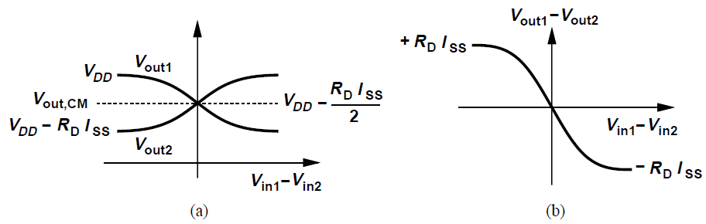
Basic Differential Pair: Qualitative Analysis
The circuit contains three differential quantities: V_{in1} – V_{in2}, V_{out1} – V_{out2}, and I_{D1} – I_{D2}
The maximum and minimum levels at the output are well-defined and independent of the input CM level
The small-signal gain (slope of V_{out1} – V_{out2} versus V_{in1} – V_{in2}) is maximum for V_{in1} = V_{in2} and gradually falls to zero as |V_{in1} – V_{in2}| increases
Circuit becomes more nonlinear as input voltage swing increases
For V_{in1} = V_{in2}, circuit is said to be in “equilibrium”

Slide 13
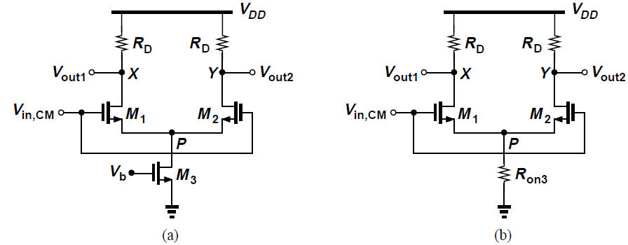
Basic Differential Pair: Common-mode behavior
Tail current source suppresses the effect of input CM level variations on the output level
Set V_{in1} = V_{in2} = V_{in,CM} and vary V_{in,CM} from 0 to V_{DD} [Fig. (a)]
Due to symmetry, V_{out1} = V_{out2}
For V_{in,CM} = 0, M₁ and M₂ are off, I_{D3} = 0 and M₃ operates in the deep triode region [Fig. (b)]
With I_{D1} = I_{D2} = 0, circuit is incapable of signal amplification; V_{out1} = V_{out2} = V_{DD}, and V_{P} = 0

Slide 14
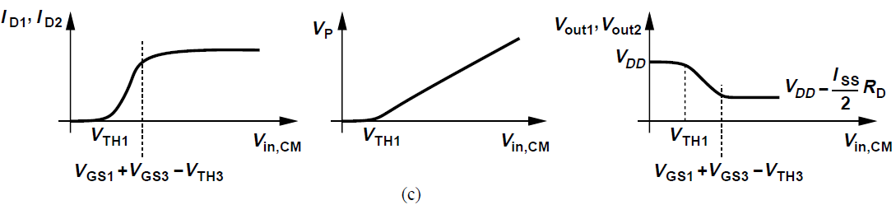
Basic Differential Pair: Common-mode behavior
M₁ and M₂ turn on if V_{in,CM} ≥ V_{TH}
Beyond this point, I_{D1} and I_{D2} continue to increase and V_{P} also rises [Fig. (c)]
M₁ and M₂ act as a source follower, forcing V_{P} to follow V_{in,CM}
When V_{in,CM} is sufficiently high, V_{DS3} exceeds V_{GS3} – V_{TH3}, and M₃ operates in saturation so that I_{D1}+I_{D2} is constant
For proper operation, V_{in,CM} ≥ V_{GS1} + (V_{GS3} – V_{TH3})

Slide 15
Basic Differential Pair: Common-mode behavior
As V_{in,CM} rises further, V_{out1} and V_{out2} stay relatively constant, therefore, M₁ and M₂ enter the triode region if V_{in,CM} > V_{out1} + V_{TH} = V_{DD} – R_{D}I_{SS}/2 + V_{TH}
The allowable value of V_{in,CM} is bounded as follows:
Beyond the upper bound, the CM characteristics of Fig. (c) do not change, but the differential gain drops

Slide 16
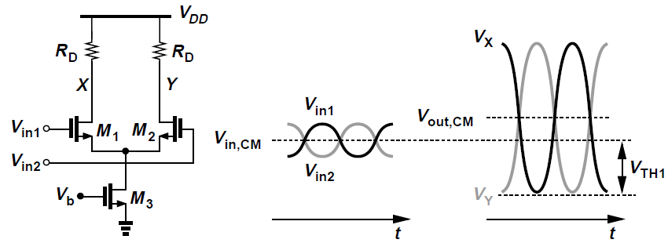
Basic Differential Pair: Output Swings
Suppose the input and output bias levels are V_{in,CM} and V_{out,CM} respectively, and V_{in,CM} < V_{out,CM}
Assume a high voltage gain so that input swing is much lesser than the output swing
For M₁ and M₂ to remain saturated, each output can go as high as V_{DD} and as low as V_{in,CM} – V_{TH}
V_{in,CM} can be no less than V_{GS1} + (V_{GS3} – V_{TH3})
With this choice of V_{in,CM}, single-ended peak-to-peak swing is V_{DD} – (V_{GS1} – V_{TH1}) – (V_{GS3} – V_{TH3})

Slide 17
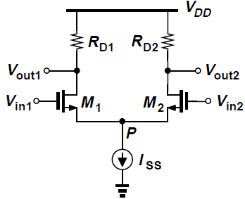


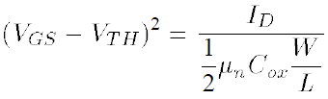
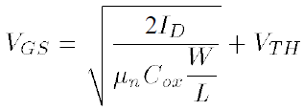
Basic Differential Pair: Large-signal Analysis
Objective is to determine V_{out1} – V_{out2} as a function of V_{in1} – V_{in2}
If R_{D1} = R_{D2} = R_{D}, we have
Assume the circuit is symmetric, M₁ and M₂ are saturated and λ = 0
Since V_{P} = V_{in1} – V_{GS1} = V_{in2} – V_{GS2} , V_{in1} – V_{in2} = V_{GS1} – V_{GS2}
For a square-law device,
Therefore,

Slide 18
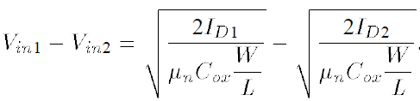


Basic Differential Pair: Large-signal Analysis
It follows from previous derivation that
To find I_{D1} – I_{D2}, square both sides of above eqn., and recognize that I_{D1} + I_{D2} = I_{SS}
Thus,
Squaring both sides and noting that 4I_{D1}I_{D2} = (I_{D1} + I_{D2})² – (I_{D1} – I_{D2})², we arrive at

Slide 19
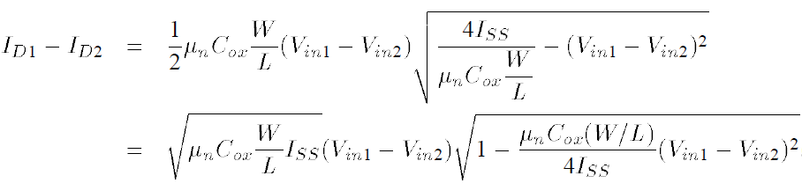
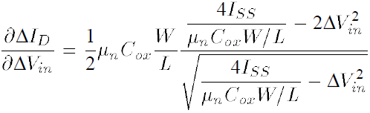
Basic Differential Pair: Large-signal Analysis
Thus
I_{D1} – I_{D2} is an odd function of V_{in1} – V_{in2}, falling to zero for V_{in1} = V_{in2}
As |V_{in1} – V_{in2}| increases from zero, |I_{D1} – I_{D2}| increases
To find the equivalent G_{m} of M₁ and M₂, denote I_{D1} – I_{D2} and V_{in1} – V_{in2} as ΔI_{D} and ΔV_{in} respectively
It can be shown that

Slide 20



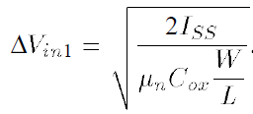
Basic Differential Pair: Large-signal Analysis
For ΔV_{in} = 0, G_{m} is maximum and equal to
Since V_{out1} – V_{out2} = R_{D}ΔI_{D} = -R_{D}G_{m}ΔV_{in} , small-signal differential voltage gain in equilibrium condition is
Since each transistor carries I_{SS}/2 in equilibrium, the factor is the same as g_{m}, i.e., |A_{V}|=g_{m}R_{D}
Previous result suggests that G_{m} falls to zero for
As ΔV_{in} exceeds a limit ΔV_{in1}, one transistor carries the entire I_{SS}, turning off the other
For this ΔV_{in,} I_{D1} = I_{SS}, and ΔV_{in1} = V_{GS1} – V_{TH} since M₂ is nearly off, thus

Slide 21
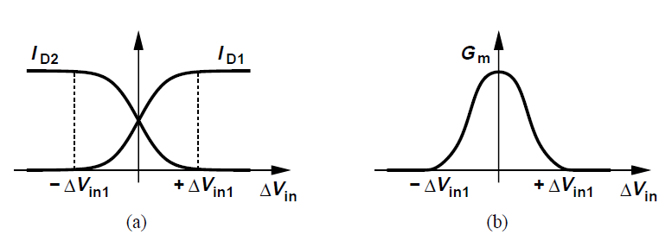
Basic Differential Pair: Large-signal Analysis
For ΔV_{in} > ΔV_{in1}, M₂ is off and the equation derived for ΔI_{D} no longer holds [Fig. (a)]
G_{m} is maximum for ΔV_{in} = 0 and falls to zero for ΔV_{in} = ΔV_{in1} [Fig. (b)]

Slide 22
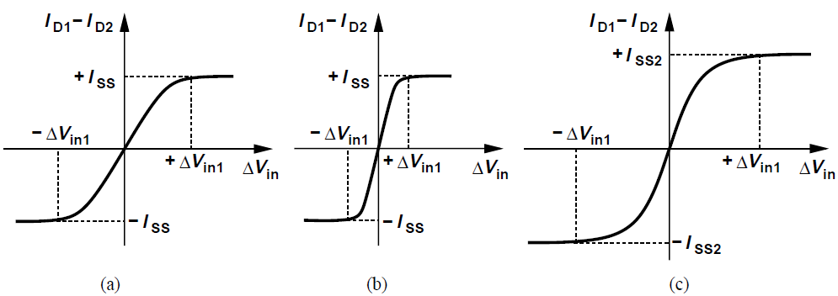
Basic Differential Pair: Large-signal Analysis
As W/L increases, ΔV_{in1} decreases, narrowing the input range across which both devices are on [Fig. (b)]
As I_{SS} increases, both the input range and the output current swing increase [Fig. (c)]
Intuitively, circuit becomes more linear as I_{SS} increases or W/L decreases

Slide 23
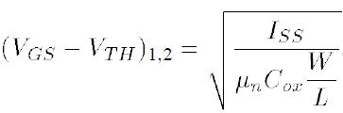
Basic Differential Pair: Large-signal Analysis
ΔV_{in1} represents the maximum differential input the circuit can “handle”
ΔV_{in1} can be tied to the overdrive voltage of M₁ and M₂ in equilibrium
For zero differential input, I_{D1} = I_{D2} = I_{SS}/2, yielding
Thus, ΔV_{in1} is equal to √2 times the equilibrium overdrive
Increasing ΔV_{in1} to improve linearity increases overdrive of M₁ and M₂, which for a given I_{SS} is achieved only by decreasing W/L and hence g_{m}, thereby reducing differential gain
Alternatively, I_{SS} can be increased but with higher power consumption

Slide 24
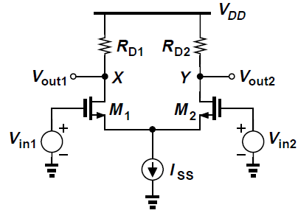

Basic Differential Pair: Small-signal Analysis
Assume M₁ and M₂ are saturated and apply small-signal inputs V_{in1} and V_{in2}
The differential gain (V_{out1} – V_{out2})/(V_{in1} – V_{in2}) was found to be from large-signal analysis
Since each transistor carries approximately I_{SS}/2 current in the vicinity of equilibrium, this expression reduces to g_{m}R_{D}
Assume R_{D1} = R_{D2} = R_{D}, the small-signal analysis is carried out using two methods

Slide 25
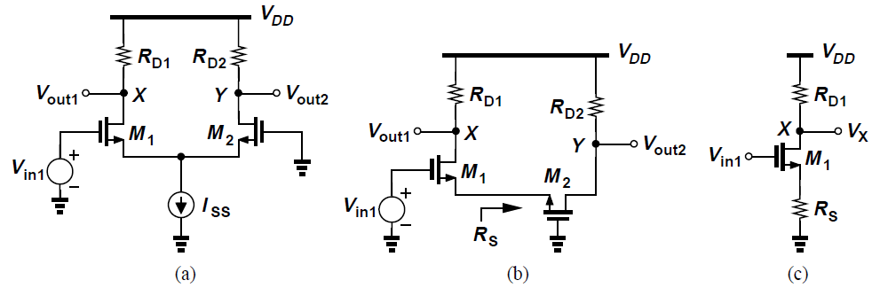
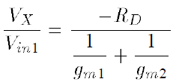
Basic Differential Pair: Small-signal Analysis (I)
Method 1: Superposition
First set V_{in2} = 0 and find the effect of V_{in1} at X and Y
To find V_{X}, note that M₁ forms a CS stage with a degeneration resistance equal to the impedance looking into the source of M₂, R_{S} = 1/g_{m2}, neglecting channel-length modulation and body effect [Fig. (b)]
Then from Fig. (c),

Slide 26
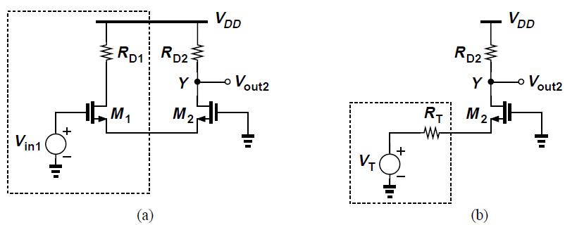
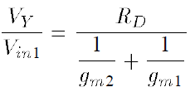
Basic Differential Pair: Small-signal Analysis (I)
Method 1: Superposition
To find V_{Y}, we note that M₁ drives M₂ as a source follower and replace V_{in1} and M₁ by its Thevenin equivalent
Thevenin voltage V_{T} = V_{in1}, and resistance R_{T} = 1/g_{m1}
M2 operates as a common-gate stage, with a gain

Slide 27
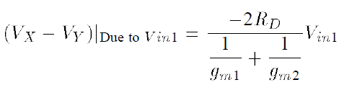

Basic Differential Pair: Small-signal Analysis (I)
From previous analysis, the overall voltage gain for V_{in1} is
For g_{m1} = g_{m2} = g_{m}, this reduces to
By symmetry, the effect of V_{in2} at X and Y is identical to that of V_{in1} with reverse polarities
Adding the two results to perform superposition,
Magnitude of gain is g_{m}R_{D} regardless of how inputs are applied, halved for single-ended output

Slide 28
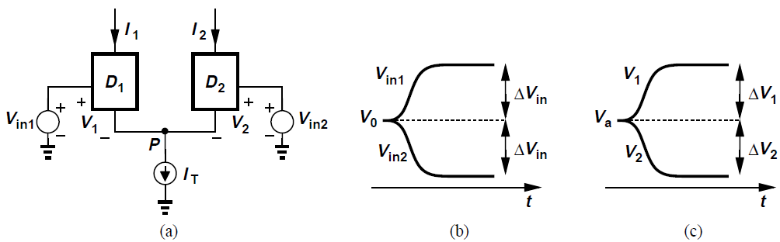
Half-Circuit Lemma/Concept
D₁ and D₂ represent any three-terminal active device in a symmetric circuit
Assume V_{in1} and V_{in2} change differentially, from V₀ to V₀ + ΔV_{in} and from V₀ to V₀ – ΔV_{in} respectively
If the circuit remains linear, V_{P} does not change (acts as a virtual or ac ground)
This is referred to as the “half-circuit concept”

Slide 29
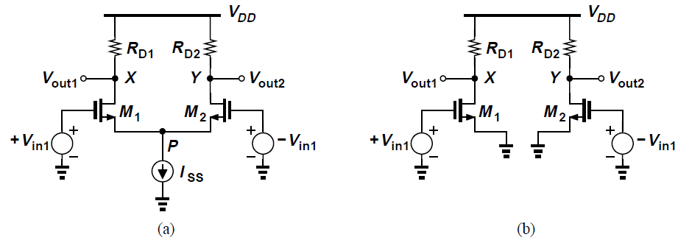


Basic Differential Pair: Small-signal Analysis (II)
Using the half-circuit concept, V_{P} experiences no change node P can be considered “ac ground” or virtual ground and the circuit can be decomposed into two separate halves
We can write and
V_{in1} and –V_{in1} represent the voltage change on each side
Thus, , same result as in Method 1

Slide 30
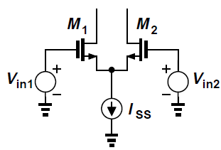
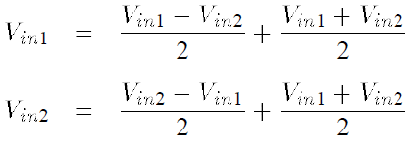
Half-Circuit Technique
The half-circuit technique can be applied even if the two inputs are not fully differential
The unsymmetrical inputs V_{in1} and V_{in2} each can be viewed as the sum of a differential component and a common-mode component, as

Slide 31
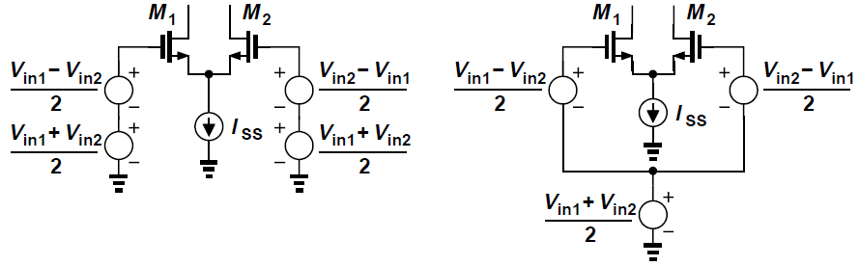
Half-Circuit Technique
The circuit can be visualized as shown above
The circuit senses a combination of a differential input and a common-mode variation
Effect of each type of input can be computed by superposition, with the half-circuit applied to the differential-mode operation

Slide 32
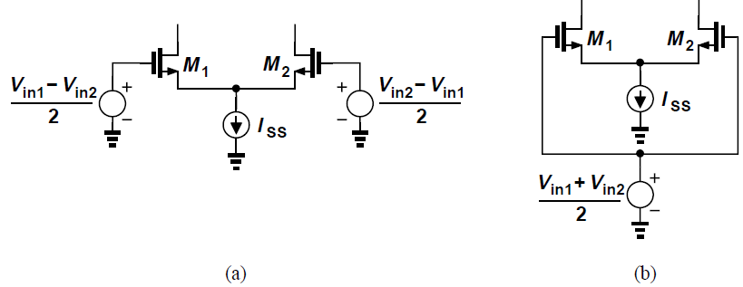
Half-Circuit Technique: Example
Unsymmetrical inputs V_{in1} and V_{in2} are superposed as differential [Fig. (a)] and common-mode [Fig. (b)] signals

Slide 33
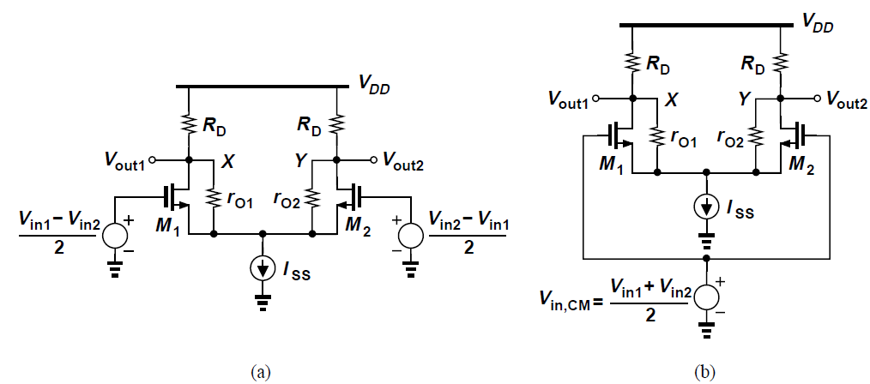
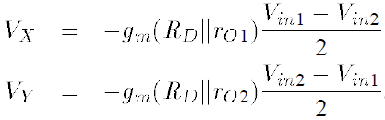
Half-Circuit Technique: Example
For differential-mode operation, circuit reduces to Fig. (a)
Thus,

Slide 34
Half-Circuit Technique: Example
For common-mode operation, circuit reduces to that in Fig. (b)
If circuit is fully symmetric and I_{SS} is an ideal current source, the currents drawn by M₁ and M₂ from R_{D1} and R_{D2} are exactly equal to I_{SS}/2 and independent of V_{in,CM}
V_{X} and V_{Y} remain equal to V_{DD} – R_{D}(I_{SS}/2) and do not vary with V_{in,CM}, therefore, circuit simply amplifies V_{in1} – V_{in2} while eliminating the effect V_{in,CM}

Slide 35
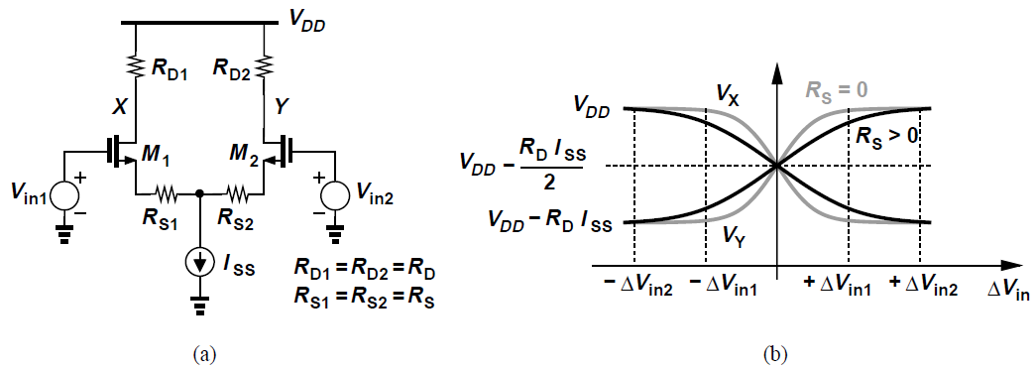
Degenerated Differential Pair
A differential pair can incorporate resistive degeneration to improve linearity [Fig. (a)]
R_{S1} and R_{S2} soften the nonlinear behavior of M₁ and M₂ by increasing the differential voltage necessary to turn off one side [Fig. (b)]
Suppose at V_{in1} – V_{in2} = ΔV_{in2}, M₂ turns off and I_{D1} = I_{SS}, then V_{GS2} = V_{TH} and hence

Slide 36
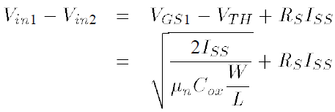

Degenerated Differential Pair
Thus
First term on RHS is ΔV_{in1}, the input difference needed to turn off M₂ if R_{S} = 0, giving
Linear input range is widened by approximately ±R_{S}I_{SS}

Slide 37
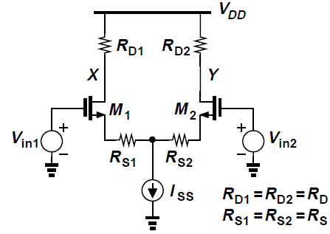
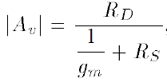
Degenerated Differential Pair
The small-signal voltage gain can be found using the half-circuit concept
The half-circuit is simply a degenerated CS stage exhibiting a gain of
if λ = γ = 0
The degenerated circuit trades gain for linearity
A_{V} is less sensitive to g_{m} variations

Slide 38
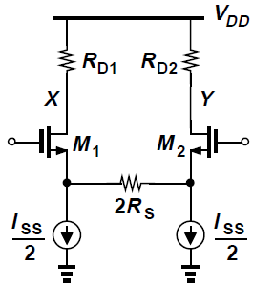
Degenerated Differential Pair
Degeneration resistors consume voltage headroom
In equilibrium, each resistor sustains a voltage drop of R_{S}I_{SS}/2 and maximum allowable differential swing is reduced by R_{S}I_{SS}/2
This can be resolved by splitting the tail current source in half and connecting each to the source terminal
No headroom is sacrificed across the degeneration resistance in equilibrium

Slide 39
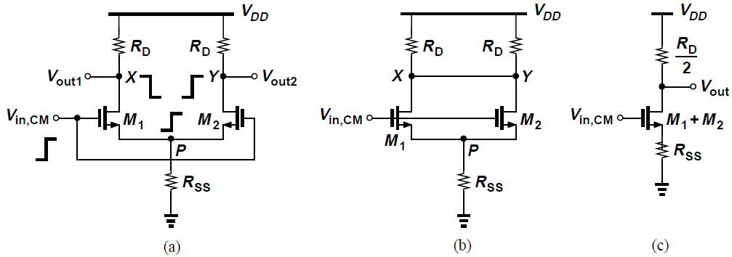
Basic Differential Pair: Common-Mode Response
In reality, the differential pair is not fully symmetric and the tail current source exhibits a finite output impedance
A fraction of the input CM variations appear at the output
First assume that circuit is symmetric but tail current source has a finite output impedance R_{SS} [Fig. (a)]
Increase in V_{in,CM} causes V_{P} to increase and both V_{X}, V_{Y} to drop, which remain equal due to symmetry [Fig. (b)]

Slide 40
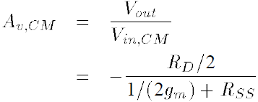
Basic Differential Pair: Common-Mode Response
M₁ and M₂ are “in parallel” and can be reduced to one composite device with twice the width, bias current and transconductance
“Common-mode gain” of the circuit is (λ = γ = 0)
Input CM variations disturb bias points and affect small-signal gain and output swings

Slide 41
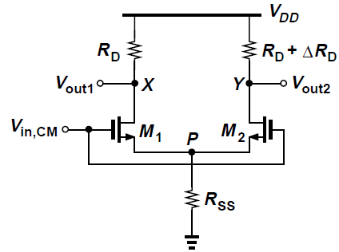
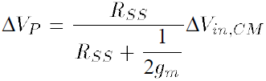
Basic Differential Pair: Common-Mode Response
There is variation in differential output due to change in V_{in,CM} since the circuit is not fully symmetric, i.e., slight mismatches between the two sides
R_{D1} = R_{D}, R_{D2} = R_{D} + ΔR_{D}, where ΔR_{D} denotes a small mismatch and circuit is otherwise symmetric (λ = γ = 0 for M₁ and M₂)
M₁ and M₂ operate as one source follower, raising V_{P} by

Slide 42

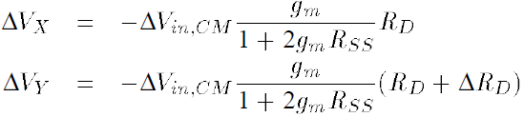
Basic Differential Pair: Common-Mode Response
Since M₁ and M₂ are identical, I_{D1} and I_{D2} increase by
V_{X} and V_{Y} change by different amounts
Common-mode change at the input introduces a differential component at the output – common-mode to differential conversion

Slide 43
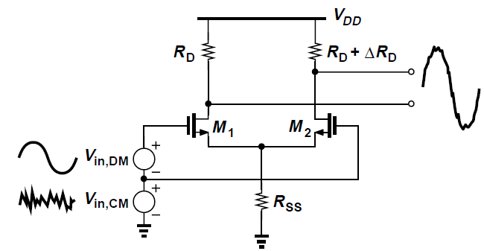
Basic Differential Pair: Common-Mode Response
Common-mode response depends on output impedance of tail current source and asymmetries in the circuit
Two effects:
Variation of output CM level (in the absence of mismatches)
Conversion of input CM variations to output differential components (more severe)

Slide 44
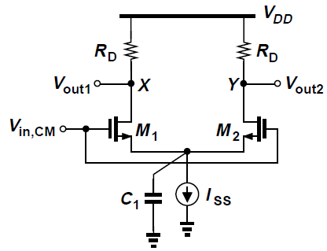
Common-mode to differential conversion
CM to differential conversions become significant at high frequencies since the total capacitance shunting the tail current source introduces larger tail current variations
This capacitance is arises from parasitics of the current source and source-bulk junctions of M₁ and M₂
Asymmetry in the circuit stems from both the load resistors and the input transistors
Latter contributes a greater mismatch

Slide 45
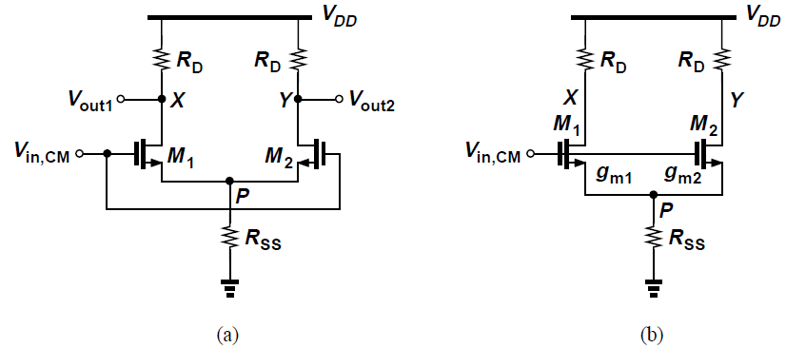



Common-Mode Response: Transistor Mismatch
M₁ and M₂ exhibit unequal transconductances g_{m1} and g_{m2} due to dimension and VTH mismatches (assume λ = γ = 0)
Calculate small-signal gain from V_{in,CM} to X and Y [Fig. (b)]
Also,

Slide 46

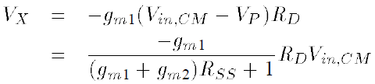
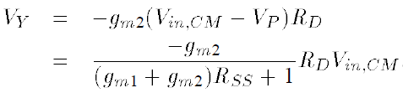

Common-Mode Response: Transistor Mismatch
Thus,
We now obtain the output voltages as
The differential component at the output is

Slide 47

Common-Mode Response: Transistor Mismatch
The circuit converts input CM variations to a differential error by a factor of
A_{CM-DM} denotes common-mode to differential-mode conversion and Δg_{m} = g_{m1} – g_{m2}

Slide 48




Common-Mode Response
Common-mode rejection ratio (CMRR) is defined as the desired gain divided by undesired gain
If only g_{m} mismatch is considered, it can be shown that
Hence,
g_{m} denotes the mean value, i.e., g_{m} = (g_{m1} + g_{m2})/2
2g_{m}R_{SS} >> 1 and hence

Slide 49


Differential Pair with MOS Loads
Differential pairs can employ diode-connected [Fig. (a)] or current-source loads [Fig. (b)]
For Fig. (a), small-signal differential gain is
N and P subscripts denote NMOS and PMOS respectively

Slide 50


Differential Pair with MOS Loads
Expressing g_{mN} and g_{mP} in terms of device dimensions,
For current-source loads [Fig. (b)], the gain is

Slide 51

Differential Pair with MOS Loads
Diode-connected loads consume voltage headroom and create trade-off between output voltage swing, input CM range and gain
For higher gain, (W/L)_{P} must decrease, thereby increasing |V_{GS} – V_{THP}| and lowering output CM level
Solved by adding PMOS current sources M₅ and M₆ to supply part of input pair bias current [Fig. (a)]

Slide 52
Differential Pair with MOS Loads
In Fig. (a), g_{m} of load devices M₃ and M₄ is lowered by reducing their current instead of (W/L)_{P}
For I_{D5} = I_{D6} = 0.8I_{D1} = 0.8I_{D2}, I_{D3} and I_{D4} are reduced by a factor of 5
For a given overdrive, g_{mP} is lowered by the same factor
Differential gain is five times that of the case without auxiliary PMOS current sources (if λ = 0)

Slide 53


Differential Pair with MOS Loads
Since diode-connected loads limit output swings, loads are realized by resistors
Maximum voltage at each output node is V_{DD} - |V_{GS3,4} – V_{TH3,4}| instead of V_{DD} - |V_{TH3,4}| for diode-connected loads
For a given output CM level and 80% auxiliary currents, RD can be five times larger, yielding a voltage gain of

Slide 54

Cascode Differential Pair
Small-signal voltage gain can be increased by increasing output impedance of both NMOS and PMOS devices via cascoding [Fig. (a)], but at the cost of less headroom
The gain is calculated using the half-circuit technique [Fig. (b)]

Slide 55

Gilbert Cell
Differential pair whose gain is controlled by a control voltage [Fig. (a)]
In Fig.(a), the control voltage Vcont controls the tail current and hence the gain
Here, A_{v} = V_{out}/ V_{in} varies from zero (if I_{D3} = 0)to a maximum value given by voltage headroom limitations and device dimensions
Simple example of Variable Gain Amplifier (VGA)

Slide 56

Gilbert Cell
An amplifier is sought whose gain can be continuously varied from a negative to a positive value
Fig. (b) shows two differential pairs that amplify the input by opposite gains
Here, V_{out1}/V_{in} = -g_{m}R_{D} and V_{out2}/V_{in} = +g_{m}R_{D}
If I₁ and I₂ vary in opposite directions, so do |V_{out1}/V_{in}| and |V_{out2}/V_{in}|

Slide 57

Gilbert Cell
V_{out1} and V_{out2} are combined into a single output as shown in Fig. (a)
The two voltages are summed , producing V_{out} = V_{out1} + V_{out2} = A₁V_{in} + A₂V_{in}, where A₁ and A₂ are controlled by V_{cont1} and V_{cont2} respectively
Actual implementation shown in Fig. (b) where drain terminals are shorted to sum the currents and generate the output voltage

Slide 58

Gilbert Cell
V_{out1} and V_{out2} must change I₁ and I₂ in opposite directions so that the amplifier gain changes monotonically
This is done using a differential pair, as shown in Fig. (c)
For large |V_{cont1} – V_{cont2}|, all of I_{SS} is steered to one of the top differential pairs and |V_{out}/V_{in}| is maximum
If V_{cont1} = V_{cont2}, the gain is zero
Simplified structure in Fig.(d), called a “Gilbert Cell”

