Slide 1
Chapter 9: Operational Amplifiers
9.1 General Considerations
9.2 One-Stage Op Amps
9.3 Two-Stage Op Amps
9.4 Gain Boosting
9.5 Comparison
9.6 Output Swing
9.7 Common Feedback
9.8 Input Range Limitations
9.9 Slew Rate
9.10 High-Slew-Rate Op Amps
9.11 Power Supply Rejection
9.12 Noise in Op Amps

Slide 2
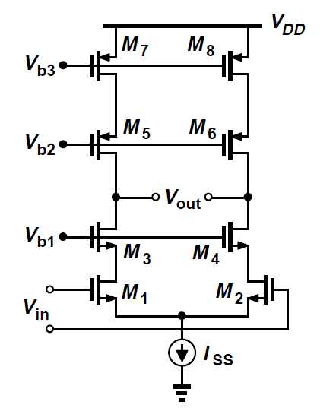
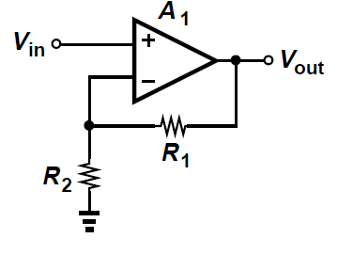
Op Amp Definition
We loosely define an op amp as a “high-gain differential amplifier.”
Usually employed in a feedback system when precision is a requirement.
Applications ranging from DC generation, high-speed amplification or filtering.

Slide 3
Op Amp Design Challenge
Three decades ago
General-purpose blocks as an “ideal” op amp
Design effort is to satisfy an ideal op amp
- infinite gain
- infinite input impedance
- zero output impedance
Today
Design effort is to make trade-offs for a specific application, often sacrificing the unimportant aspects to improve the critical ones.
E.g., gain error vs speed, open loop gain vs VDD

Slide 4
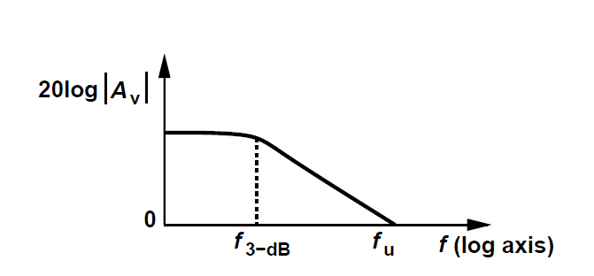
Performance Parameter
Gain(Precision), Bandwidth(Speed): 3-dB/fu Output Swing, Power dissipation
Noise, Linearity, Supply Rejection, offset
Input CM Range, Input/Output Impedance
Large-Signal behavior (e.g. slew rate)

Slide 5
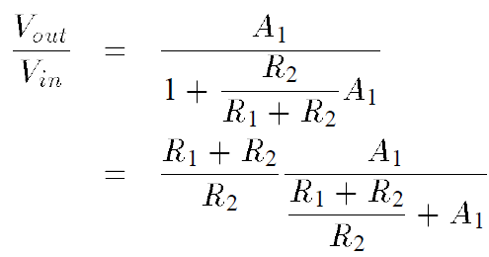

Example 9.1
The circuit has a nominal gain of 10. i.e.,1+R1/R2=10.
Determine the minimal value of A1 for a gain error 1%:
Solution:
Thus, A1>1000. Open-loop gain
determines precision.

Slide 6
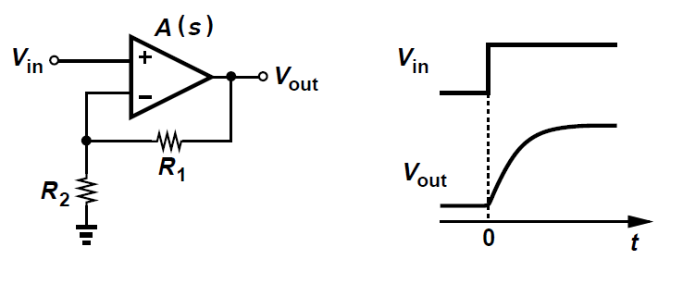



Example 9.2
Assume the op amp is a single-pole voltage amplifier.
For a small step input, calculate the time required for the
output to reach within 1% and its unity-gain bandwidth
if 1+R1/R2=10 and its settling time is less than 5ns.
Solution:
Speed vs. Bandwidth

Slide 7
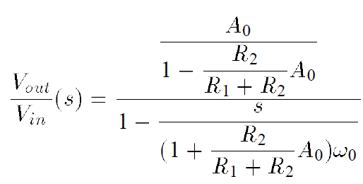
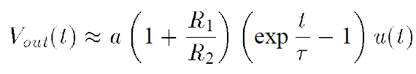
Example 9.3
Explain the circuit behavior if we swap the inverting and
non-inverting inputs of the op amp.
Solution:
Positive feedback destabilizes the circuit.
Output grows exponentially to non-linearity range.

Slide 8

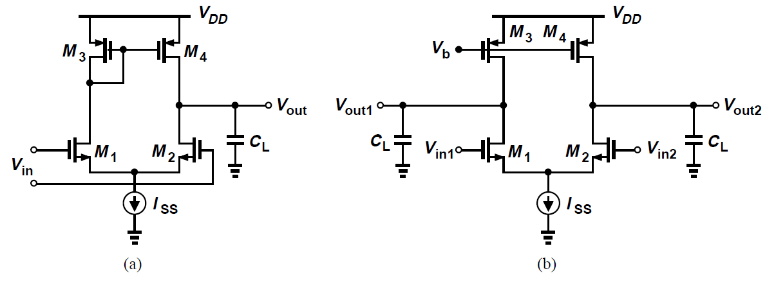
One-Stage Op Amps
Low-frequency gain:
Bandwidth: usually proportional to 1/(CL*Rout)
Output Swing (single-side): VDD-3Overdrive
Mirror pole in single-ended circuit
Power and noise: good, with four devices -> input noise

Slide 9
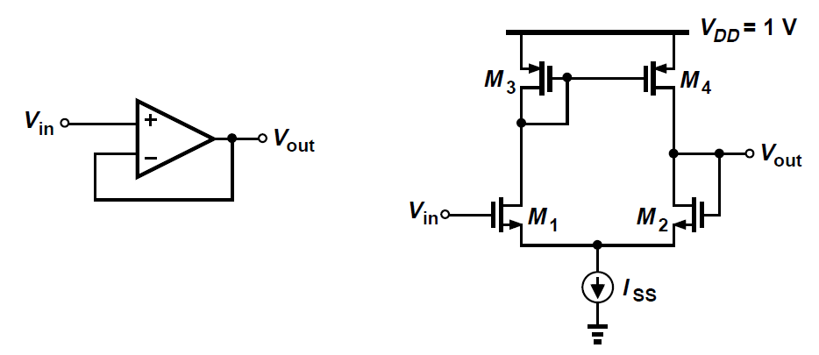


Example 9.4
Calculate the input common-mode voltage range and the
closed-loop output impedance of the unity-gain buffer.
Solution:
<Vin<
Output impedance:
The closed-loop pole is independent of open-loop
output impedance.

Slide 10

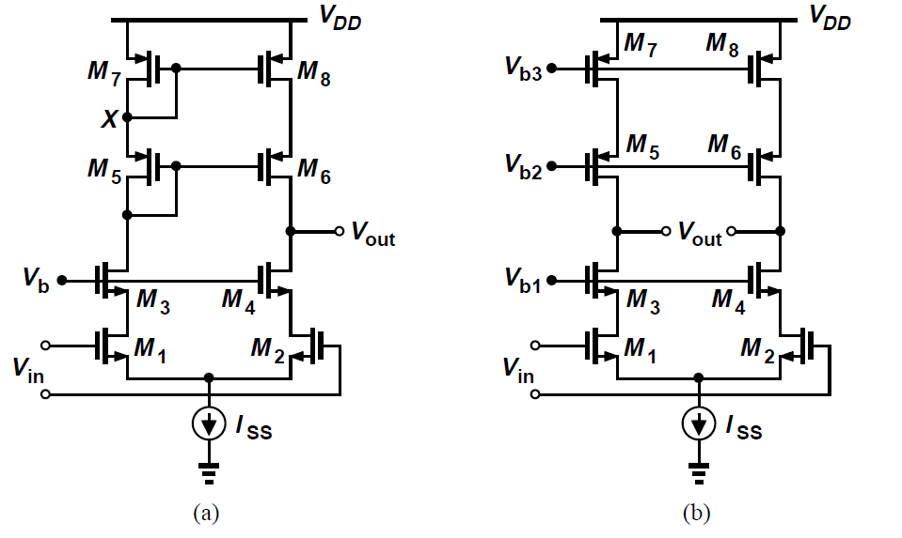
Telescopic Cascode Op Amps
Low-frequency gain:
Speed: Additional poles
Output Swing (single-side): VDD-5Overdrive
Mirror pole in single-ended
Difficult to short telescopic op amp output to input
Power and noise: good, input noise mainly has four devices contribution

Slide 11


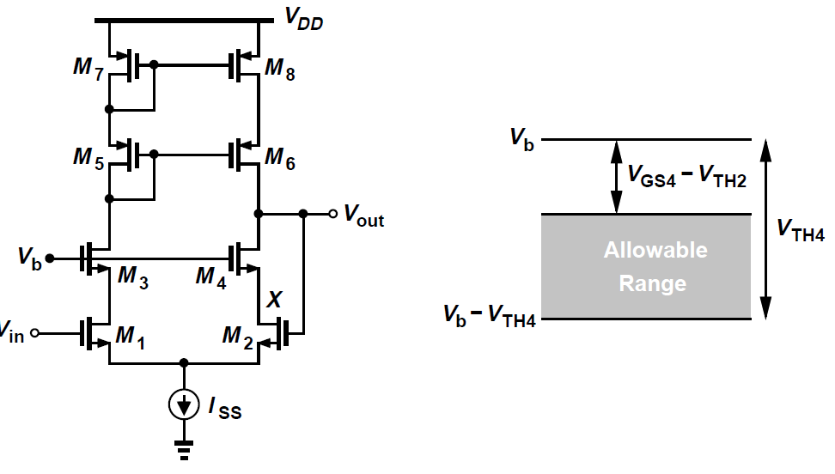


Example 9.5
For this unity-gain buffer configuration, explain in which region each transistor operates as Vin varies from
below to above
Solution: Remedy in switched-capacitor circuit
When , M4 is in triode, others are saturated;
M2, M4 are saturated;
M2, M1 in triode,M4 is in saturation.

Slide 12
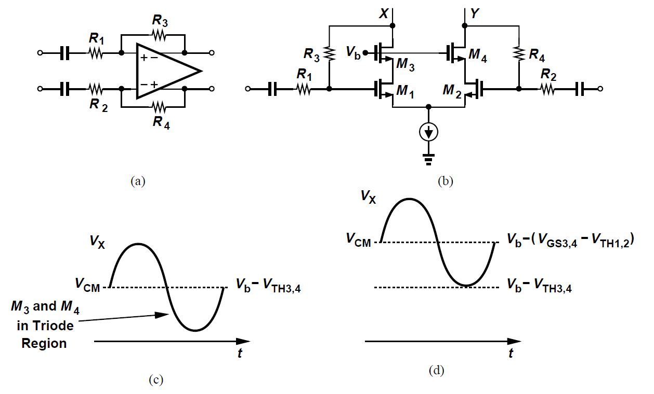
Example 9.6
Assuming that the op amp has a high open-loop gain, determine the maximum allowable output swing.
Solution: ±(one threshold-one overdrive)

Slide 13
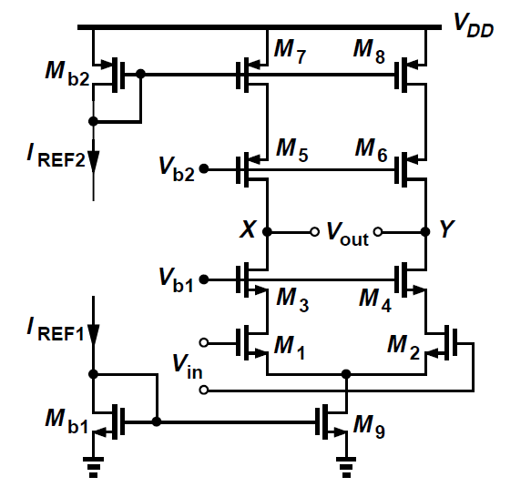
Telescopic Cascode Op Amps Design
Generally, power budget determines branch current
Gain and Output voltage swing
Deal with
Design Procedure (Example 9.7)
Define drain current
Distribute overdrive voltage
Calculate the aspect ratio
Calculate the gain with Lmin
Iteration by increasing W,L until achieving gain criterion
Finally, DC bias voltage setup
and exam residual goals
- CMFB is necessary
PMOS>Cascode_N>Input_N

Slide 14
Linear Scaling
How to modify design if power budget is different while all the other specifications are the same?
Only scale the widths of all the transistors while keeping the lengths constant.
Example 9.6
Explain what aspects of the performance degrade for a low-power op amp design when we scale down the transistor width.
Solution:
The speed of the op amp in driving a capacitive load
The input-referred noise voltage rises by a square root factor of scale constant. (for input device)

Slide 15
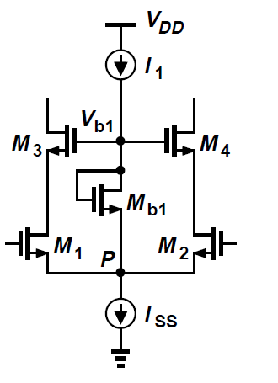


Gate Bias Voltage Generation
Ensure bias voltage to track the input CM level
Choose Mb1 to be a narrow, long, “weak” device

Slide 16
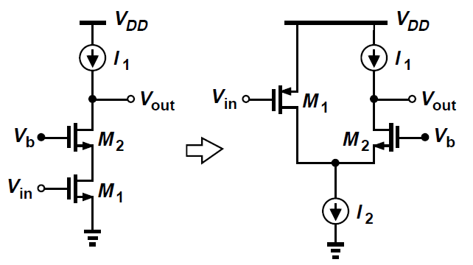
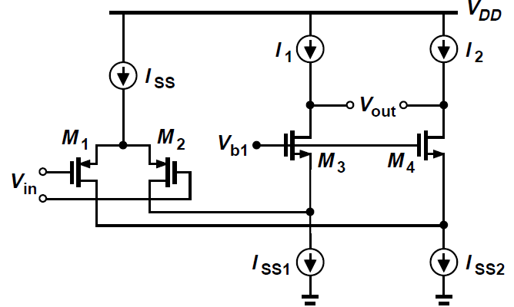
Folded Cascode Op Amps
Recall Folded Cascode
Not “stack” the cascode transistor on the input device
Consume higher power
Output Voltage Swing: VDD-4overdrive
Output and input could short together

Slide 17




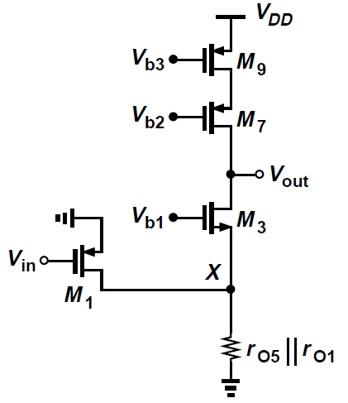
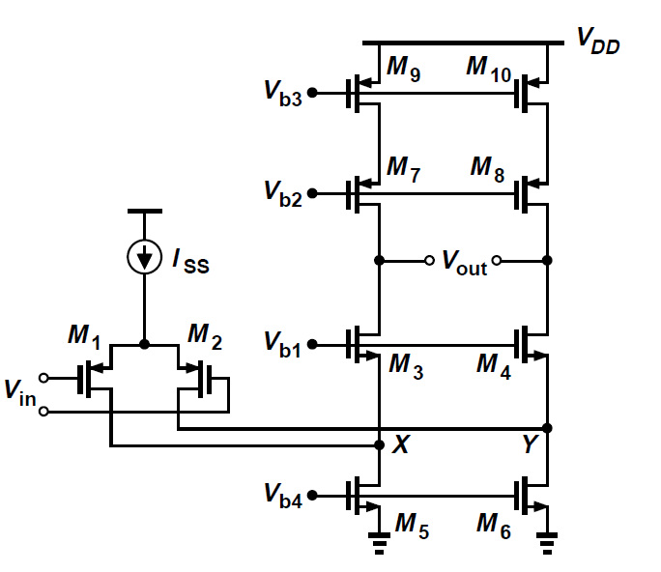
Folded Cascode Voltage Gain
Since << , thus
Two or three times lower than a telescopic topology

Slide 18
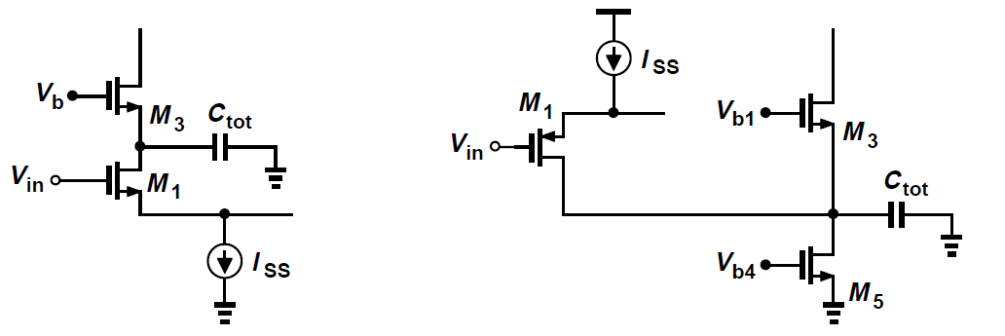
Effect capacitance on the nondominant pole
At “folding point”, a large capacitance due to a large current device M5 would be added to the total capacitance.

Slide 19
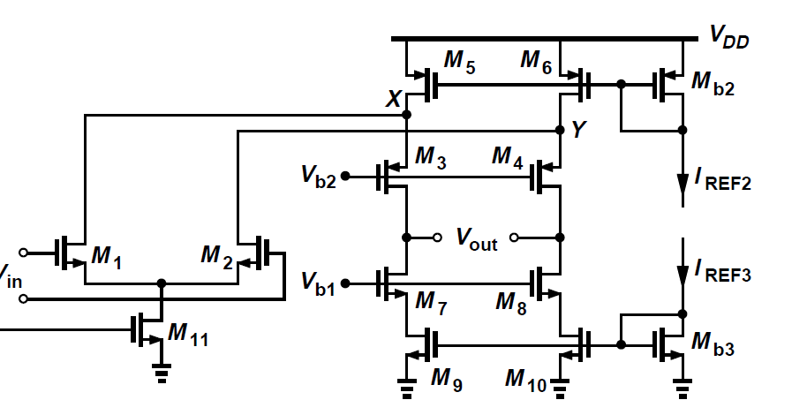
NMOS vs. PMOS input
Greater mobility from NMOS input leads to higher gain
Lowering the pole at folding point
PMOS input is less sensitive to flicker noise(wider WL)

Slide 20
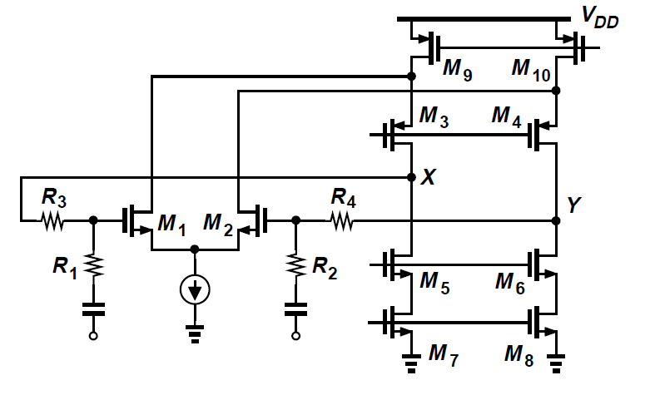
Folded Cascode Properties
Slighter Higher Output Swing than telescopic
Higher Power dissipation, lower voltage gain, lower pole frequency and higher noise
Input and output can be shorted: 2overdrive from bound
A better input CM range

Slide 21
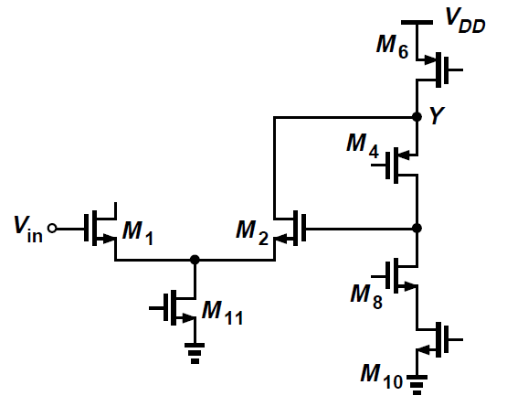
Example 9.9
Design a folded- cascode op amp with an NMOS pair.
Specifications: VDD = 3V, differential output swing = 3V,
Power dissipation = 10mW, voltage gain = 2000.
Solution:
(1)Current allocation
(2)Overdrive voltage allocation
(3)Aspect ratio calculation
(4)Small-signal gain with minimal length
(5)Iteration by increase M5/M1/M4 in turns
Note that the folding point capacitance may limit here.

Slide 22
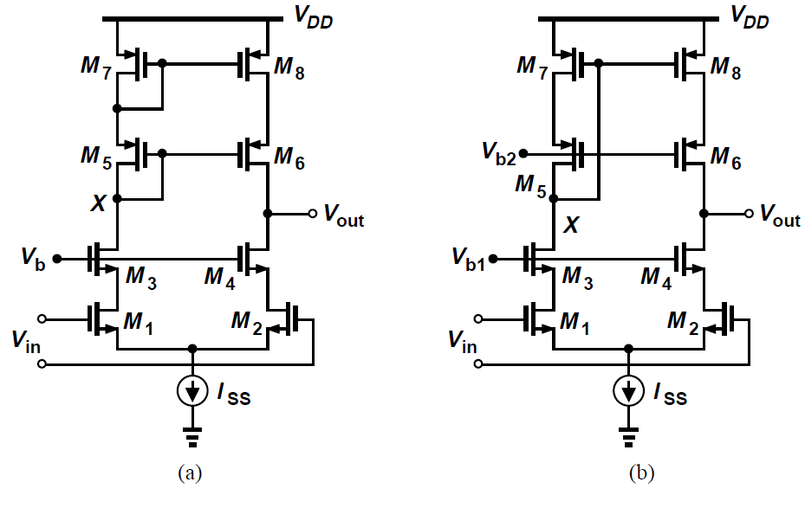
Low Voltage Single-ended Output
M7 is biased at the edge of triode
Could M5 always in saturation?
Left implementation wastes one threshold voltage
Still, single-ended output is unfavorable due to half output swing and a mirror pole
Note that almost all the differential output circuits need a CMFB

Slide 23


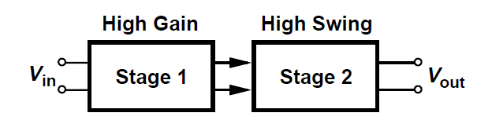
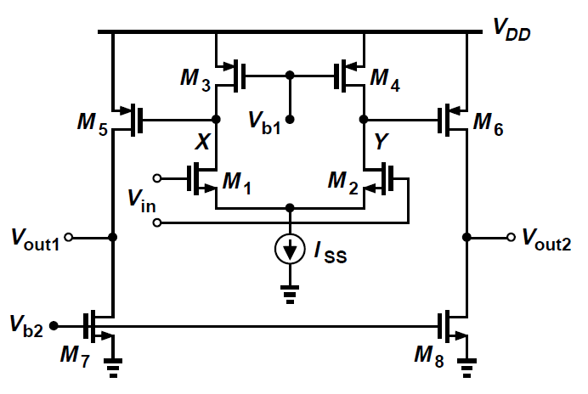
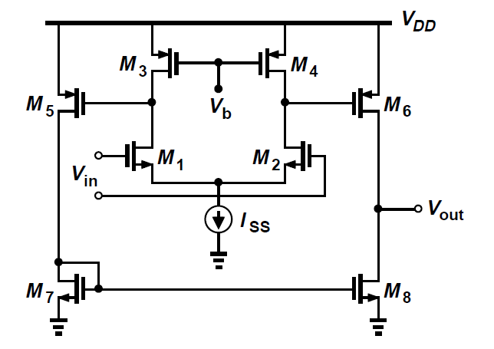
Two-Stage Op Amps
Voltage headroom in today’s design is constrained with low supply voltage and large output swing
Gain:
Output Swing: Vdd-2Overdrive

Slide 24
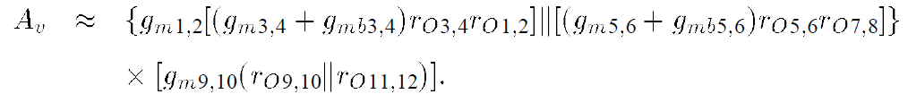
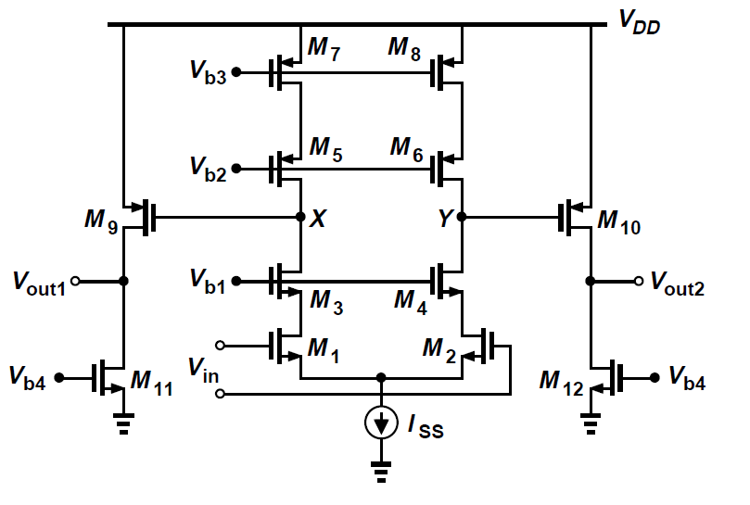
Two-Stage Op Amps with cascode devices
Voltage headroom in today’s design is constrained with low supply voltage and large output swing
Gain:
Can we have more stages? Feedback stability limits

Slide 25
Two-Stage Op Amps Design
Example 9.10
Design the two-stage op amp for VDD = 1V, P = 1mW, a differential output swing of 1 Vpp, and a gain of 100.
Solution:
(1)Current allocation
(2)Voltage allocation:
300mV to M7, 200mV to M5,
400mV to M3, 100mV to M1
(noise and gm consideration)
(3)Calculate aspect ratio
(4)Calculate gain > 2000

Slide 26
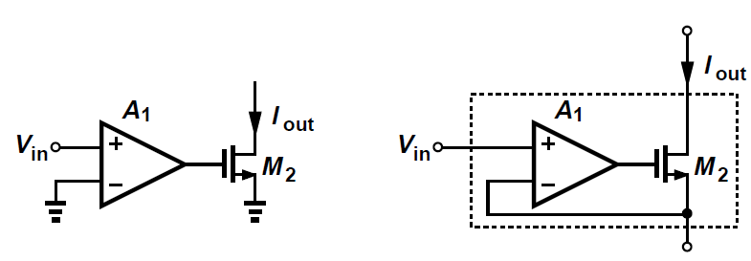
Gain Boosting
Increase the output impedance without adding more cascode devices. But how?
A transistor preceded by an ideal voltage amplifier exhibits a transconductance of gmA1 and a output resistance of ro.

Slide 27


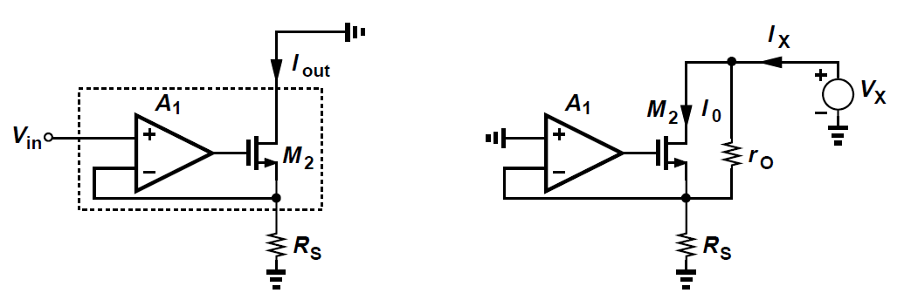
Gain Boosting
Increase the output impedance without adding more cascade devices. But how?
First Perspective:
A degenerated transistor preceded by an ideal voltage amplifier
In fact, the output resistance is “boosted. The headroom is similar to a simple degenerated transistor

Slide 28
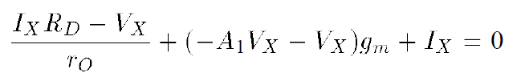

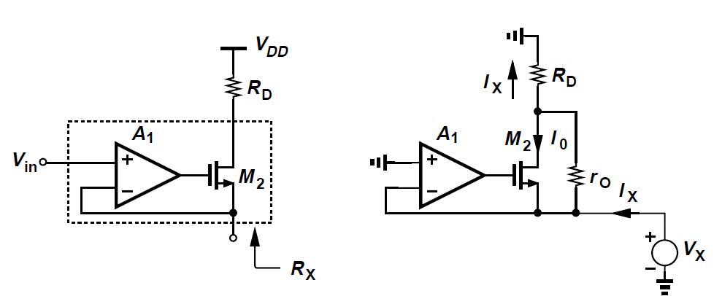
Example 9.11
Determine the resistance seen at the source of M2 without considering body effect.
Solution:

Slide 29
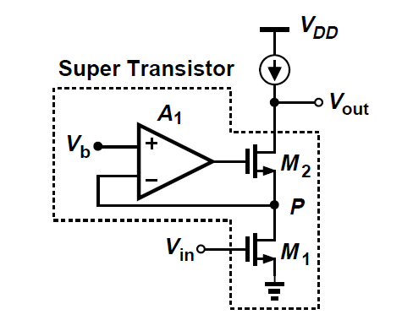
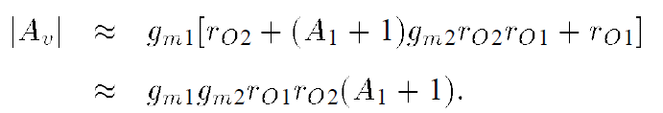
Basic gain-boosted stage
Current-Voltage feedback increase the output impedance by a factor of A1+1, while the real gm raised by A1 is reduced by A1+1 when feedback is applied.
- Rout:
- Gm: gm1A1/(A1+1)~gm1
- Rp:(look above P, see example 9.11)
(<<ro1, can be neglected)
-

Slide 30
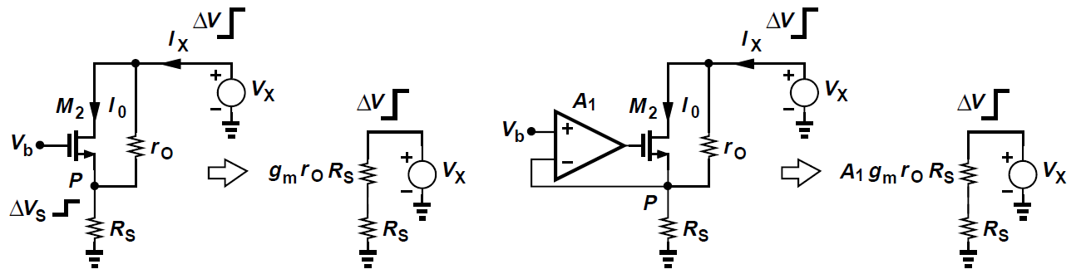
Regulated Cascode
Second Perspective
Loosely view the voltage change divided by Rs and gmroRs.
Drain current response can be suppressed as
- Vp is constant
- Current through Rs is constant
Vp is “pinned” to Vb by feedback regulation.

Slide 31



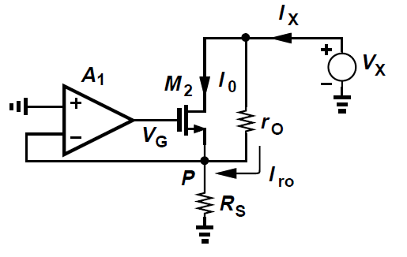
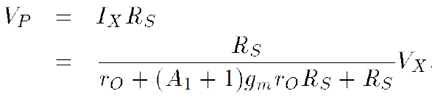
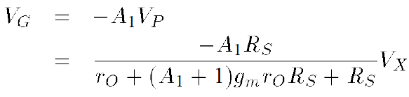


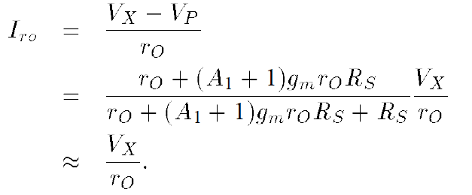

Example 9.12
Determine the small-signal values of and .
Assume is large.
Solution: Current circulates M2

Slide 32
Gain boosting Key
The amplifier boosts the gm of the cascode device
The amplifier regulates the output current by monitoring and pinning the source voltage

Slide 33
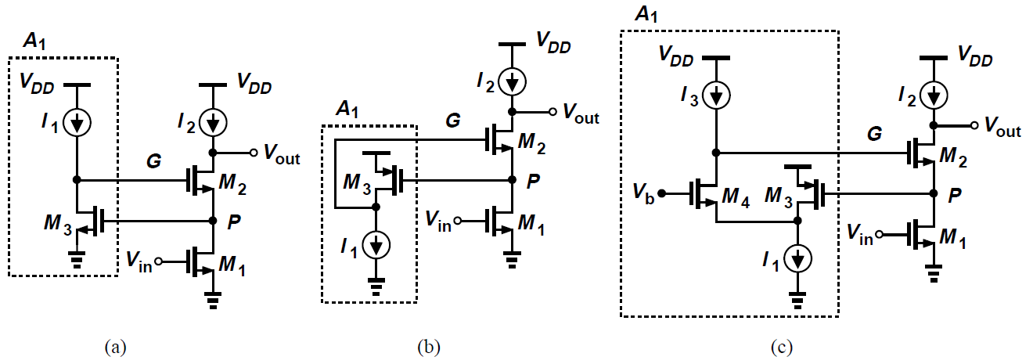
Gain Boosting Circuit Implementation
Simplest a common-source stage
Avoid headroom limitation, PMOS common-source stage is better, but M3 could go in triode
Folded-cascode inserts one more stage

Slide 34


Example 9.13
Determine the allowable range for Vb.
Solution:

Slide 35
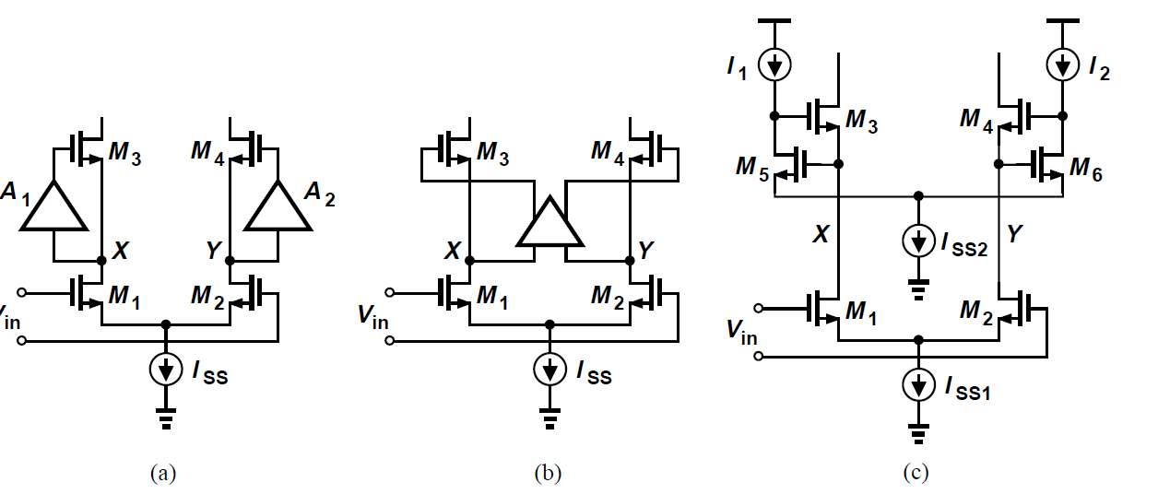
Gain Boosting with a Differential Pair
One threshold higher than a simple differential circuit
Merge two gain boosting blocks to differential one

Slide 36
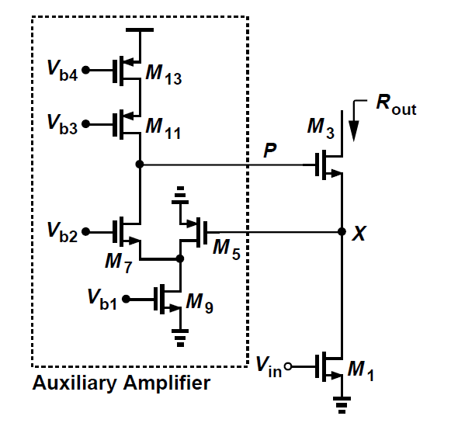
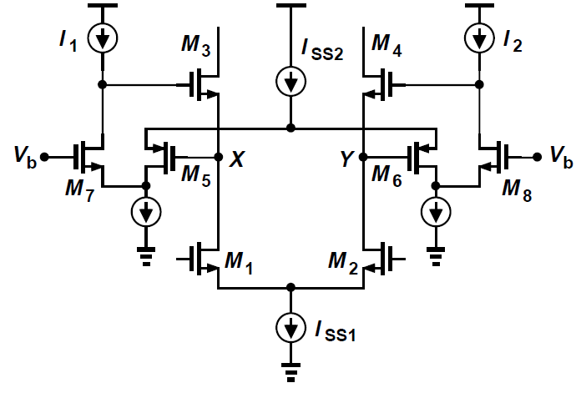
Differential Folded Cascode Gain Boosting
The minimal allowable Vx,Vy is VOD12+VISS1
The output impedance of the circuit (Example 9.14)

Slide 37
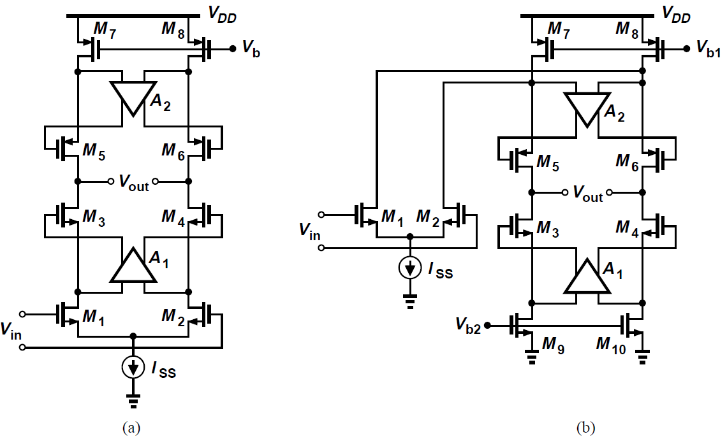
Gain Boosting in Signal Path and Load
Gain boosting can be utilized in the load current source
To allow maximum swings, A2 employs NMOS-input.

Slide 38
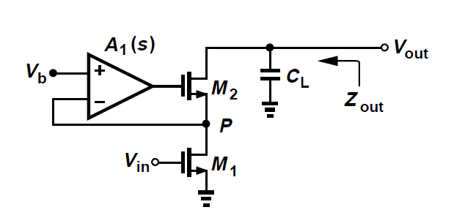
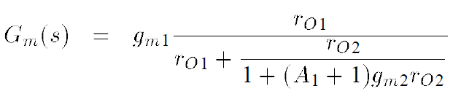

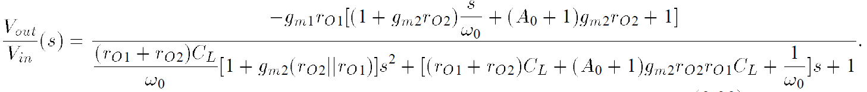

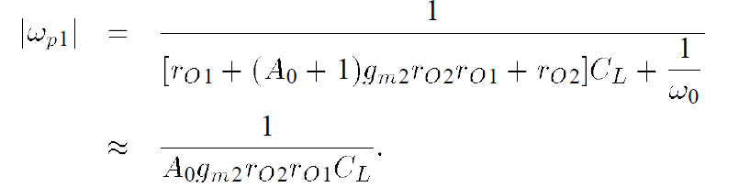
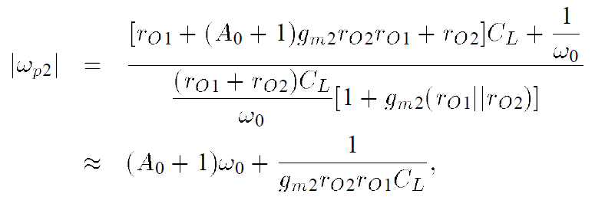
Gain Boosting Frequency Response
Zero:
Dominant pole:
Non-dominant pole: Above the original-3dB bandwidth

Slide 39
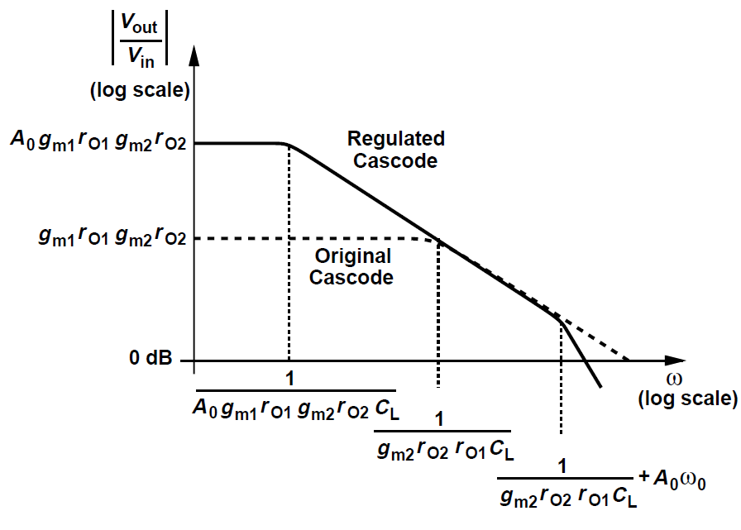
Frequency Response Bode Plot
Gain boosting frequency response bode plot
Two poles, non-dominant is below the original 3dB pole

Slide 40

Example 9.15
Is the dominant-pole approximation valid here.
Solution:
The second term is typically much greater than unity and the approximation is valid.

Slide 41

Comparison

Slide 42

Output Swing Calculation
Be careful about distortion and gain error
The maximum output amplitude that yields an acceptable distortion or gain error
Apply a growing sinusoid wave, monitor the resulting output, and calculate the maximum allowable gain

Slide 43


Common-Mode Feed Back
Vcm(in) and Vcm(out):

Slide 44


Basic Concepts
In fully-differential op amps, the output CM level is usually not well defined.
- Case 1: , Vx,Vy decreases, Iss triode;
- Case 2: In reverse, Vx,Vy increases, M3,M4 triode.

Slide 45

Basic Concepts
In high-gain amplifiers, CMFB balances the PMOS and NMOS current mismatches, thus avoid driving one of them into triode region.
Differential feedback cannot define CM level
In simulation, CM may be well-defined around half VDD, yet in real world, random mismatches and device variations would degrade CM easily without CMFB.

Slide 46


Example 9.16
Consider the telescopic op amp below. Suppose M9 suffers from a 1% current mismatch with respect to M10, producing Iss = 2.97 mA rather than 3 mA. Assuming perfect matching for the others. Explain what happens in the circuit.
Solution:
Output voltage error: =3.99V
Vx, Vy must rise so much that
M5, M6, M7, M8 go to triode,
yielding ID7 = 1.485 mA.
Current mismatch is largely
depended on different drain-
source voltage.

Slide 47

Conceptual topology
Measure output CM level;
Compare with a reference;
Apply the error to correct the level.

Slide 48


CM Sensing Techniques
Resistive sensing
- large R1,R2 to avoid loading effect
- large chip area and parasitic capacitance
- reduce frequency performance
Source follower sensing
- lose one Vth in swing
- large R1, I1 to avoid “starved”

Slide 49



CM Sensing Techniques
Capacitive sensing
Switched-capacitor
Deep triode sensing
- Rtot ~ vout1+vout2
- Rtot has no relationship
with differential voltage
- may go to saturation region

Slide 50

Example 9.17
A student simulates the step response of a closed-loop op amp circuit and observes the output waveforms shown in below. Explain why Vout1 and Vout2 do not change symmetrically.
Solution:
As evident from waveforms, the output CM levels change from t1 to t2, indicating CM sensing mechanism is nonlinear. For example, if M7 or M8 in last slide does not in
deep triode at t2, the CM level would change because now it is a function of differential output.

Slide 51


CM Sensing Techniques
Differential pair sensing
- by small signal analysis
- Under Large swings situation, sensing is not valid due to
large non-linearity.

Slide 52


CM Feedback Techniques
Control cascade current source
Control tail current source

Slide 53



CM Feedback Techniques
Deep triode sensing feedback
- Limited headroom
- Large C
- Device variation
Deep triode folded-cascade sensing feedback

Slide 54



Example 9.18
Determine the sensitivity of Vout,CM to Vb, i.e, dVout,CM/dVb.
Solution:
CMFB small signal analysis
Maximize Vds7,8 for Sensitivity

Slide 55



CM Feedback Techniques
Modification of deep triode sensing feedback
The output level is relatively independent of device parameters and lowers sensitivity of Vb

Slide 56

CM Feedback Techniques
Modification of deep triode sensing feedback
M17, M18 reproduces the drain of M15 a voltage equal to the source voltage of M1 and M2

Slide 57




CM Feedback Techniques
Another type of CM feedback topology
Diode-connected loads’ output CM level is well-defined
Differential small signal gain
Common-mode work as a diode-connected
Low supply voltage design

Slide 58

Example 9.19
Determine the maximum allowable output swings.
Solution:
Each output can fall to two overdrive voltages above ground if Vin,CM is chosen to place Iss at the edge of the triode region. The highest level allowed at the output is equal to the output CM level at P plus |Vth3,4| (by selecting suitable RF). Thus, output swing is VDD-3Vov.
(RF is small, not like previous setup)

Slide 59



Example 9.20
Facing voltage headroom limitations, a student constructs the circuits below. Determine the small-signal gain from the input CM level to the output CM level.
Solution:
(A poor CMRR)

Slide 60


CMFB in Two-Stage Op Amps
CMFB around second stage (not good)
- May establish a current beyond nominal value
CMFB from second stage to first stage
- Global loop control of both stages

Slide 61

CMFB from Second to First Stage
CMFB from second stage to first stage limitation
- 3 or 4 poles, which makes it difficult for the loop stable

Slide 62

CMFB at both Stages
All the drain currents are copied from Iss
The differential voltage gain is equal to

Slide 63

Example 9.21
For the below design explain why the output CM level is inevitably well below VDD/2 and hence the output swings are limited. Devise a solution.
Solution:
The output CM is equal to VG7,8, which is only slightly greater than one threshold. The issue can be resolved by drawing a small current from node Q. It can be upwards to desired output and the device is still in saturation.

Slide 64

CMFB for Cascode First Stage
First stage use deep triode feedback loop to avoid loading.
Achieving high gain while not precise

Slide 65

Input Range Limitations
Input common-mode level may need to vary over a wide range, e.g. ADC input comparator.
Input swing limits the total range sometimes.
In the below single-end unity-gain buffer the input CM minimal voltage is VGS1,2+VISS, which is one threshold greater than 2Vov in the output CM.

Slide 66


Extension of Input Range
Incorporate both NMOS and PMOS differential pair to keep a necessary transconductance
The transconductance variation should be concerned
Gain, speed and noise may vary

Slide 67




Slew Rate
In a linear circuit, the slope of the step depends on final output value
The observation applies to linear feedback system

Slide 68

Slew Rate
In a realistic case, with large input steps, the output displays a linear ramp having a constant slope. The slope of ramp is the “slew rate”.
It seems that the maximum current to charge the load capacitance is limited.
Nonlinear behavior. Reduce speed and increase distortion.
Increase SR would consume power and wider device

Slide 69



Slew Rate Example
A small step rises Vout by and hence adjusts through R1, R2 negative feedback circuit.
When M1 experiences a large step, M2 turns off. Thus, CL is charged by a constant current ISS.
Feedback is broken but after M2 turns on, the circuit returns to a linear operation.

Slide 70






Example 9.22
(a)Determine the small-signal step response of the circuit.
(b)Calculate the positive and negative slew rates.
Solution:

Slide 71



Slew Rate of Telescopic Op Amp
Each side appears a ramp with slope equal to
The total slew rate for Vout1- Vout2 equal to

Slide 72



Slew Rate of Folded-cascode Op Amp
Yield a slew rate of if
Otherwise, M3 turns off and tail current source enters the triode region. The settling time increases.

Slide 73

Clamp transistor
Limit Vx,Vy to produce large different voltage
More aggressive design, Vx,Vy higher than VDD-VTHN

Slide 74




Example 9.23
As Vout rises, so does Vx, eventually turning M2 on. As ID2 increases from zero, the plot becomes linear. Considering M1 and M2 becomes linear if difference between their drain current is less than
Calculate the time to linear.
Solution:

Slide 75

High-Slew-Rate Op Amp
Slew rate is limited by power consumption
The trade-off could be mitigated if the capacitor could be charged to a desired value quickly. And the voltage falls back to original value.
Complementary topology jumps fast but suffer from poor power supply rejection

Slide 76

Push-Pull Stages
Use current-mirror. E.g. If Vin+ jumps down, and Vin- jumps up then
- M5 draws less current, lowering ID4;
- M3, M6 draws more current;
- M7 draws more current, raising ID2;
- M1 draws less current, charging CL.

Slide 77

Push-Pull Stages
Improve the input common-mode rejection by adding tail current sources to build differential circuits
The differential slew rate is
SR increases with a around twofold power penalty

Slide 78


Example 9.24
Calculate the small-signal voltage gain of the class-AB op amp shown below.
Solution:

Slide 79





Frequency Response and Mirror Pole
It is not possible to equate zero and pole
Raise SR would decrease mirror pole frequency

Slide 80

Two-Stage Op Amp with High SR
Voltage Gain:
Slew Rate
- If P is low capacitance, it is “agile” enough to go upon
to VDD, thus providing a large SR.

Slide 81


Power Supply Rejection
Power line contains noise
PSRR(power supply rejection ration):
- Gain from input to output divided by the gain from
supply to the output
At low frequency

Slide 82




Example 9.25
Calculate the low-frequency PSRR of the feedback circuit shown below
Solution:
Feedback reduce the same and PSRR is relatively constant.

Slide 83


Noise in Telescopic Op Amp
At low frequency the cascode devices contribute negligible noise

Slide 84


Noise in Folded-Cascode Op Amp
At low frequency the cascode devices contribute negligible noise

Slide 85


Noise in two-stage Op Amp
The noise in the second stage contributes negligible noise

Slide 86






Example 9.26
A simple amplifier is constructed below. Note that the first stage incorporates diode-connected – rather than current-source loads. Assuming all the transistors in saturation. (W/L)1=50/0.6 (W/L)3=10/0.6 (W/L)5=20/0.6 (W/L)7=56/0.6
Solution:
=

