Slide 1
Data Science Accelerator
Capstone Decipher
Niels Denissen

Slide 2
Goal – Decipher text
INPUT
Yzyiv iez
OUTPUT
Forty two
CIPHER

Slide 3
How?
For each letter
Get possible words
Already valid sentence?
Order words on # possibilities
Reduce options with cipher so far
Recursion through possibilities
Found decipher for letter
All letters done?
DONE

Slide 4
Preparation
Download
Wordlist
Hash
7, 5, ((1,5),(3,6))
Science
Alphabet
Analytics
Awesome
Best
Chance
Check
Data
Science
…
Example word:
Science -> 7, 5, ((1,5),(3,6))
Length
7 characters: 7
# unique letters
S, c, i, e, n: 5
Duplicate indices
c -> indices 1,5 ((1,5),(3,6))
e -> indices 3,6
4, 3, ((1,3))
Data
Polo
Piri

Slide 5
Let’s try to translate: phrh rchvqbhrlgv
Get possible words
Already valid sentence?
Order words on # possibilities
phrh:
[ polo, data, piri, … ]
rchvqbhrlgv :
[ gunslingers, translation, … ]
rchvqbhrlgv : [gunslingers , translation, … ]
phrh: [ polo, data, piri, … ]

Slide 6
Letters are deciphered one by one
Determine best letter to start with
Select # words on complexity
Reduce options with cipher so far
Recursion through possibilities
One with most
occurences in words
If possibilities for all words
letter occurs in is too high:
Reduce set to acceptable level
Possibilites rchvqbhrlgv: [ gunslingers, translation ]
rchvqbhrlgv = gunslingers
Cipher: { h: n, r: g, …. }
Words correct 1/2
Possibilities phrh (*ngn): []
Our case
(phrh rchvqbhrlgv): h
rchvqbhrlgv: 14
phrh : 1719
Possibilities:
14*1719=24066

Slide 7
Letters are deciphered one by one
Reduce options with cipher so far
Recursion through possibilities
Found decipher for letter
h=a
1. Possibilites rchvqbhrlgv: [ gunslingers, translation ]
2. rchvqbhrlgv = gunslingers
Cipher: { h: n, r: g, …. }
Words correct 1/2
2.1. Possibilities phrh (*ngn): []
Words correct 1/2
3. rchvqbhrlgv = translation
Cipher: { h: a, r: t, …. }
Words correct 1/2
3.1. Possibilities phrh (*ata): [ data, kata, … ]
3.2 phrh = data
Cipher = { p: d, h: a, r: t, … }
Words correct 2/2

Slide 8
One more letter: p
Reduce options with cipher so far
Recursion through possibilities
Reduce options with cipher so far
Recursion through possibilities
Found decipher for letter
Possibilites rchvqbhrlgv: [ translation ]
rchvqbhrlgv = translation
Cipher: { h: a, r: t, …. }
Words correct 1/2
Possibilities phrh: [ data, mata, lata, … ]
Phrh = data
Cipher: { p: d, h: a, r: t, … }
Words correct 2/2
h=a
r=t
p=d
Cipher so far: { h: a, r: t}
Possibilites phrh: [ data, mata, lata, … ]
Phrh = data
Cipher: { p: d, h: a, r: t, … }
Words correct 2/2

Slide 9
DEMO

Slide 10
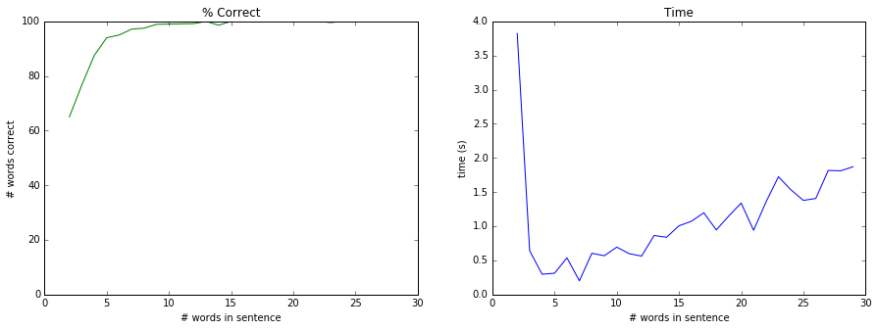
Results - Dutch

Slide 11
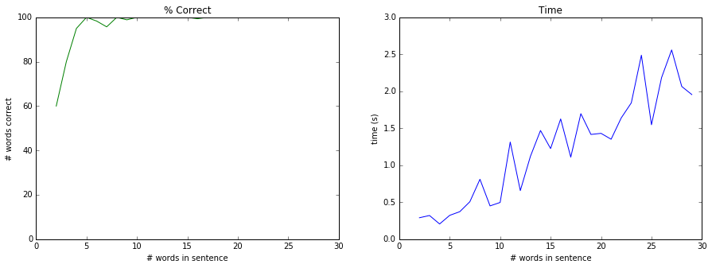
Results - German

Slide 12
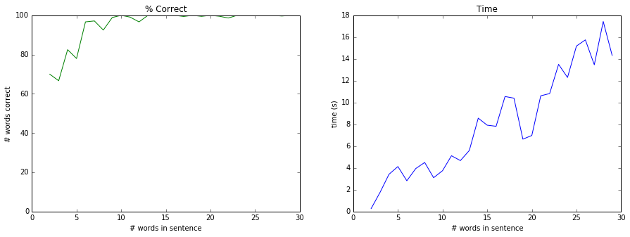
Results - English

Slide 13
# Words English: 3.086.974 Dutch: 398.276 German: 406.243

Slide 14
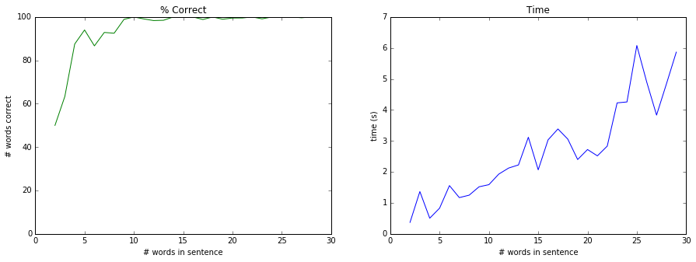
Results – English - lower complexity: 1e6

Slide 15
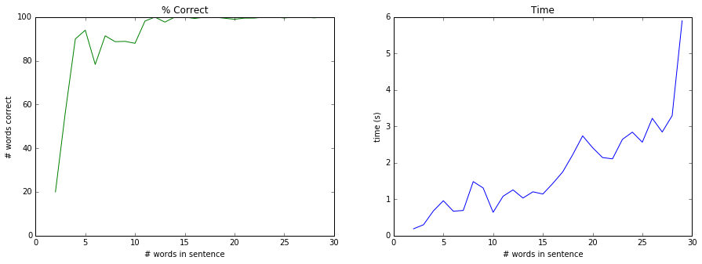
Results – English - lower complexity: 1e3

Slide 16
Assumptions:
All words exist in wordlist
A-Z characters
Certain complexity is chosen

